Slide 1
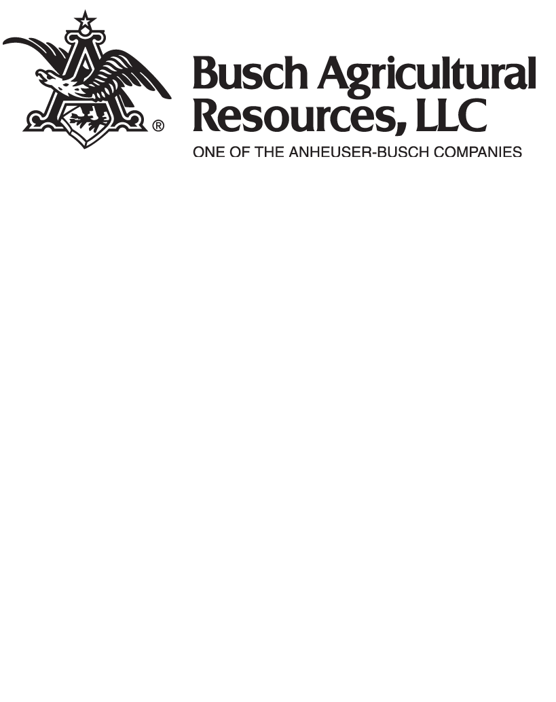
ABI Voyager
ABI Voyager has high yield potential combined with excellent malting quality characteristics developed by AB InBev. This variety provides stable kernel plumpness and predictable quality in the intermountain region. This protocol is for irrigated ABI Voyager in Montana.
The following agronomic, yield and quality, pathology and botanical information on ABI Voyager is based on the best available data (Global Barley Research, SmartBarley, and University of Idaho). However, it is up to each farmer to interpret the validity of the contained information and assess how it relates to their own barley growing operations.
Maturity: ABI Voyager has a medium length maturity of approximately 120 days and reaches maturity typically 5-10 days before Merit 57. Heading date typically occurs around June 23rd [1].
Irrigation Scheduling: Field capacity must be maintained throughout season for optimum yield. ABI Voyager requires fewer irrigations than Merit 57, especially near grain-fill due to earlier maturity and genetically plumper grain.
Drought Sensitivity: Holds approximately 5% yield advantage over Merit 57 in water stress trials, while plumper kernels make it better at maintaining malting quality under water stress.
Lodging and Straw Length: ABI Voyager has 50% fewer lodging events compared to Merit 57. Although it has greater straw strength than Merit 57, ABI Voyager is tall enough to warrant the need for a growth regulator. ABI Voyager responds to Palisade growth regulator. ABI Voyager is approximately 3% taller than Merit 57 and averages 34 inches tall.
Nitrogen Rate – Yield, Protein, and Lodging:
These Nitrogen recommendations may vary region to region with soil type, temperature, and rainfall. Please use this information as best fits your region. We advise to consult your agronomist if you have any further questions.
Yield: ABI Voyager optimized yields between 110-130 lbs/ac total N (Soil test Nitrogen + Rotational Crop credit + Applied) with an optimal rate of 120 lbs/ac. ABI Voyager demonstrated that over application of nitrogen did not add substantially to yields for a grower. For example, the gain in yield between 80 and 120 lbs/ac nitrogen applied was 4.5 bu/ac. This indicates that the additional 40 lbs/ac n applied will not likely result in substantial ROI for growers [1].
Protein: ABI Voyager is 0.4% lower protein than Merit 57 and is in general a lower protein variety compared to other varieties in the Midwest. For every 10 lbs of nitrogen applied, ABI Voyager increased its protein by 0.01%. Based on 2 years of data, our recommended nitrogen rate for yield optimization (120 lbs/ac n) would deliver a protein percentage of 12% [1].
Lodging: Lodging scores increased as nitrogen rates were increased. Lodging increased by 25% when total N (Soil test Nitrogen + Rotational Crop credit + Applied) rates went from 120 lbs/ac to 150 lbs/ac [1].
Seeding Rate: The recommended seeding rate for Voyager is 1,000,000 seeds/ac. If planting late, this rate should be increased. Since kernel weights will vary by source and year, seeding rate should be based on kernel count. Crop management trial data showed that increasing the seeding rate, decreased protein. For every 500,000 seeds/ac increase, there was a 1% decrease in protein [1].
Crop Rotation and Nitrogen Interaction: Farmers need to consult their soil tests prior to nitrogen application because certain rotations leave more or less residual nitrogen which will impact crop yields. There are examples of farmers that had their yield penalized from additional nitrogen when their crop rotation prior to barley was alfalfa, potatoes or corn. Too high levels of total nitrogen have the potential to not only reduce yield but push barley over protein specification.
Crop Rotation and Micro-Macro Interaction: Barley following potatoes often results in the best yields for growers. While there is usually a nitrogen boost, a major reason as to these yield gains compared to grain following grain are other micro and macronutrients available after potatoes particularly phosphorus, potassium and sulfur. Growers must consider these other nutrients as critical to their yield and quality goals when determining their fertilizer applications. University of Idaho recommendations are included within this crop protocol.

Slide 2
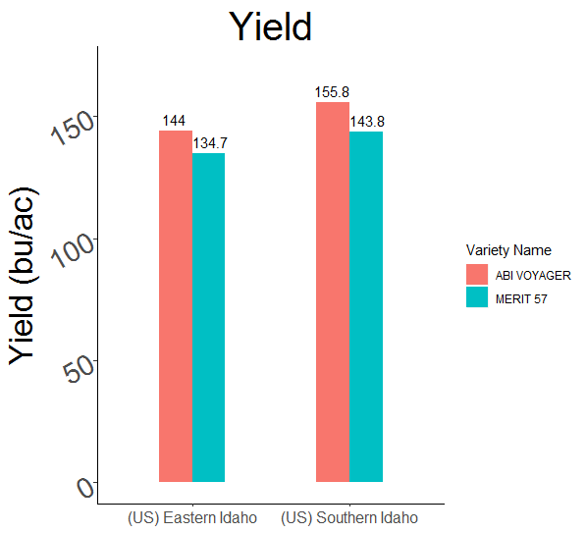
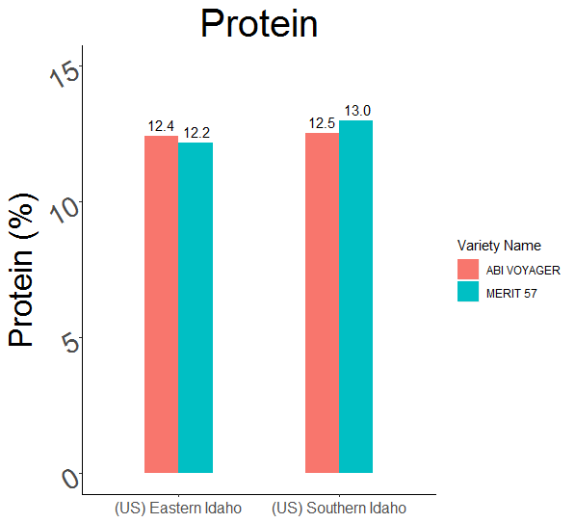
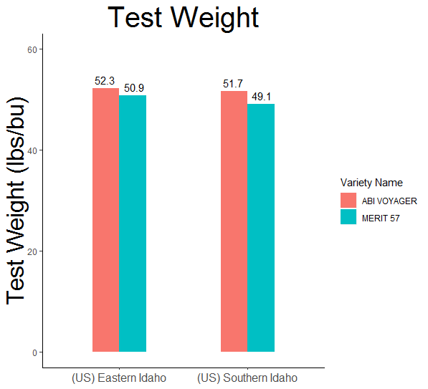
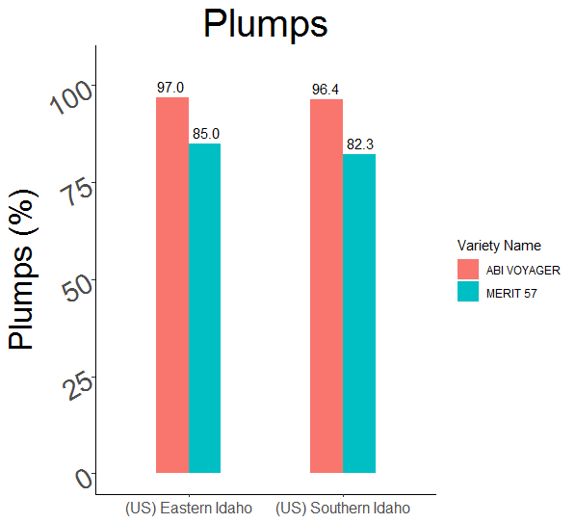
ABI Voyager
    High yield potential
    Good plumpness
Low protein
Great test weight
AB InBev Researcher’s notes on ABI Voyager: “ABI Voyager’s improved agronomic traits make it the highest yielding variety to be released by ABInBev’s barley breeding program. Voyager can be pushed to higher yields in high-input environments. We do caution that targeting maximum yield potential increases risk of losing malting spec by high protein. We see evidence of the success of ABI Voyager because farmers in Idaho are beating test plot yield.”
[1]
Micro and Macronutrient Recommendations
Disease | Resistance Rating
Splot blotch
Net blotch net form
Net blotch spot form
Fusarium head blight
Pre harvest sprout
Phosphorus (P)
Phosphorus fertilizer rates based on soil testing
NaHCO3, soil test P | Free Lime %
(0-12 inches) | 0 | 5 | 10 | 15
(ppm) |  | (lb P2 O5 /acre)
0 | 240 | 280 | 320 | 360
5 | 160 | 200 | 240 | 280
10 | 80 | 120 | 160 | 200
15 | 0 | 40 | 80 | 120
20 | 0 | 0 | 0 | 40
Moderately Susceptible
Resistant
Potassium (K)
With soil test levels of 0 to 75 ppm K, apply 0 to 240 lb/acre K2O.
Sulfur (S)
With soil test levels of less than 10 ppm S and low-sulfur irrigation water, apply 20 to 40 lb/acre of S.
Susceptible
Moderately resistant
[1]
[2]

Slide 3
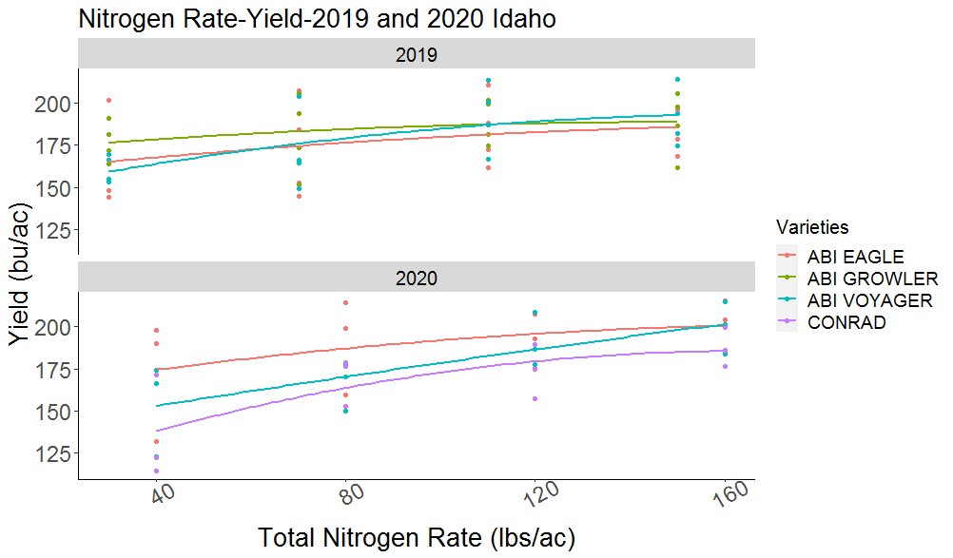
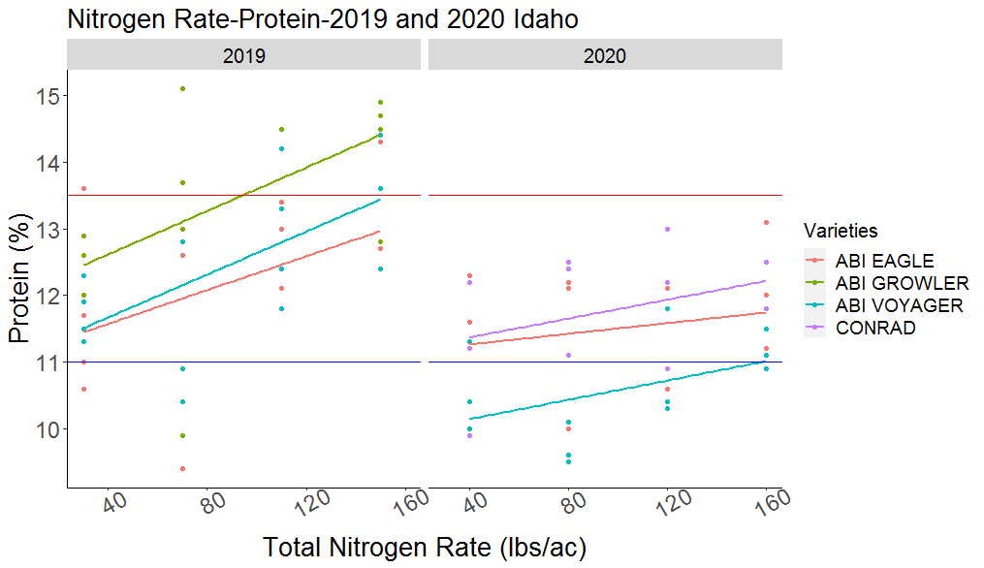
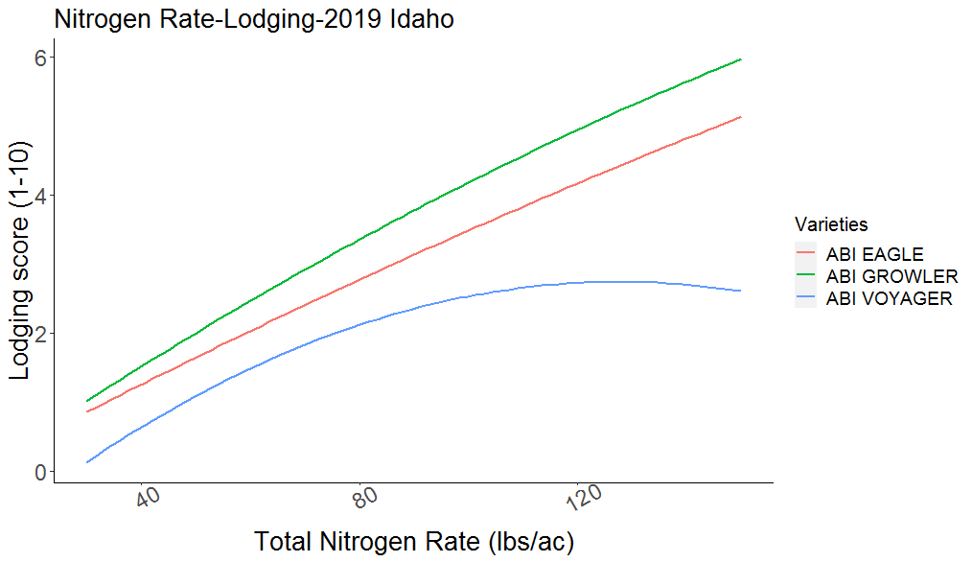
ABI Voyager
    High yield potential
    Good plumpness
Low protein
Great test weight
Yield response to total N (Soil test Nitrogen + Rotational Crop credit + Applied).
When total nitrogen rates are above 120 lbs/ac, there was a diminishing return to yield while also increasing risk of lodging and out of spec protein.
Protein response to total N.
Top horizonal red line indicates maximum accepted protein levels (13.5%), and blue horizonal line indicate minimum protein specification at malthouses. In 2020, ABI Voyager had a banner year where yields could be pushed with nitrogen with low risk to over high proteins. But when considering rates across normal years like 2019, overly high N applications would have pushed ABI Voyager over protein spec.
These three graphs represent the balance between yield, protein and lodging that farmers must make when considering their nitrogen application rate. While there was limited risk from too high of protein from high N rates in our data for ABI Voyager in cool years, this risk increases drastically in normal years.
Additionally, the diminishing returns from nitrogen to yield should be considered in the economics of farm operations. Most importantly, this information indicates the importance of soil tests 2 weeks prior to planting to optimize fertility on a farm. The difference between good yield-good quality and good yield-bad quality is only 30 lbs/ac of nitrogen.
Lodging score’s relationship to total N. Lodging increased by 25% when total rates went from 120 lbs/ac to 150 lbs/ac.
Updated March 2021
Data sources: [1] AB InBev breeding and Crop Management Data. [2] University of Idaho Extension. Spring Barley Quick Facts. file:///C:/Literature_review/Barley/U.%20Idaho%20Docs/Spring%20Barley%20Protocol.pdf

