Slide 1
EELE 461/561 – Digital System Design
Module #1 – Digital Signaling
Topics
    Course Overview
    Signaling Definitions
    Signal Composition
Textbook Reading Assignments
    1.1 – 1.7, 2.1, 2.10
What you should be able to do after this module
    Describe what signal integrity is and why it is important
    Understand the terminology used in digital signaling
    Describe and use the risetime-bandwidth-product
    Describe the frequency components of a digital signal

Slide 2
Course Overview
Instructor: Brock J. LaMeres
Office : 533 Cobleigh Hall
Phone : (406)-994-5987
Email : lameres@ece.montana.edu
Web : www.coe.montana.edu/ee/lameres/
Time / Location: Lecture : Monday, Wednesday, Friday
9:00am – 9:50am
110 EPS
Textbook: “Signal & Power Integrity Simplified",
Eric Bogatin,
Prentice Hall, 2nd edition 2009
Website: www.coe.montana.edu/ee/lameres/courses/eele461_spring12
- all handouts and homework are found on the website
- it is your responsibility to download assignments

Slide 3
Course Overview
Office Hours: Check instructor website for most recent hours
Requisites: Pre-requisite EE308, EE334, EE371 (or consent of instructor)
Grading: Homework - 25%
Exam #1 - 25%
Exam #2 - 25%
Final Project - 25%
- Homework Assignments are due at the beginning of class on indicated date.
- Late homework will be accepted for one week after the due date with a penalty of
50% point reduction. No credit will be given for assignments over one week late.
- No make up exams will be given. Plan on being available on the exam dates.

Slide 4
Course Overview
Final Project:
- A final design project will be assigned midway through the semester
- the project will consist of a high speed link design including architecture, design, and simulation
- a paper will be required that explains the design, its operation, simulation results, and layout
- an in-class presentation will be required during the last week of the semester
- you may work in teams of 2

Slide 5
Course Content
What is this course?
- We will look at how to design and analyze digital communication links in a wireline medium
(i.e., conducting wires vs. wireless)
- a communication link is the circuitry (Tx, Rx, and interconnect) used to transfer information between
logical blocks
ex) uP to memory system or peripherals
computer-to-computer networking
- We will look at the analog effects of a digital signal in order to understand how to design
chip-to-chip communication links
- We will learn how to create a noise budget that considers voltage and timing noise
- We will see that the physical interconnect between IC’s tends to limit the speed at which
data can be transferred
- We will also see that at modern integrated circuit speeds, interconnect needs to be treated as
a transmission line (as opposed to just a simple capacitance)
- We will learn to use modern CAD tools to help design and analyze these links

Slide 6
Course Content
What topics will be covered?
1) Signaling (Exam #1 Topics)
2) Interconnect Analysis
3) Interconnect Fabrication and Modeling
4) Noise Sources & Budgeting
5) Power distribution
6) Link Architectures
7) Measurement Techniques (Exam #2 Topics)
8) Modern Bus Architectures
9) Design Trade-offs

Slide 7
Course Content
Why do we need this course?
- We create all of our digital circuits using integrated circuit technology
- In order for two digital circuits to communicate information, the transmitter (Tx) sends a signal
to the receiver (Rx).
- As long as the DC specifications are met at the Rx, the receiver can determine whether a 1 or 0
was sent.
- As along as sufficient time is allowed before and after the associated clock, the Rx flip-flops
can latch and store the information that was sent.

Slide 8
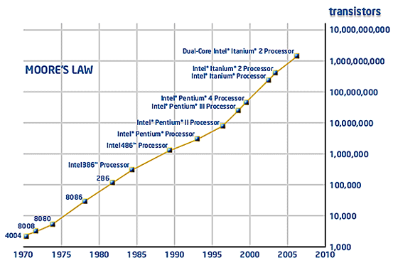
Course Content
Why do we need this course?
- So now all we need to do is meet DC and Timing specifications, and then go faster…
- In the beginning, integrated circuit performance was the limiting factor in going faster.

Slide 9
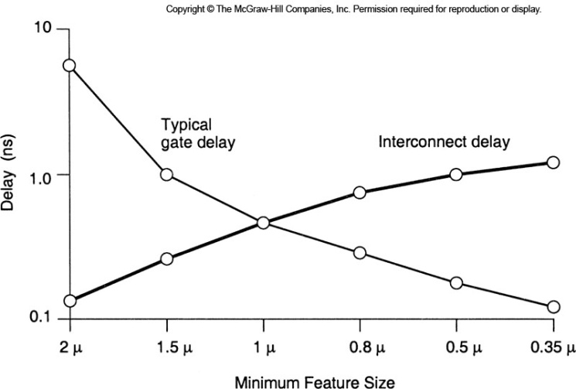
Course Content
Why do we need this course?
- We used to only care about the delay associated with the IC gates.
- On-chip and off-chip interconnect were modeled as capacitances, but they were secondary effects
- As we moved beyond 1um process capability, the on-chip interconnect began to contribute
more delay to the circuit than the gate itself
- Also at this time, the rise times of the IC drivers became fast enough so that off-chip interconnect
(i.e., PCB’s and cables) needed to be modeled as transmission lines.
- The mismatch in IC circuit performance and off-chip interconnect performance has to do with the
manufacturing processes used (IC=photolithography/chemistry, Interconnect=chemistry/mechanical)

Slide 10
Course Content
Why do we need this course?
- Now, modern digital system speed is dominated by the interconnect between the integrated
circuits making the Tx and Rx.
- The interconnect must be modeled not as simple wires, but as distributed capacitances,
inductances, and impedances.
- This modeling also applies to the interconnect of the power distribution (i.e., V_{DD} and GND)
- We now have to consider the analog behavior of the signal as it travels through the
interconnect to understand how fast and how robust a digital system can be.
- This course will present the techniques to design, model, analyze, and measure a modern
digital system at the physical level.
- This type of design and analysis is also called
”Signal Integrity”

Slide 11
Course Content
Signal Integrity
- Signal integrity consists of 3 categories.
1) Voltage Noise
- sometimes just called Noise
- what factors in the system eat into our Voltage Noise Margin
2) Timing Noise
- also called Jitter
- the factors in the system eat into our Timing Margin
3) Electromagnetic Interference (EMI)
- when our system creates unwanted energy that interferes with the
standards set by the Federal Communication Commission (FCC)

Slide 12
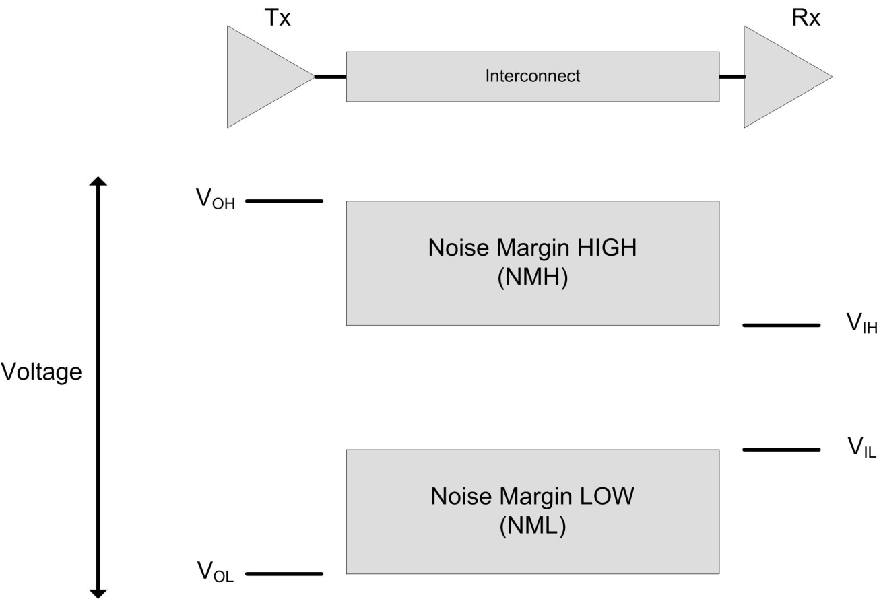
Signaling
Digital Signaling
Voltage Noise
- what we’re really after is a stable region between V_{IH} and V_{IL}

Slide 13

Signaling
Digital Signaling
Voltage Noise
- this area of Signal Integrity can further be sub-categorized into 4 distinct sources of noise:
1) Single Net Quality
2) Cross-talk
3) Power Supply Quality
4) EMI

Slide 14
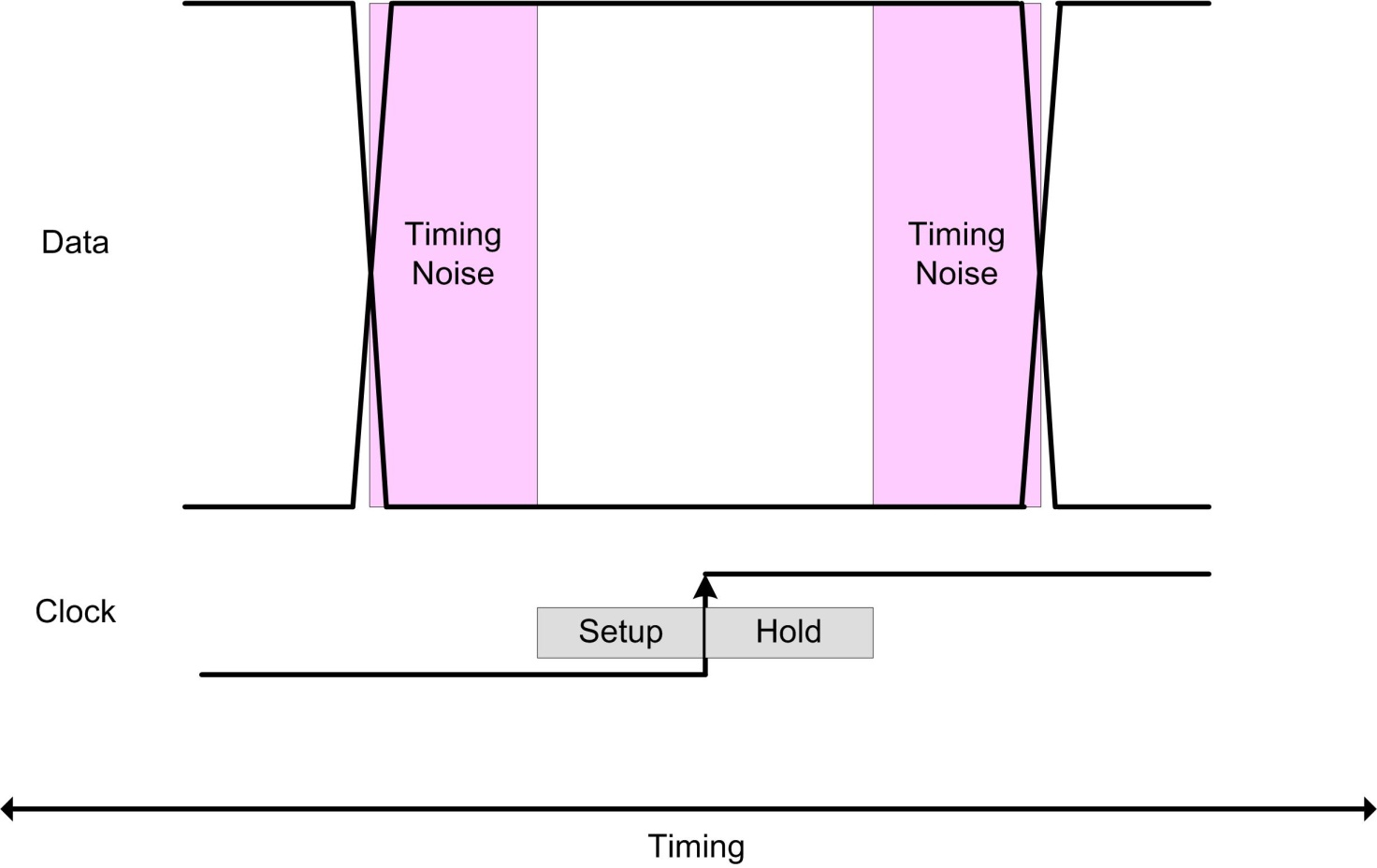
Signaling
Digital Signaling
Timing Noise
- we need to ensure that the data is stable long enough to meet the setup/hold specification of the Rx

Slide 15

Signaling
Digital Signaling
Timing Noise
- the entire timing of a signal can be broken down into 3 distinct parts:
1) Logical timing
- i.e., the time for the gates to switch on chip
2) Interconnect Propagation
- the time we have to wait for the signal to propagate
- the time that we have to wait for any distortions to settle out
3) Receiver Setup/Hold
- the time the data must remain
stable around the receiver clock event

Slide 16
Signaling
Digital Signaling
Electromagnetic Interference
- The FCC sets standards for how much Electromagnetic energy can be transmitted in a given
frequency band.
- Some of the bands are licensed (i.e., you have to pay to use them)
- If you make a product that isn’t intended to use one of the FCC bands, you cannot inadvertently
transmit energy into an FCC band above a certain level.
- This is considered breaking the law and you will not be able to ship your product if it does this.
- Products undergo EMI testing prior to shipping.
- As our systems go faster, it becomes easier for the energy to radiate out of our product because
our small interconnect begins to look like an antenna

Slide 17
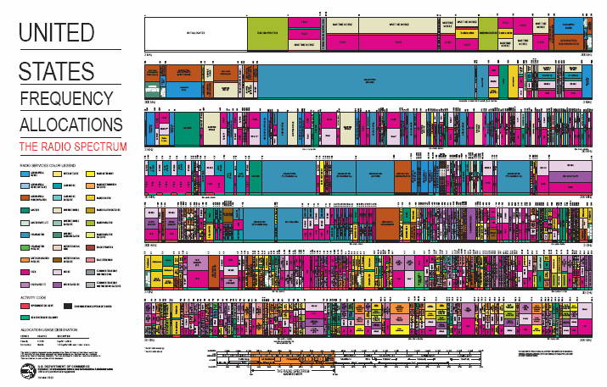
Signaling
Digital Signaling
Electromagnetic Interference (EMI)

Slide 18
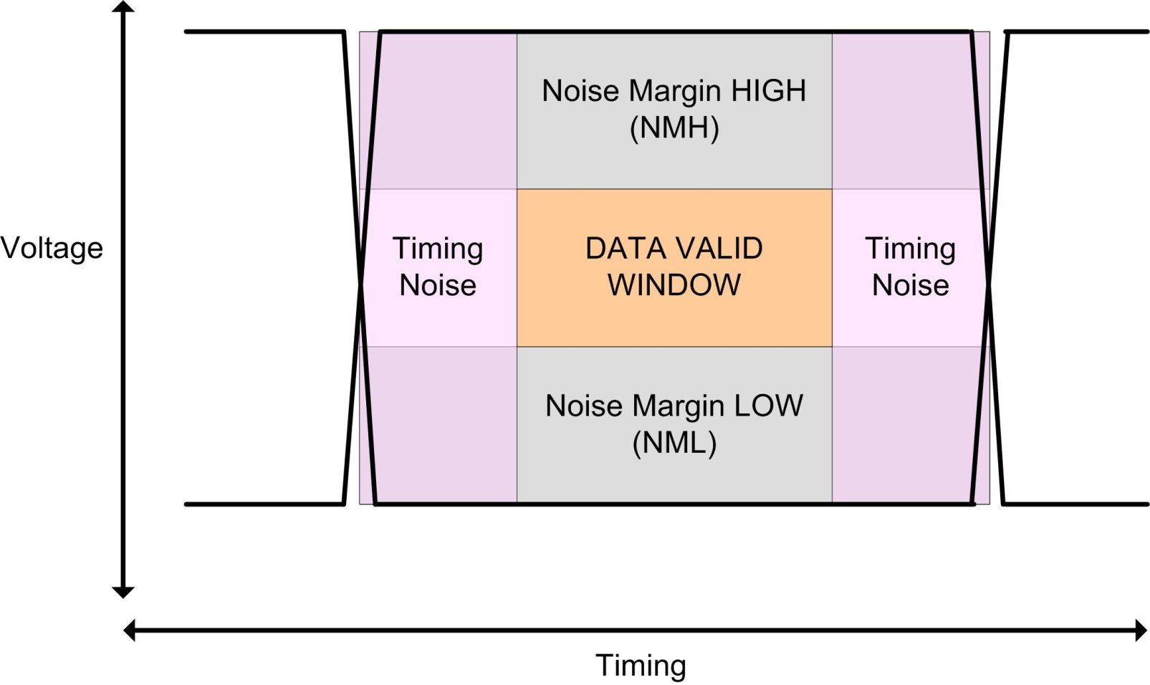
Signaling
Digital Signaling
Eye Pattern
- we can combine the voltage and timing specifications into one diagram called an “Eye Pattern”

Slide 19
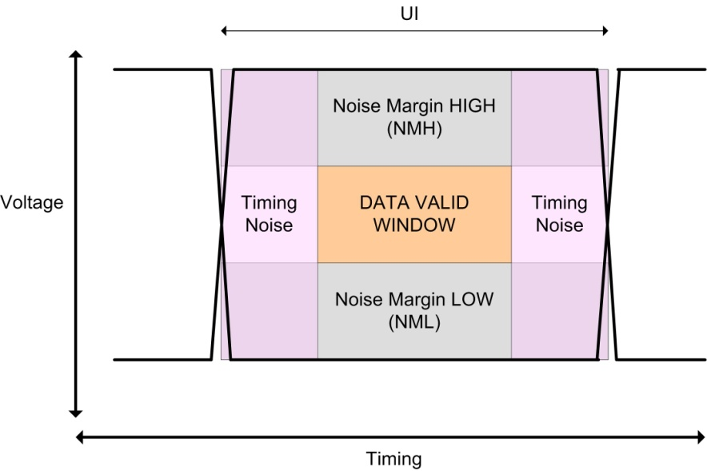
Signaling
Digital Signaling
Data Valid Window - the stable region in Voltage & Time around a timing event (i.e, a clock) that
will guarantee a logic level is received
Unit Interval (UI) - the time between transitions on the data line
Max Data Rate - the fastest we can transmit information on the data line:

Slide 20
Signaling
Digital Signaling
- in this class, we will learn how to create a Noise Budget that tabulates the contribution of each
noise sources in our system.
- we can then predict if our system will reliably transmit data (i.e., does it work?) and how fast
it can go.
- In order to do this, we must understand how to model and analyze the all of the components
in a system (Tx, Interconnect, and Rx)

Slide 21
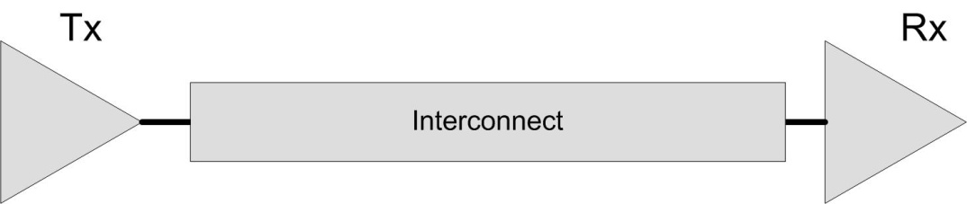
Signal Composition
A Digital Link
- A digital communication link, consists of 3 elements
1) A Driver (Tx)
2) Interconnect
3) A Receiver (Rx)
- The Driver and Receiver are constructed using Integrated Circuit Technology (ICs)
- The interconnect consists of all wires that connect the Tx and Rx. These include:
On-chip traces, package leads, PCB traces, connectors, and cables

Slide 22
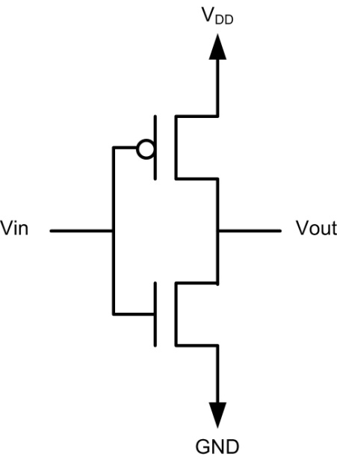
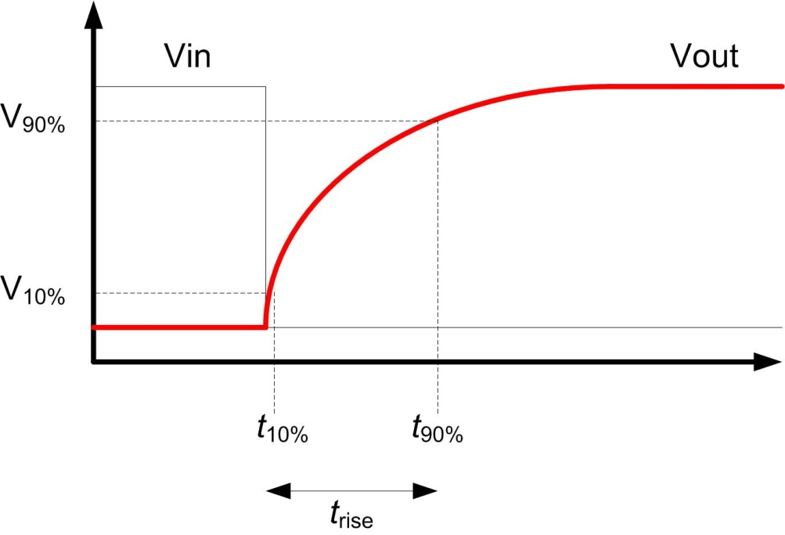
Signal Composition
Driver Risetime
- The driver produces a digital edge
- We define the risetime (t_{rise}) as the time it takes for the edge to go from 10% of steady state
to 90% of steady state.
- If the IC driver is NOT connected to any interconnect (on-chip or package), then the rise time
will follow an RC exponential ramp where the R and C come from the Tx transistors.

Slide 23
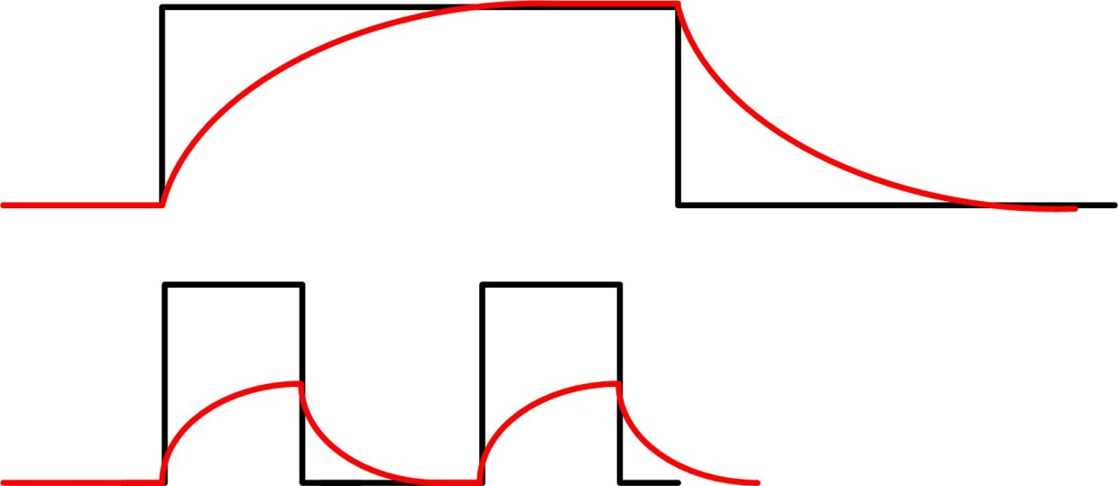
Signal Composition
Risetime and Frequency
- The speed of the driver risetime is important because it tells us how fast we can possibly
switch logic states (i.e., how fast of a frequency can be generated.
- If we try to switch too fast, there isn’t enough time for the rise time to get to its final value. This
leads to data loss.

Slide 24
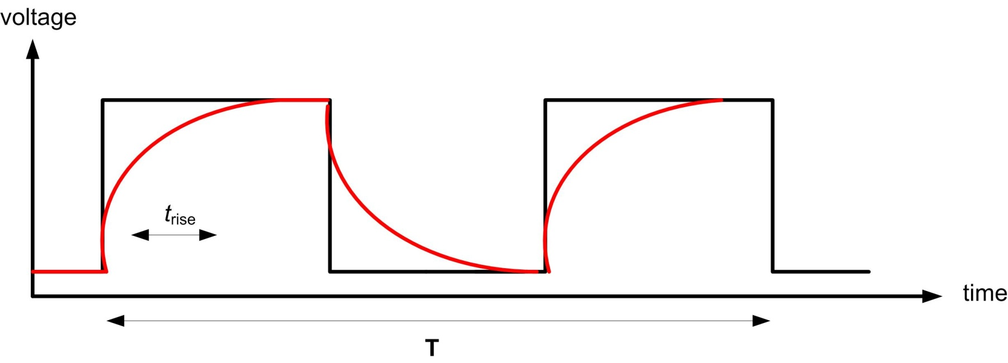
Signal Composition
Risetime and Frequency
- While the relative speed of the risetime to Period (T) is arbitrary, we can use a rule of thumb
that it needs to be ~10% of the Fastest Period.
- We’ll see how this is derived when we look at the Fourier Transform of a Square Wave

Slide 25
Signal Composition
Risetime and Bandwidth
- Note that the driver rise time is NOT always what we get at the Receiver end of the interconnect
- We can think of this as a Linear Time Invariant (LTI) System where we have:
1) A forcing function, x(t) (i.e., the driver edge and pattern)
2) A transfer function, h(t) (i.e., the response of the interconnect)
3) The system output, y(t) (i.e., what is seen at the Rx)

Slide 26
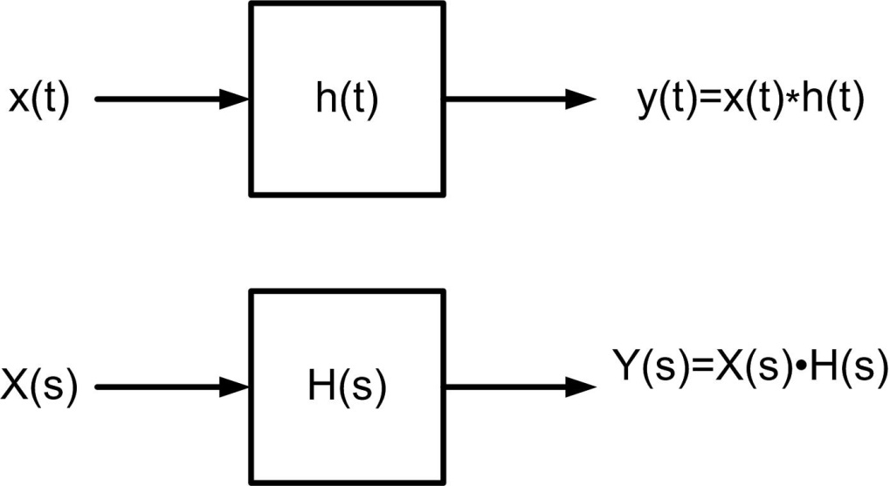
Signal Composition
Risetime and Bandwidth
- A very nice feature of an LTI system is that we can transform between the Time and Frequency
domains easily.
- Not only do the functions transform, but so do operators.
- One of the main operator transforms that we take advantage of is convolution in the time domain
becomes multiplication in the frequency domain.

Slide 27
Signal Composition
Risetime and Bandwidth
- We like to use the Frequency Domain because some things are easier to observe and some
operations are easier.
- We are interested in what our forcing function looks like in the Frequency Domain because it
tells us:
1) what spectrum of energy is stimulated in the system?
2) what bandwidth our Interconnect needs in order to pass X(s)?
- this helps us scale the cost of our materials and construction for the application.
i.e., we don’t need to build a $100k, 100GHz, PCB if we only stimulate
1GHz of spectral energy.
3) what bandwidth do our equivalent circuit models need to have?
- higher frequency models take more simulation time to compute.
- we want sufficient bandwidth for accuracy, but not too much that our simulations
run longer than necessary.

Slide 28
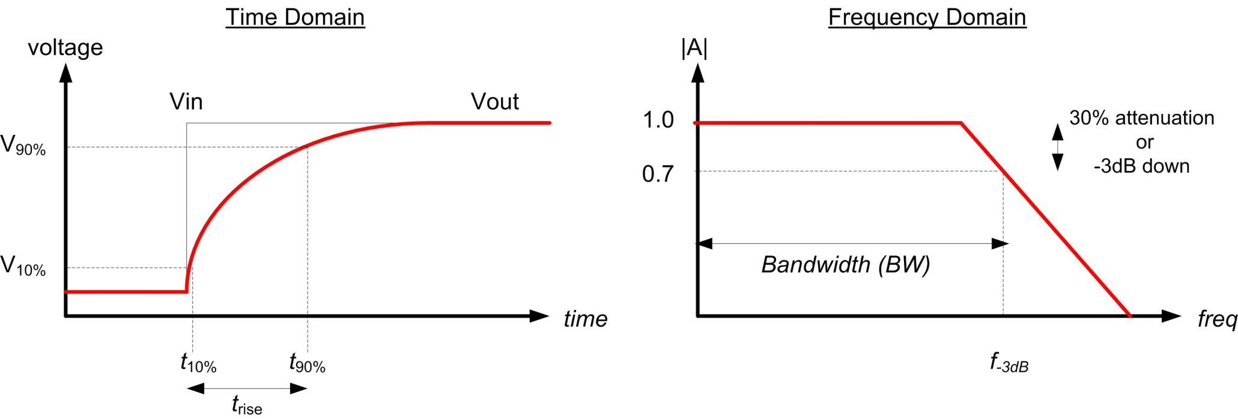
Signal Composition
Risetime and Bandwidth
- Let’s start by creating a rule of thumb that will allow us to easily switch between the Time
and Frequency Domain for our RC Exponential Ramp.
- This is a relevant transform because this tends to be what CMOS edges look like.
- First, let’s define two metrics that we will use to describe the RC circuit.

Slide 29
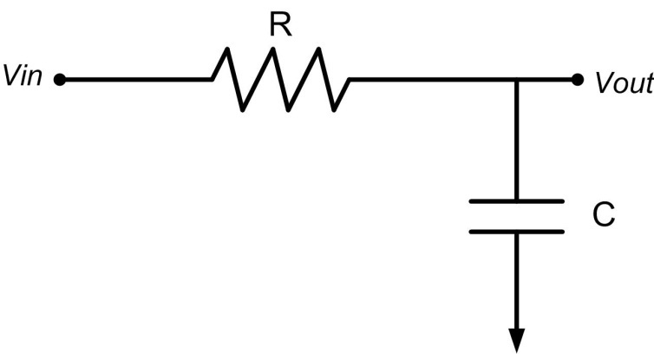
Signal Composition
Risetime and Bandwidth
- Let’s Solve the RC circuit and derive the expressions for risetime and bandwidth

Slide 30
Signal Composition
Risetime and Bandwidth
- RC circuit cont…
We want to get this into a form so that we can use the Laplace Transform for an exponential approach.
Let’s set ∝= 1/RC
Now let’s plug in the transform for a unit step (1/s)

Slide 31
Signal Composition
Risetime and Bandwidth
- RC circuit cont…
Now we can transform into the time domain
Now we can plug in u(t)=1 for t>0
This is the generic Time Domain solution for an exponential ramp (i.e., a rising edge)

Slide 32
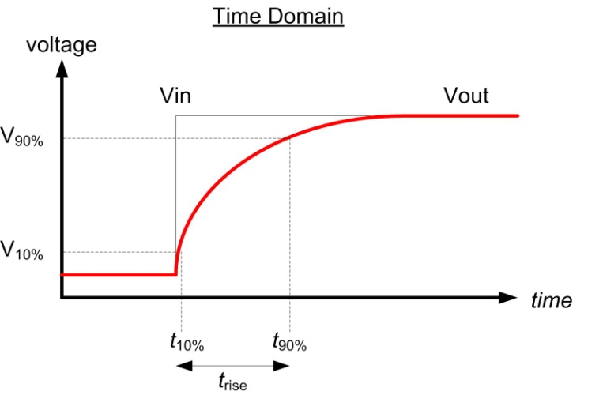
Signal Composition
Risetime and Bandwidth
- RC circuit cont…
Let’s solve for the risetime. First t_{10%}
Then t_{90%}
Finally, we solve for t_{rise}

Slide 33
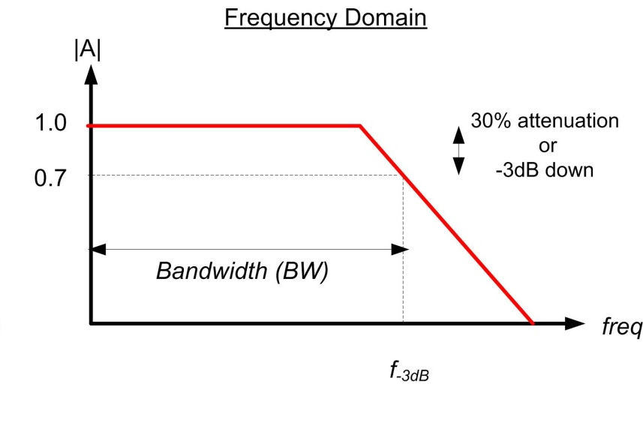
Signal Composition
Risetime and Bandwidth
- Let’s now solve for Bandwidth in the Frequency Domain
We go back to an earlier form of the RC solution:
We are after the frequency at which the Magnitude of V_{out}/V_{in} is equal to 0.7.
In a logarithmic scale, this attenuation can also be described as where the Amplitude is 3dB less than the Amplitude at DC.
We can use 1/√2 to make the math come out easier since (1/√2 = 0.7).
1
Re
RCw
Im

Slide 34
Signal Composition
Risetime and Bandwidth
- RC circuit cont….
Now we rearrange to solve for f_{-3dB}

Slide 35
Signal Composition
Risetime Bandwidth Product
- We can relate the risetime to the bandwidth in what is known as the “Risetime Bandwidth Product”

Slide 36
Signal Composition
Risetime Bandwidth Product
- We now have a quick expression to convert between key metrics in the Time and Frequency
Domains for an RC circuit.
- This not only tells us how much bandwidth a passive network has, but also how much
Spectral Energy is stimulated by a driver that outputs an exponential approach (i.e., an RC step)
ex) how much spectral energy is created by a driver with a 1ns step?

Slide 37
Signal Composition
Risetime Bandwidth Product
- This expression also illustrates that as the risetime gets faster, higher frequencies are generated
which makes sense…

Slide 38
Signal Composition
System Risetime & Bandwidth
- We found a very powerful and quick way to convert between a Time Domain metric (risetime) and
a Frequency Domain metric (BW) using the Risetime Bandwidth Product.
- this was derived for a simple RC circuit, but we’ll see it can be extended to a variety of step shapes.

Slide 39
Signal Composition
System Risetime & Bandwidth
- Note that this rule-of-thumb is used on a single element
(i.e., a single driver, a single interconnect network, etc..)
- Remember that BW is when the sine wave at f-3dB is reduced to 70% of its value at steady state.
- Now we look at how to combine multiple elements to derive the system risetime of cascaded blocks
- We can combine multiple risetimes in a system to form the reduced equivalent system risetime
using an RMS summation

Slide 40
Signal Composition
System Risetime & Bandwidth
- This expression can also be used on networks that have risetimes that aren’t RC steps.
- This expression can be used if the system follows the Central Limit Theorem
- The Central Limit Theorem states:
the sum of independent, random variables approaches a normal distribution with squared
standard deviations equal to the sum of squares of individual standard deviations regardless
of individual distributions as long as each element’s distribution:
- follows a Gaussian distribution (i.e., what you get if you differentiate the step)
- is symmetrical and uni-modal
- is continuous
- no one term dominates the expression

Slide 41

Signal Composition
System Risetime & Bandwidth
- Let’s see how we’d use this:
ex) We have a digital link with a driver outputting a risetime of 300ps. The interconnect system looks
like an RC network with bandwidth of 2GHz. What is the risetime we would expect to
see at the receiver?
- first convert the interconnect bandwidth to a
risetime using the Risetime Bandwidth Product
- now use the RMS sum to find the equivalent (or composite)
risetime of the system.

Slide 42
Signal Composition
System Risetime & Bandwidth
- This can be expanded for as many elements that are in the system as long as they follow the
Central Limit Theorem.
- Since risetime and bandwidth are inversely proportional, we can also use this technique for
Bandwidths directly.

Slide 43
Signal Composition
Square Waves
- Let’s now look at the composition of a square wave.
- We are interested in the Frequency Domain representation of square waves because this
a digital driver will ultimately output a data pattern which will have a square wave spectrum.
- We can visualize how much bandwidth a link will need to transmit a certain data pattern
by looking at the data patterns spectrum.
- For now, let’s assume that the risetime is instantaneous (we’ll incorporate real risetimes at the end)

Slide 44
Signal Composition
Time and Frequency Domains
Frequency Domain Basics
- The Frequency Domain is completely made up by engineers and scientists. The only “Real” domain
is the Time Domain.
- We create the Frequency Domain in order to visualize problems in a more intuitive manner.
- Also, some mathematical operations are easier in the Frequency Domain.
- The Frequency Domain only contains Sine Waves
- We represent a single Sine wave with a dot or line representing its Frequency and Amplitude
- We can put phase on a 3rd axis, or on a different plot

Slide 45
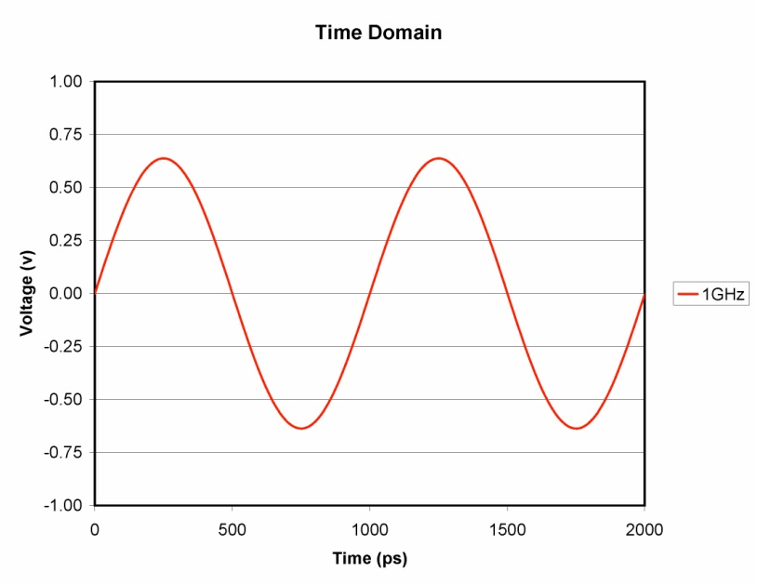
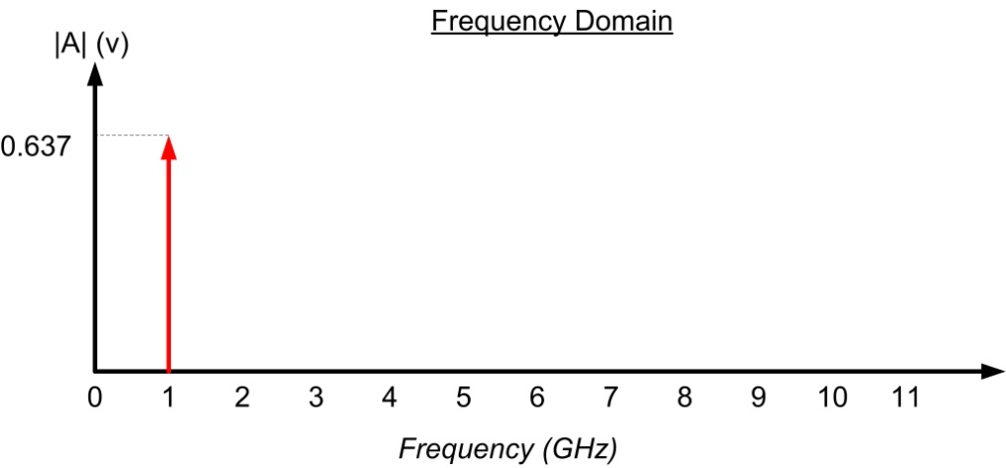
Signal Composition
Time and Frequency Domains
- data in the Frequency Domain contains the same information as the Time Domain, but in less space
- DC offset information for a waveform is represented in the Frequency Domain by
placing magnitude information at 0 Hz

Slide 46
Signal Composition
Time and Frequency Domains
- Fourier Analysis tells us that any repetitive waveform in the Time Domain can be represented
by one or more sine waves in the Frequency Domain.
- When a waveform is created using more than one sine wave, we say it has a Frequency Spectrum
- We can Transform back and forth between the domains using the Fourier Transform
- The Fourier Integral will transform any repetitive function:
Time to Frequency Domain Frequency to Time Domain

Slide 47
Signal Composition
Time and Frequency Domains
Discrete Fourier Transform (DFT)
- In the real world, we perform this transformation on discrete points of the function.
- The number of points is fixed prior to the transform.
- The pattern is assumed to repeat indefinitely every T seconds.
- This is called a Discrete Fourier Transform (DFT).
Fast Fourier Transform (FFT)
- A special case of the DFT is when the number of points is a power of 2 (256, 512, 1024, …)
- This special case enables the Matrix Math to be sped up considerably.
- This is called a Fast Fourier Transform (FFT) and is the most common algorithm used today.
- The FFT can be 100-10,000 times faster than a general DFT.

Slide 48
Signal Composition
Fourier Transform of Square Waves
- One way to construct the Fourier Transform of a Square Wave is to construct the Square Wave
using multiple, basic functions.
- The Fourier Transform not only allows functions to be transformed, but also operations.
- This means we can construct a complex expression for a waveform, and then transform the
individual parts and operations.
- There are two common operations that we use when looking at Square Waves
Fourier Transform of Operations
Operation Time Domain Frequency Domain
“Scaling”
“Convolution”

Slide 49
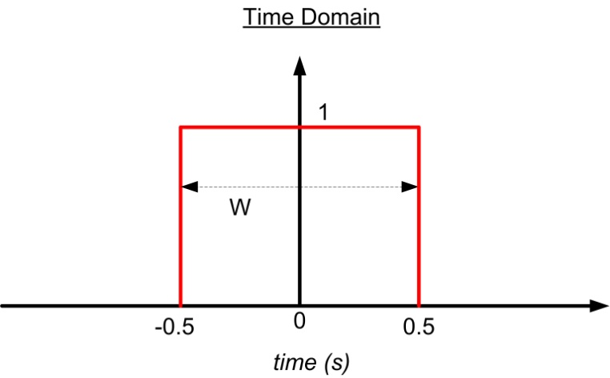
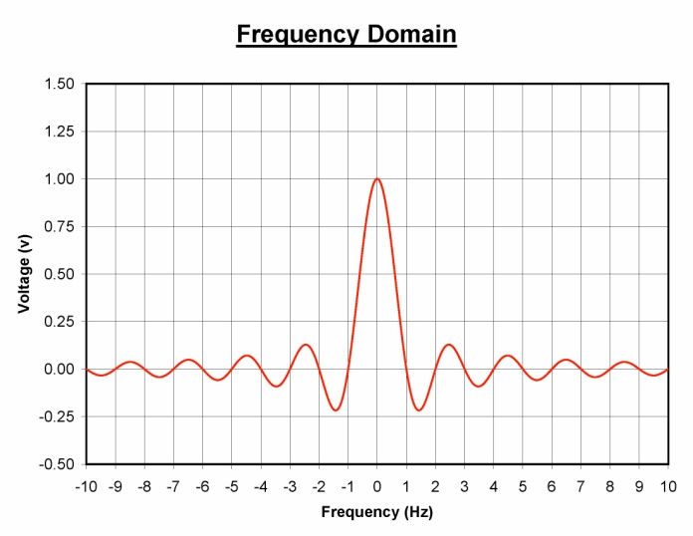
Signal Composition
Fourier Transform of Basic Functions
Rectangle Function
- A Rectangle Function is a pulse with unit width and height.
- We can use this to represent a single pulse of a square wave with a finite pulse width (W).
- This transforms into the sinc function with zero crossings at integer multiples of 1/W.
Function:

Slide 50
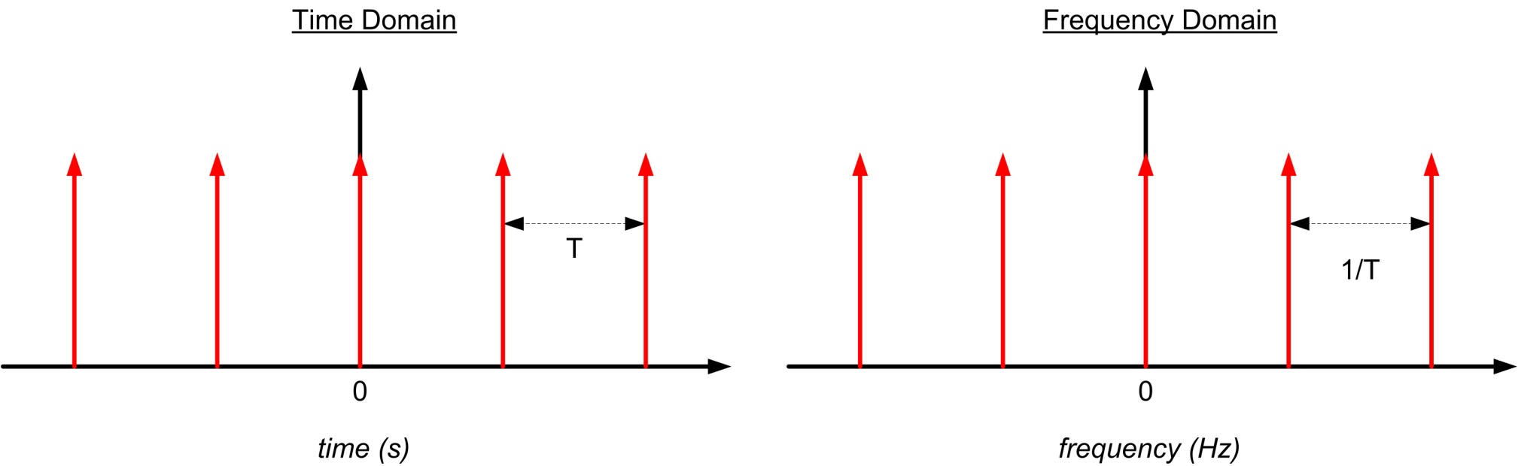
Signal Composition
Fourier Transform of Basic Functions
Shaw Function
- A Shaw Function is an infinite series of impulse functions.
- This functions transforms into another Shaw function in the Frequency Domain
Functions:

Slide 51
Signal Composition
Fourier Transform of Basic Functions
Square Wave
- In the Time Domain, if we convolve a Rectangle Function with a Shaw Function, we will get
a repetitive sequence of pulses.
- If W is set to T/2, then we will have a 50% duty cycle square wave (a special case).

Slide 52
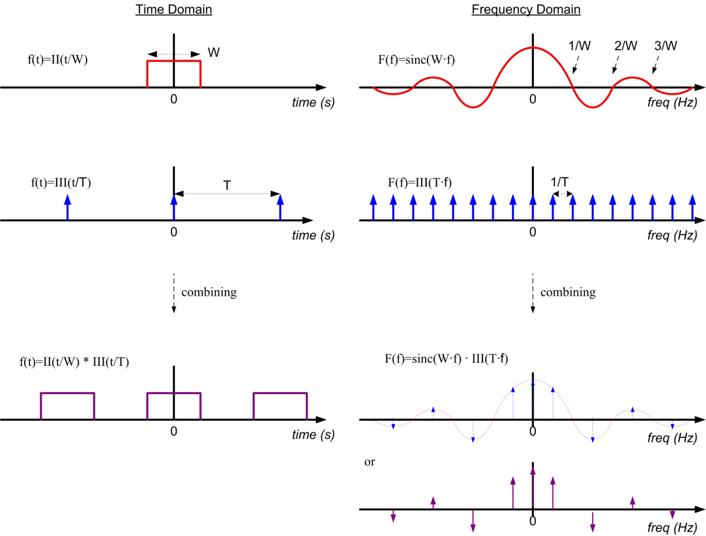
Signal Composition

Slide 53
Signal Composition
Fourier Composition of a Square Wave
- Notice that when we have a 50% duty cycle, the sinc envelope eliminates all even harmonics.
- We are left with only the DC offset, the Fundamental Frequency, and Odd Harmonics.
- This is what most people are familiar with when they talk about the Fourier spectrum of a
square wave.
- However, this illustrates that if we alter the duty cycle, we WILL start getting even harmonics due
to the sinc function spreading out.

Slide 54
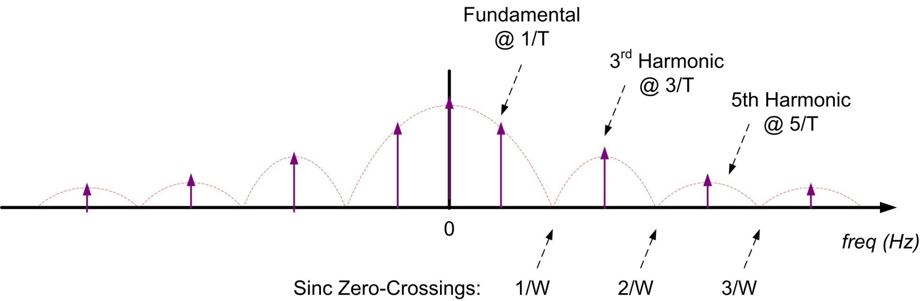
Signal Composition
Fourier Composition of a Square Wave
- if we only concern ourselves with the Magnitude, we get the more familiar Fourier Spectrum.
- Note that a smaller pulse increases the width of the sinc envelope
- The amplitude of the spikes of energy at each multiple of the fundamental frequency depend
the shape of the sinc envelope.

Slide 55
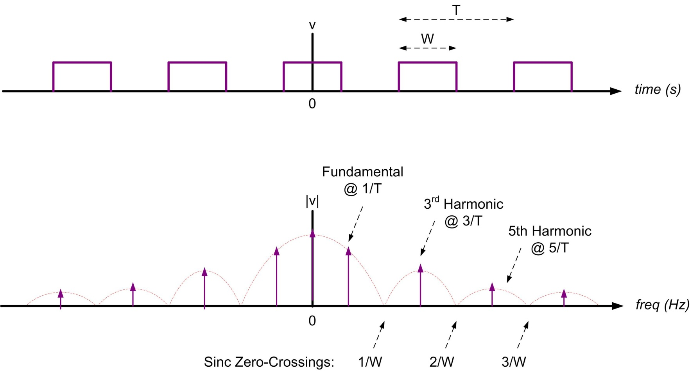
Signal Composition
Fourier Composition of a Square Wave
- We now have a transform for an Ideal Square Wave

Slide 56
Signal Composition
Fourier Composition of a Square Wave
- We now have two uses for the word “Frequency”.
- We use Frequency to describe the rate at which the digital square wave toggles.
- We also use Frequency to describe the harmonics that make up the square wave.
- To distinguish the two, we typically use the term Toggle Rate or Toggle Frequency
for the time domain square wave.
- But we still sometimes use the word frequency when we discuss digital signals, so we always
need to be aware of the difference between Toggle Frequency and the frequency of the
Square Wave’s Spectral Content.

Slide 57
Signal Composition
Fourier Composition of a Square Wave
- What the Frequency Domain shows us is that the Square wave is made up of a series
of sine waves with different amplitudes and frequencies that are at harmonic multiples of
the fundamental.
- An ideal square wave is made up of only the ODD harmonics of the fundamental frequency.
- A square wave with less than 50% duty cycle begins to include EVEN harmonics due to the
sinc envelope expanding.
- The amplitude of each harmonic is given by:
where n is the harmonic number (i.e., 1, 3, 5, 7, etc…)

Slide 58
Signal Composition
Fourier Composition of a Square Wave
- An ideal square wave will have amplitudes that get smaller and smaller as the harmonic frequency
goes up.
Ex) a 1v square wave (V_{LOW}=-0.5v, V_{HIGH}=+0.5v) will be made up of sine waves with Amplitudes:
Amplitude
Fundamental 0.637 v
3rd 0.212 v
5th 0.127 v
7th 0.091 v
9th 0.071 v
11th 0.058 v
- notice that the higher the frequency, the less amplitude that the harmonic contributes to the
reconstruction of the Square Wave.

Slide 59
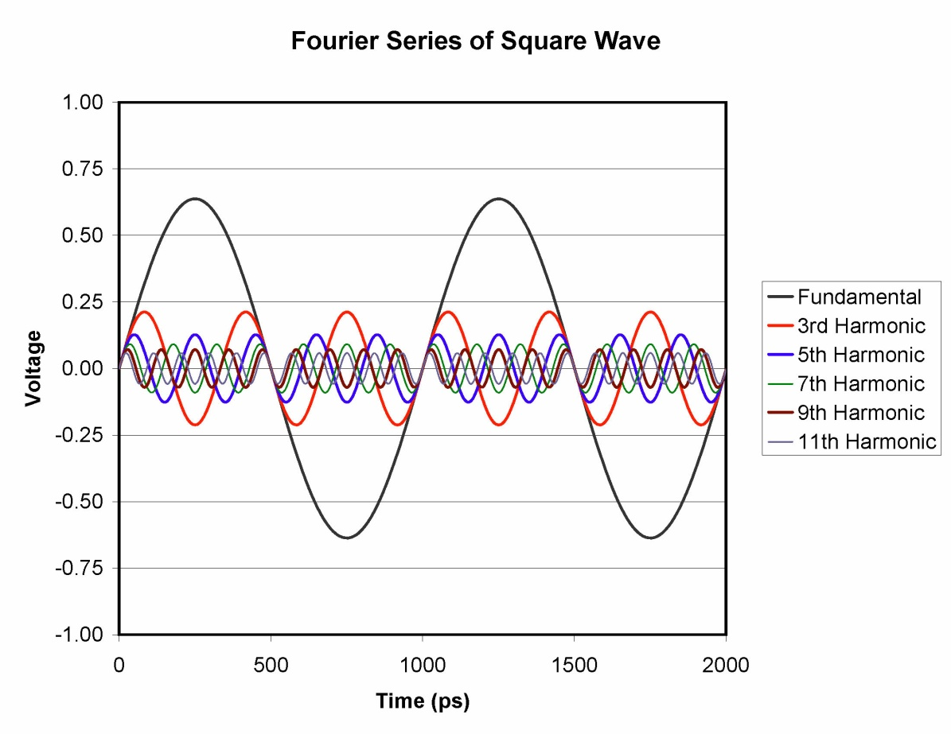
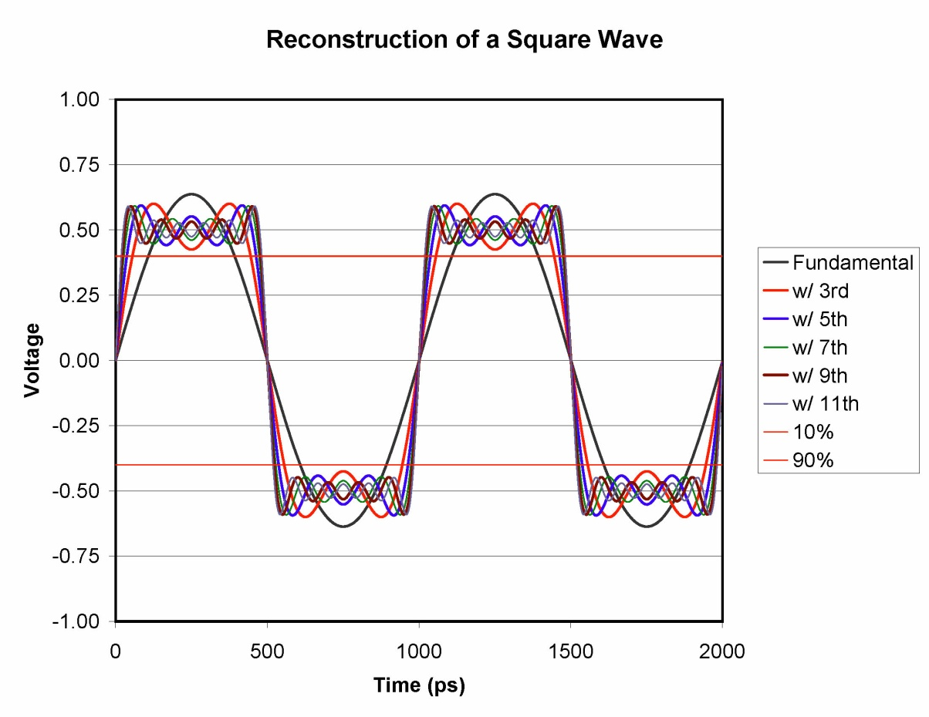
Signal Composition
Fourier Composition of a Square Wave
- if we split out the sine waves in the Time Domain, we can see the individual components:

Slide 60
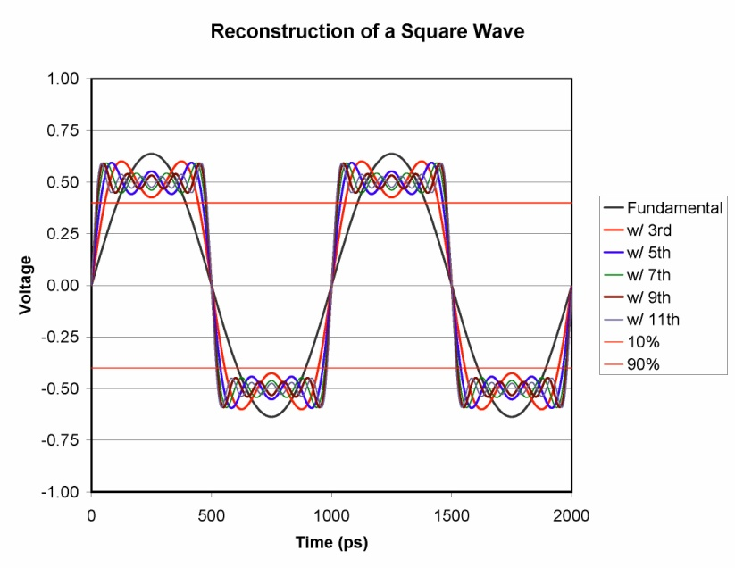
Signal Composition
Fourier Composition of a Square Wave
- Notice that as we add more harmonics to the fundamental, we get a waveform that looks more
and more like an ideal square wave.
- If we add all the harmonics (up to infinity), we will get a perfect square wave with instantaneous
risetimes.

Slide 61
Signal Composition
Fourier Composition of a Square Wave
- However, we know that no system can output or transmit infinite frequency.
- The big question for digital system designers becomes…
“How many harmonics do I need to get a square wave that is good enough?

Slide 62
Signal Composition
Fourier Composition of a Square Wave
- This is an arbitrary question and depends on how fast of a risetime each system needs.
- But, we can tie this question back to one of our rules-of-thumbs relating
the risetime to the period of the square wave.
- earlier we stated that the risetime should be ~10% of the period

Slide 63
Signal Composition
Fourier Composition of a Square Wave
- Let’s start with only the fundamental frequency and see what percentage of the period
that the risetime takes.
- Then we’ll add harmonics and see how it changes:
Square Wave Composition (t_{rise}/T_{period})%
----------------------------------- -----------------
Fundamental 22%
Fund + 3rd 11%
Fund + 3rd + 5th 7.4% **
Fund + 3rd + 5th + 7th 5.7%
Fund + 3rd + 5th +7th + 9th 4.4%
Fund + 3rd + 5th +7th + 9th + 11th 3.6%

Slide 64
Signal Composition
Fourier Composition of a Square Wave
- This tells us that if we include the fundamental + 3rd harmonic, the square wave risetime is 11%
of the period.
- If we include the 5th, this goes down to 7.4%, which meets our objective.
- So we can say that we really should try to get the 5th harmonic of the square wave in order
to reconstruct a reasonable representation.

Slide 65
Signal Composition
Fourier Composition of a Square Wave
- How does this all compare to the Risetime Bandwidth Product?
- Remember our original expression was derived for a single-pole, RC circuit
- If we look at the risetime bandwidth product of a Square Wave made up of
a Fourier Series of sine waves, we get:
Spectral Content Risetime Bandwidth Product
Fundamental 0.21
Fund + 3rd 0.33
Fund + 3rd + 5th 0.37 ***
Fund + 3rd + 5th + 7th 0.4
Fund + 3rd + 5th +7th + 9th 0.4
Fund + 3rd + 5th +7th + 9th + 11th 0.4
NOTE: The BW we use is the frequency of the highest harmonic present in the spectrum of the square wave.
- the product is pretty close to 0.35, especially if we try to include up to the 5th harmonic.

Slide 66
Signal Composition
Fourier Composition of a Square Wave
- This also shows that for different shaped risetimes, we can simply change the risetime BW product
to get more accurate results
- RC step, use 0.35
- Gaussian step, use 0.4
- BUT REMEMBER, this is an approximation to get a gut-feel. So we don’t need to get too
hung up on the exact number as long as it is around 0.35.
- One more nice thing is that the Fourier Series Representation has a Gaussian Distribution
by nature, which means it follows the Central Limit Theorem.
- That means that even if we choose to use 0.4 in our risetime BW product, we can still use a
sum-of-squares expression to describe the composite risetime.

Slide 67
Signal Composition
Fourier Composition of a Square Wave
- Once again, remember that we are talking about the stimulated energy of the driver.
- What gets to the Receiver in our digital link is another story.
- At first glance, we think this is pretty straight forward because an interconnect system will
simply attenuate the forcing function’s harmonics.
- In reality, when we look at the distributed nature of an interconnect system, we see that reflections
can actually cause the harmonics to be amplified!!!
- this makes the analysis a little more interesting.
- Next, we look how to model the interconnect in order to understand how its response will
effect the wave shape of the forcing function.

