Slide 1
EELE 461/561 – Digital System Design
Module #5 – Crosstalk
Topics
    Near-End and Far-End Crosstalk
    Simultaneous Switching Noise
Textbook Reading Assignments
    10.1-10.12, 10.18
What you should be able to do after this module
    Calculate NEXT & FEXT
    Calculate ground bounce
    Use a modern CAD tool to extract crosstalk parameters for an interconnect structure

Slide 2
Crosstalk
Crosstalk
- Crosstalk (or X-talk) is when the switching on one signal causes noise on an adjacent line.
- The Crosstalk can be due to Electric or Magnetic Field lines interacting with a neighboring line.
- The term Crosstalk comes from the early analog phone lines where you could actually hear voices
from neighboring lines due to EM coupling.
- Cross talk is due to the capacitance and inductance between conductors, which we call:
"Mutual Capacitance" (C_{M})
"Mutual Inductance" (L_{M})
Superposition
- Crosstalk is based on the principle of Superposition where:
1) Multiple signals can exist on the same line without interacting or effecting each other.
2) An arbitrary signal can be coupled onto a line independent of what may already exist
on that line.

Slide 3
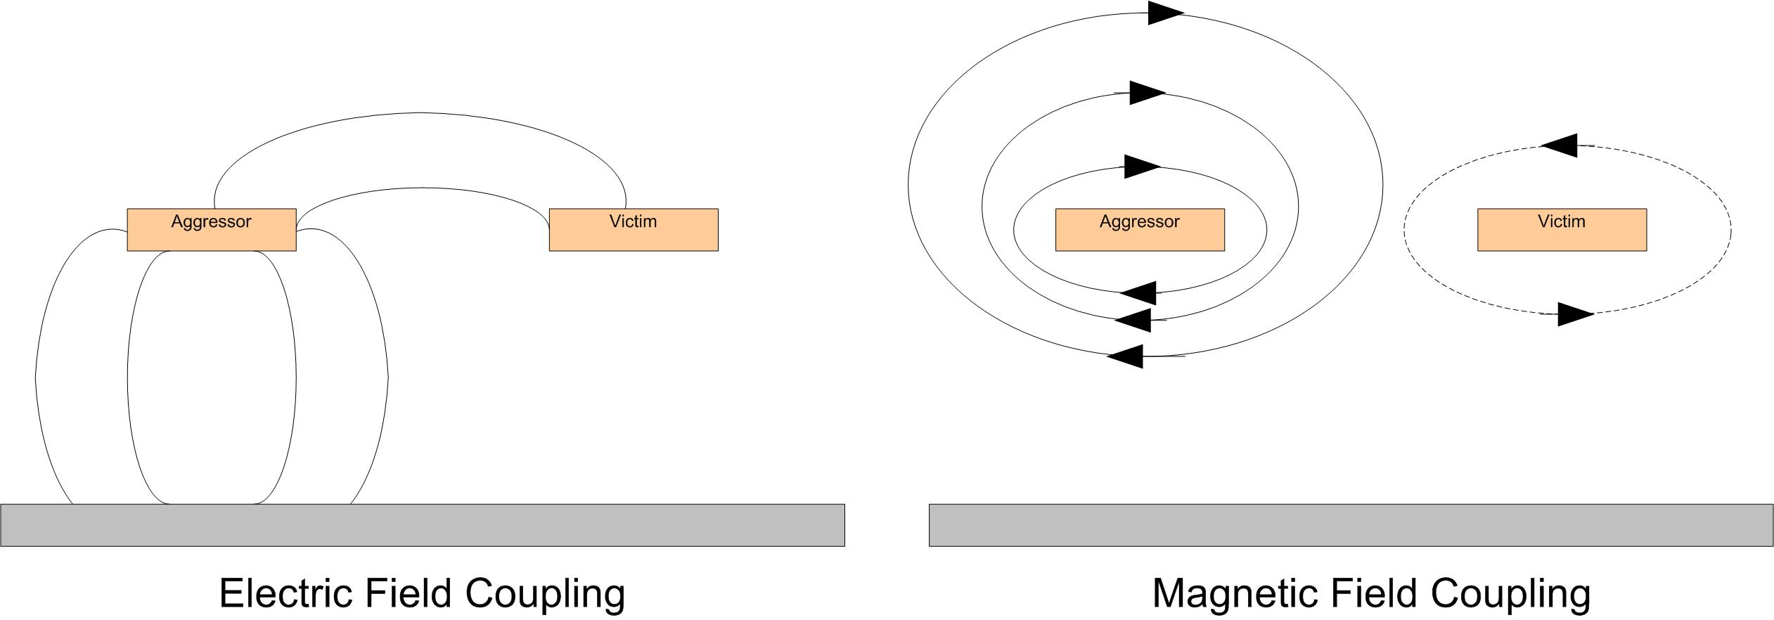
Crosstalk
Crosstalk Terminology
- We call the switching signal the "Aggressor"
- We call the line receiving the noise the "Victim"

Slide 4
Crosstalk
Crosstalk Classes
- There are two main classes of X-talk
1) Signal X-talk
- When C_{M} and L_{M} produce X-talk noise on the same order of magnitude
- When the signal path is the reason for the X-talk
- This is what we see on PCB's and on-chip traces
2) Switching Noise
- When the return path is highly inductive and the inductive noise dominates
- When the inductance in the return path is the reason for the X-talk
- This is what we see on packages and in connectors
- This is also called:
"Ground Bounce / Power Supply Droop"
"Simultaneous Switching Noise (SSN)"
"Simultaneous Switching Output (SSO) Noise"

Slide 5
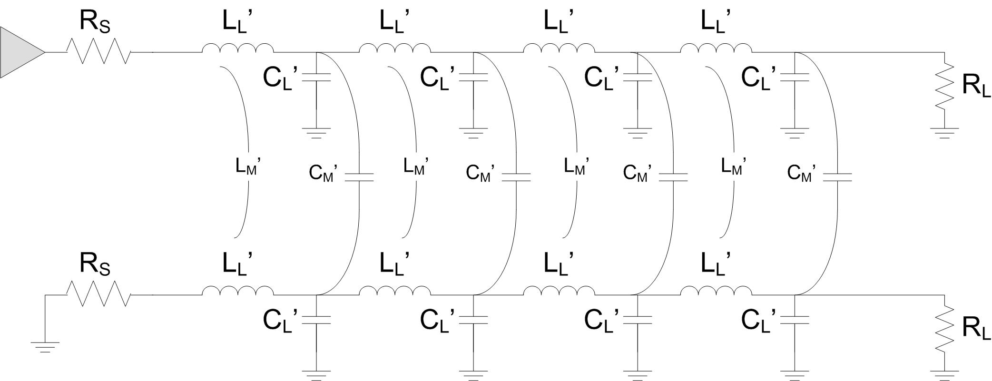
Crosstalk
Crosstalk Location
- There are two locations where we observe and define X-talk
Near End - the location closest to the driving source resistor
Far End - the location closest to the receiving termination resistor
Near End
Far End

Slide 6
Crosstalk
Crosstalk Definitions
- We define parameters for X-talk based on a double terminated system.
NEXT - Near End Crosstalk Coefficient (V_{rev}/V_{A})
FEXT - Far End Crosstalk Coefficient (V_{for}/V_{A})
V_{A}
Near End
Far End
V_{rev}
V_{for}

Slide 7
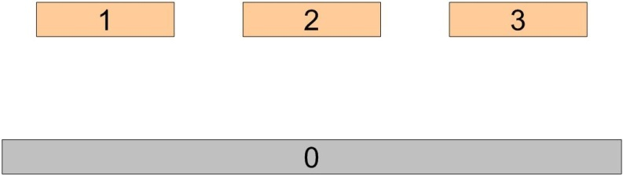
Crosstalk
SPICE Matrixes
- There can be multiple signal lines in a system
- To keep track of their LC values, we use a matrix
- Each signal is given an index, where ground is "0"
- We define C₁₁ as the self capacitance of signal 1 (and also for C22, C33, etc…)
- We define C₁₂ as the mutual capacitance between signals 1 and 2 (and also for C13, C23, etc….)
- In this system, C₁₂ and C₂₁ are equal
- We then put all the values in a Matrix for easy record keeping
- We do the same for the Inductances
C₁₁ C₁₂ C₁₃
C₂₁ C₂₂ C₂₃
C₃₁ C₃₂ C₃₃
L₁₁ L₁₂ L₁₃
L₂₁ L₂₂ L₂₃
L₃₁ L₃₂ L₃₃

Slide 8
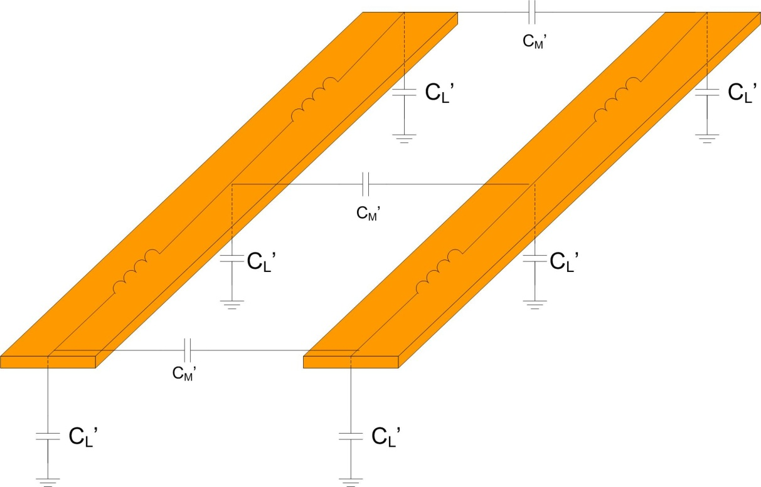
Crosstalk
Capacitive Crosstalk
- As the Aggressor Edge propagates down the line, it will inject current into the Victim line through
the Mutual Capacitance following:
- As the current is injected, it will see an
equal impedance in both the forward
and reverse directions (i.e., 50ohms)
- As a result, the current will equally
split and half will travel forward
and half will travel backwards
Far End
I_{C}
Near End

Slide 9
Crosstalk
Capacitive Crosstalk
- The total amount of current injected at any given time is related to the spatial extent of the risetime
- This can be described using the per unit length value for Mutual Capacitance (C_{M}')
- The total amount of instantaneously injected
current is then described by:
Far End
I_{C}
Near End

Slide 10
Crosstalk
Capacitive Crosstalk (Near End)
- Half of the current injected into the victim as the incidence voltage step travels down the
aggressor travels back to the Near End.
- At any given time, only a fixed amount of current will be observed at the Near End
- This means the Near End voltage will raise to
a fixed value and remain there.
- At the point the aggressor edge reaches the
end of the line (T_{D}), the injected noise
on the victim still needs to travel
back to the Near-End (taking another T_{D}).
- This means the fixed noise level at the
Near End will remain for 2·T_{D}
I_{C}
I_{C}
I_{C}
Near End

Slide 11
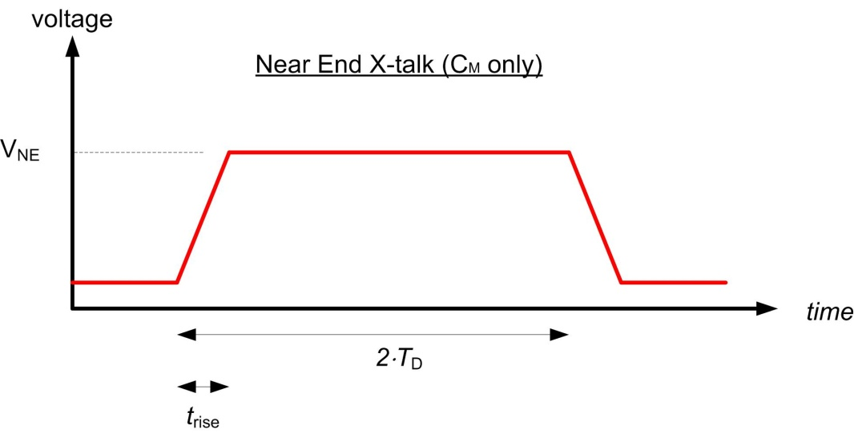
Crosstalk
Capacitive Crosstalk (Near End)
- This gives a voltage profile at the near-end as follows:
- The maximum amount of current injected is reduced by a factor of 1/2 to account for the injected
energy splitting in both the forward & reverse directions.
- This current is further reduced by an additional factor of 1/2 to account for the energy
being spread out over 2·T_{D}

Slide 12
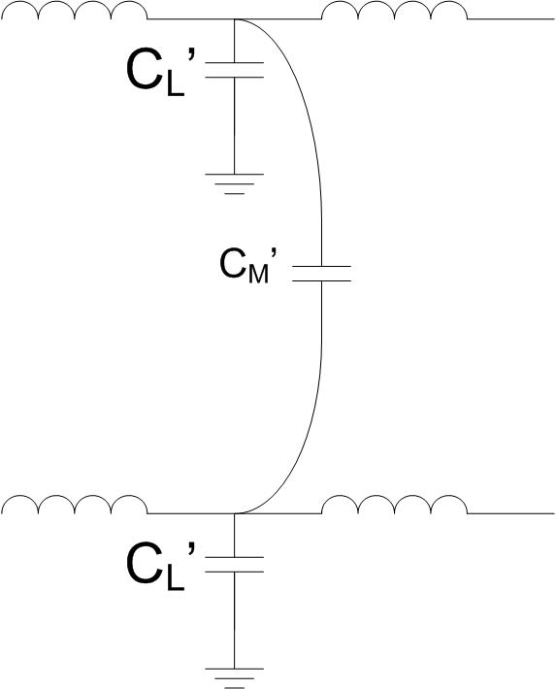
Crosstalk
Capacitive Crosstalk (Near End)
- We can convert this into a ratio of Voltages by looking at KCL at an arbitrary point of injection.
- a dV/dt occurs on the aggressor node which is seen across the C_{L} of the aggressor and
C_{M} of the victim.
(NOTE: we assume that the victim line is at 0volts for our derivation)
dV_{A}/dt
A
I_{C}
B
•
I_{C}

Slide 13
Crosstalk
Capacitive Crosstalk (Near End)
- this change in voltage causes a current to flow through C_{M} given by:
- when this current reaches the victim line and evaluate KCL,
it instantaneously sees opens in the directions of the Inductors
due to their high impedances at AC. As a result
100% of the current flows into C_{L} of the victim.
- This current in C_{L} then creates a dV/dt given by:
dV_{A}/dt
A
I_{C}
B
•
I_{C}

Slide 14
Crosstalk
Capacitive Crosstalk (Near End)
- we can now relate the magnitude of the voltage observed on the aggressor (V_{A}) to
the voltage on the aggressor (V_{B})
- this is the total voltage created at the injection point prior to the inductors
beginning to conduct and allowing the current to flow in both the forward
and reverse directions.
dV_{A}/dt
A
I_{C}
B
•
I_{C}

Slide 15
Crosstalk
Capacitive Crosstalk (Near End)
- we now apply our 1/4 factor to come up with our final expression for the magnitude
of the capacitively coupled voltage observed at the Near-End

Slide 16

Crosstalk
Capacitive Crosstalk
- As the Aggressor edge propagates down the line,
it will inject current into the Victim line through
the Mutual Capacitance
- We've derived the Near End Cross-talk
due to Mutual Capacitance and saw
that the voltage rises to a constant level
and remains there for 2·T_{D}
Far End
I_{C}
Near End

Slide 17
Crosstalk
Capacitive Crosstalk (Far End)
- Now we look at the Noise observed at the Far-End
of the Victim line.
- This noise is due to the forward traveling
current that is injected through C_{M}.
- 1/2 of this current travels forward toward the Far-End.
- The current noise is not seen until the Aggressor incident wave reaches the Far-End
I_{C}
Far End
I_{C}
I_{C}
Near End

Slide 18
Crosstalk
Capacitive Crosstalk (Far End)
- The net voltage at the far end will be the sum
of all of the injected current along the length
of the coupled line.
- The TOTAL amount of current that is
injected through C_{M} is proportional to
the total length that the lines are coupled.
I_{C}
Far End
I_{C}
I_{C}
Near End

Slide 19
Crosstalk
Capacitive Crosstalk (Far End)
- All of the current that is injected into the victim
line will add together and be injected into
the last C_{L} segment of the Victim at the Far-End
- The current in the last segment is
described as:
dV_{A}/dt
A
I_{C}
Sum(I_{C})
B
•
I_{C}

Slide 20
Crosstalk
Capacitive Crosstalk (Far End)
- We can now relate the total current injected along
the line to the voltage induced at the Far-End
using:
dV_{A}/dt
A
I_{C}
Sum(I_{C})
B
•
Sum(I_{C})
Notes:
20

Slide 21
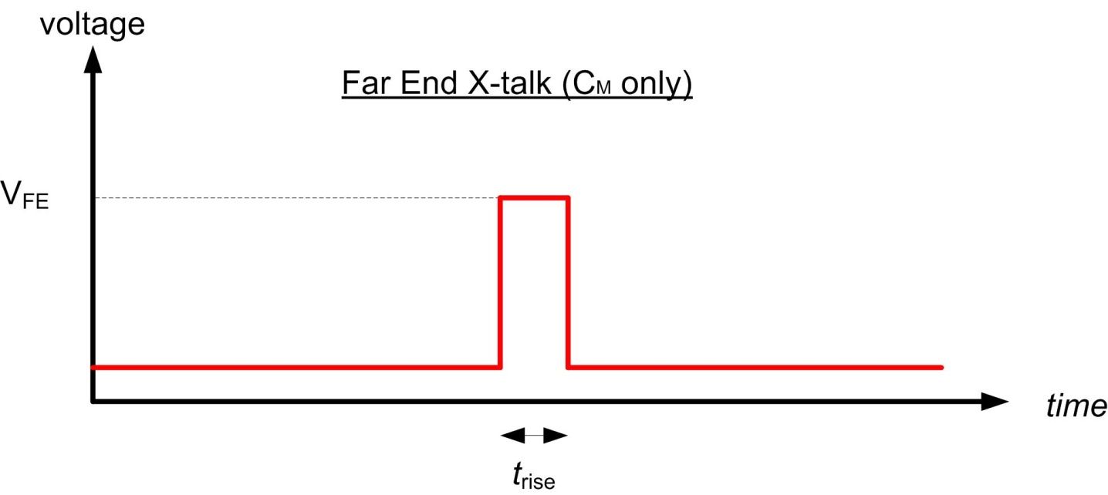
Crosstalk
Capacitive Crosstalk (Far End)
- We now apply our factor of 1/2 to account for the forward and reverse traveling current and we get:
NOTE: The magnitude of FE X-talk can get very large because it is proportional to coupled length
and inversely proportional to t_{rise}
Notes:
21

Slide 22
Crosstalk
Inductive Crosstalk
- Magnetic Fields exist as the current travels down the Aggressor line.
- These B-field lines induce B-field lines around the Victim line, which in turn creates current.
- The direction of the B-field lines in the Aggressor follow the Right-Hand-Rule.
- The direction of the B-field lines in the Victim are opposite of the Aggressor.

Slide 23
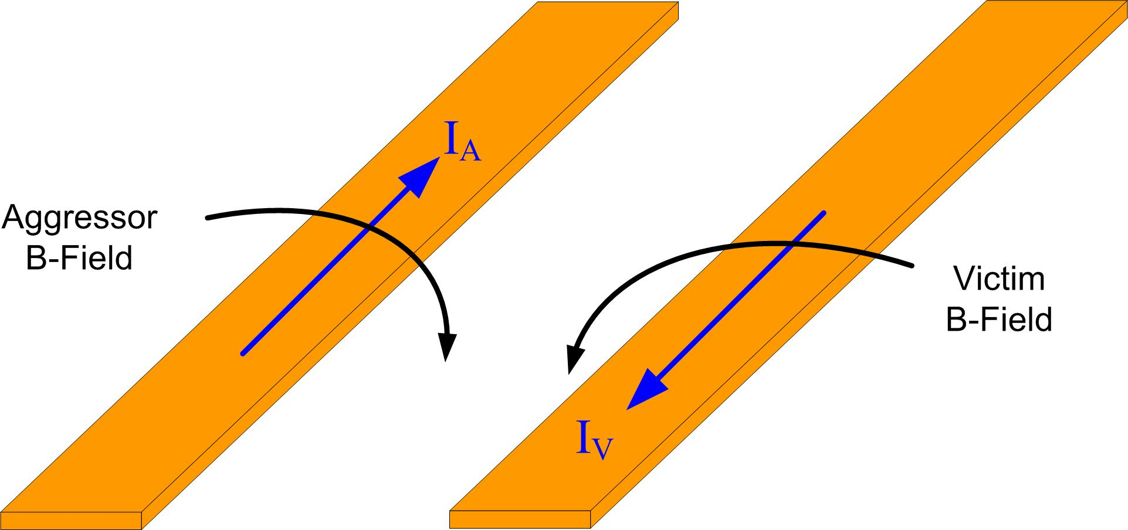
Crosstalk
Inductive Crosstalk
- The B-Field lines induced on the Victim create a current that flows in the opposite direction
of the Aggressor current.

Slide 24
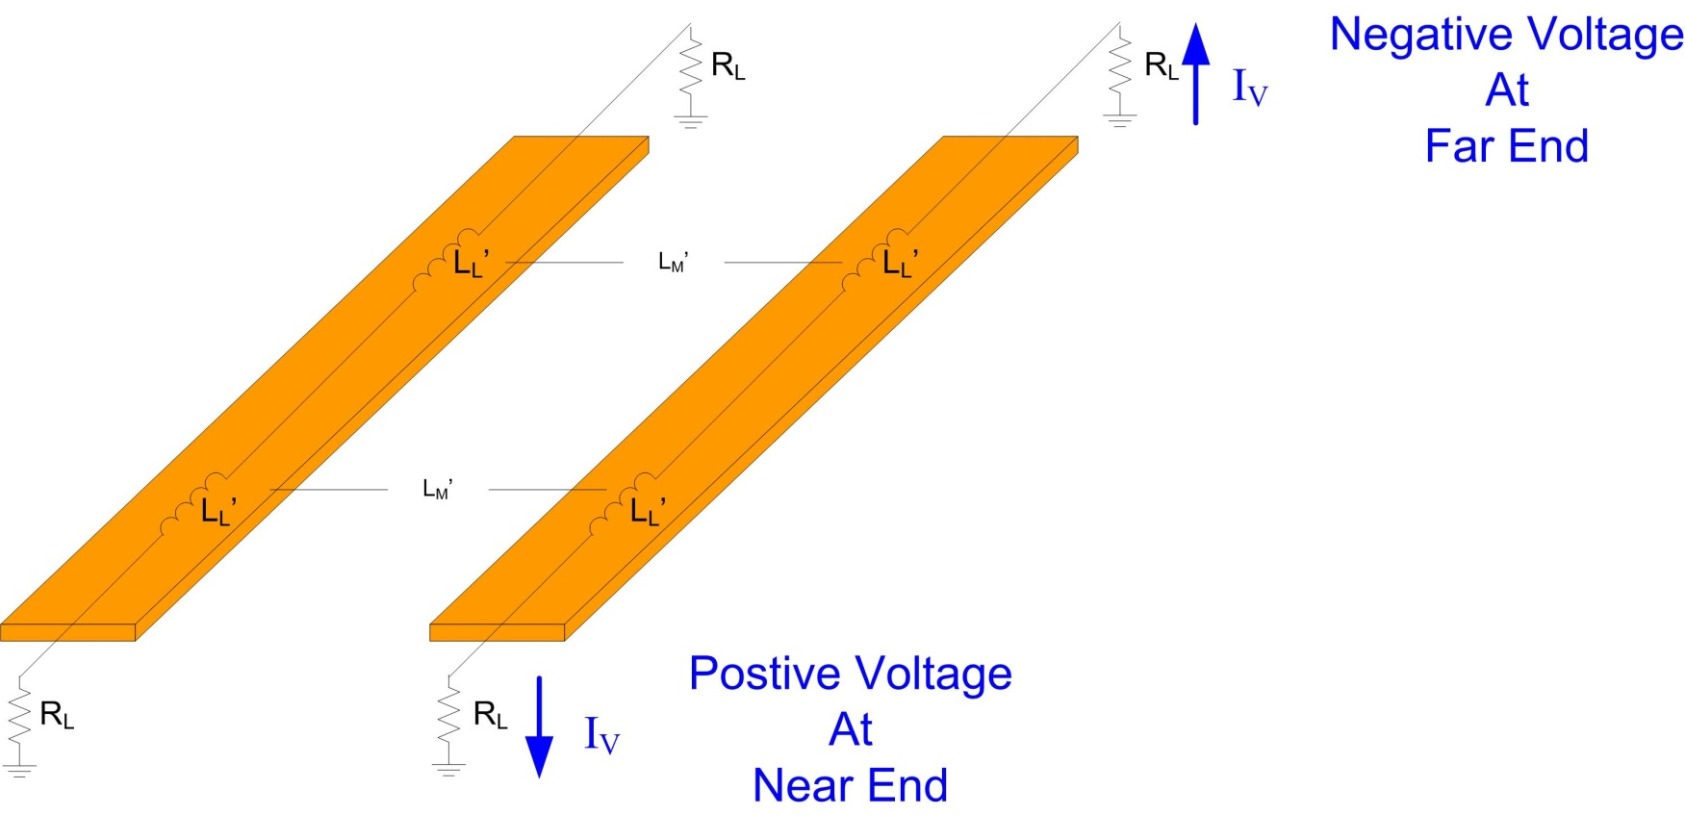
Crosstalk
Inductive Crosstalk
- The direction of the induced current creates a Negative Voltage at the Far-End
and a Positive Voltage at the Near-End as it flows through the termination impedances.

Slide 25
Crosstalk
Inductive Crosstalk (Near End)
- Just as in Near-End Capacitive X-talk, the currents that are induced by the inductive coupling
will travel back to the Source (or Near End) over a time span of 2·T_{D}
I
I
I
I

Slide 26
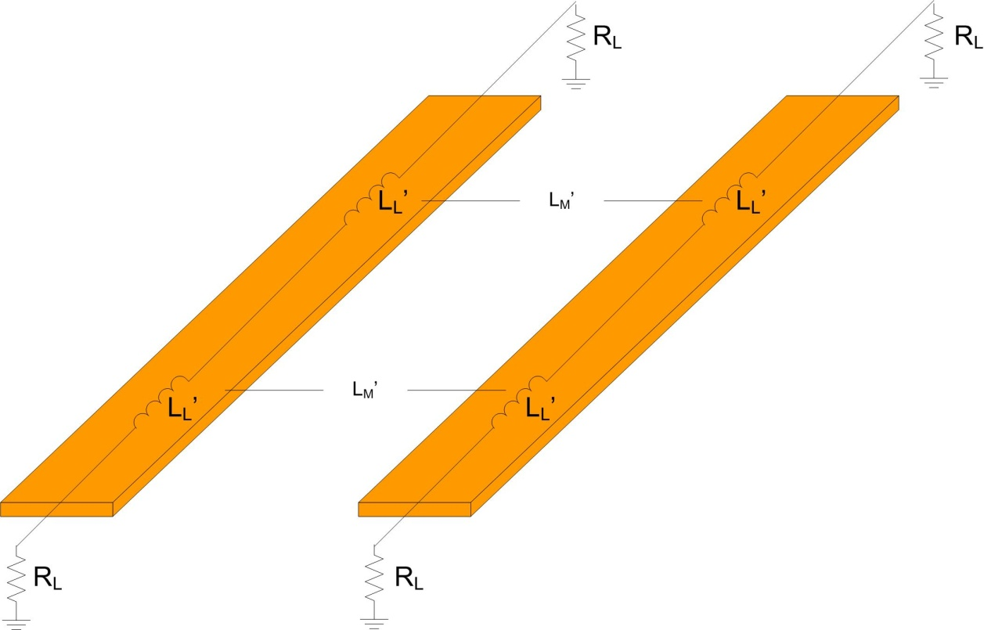
Crosstalk
Inductive Crosstalk (Near End)
- The current that flows through the self inductance of the Aggressor line causes a voltage on
the Victim line as follows:
- This voltage appears across the Line
inductance of the Victim which in turn
causes a current to flow:
I_{A}
+
I_{B}
V_{L}
-
Near End

Slide 27
Crosstalk
Inductive Crosstalk (Near End)
- Since the coupled voltage (V_{M}) is the same as the Victim line voltage (V_{L}) which creates the
current, we can relate the currents of the Aggressor and Victim.
- This can be converted to voltage by
multiplying the current by the
impedance (which is the same
in both lines):
I_{L}
I_{L}
Near End

Slide 28
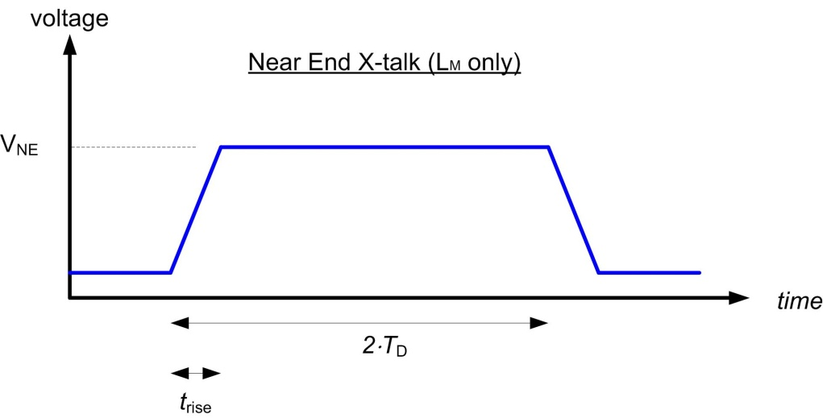
Crosstalk
Inductive Crosstalk (Near End)
- Now we have a relationship between the Aggressor and Near-End Victim Voltages:
- We now apply a factor of 1/2 for the forward/reverse traveling current and 1/2 to account for the
energy being split out over 2·T_{D}

Slide 29
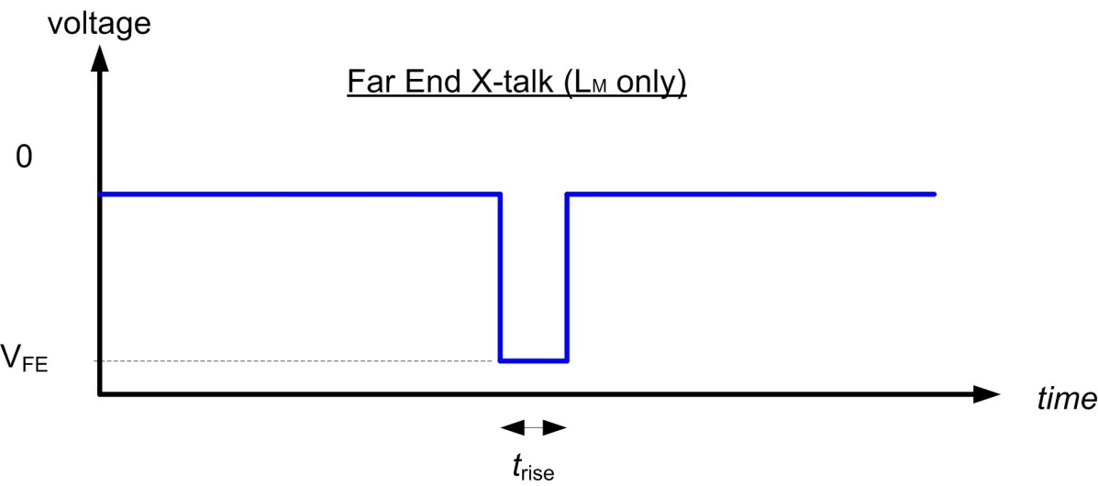
Crosstalk
Inductive Crosstalk (Far End)
- The exact derivation is applied to the Far-End inductive Xtalk to derive the maximum amount of
noise due to Inductive coupling.
- The only difference is that the magnitude of the Far-End noise is NEGATIVE.

Slide 30
Crosstalk
NEXT
- We can combine all of the coupling at the Near-End to come up with the
Near End Crosstalk Coefficient (NEXT)
- We define k_{b} as the Backward Coefficient which is only in terms of intrinsic values.

Slide 31
Crosstalk
FEXT
- We can combine all of the coupling at the Far-End to come up with the
Far End Crosstalk Coefficient (FEXT)
- We define k_{f} as the Forward Coefficient which is only in terms of intrinsic values.
where,

Slide 32
Crosstalk
Total X-talk
- If we look at NEXT, we see that:
1) Near End X-talk doesn't depend on risetime
2) Near End X-talk is always positive (for a rising edge on the Aggressor)
- If we look at FEXT, we see that:
1) Far End X-talk depends on coupled length and t_{rise}
2) FE X-talk can actually cancel if the ratios of Capacitance and Inductance are equal
- NOTE: this cancellation occurs if all of the field lines are contained within a
homogenous dielectric.

Slide 33
Crosstalk
Scaling Near-End X-talk
- If the coupled length of the T-line is shorter than the risetime, the peak value of NEXT will not
reach its maximum value.
- We scale the maximum value that it will reach using:
- Risetime is converted to Length using:

Slide 34
Crosstalk
Switching Noise
- We've covered the 1st class of X-talk (Signal X-talk)
- Now we turn to the 2nd class of Crosstalk:
2) Switching Noise
- When the return path is highly inductive and the inductive noise dominates
- When the inductance in the return path is the reason for the X-talk
- This is what we see on packages and in connectors
- This is also called:
"Ground Bounce / Power Supply Droop"
or
"Simultaneous Switching Noise (SSN)"
or
"Simultaneous Switching Output (SSO) Noise"
Notes:
34

Slide 35
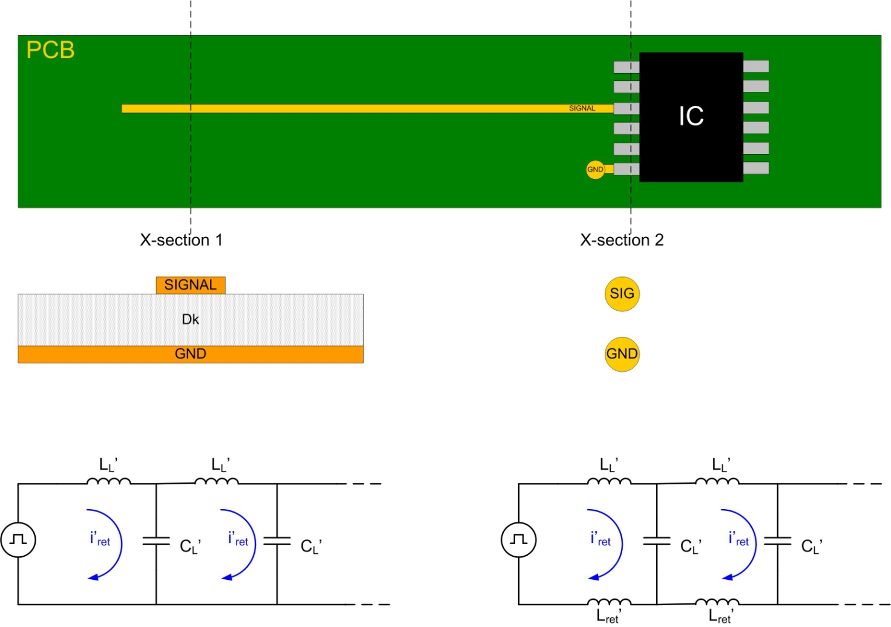
Crosstalk
Switching Noise
- When we derived the LC model of a transmission line,
we assumed that the ground (or return path) was a
perfect conductor.
- That allowed us to model the ground with a simple wire.
- This is reasonable in a transmission line when the
ground conductor is much larger than the signal
conductor.
Ex) PCB trace:
- the signal sees an infinite ground plane
beneath it.
Notes:
35

Slide 36
Crosstalk
Switching Noise
- When the signal travels through connectors or packages, the shape of the return path changes.
- This typically results in a return path with the same geometry as the signal.
Notes:
36

Slide 37
Crosstalk
Switching Noise
- This means we need to model the
return path's electrical properties.
- The capacitance between the signal and
ground is already present in our LC model.
- However, we need to add an inductive component
into the return path for an accurate model
Notes:
37

Slide 38

Crosstalk
Switching Noise
- This geometry change in the conductors results in a highly inductive path that the current
needs to flow through.
- In addition, the capacitance typically is reduced due to the surface area of the connector/package
being less than in the trace section of the link.
Notes:
38

Slide 39

Crosstalk
Switching Noise
- This inductive interconnect is the source of Switching Noise
Notes:
39

Slide 40
Crosstalk
Switching Noise (Ground Bounce)
- The return current that passes through the inductive interconnect causes a voltage
to form following:
- This voltage changes the ground potential of the integrated circuit relative to the ground of the
system which gives the name Ground Bounce
Notes:
40

Slide 41
Crosstalk
Switching Noise (Ground Bounce)
- This becomes a more critical problem when signals in packages and connectors share a
common return pin.
- It is cost effective to reduce the pin count of packages/connectors by sharing ground pins.
- However, the Ground Bounce now becomes proportional to the # of signal lines using
that return pin.
- This can be related to voltage by using V=IZ
Notes:
41

Slide 42
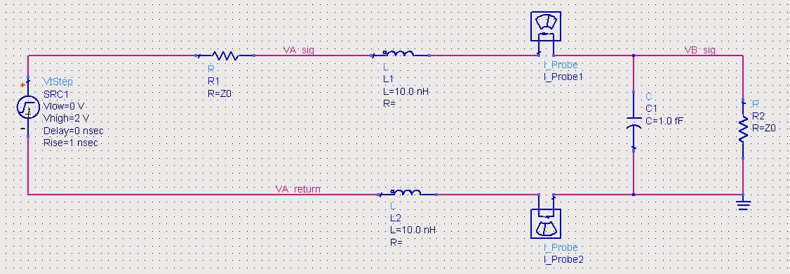
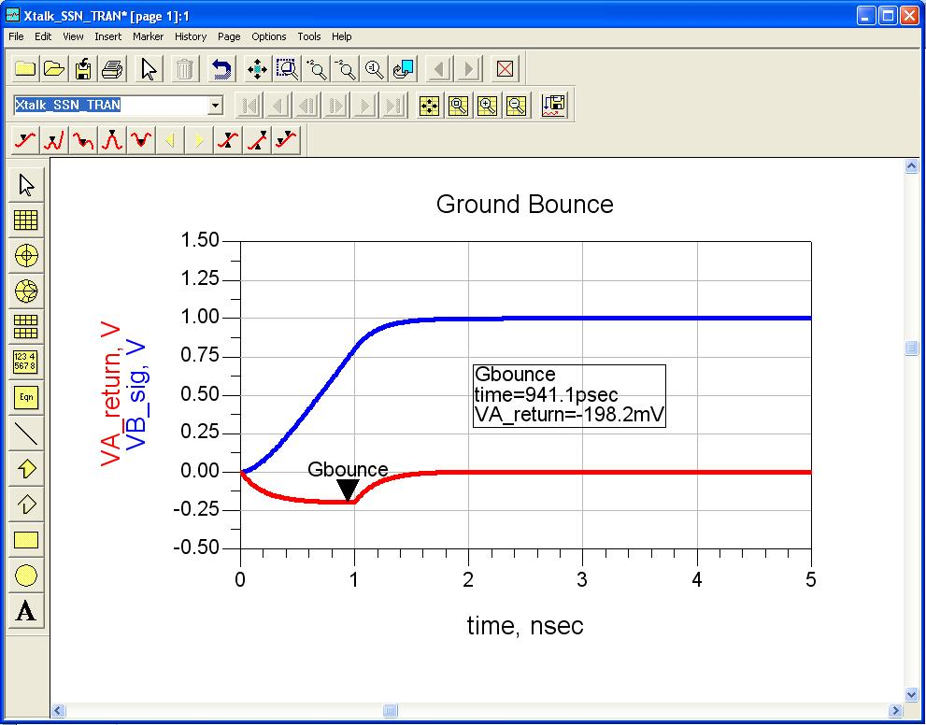
Crosstalk
Switching Noise (Ground Bounce)
- ex) L_{ret} = 10nH
t_{rise}=800ps
Z₀=50Ω
- a positive dv/dt causes current to flow back to
the source. The inductor acts as a passive
element in this case so the voltage induced
causes the source ground to become negative.
Notes:
42

Slide 43
Crosstalk
Switching Noise (Mutual Inductance)
- there is also mutual inductance that couples between the signal inductance and the
return path inductance.
- in this case, the inductor acts as a voltage source in the return path, which creates a voltage
in the opposite polarity as the noise caused by the return current.
- this actually has the result of decreasing the total inductive ground bounce noise and
can be a good thing.
- however, this is a secondary effect compared to the noise generated when multiple signals
share a common return path.
Notes:
43

Slide 44
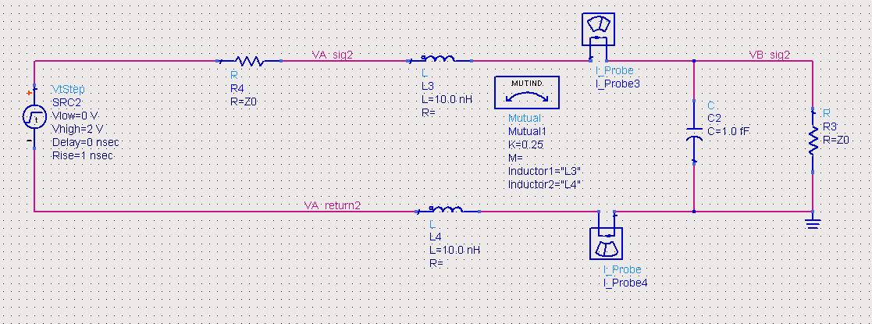
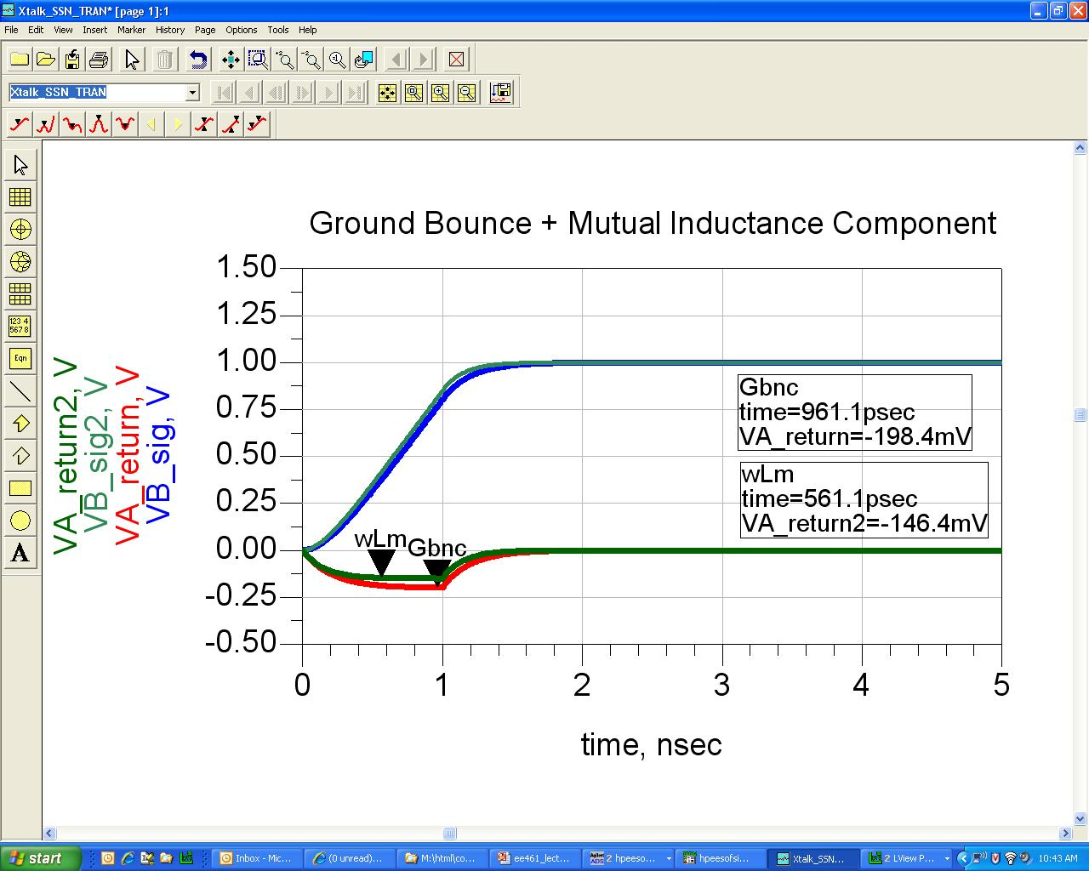
Crosstalk
Switching Noise (Mutual Inductance)
- ex) L_{ret} = 10nH
L_{M}=2.5nH
t_{rise}=800ps
Z₀=50Ω
- Mutual inductive coupling causes the return
inductor to act as a voltage source so the
resultant voltage is opposite in polarity to the
return noise. The total voltage in this case
is: -0.2 + 0.05 = -0.15v
Notes:
44

