Slide 1
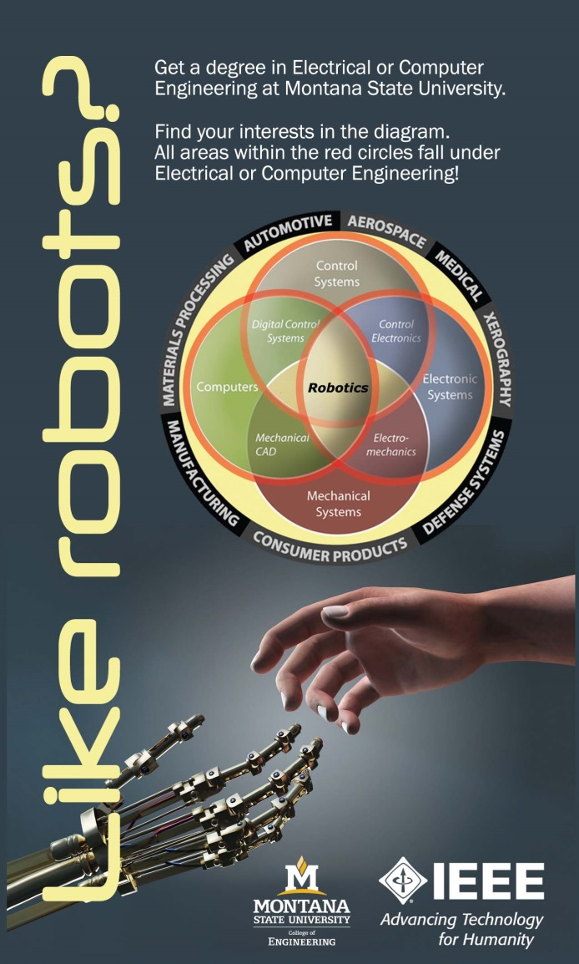
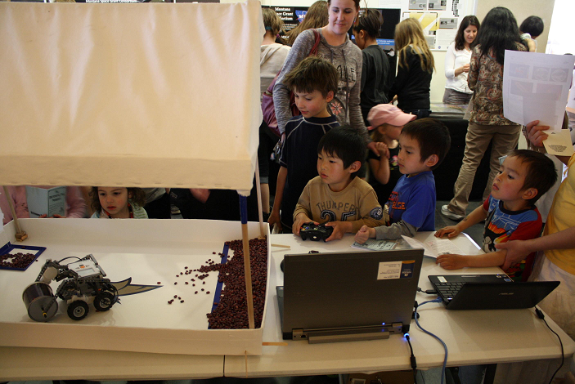
Using Robotics for STEM Education from K-20
Brock J. LaMeres
Associate Professor
Department of Electrical & Computer Engineering
Montana State University - Bozeman

Slide 2
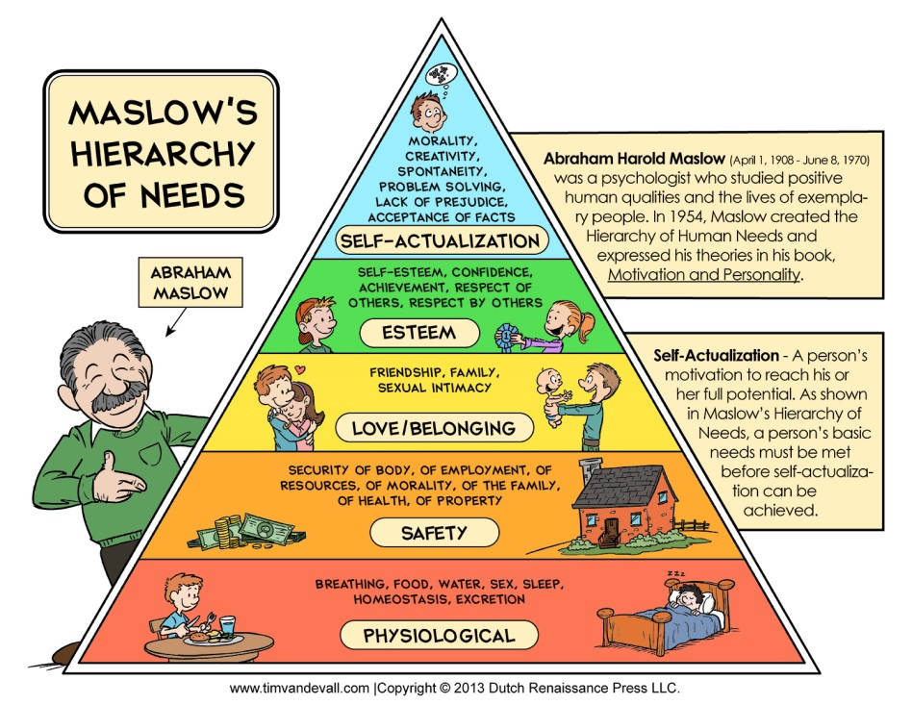
STEM Education – Who Cares?
First, does technology make our lives better?
  In the US, we have electricity, smart phones, and more food that we can eat.
  In the US, we don’t spend the majority of our time looking for food, shelter, or fending off invaders.
  This allows us to spend our time developing specialized expertise and exploring higher levels of abstract thought (or watching football and drinking lots of beer).

Slide 3

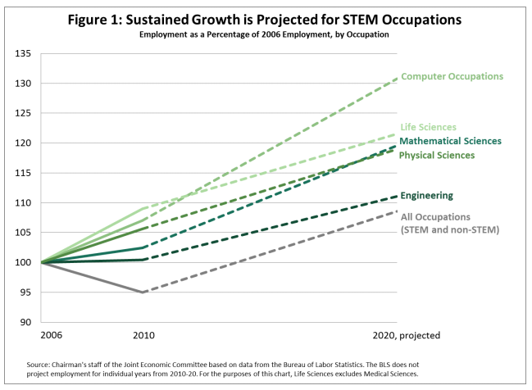
STEM Education – Who Cares?
Whether or not you think this is “Better”, technology does do 3 things:
1) Increase the population density
  Higher efficiency agriculture/ranching/housing
  More effective medicine
2) Helps protect us
  Advanced weapons & surveillance
3) Fuels our economy
  Scientific innovations account for 50%
  of the growth in U.S. economy.
  Predicted 10 year growth in STEM jobs (17%)
  Predicted 10 year growth in non-STEM jobs (14%)
  The non-STEM job rate includes recession recovery
  while the STEM jobs rate has increased throughout.
More people per square mile
A smaller fraction of our population is needed to protect us.

Slide 4
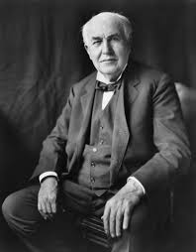


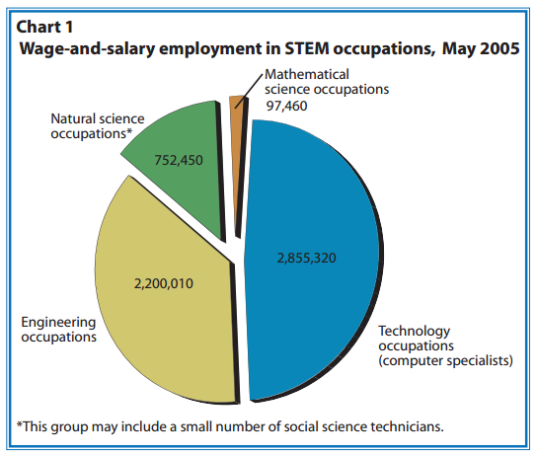
Who are these STEM People?
  Scientists, Technologies, Engineers, Mathematicians = STEM
  ~132M people work in the U.S.
  In 2012, 7.2M were in STEM (1 of 18 jobs)
  1.1M science related jobs
  2.4M engineering/tech related jobs
  3.7M computer/math/tech related jobs
  (healthcare practitioners are not included in STEM)
Is the STEM field growing? Think about this…
  In 2005, STEM fields accounted for 6.2M jobs in the U.S.
  In 2014, there were 4.4M STEM JOB OPENINGS requiring
  a bachelors degree.
  Of these openings, 2.3M were considered entry level.
  Where did these extra millions of jobs come from?
  - Today it’s hard to find a sector that doesn’t NOT use STEM
  - The recover is replacing traditional jobs with high tech jobs
Tom
Al
Steve

Slide 5

Are there enough STEM grads?
Let’s look at engineering (easier to compare the number because we keep better track)
  First, what is an engineer?
  “A super nerdy person that …”
  “A person who designs technology that applies
  scientific knowledge to solve societal problems.”
  ~1 out of every 125 people in the U.S. is an engineer.
Are there enough engineering grads in the USA to fill the need?
  If there are 2.3M entry level STEM jobs, and engineering represents ~30% of STEM, then we need ~700k engineering grads to meet the demand.
  And we produced….. 80k in 2013…

Slide 6


The Gathering Storm
Around 1990, things started changing…
  The Berlin Wall came down ending a isolation between the east and west.
  The internet proliferation hit critical mass, information was now available to all individuals, not just the privileged.
  Our competition was now global.
What do you think emerging countries did to complete?
  They went all in on STEM

Slide 7

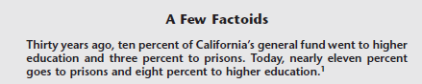
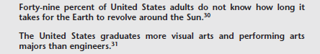
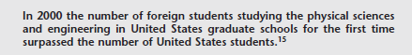
The Gathering Storm
In 2005 the National Academies released “Rising Above the Gathering Storm”
  The report was requested by congress to give recommendations on how to keep the U.S. competitive in the rapidly changing global economy.
  The report was updated in 2010.
  The report highlighted that the U.S. may be slipping..

Slide 8
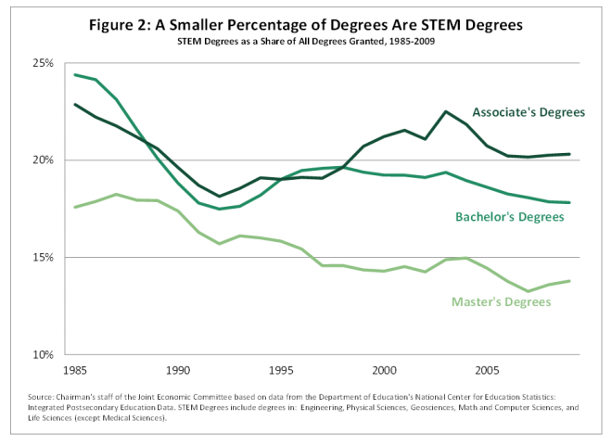
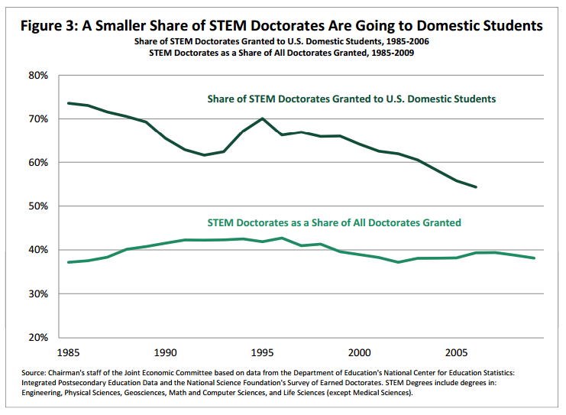
The Gathering Storm (Higher Ed)
But we did graduate 80k engineering bachelor’s degrees last year!
  There were 2M engineering B.S. graduates globally
  India produced 340k
  China produced 700k
U.S. students seem to becoming LESS interested in STEM
Half of all engineering B.S. degrees

Slide 9

The Gathering Storm (Higher Ed)
How many engineering grads do we need?
  To keep the U.S. economy strong and growing, we need a STEM workforce of ~8.65M by 2018.
  That’s ~1.5M new jobs in the next 4 years!
How do we get there?
  Obama calls for 10k new engineering grads NOW through retention efforts.
  But there’s only so much that higher ed can do because only so many students go into engineering.
We need to fill the pipeline
  The #1 recommendation by the National Academies is:
  Move the United States K-12 education system in
  science and mathematics to a leading position by
  global standards.
  “10,000 Teachers Educating 10 Million Minds”

Slide 10
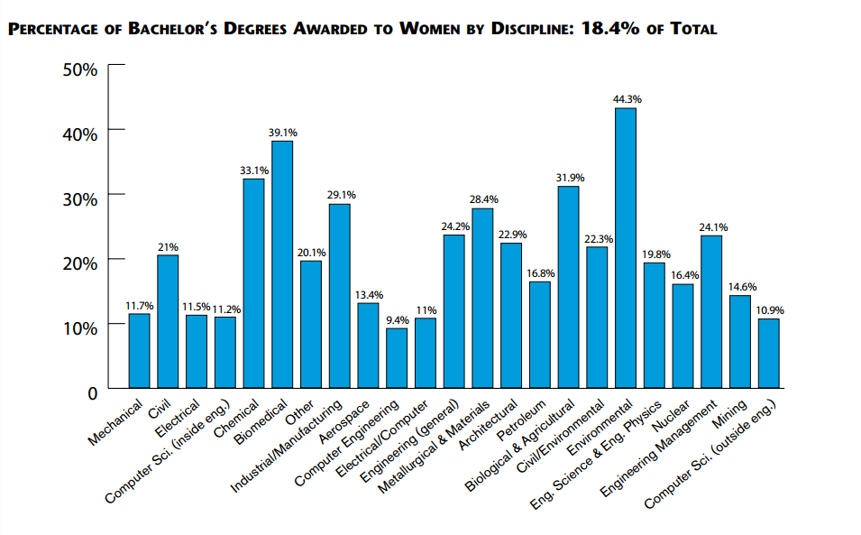
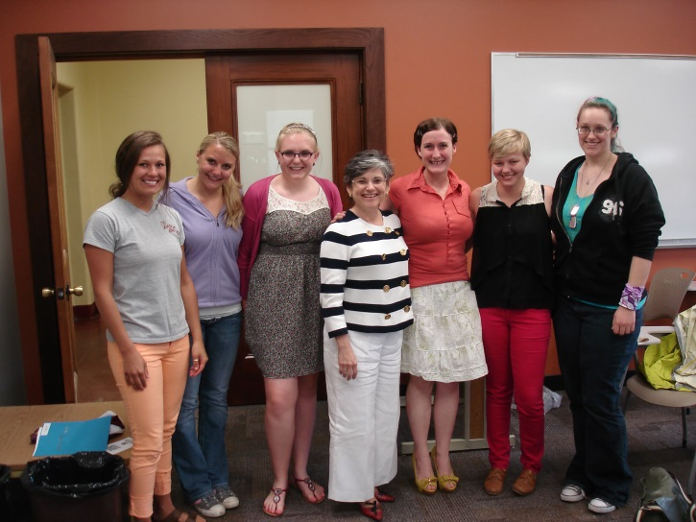
Fillings the STEM Pipeline (K-20)
Step 1 – Increase Diversity
  Only 18% of engineering graduates were female.
  This is the largest underrepresentation of all demographics.
  As early as 1st grade, students begin to form stereotypes about careers (jocks, nerds, male vs. female)
  Role Models are HUGE! (what do you want to be when you grow up?)
My research team with MSU President Cruzado

Slide 11

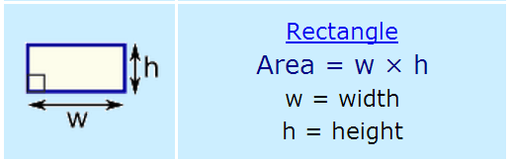
Fillings the STEM Pipeline (K-20)
Step 2 – Application of Theory
  Theory in a vacuum only appeals to a minority of students (e.g., the geeks).
  Applying theory to application brings new types of thinkers into STEM.
  Finding real world, and EXCITING applications of math and science makes STEM more appealing as a career choice.
This is OK
This is better
The pay is 1¢ per square foot.
h
w

Slide 12
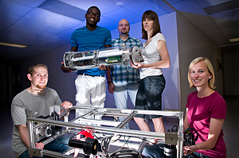
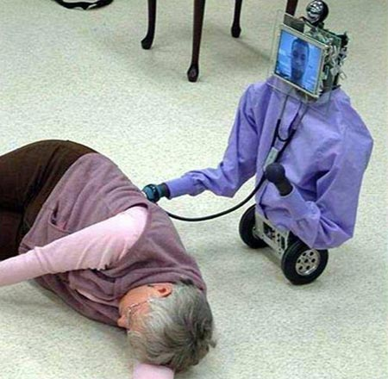
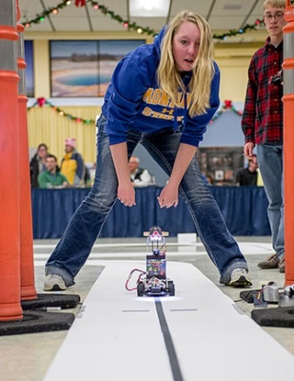

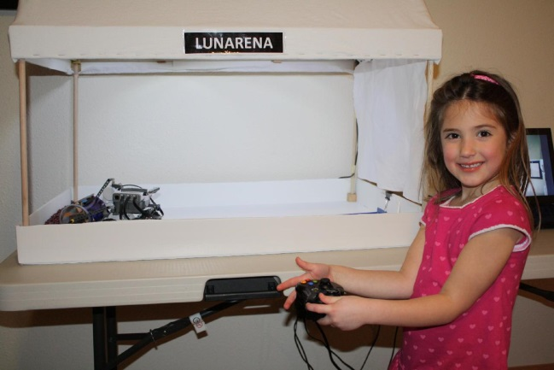
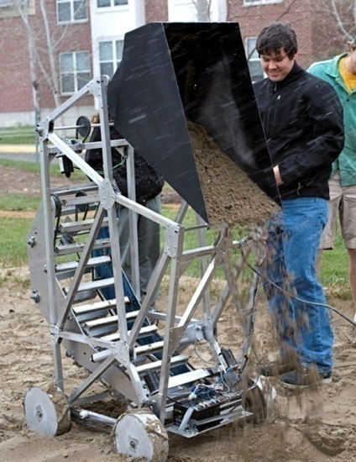


Fillings the STEM Pipeline (K-20)
Robotics can provide an application for STEM.
Applications can breakdown stereotypes of STEM careers.

Slide 13
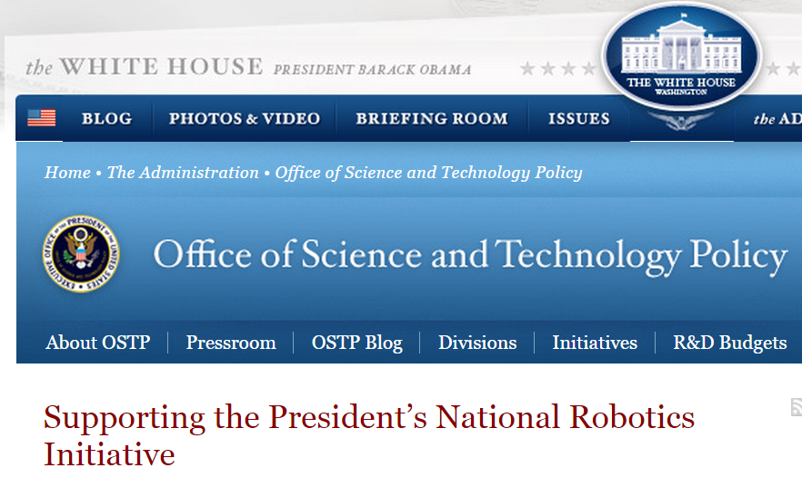




It’s also a National Priority
“National Robotics Initiative”

Slide 14


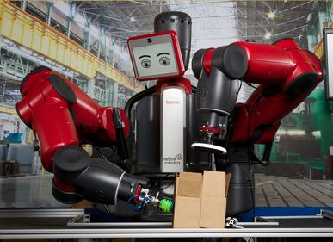


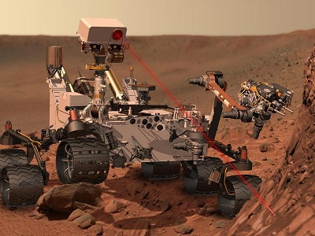

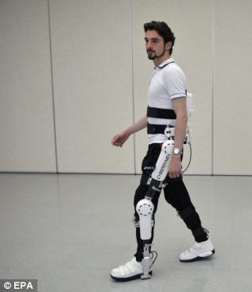

Applications are Everywhere
Farming & Ranching
Public Safety & Economic Boost
“Manufacturing”
“Dangerous Jobs”
“When there is a LOT of work to do.”
Exploration
Healthcare
“Surgical Procedures”
“Helping the disabled”
“To go where people can’t.”

Slide 15
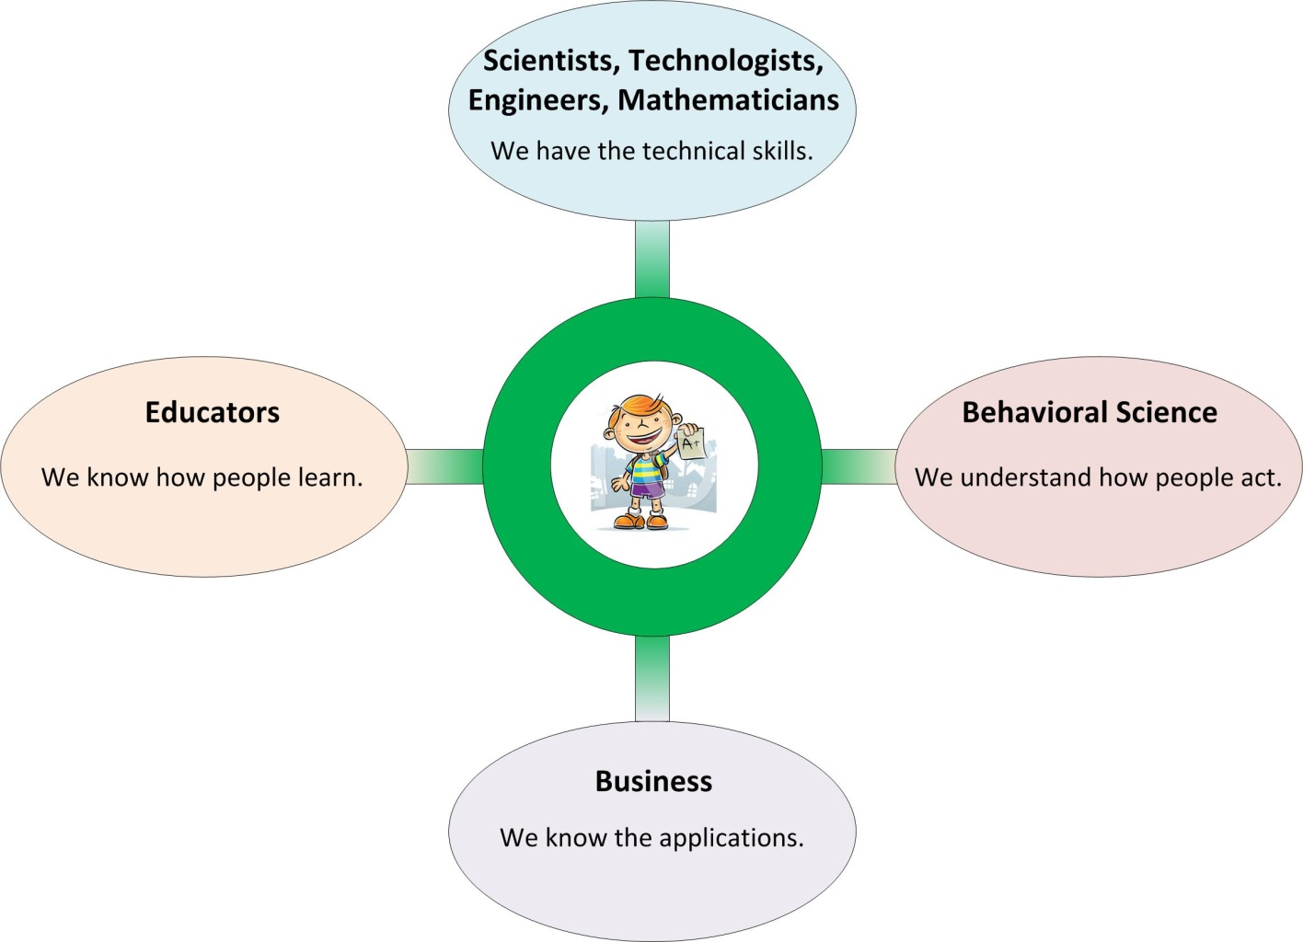
What now?
We need to work together…
Thank you for coming today!

Slide 16
References
U.S. News & World Report, Feb. 5, 2014, Report: STEM Job Market Much Larger Than Previously Reported
Stem occupations, Nicholas Terrell, 2007
Beareau of Labor and Statistics, 2013 data.
Number of US engineers in decline relative to China, India By Mike Shammas | September 19, 2011
STEM Education: Preparing for the Jobs of the Future ,, U.S. Congress Joint Economic Committee 2012
Where are the STEM Students?, myCollegeOptions, STEM connector, 2012
Woman running with prosthetic leg, Carlos Serrao – Photographer www.carlosserrao.com)

