Slide 1



Increasing Your Child’s Motivation for STEM
Dr. Brock J. LaMeres
Director, Montana Engineering Education Research Center (MEERC)
Associate Professor, Electrical & Computer Engineering Department
Parent University January 19, 2017

Slide 2

Today’s Agenda
What is STEM?
Why does STEM matter?
Tomorrow’s STEM workforce.
Thoughts on motivation.

Slide 3

What is STEM?
The buzzword of our time…

Slide 4
What is STEM?
Scientist = someone that explains the physical world through observations and experimentations.

Slide 5
What is STEM?
Scientist = someone that explains the physical world through observations and experimentations.
Engineer = someone that uses the knowledge from science to make systems and devices to benefit society.

Slide 6
What is STEM?
The E turns the S into useful things

Slide 7
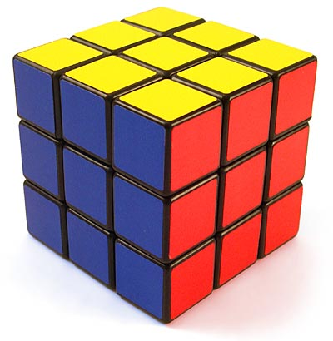
What is STEM?
The E turns the S into useful things
The things engineers make are the T

Slide 8

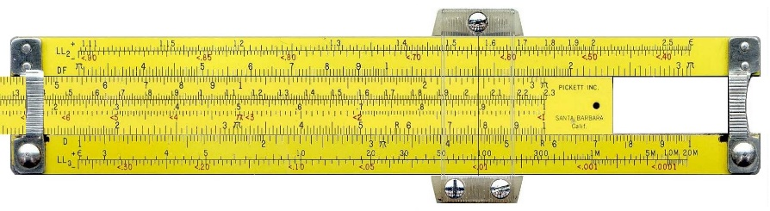
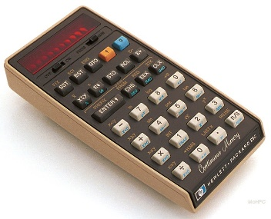
What is STEM?
The E turns the S into useful things
We use our things to make more things.

Slide 9

What is STEM?
Scientists use the M to model the physical world.

Slide 10

What is STEM?
Scientists use the M to model the physical world.
Engineers need the M to understand the science.
Engineers also use the M to model complex designs.

Slide 11
What is STEM?
Computer Science is primarily lumped into the E.

Slide 12
What is STEM?
Beyond the Acronym, what is STEM?
  STEM = defined as “people who create knowledge”.
  Per the National Science Foundation, this doesn’t include health practitioners.
    chemistry,
    computer and information technology science,
    engineering,
    geosciences,
    life sciences,
    mathematical sciences,
    physics and astronomy,
    social sciences (anthropology, economics, psychology and sociology),
    STEM education and learning research

Slide 13
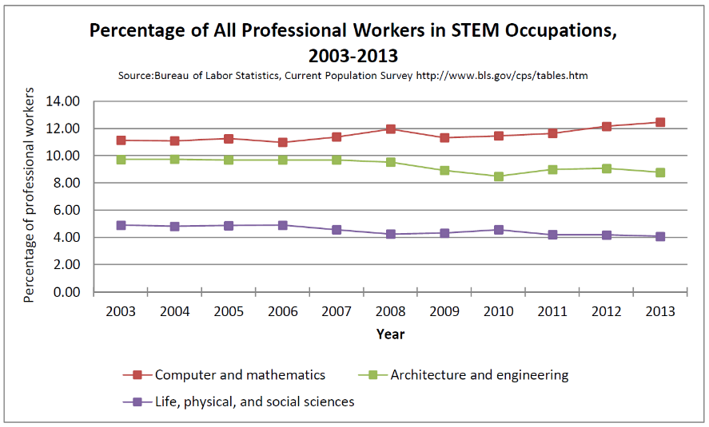
What is STEM?
Who are these STEM people?
  In 2016, there were 124M people working full time in the US (workforce of 142M).
  Of these, ~8M were in STEM (1 of ~18).
    3.8M in Computers & Math
    2.85M in Architecture & Engineering
    1.35 in Science
  That’s 25% of the professional workforce.
  That’s 5% of the overall workforce

Slide 14
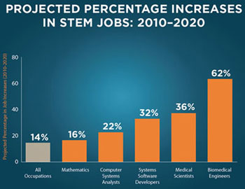
Why does STEM matter?
STEM Fuels the US economy
  STEM innovations account for 50% of the growth in U.S. economy.
  Predicted growth rate through 2018 in STEM jobs (20.6%).
  Predicted growth rate through 2018 in non-STEM jobs (10.1%).
  Jobs are shifting from non-STEM to STEM.

Slide 15
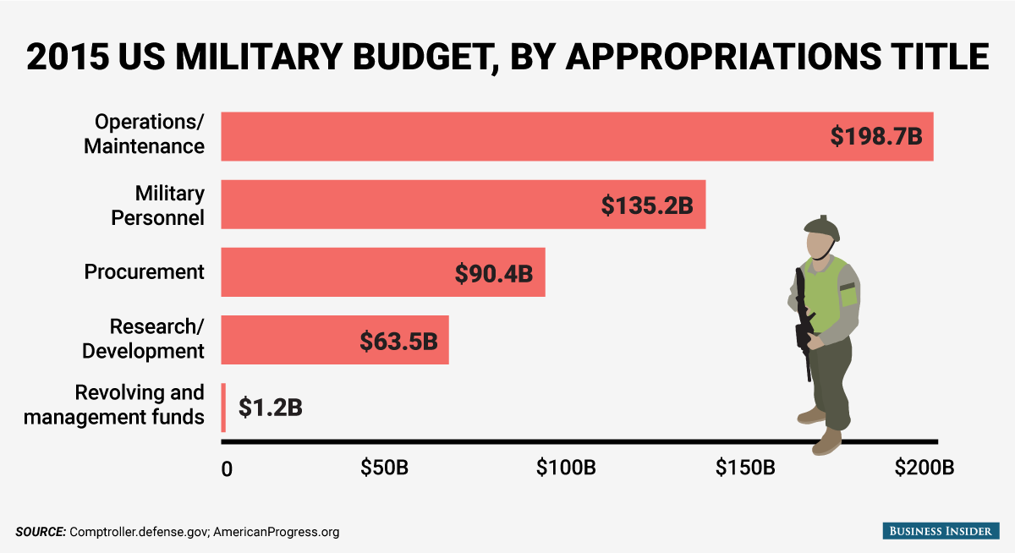
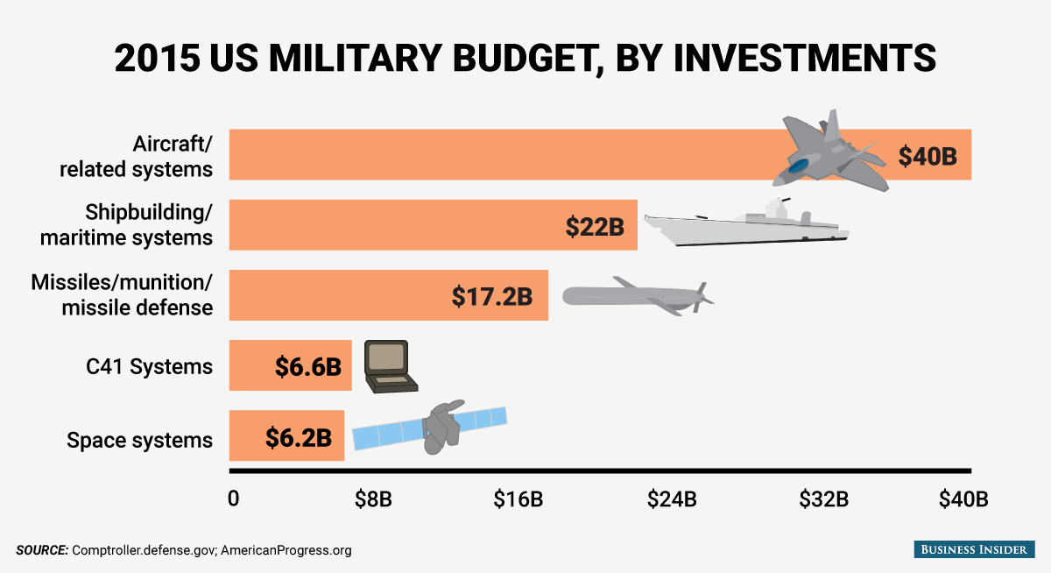
Why does STEM matter?
STEM technology helps protect us.
  military technology expenditures ~90B.

Slide 16
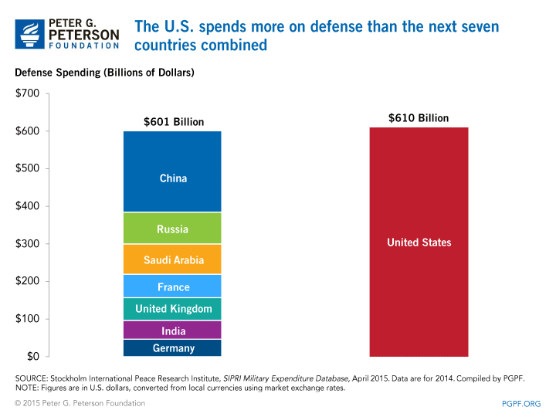
Why does STEM matter?
STEM technology helps protect us.
  military technology expenditures ~90B.

Slide 17


Why does STEM matter?
STEM jobs are also nice jobs
  Fun & meaningful work.
  Flexible schedules.
  White collar, work forever if you want.

Slide 18
Why does STEM matter?
STEM jobs are also nice jobs
  Fun & meaningful work.
  Flexible schedules.
  White collar, work forever if you want.
Predicted that there will be 1M new STEM jobs in next 5 years.

Slide 19
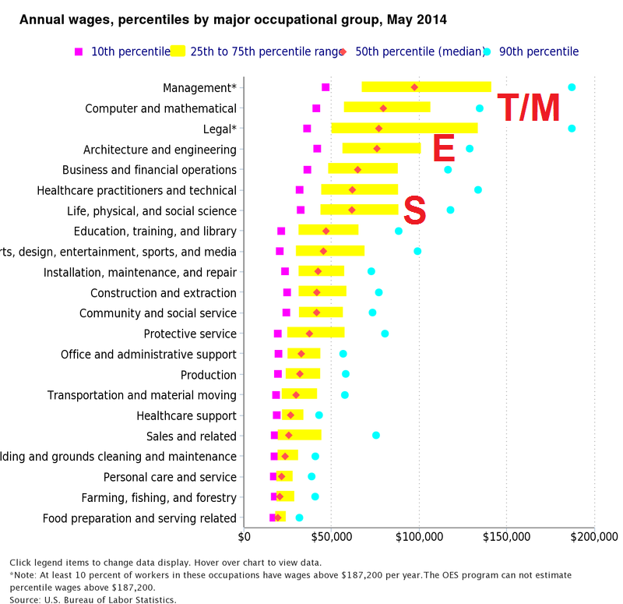
Why does STEM matter?
STEM jobs are also nice jobs
  Higher than average salaries

Slide 20
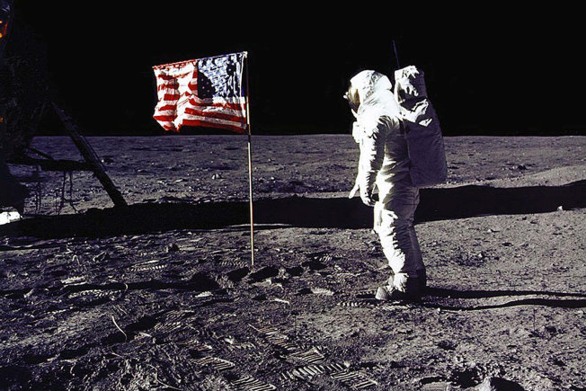
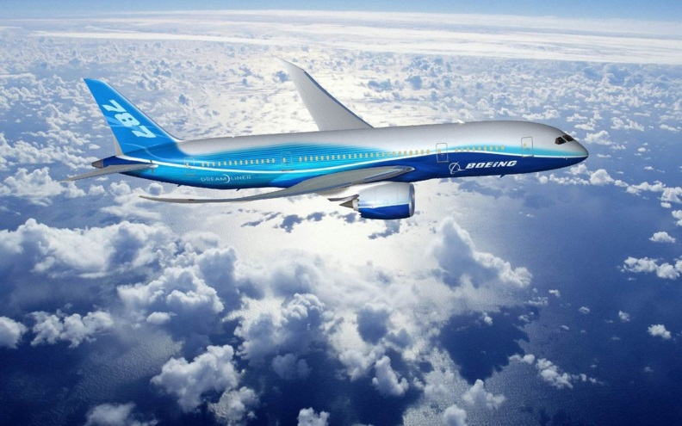
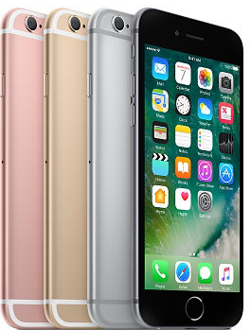

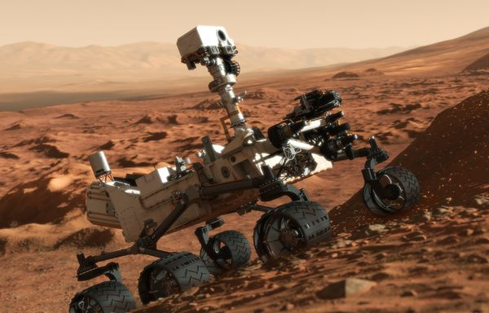
Why does STEM matter?
Technology has brought us some amazing things
Life
is
good!

Slide 21



Why does STEM matter?
Life is Good
  It might actually be TOO good.
  Good engineering is invisible
  Most of us don’t think about where any of our technology comes from.

Slide 22
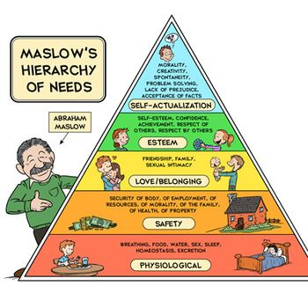
Why does STEM matter?
Life is Good
  When was the last time you thought about the lower levels of Maslow’s Hierarchy?
Technology is covering these.

Slide 23
Why does STEM matter?
Life is Good
  When was the last time you thought about the lower levels of Maslow’s Hierarchy?
Living up here isn’t a BAD thing...
Technology is covering these.

Slide 24
Why does STEM matter?
Life is Good
  When was the last time you thought about the lower levels of Maslow’s Hierarchy?
Living up here isn’t a BAD thing...
But this isn’t going away
Technology is covering these.

Slide 25
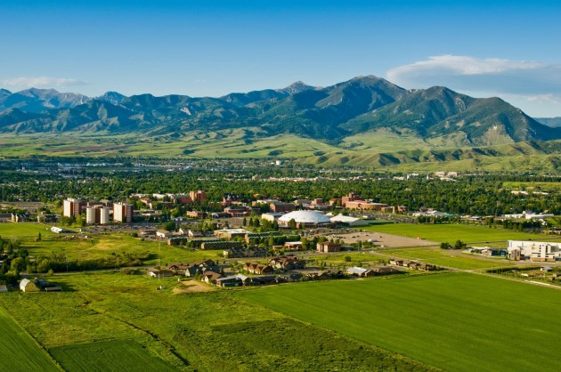
Why does STEM matter?
Life is Good
  With a shift to living in cities, we have created “localized utopias”.
  We push the negative side-effects of technology down the road (or off-shore)
Bozeman
the shining city upon a hill…

Slide 26

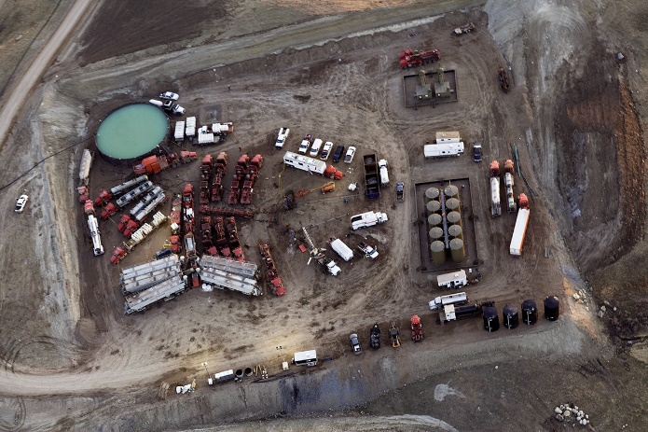
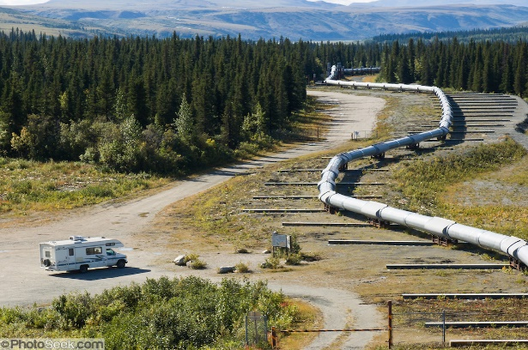
Why does STEM matter?
Life is Good
  With a shift to living in cities, we’ve created “localized utopias”.
  We push the negative side-effects of technology down the road (or off shore)
Bozeman
the shining city upon a hill…
Colstrip
Bakken
AK Pipeline

Slide 27
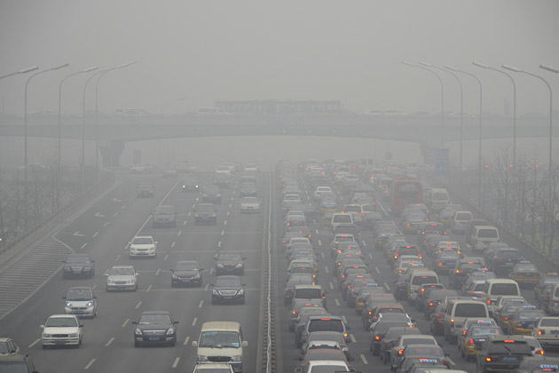
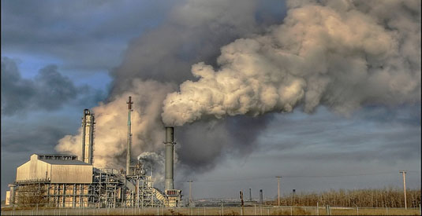
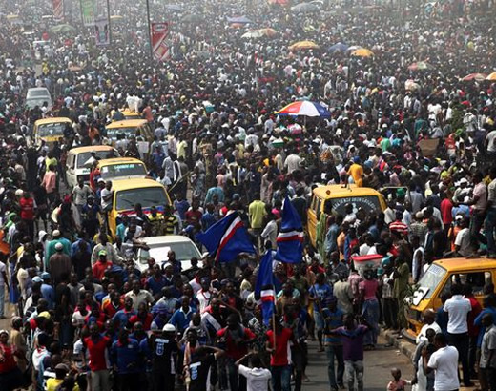

Why does STEM matter?
Life is Good for how long…

Slide 28
Why does STEM matter?
Life is Good for how long…
Problems building on a grander scale than ever seen before:
Global Warning
Refugee crises
Overpopulation
Drought
Extreme Weather

Slide 29
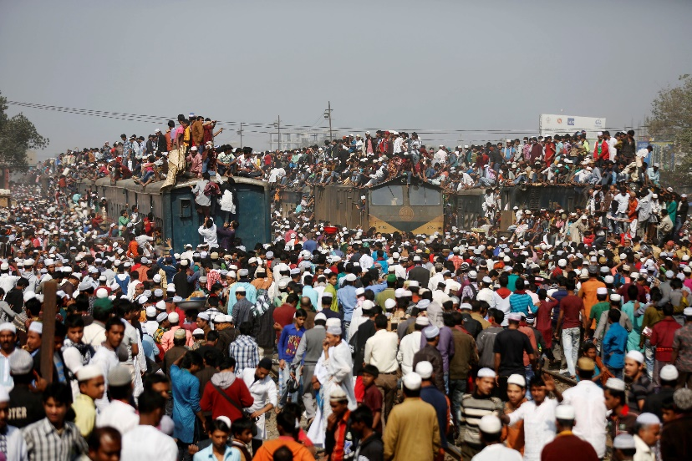
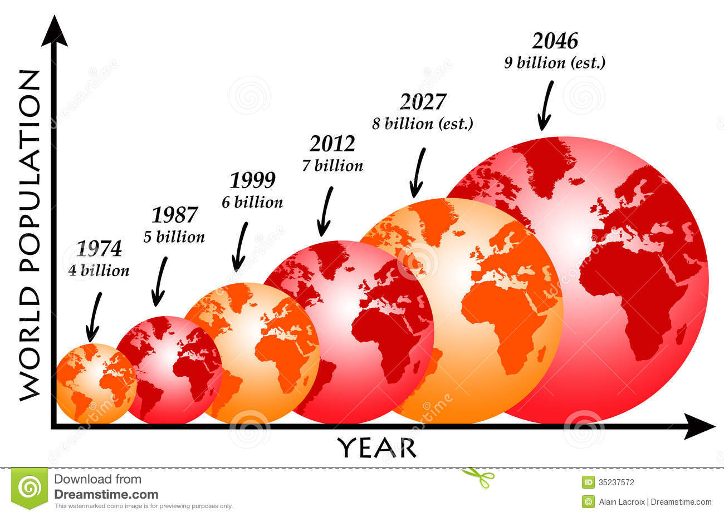
Why does STEM matter?
Life is Good for how long…
  Can our planet sustain 9B people by 2045?
  70% will live in urban areas

Slide 30
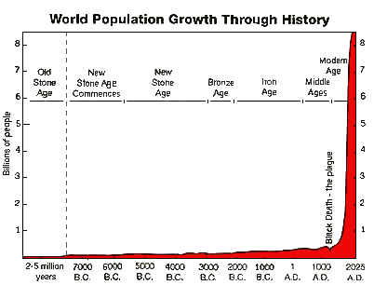

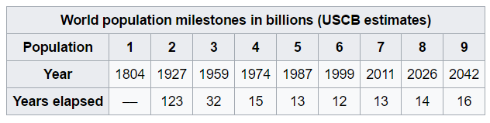
Why does STEM matter?
The Consequence of Technology
  The highest level tie between technology & societal impact is more people.

Slide 31

Why does STEM matter?
The Consequence of Technology
  The impact is that the scale of the problems become overwhelming.
Honey, the remote’s dead, can you bring me some batteries?

Slide 32
Why does STEM matter?
The Consequence of Technology
  The impact is that the scale of the problems become overwhelming.
Honey, the remote’s dead, can you bring me some batteries?
3 Billion batteries are thrown away in the US each year.

Slide 33

Why does STEM matter?
The Consequence of Technology
  The impact is that the scale of the problems become overwhelming.
Honey, the remote’s dead, can you bring me some batteries?
What’s wrong with a cup of coffee?
3 Billion batteries are thrown away in the US each year.

Slide 34
Why does STEM matter?
The Consequence of Technology
  The impact is that the scale of the problems become overwhelming.
Honey, the remote’s dead, can you bring me some batteries?
What’s wrong with a cup of coffee?
13 Billion non-biodegradable
K-cups went to landfills in 2014.
3 Billion batteries are thrown away in the US each year.

Slide 35
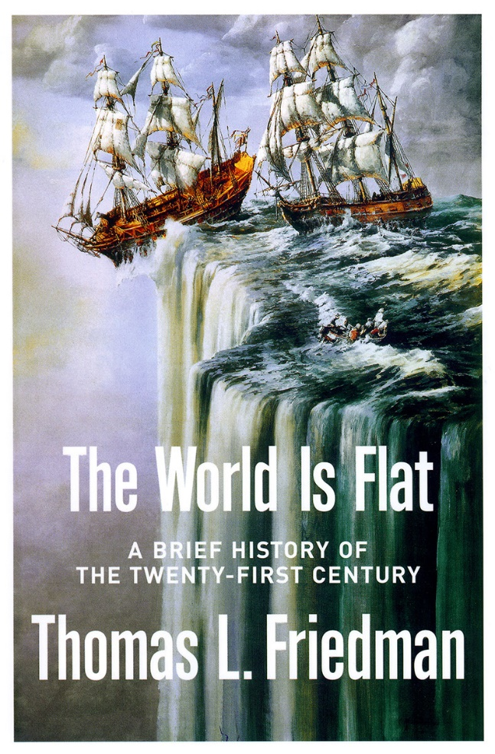
Why does STEM matter?
Calls for Action
  Around 2005, a number of high profile publications spurred discussion of change to engineering education.
The global playing field was flatted due to end of cold war & advances in information technology.
India and China are going all in on STEM. Our outsourcing is fueling their economic rise.

Slide 36
Why does STEM matter?
Calls for Action
  Around 2005, a number of high profile publications spurred discussion of change to engineering education.
The global playing field was flatted due to end of cold war & advances in information technology.
India and China are going all in on STEM. Our outsourcing is fueling their economic rise.
Recommendations: To remain a leader, the US must:
Invest in keeping the skills of our workforce relevant and adaptable.
Invest it recruiting more K-12 into STEM.

Slide 37

Why does STEM matter?
Calls for Action
  Around 2005, a number of high profile publications spurred discussion of change to engineering education.
US is in danger of losing its economic dominance.
Our investment in STEM is slowing while other countries is exploding.
Interest in STEM in the K-12 pipeline is at an all time low.

Slide 38
Why does STEM matter?
Calls for Action
  Around 2005, a number of high profile publications spurred discussion of change to engineering education.
US is in danger of losing its economic dominance.
Our investment in STEM is slowing while other countries is exploding.
Interest in STEM in the K-12 pipeline is at an all time low.
Recommendations: To remain a leader, the US must:
Invest in K-12 STEM teaching (10k teachers /10M minds).
Invest STEM Research
Invest in STEM Higher Ed
Reform economic policy

Slide 39

Tomorrow’s STEM Workforce
Preparing engineering students to meet the grand challenges of the 21st century.
STEM

Slide 40
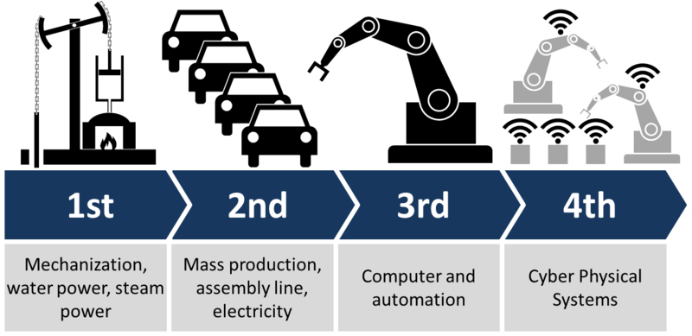
Tomorrow’s STEM Workforce
Preparing engineering students to meet the grand challenges of the 21st century.
  The 4th industrial revolution.
  Designing for sustainability.
  Understanding the global context and ethical impact of our decisions.
  Promoting inclusion and social justice.
  Working in interdisciplinary AND multicultural teams.

Slide 41

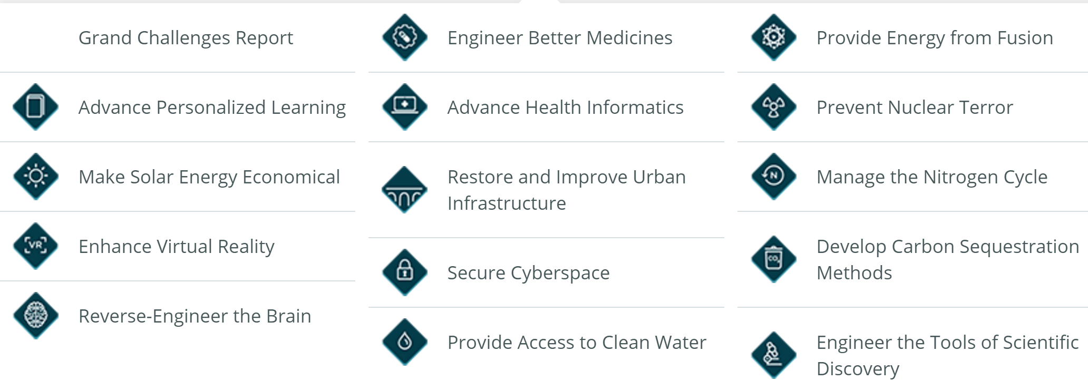
Tomorrow’s STEM Workforce
Preparing engineering students to meet the grand challenges of the 21st century.
High Level
Global Context
Multidisciplinary

Slide 42

Tomorrow’s STEM Workforce
Preparing engineering students to meet the grand challenges of the 21st century.
(Same thing at the UN level)

Slide 43
Tomorrow’s STEM Workforce
Are We Producing Enough STEM Grads To Meet the Demand?
  There are 8M STEM workers in the U.S. right now.
  9M+ by 2022.
U.S. STEM Workforce (8M)
287k STEM Openings

Slide 44
Tomorrow’s STEM Workforce
The Question requires looking at the entire pipeline
  Data can be difficult to find.
  Different sources define STEM professions differently. We use NSF def.
K-12
(3M/yr)
U.S. STEM Higher Ed
U.S. STEM Workforce (8M)
287k STEM Openings

Slide 45
Tomorrow’s STEM Workforce
The STEM Pipeline
  Who enters U.S. higher education system?
International
K-12
(3M/yr)
U.S. STEM Higher Ed
U.S. STEM Workforce (8M)
25% STEM
More than 1 out of 3
choose STEM
287k STEM Openings
40%
non-STEM
35% Don’t Enter College

Slide 46
Tomorrow’s STEM Workforce
The STEM Pipeline
  Who obtains a STEM degree?
International
65k – 80k H1B
K-12
(3M/yr)
U.S. STEM Higher Ed
U.S. STEM Workforce (8M)
287k BS
25% STEM
92k MS
60% entering choose STEM
287k STEM Openings
25k PhD
40%
non-STEM
35% Don’t Enter College
40% Don’t Persist to Graduation

Slide 47
Tomorrow’s STEM Workforce
The STEM Pipeline
  Including retirement completes the flow diagram. Looks like we are fine?
International
65k – 80k H1B
K-12
(3M/yr)
U.S. STEM Higher Ed
U.S. STEM Workforce (8M)
Retire
287k BS
25% STEM
92k MS
235k
60% entering choose STEM
287k STEM Openings
25k PhD
~3%
40%
non-STEM
35% Don’t Enter College
40% Don’t Persist to Graduation

Slide 48
Tomorrow’s STEM Workforce
The STEM Pipeline – The off roads are the concern.
  Some STEM graduates don’t enter the field after getting a degree.
International
65k – 80k H1B
K-12
(3M/yr)
U.S. STEM Higher Ed
U.S. STEM Workforce (8M)
Retire
287k BS
25% STEM
92k MS
235k
60% entering choose STEM
287k STEM Openings
25k PhD
~3%
40%
non-STEM
35% Don’t Enter College
40% Don’t Persist to Graduation
50% Don’t Choose a STEM Career

Slide 49
Tomorrow’s STEM Workforce
The STEM Pipeline – The off roads are the concern.
  People leave the workforce at an alarming rate.
International
65k – 80k H1B
K-12
(3M/yr)
U.S. STEM Higher Ed
U.S. STEM Workforce (8M)
Retire
287k BS
25% STEM
92k MS
235k
60% entering choose STEM
287k STEM Openings
25k PhD
~3%
40%
non-STEM
35% Don’t Enter College
40% Don’t Persist to Graduation
50% Don’t Choose a STEM Career
Opt Out of Profession
(only 26% of people w/ STEM degrees work in STEM ages 22-65)

Slide 50
Tomorrow’s STEM Workforce
The off-roads impact certain demographics more than others
  The fastest growing fields have the most severe underrepresentation of women.

Slide 51
Tomorrow’s STEM Workforce
The off-roads impact certain demographics more than others
  The fastest growing fields have the most severe underrepresentation of women.
  Growth in the area of computers accounted for over 90% of the job growth in STEM occupations between 2003 and 2013.
    Yet only 26% of jobs in this area were held by women.
    The percentage of BS degrees awarded to women in this area decreased from 23% to 18% between 2004 and 2014.

Slide 52

Tomorrow’s STEM Workforce
The off-roads impact certain demographics more than others
  The fastest growing fields have the most severe underrepresentation of women.
  Growth in the area of computers accounted for over 90% of the job growth in STEM occupations between 2003 and 2013.
    Yet only 26% of jobs in this area were held by women.
    The percentage of BS degrees awarded to women in this area decreased from 23% to 18% between 2004 and 2014.
  Women are 45% more likely than their male peers to leave the STEM industry within their first year. By age 35, 52% of women employed in STEM leave the field (Hewlett, 2008).

Slide 53

Tomorrow’s STEM Workforce
Be honest, what do you think about when you hear scientist?

Slide 54
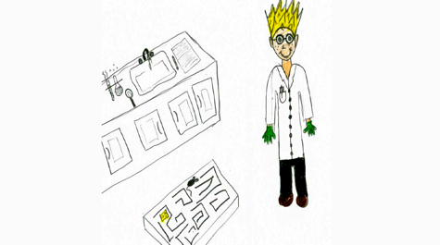
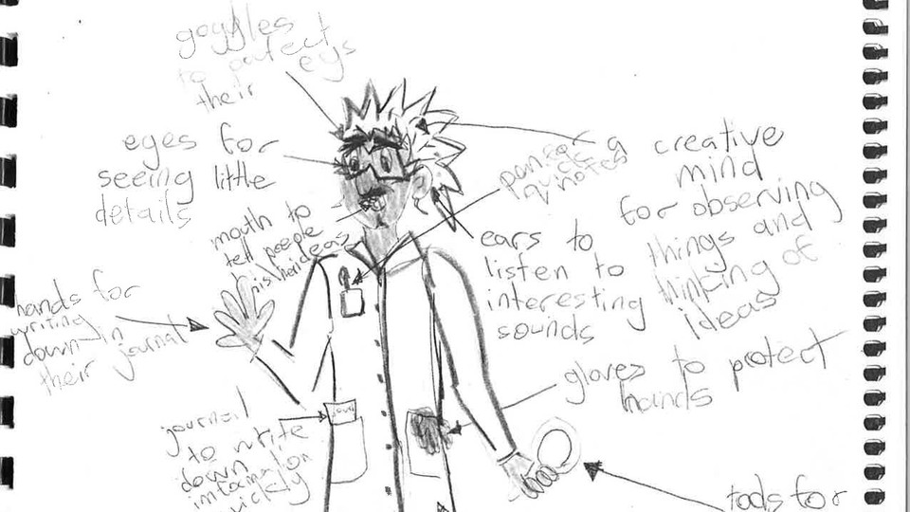
Tomorrow’s STEM Workforce
Be honest, what do you think about when you hear scientist?

Slide 55
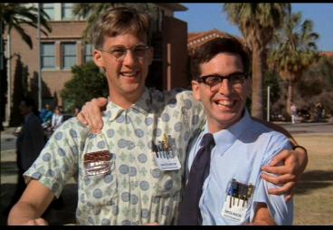

Tomorrow’s STEM Workforce
Be honest, what do you think about when you hear engineer?

Slide 56
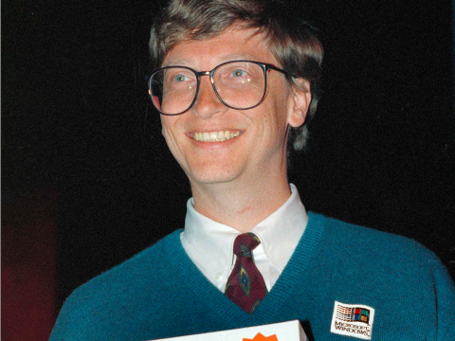


Tomorrow’s STEM Workforce
Be honest, what do you think about when you hear engineer?
Tech Billionaires have helped grow engineering enrollments.

Slide 57
Tomorrow’s STEM Workforce
Be honest, what do you think about when you hear engineer?
But making money doesn’t solve our grand challenges.

Slide 58

Tomorrow’s STEM Workforce
The Challenge: Broaden Participation in the STEM Workforce
We need a larger STEM workforce.
We need more diverse ideas.
We can only get there by broadening participation.

Slide 59
Tomorrow’s STEM Workforce
The Challenge: Broaden Participation in the STEM Workforce
We need a larger STEM workforce.
We need more diverse ideas.
We can only get there by broadening participation.
More white nerdy dudes?

Slide 60
Tomorrow’s STEM Workforce
The Challenge: Broaden Participation in the STEM Workforce
We need a larger STEM workforce.
We need more diverse ideas.
We can only get there by broadening participation.
More white nerdy dudes? Yep

Slide 61
Tomorrow’s STEM Workforce
The Challenge: Broaden Participation in the STEM Workforce
We need a larger STEM workforce.
We need more diverse ideas.
We can only get there by broadening participation.
More white nerdy dudes? Yep
More women?

Slide 62
Tomorrow’s STEM Workforce
The Challenge: Broaden Participation in the STEM Workforce
We need a larger STEM workforce.
We need more diverse ideas.
We can only get there by broadening participation.
More white nerdy dudes? Yep
More women? Yep

Slide 63
Tomorrow’s STEM Workforce
The Challenge: Broaden Participation in the STEM Workforce
We need a larger STEM workforce.
We need more diverse ideas.
We can only get there by broadening participation.
More white nerdy dudes? Yep
More women? Yep
Just more smart people in general

Slide 64
Tomorrow’s STEM Workforce
The Challenge: Broaden Participation in the STEM Workforce
We need a larger STEM workforce.
We need more diverse ideas.
We can only get there by broadening participation.
More white nerdy dudes? Yep
More women? Yep
Just more smart people in general Yep

Slide 65
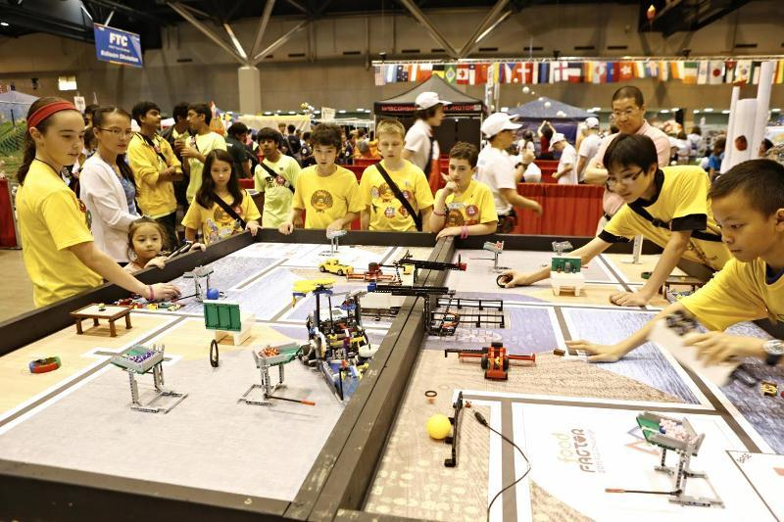
Thoughts on motivation
The traditional STEM demo…
Tinkerers and coders
  They don’t need much encouragement.
  Provide the resources, and off they go.
  This will get 1 out of 18 people (what we have today).
These folks are probably heading to STEM anyway.

Slide 66
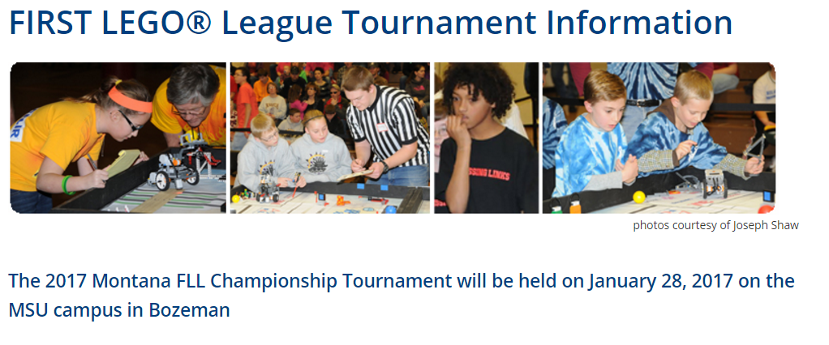

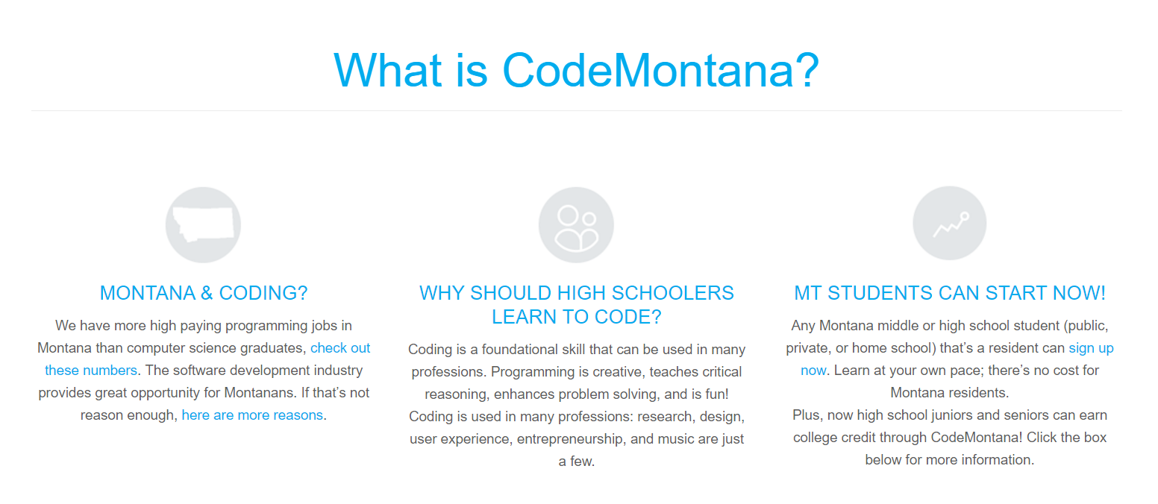
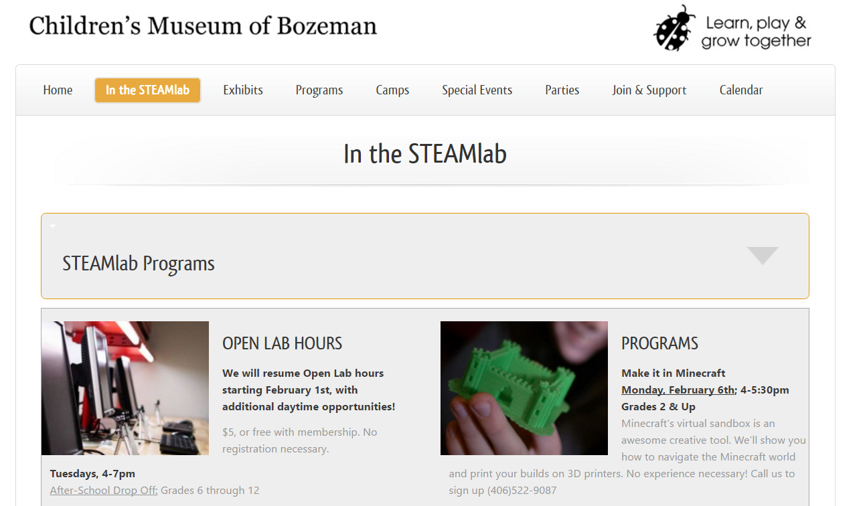
Thoughts on motivation
The traditional STEM demo…
Some local resources
Tinkerers and coders

Slide 67

Thoughts on motivation
The traditional STEM demo…
Some local resources
Tinkerers and coders

Slide 68

Thoughts on motivation
The non-traditional STEM demo…
Intelligent students, wanting to make a difference.

Slide 69
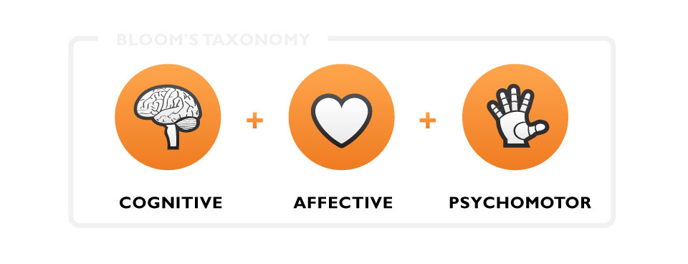
Thoughts on motivation
Why do certain people avoid STEM?
Our intellectual skills.
The first thing we think of when we talk about “learning”.
1) COGNITIVE
Our feelings (attitudes, motivation, willingness to participate, value of what is being learned).
Heavily influences success of cognition.
2) AFFECTIVE
Motor skills.
Cognition is underlying component, but practice-makes-perfect.
3) PSYCHOMOTOR

Slide 70
Thoughts on motivation
Why do certain people avoid STEM?
Motivation = Expectancy x Value
More than just wanting good grades & lots of money…
Will a student “choose” a STEM degree
Will the student put in the time necessary to achieve graduation.
Will the person “choose” a STEM profession.
Will the professional “choose” to stay in STEM.
(Atkinson 50’s 60’s, Eccles 80’s)

Slide 71
Thoughts on motivation
Why do certain people avoid STEM?
Motivation = Expectancy x Value
Beliefs about one’s own ability and chances for success.
(Atkinson 50’s 60’s, Eccles 80’s)

Slide 72
Thoughts on motivation
Why do certain people avoid STEM?
Motivation = Expectancy x Value
Beliefs about the importance of the tasks.
(Atkinson 50’s 60’s, Eccles 80’s)

Slide 73
Thoughts on motivation
Why do certain people avoid STEM?
Motivation = Expectancy x Value
Beliefs about the importance of the tasks
Agentic
(self)
Communal
(others)
(Atkinson 50’s 60’s, Eccles 80’s)

Slide 74
Thoughts on motivation
Why do certain people avoid STEM?
Motivation = Expectancy x Value
Beliefs about the importance of the tasks
Agentic
(self)
Communal
(others)
Simple interventions can make a big difference.

Slide 75
Thoughts on motivation
The next generation wants to make a difference
Colstrip
Bakken
AK Pipeline

Slide 76
Thoughts on motivation
The next generation wants to make a difference
We sometimes shelter kids from our global problems.
But it actually will make them more motivated.
(doctors becomes engineers)
STEM is about helping others
(nurses become scientists).

Slide 77

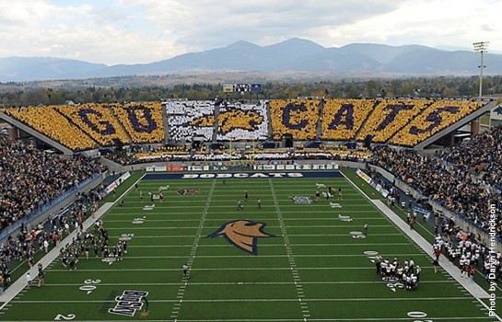
Thank you!
Questions

