Slide 1
Montana Engineering Education Research Center
(MEERC)
Brock LaMeres
Director, MEERC
Boeing Professor of Engineering Education
Professor, Electrical & Computer Engineering

Slide 2

The Mission of the MEERC
Transform Engineering Education through interdisciplinary, empirical research on improving student success.

Slide 3
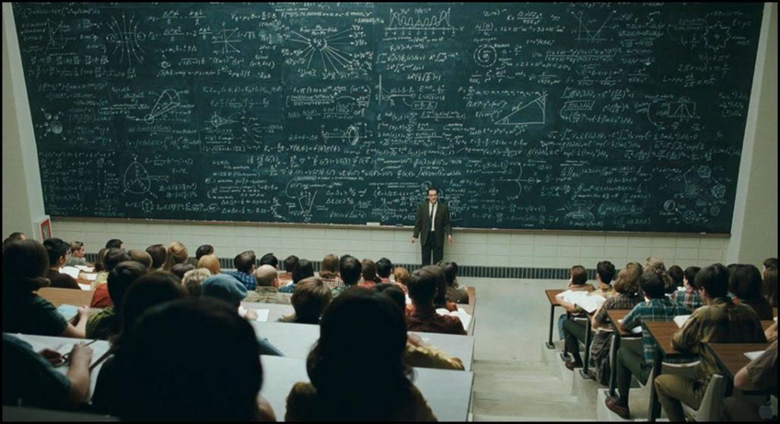
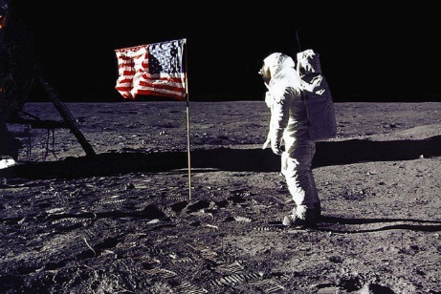
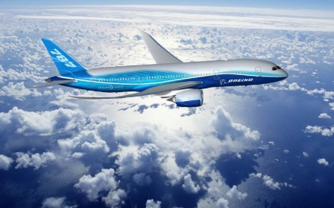

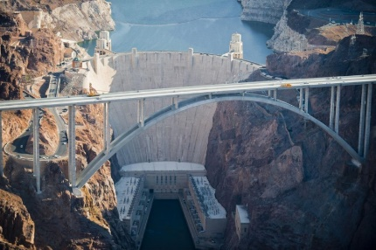

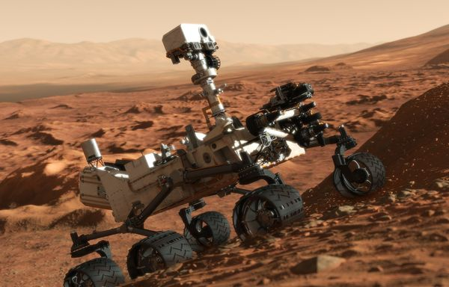
The Mission of the MEERC
Why Transform?
Life is good, right?

Slide 4

The Mission of the MEERC
Why Transform?

Slide 5
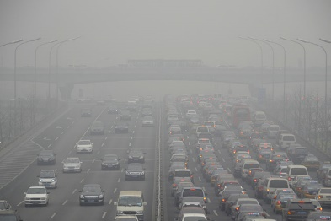
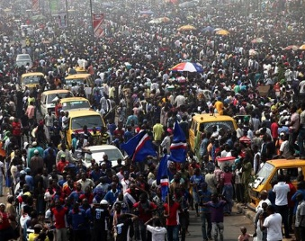
The Mission of the MEERC
Why Transform?
The Scale of the Problem
A different skillset is needed to solve the grant challenges (teamwork, communications w/ non-STEM, leadership)

Slide 6
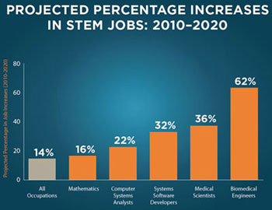
The Mission of the MEERC
Why Transform?
The Scale of the Problem
A different skillset is needed to solve the grant challenges (teamwork, communications w/ non-STEM, leadership)
Workforce Demand
50% of economic growth is due to STEM
Projected job growth for STEM is 20%
How do we train 1M more engineers

Slide 7
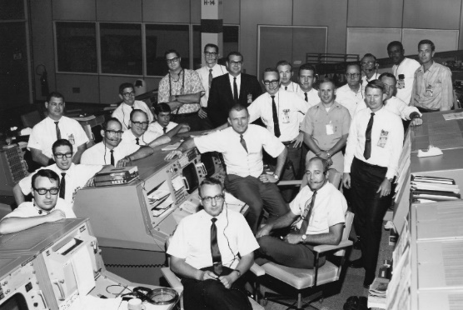
The Mission of the MEERC
Why Transform?
The Scale of the Problem
Broadening Participation
A different skillset is needed to solve the grant challenges (teamwork, communications w/ non-STEM, leadership)
Diversity = New Solutions
Diversity = More Engineers
Workforce Demand
50% of economic growth is due to STEM
Projected job growth for STEM is 20%
How do we train 1M more engineers

Slide 8

The Mission of the MEERC
Why Transform?
The Scale of the Problem
Broadening Participation
A different skillset is needed to solve the grant challenges (teamwork, communications w/ non-STEM, leadership)
Diversity = New Solutions
Diversity = More Engineers
Workforce Demand
Student Loan Debt
50% of economic growth is due to STEM
Projected job growth for STEM is 20%
How do we train 1M more engineers
$1.6T in Student Loan Debt,
This bubble will pop.

Slide 9
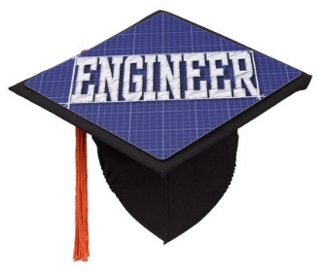
What Influences Eng. Education?

Slide 10

What Influences Eng. Education?
Accreditation

Slide 11



What Influences Eng. Education?
Accreditation
National
Agencies

Slide 12
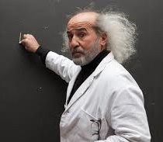
What Influences Eng. Education?
Accreditation
National
Agencies
Faculty

Slide 13


What Influences Eng. Education?
Accreditation
National
Agencies
Industry
Faculty

Slide 14




What Influences Eng. Education?
The role EER plays...
EER provides a unique
mechanism to make
educational
change.
It is the
connection
between
components.
Accreditation
National
Agencies
Industry
Faculty

Slide 15
The Mission of the MEERC
Transform Engineering Education through interdisciplinary, empirical research on improving student success.

Slide 16
The Mission of the MEERC
Transform Engineering Education through interdisciplinary, empirical research on improving student success.
Research Goals
Strengthen the engineering workforce by better preparing our students with the skills needed to solve our grand challenges.
Strengthen the engineering workforce by broadening participation in engineering.
Improve the efficiency of engineering education.

Slide 17
The Mission of the MEERC
Transform Engineering Education through interdisciplinary, empirical research on improving student success.
Research Goals
Strengthen the engineering workforce by better preparing our students with the skills needed to solve our grand challenges
Strengthen the engineering workforce by broadening participation in engineering.
Improve the efficiency of engineering education.
Four Strategies
Increase faculty productivity in the area of engineering education research.
Initiate large-scale research projects and programs at MSU.
Contribute to the training of tomorrow’s professoriate.
Establish MSU as a leader within the American Society of Engineering Education (ASEE).

Slide 18

The Mission of the MEERC
Transform Engineering Education through interdisciplinary, empirical research on improving student success.
Phase 0
Garner interest
Understand obstacles
You are here
2014
2016
2018
2020
2022

Slide 19
The Mission of the MEERC
Transform Engineering Education through interdisciplinary, empirical research on improving student success.
Phase 1
Grow funded research
Raise visibility
Phase 0
Garner interest
Understand obstacles
You are here
2014
2016
2018
2020
2022

Slide 20
The Mission of the MEERC
Transform Engineering Education through interdisciplinary, empirical research on improving student success.
Phase 2
Implement programs
REALLY grow research
Phase 1
Grow funded research
Raise visibility
Phase 0
Garner interest
Understand obstacles
You are here
2014
2016
2018
2020
2022

Slide 21
The Mission of the MEERC
Phase 3
tbd?
Transform Engineering Education through interdisciplinary, empirical research on improving student success.
Phase 2
Implement programs
REALLY grow research
Phase 1
Grow funded research
Raise visibility
Phase 0
Garner interest
Understand obstacles
You are here
and here…
2014
2016
2018
2020
2022

Slide 22
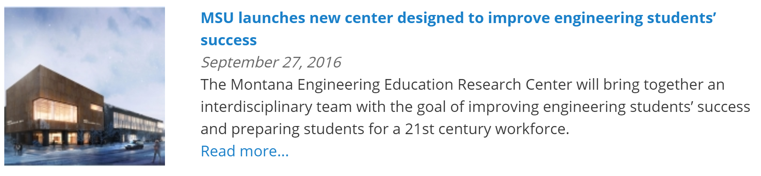
MEERC History – Year 1
Established in September 2016

Slide 23
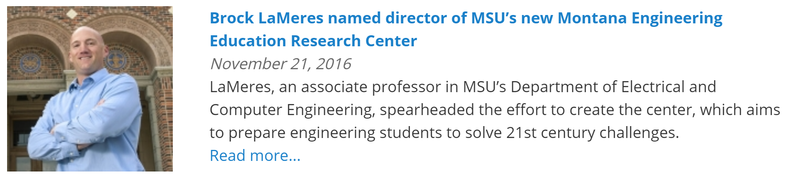
MEERC History – Year 1
Established in September 2016

Slide 24
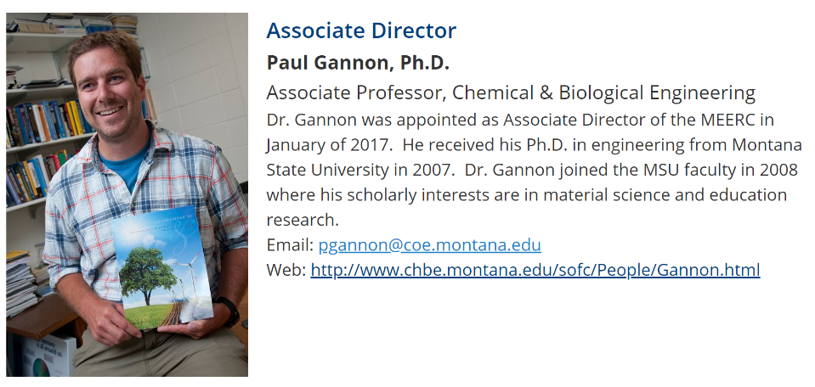
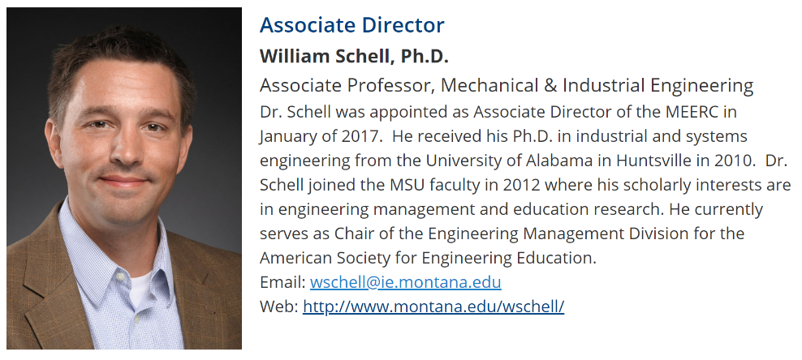
MEERC History – Year 1
Established in September 2016

Slide 25
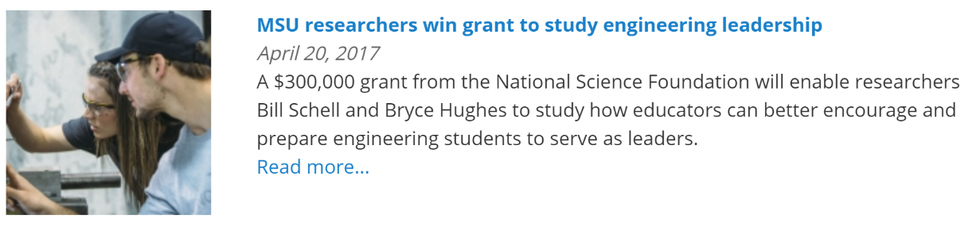
MEERC History – Year 1
Established in September 2016
  Phase 1: Form teams to write proposals, disseminate findings, raise our profile.

Slide 26
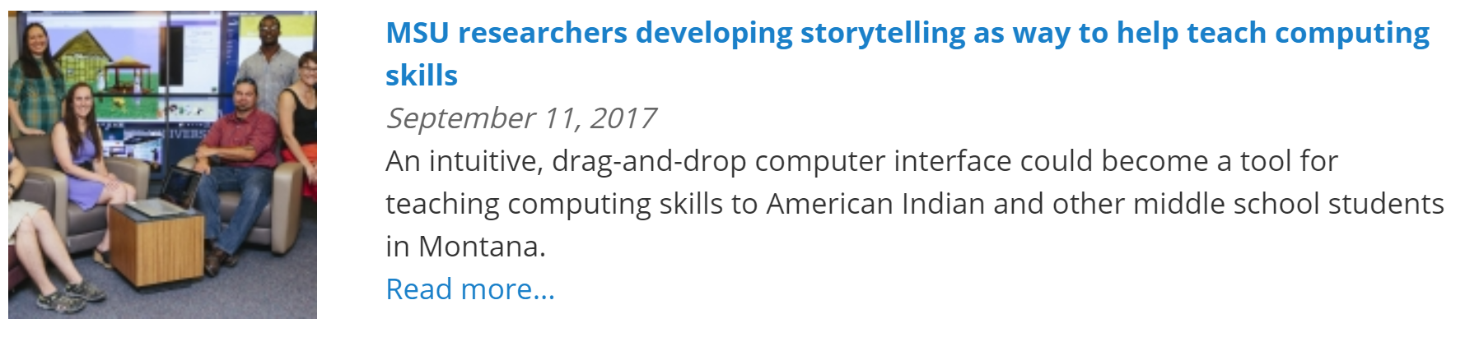
MEERC History – Year 1
Established in September 2016
  Phase 1: Form teams to write proposals, disseminate findings, raise our profile.

Slide 27
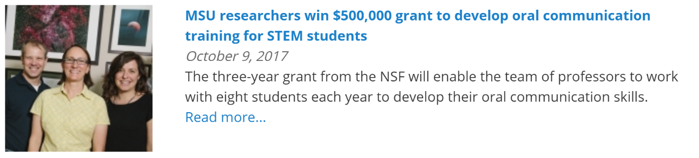
MEERC History – Year 1
Established in September 2016
  Phase 1: Form teams to write proposals, disseminate findings, raise our profile.

Slide 28
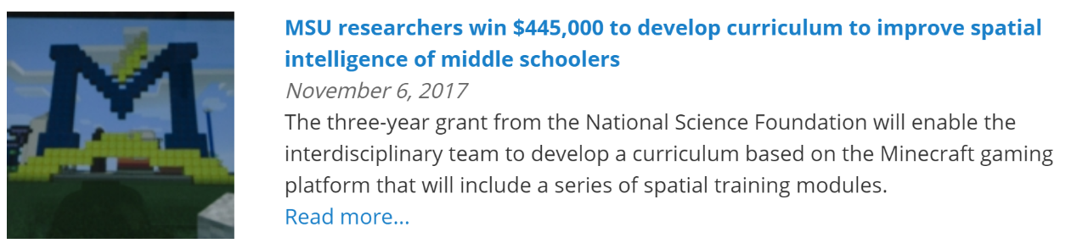
MEERC History – Year 1
Established in September 2016
  Phase 1: Form teams to write proposals, disseminate findings, raise our profile.

Slide 29
MEERC History – Year 1
Established in September 2016
  Phase 1: Form teams to write proposals, disseminate findings, raise our profile.
$2.5M in new NSF Funding in Year 1 !!!

Slide 30
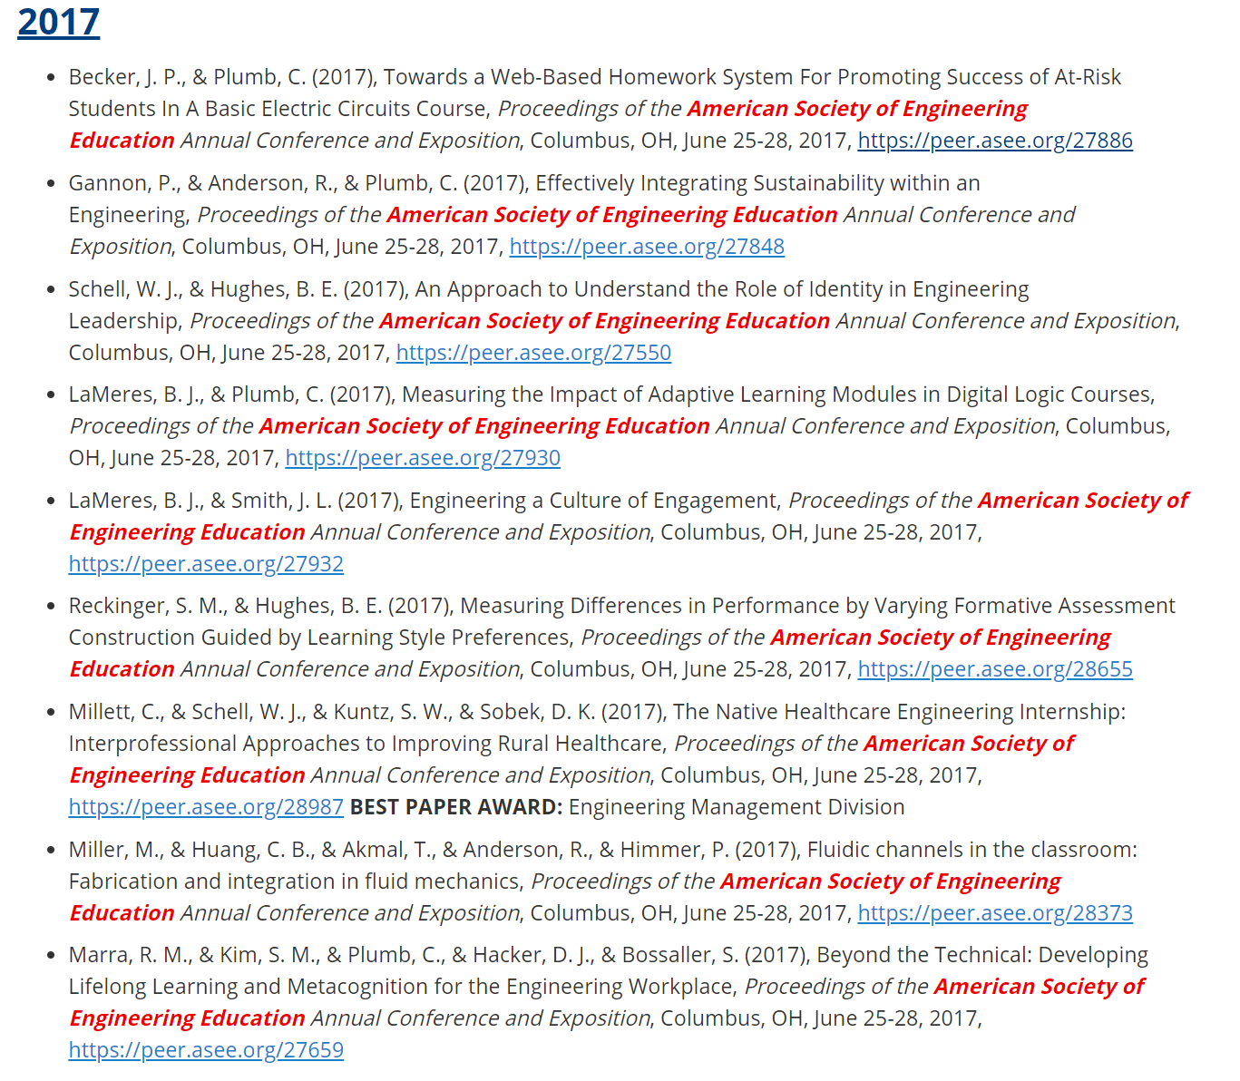
MEERC History – Year 1
Established in September 2016
  Phase 1: Form teams to write proposals, disseminate findings, raise our profile.
9 papers at ASEE
+
1 Best Paper Award

Slide 31
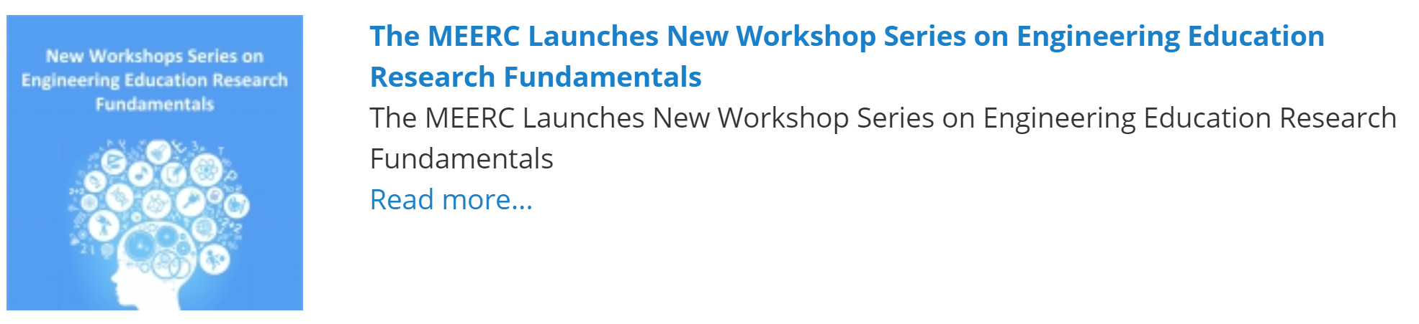
MEERC History – Year 2
Things start heating up in year 2…

Slide 32
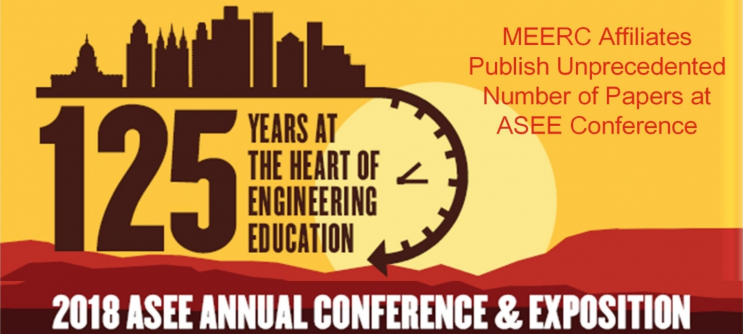
MEERC History – Year 2
Things start heating up in year 2…
The ASEE Paper Campaign Begins
Publish 17 papers in Salt Lake
(17 in Salt Lake)
Raise profile of MEERC affiliates through winning ASEE awards
Raise profile of MEERC affiliates by seeking leadership positions

Slide 33
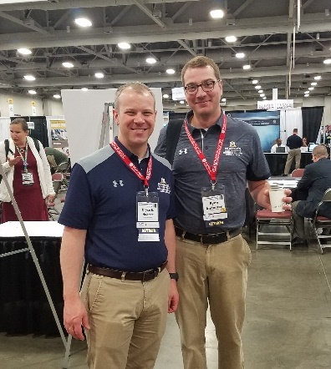
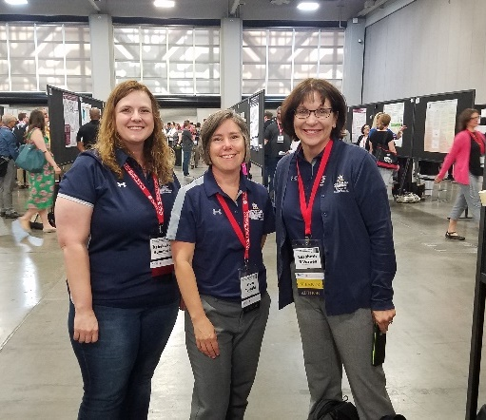
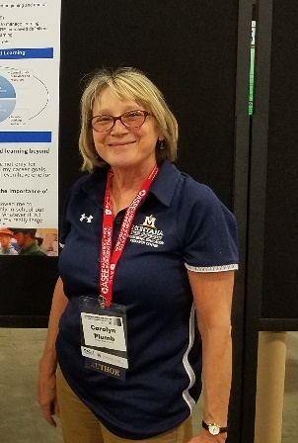
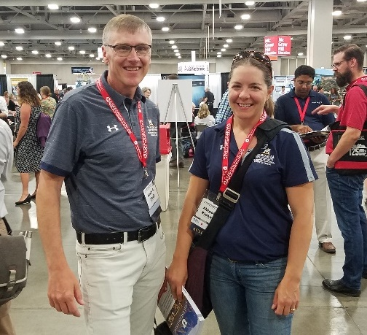
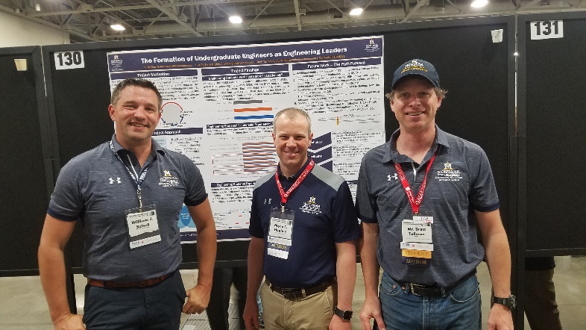
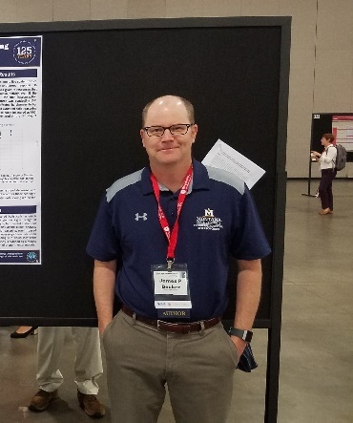
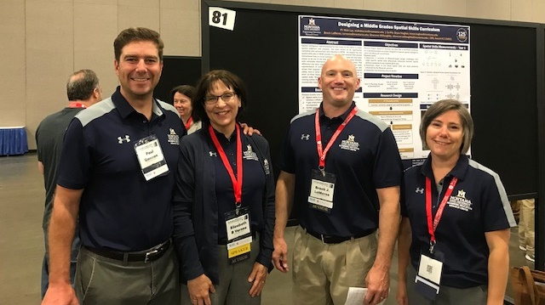
MEERC History – Year 2
Fourteen (14) MEERC Authors Attended ASEE
All in MEERC Shirts!
Bryce Hughes (Edu) &
Ryan Anderson (ChBE)
Becky Hammack (Edu),
Staci Turoski (NACOE) &
Beth Varnes (NACOE)
Carolyn Plumb (NACOE)
Kevin Cook (M&IE) &
Abby Richards (ChBE)
Bill Schell (M&IE)
Brett Tallman (Edu)
Jim Becker (ECE)
Paul Gannon (ChBE)
Brock LaMeres (ECE)
Liz Kovalchuk (M&IE), not pictured

Slide 34
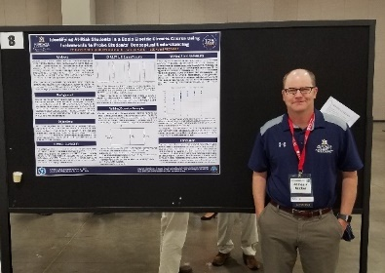
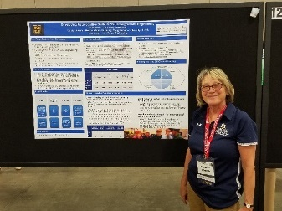
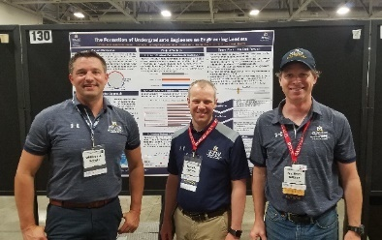
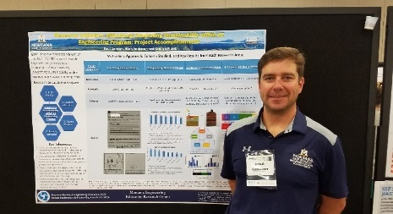
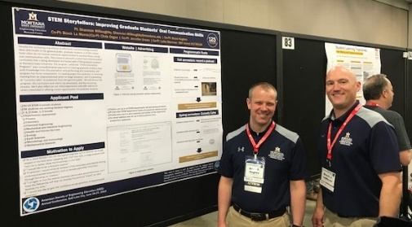
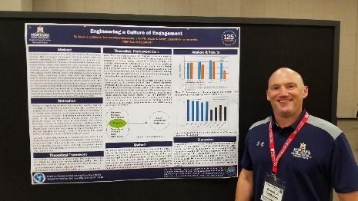
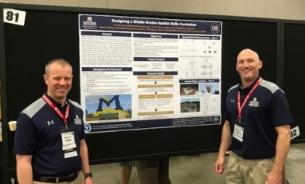
MEERC History – Year 2
Seventeen (17) MEERC Papers Published
7 in NSF Grantees Poster Session
Bold = MSU Author
+ = Pictured
Underline = Student
James Becker⁺ & Carolyn Plumb,
“Identifying At-Risk Students in a Basic Electric Circuits Course Using Instruments to Probe Students’ Conceptual Understanding”
Rose Marra, Carolyn Plumb⁺ & Doug Hacker,
“Developing Metacognitive Skills in PBL Undergraduate Engineering”
Bill Schell⁺, Bryce Hughes⁺ & Brett Tallman⁺,
“The Formation of Undergraduate Engineers as Engineering Leaders”
Paul Gannon⁺, Carolyn Plumb, & Ryan Anderson, “Research Initiation: Effectively Integrating Sustainability within an Engineering Program: Project Accomplishments”,
Shannon Willoughby, Bryce Hughes⁺, Brock LaMeres⁺, Chris Organ, Jennifer Green, Leila Sterman & Kent Davis,
“STEM Storytellers: Improving Oral Communication Skills of Graduate Students”
Nick Lux, Bryce Hughes⁺, Brock LaMeres⁺ & Shannon Willoughby,
“Increasing the Spatial Intelligence of 7th Graders using the Minecraft Gaming Platform”
Brock LaMeres⁺ & Jessi Smith, “Engineering a Culture of Engagement”

Slide 35
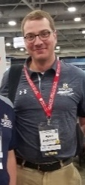
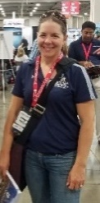

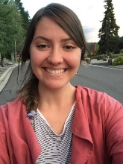
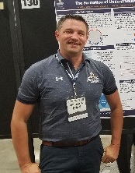
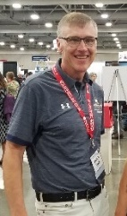
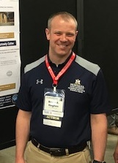

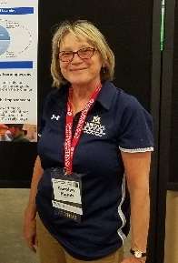
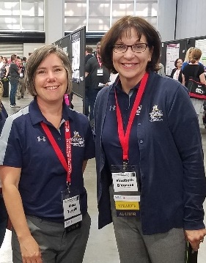
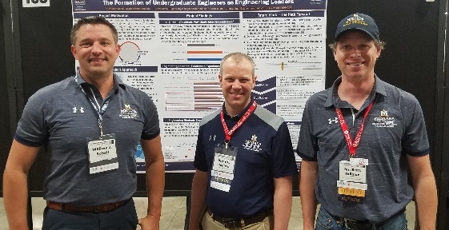
MEERC History – Year 2
Seventeen (17) MEERC Papers Published
10 in Technical Sessions
Bold = MSU Author
+ = Pictured/Presenter
Underline = Student
Ryan Anderson⁺ & Abigail Richards ⁺,
“Building the Undergraduate Chemical Engineering Community by Involving Capstone Design Students in Undergraduate Courses”
Ryan Anderson⁺, T. Akmal, Phil Himmer,
“Group Laboratory Experiment during Lecture in an Undergraduate Fluid Dynamics Class: Increasing Student Learning and Communication Skills”
Kevin Cook⁺, Robb Larson, & Dan Miller,
“Using Lean Principles to Improve an Engineering Technology Assessment Process”
Elizabeth Kovalchuk⁺ & William Schell⁺,
“Writing as a Method to Build Better Engineers: Examining Faculty Perceptions of Writing’s Importance”
Michell Miley, Todd Kaiser & Elizabeth Kovalchuk⁺,
“Improving the Teaching and Learning of Writing through the Writing Studio Model”
Shannon Reckinger & Bryce Hughes⁺,
“Partnering Strategies for Paired Formative Assessment in Programming
Carolyn Plumb⁺, Rose Marra, Doug Hacker & J. Dunlosky,
“Measuring Engineering Students’ Metacognition with a Think-Aloud Protocol”
Amanda Rutherford, Brad Stanton, Staci Turoski⁺, Elizabeth Varnes⁺,
“Designing a Comprehensive Project for a Junior Level Multidisciplinary Engineering Design Course”
William Schell⁺, Bryce Hughes⁺ & Brett Tallman⁺,
“Understanding the Perceived Impact of Leadership Experiences in College”
M. Ingalls, E. Hill, H. Finger, M.J. Lam, G.G. Ma, D.L. Peters, D.L., Stephanie Wettstein, D.S. Won, C.M.D. Wilson, C.F. Rivera, E. Silva, Tara Sundsted,
“Changing of the Guard: Tips for Enabling Smooth Officer Transitions”

Slide 36
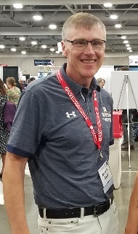
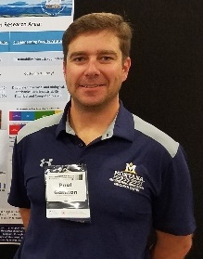
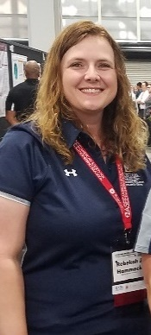

MEERC History – Year 2
MEERC Affiliates Serving in ASEE Leadership Roles
Kevin Cook
  Elected as Assistant Vice-Chair for ASEE Annual Programs for the Engineering Technology Division.
Paul Gannon
  Elected as co-chair of the ASEE / IEEE Frontiers in Education Conference “New Faculty Fellows” program.
Becky Hammack
  Elected as Member-at-Large for the Pre-College Division.
Bill Schell
  Elected to 2-year term on Board of Directors for the Engineering Management Division.
  Re-elected as Director of Scholarly Activity for the Engineering Leadership Division.
  Completed final year as past-chair of Engineering Management Division.

Slide 37

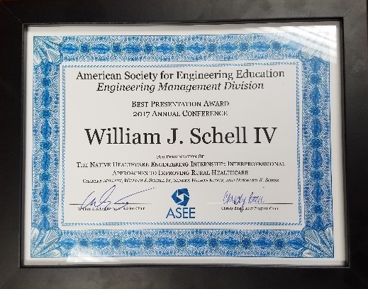
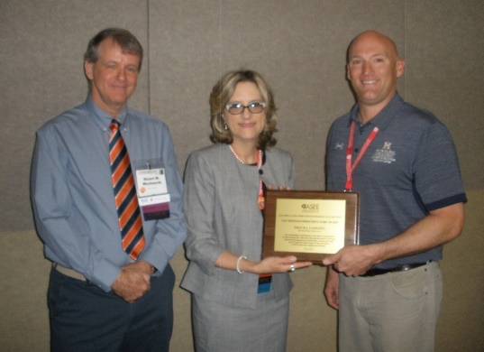


MEERC History – Year 2
MEERC-ats Winning ASEE Awards
Bill Schell
  2018 Zone IV Outstanding Campus Representative.
  2018 Pacific Northwest Section Outstanding Campus Representative.
  (presented in SLC).
Brock LaMeres
  Distinguished Educator Award,
  Electrical & Computer Engineering
  Division.
Elizabeth Kovalchuk
  Student Travel Grant from ASEE Industrial Engineering Division ($500).
Note: Liz’s research was funded by the MSU Undergraduate Scholars Program (USP). USP also awarded Liz a travel grant to present her work at ASEE in Salt Lake.

Slide 38


MEERC History – Year 2
MSU Alumni Mixer
With so many MSU faculty in town, we decided to have a mixer with MSU alumni to reconnect and spread the word about the MEERC.
Thanks to Dean Brett Gunnink from the NACOE for sponsoring the mixer.

Slide 39





MEERC History – Year 2
MSU Alumni Mixer - A few notable alumni
Allan McDonald (BSChemE, 1959,
Hon. Dr. of Engineering, 1987) wrote this nationally acclaimed book about the Challenger disaster. This book is required reading in numerous engineering ethics courses nationwide.
M. Keith Opprecht’s (MSChemE, 1958) master’s thesis advisor was NACOE legend Lloyd Berg.
Dennis Eyre (BSEE, 1963) was involved in the creation of our power grid’s Western Interconnection and also was part of the effort to establish the National Infrastructure Advisory Council in 2002.

Slide 40
What Does Year 3 Hold?
Transform Engineering Education through interdisciplinary, empirical research on improving student success.
Phase 1
Form teams, write proposals, raise profile.
We still have more grants to win.
Phase 2
Increase funding levels from level 1 to level 2.
Move toward a sustainable model for center operation.
Begin putting in place programs and studies at MSU.

Slide 41
What Does Year 3 Hold?
A few things to get year 3 started…

Slide 42



What Does Year 3 Hold?
A few things to get year 3 started…
Paul Gannon & Nick Lux win new $350k grant from NSF to study engineering identify in 4th graders
Five (5) new NSF grants since MEERC inception totaling $2.8M !!!

Slide 43


What Does Year 3 Hold?
A few things to get year 3 started…
Paul Gannon & Nick Lux win new $350k grant from NSF to study engineering identify in 4th graders
Five (5) new NSF grants since MEERC inception totaling $2.8M !!!
  An Endowment to Enhance Engineering Education at MSU
  Better prepare graduates for the challenges they face in the workforce
  Provide a meaningful interdisciplinary experience.
  Instill an understanding of the valuestream (design to delivery)
  Develop leadership within our graduates.

Slide 44

What Does Year 3 Hold?
A few things to get year 3 started…
Paul Gannon & Nick Lux win new $350k grant from NSF to study engineering identify in 4th graders
Five (5) new NSF grants since MEERC inception totaling $2.8M !!!
The MEERC to get physical space in new Norm Asbjornson Hall

Slide 45


Random Cool Picture
Questions / Discussion

