Slide 1


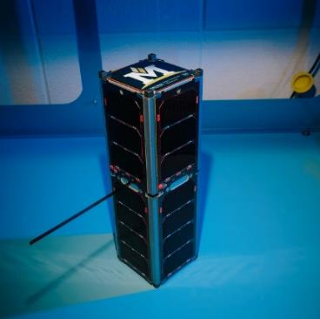
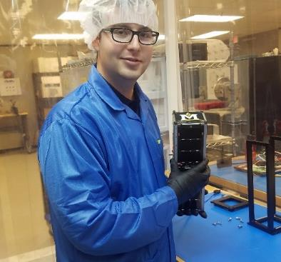
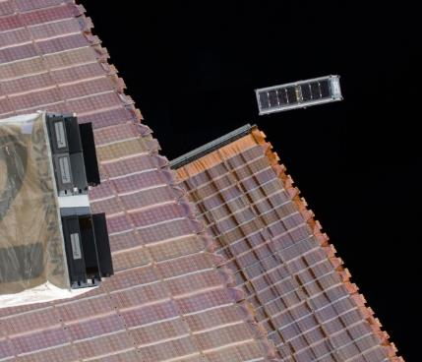
RadSat
Chronicles of Student Built Satellites at Montana State
Dr. Brock J. LaMeres
Professor, Electrical & Computer Engineering
Director, MT Engineering Education Research Center
Boeing Professor of Engineering Education

Slide 2

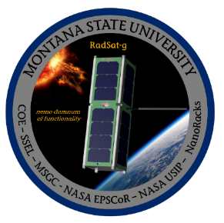
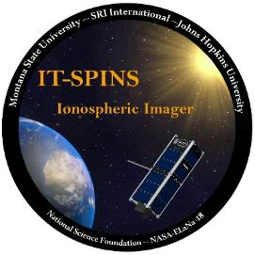
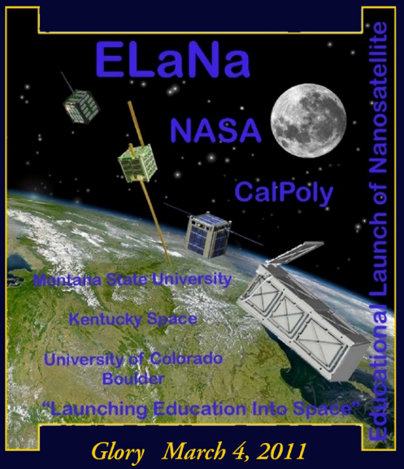
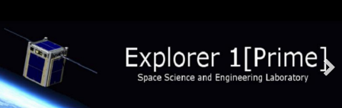
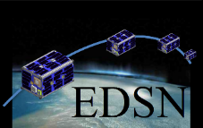



Quick Background of MSU
Space Science & Engineering Lab
Founded in 2000 with support from MSGC.
Provides students hands-on experience w/ real space missions.
One of the first universities to engage in small satellites
(part of the inaugural ELaNa-I).
Has sent 9 small satellites into space (10 & 11 within next 6 months.)

Slide 3
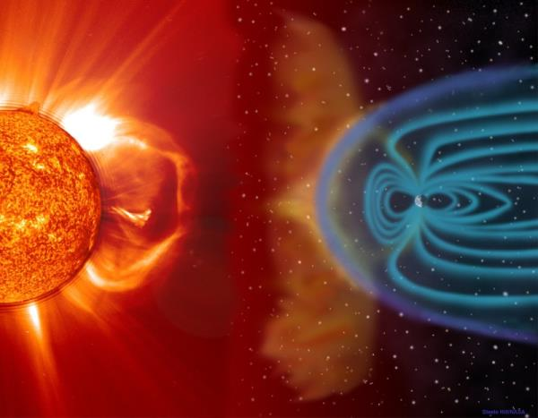
Objective of the RadSat Mission
Demonstrate a Radiation Tolerance Strategy for Computers
  Reconfigurable/redundant architecture.
  Build on COTS parts.
    Low cost
    High performance
    Low Power

Slide 4
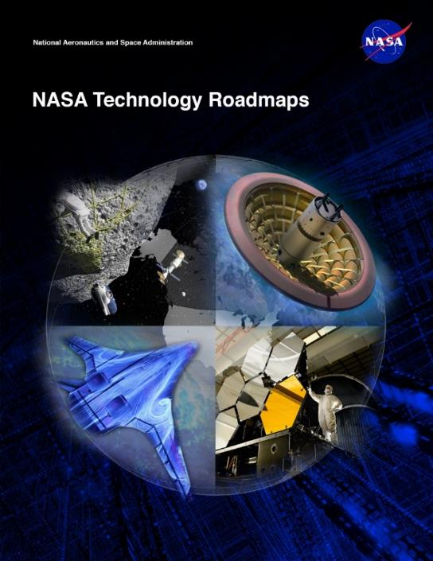
Why Do This Research?
Space Computing Needs
  NASA Technology Area 11 – Flight Computing
    Increased Computation
    Radiation hardened technologies
    Low power requirements
  Can our technology meet the needs of
  future missions?
Small Satellites
  Typically use non-radiation hardened parts.
  Are taking on longer and more meaningful
  missions.
  Can our technology provide computation and
  reliability at a price point suitable for SmallSats?
Reconfigurability = Cost & Performance
  Reusing hardware reduces mass
  Real-time updating of hardware optimizes for task at hand.

Slide 5
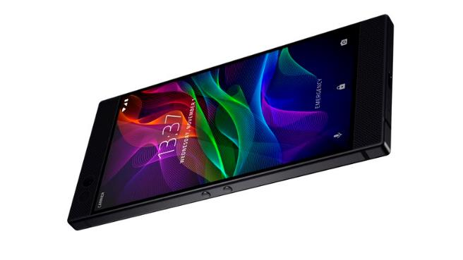
Why Not Just Fly COTS Computers?

Slide 6
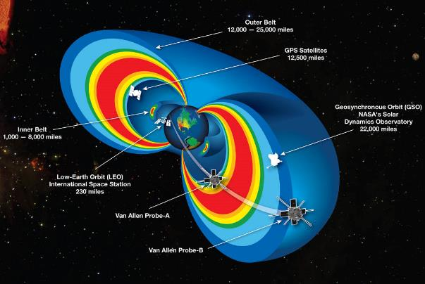
Why Not Just Fly COTS Computers?
Space is Harsh
Earth is Protected
Particle Type | Energy Range
Trapped protons and electrons | ≤ 100 MeV
Alpha particles | 5 MeV
Solar protons | ≤ 1 GeV
Cosmic rays | ≥ 1 GeV

Slide 7
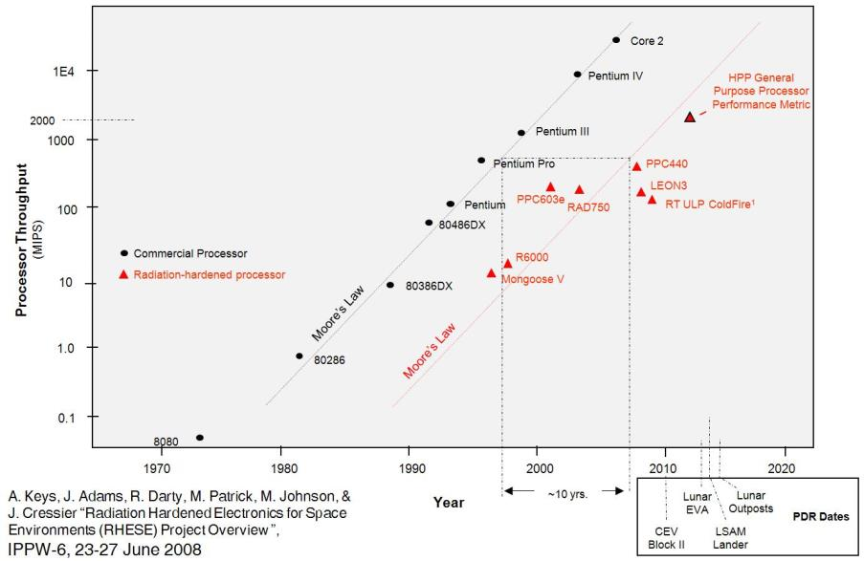
How we currently handle the effects?
The Issue with Existing Techniques
  The unique processing techniques lowers the volume, which increases cost.
  The unique processing techniques reduces the performance.
- Rad-Hardened Processers lag in performance to their commercial counterparts by ~10 years

Slide 8
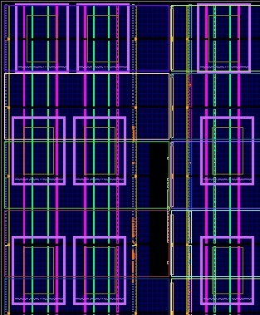
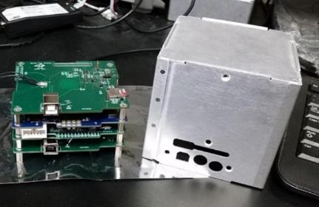
MSU’s Approach
Fault Tolerance Through Abundant Spares
  Use <65nm process node to achieve TID tolerance.
  Triple Modular Redundancy + Spares
    3 Tiles run in TMR with the rest reserved as spares
  Spatial Avoidance and Background Repair
    If TMR detects a fault, the damaged tile is replaced with a spare and foreground operation continues
    The tile is “repaired” in the background via partial reconfiguration (PR).
  Scrubbing
    Blind scrubbing continually runs through tiles (fast)
    Readback scrubbing periodically runs through rest of fabric (slower)
FPGA Floor Plan
Build as a SmallSat Computer

Slide 9
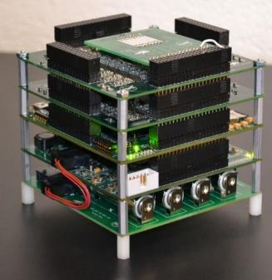
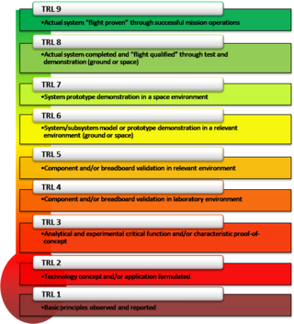
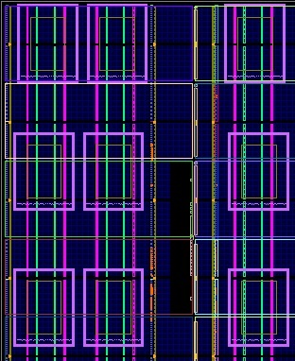
Ok, Now Test It…
Technical Readiness Level (TRL)

Slide 10
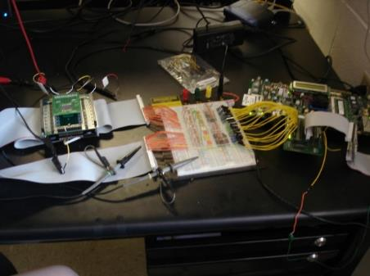
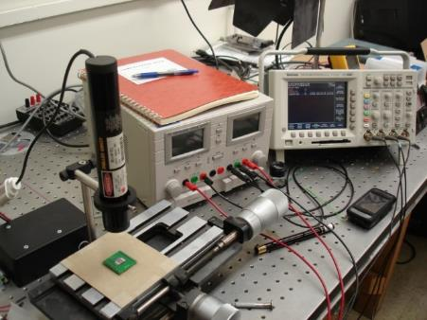
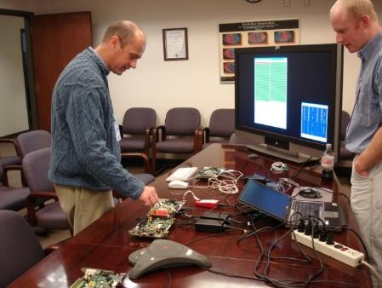

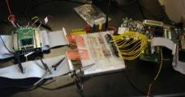
Technical Readiness Level (TRL-1/2)
Step 1 – Build a Prototype to See if it is Possible
  The Montana Space Grant Consortium funds an investigation into conducting radiation tolerant computing research at MSU. The goal is to understand the problem, propose a solution, and build relationships with scientists at NASA.
Clint Gauer (MSEE from MSU 2009) demo’s computer to MSFC Chief of Technology Andrew Keys
Timeline of Activity at MSU
Proof of Concept
(2008-2010)
2008
2009
2010
2011
2012
2013
2014-16
2016
2017-20

Slide 11
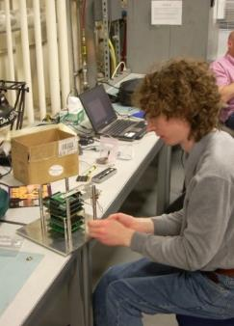
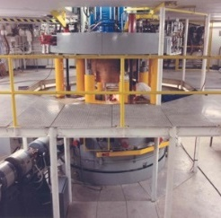
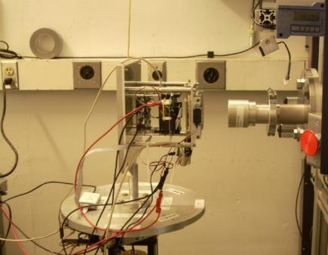

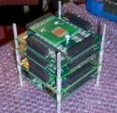
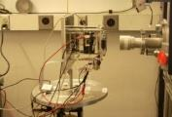
Technical Readiness Level (TRL-3)
Step 2 –Test in a Cyclotron
  NASA EPSCoR funds the development of a more functional prototype and testing
  under bombardment by radiation at the Texas A&M Radiation Effects Facility.
MSU Computer
Ray Weber (Ph.D., EE from MSU, 2014) prepares experiment.
Timeline of Activity at MSU
Proof of Concept
Prototype Development & Cyclotron Testing
(2008-2010)
(2010-2012)
2008
2009
2010
2011
2012
2013
2014-16
2016
2017-20

Slide 12
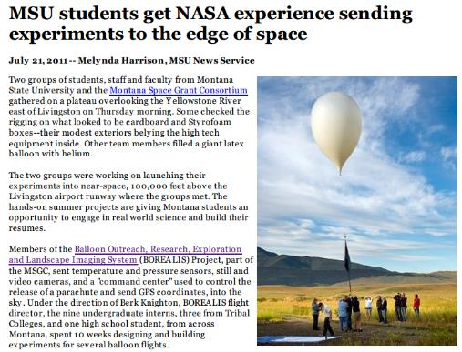
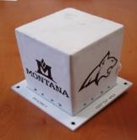
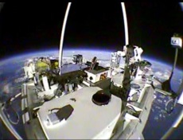
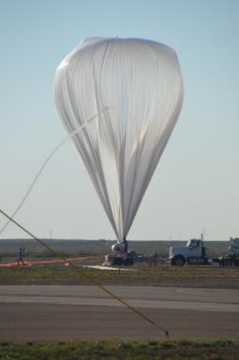
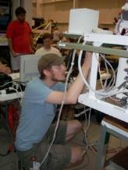

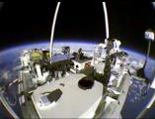
Technical Readiness Level (TRL-5)
Step 3 – Demonstrate as Flight Hardware on High Altitude Balloons
  NASA Education Office funds the development of the computer into flight hardware for demonstration on high altitude balloon systems, both in Montana and at NASA.
MSU
Computer
Timeline of Activity at MSU
Justin Hogan (Ph.D., EE from MSU, 2014) prepares payload.
Proof of Concept
Prototype Development & Cyclotron Testing
High Altitude Balloon Demos
(2008-2010)
(2010-2012)
(2011-2013)
2008
2009
2010
2011
2012
2013
2014-16
2016
2017-20

Slide 13
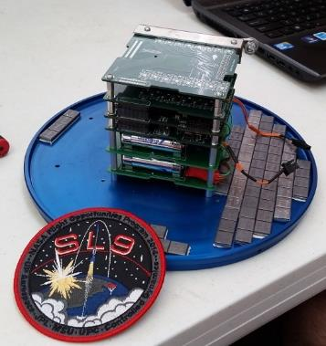
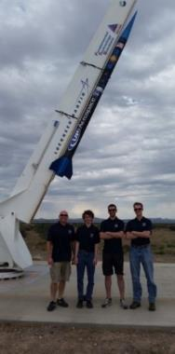

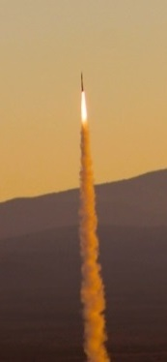
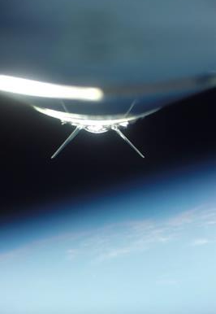
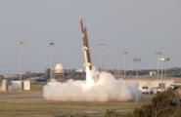
Technical Readiness Level (TRL-6)
Step 4 – Demonstrate as Flight Hardware on a Sounding Rocket
  NASA OCT & FOP fund the demonstration of the computer system on sounding rocket.
  Flew on UP Aerospace SpaceLoft-9 in Oct 2014.
MSU
Computer
Timeline of Activity at MSU
Proof of Concept
Prototype Development & Cyclotron Testing
High Altitude Balloon Demos
Sounding
Rocket Demo
(2008-2010)
(2010-2012)
(2011-2013)
(2012-2016)
2008
2009
2010
2011
2012
2013
2014-16
2016
2017-20

Slide 14
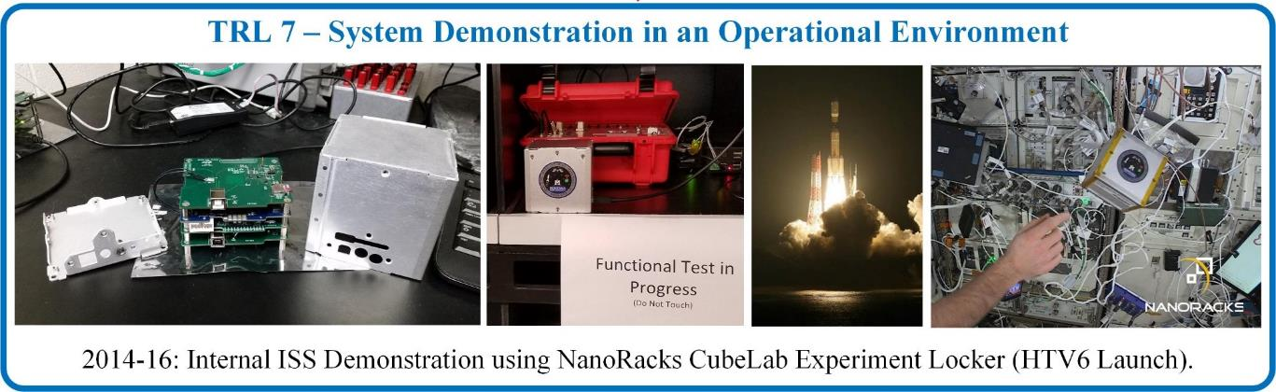
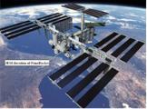
Technical Readiness Level (TRL-7)
Step 5 – Demonstrate on the International Space Station
  NASA EPSCoR funds the demonstration of computer system on ISS
Timeline of Activity at MSU
Proof of Concept
Prototype Development & Cyclotron Testing
High Altitude Balloon Demos
Sounding
Rocket Demo
ISS
Demo
(2008-2010)
(2010-2012)
(2011-2013)
(2012-2016)
(2014-2016)
2008
2009
2010
2011
2012
2013
2014-16
2016
2017-20

Slide 15

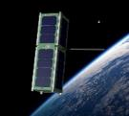
Technical Readiness Level (TRL-8)
Step 6 – Demonstrate as a Stand-Alone Satellite
  NASA SmallSat Technology Partnership Program (SSTP) funds the planning for a stand-alone satellite demonstration of the computer technology.
  NASA Undergraduate Student Instrument Program (USIP) funds a team of undergraduates to build the satellite and prepare for deployment.
  NASA CubeSat Launch Initiative (CSLI) selects RadSat-g for launch on ELaNa-23 mission on CRS-OA9.
  NASA ISS EPSCoR funds building the flight unit, delivering to the launch provider, and operating the satellite post-deployment.
Timeline of Activity at MSU
Proof of Concept
Prototype Development & Cyclotron Testing
High Altitude Balloon Demos
Sounding
Rocket Demo
ISS
Demo
Satellite
Demo
(2008-2010)
(2010-2012)
(2011-2013)
(2012-2016)
(2014-2016)
(2015-2018)
2008
2009
2010
2011
2012
2013
2014-16
2016
2017-20

Slide 16
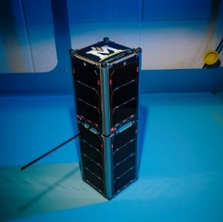
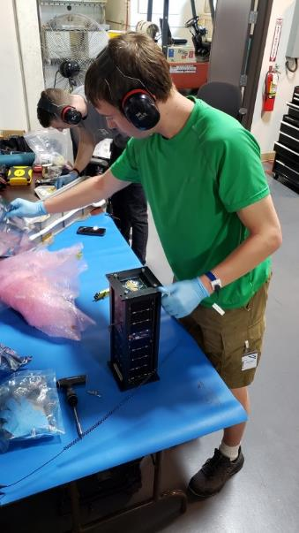
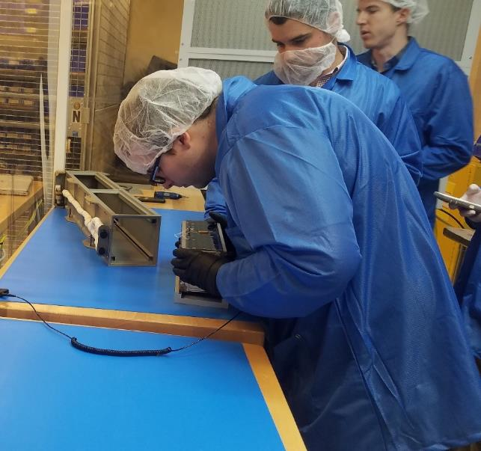
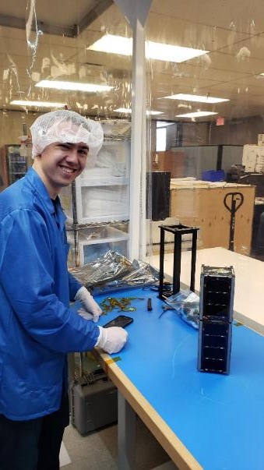
RadSat Mission Concept
Students Build It

Slide 17
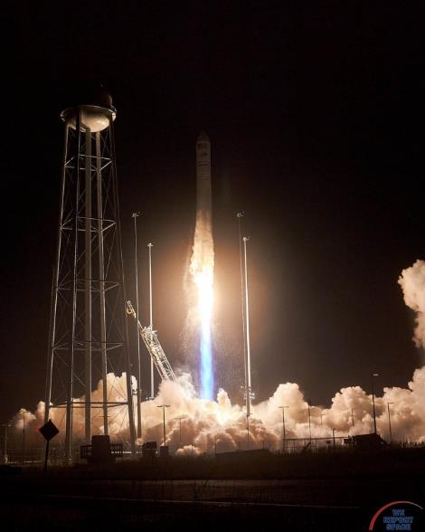
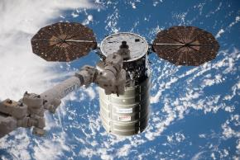
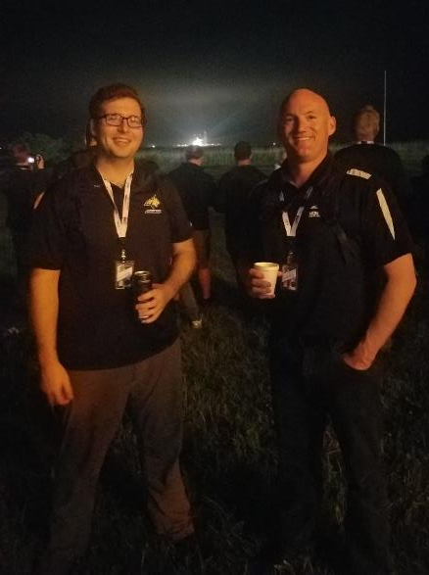
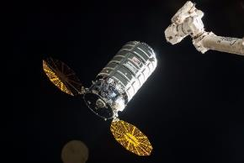
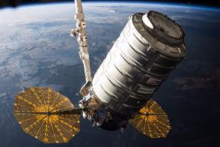
RadSat Mission Concept
Students Build It
Launch it to the International Space Station

Slide 18



RadSat Mission Concept
Students Build It
Launch it to the International Space Station
Put into Orbit using NanoRacks CubeSat Deployer

Slide 19



RadSat Mission Concept
Students Build It
Launch it to the International Space Station
Put into Orbit using NanoRacks CubeSat Deployer
Operate from SSEL Ground Station

Slide 20










~150 Students Involved
Everything was Designed and Built By MSU Students
Todd Buerkle, Justin Hogan, Ray Weber at Johnson Space Center for demo, 2012.
Todd Buerkle & Jennifer Hane demo computer at Marshall Space Flight Center, 2012.
Justin Hogan at the NASA Columbia Scientific Balloon Facility, 2012.
Clint Gauer at Marshall Space Flight Center for demo, 2009.
Clint Gauer demo’s computer at Marshall Space Flight Center, 2009.
Kaysha Young prepares payload for balloon flight, 2012.
2011 balloon team featured in MSU news story, 2011.
Todd Buerkle, Jennifer Hane at the Marshall Space Flight Center, 2011.
2013 balloon team recovers payload in front of moose, 2013.
Justin Hogan & Ray Weber featured in MSU News Story, 2012.

Slide 21






What’s Next for MSU Students?

Slide 22


Professor Reflections
The Pros…
  Fantastic experience for students.
  They are HIGHLY recruited.
  High profile for the university.

Slide 23
Professor Reflections
The Pros…
  Fantastic experience for students.
  They are HIGHLY recruited.
  High profile for the university.
The Cons…
  Graduation kills productivity.
  (the experience often displaces results)
  Keeping funding going is piecemeal and exhausting.
  (The work I showed represents 14 different grants)
  NASA schedules don’t match academic calendars.

Slide 24

Professor Reflections
The Pros…
  Fantastic experience for students.
  They are HIGHLY recruited.
  High profile for the university.
The Cons…
  Graduation kills productivity.
  (the experience often displaces results)
  Keeping funding going is piecemeal and exhausting.
  (The work I showed represents 14 different grants)
  NASA schedules don’t match academic calendars.
The Box Score
  It’s worth it!

Slide 25






Questions
MSU Computer
MSU Computer
MSU Computer
MSU Computer

