Slide 1
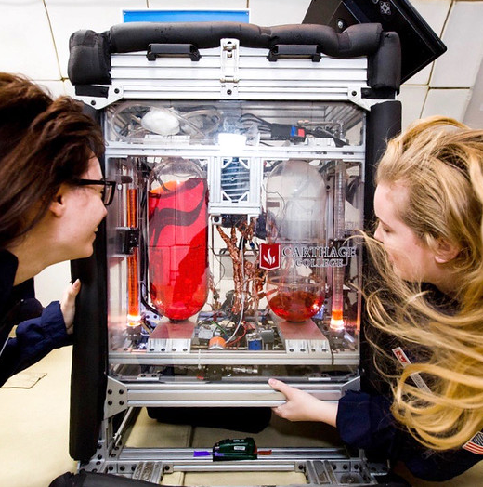
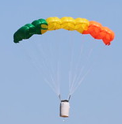
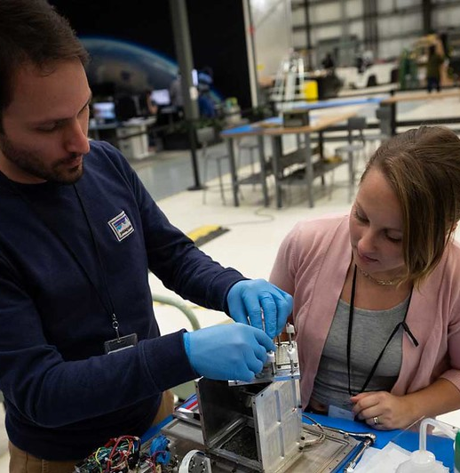
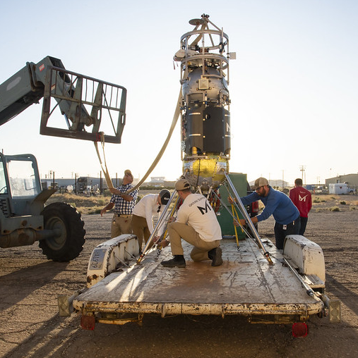
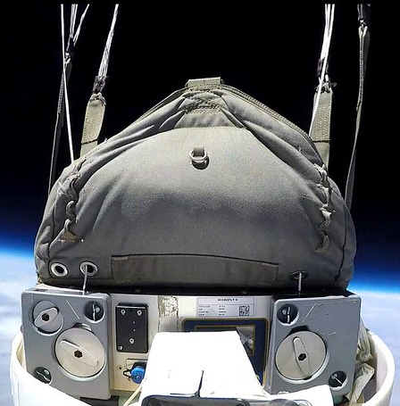
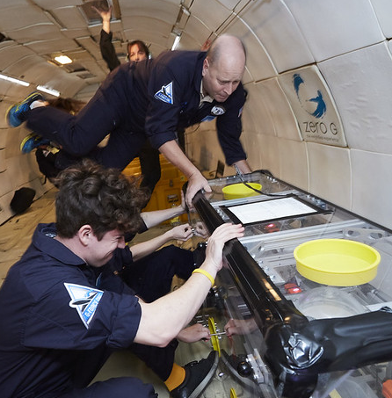
Tips for Preparing Proposals for Payload Flight Testing
NASA Flight Opportunities
Stephan Ord, NASA Flight Opportunities
Brock LaMeres, Ph.D., Montana State University
Community of Practice Webinar Series – February 3, 2021
Session will start at 10 a.m. PT – Please mute your microphone and turn off your camera

Slide 2
Welcome to the Community of Practice Webinar Series!
First, a bit of housekeeping…​
Please mute your microphone and turn off your camera​
Today’s session will be recorded​
Recordings for this and all future sessions will be posted on the Flight Opportunities website​
Please engage!​
  Use the chat throughout the session to ask questions

Slide 3
Welcome to the Community of Practice Webinar Series!​
Flight Opportunities hopes these webinars will enable researchers, program staff, and flight providers to connect informally and share information​
Designed to distill and share the most important lessons learned to:​
  Increase the impact of suborbital flight tests​
  Transfer best practices​
  Optimize the experience of current and prospective program participants​
Part of a broad effort to capture, organize, and communicate lessons learned by suborbital researchers​
An opportunity to hear from subject matter experts on best practices for preparing for suborbital flight tests​

Slide 4
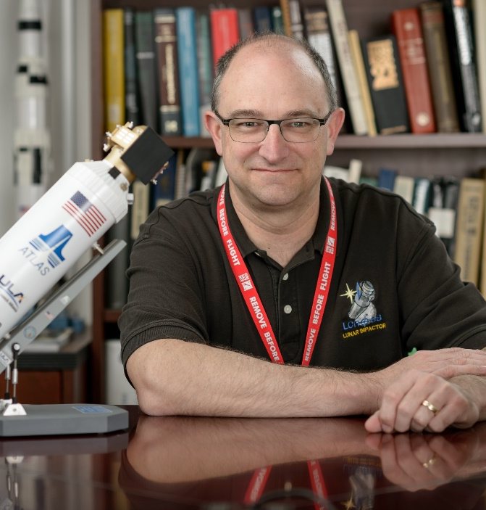

Today’s Speakers
Picture
Picture
Stephan Ord
Chief Technologist
NASA’s Flight Opportunities Program
Brock LaMeres
Professor | Electrical & Computer Engineering
Director | Montana Engineering Education Research Center
Montana State University

Slide 5
Proposal Tips for Suborbital Testing with Flight Opportunities
NASA Flight Opportunities
Stephan Ord, Chief Technologist, Flight Opportunities | February 2021

Slide 6
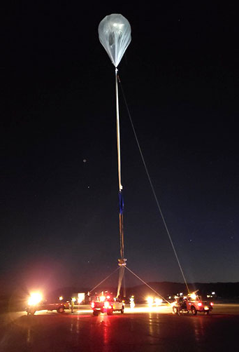
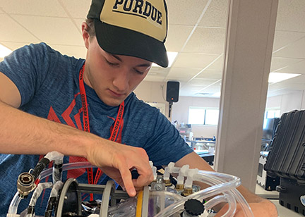
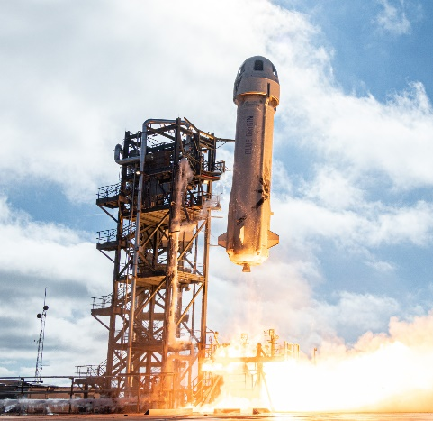
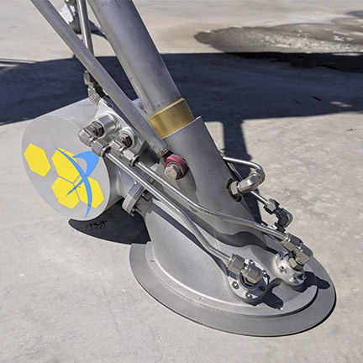

Flight Opportunities mission
The Flight Opportunities program facilitates rapid demonstration of promising technologies for space exploration, discovery, and the expansion of space commerce through suborbital testing with industry flight providers.

Slide 7
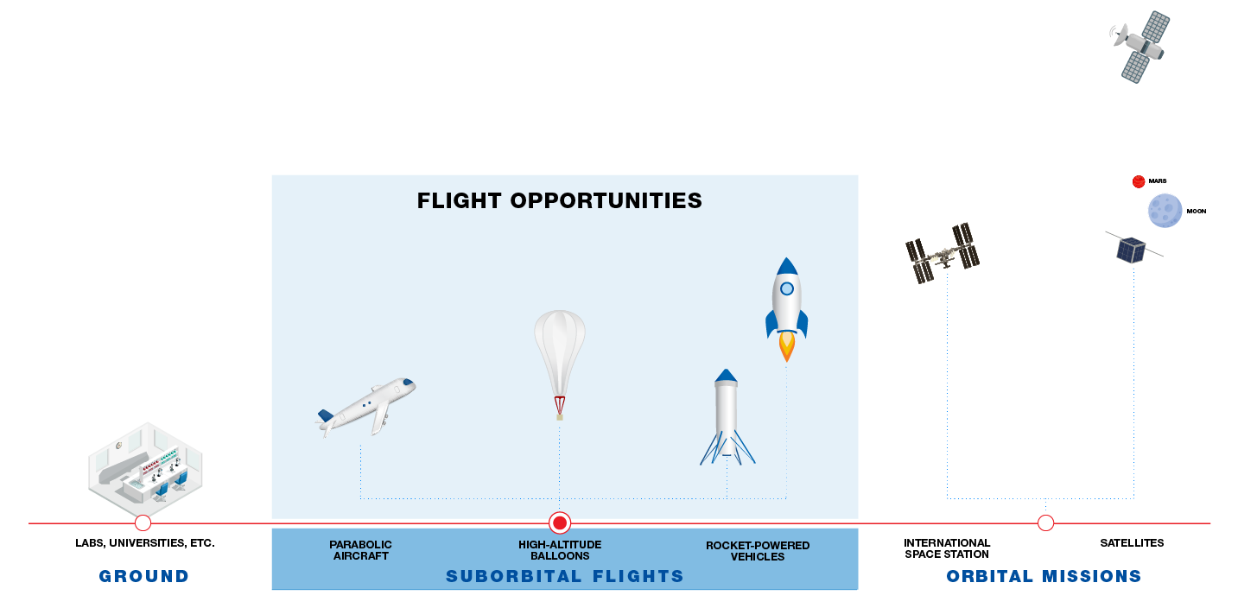
Suborbital flights – a step on the way to orbit

Slide 8
Accessing suborbital flights
Tech Flights Solicitation
  Awards and agreements for flight tests are open to researchers from industry, academia, and non-profit research institutes.
  Awardees select a flight provider of their choice and work directly with this provider.
NASA’s Established Program to Stimulate Competitive Research (EPSCOR)
  An amendment to the existing 2021 EPSCoR International Space Station Flight Opportunity solicitation allows proposal of suborbital flights to further EPSCoR-funded research.
  Proposals are due by February 22, 2021 (more info on NSPIRES).
Small Business Innovation Research (SBIR) and Small Business Technology Transfer (STTR)
  Flight Opportunities can be an “external investor” for SBIR/STTR Post Phase II activities with suborbital flight testing.
  Funds can be used for services from any viable U.S. commercial flight vendor that best meets the project’s needs.
NASA-Supported Technology Development
  NASA researchers should reach out to Flight Opportunities at any time to discuss their need for suborbital flight tests.
Notes:
There are several funding sources available to external entities only
Encourage your partners to pursue this funding
It is a great way for NASA to leverage these partners to achieve its tech development goals
PI Launchpad: Developing Your First Flight Mission Proposal
Applications due via NSPIRES: March 22, 2021
Workshop Dates: June 14th-June 25th
Are you thinking about developing your first flight mission proposal in the next few years but have no idea where to start? If you are a researcher or engineers who would like to submit a NASA space mission proposal in the next few years but don’t know where to start, this June virtual workshop is for you! We are interested in broadening the pool of potential NASA space mission PIs. People with marginalized identities are strongly encouraged to apply. There is no cost to attend the workshop.

Slide 9
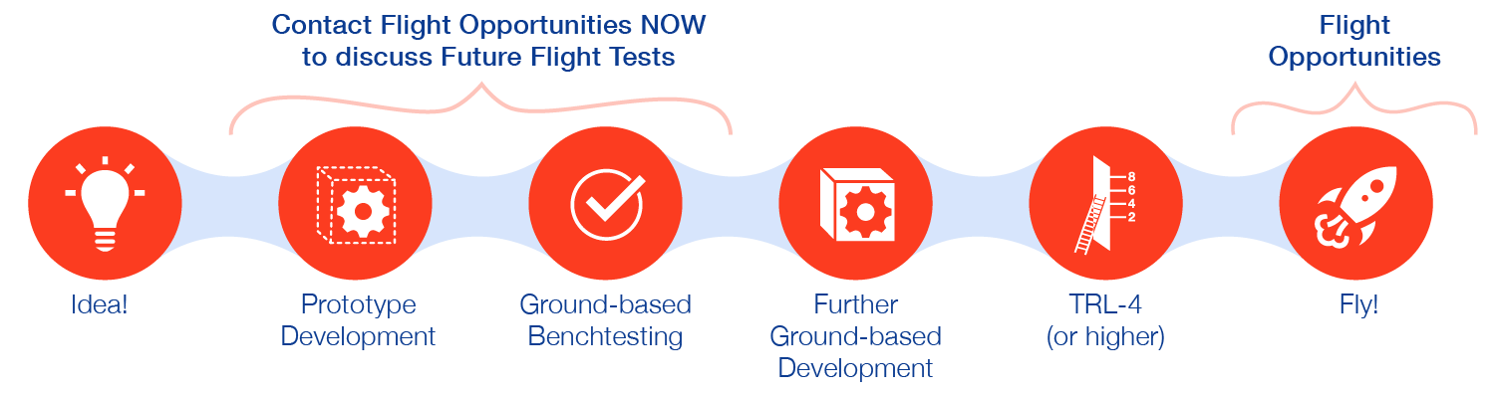
Talk to us at any time!
Get in touch with Flight Opportunities early in the technology development cycle
Talk with us about technologies in development
Identify the earliest opportunities to fly prototypes and preliminary hardware
Discuss the best available flight platforms/profiles to help de-risk key components of hardware or software
Contact Stephan Ord, Chief Technologist for Flight Opportunities, to learn more: stephan.f.ord@nasa.gov
Notes:
E.g., GCD stuff, stuff that NASA is already funding
Come talk to us, we can find a way to get your stuff matured

Slide 10
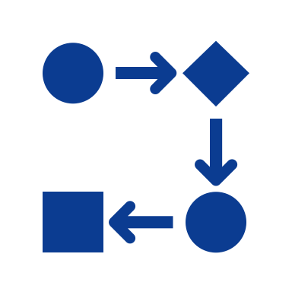




Tips for successful Tech Flights proposals
Communicate the connection to NASA's goals
How will your technology and flight experiment benefit NASA's missions and the agency's strategic goals? Stay up to date on NASA's priorities and clearly communicate how your technology may help the agency achieve them.
Explain why
your technology is outstanding
Know the state of the art, and clearly explain why your technology is superior to what has been done before – or may be superior by maturing the technology via flight testing.
State your case for flight
Why does your experiment need a test flight, and why now? Communicate what you will learn or gain by doing a flight experiment and why it cannot be done on the ground.
Don’t overlook
the basics
Pay close attention to flight plan and cost details, and word/page limits. (Extra pages are eliminated and will not be reviewed by the selection committee, regardless of the information they contain.)
Be clear and
to the point
Make sure your writing is clear and cogent. Ask for peer reviews to give feedback before you submit your proposal, and make sure you allow enough time to make revisions before the deadline.

Slide 11
Best practices for preparing for a solicitation
1
Leverage the Flight Opportunities website.
Review Q&A presentation from prior solicitation.
Check out the Resources page on the website, which has program factsheets, annual reports, and more.
Review previous solicitations, keeping in mind that each solicitation may vary.
Subscribe to the Flight Opportunities newsletter and monitor NSPIRES to keep up with the latest news about calls and solicitations.
Gather your proposal information and line up colleagues to help with peer reviews.
Reach out to fellow community members.
2
3
4
www.nasa.gov/flightopportunities

Slide 12
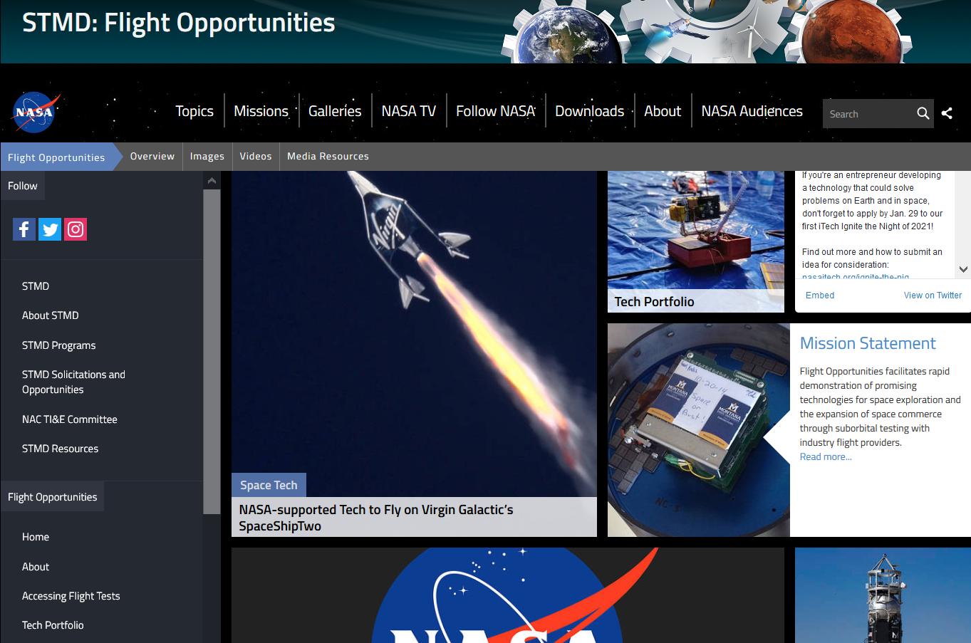
Leverage the Flight Opportunities community
Search the technology portfolio
Identify technologies similar to yours
Familiarize yourself with tests performed on various vehicles
Identify community members to connect with
www.nasa.gov/flightopportunities

Slide 13
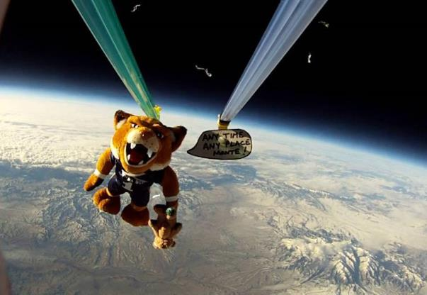


RadPC – Radiation Tolerant Computer
Technology Maturation Through the NASA Flight Opportunities Program
Principal Investigator
Dr. Brock LaMeres
Montana State University

Slide 14
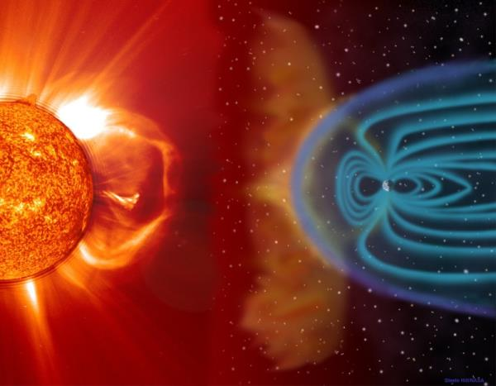
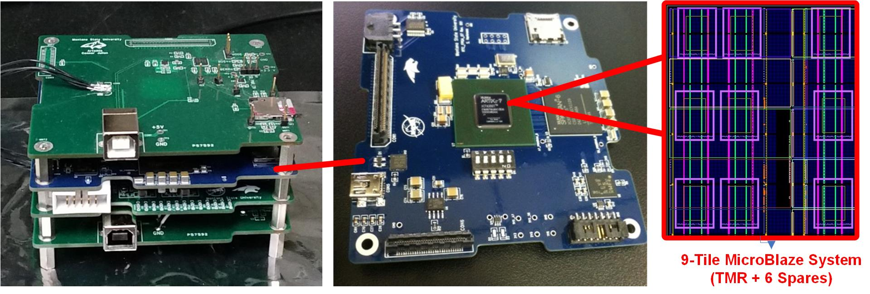
RadPC
A Novel Computer Architecture Implemented on a COTS FPGA
  A modern COTS part (<65nm) provides ~600krad TID immunity inherently.
  A modern COTS parts significantly reduces cost over custom, “Rad-Hard” parts.
  SEUs are handled via the redundant processing cores, each that can be partially reconfigured to a healthy state if faulted by radiation.

Slide 15
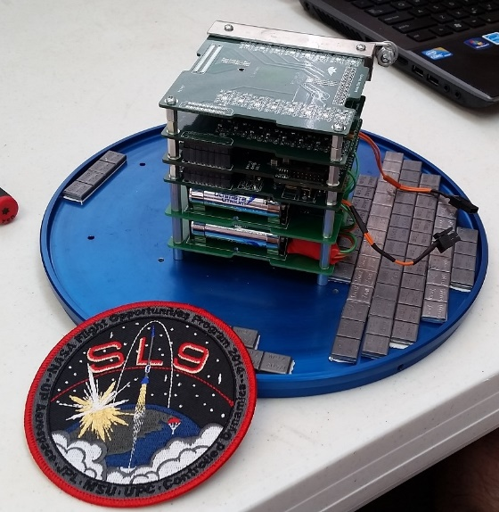
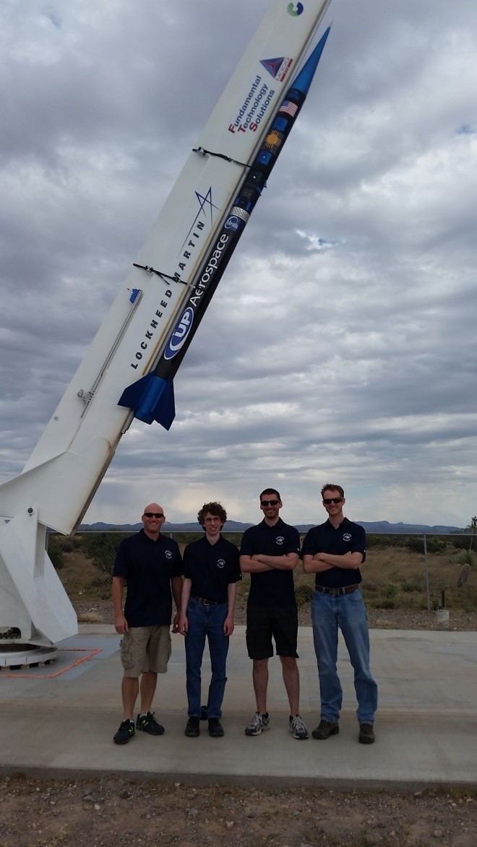
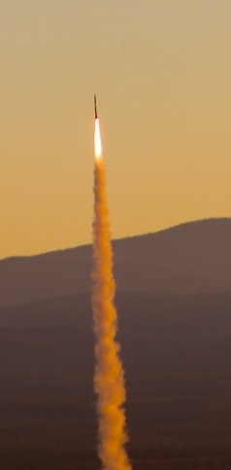
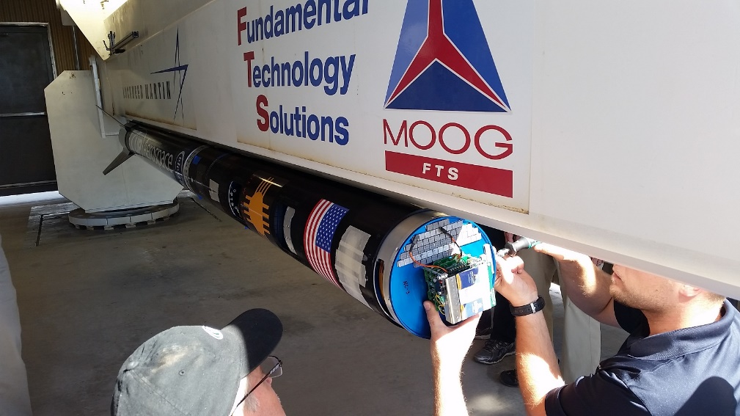
Flight Opportunities Testing
Sounding Rocket Testing #1
  Flown on an UP Aerospace vehicle on 10/23/2014 out of New Mexico.

Slide 16
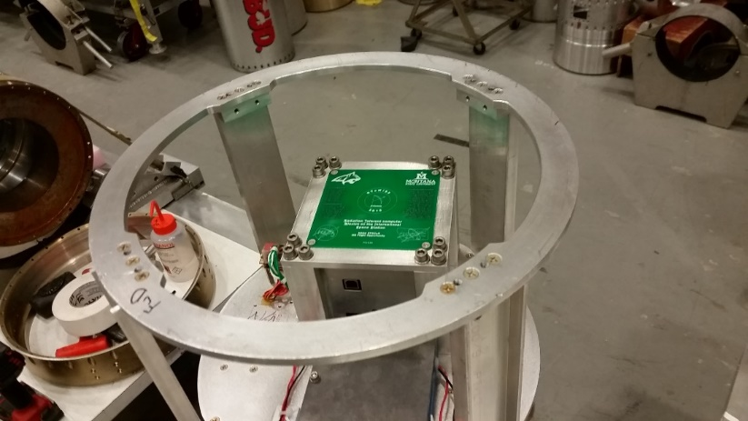
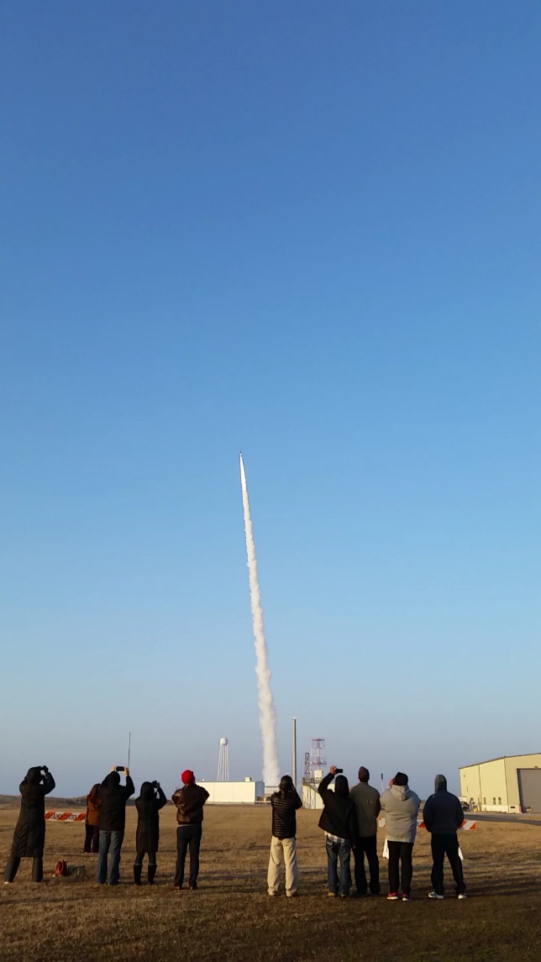
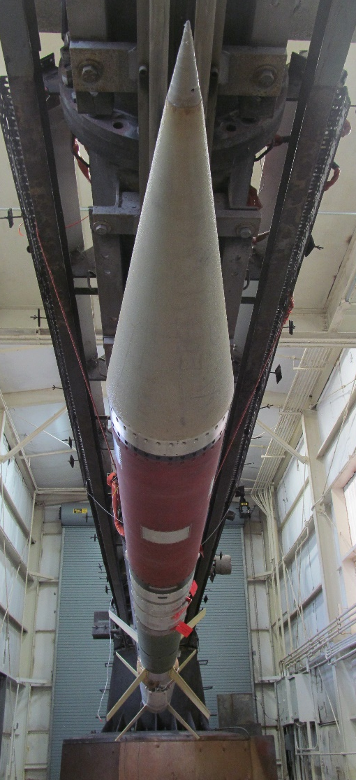
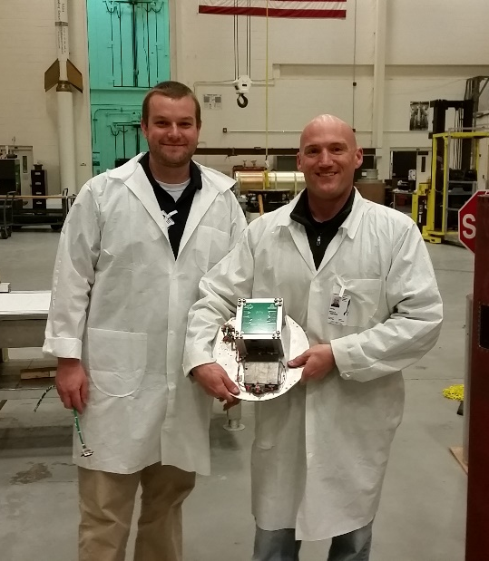
Flight Opportunities Testing
Sounding Rocket Testing #2
  Flown on a NASA Terrier-Orion vehicle on 3/7/2016 out of Wallops.

Slide 17
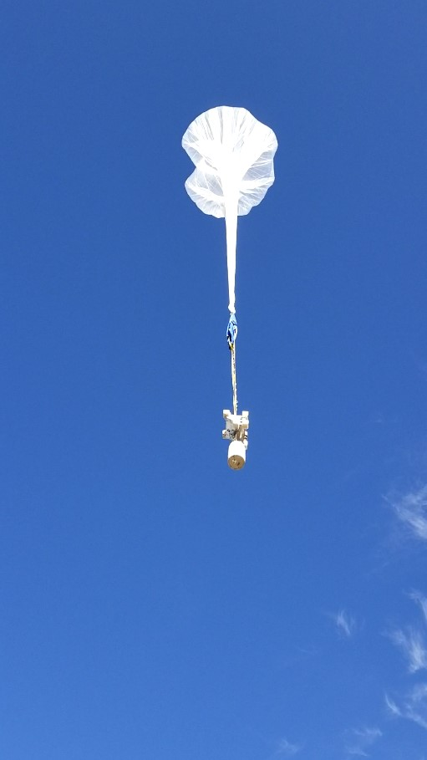
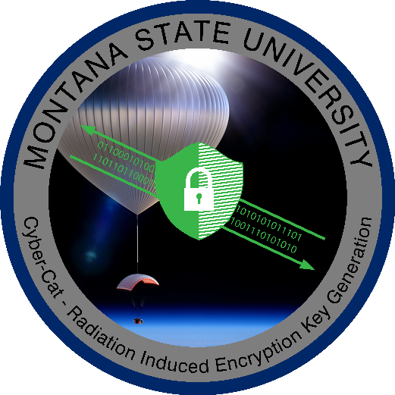
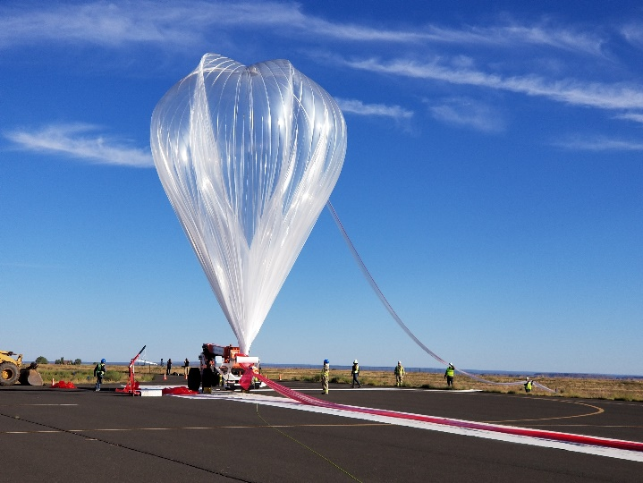
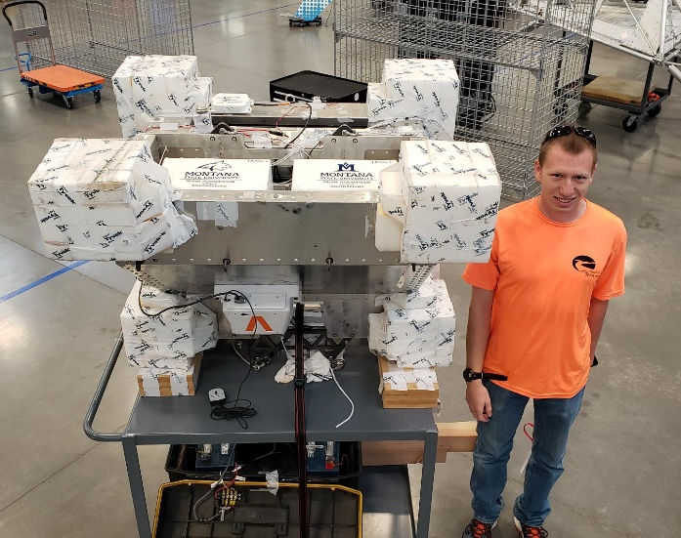
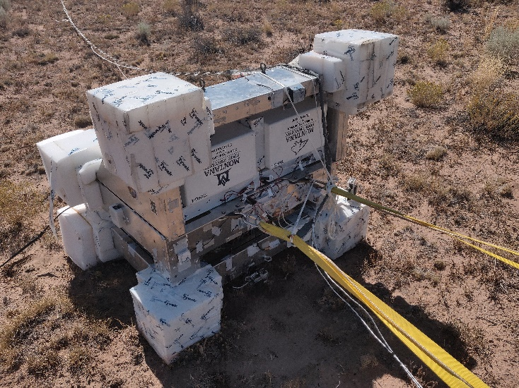
Flight Opportunities Testing
High Altitude Balloon Testing #1
  Flown on a World View Stratocraft on 9/22/2019.

Slide 18
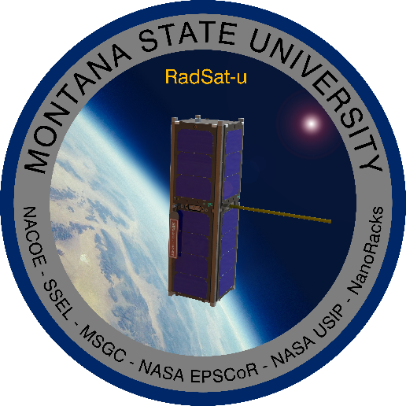
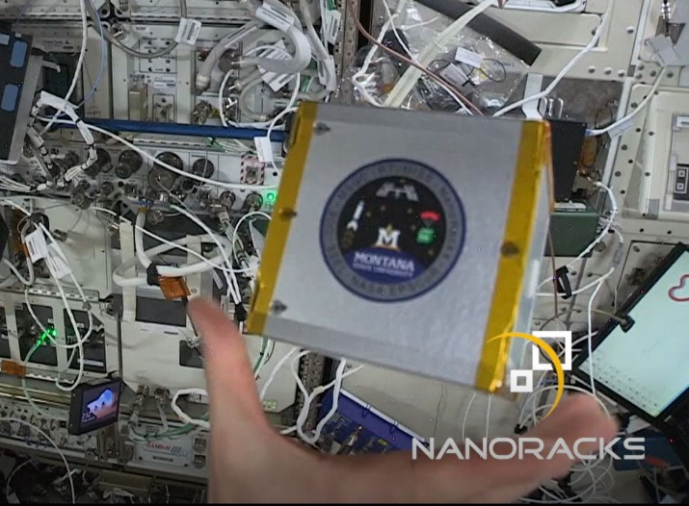
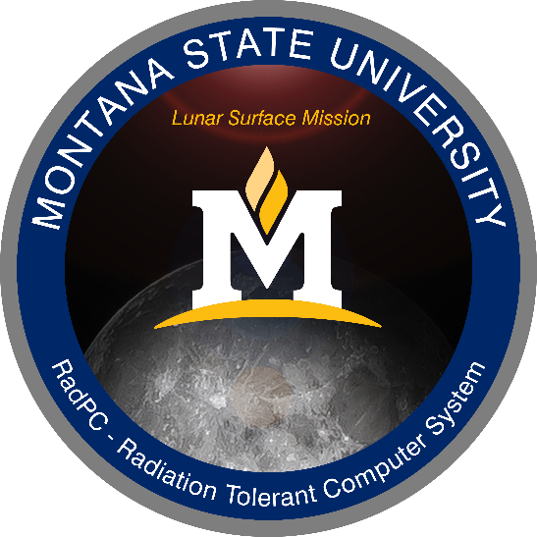
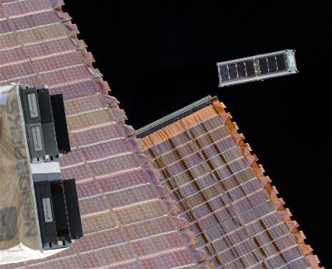
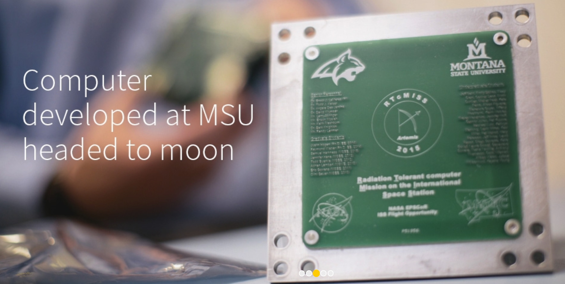
What’s Next for RadPC?
FOP Enabled Demos on CubeSats, the ISS, and the Moon

Slide 19

Join us for future Community of Practice webinars!
Look for the March topic in our newsletter & on the website
March 3, 2021 at 10 a.m. PST ​
Future webinars​
Webinars are held 1st Wednesday of each month at 10 a.m. PT​
Topics will be announced in the Flight Opportunities newsletter and website​
Session recordings will be posted on the Flight Opportunities website​
Let us know session topics you would like to see covered

Slide 20
Thank you!
Flight Opportunities website: http://nasa.gov/flightopportunities
Contact us:
NASA-FlightOpportunities@mail.nasa.gov

