Slide 1



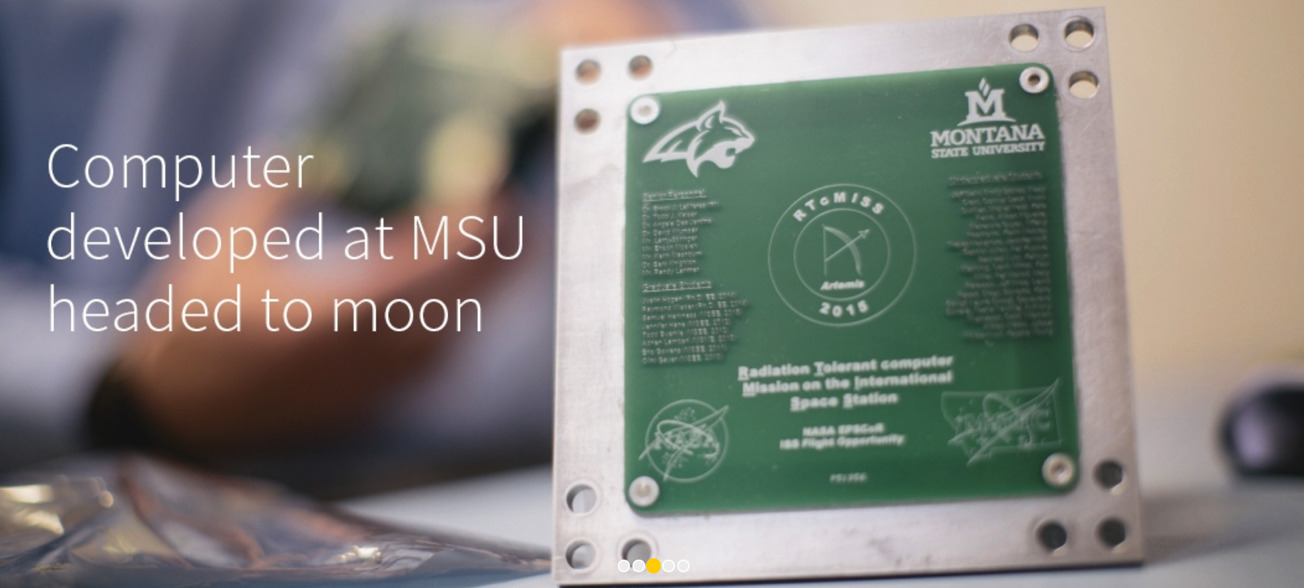
Building Computers for the Moon and Beyond…
Dr. Brock J. LaMeres
Professor, Electrical & Computer Engineering
Director, MT Engineering Education Research Center
Boeing Professor of Engineering Education

Slide 2


Tonight
The Long Road…

Slide 3
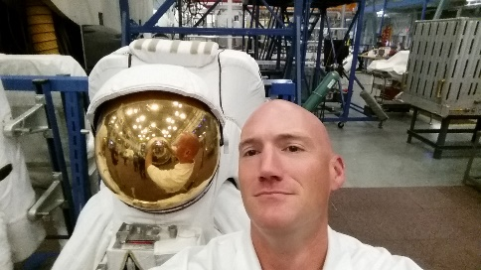
A little bit about me…

Slide 4


A little bit about me…

Slide 5


A little bit about me…
Class of 98

Slide 6

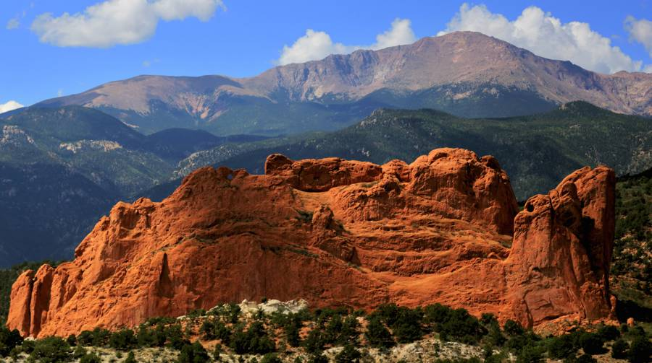

A little bit about me…
Class of 98

Slide 7

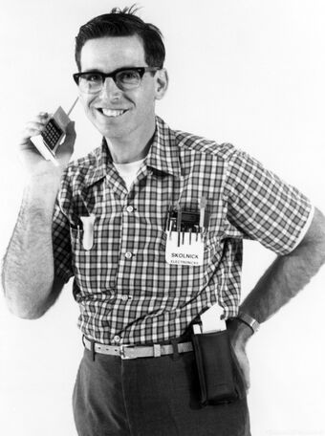
A little bit about me…
Class of 98
17 years later…

Slide 8
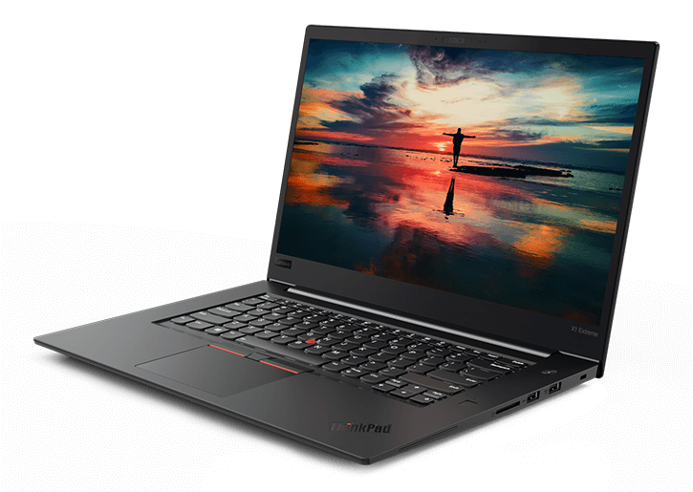
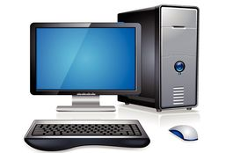
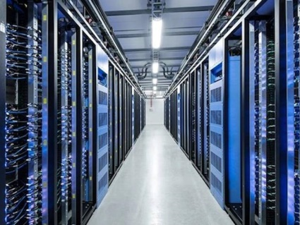
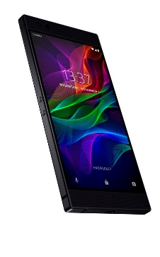
Brock’s Computer Research
Can you image life without a computer?
  What images do you conjure when someone says “computer”?

Slide 9
Brock’s Computer Research
Can you image life without a computer?
  What images do you conjure when someone says “computer”?
  There were ~400M personal computers sold in 2018.
  There were ~1.5B smart phones sold in 2018 (1.3B Android, 0.2B iOS)

Slide 10
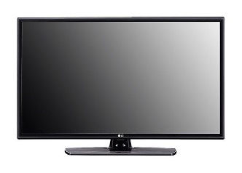
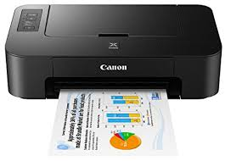
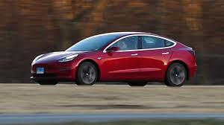
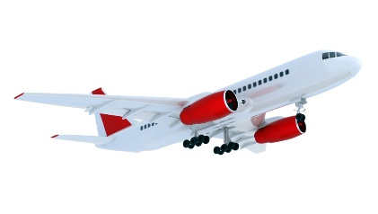
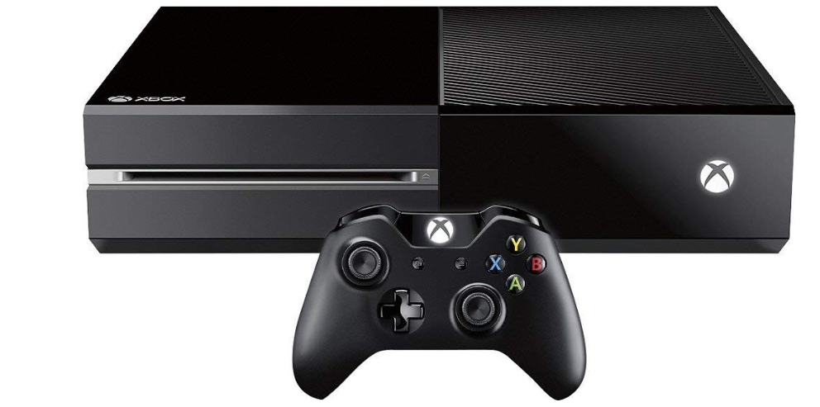

Brock’s Computer Research
Can you image life without a computer?
  What images do you conjure when someone says “computer”?
  There were ~400M personal computers sold in 2018.
  There were ~1.5B smart phones sold in 2018 (1.3B Android, 0.2B iOS)
But what about these things?

Slide 11
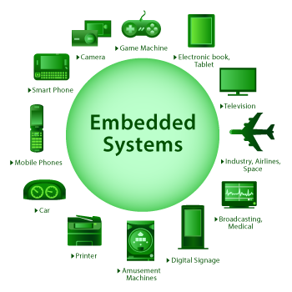
Brock’s Computer Research
Can you image life without a computer?
  What images do you conjure when someone says “computer”?
  There were ~400M personal computers sold in 2018.
  There were ~1.5B smart phones sold in 2018 (1.3B Android, 0.2B iOS)
But what about these things?
  There were 25B embedded computers sold in 2018.

Slide 12
Brock’s Computer Research
Our Existing Computers Work Well. What’s the Problem?

Slide 13
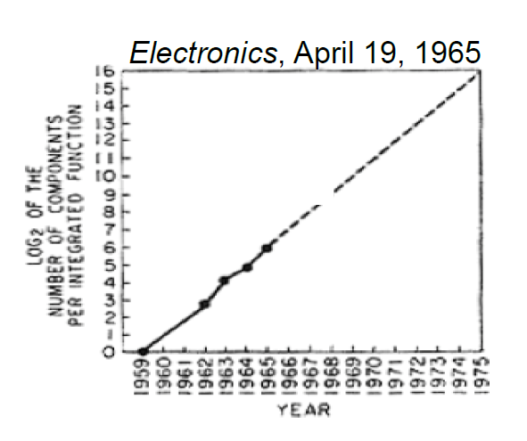
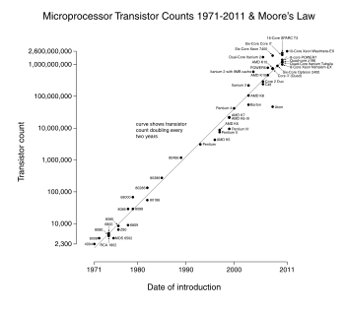
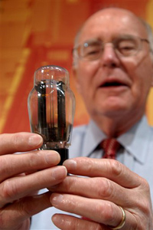
Brock’s Computer Research
Our Existing Computers Work Well. What’s the Problem?
  Our existing computers have benefited from 40+ years of Moore’s Law.
  In the 1960’s, Gordon Moore predicted that the number of transistors on a chip would double every ~24 months.
1959 - 1965
1971* - 2011
Gordon Moore, co-founder of Intel, holding a vacuum tube.
Note: First microprocessor introduced in 1971,
the Intel 4004 with 2300 transistors.

Slide 14
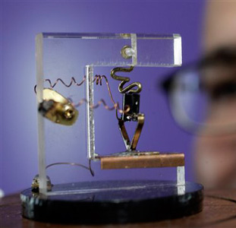
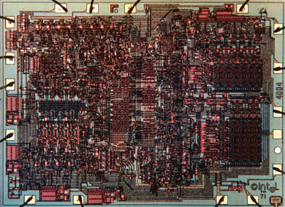
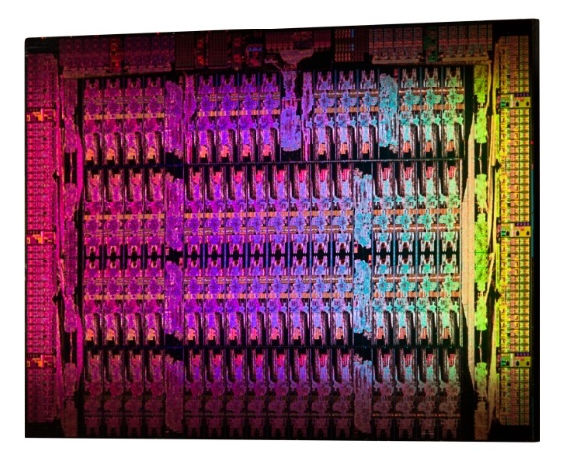
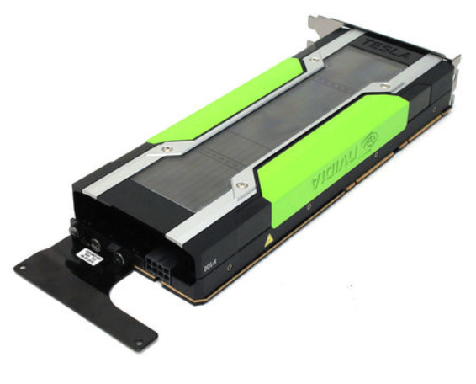
Brock’s Computer Research
Why is Moore’s Law so Cool?
  Our general-purpose computer model has gotten smaller, faster, and more power efficient every 24 months.
  This has allowed faster operation and more sophisticated software to be executed.
  and
  prevented any major overhaul in the way we do things…
1947 (1 transistor)
1971 (2300 transistors)
2012 (5B transistors)
2019 (15B transistors)
Replica of the First Transistor
(Source: AP Photo Paul Sakuma)
Intel 4004, 10um
(Source: newsroom.intel.com)
Intel Xeon Phi, 22nm
(Source: newsroom.intel.com)
NVIDIA Pascal GPU
(Source: invidia.com)

Slide 15
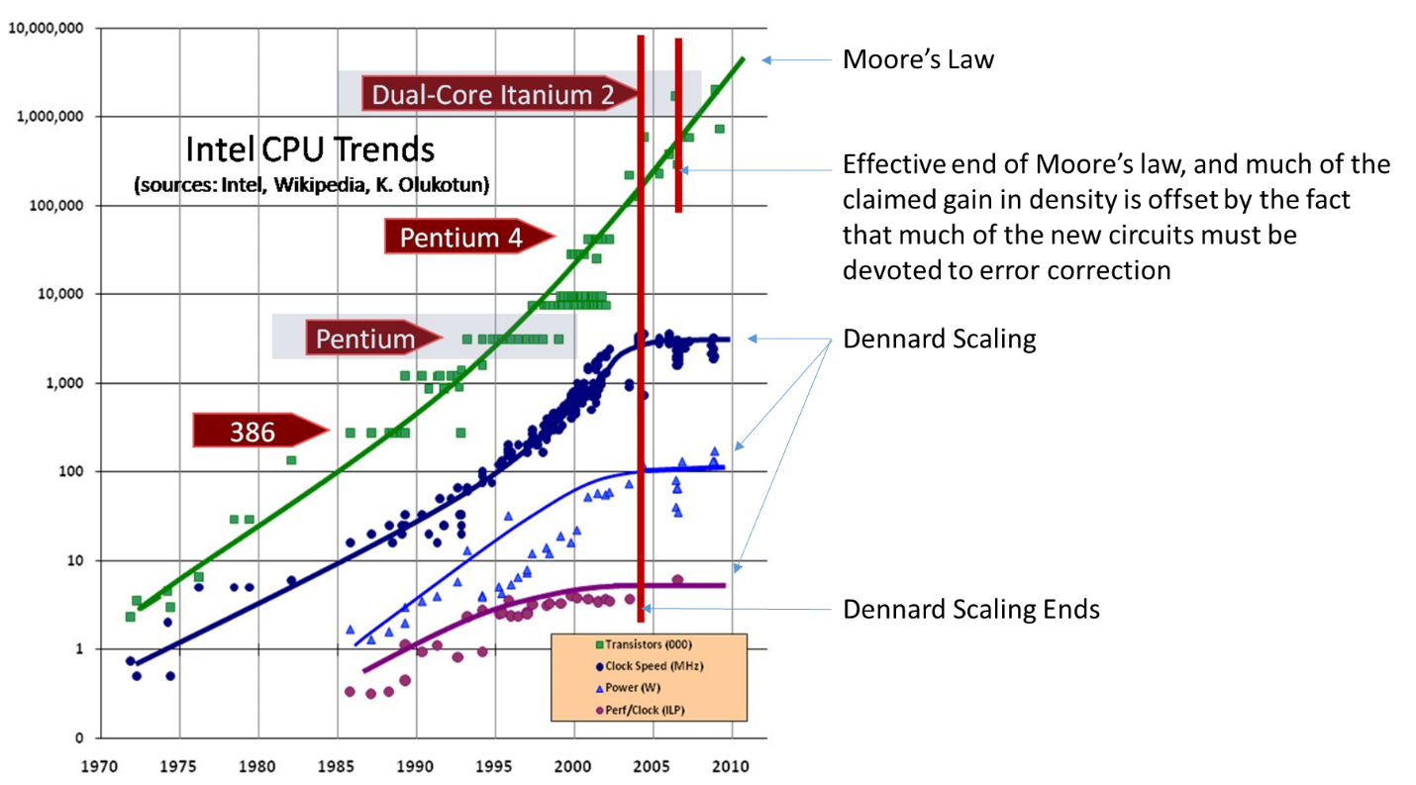
Brock’s Computer Research
When will Moore’s Law End?
  Most exponentials do come to an end.
Clock Speed
Power
Performance per Clock Cycle

Slide 16

Brock’s Computer Research
When will Moore’s Law End?
  Most exponentials do come to an end.
So it’s over?
Clock Speed
Power
Performance per Clock Cycle

Slide 17
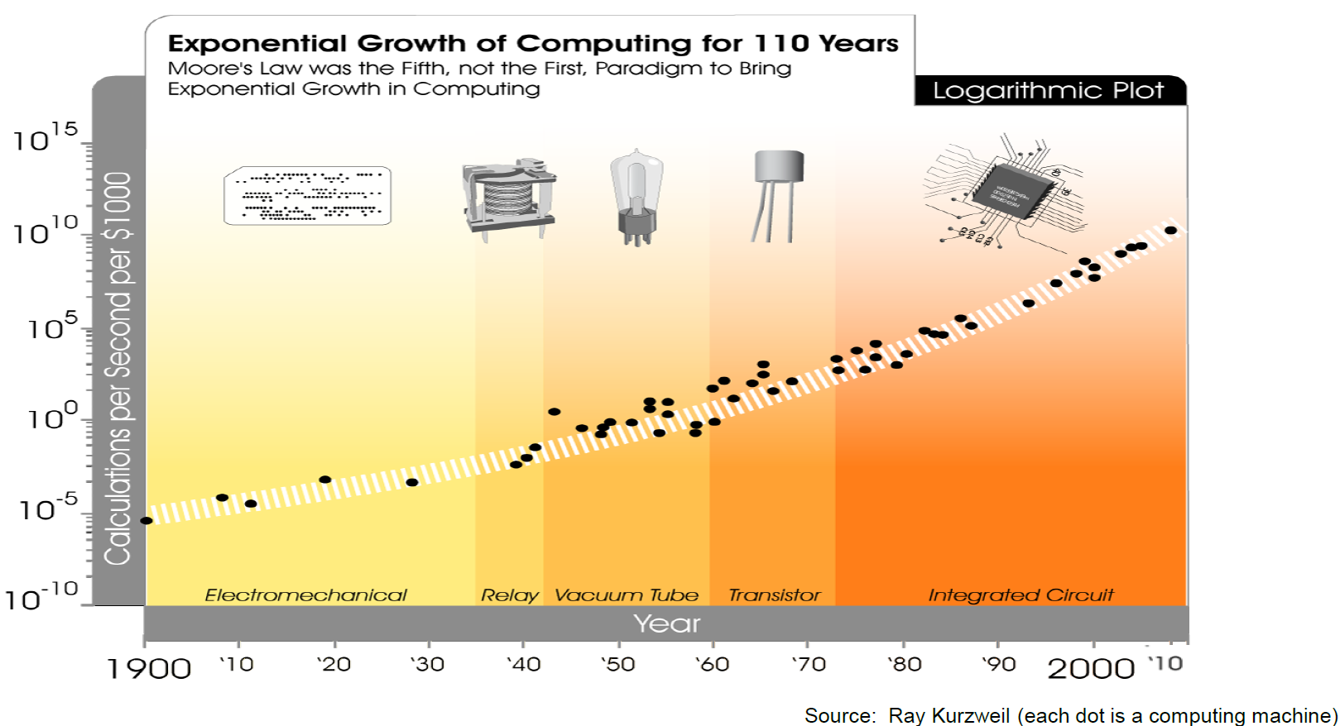

Brock’s Computer Research
Moore’s Law Wasn’t the First Exponential, and Won’t be the Last…
You Are Here

Slide 18

Brock’s Computer Research
Reconfigurable Computing
The typical approach to computer hardware is to build everything that will ever be needed.
Then the software can decide what to use later.

Slide 19

Brock’s Computer Research
Reconfigurable Computing
The typical approach to computer hardware is to build everything that will ever be needed.
Then the software can decide what to use later.
What if the hardware could be changed based on the application?

Slide 20
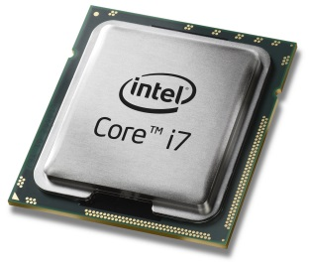
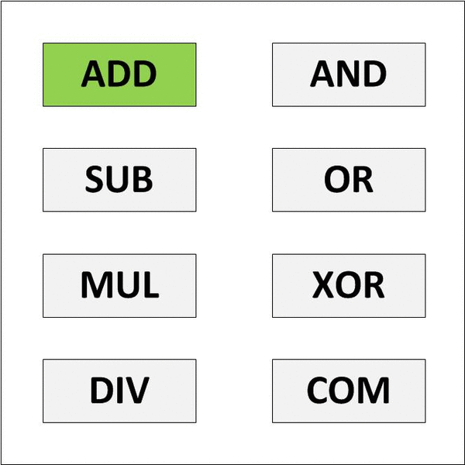
Brock’s Computer Research
Today’s Computers are Based on a General-Purpose Processor
  The GP CPU is designed to do many things.
  This is the “Jack of All Trades, Master of None” approach.
General Purpose CPU Model

Slide 21
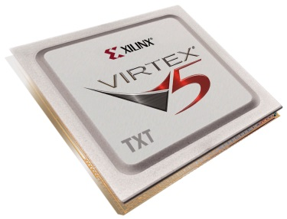

Brock’s Computer Research
Today’s Computers are Based on a General-Purpose Processor
  The GP CPU is designed to do many things.
  This is the “Jack of All Trades, Master of None” approach.
General Purpose CPU Model
Reconfigurable Computing Model
This can be faster because the hardware is smaller and consumes less power.

Slide 22
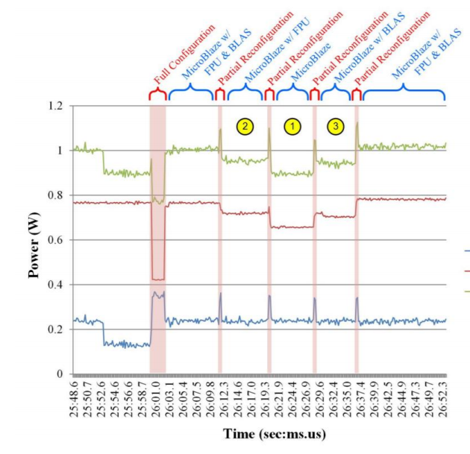
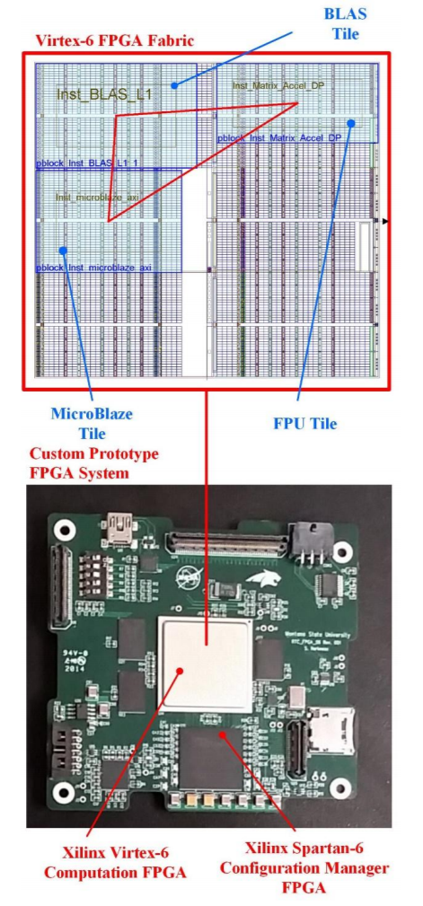
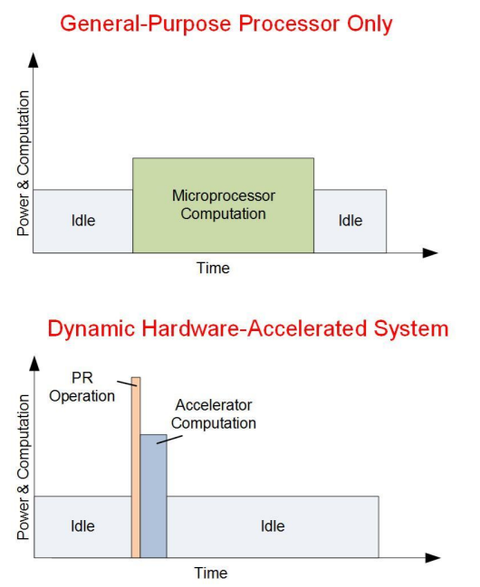
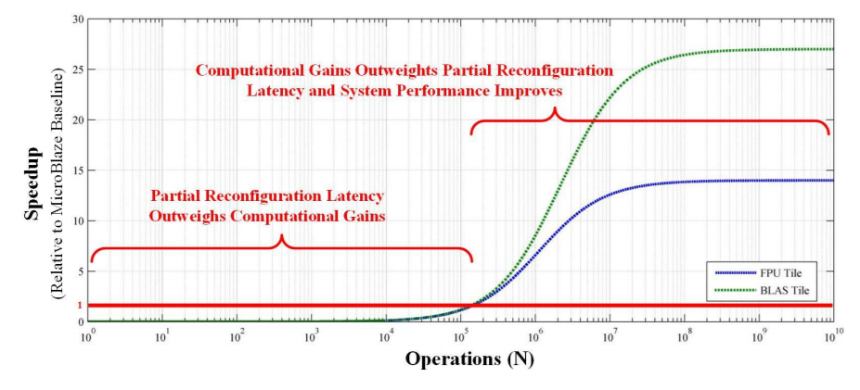
Brock’s Computer Research
So off to work…
  We started investigating computational speedup by swapping in HW in real-time.

Slide 23

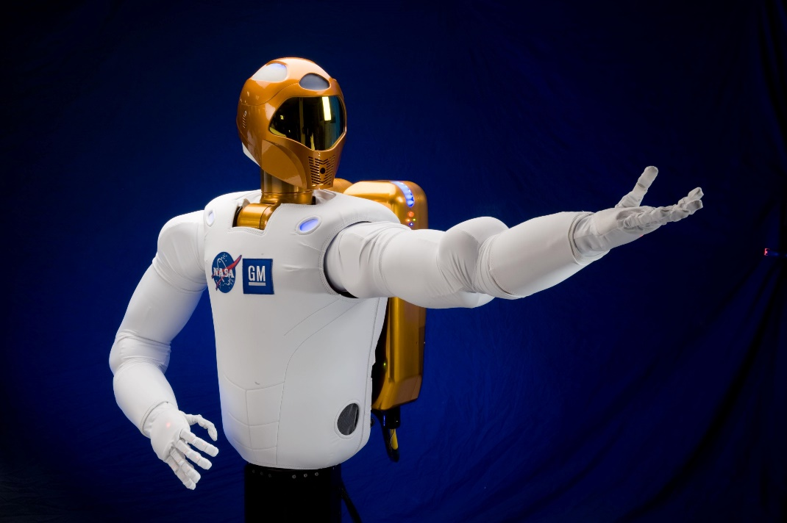
Brock’s Computer Research
But then…
Hey, that’s pretty cool. That might help our space computers.

Slide 24
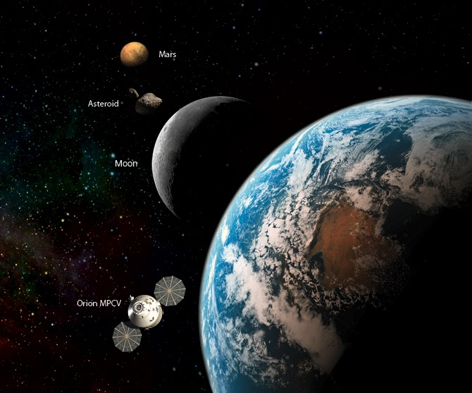
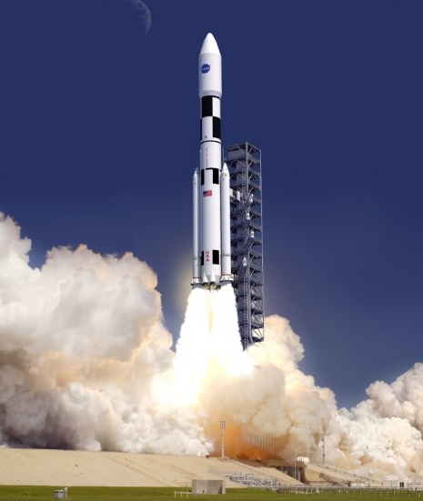
NASA’s Computing Needs
The Promise of RC
  We discovered that space computers could be greatly enhanced by RC.
  They need to be light. RC reuses hardware, that saves mass.

Slide 25

NASA’s Computing Needs
The Promise of RC
  We discovered that space computers could be greatly enhanced by RC.
  They need to be light. RC reuses hardware, that saves mass.

Slide 26
NASA’s Computing Needs
The Promise of RC
  We discovered that space computers could be greatly enhanced by RC.
  They need to be light. RC reuses hardware, that saves mass.
  They need to be low power. RC eliminates unnecessary circuitry.

Slide 27
NASA’s Computing Needs
The Promise of RC
  We discovered that space computers could be greatly enhanced by RC.
  They need to be light. RC reuses hardware, that saves mass.
  They need to be low power. RC eliminates unnecessary circuitry.

Slide 28
NASA’s Computing Needs
The Promise of RC
  We discovered that space computers could be greatly enhanced by RC.
  They need to be light. RC reuses hardware, that saves mass.
  They need to be low power. RC eliminates unnecessary circuitry.
  They need to have high computation. RC can do that.

Slide 29
NASA’s Computing Needs
The Promise of RC
  We discovered that space computers could be greatly enhanced by RC.
  They need to be light. RC reuses hardware, that saves mass.
  They need to be low power. RC eliminates unnecessary circuitry.
  They need to have high computation. RC can do that.

Slide 30
NASA’s Computing Needs
The Promise of RC
  We discovered that space computers could be greatly enhanced by RC.
  They need to be light. RC reuses hardware, that saves mass.
  They need to be low power. RC eliminates unnecessary circuitry.
  They need to have high computation. RC can do that.
  They need to operate in the presence of harsh radiation.

Slide 31
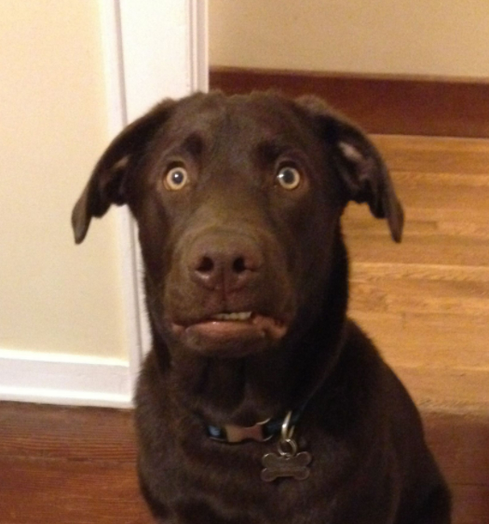
NASA’s Computing Needs
The Promise of RC
  We discovered that space computers could be greatly enhanced by RC.
  They need to be light. RC reuses hardware, that saves mass.
  They need to be low power. RC eliminates unnecessary circuitry.
  They need to have high computation. RC can do that.
  They need to operate in the presence of harsh radiation.
Can you repeat the question???

Slide 32
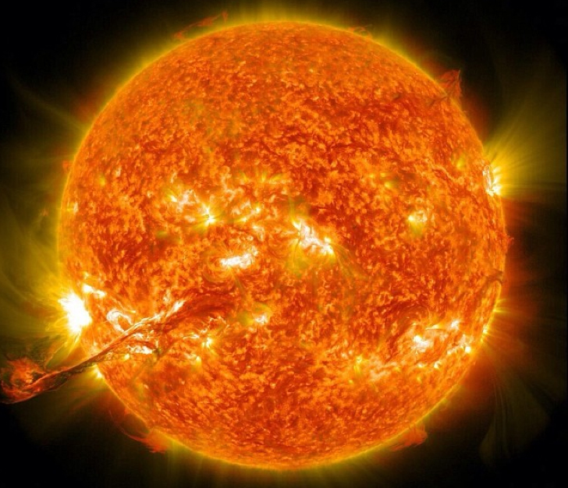
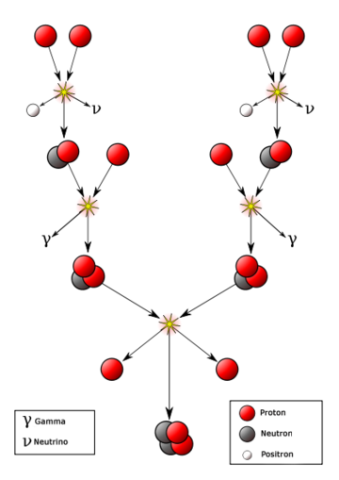
NASA’s Computing Needs
The Space Radiation Environment
Nuclear Fusion

Slide 33
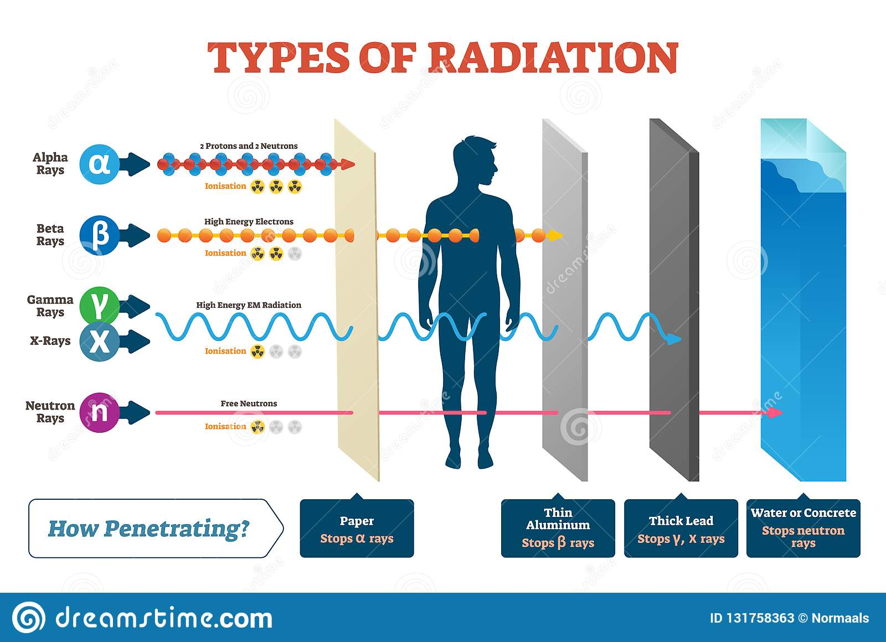
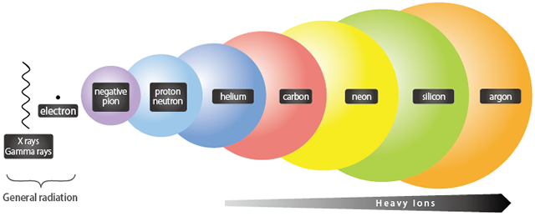
NASA’s Computing Needs
The Space Radiation Environment

Slide 34
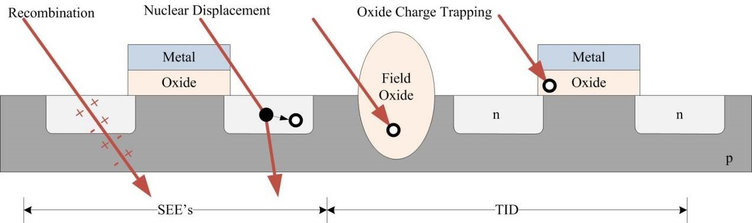
NASA’s Computing Needs
What Does Radiation do to our Computers?
Single Event Effects
Bit flips (1 → 0, 0 → 1).
Erroneous performance.
Full system crashes.
Total Ionizing Dose (TID)
Doping of insulators.
Causes leakage current
Causes transistors to be stuck on/off.

Slide 35
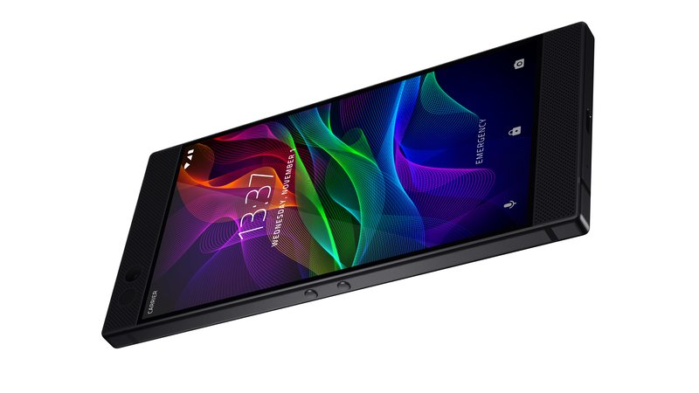
NASA’s Computing Needs
If this radiation is a problem, how do our computers work now?

Slide 36
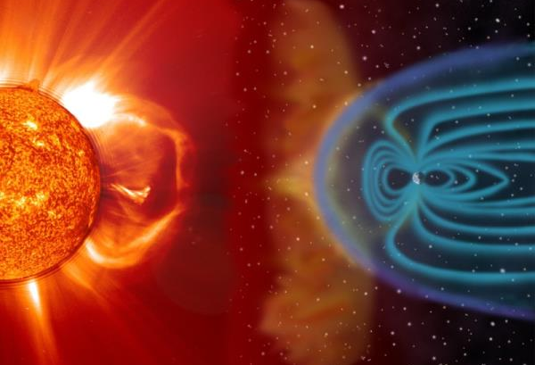

NASA’s Computing Needs
The Earth’s Magnetic Field Deflects Much of the Radiation
You Are Here

Slide 37

NASA’s Computing Needs
The Atmosphere Attenuates the Rest
You Are Here

Slide 38
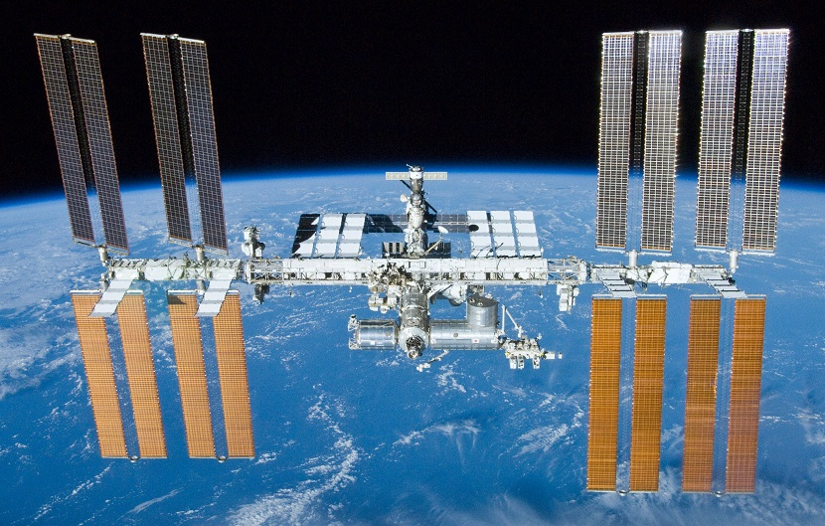
NASA’s Computing Needs
But There are Computers in Space Now?

Slide 39
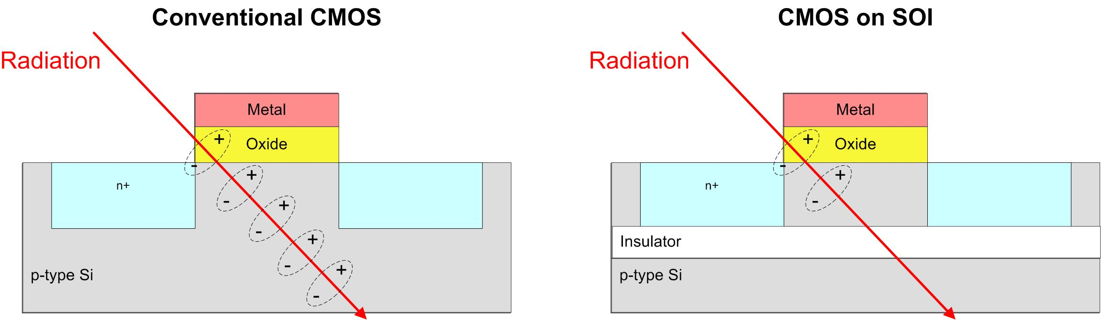
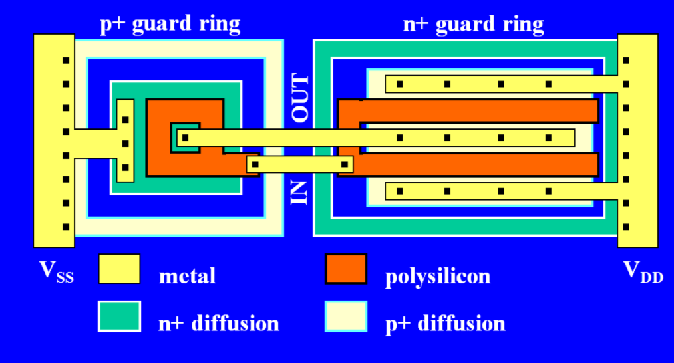
NASA’s Computing Needs
NASA and the Military have Devised “Hardening Techniques”
  The goal: reduce the amount of electrical charge generated when struck by radiation.
Change the Materials
Change the Layout

Slide 40
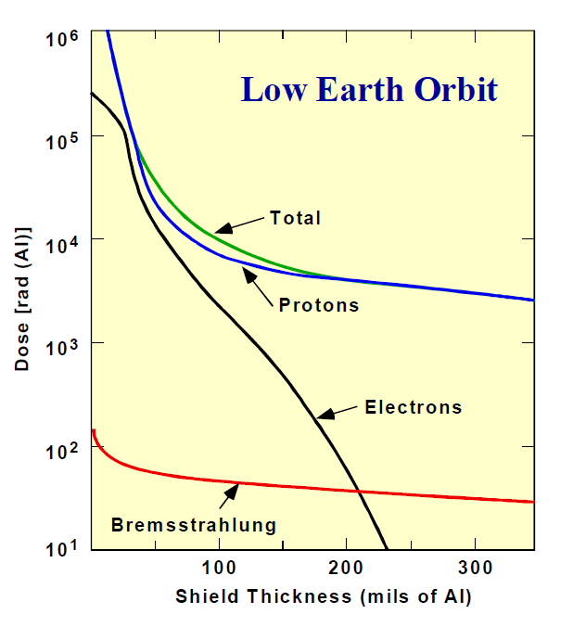
NASA’s Computing Needs
NASA and the Military have Devised “Hardening Techniques”
  The goal: reduce the amount of electrical charge generated when struck by radiation.
  What about just shielding them?
Shield Thickness vs. Dose Rate (LEO)
It is expensive to get mass into space.
It would take a meter of aluminum to stop all radiation energies!
It can sometimes make things worse due to scattering.

Slide 41
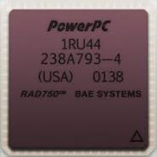
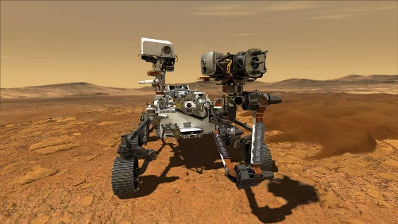

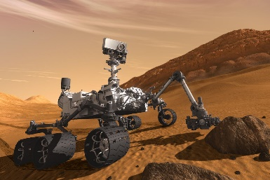

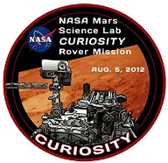
NASA’s Computing Needs
Existing Space Processors are “Radiation Hardened”
  But they are expensive ($200,000).
  And they are slow (20 years behind Earth computers)
1. The most advanced space mission ever attempted uses a BAE RAD750 radiation-hardened computer.
($200,000 USD, 200 MHz)
2. This was also used on Mars Curiosity 11 years earlier.
3. And started being used in 2002.
2002
2021

Slide 42
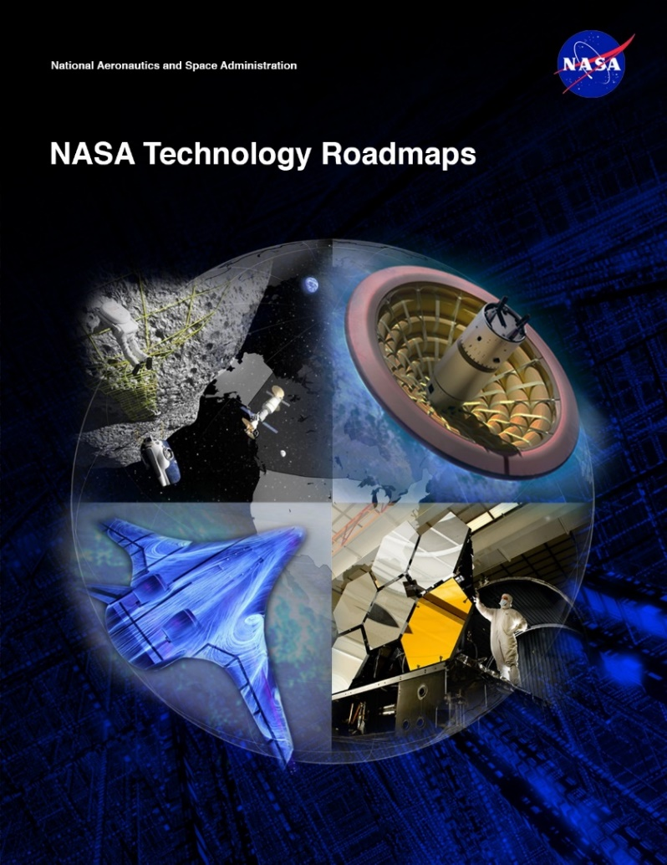
NASA’s Computing Needs
Space Computing Needs
  NASA Technology Area 11 – Flight Computing
    Increased Computation
    Radiation hardened technologies
    Low power requirements
    Cost Feasible
This is the new variable for NASA
So that it the problem statement:
Fast, Low-Power, Cheap, Reliable
Good luck…

Slide 43


MSU’s Approach

Slide 44
MSU’s Approach
  Instead of preventing crashes, expect them to happen and elegantly recover from them.
1. Off-the-Shelf Programmable Part
Gives us lower cost
Gives us higher performance
2. Multiple Computers on Single Chip
Vote on the outputs.
The majority is the right answer.
3. “Fix” Errors in the Background
Reprogram the damaged region.
Kind of like “Reconfigurable Computing”.

Slide 45

MSU’s Approach
  Instead of preventing crashes, expect them to happen and elegantly recover from them.
1. Off-the-Shelf Programmable Part
Gives us lower cost
Gives us higher performance
2. Multiple Computers on Single Chip
Vote on the outputs.
The majority is the right answer.
3. “Fix” Errors in the Background
Reprogram the damaged region.
Kind of like “Reconfigurable Computing”.
It sounds like you are only dealing with SEEs?

Slide 46

MSU’s Approach
As transistors get smaller, the probability of charge getting trapped in the insulators goes down.
Courtesy of the Boeing Company

Slide 47
MSU’s Approach
As transistors get smaller, the probability of charge getting trapped in the insulators goes down.
Courtesy of the Boeing Company
OK

Slide 48






MSU’s Approach - RadPC
Simulate it and See if it is Better.
  So, we did.
ISS
HEO
HRBE
GEO
And it looked promising.

Slide 49


MSU’s Approach - RadPC
Technical Readiness Level (TRL)
  If you want to fly on a NASA mission, you need to prove it works.

Slide 50




MSU’s Approach - RadPC
Step 1 – Build a Prototype to See if it is Possible
  The Montana Space Grant Consortium funds an investigation into conducting radiation tolerant computing research at MSU. The goal is to understand the problem, propose a solution, and build relationships with scientists at NASA.
Clint Gauer (MSEE from MSU 2009) demo’s computer to MSFC Chief of Technology Andrew Keys
Timeline of Activity at MSU
Proof of Concept
(2008-2010)
2008
2009
2010
2011
2012
2013
2014-16
2016
2017-20

Slide 51






MSU’s Approach - RadPC
Step 2 –Test in a Cyclotron
  NASA funds the development of a more functional prototype and testing
  under bombardment by radiation at the Texas A&M Radiation Effects Facility.
MSU Computer
Ray Weber (Ph.D., EE from MSU, 2014) prepares experiment.
Timeline of Activity at MSU
Proof of Concept
Prototype Development & Cyclotron Testing
(2008-2010)
(2010-2012)
2008
2009
2010
2011
2012
2013
2014-16
2016
2017-20

Slide 52






MSU’s Approach - RadPC
Step 3 – Demonstrate as Flight Hardware on High Altitude Balloons
  NASA funds the development of the computer into flight hardware for demonstration on high altitude balloon systems, both in Montana and at NASA.
MSU
Computer
Timeline of Activity at MSU
Justin Hogan (Ph.D., EE from MSU, 2014) prepares payload.
Proof of Concept
Prototype Development & Cyclotron Testing
High Altitude Balloon Demos
(2008-2010)
(2010-2012)
(2011-2013)
2008
2009
2010
2011
2012
2013
2014-16
2016
2017-20

Slide 53






MSU’s Approach - RadPC
Step 4 – Demonstrate as Flight Hardware on a Research Rockets
  NASA fund the demonstration of the computer system on sounding rocket.
  Flew on two rockets (2014 and 2016)
MSU
Computer
Timeline of Activity at MSU
Proof of Concept
Prototype Development & Cyclotron Testing
High Altitude Balloon Demos
Sounding
Rocket Demo
(2008-2010)
(2010-2012)
(2011-2013)
(2012-2016)
2008
2009
2010
2011
2012
2013
2014-16
2016
2017-20

Slide 54
MSU’s Approach - RadPC
Step 5 – Demonstrate on the International Space Station
  NASA funds the demonstration of RadPC on ISS

Slide 55
MSU’s Approach - RadPC
Step 5 – Demonstrate on the International Space Station
  NASA funds the demonstration of RadPC on ISS

Slide 56



MSU’s Approach - RadPC
A little help please
  Larry Springer, Project Manager
  Space Science & Engineering Lab
  Montana State University (14 years)
  Expertise: Spacecraft Development
  Dr. David Klumpar, Science-I
  Director, Space Science & Engineering Lab
  Montana State University (21 years)
  Expertise: Spacecraft Development &
  Space Radiation
Program Manager
Spacecraft instrument development.
Solar & atmospheric instrumentation.
(35 Years)
Staff Physicist
Spacecraft instrument development.
Space radiation research.
(16 Years)

Slide 57














MSU’s Approach - RadPC
SSEL Track Record
MEROPE
PrintSat
Explorer 1’
FIREBIRD 1 & 2
HRBE
FIREBIRD 3 & 4
IT-SPINS
2006
2016
2021

Slide 58

MSU’s Approach - RadPC
Step 5 – Demonstrate on the International Space Station
  NASA funds the demonstration of RadPC on ISS

Slide 59

MSU’s Approach - RadPC
Step 5 – Demonstrate on the International Space Station
  NASA funds the demonstration of RadPC on ISS

Slide 60





MSU’s Approach - RadPC
Step 5 – Demonstrate on the International Space Station
  NASA funds the demonstration of RadPC on ISS

Slide 61




MSU’s Approach - RadPC
Step 6 – Demonstrate as a Stand-Alone Satellite
  NASA funds the development of satellites to carry RadPC.
Timeline of Activity at MSU
Proof of Concept
Prototype Development & Cyclotron Testing
High Altitude Balloon Demos
Sounding
Rocket Demo
ISS
Demo
Satellite
Demo
(2008-2010)
(2010-2012)
(2011-2013)
(2012-2016)
(2014-2016)
(2015-2020)
2008
2009
2010
2011
2012
2013
2014-16
2016
2017-20

Slide 62


MSU’s Approach - RadPC
RadSat-g
Brock & Skylar Tamke (MSEE 2019) at Integration
Houston, TX. 2018.

Slide 63


MSU’s Approach - RadPC
RadSat-g
Orbital ATK OA9 ISS Resupply Mission.
NASA Wallops Flight Facility, 5/22/18.
Brock & Skylar Tamke (MSEE 2000) at Launch.

Slide 64



MSU’s Approach - RadPC
RadSat Mission Concept
Students Build It
Launch it to the International Space Station
Push into orbit
Operate from Ground Station at MSU

Slide 65

MSU’s Approach - RadPC
In case you
didn’t see
that…

Slide 66

MSU’s Approach - RadPC
In case you
didn’t see
that…

Slide 67

MSU’s Approach - RadPC
In case you
didn’t see
that…

Slide 68

MSU’s Approach - RadPC

Slide 69




MSU’s Approach - RadPC

Slide 70


MSU’s Approach - RadPC
RadSat-u
Chris Major (MSEE 2000) at Integration
Houston, TX. 2018.

Slide 71


MSU’s Approach - RadPC
RadSat-u
Chris Major (MSEE 2000), Brock, & Colter Barney (BSCpE 2021) at Launch.
Northrop Grumman NG-12 ISS Resupply Mission.
NASA Wallops Flight Facility, 11/2/19.

Slide 72

MSU’s Approach - RadPC
RadSat-u

Slide 73




MSU’s Approach - RadPC
RadSat Mission Concept
Students Build It
Launch it to the International Space Station
Put into Orbit using NanoRacks CubeSat Deployer
Operate from Ground Station at MSU

Slide 74

MSU’s Approach - RadPC
In case you
didn’t see
that…

Slide 75

MSU’s Approach - RadPC
In case you
didn’t see
that…

Slide 76

MSU’s Approach - RadPC
In case you
didn’t see
that…

Slide 77
MSU’s Approach - RadPC
Now What?

Slide 78


MSU’s Approach - RadPC
Now What?

Slide 79
MSU’s Approach - RadPC
Nice!

Slide 80

Bobcats on the Moon
Let’s step back and see and look at the Space Exploration Roadmap

Slide 81


Bobcats on the Moon
Let’s Talk Moon Rockets – NASA’s Artemis

Slide 82

Bobcats on the Moon
Let’s Talk Moon Rockets – NASA’s Artemis

Slide 83

Bobcats on the Moon
Let’s Talk Moon Rockets – NASA’s Artemis

Slide 84


Bobcats on the Moon
Let’s Talk Moon Rockets – NASA’s Artemis
The Orion capsule is a little cramped. But it is only for a 3-day trip.
This is only for Lunar and low Earth Orbit.
Gateway will be a BIG DEAL, but it isn’t used in Artemis III

Slide 85


Bobcats on the Moon
Let’s Talk Moon Rockets - Starship

Slide 86




Bobcats on the Moon
Let’s Talk Moon Rockets - Starship
A Different Approach
Roomy
Reusable
Refuel it over and over.

Slide 87

Bobcats on the Moon
Let’s Talk Moon Rockets - Starship
That’s because it is being designed for Mars!

Slide 88

Bobcats on the Moon
Lunar Exploration in the Next 10 Years

Slide 89
Bobcats on the Moon
Lunar Exploration in the Next 10 Years
RadPC is going to be part of this.

Slide 90



Bobcats on the Moon
What does MSU’s Moon Mission Look Like?

Slide 91


Bobcats on the Moon
What does MSU’s Moon Mission Look Like?

Slide 92



Bobcats on the Moon
What does MSU’s Moon Mission Look Like?
The RadPC-Lunar payload isn’t huge. A little larger than a Rubik’s cube.

Slide 93
Bobcats on the Moon
What does MSU’s Moon Mission Look Like?

Slide 94

Bobcats on the Moon
What does MSU’s Moon Mission Look Like?

Slide 95

Bobcats on the Moon
What does MSU’s Moon Mission Look Like?

Slide 96


Bobcats on the Moon
Landing Site:
Mare Crisium
“the sea of crisis”

Slide 97

Bobcats on the Moon
Are you coming back? Nope…
Mare Crisium
“the sea of crisis”
Visible from Earth with the Naked Eye
Bobcats on the Moon for the next 1000 years!

Slide 98


Bobcats on the Moon
We Decided to Send Messages to the Moon Too

Slide 99




Bobcats on the Moon
We Decided to Send Messages to the Moon Too
  1000 inspirational messages (well, mostly…)
  700+ pictures
  Tributes from MSU departments, colleges, & President Cruzado.
  Videos from the Governor, our two US Senators, and our US Representative.
  Every Edition of the MSU Student News Paper the Exponent (since 1895!)

Slide 100





Bobcats on the Moon
This Research has had Local Economic Impact Too

Slide 101

Bobcats on the Moon
How are you doing all this?

Slide 102










MSU’s Approach - RadPC
Everything was Designed & Built By MSU Students (~150)
Todd Buerkle, Justin Hogan, Ray Weber at Johnson Space Center for demo, 2012.
Todd Buerkle & Jennifer Hane demo computer at Marshall Space Flight Center, 2012.
Justin Hogan at the NASA Columbia Scientific Balloon Facility, 2012.
Clint Gauer at Marshall Space Flight Center for demo, 2009.
Clint Gauer demo’s computer at Marshall Space Flight Center, 2009.
Kaysha Young prepares payload for balloon flight, 2012.
2011 balloon team featured in MSU news story, 2011.
Todd Buerkle, Jennifer Hane at the Marshall Space Flight Center, 2011.
2013 balloon team recovers payload in front of moose, 2013.
Justin Hogan & Ray Weber featured in MSU News Story, 2012.

Slide 103





Questions
MSU Computer
MSU Computer
MSU Computer
MSU Computer
MSU Computer
Coming May 2024

