Slide 1
Introduction to Evidence
By Jennifer Glad, Associate Legal Counsel

Slide 2
General Evidence Principles of an Investigation
It is the University’s responsibility to conduct the investigation, identify and collect relevant inculpatory and exculpatory evidence, and interview witnesses
Parties must have an equal opportunity to provide evidence (documents, testimony, etc.) and identify witnesses
Parties must have an equal opportunity to review and comment on “directly related” evidence
The goal of an investigation is evidence-gathering and ensuring an equitable process, not proving guilt or responsibility of the respondent

Slide 3

What is Inculpatory Evidence?
Evidence tending to support the proposition that the respondent engaged in the conduct alleged.
Examples may include:
  Surveillance or video footage showing a sexual assault
  A text message from the respondent stating: “I’m sorry, I should have stopped when you said no.”

Slide 4

What is Exculpatory Evidence?
Evidence tending to support the proposition that the respondent did not engage in the conduct alleged.
Examples may include:
  A text message from the complainant to a friend saying: “I said yes, but now I feel like he just used me.”

Slide 5
Types of Evidence
Physical Evidence
Documentary Evidence
Demonstrative Evidence
Verbal Evidence
SANE kits
Other physical objects
Emails
Snapchats
Text messages
Social media postings
Student records, medical records, etc.
Police reports
Diary or journal
Photos of injuries or locations of incidents
Videos
Security footage of an incident
Timeline of events
X-rays
Maps or diagrams
Witness statements

Slide 6

Sources of Evidence
Signed statements or interviews from the parties and witnesses
Emails, text messages and other communications
Social media posts
Drawings or diagrams of an incident created after the fact
Photographs or video recordings (security footage, phones, etc.)
Medical records
Student records
Personnel files
Documents that create a timeline of events (e.g., photos with timestamps, key card swipes, receipts, social media posts, etc.)
Maps to reference distances
Relevant notes, timecards, logs, expense reports, calendars, diaries or journals, etc.
Registrar’s Office, student conduct records, Office of Disability Services, class attendance records, HR records, ADA coordinator, etc.

Slide 7

Potential Evidentiary Exclusions
Rape Shield
Privacy restrictions (FERPA, personnel files, etc.)
Medical, psychological, or similar records
Information or evidence protected by a legally recognized privilege unless waived

Slide 8

Rape Shield
All questions and evidence of a complainant’s sexual predisposition are irrelevant, with no exceptions
Questions and evidence about a complainant’s prior sexual behavior are irrelevant, unless:
  The questions or evidence are offered to prove someone other than the respondent committed the conduct alleged; or
  The questions and evidence concern specific incidents of the complainant’s prior sexual behavior with the respondent and are offered to prove consent

Slide 9
What is Relevant Evidence?
Evidence is relevant if:
It has any tendency to make a fact or allegation more or less probable than it would be without the evidence; and
It is of consequence in determining the claim or allegation

Slide 10
Dangers of Irrelevant Evidence
1
Wastes the time of the investigator, parties, and witnesses
2
May result in actual or perceived bias
4
May result in faulty or indefensible findings
5
May deny a party their rights to a fair determination
3
May result in determinations based on improper considerations

Slide 11
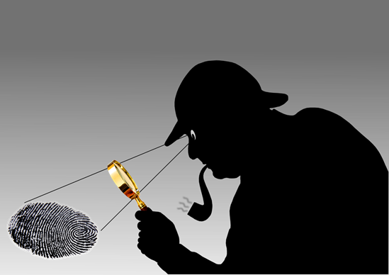
How to Evaluate Relevancy?
Review the evidence being offered (email, text messages, social media, etc.)
Consider the allegations of the complaint
Ask yourself if the evidence offered has the potential to prove/explain or disprove an allegation or claim

Slide 12

Evidence Review in Title IX Investigations
Complainants and Respondents are entitled to review and respond to all evidence directly related to the complaint.
This is broader than just relevant evidence and includes:
  Evidence directly related to the allegations in the complaint,
  Relevant evidence, and
  Evidence of potential bias or other considerations relevant to the allegations

Slide 13

What Evidence Goes in the Report?
Investigators must summarize the relevant evidence in the investigation report. That evidence should include:
  Determinations based on logic and common sense
  Probative facts (e.g., tends to prove but not necessarily dispositive)
  Material facts (e.g., necessary to decide an issue in the case)

Slide 14
Burden of Proof/Standard of Evidence
Insufficient
Evidence
Clear and Convincing
No Evidence
Preponderance
of the Evidence/More Likely Than Not
Beyond a Reasonable Doubt

