Slide 1
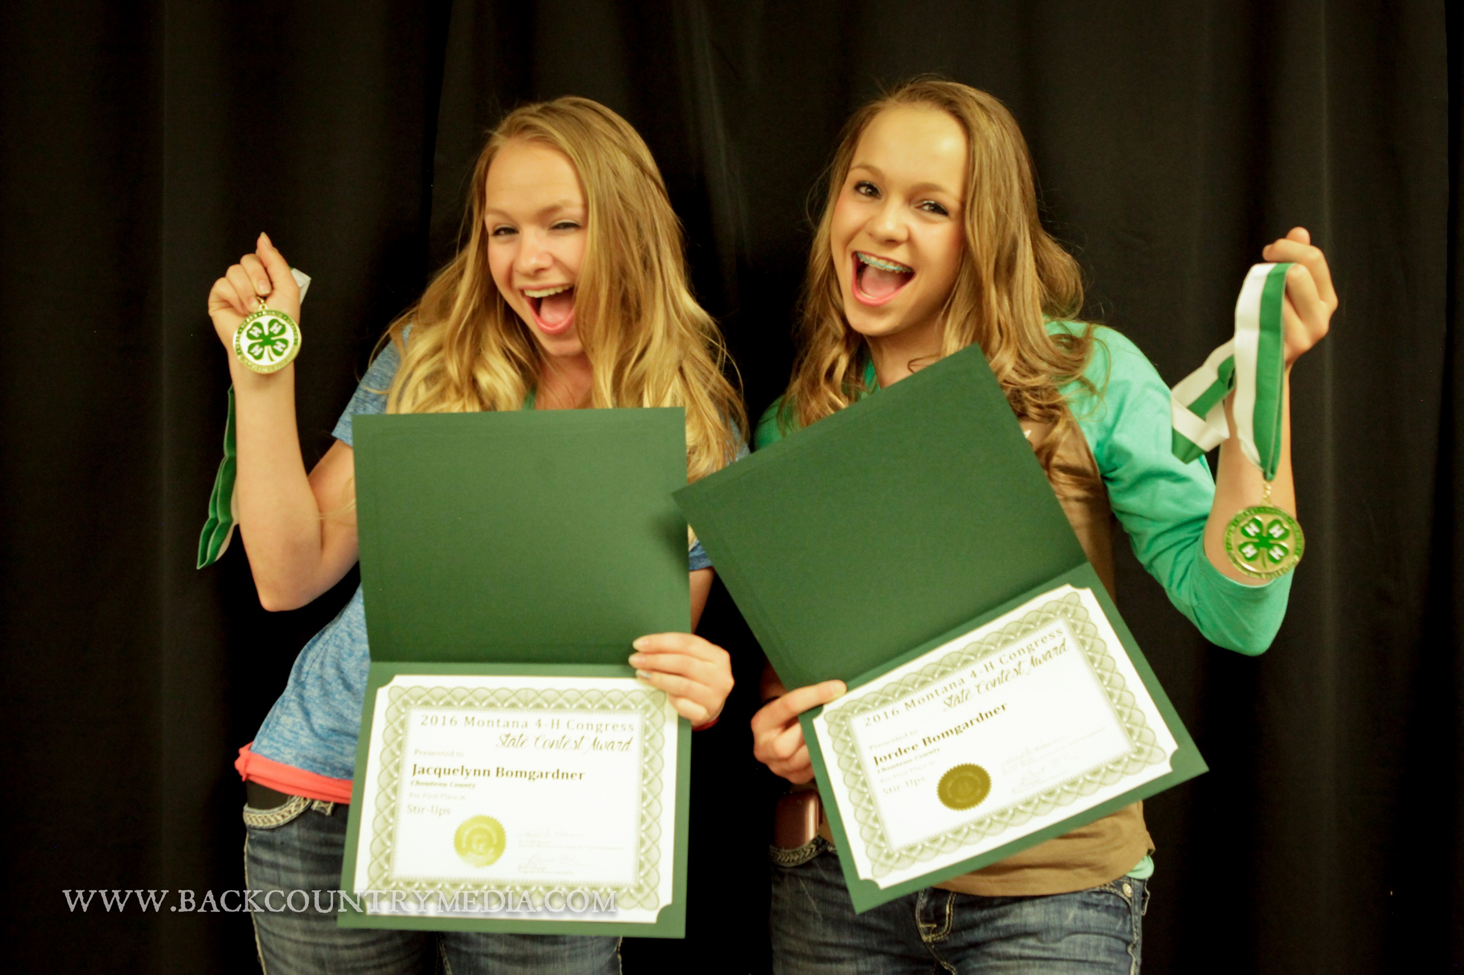

MONTANA 4-H
STATE CONTESTS

Slide 2
MONTANA 4-H CONGRESS CONTESTS
State contests are designed to provide educational and state level competitive events to Montana 4-H'ers age 14 years and older. Most state contests take place and are recognized at Montana 4-H Congress each year. The following contest will take place Thursday July 13, 2017 in conjunction with Montana 4-H Congress. Please review the contest guidelines for individual contest scoring and information.
OTHER STATE LEVEL CONTESTS
Meats Judging Contest takes place each year during KMON Events in Great falls each January. Contact MSU Cascade County Extension Office for details.
The Montana 4-H State Shoot (early March) serves as the state level competition and qualifying events for the National 4-H Shooting Sports Tournament.

Slide 3
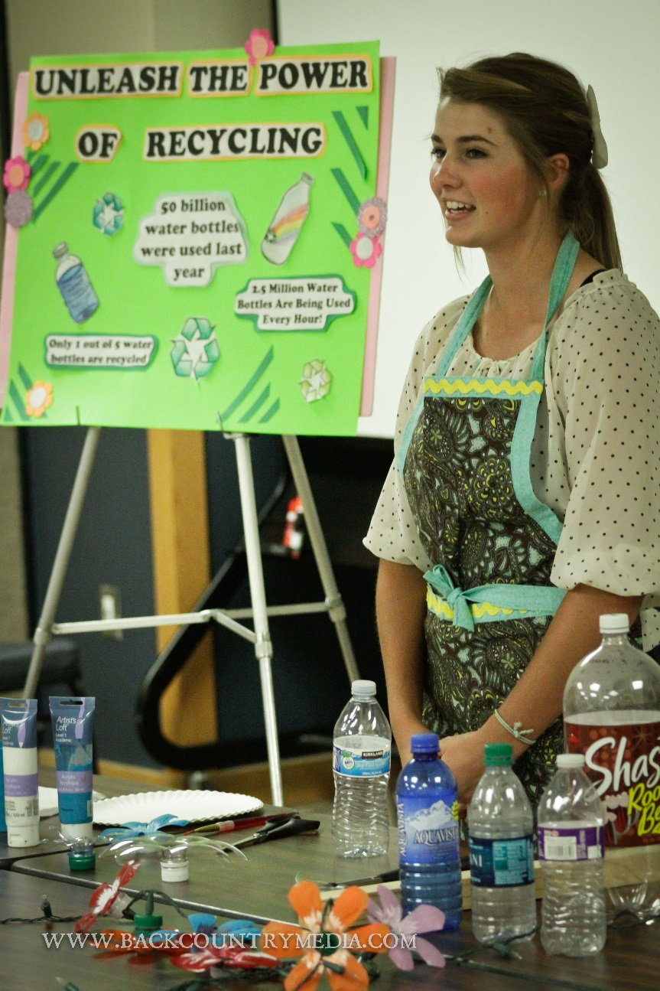
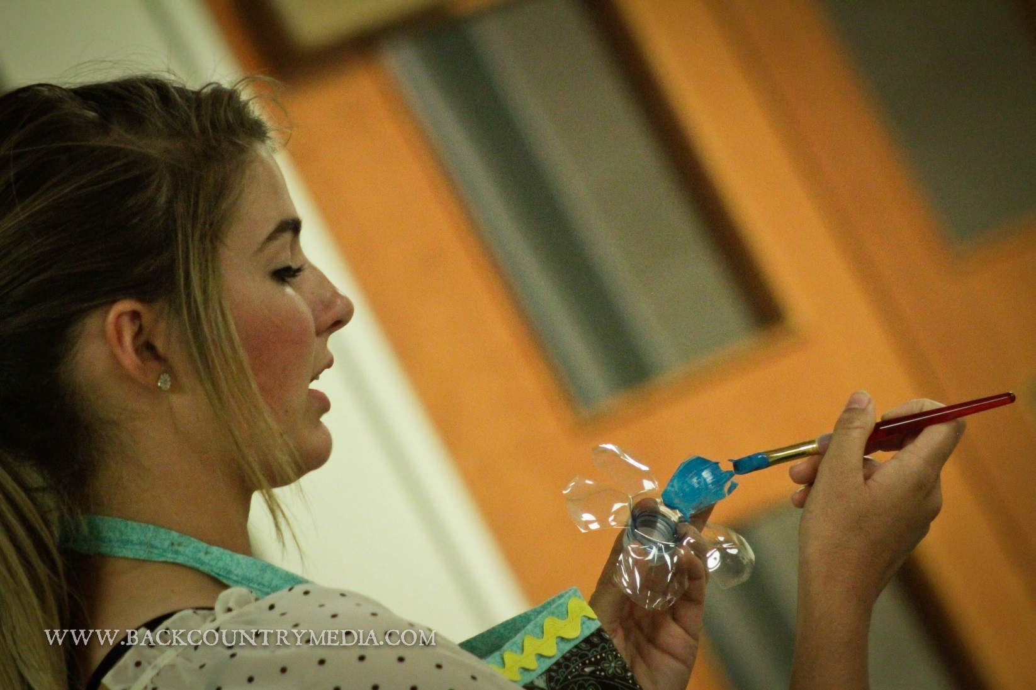
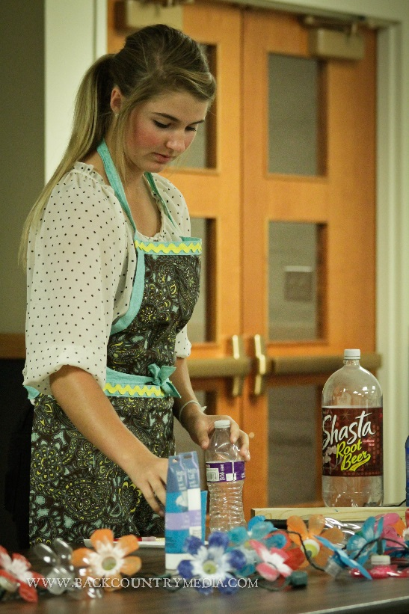
4-H DEMONSTRATED OR ILLUSTRATED TALK CONTEST
Through a demonstration or illustrated talk, Montana 4‐H members will present previously gained knowledge by using the “show and tell” method to teach skills they possess to an audience.

Slide 4
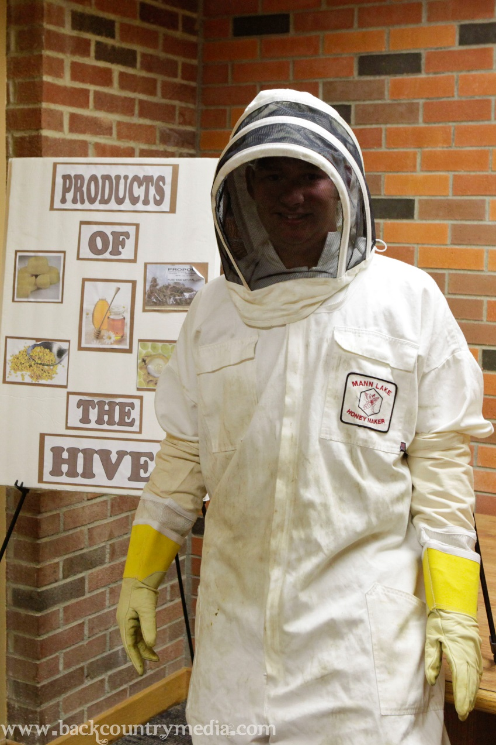
An Illustrated Talk:
Is talking.
Is telling “how,” using visual aids.
Uses charts, posters, photos, computer programs, slides, pictures, models or cut-outs
Each presentation should have clearly identifiable sections including an introduction, main body, and conclusion.

Slide 5
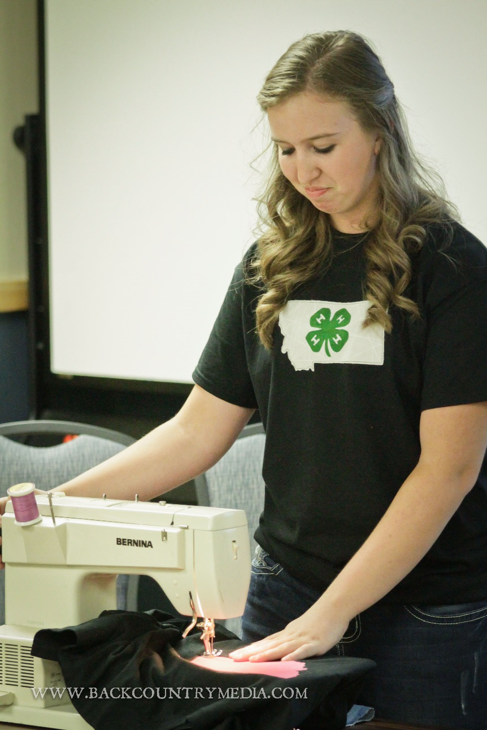
A Demonstration:
Is doing.
Is showing how. As you show how, you tell how.
Is where you make something or do something.
Is creating a final product.

Slide 6
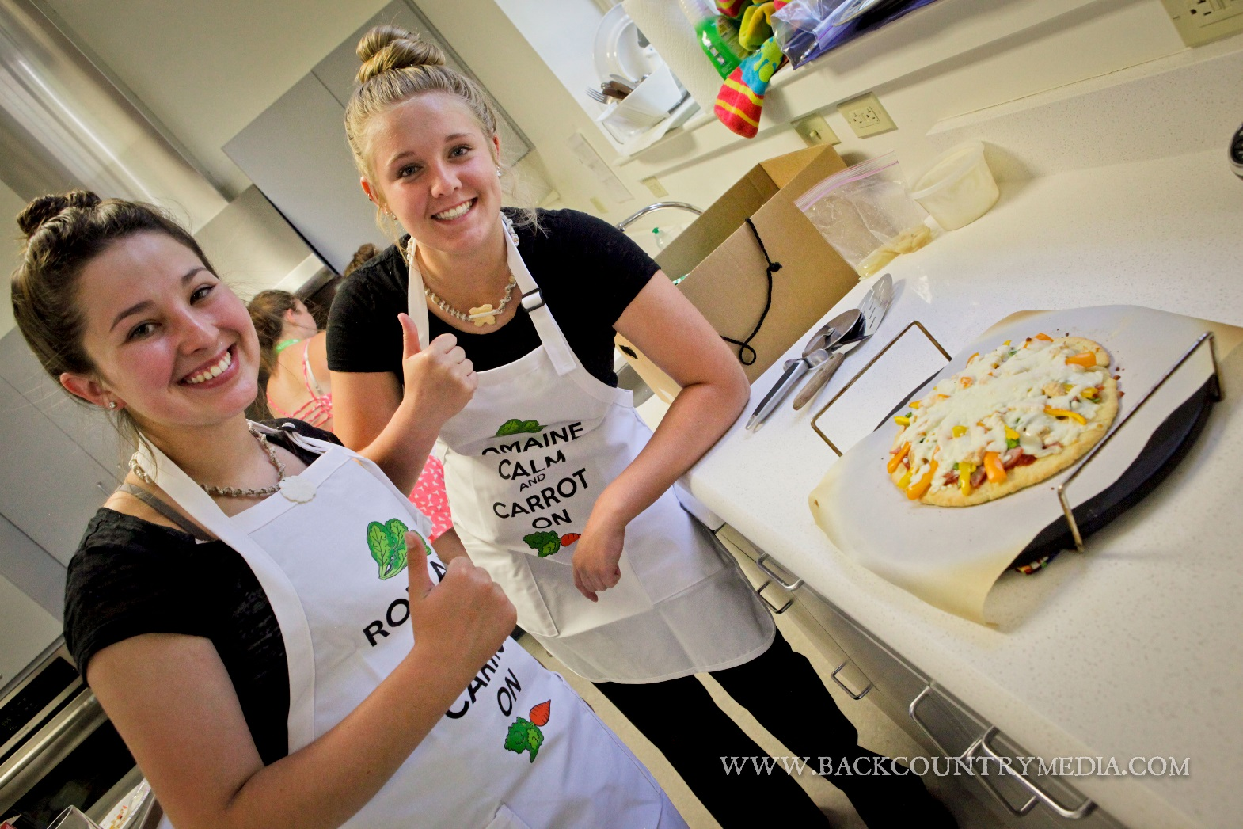
4-H STIR-UPS: Food & Nutrition Contest
Contest participants prepare an appealing, nutritious meal that can be prepared easily by using common ingredients available in many homes. Each year the contest highlights a theme such as pizza or soup, requiring participants to prepare a dish using a pre-set list of ingredients. Dishes should be prepared using food safe techniques and reflect creative use of ingredients. The presentation should exhibit knowledge of the foods prepared and excellent public speaking and use of visual aid skills.

Slide 7
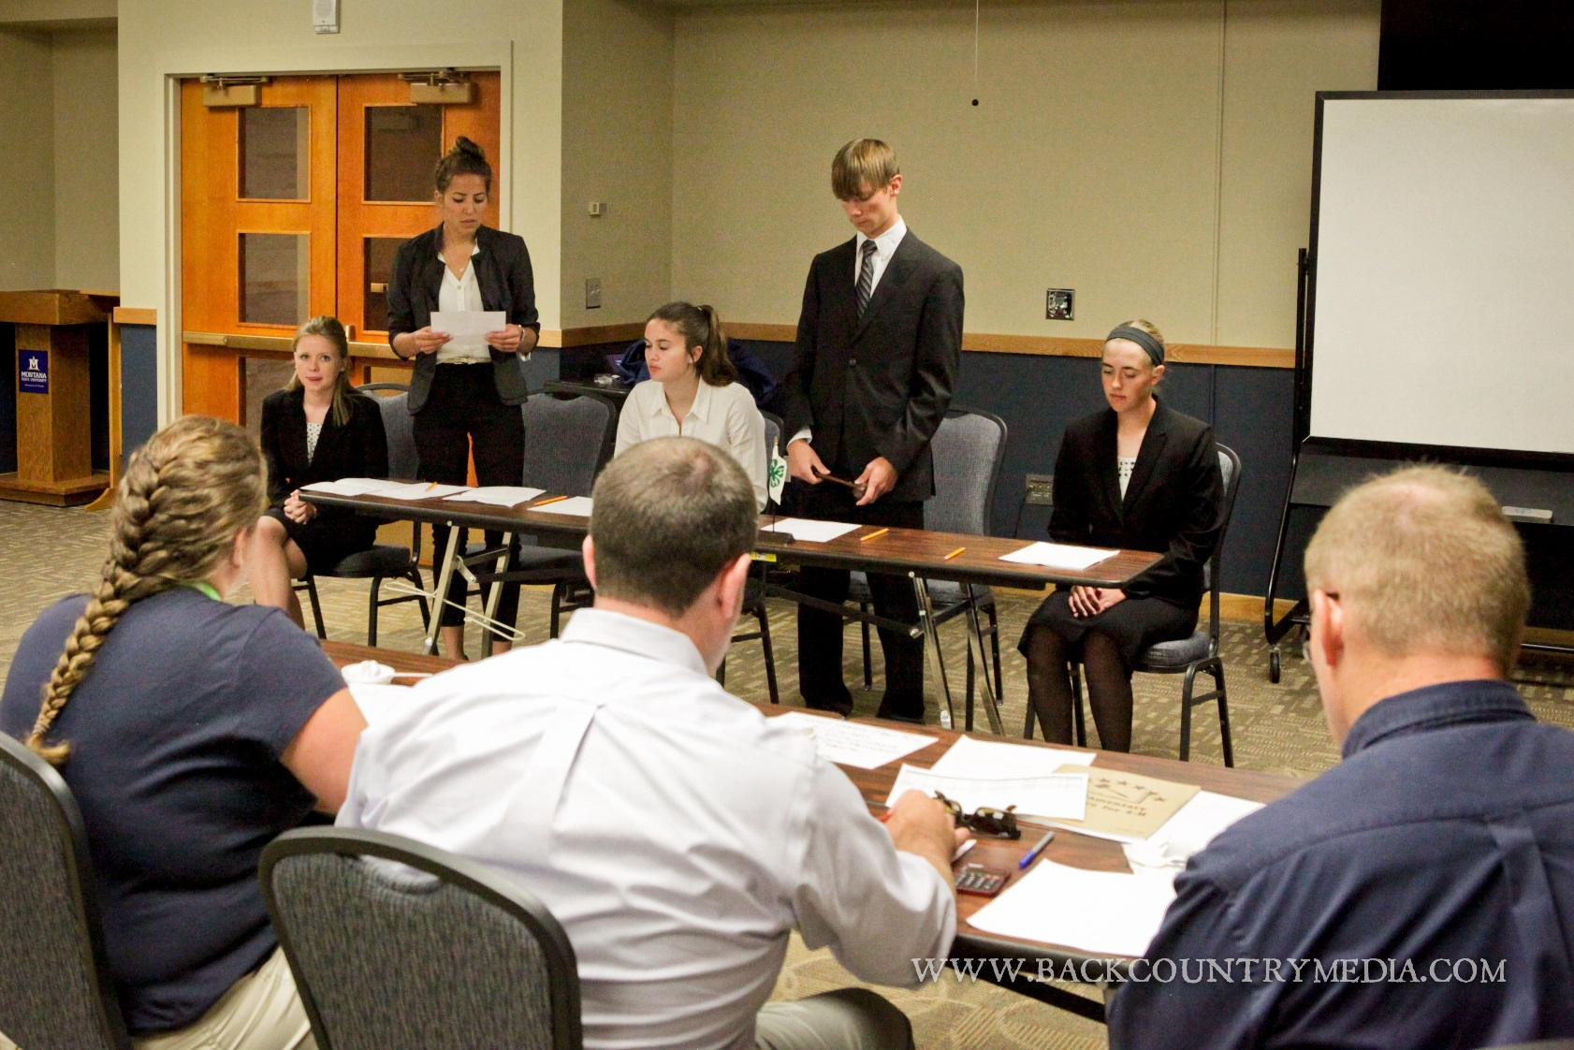
4-H GAVEL GAMES: Parliamentary Procedure Contest
Through Gavel Games, Montana 4‐H members show their knowledge of parliamentary procedure by acting as officers and members for a model 4‐H business meeting.

Slide 8
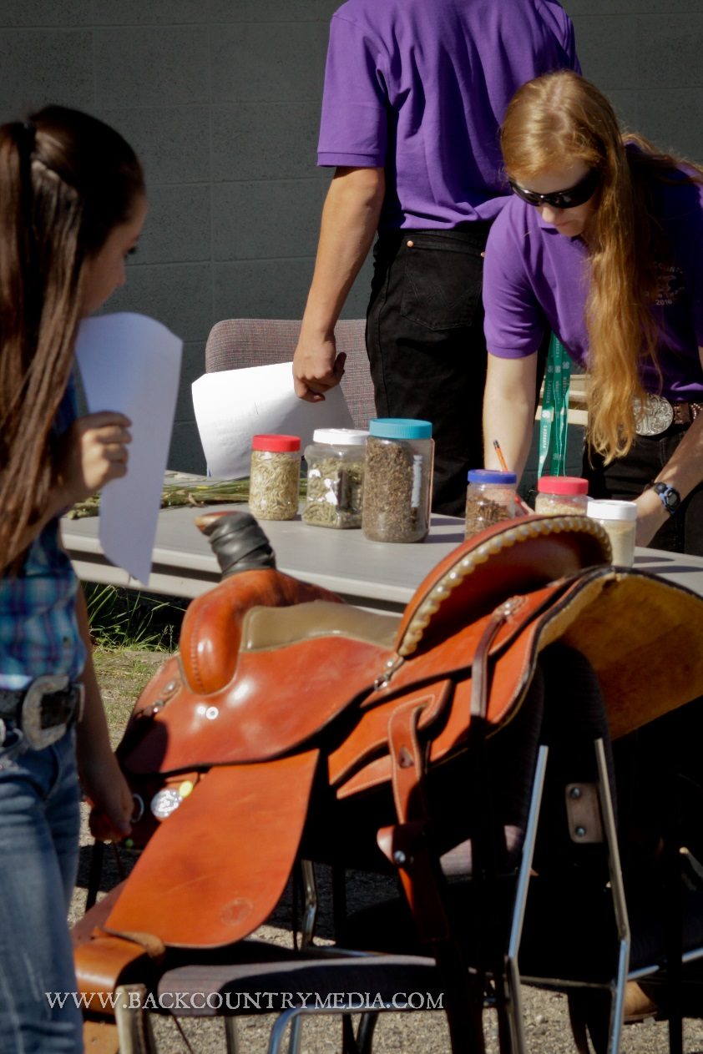
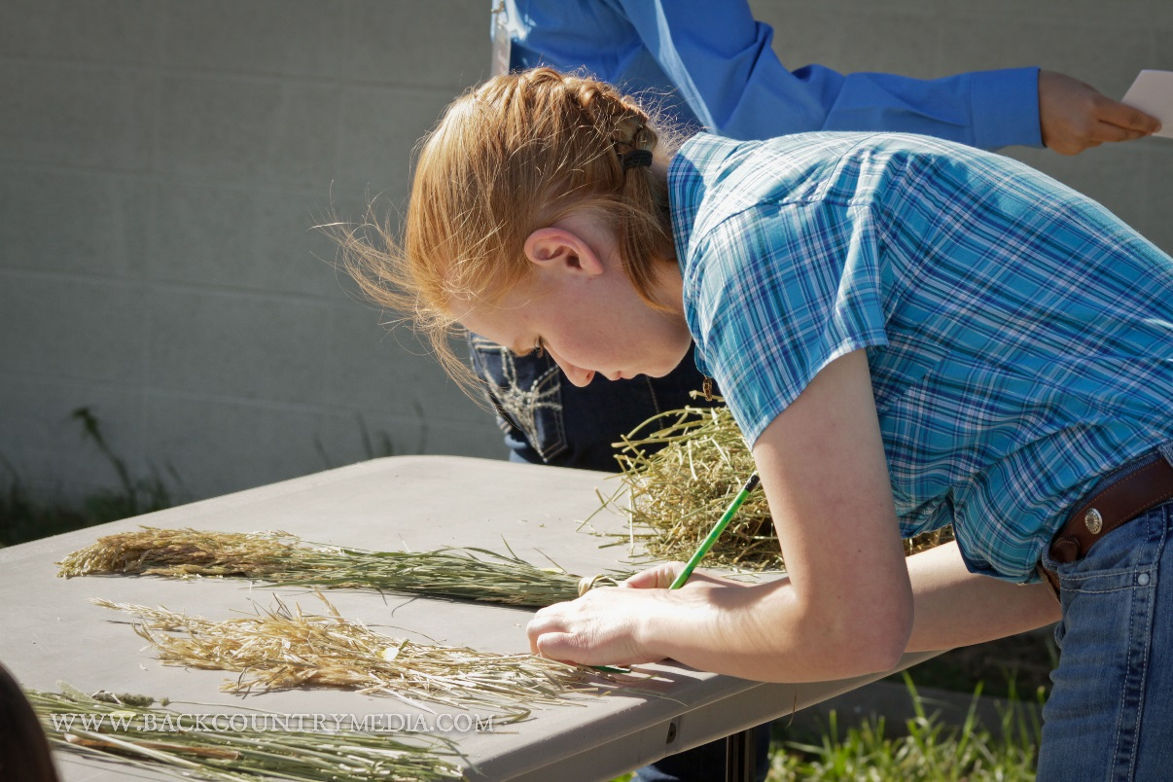
4-H HORSE SKILL-A-THON CONTEST
Horse Skill‐A‐Thon is an activity that can make learning fun for 4‐H members, by letting them exhibit their horse knowledge in a friendly but competitive setting. You can use Horse Skill‐A‐ Thon at your regular 4‐H meetings as a great learning tool.
Examination phase
Station phase
Judging phase
Team problem

Slide 9
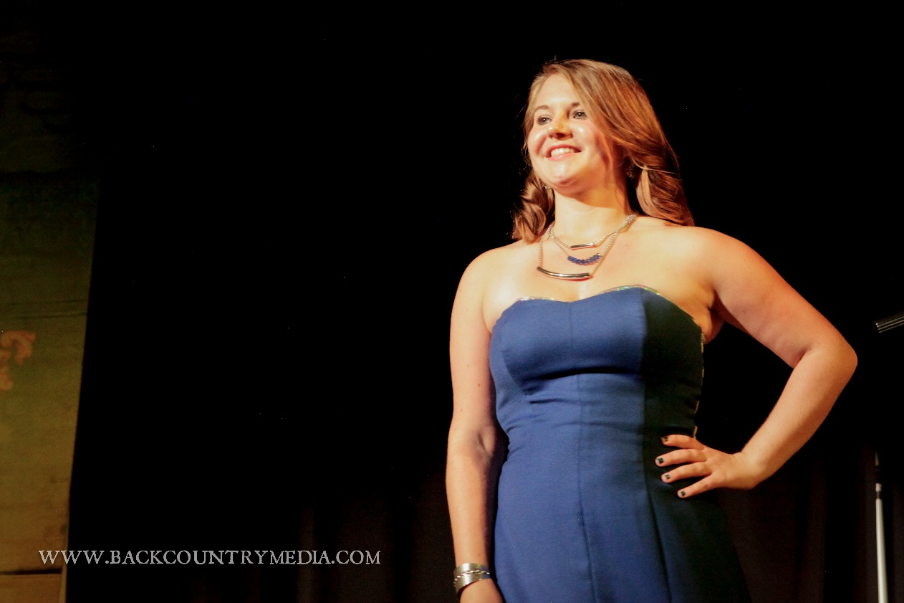
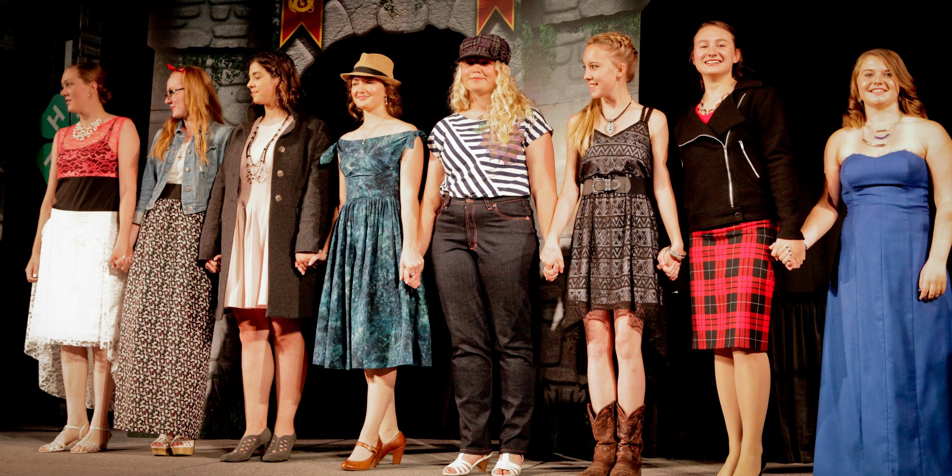
4-H FASHION REVUE CONTEST
The State Fashion Revue is an educational component of the 4‐H sewing and textiles program. It emphasizes skill development in selecting, constructing, accessorizing, and modelling of a garment or garments. Additional skills developed through the Fashion Revue are leadership, self‐confidence, poise, good posture, good grooming, and planning.
TRADITIONAL: At least one clothing item newly constructed and worn by contestant. Multiple clothing items constructed to make a complete outfit are encouraged.
REFASHIONED: At least one clothing item that has been repurposed into a significantly different wearable garment or look. A photograph of the original clothing item is required to be brought to the judging.

Slide 10
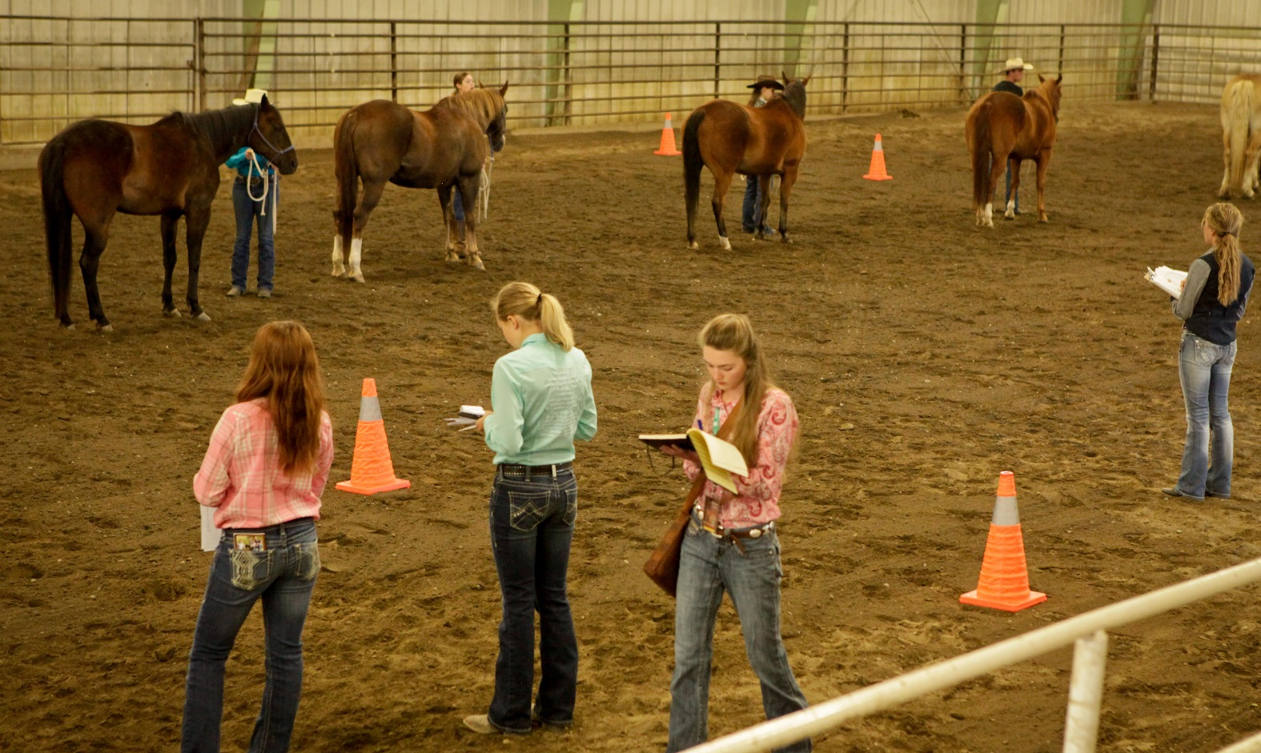
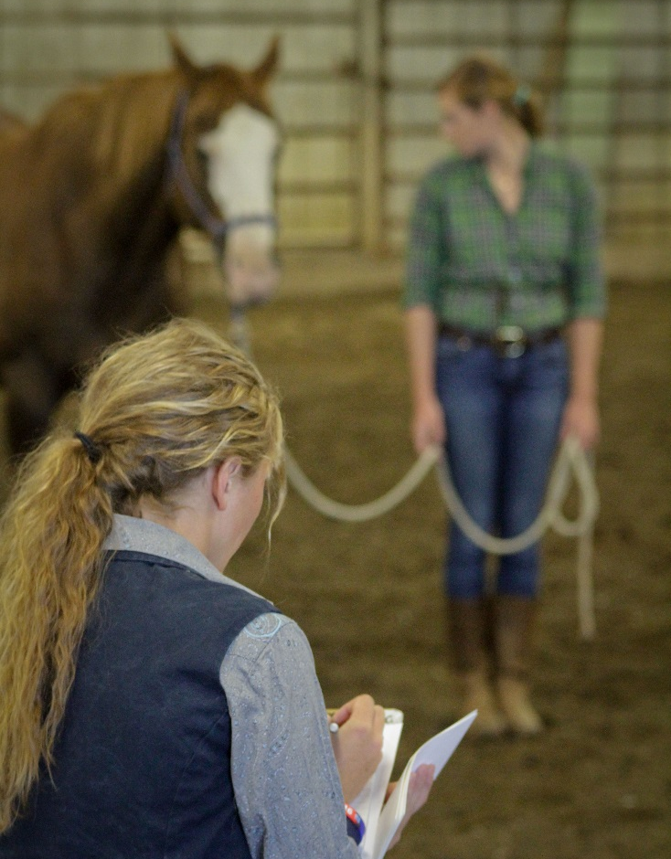
4-H HORSE JUDGING CONTEST
To provide an opportunity for all youth enrolled in 4‐H horse projects to demonstrate the skills they have developed in visually evaluating horses at halter and in performance classes. In addition, youth will demonstrate their knowledge of equine‐related equipment and subject matter in a competitive setting.

Slide 11
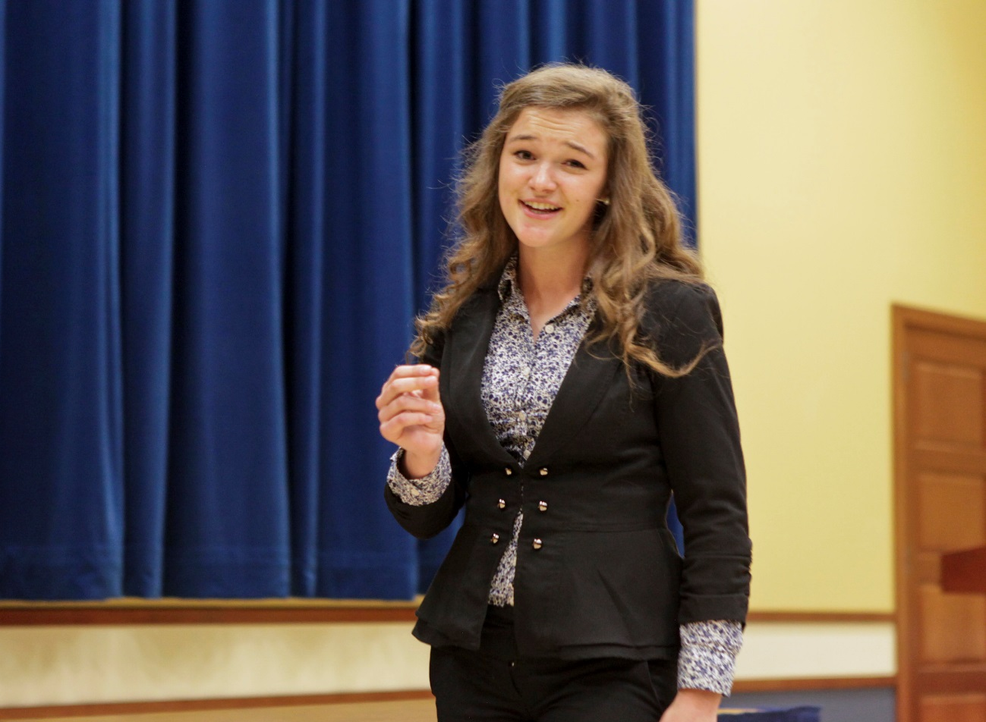
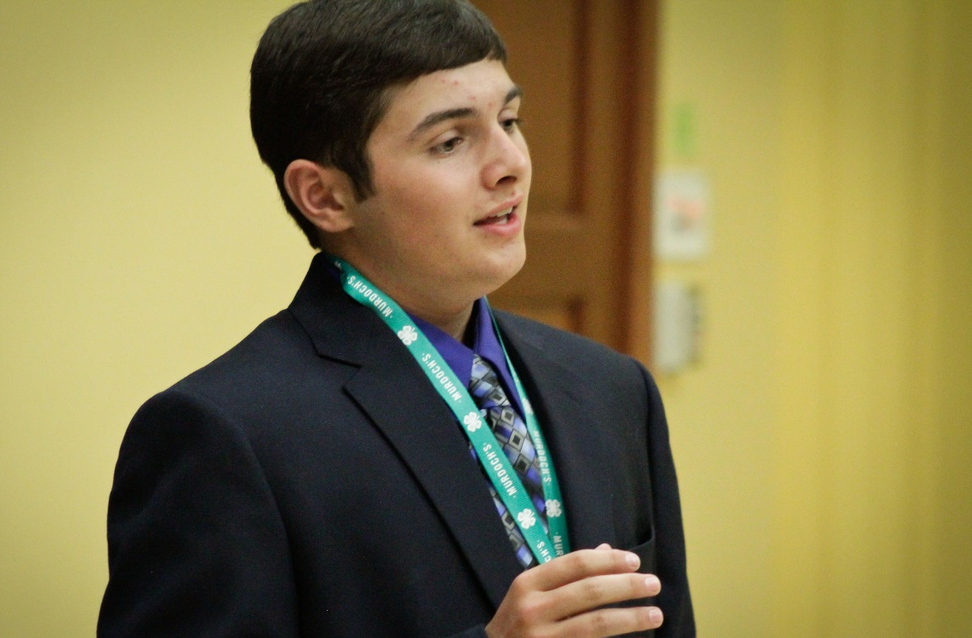
4-H PUBLIC SPEAKING: Prepared Speech
Participants present a 5-7 prepared speech. Talks are original material prepared by the contestant. The speaker will inform or educate the audience on a single issue or topic of their choosing.
The purpose of this contest is to encourage participants to give a speech in which they seek out accurate information, organize it into a useful format, and competently present the information.

Slide 12
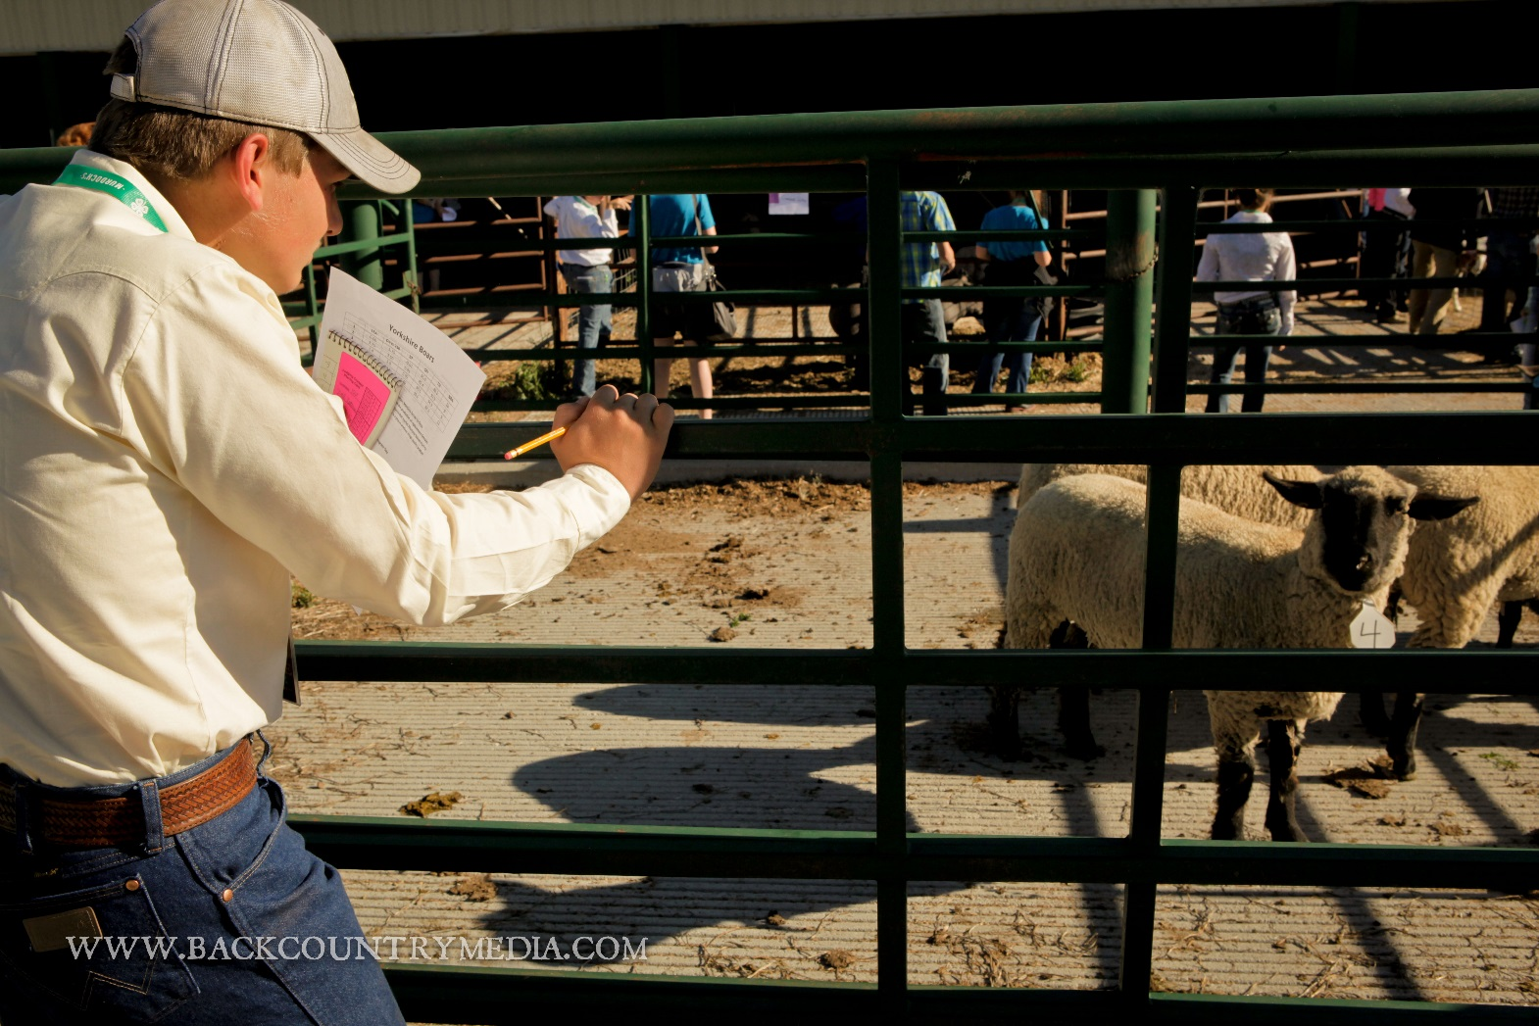
4-H LIVESTOCK EVALUATION CONTSET
Participants are provided an opportunity to evaluate livestock, determine placings and deliver oral reasons.
Classes may include:
Up to 4 Beef Classes
Up to 4 Swine Classes
Up to 4 Sheep Classes
2 classes of market/breeding meat goats
6 Reasons Classes
The contest maximizes the youth livestock
learning experience as well as public speaking skills.

Slide 13
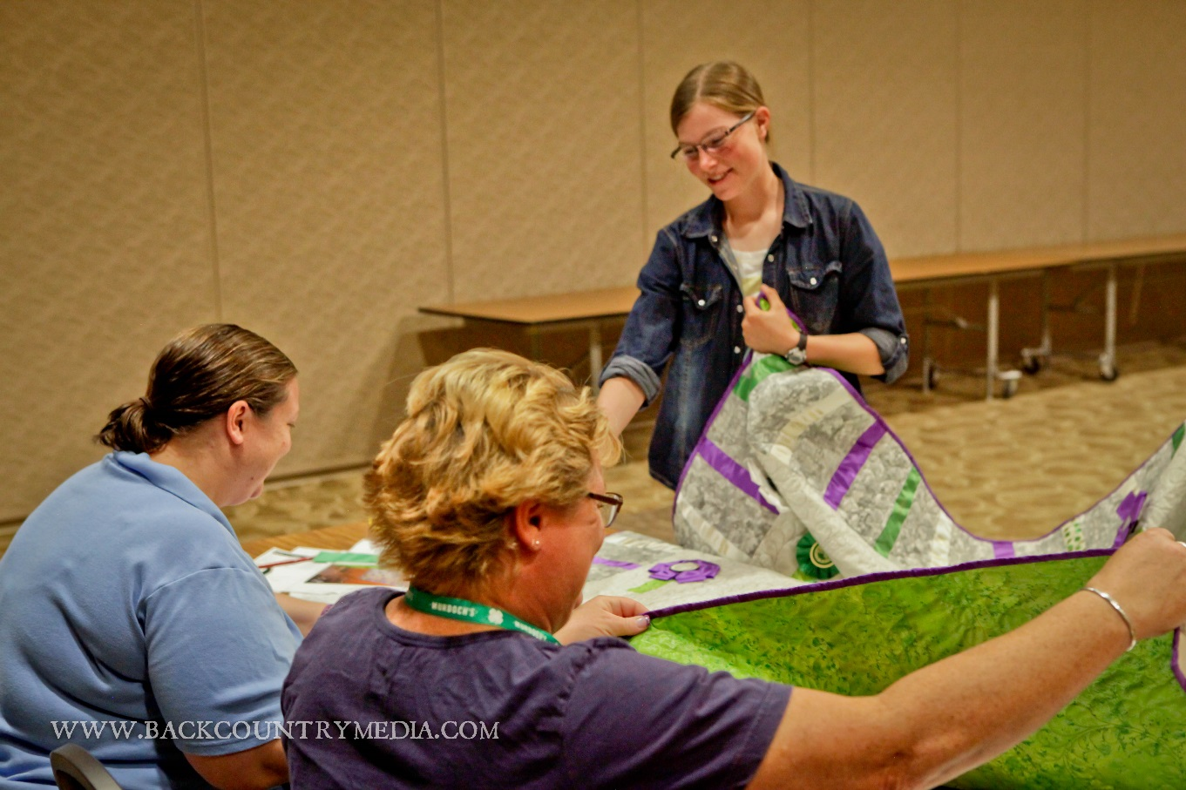
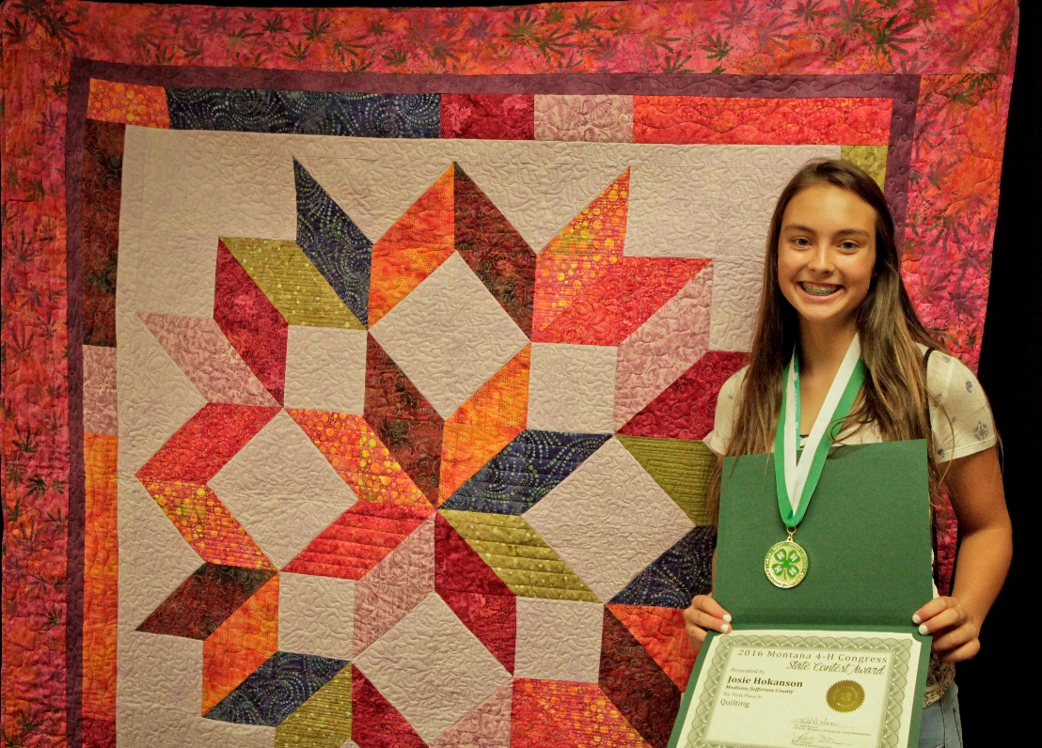
4-H QUILTING
CONTEST
The Quilt Contest is an educational component of the 4‐H Clothing and Textiles program. It demonstrates the application of the principles of design and an understanding of the techniques required to construct a quilt or other quilted item.

Slide 14
New in 2016
CAREER COMMUNICATIONS CONTEST
To allow 4-H members to learn skills related to careers, including research, application, resume writing and interviewing.
  Complete the provided job application
  Develop a cover letter and résumé
  Participate in a job interview
VIDEO CONTEST
To allow 4-H members to learn communication skills through preparing and presenting a video, as well as answering questions from the audience.
All videography and editing done by contestants.
Follows copyright laws regarding music, still images, clip art, etc.
Includes contestant’s choice of music and video production techniques.
Format may include video footage, still photography, computer animation, stop motion, etc.

Slide 15
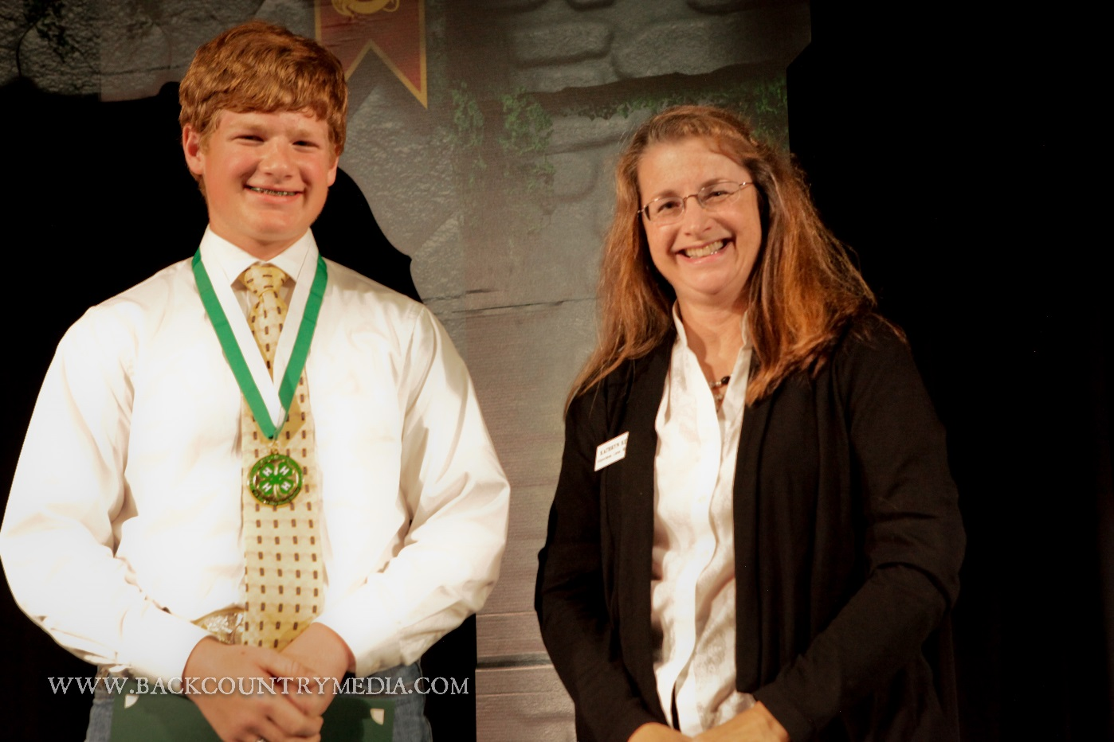


Complete contest guidelines, scoresheets and award details are available HERE.
Don’t miss your chance to compete in state contests. Make sure you know your county contest deadlines in order to earn your eligibility.
2017 State Contests held during Montana 4-H Congress will be Thursday July 13th.

