Slide 1
Equine 101
Today’s Lesson: Body Condition Scoring

Slide 2
What is body condition scoring?
An objective system of evaluating a horse's level of body condition (amount of stored fat) and assessing a numeric score to facilitate comparisons between horses.
Important so you know your horses average body score, can adjust your feed plan and keep your horse overall healthy.
Typically horses are scores on a scale from 1-9.
1 being Poor all the way to 9 being Overly Obese.

Slide 3
Objectives for today’s lesson
Students will be able to define what Body Condition Scoring(BCS) is
Students will be able to identify key body areas and other factors for a BCS
Students will be able to evaluate a horses BCS

Slide 4
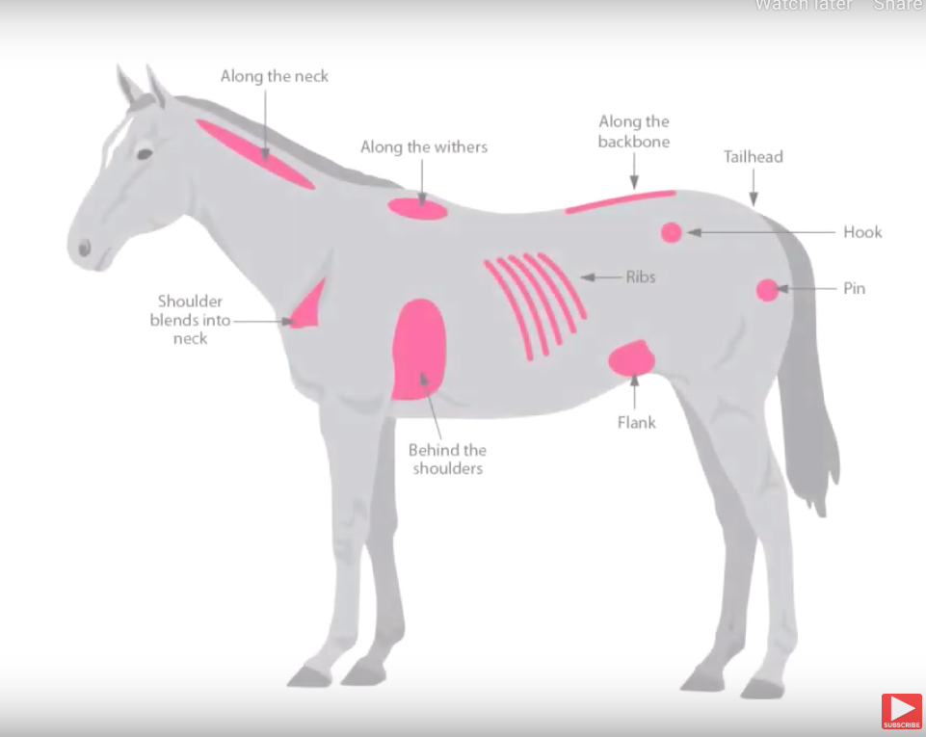
Key Body Areas Other important factors
Along the neck
Withers
Along the backbone
Behind the shoulders
Where shoulder blends into neck
Ribs
Flank
Hook
Pin
Tailhead
Age
Temperament
Metabolism
Level of work
Breed
Current or past injuries/illness
Time of the year
If a mare is pregnant or currently has a foal

Slide 5


Slide 6
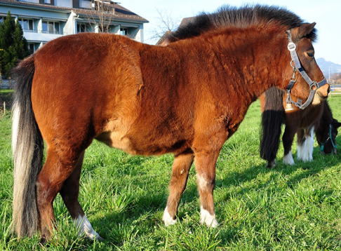
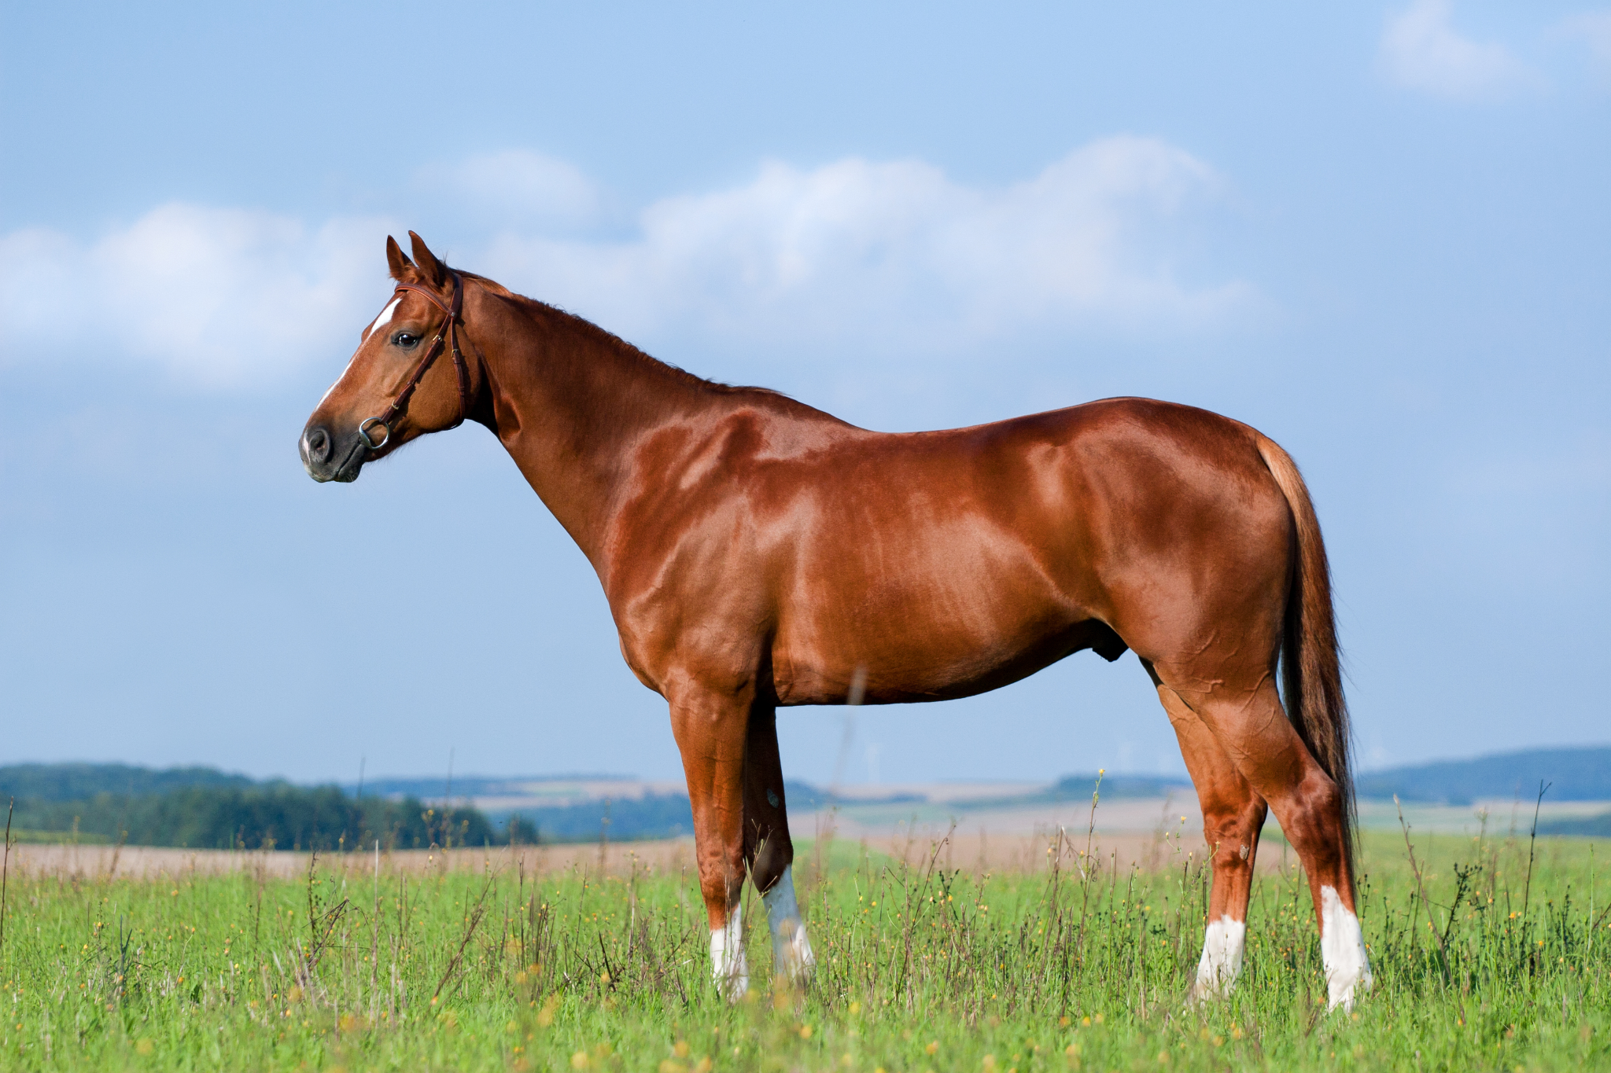
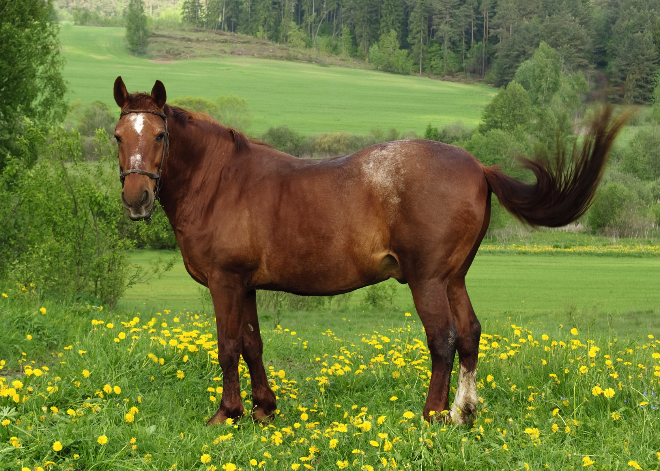

Let’s do some Scoring!
Discuss identifying factors.
Also consider age of the horse and breed when you are scoring!

