Slide 1
What is 4-H
Robotics

Slide 2
Who can tell me what 4-H is?
An out of school fun educational experience
Over 200 different projects!
Opportunity to make new lifelong friends
Learn about things your passionate about!
Learn life skills
Try something new!
Build connections with your community

Slide 3
4-H Robotics Project
Robotics introduces science, math, engineering and technology skills while teaching life skills.
Robotics with EV3
Use the newest LEGO technology to learn what a robot is, how to build one, and how to program it. Activities are based on the EV3 core set available from LEGO Education for about $380. A computer for running programming software and internet access to watch videos are required. Appropriate for all age levels. Curriculum authored by The Ohio State University.
Junk Drawer Robotics, Level 1
Youth are challenged to build robots from everyday items. Youth explore and learn about robot arms. Concepts covered include arm designs, and three-dimensional space. Big ideas include form and function, scientific habits of mind, and engineering design. None of the levels require or use computers. Youth will use their Robotics Notebook to record learning experiences, robotic designs and data from investigations.
Junk Drawer Robotics, Level 2
Youth learn about robots that move with legs, wheels and underwater. Concepts covered include friction, basic electrical power and motors, engineering constraints, gear system and buoyancy.
Junk Drawer Robotics, Level 3
Youth will explore sensors and analog and digital systems. The track introduces simple electronic components; youth will build basic circuits to see how the components work. They will investigate basic elements of programming and instructions for robotic computer control.

Slide 4
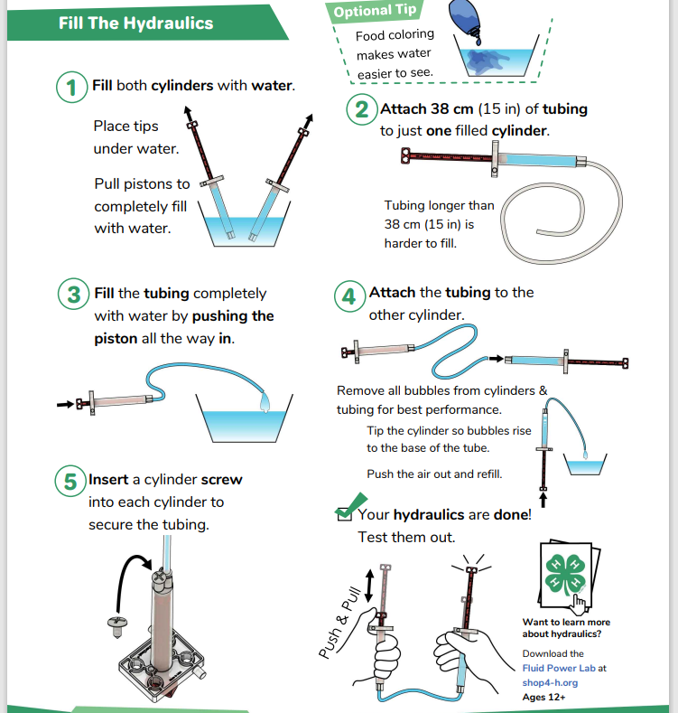
Hydraulic Claw Activity

Slide 5


Slide 6
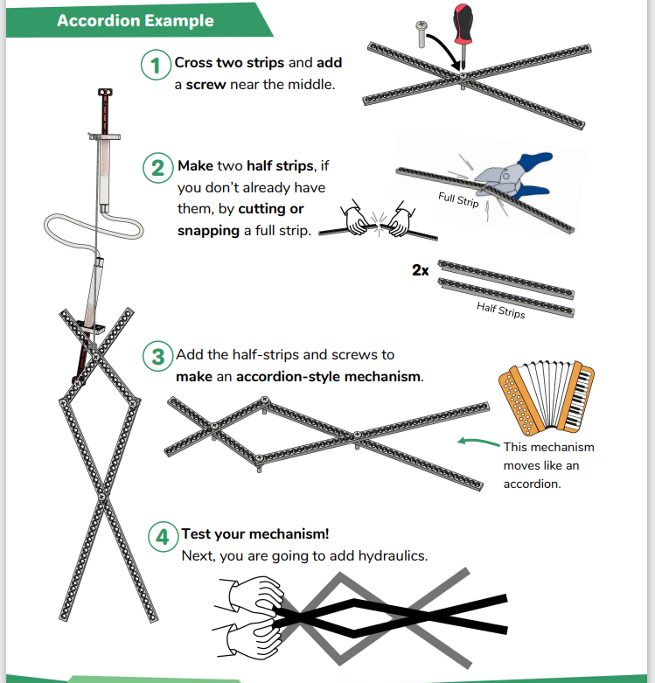

Slide 7
