Slide 1
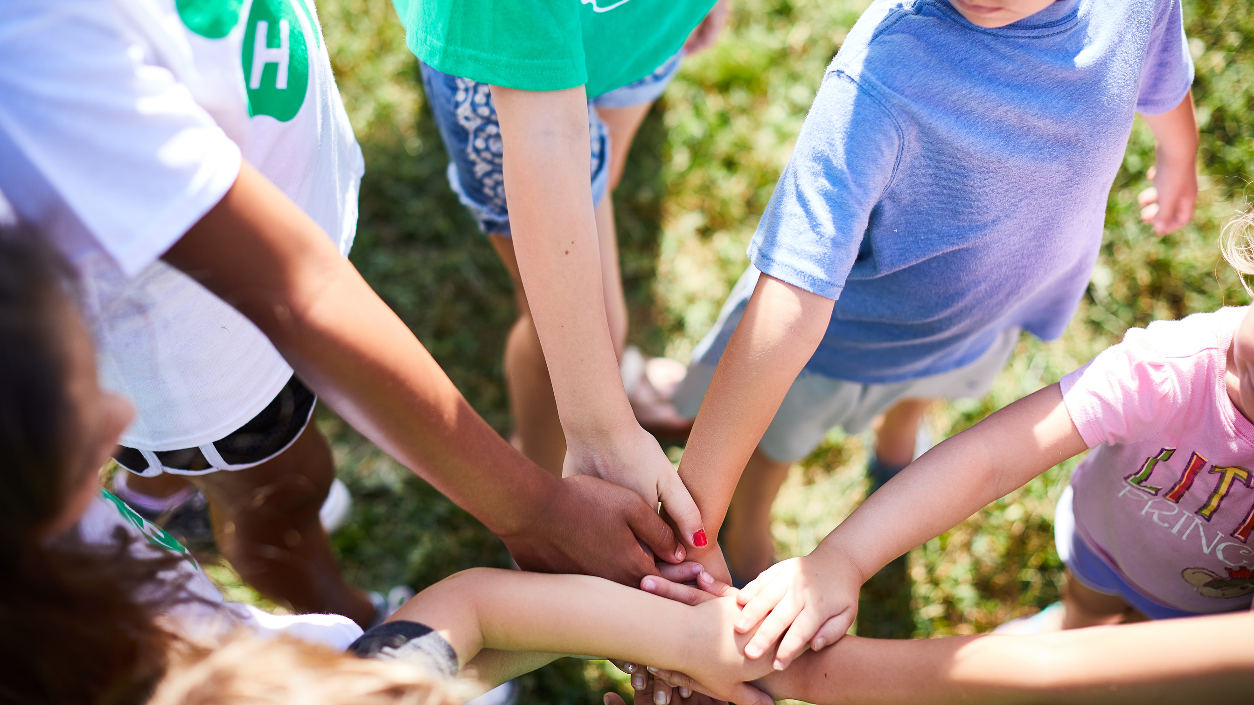


Navigating Record Books
GALLATIN COUNTY 4-H

Slide 2
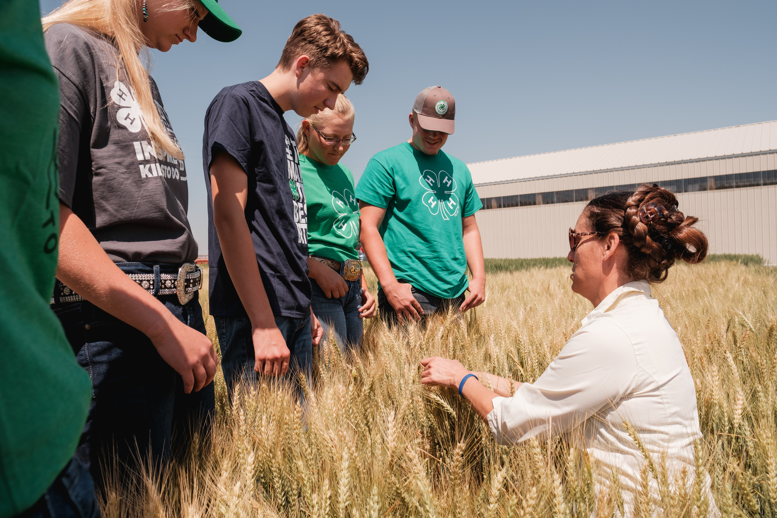

WHAT ARE RECORD BOOKS?

Slide 3
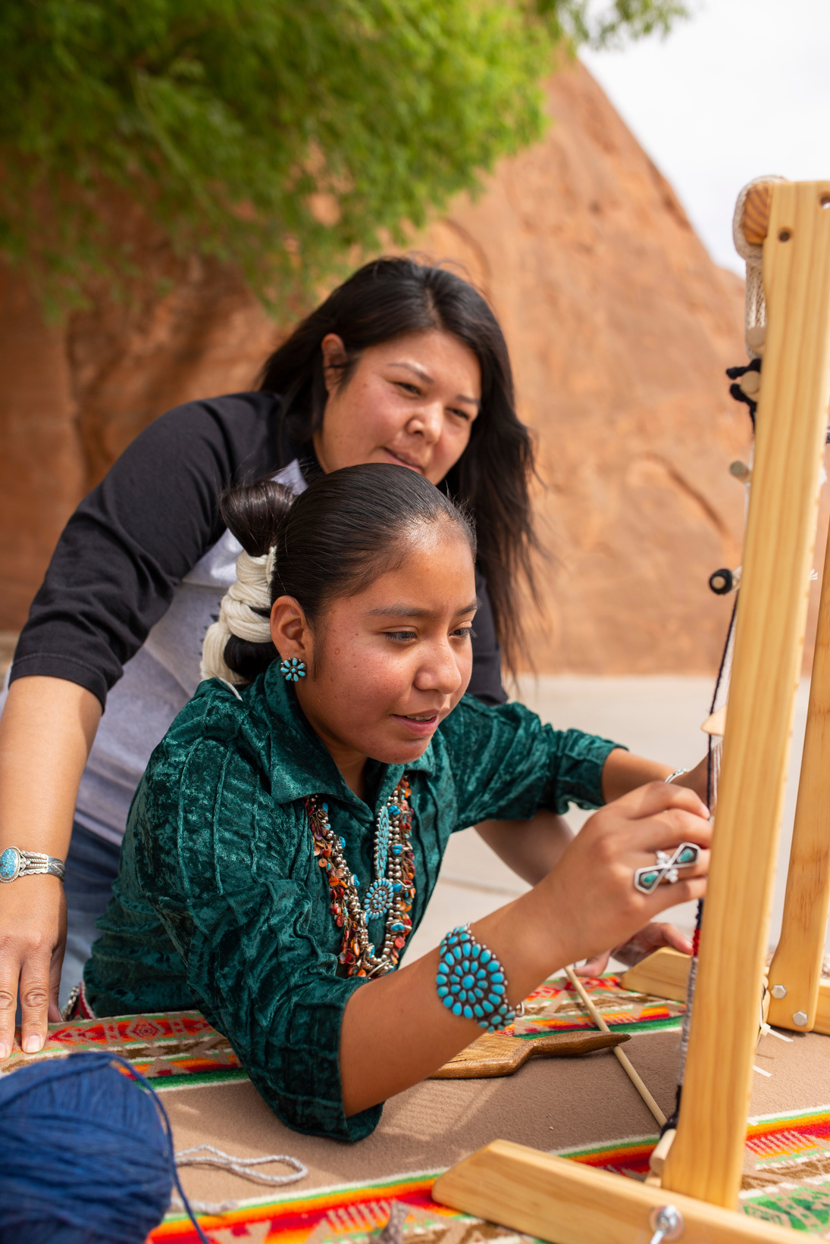
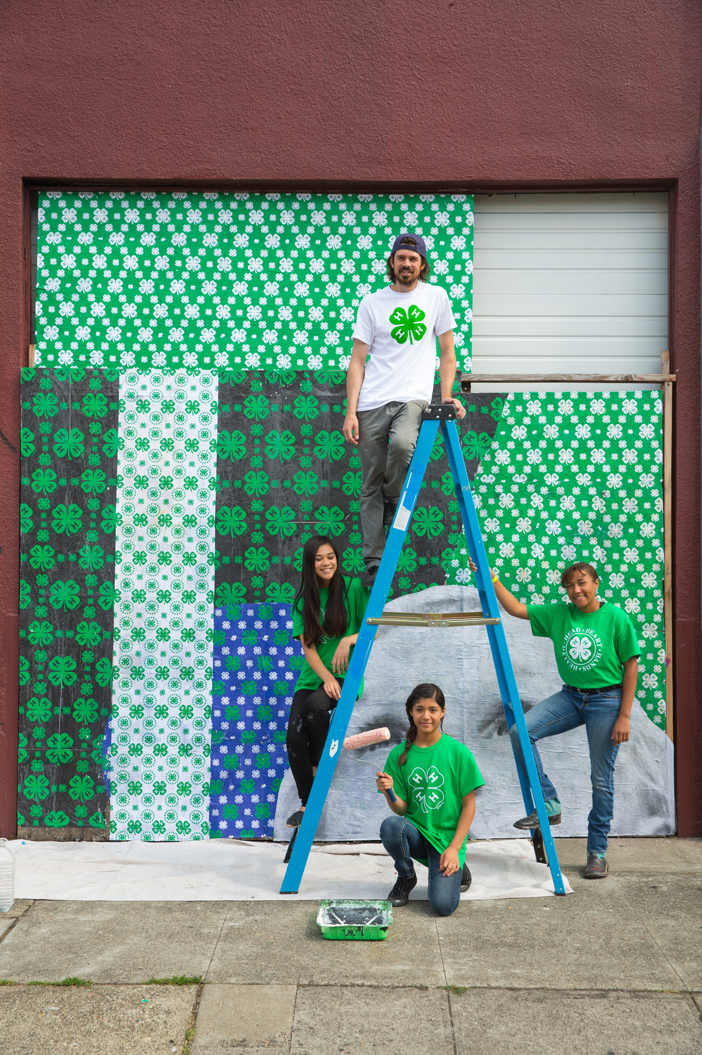
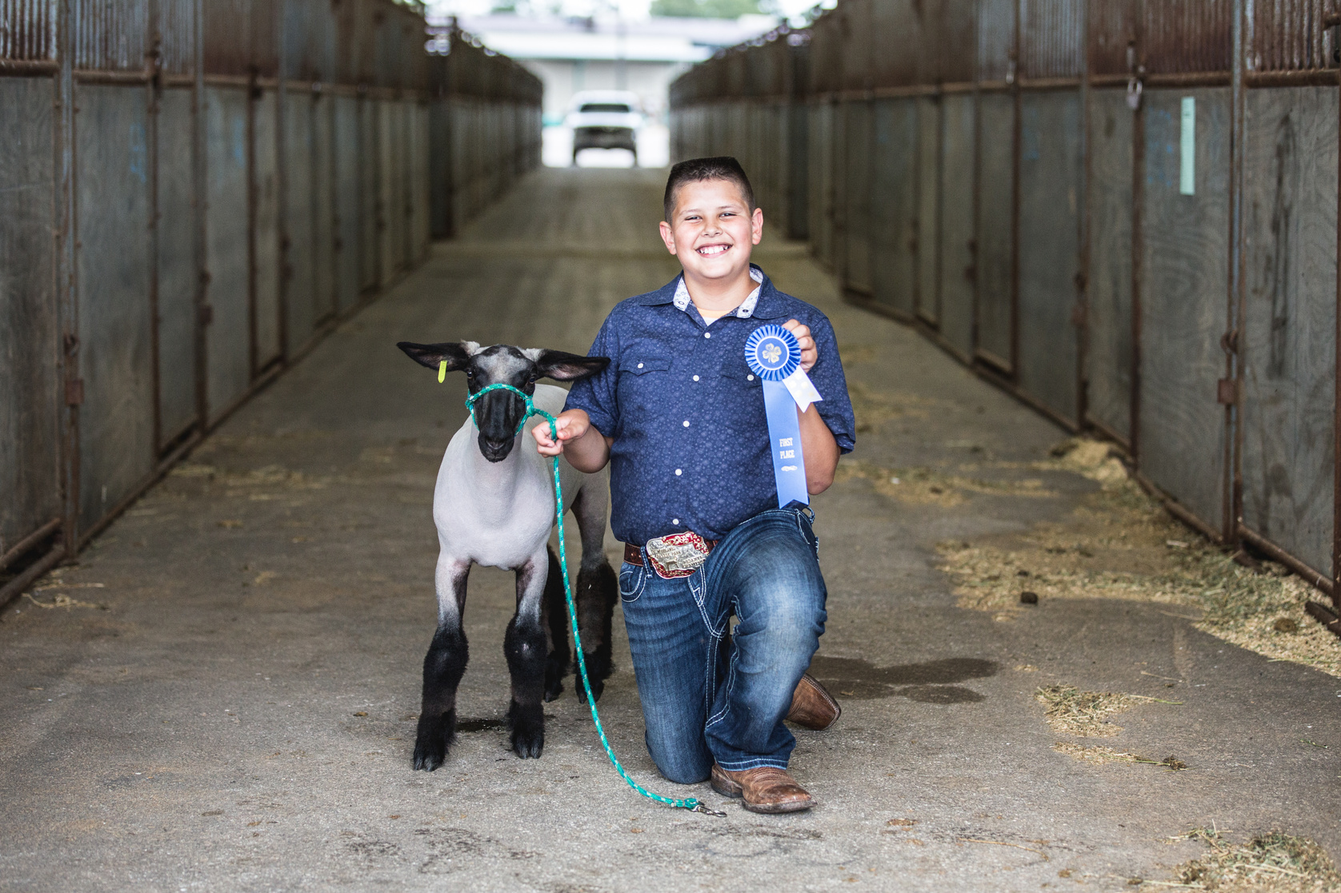
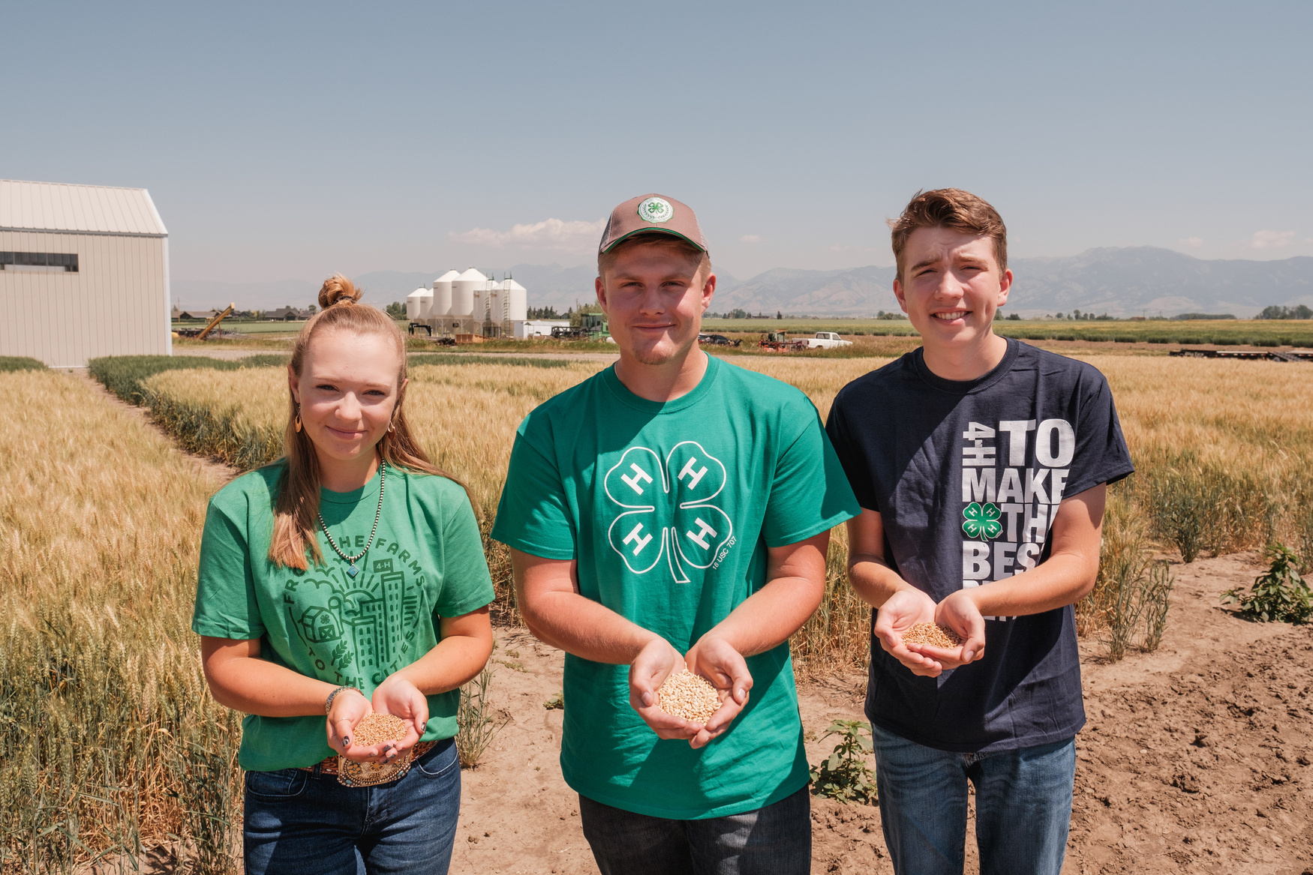
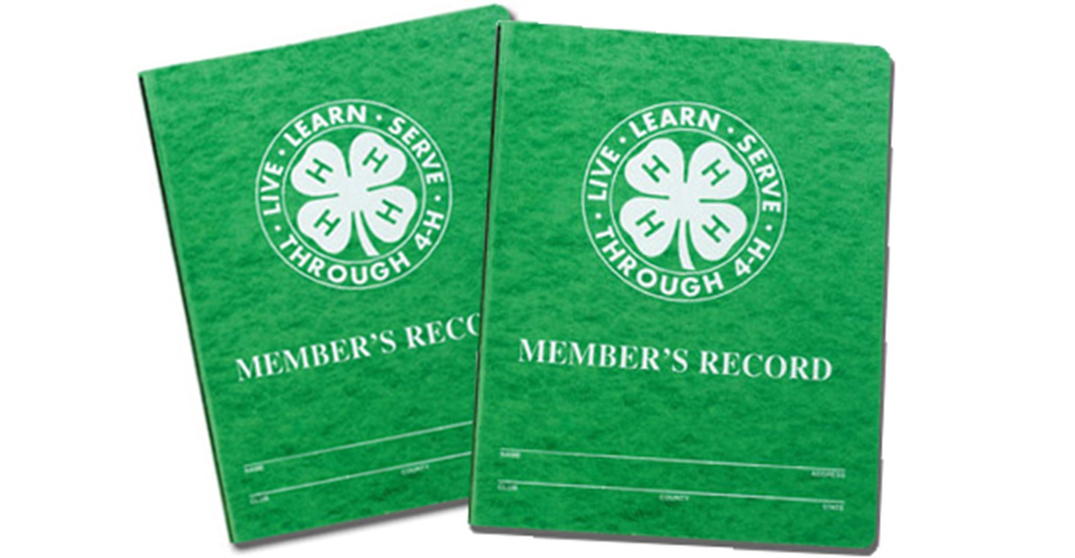
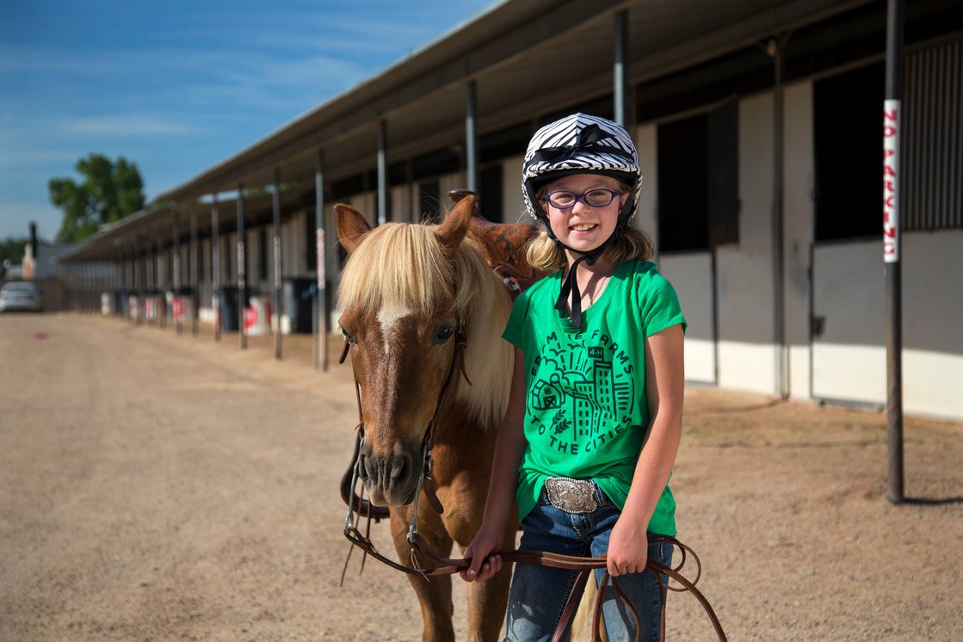
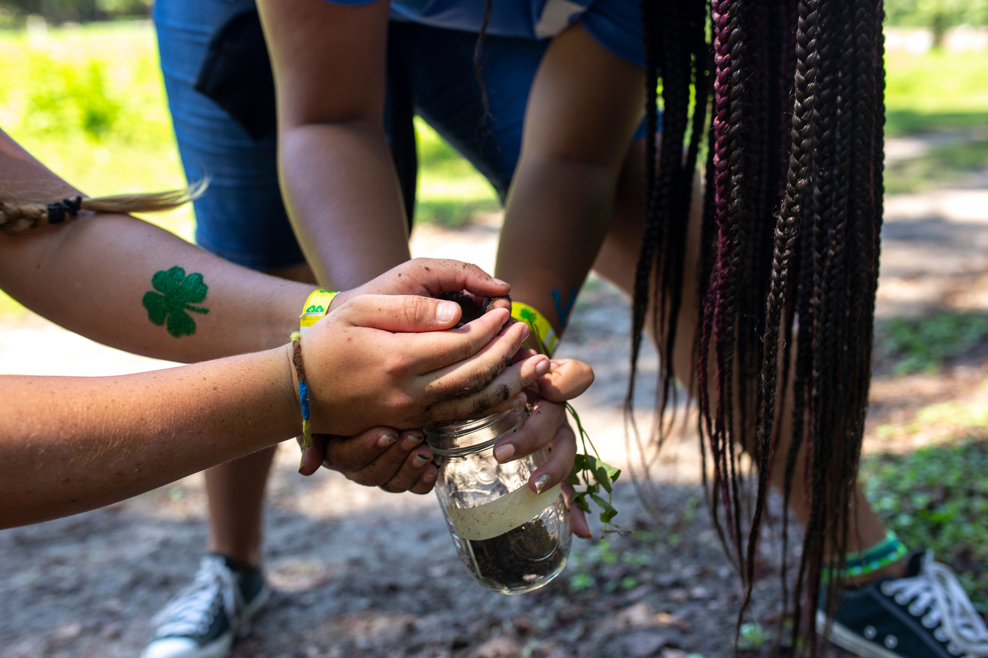

The Record Book is a summary of your 4-H Year. A log of activities, events, profits / losses, skill development and any other learning experiences, captured on specific forms.

Slide 4

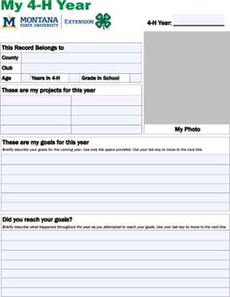
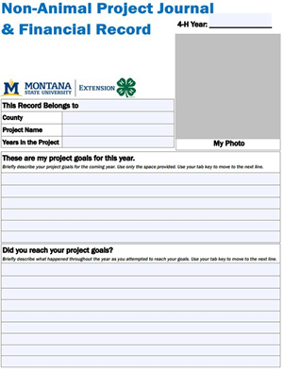
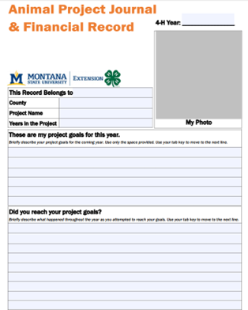

What Makes A Record Book?
My 4-H Year
Non-Animal Project
Animal Project
Project Curriculum Books
Second Subheader
-Complete one per year
-Focus on club and extracurricular, non-4- H project activities
-It is signed by your club leader or parent helper PRIOR to your interview
-Complete one per year per non-animal project
-Record any goals & activities directly related to your project (expenses, materials, skills)
-It is signed by your Project Leader PRIOR to your interview
-Complete one per year per animal project
-Record and goals & activities directly related to your project (expenses, vet care, feed)
-It is signed by your Project Leader PRIOR to your interview
-Complete 7 activities per year per project
-Learning activites - at home or during meetings
Optional Components: My 4-H Story – story written about their year, project and experiences.
Pictures of your 4-H Year, including activities outside of 4-H.

Slide 5
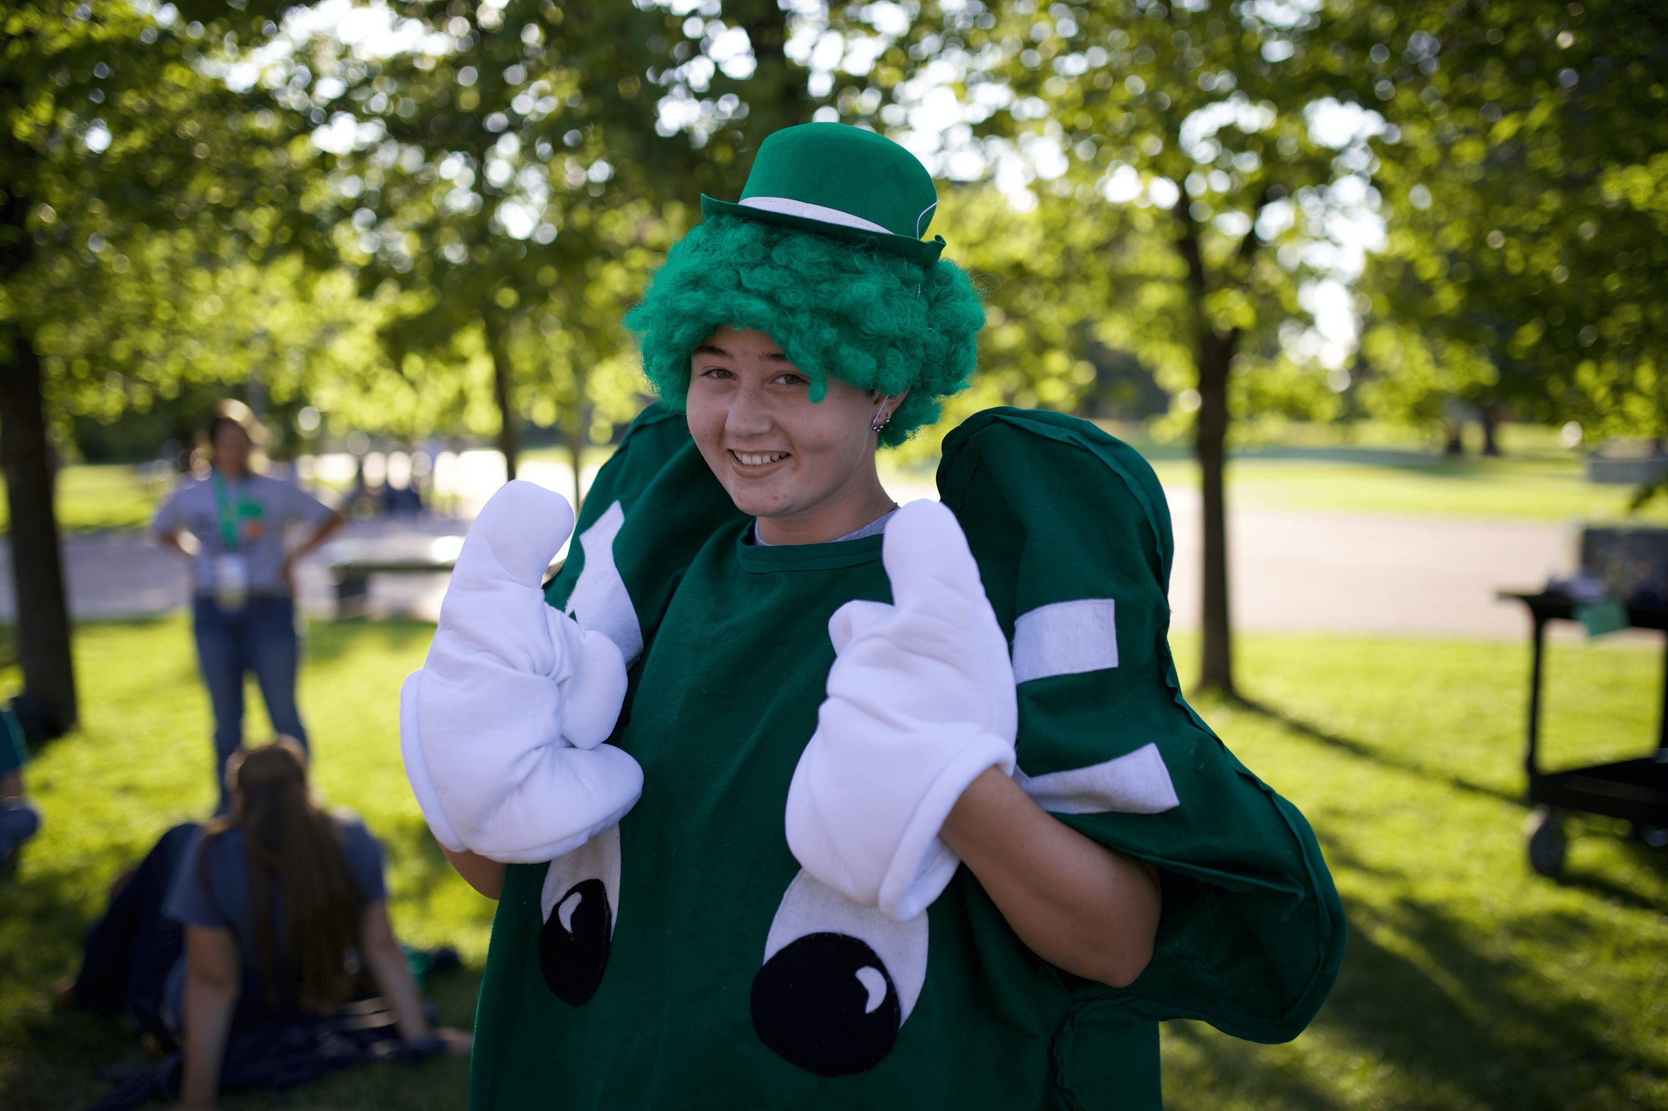
Examples
Michael is 8 years old and is in the Dry Creek Club, the poultry project and the swine project.
Taylor is 17 years old and is a Member At Large, is in the sewing project, leadership project and the rabbit project.
Sarah is 6 years old and is in the Belgrade Pioneers Club, the dog project and the Cloverbud project.

Slide 6
Examples
Michael is 8 years old and is in the Dry Creek Club, the poultry project and the swine project.
(1) My 4-H Year, signed by Club Leader
(2) Animal Project Journals
Taylor is 17 years old and is a Member At Large, is in the sewing project, leadership project and the rabbit project.
Sarah is 6 years old and is in the Belgrade Pioneers Club, the dog project and the Cloverbud project.

Slide 7
Examples
Michael is 8 years old and is in the Dry Creek Club, the poultry project and the swine project.
(1) My 4-H Year, signed by Club Leader
(2) Animal Project Journals
Taylor is 17 years old and is a Member At Large, is in the sewing project, leadership project and the rabbit project.
(1) My 4-H Year, signed by parent/guardian/helper
(2) Non-Animal Project Journals
(1) Animal Project Journal
Sarah is 6 years old and is in the Belgrade Pioneers Club, the dog project and the Cloverbud project.

Slide 8
Examples
Michael is 8 years old and is in the Dry Creek Club, the poultry project and the swine project.
(1) My 4-H Year, signed by Club Leader
(2) Animal Project Journals
Taylor is 17 years old and is a Member At Large, is in the sewing project, leadership project and the rabbit project.
(1) My 4-H Year, signed by parent/guardian/helper
(2) Non-Animal Project Journals
(1) Animal Project Journal
Sarah is 6 years old and is in the Belgrade Pioneers Club, the dog project and the Cloverbud project.
Records & Interview not required due to Cloverbud age (5-7)
Records are not scored/judged

Slide 9


Record Book FAQs
Where do I find the Forms I need?
How do I keep these documents organized?
  Extension Office
  ZSuite
  https://www.montana.edu/extension/4h/projects/support/record_books/index.html
  The green clover folder is optional ($3 at the Extension office).
  Binders - (1) per year or with dividers to clearly separate years.
  Leaders/parents initial 7 activities per year in workbook.
Where do I get a Project Workbook?
  Extension office after you register/pay
  One level of workbooks can last up to 3 years in the project (21 activities / 3 years = 7 activities per year).
Do records have to be handwritten?
  Records can be handwritten on paper forms or typed on ZSuite online record books
  Online can be finicky with saving/updating
  Accommodations per child - let office know

Slide 10

WHY ARE RECORD BOOKS IMPORTANT?

Slide 11
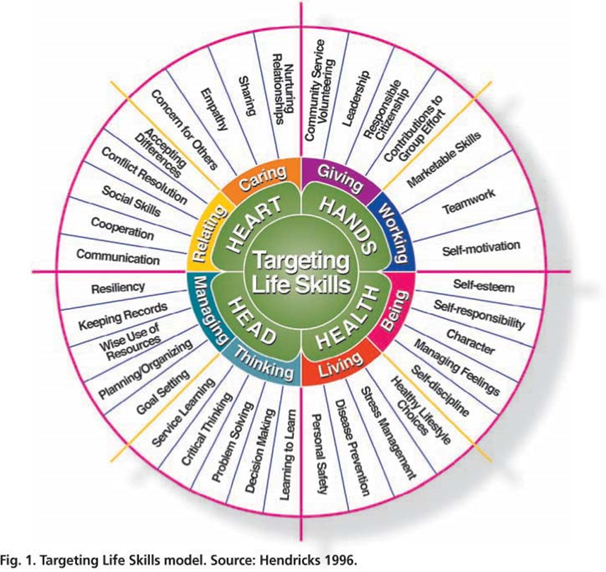

Slide 12


Slide 13
  4-H Record Books encourage members to set goals, pursue strategies to meet those goals, and to shift gears in the face of challenges and obstacles.
  Completing records and bookkeeping are valuable life skills.
Record books are NOT a form of punishment set forth by the 4-H leaders or 4-H Office.

Slide 14
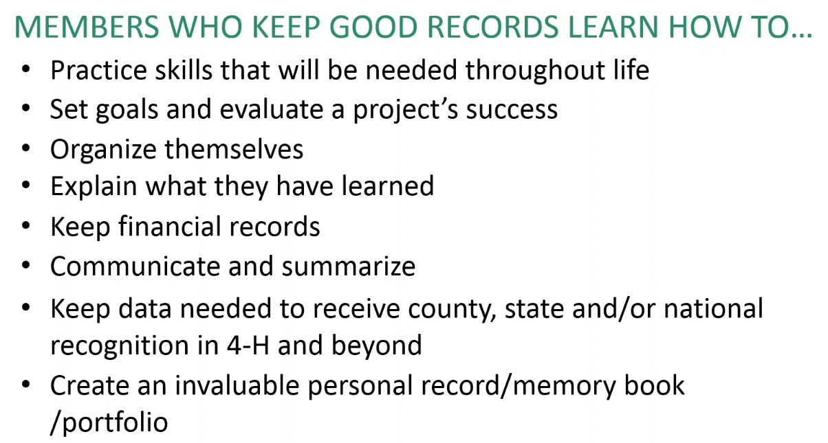

Slide 15
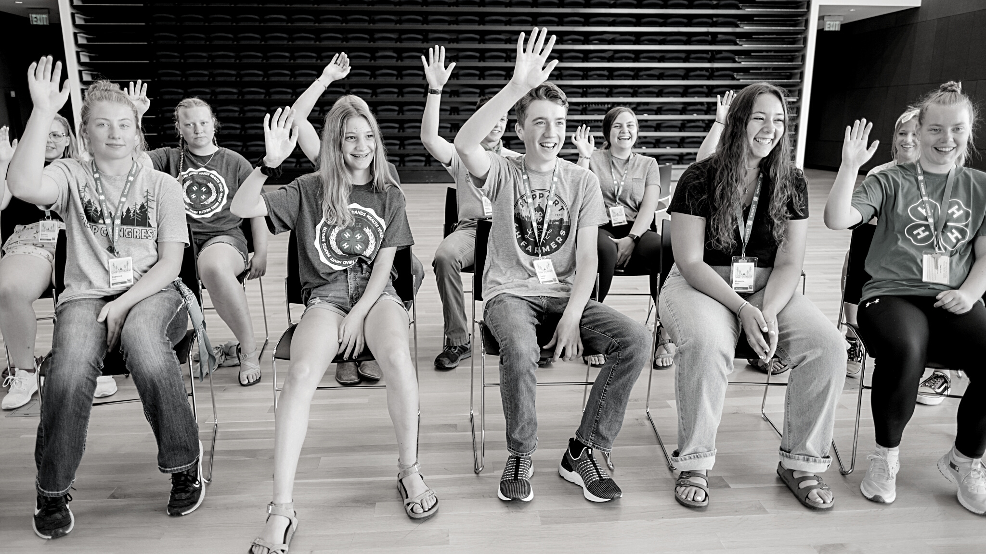
SET GOALS AND EVALUATE A PROJECT'S SUCCESS

Slide 16
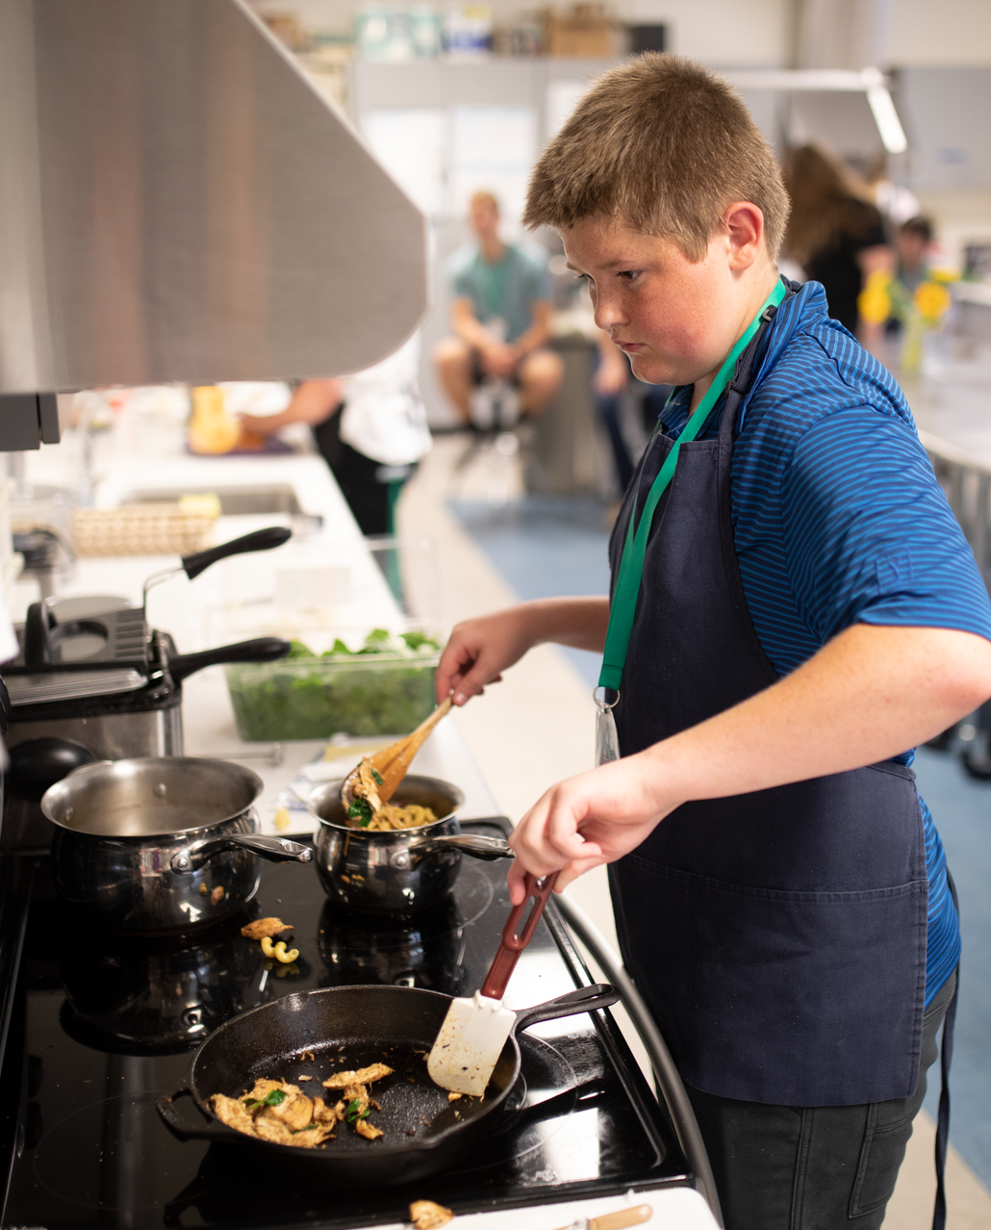
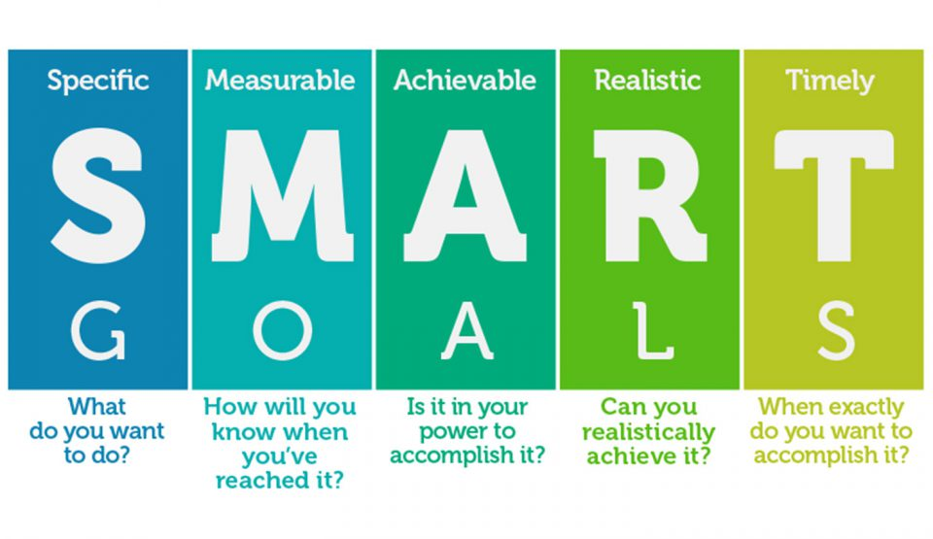

SETTING S.M.A.R.T GOALS

Slide 17
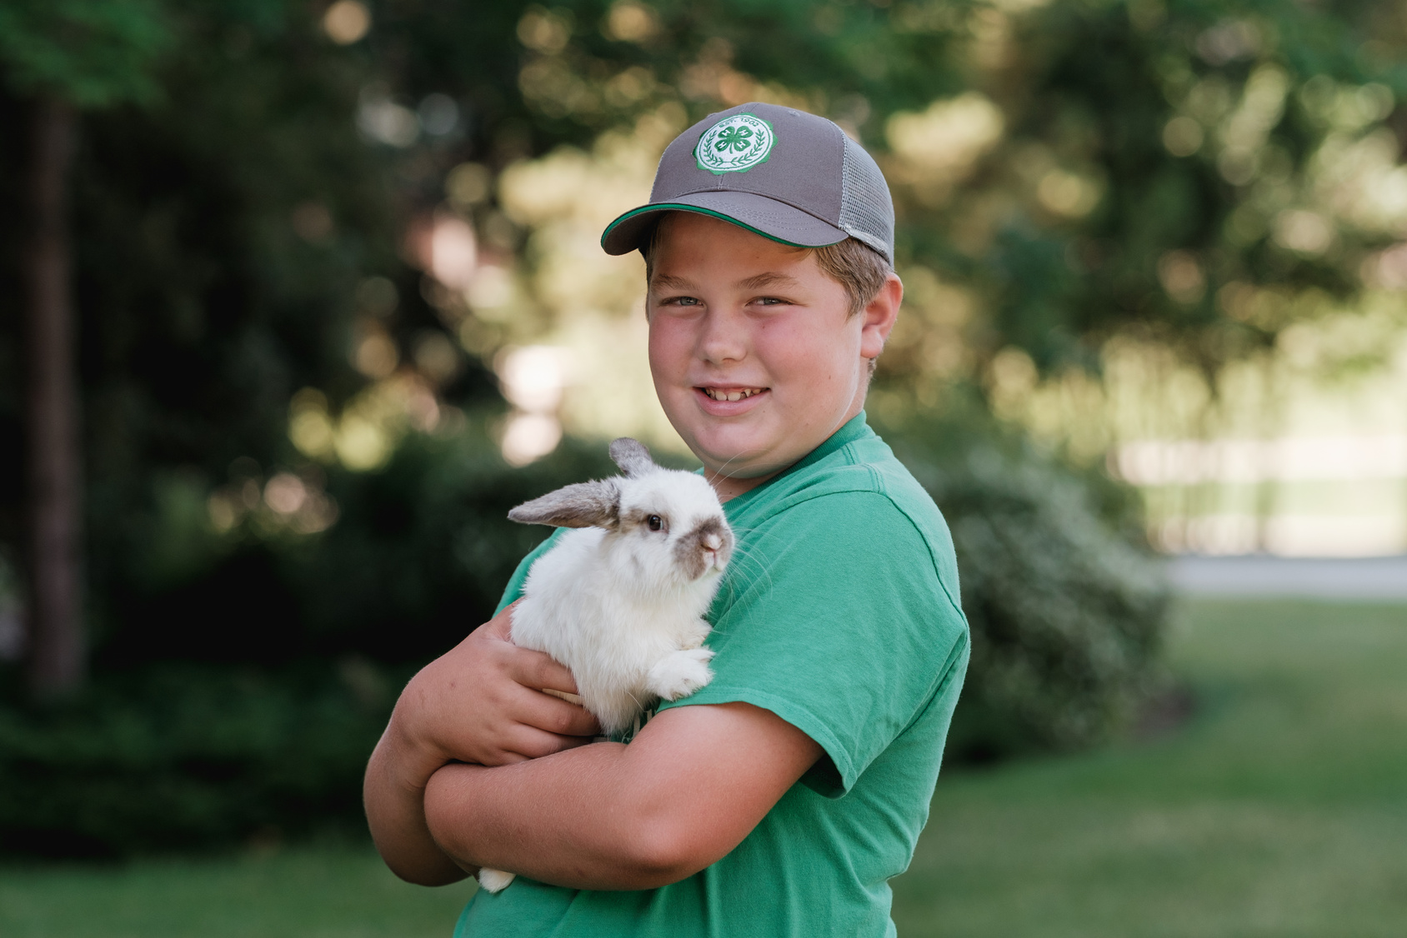

Do's & Don'ts
"My rabbit eats orchard grass pellets and went to the vet last week for a vaccine. I recorded my expenses, date and type of vaccine all in my Animal Project Journal"
  DON'T wait until the last minute to fill out record books
  DON'T forget to get the receipts from any purchases
  DON'T do all the work as the parent/guardian
  DO work on your project curriculum book's activities regularly
  DO take pictures throughout the year to add to your record book
  DO keep your records tidy in a 3-ring binder or report folder
  DO keep records/recordkeeeping age-appropriate
"I participated in County Communication Day and attended 3 workshops for my leadership project. I recorded these activities in my My 4-H Year and my Non-Animal Project Journal.

Slide 18

Tracking The Timeline
Record Books & Achievement Journals DUE
Record Book Interviews
4-H Year Begins
Week BEFORE Fair
If nominated for a project award, books will be re-submitted
4-H Year Ends
October 1st
September 30th
Record Books DUE for Fair
Big Sky Country State Fair
Awards Night
Late September every year
LAST Wednesday of June
July

Slide 19
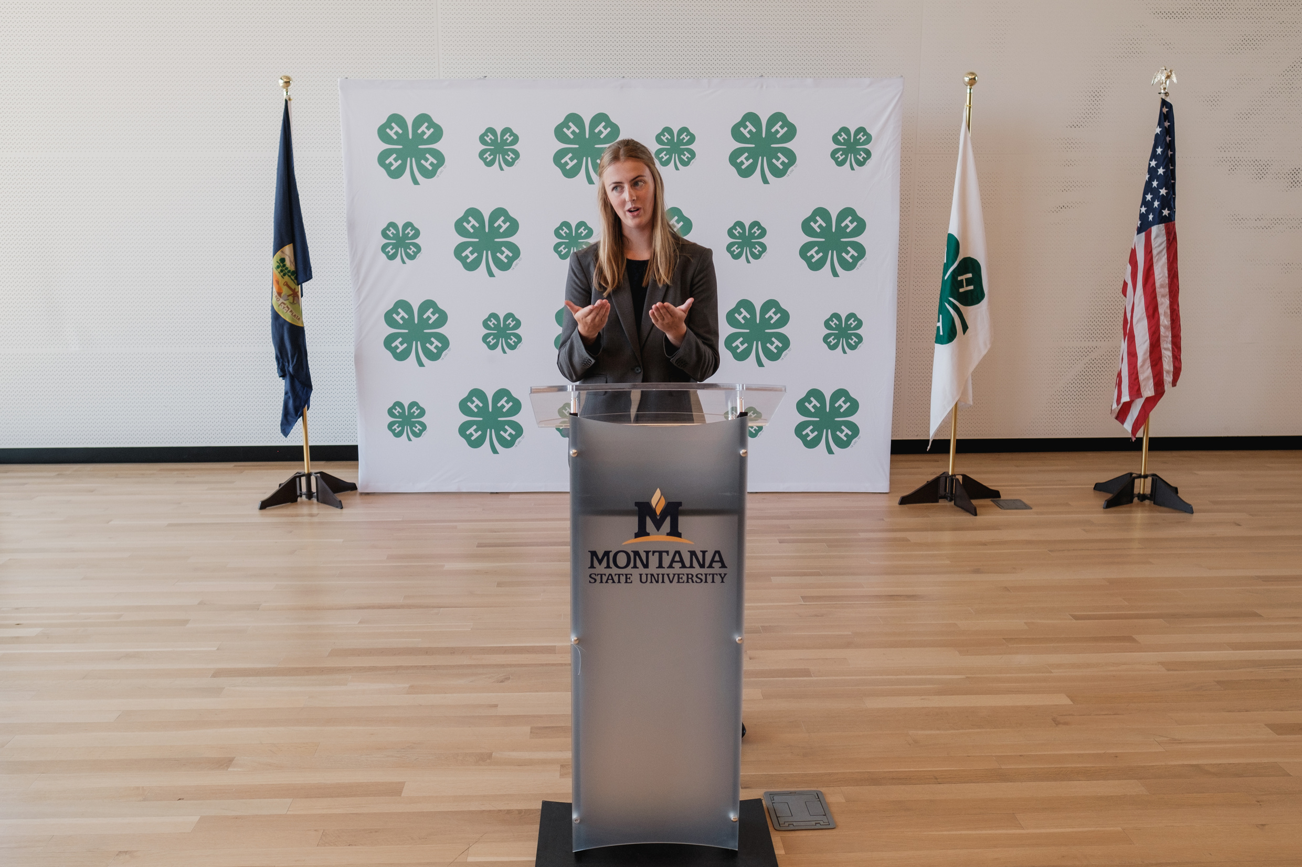
Looking Ahead
  Record Book Interviews
    This is the opportunity for the member to discuss the knowledge/skills learned about their project from the past year with an Adult Volunteer from the community.
    REQUIRED if participating in Fair
    Records will be reviewed by leaders prior to interviews, judge will look over/score during interview.
  Fair Week & Market Livestock Auction
  Awards Night
  Achievement Journals
  Scholarships

Slide 20


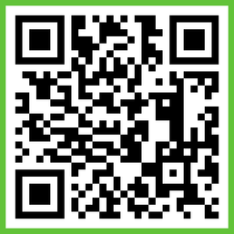


Where to Find 4-H Information
Gallatin County 4-H Website
  Forms and Documents, Newsletter, Online enrollment, Record Books
Email Listserv
  Enrolling on ZSuite auto-adds you to our listserv
  Reminders, announcements, newsletter, opportunities, deadlines
Monthly Newsletter
  Monthly 4-H Newsletter with all the information you will need to stay in the loop with 4-H activities, events and opportunities.
BAND App
Facebook

Slide 21
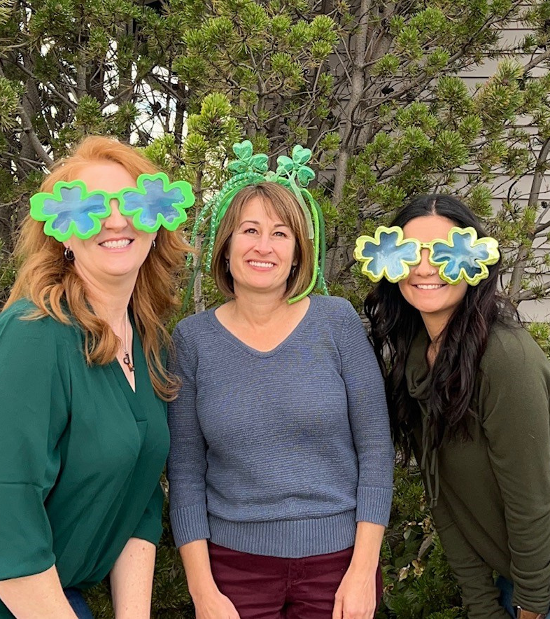

Questions?
Thank you!

