Slide 1
Some Methodological Considerations for Publishing Engineering Education Research
A Focus on Survey Development

Slide 2
Threats to Experimental Validity
Internal Validity - the degree to which observed differences on the dependent variable are a result of manipulation of the independent variable and not some other extraneous variable.
External Validity - degree to which results are generalizable to other groups and environments outside the experiment. (Ecological validity).

Slide 3
Engineering Leadership: Faculty Perceptions and Profiles” (Schell & Kauffmann)
Schell & Kauffmann (2016) reported that of the 154 participants of which 123 or 80% completed the survey.
Was the sample representative of the population?
How precise are the results?
Creative Research Systems’ can Sample Size Calculator help us answer these questions.

Slide 4
External Validity for Survey Research : Sampling
Representativeness or generalizability of results
  Confidence Level - is the probability that a value in the population is within a specific, numeric range from the corresponding value computed from a sample (Alreck & Settle, 2004)
  Confidence Interval - also called margin of error is the plus-or-minus figure usually reported in survey research (Rea & Parker, 2005).

Slide 5


Threats to Internal Validity
Mortality
Maturation
Testing
Research Methodology
Instrumentation
Selection-Maturation
History

Slide 6
“Engineering Leadership: Faculty Perceptions and Profiles” (Schell & Kauffmann)
This study sought to test the hypothesis that the faculty engaged in EL development come from a different background than those of the larger engineering faculty.
Descriptive Research
Survey Research

Slide 7
Data Sources
The first source involved analysis of biographical information of authors actively publishing in the LEAD division of ASEE.
These findings are augmented through the results of the study’s national survey of engineering faculty.

Slide 8
Analysis of Biographical Information
Descriptive Results:
Categories were well-defined.
Similar to a content analysis – usually have two researchers “code” the information and check for consistency in demographic classifications (see Data and Findings , Data Demographics – LEAD Authors.
Use of tables would help to summarize the descriptive information for efficient presentation of results

Slide 9
National Survey
To augment these findings, a survey was developed and deployed to examine faculty perceptions about the role engineering education should play in the development of engineering leadership skills in undergraduate students.
What is missing?

Slide 10
National Survey: Instrument Validation or Establishing Validity Evidence
Face Validity – does the instrument “look” like it measures the construct(s) of interest. Does the instrument look legitimate?
Content Validity- Content validity considers whether or not the items on a given test accurately reflect the theoretical domain of the construct it claims to measure. Items should be representative of all the possible questions that could have been derived from the construct (Crocker & Algina, 1986; DeVellis, 2003).

Slide 11
Criterion Related Validity
Criterion validity refers to the ability to draw accurate inferences from test scores to a related behavioral criterion of interest. This validity measure can be pursued in one of two contexts: predictive validity or concurrent validity. In criterion-oriented validity, the investigator is primarily interested in some criterion which he wants to predict. (DeVellis, 2003)

Slide 12
Construct Validity
Construct validity is the degree to which a test measures what it claims, or purports, to be measuring" (Crocker & Algina, 1986)

Slide 13
Consequential Validity
Consequential validity refers to the notion that the social consequences of test scores and their subsequent interpretation should be considered not only with the original intention of the test, but also cultural norms (Messick, 1995).

Slide 14
Validity | Methods for Establishing Validity Evidence
Content | Map to constructs in the literature – Table of Specifications; (See Li, McCoach, Swaminathan & Tang (2008, p 48, Sec. II A); Expert Panel Review (See Li, McCoach, Swaminathan & Tang (2008, p 48, Sec. II B); Pilot studies
Criterion-Related Validity | Correlation with other validated instruments or compare test results with actual results. Used for achievement tests or other tests designed to measure some type of skill or attribute such as IQ, spatial ability, verbal ability.
Construct Validity | Factor Analysis and/or Confirmatory Factor Analysis. Used to verify that items “group” or load on the constructs they are intended to measure. See Li, McCoach, Swaminathan & Tang (2008, p 50, Sec. III A);

Slide 15
Instrument Development Process
Item Generation
  Review Literature – Existing Theory
  Table of Specifications
Expert Review (Content Validity)
Item Revision
Pilot Testing – Reliability Analysis
Distribute Instrument – Use data for content validation (factor analysis, etc.)

Slide 16
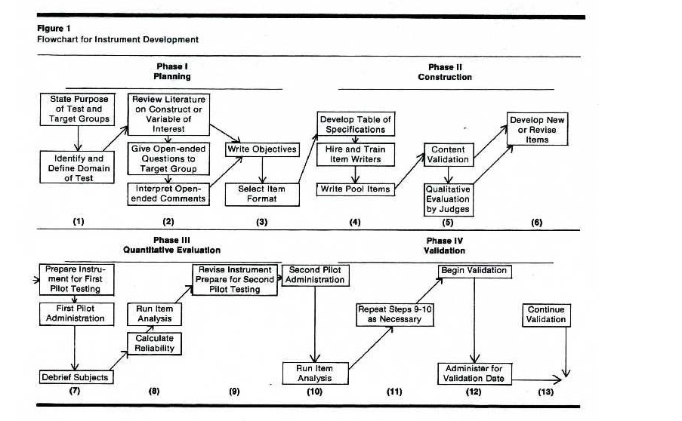
Benson & Clark (1982)

Slide 17
Coefficient Alpha
A measure of internal consistency reliability also. This type of reliability is used with items that have several possible answers which vary by degree or magnitude. For example, items that use a Likert scale such as “Strongly Agree to Strongly Disagree”.
See Li, McCoach, Swaminathan & Tang (2008, p 51, Sec. IV
Coefficient Alpha Formula

Slide 18
Construct Validity and Factor Analysis
Steps
Check assumptions
Conduct the factor analysis
Determine the number of factors to interpret
Interpret the underlying dimensions of the scale
Lastly
  Determine the internal consistency reliability

Slide 19
Stata
Before we get started we need to install two packages from the Stata Resources
sortl
You can go to the ”Search help” box and type in “sortl” and click on install from” http://fmwww.bc.edu/RePEc/bocode/s”. Click on the link to install
factortest
Again go to the “Search help” box and type in “facttortest” and install the package by clicking on factortest from http://fmwww.bc.edu/RePEc/bocode/f . Click on the link to install.

Slide 20
References
  Alreck, P.L. & Settle, R.B. (2004). The survey research handbook. Boston, MA: McGraw-Hill
Benson, J. and F. Clark (1982). A guide for instrument development and validation. The American Journal of Occupational Therapy,36(12),789-800
Crocker, L. & Algina, J. (1986). Introduction to classical test theory. New York: Holt, Rhinehart & Winston.
DeVellis, R. F. (2003). Scale development: Theory and applications (2nd ) . Thousands Oaks, CA: Sage.
Messick, S. (1995). Validity of psychological assessment: Validation of inferences from persons' responses and performances as scientific inquiry into score meaning. American Psychologist, 50(9), 741-749.
Rea, L.M. & Parker, R.A. (2005). Designing and conducting survey research: A comprehensive guide (3rd ). San Francisco, CA: Josey-Bass

