Slide 1

Qualitative Methodology I
Designing Innovative & Rigorous Engineering Education Research
Christine Rogers Stanton, Ph.D.

Slide 2
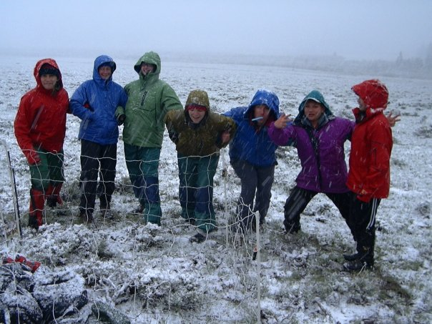
Introductions
Who
What
Why
Notes:
Who you are, what you do, why you are here

Slide 3

Overview & Objectives
Highlight opportunities for rigorous & innovative qualitative research in engineering education
Discuss ethical considerations & challenges
Look to examples from JEE article
Provide brainstorming time
Identify ways to “stand out”

Slide 4
What is Qualitative Research?
 | Quantitative | Qualitative
Purpose | WHAT is happening? Goal is to quantify results & generalize to larger population | WHY is this happening? Goal is to gain deeper understanding of social phenomena
Sample | Large sample (generalizable) | Small # of participants, cases, etc. (not typically generalizable)
Data | Focused on numerical data (e.g. surveys, assessment scores, etc.) | Focused on observational & linguistic data (e.g. observations, interviews)
Analysis | Statistical, Linear, & Positivist | Interpretive, Iterative, & Theory-Driven

Slide 5

Qualitative Research…
Is NOT basic action research or anecdotal (educational research differs from descriptions of scholarly teaching)
Is NOT unstructured or impulsive
Is NOT less rigorous than quantitative research
Untitled Oil on Canvas 2013 by KwangHo Shin

Slide 6
Benefits of Qualitative Research
Seeks answers to complex social problems & processes
Responsive to marginalized & underrepresented groups
Well-suited for small sample sizes & rural contexts
Explores how systemic issues inform local knowledge & practice
Generates specific examples, which can inform teaching practice
Supports integration of teaching, research, & service
Creates opportunities to innovate within the field (both in terms of research & pedagogy)
Notes:
Less than 6% of articles in JEE are qual (2005-2006 data)

Slide 7
The Call for Qualitative Research in Engineering Ed
“With recent calls for expanding the scope and rigor of engineering education research, use of qualitative methods to answer research questions that cannot be answered through quantitative methods is taking on increasing significance… We find that there are very few qualitative articles published, and even fewer which show epistemological consistency across different aspects of the research design. These issues may limit the rich, descriptive information that could be gained from qualitative inquiry, limiting the contributions qualitative studies could make to engineering education.”
(Koro-Ljungberg & Douglas, 2008, JEE abstract)
Notes:
In quantitative and most “hard” sciences research, achieving some agreement on a “truth” is seen as important; in qualitative research, “truth” is squishier
(For each of these, discuss possible areas of engineering ed research in tables, then as whole group)
One way to bolster rigor of qualitative research is to apply theory purposefully throughout the research process.

Slide 8
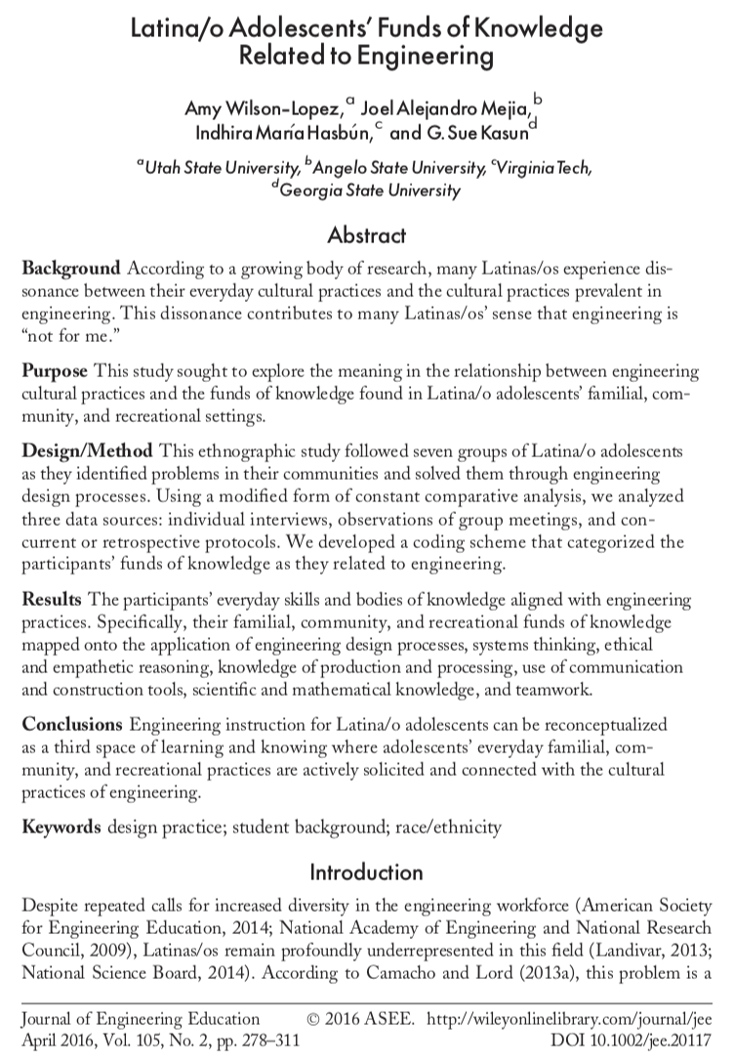
JEE Example

Slide 9
Coming to Qualitative Research
Positionality
Epistemology
Theory
What shapes our decision-making?
How can we use previous research & theory to guide our decision-making?
How can we be transparent & accountable in our decision-making?
Notes:
Our theoretical stance, or positionality, informs how we come to a research problem; furthermore, in qual research, the researcher is part of the instrumentation.
Where does our knowledge of the topic come from?
How can we view problems through various lenses?

Slide 10
Theory
“Well-designed qualitative studies often build on epistemological consistency across theoretical perspectives, research questions, and research methods… We find that there are very few qualitative articles published, and even fewer which show epistemological consistency across different aspects of the research design... We call on researchers to expand their use of qualitative methods and to design their studies with careful attention to epistemological consistency across the design.”
(Koro-Ljungberg & Douglas, 2008, JEE abstract)
STANDOUT TIP: Apply theory purposefully throughout design
Notes:
In quantitative and most “hard” sciences research, achieving some agreement on a “truth” is seen as important; in qualitative research, “truth” is squishier
(For each of these, discuss possible areas of engineering ed research in tables, then as whole group)
One way to bolster rigor of qualitative research is to apply theory purposefully throughout the research process.

Slide 11
Theory
Pragmatism (“truth” depends upon practical outcome)
Constructivism (“truth” is socially constructed)
  Situated Learning Theory
  Activity Theory
Critical Theory (“truth” is shaped by power structures)
  Feminism
  Critical Indigenous Research
Notes:
In quantitative and most “hard” sciences research, achieving some agreement on a “truth” is seen as important; in qualitative research, “truth” is squishier
(For each of these, discuss possible areas of engineering ed research in tables, then as whole group)
One way to bolster rigor of qualitative research is to apply theory purposefully throughout the research process.

Slide 12
JEE Example: Theory
“Our research methods aligned with constructivist traditions of qualitative inquiry, in which researchers seek to understand and describe a contextualized phenomenon (Lather, 2007). Constructivist research is based on the epistemological assumption that participants’ understandings, experiences, and standpoints form the basis upon which knowledge is constructed (Creswell, 2007). By implication, researchers must develop robust understandings of participants’ perspectives, and they must rely on emergent designs in which protocols are modified in dialogue with participants and others who hold these perspectives (Koro-Ljungberg & Douglas, 2008).”
p. 283
Notes:
This example demonstrates the link between theory and methods for data collection & analysis.
By recognizing the need to integrate participants’ perspectives into and throughout the research process, the team members support their claim to a constructivist stance.

Slide 13
Qualitative Design
Identify problem, purpose, & question(s)
Select methodology & methods
Analyze data
Report results

Slide 14
Problem & Topics
Identifying a Problem for Qualitative Research
Look to unanswered questions from research literature
Note “gaps” (e.g. small pops, underrepresented voices)
Topics: Learning Environments, Transfer of Theory to Practice, Achievement, Motivation, Professional Readiness, Diversity & Inclusion, College/Program Climate, Cultural/Socio-Political Contexts, Identity, Persistence & Retention, Communication & Interaction, Collaboration, Pedagogy
STANDOUT TIP: What makes this context unique?
Notes:
Brainstorming at tables

Slide 15

Research Questions
Developing a Compelling Research Question
Link directly to problem & purpose
Use “How” and “Why” starters
Focus on social behaviors, topics, & gaps
Be specific in terms of population & site
Notes:
Brainstorming at tables

Slide 16
JEE Example: Problem
“Engineering cultures are characterized by an ‘engineering way of thinking,’ ‘engineering way of doing,’ and ‘being an engineer’ (Godfrey & Parker, 2010, p. 9). Many traditionally underrepresented students in undergraduate engineering programs often feel like they ‘don’t belong,’ in part because their cultural practices and identities do not comport with those of engineering cultures (Chinn, 1999; Foor, Walden, & Trytten, 2007; McGee & Martin, 2011)... To mitigate the discrepancies that many underrepresented students face between their familial practices and those in their STEM courses, several researchers (Buxton, 2006; Gutstein, Lipman, Hernandez, & de los Reyes, 1997) have called for instruction that incorporates students’ home languages, familial and peer practices, and local community problems.”
p. 279

Slide 17
JEE Example: Purpose & Questions
“The purpose of this study was … to identify how Latina/o adolescents possessed engineering-related bodies of knowledge and skills derived from their everyday settings.”
p. 279
“What funds of knowledge did the participants apply as they developed solutions to their self-selected problems?”
“What engineering-related funds of knowledge did the participants apply as they developed solutions to other problems in their lives?”
p. 282

Slide 18
Participants
Convenience sampling
Snowball sampling
Purposeful sampling
Random sampling
Researcher-as-Participant
STANDOUT TIP: Describe participants, & their selection, in detail.
Notes:
Who are your potential participants, and why?

Slide 19
JEE Example: Participants
“Over 60 Latina/o adolescents and their parents or guardians signed and returned the [consent] forms. From this pool of potential participants, we selected 25 on the basis of two criteria: native Spanish fluency and recent enrollment in English as a Second Language (ESL) courses. We developed these criteria because ESL students are more underrepresented in advanced STEM courses and professions in the United States than native English speakers (Gandara, 2006; Lee, 2005), and we sought to work with underrepresented adolescents.”
p. 283
Notes:
Type of sampling?

Slide 20
Data Sources
Interviews
  Structured, Un-Structured, Semi-Structured
  In-depth
  Individual, Focus Group
Observations
  Field Notes
  Recording (audio and/or video)
  Journaling & Memoing
  Think-Aloud or Stimulated Recall
Content
Artifacts
STANDOUT TIP: Go beyond single interviews or observations

Slide 21
Methodologies for Engineering Ed
Case study (case = bounded event, place, individual)
  Questions: Individual Students/Instructors, Cohorts, Courses, Programs, Facilities, Teaching Practices, Mentoring
  Data: Observations, Interviews, Content, Artifacts
  Challenges: Making robust & meaningful to other contexts
Phenomenology (in-depth case study of a phenomenon)
  Questions: Experiences, Events, Hardships
  Data: Multiple, in-depth interviews; Observations; Content & Artifacts (journals, creative works, etc.)
  Challenges: Requires extensive understanding of theory
  STANDOUT TIP: Align methodology with theory

Slide 22
Methodologies for Engineering Ed
Ethnography (immersive, long-term study of cultural group)
  Questions: Behaviors, Beliefs, Identities, Interactions, Power
  Data: Extended/Repeated Observations, Multiple Interviews, Content & Artifacts (photographs, journals, letters, etc.)
  Challenges: Time, Access
Discourse Analysis (systematic analysis of language)
  Questions: Connections between Language, Society, & Learning
  Data: Observations (classroom discourse), Content (curricular resources)
  Challenges: Developing Clear Coding Procedures (codebooks)
  STANDOUT TIP: Use specificity to demonstrate rigor

Slide 23

JEE Example: Methodology
“In accordance with the constructivist paradigm, we used an ethnographic approach to data collection and analysis (Hammersley & Atkinson, 2007; Moll et al., 1992).”
p. 283

Slide 24
JEE Example: Data Sources
“We collected four types of data to ascertain the participants’ engineering-related funds of knowledge. First, we collected copies of participant-generated artifacts, such as sketches in the participants’ notebooks and photographs that the participants had taken of objects they built… Second, we conducted monthly individual interviews, ranging from 30 to 60 minutes, with each participant… Third, we collected data from two retrospective or concurrent think-aloud protocols from each participant as they conducted tasks that we believed might be relevant to engineering or as they conducted a task relevant to their self-selected projects… Fourth, we facilitated bimonthly group meetings in which the participants identified problems in their communities and developed solutions to them.”
pp. 285-286

Slide 25
Data Collection Tools: Interview Protocol (from JEE example)
Self
  If somebody asked you to write a story about your life, what would you put in it?
  What are your interests? What are your talents?
  Did you do any work on the engineering project any time between now and the last group meeting? Tell me more about that.
Family and Household
  Tell me about your family. What do your parents/guardians/older siblings do for a living?
  Have you ever helped them with their work? Please describe a time.
Work
  Do you have a job, or have you ever held a job? Please tell me about it.
  What ideas do you have for making your work go better? Have you tried to implement any of those ideas?

Slide 26
Data Collection Tools: Observations & Content
Time/Location & Observed Data | Analysis, Memo

Slide 27
Emerging Methodologies for Engineering Ed
PhotoVoice
Testimonio
Participatory research (including CBPR)
Autoethnography
Grounded Theory
  STANDOUT TIP: Try new methodologies, with caution

Slide 28
Qualitative Design
Identify problem, purpose, & question(s)
Select methodology & methods
Analyze data
Report results

Slide 29
Analysis
Revisit problem, purpose, & research question(s)
Develop a systematic process
Coding
  Open (review data, line by line)
  Focused (form categories, connect to theory/research literature)
Emergent Themes (during open & focused coding)
Constant Comparative Analysis (seek patterns & “saturation”)

Slide 30
JEE Example: Data Analysis
“We used a modified form of constant comparative analysis (Corbin & Strauss, 2014) to analyze transcripts from the individual interviews, from the retrospective and concurrent protocols, and from the bimonthly group meetings… According to this coding method, researchers notice similarities across multiple data points and develop definitions, or codes, that identify the commonalities across those data points. Though constant comparative analysis has historically been associated with grounded theory, an approach to data analysis in which all codes are developed inductively from the data, several scholars (Miles & Huberman, 1994; Smagorinsky, 2008) have argued that scholars can apply preexisting codes from previous research or theoretical literature to new datasets. Acting under this latter assumption, we read theoretical and empirical literature related to three areas: Latina/o adolescents’ science-related funds of knowledge (Barton & Tan, 2009; Moje et al., 2004); engineering design processes (Atman et al., 2007); and engineering bodies of knowledge, skills, and habits of mind (International Technology and Engineering Educators Association, 2007; Moore et al., 2014). Informed by this literature, the first and second authors developed a preliminary set of preexisting codes in each of these areas. We then read through randomly selected data points and discussed the extent to which these preexisting codes should be modified or expanded to more accurately describe the features of the data from this particular study. We developed a modified list of codes (see Tables 2 to 4) that more accurately reflected the features of the current dataset. “
pp. 286-287

Slide 31
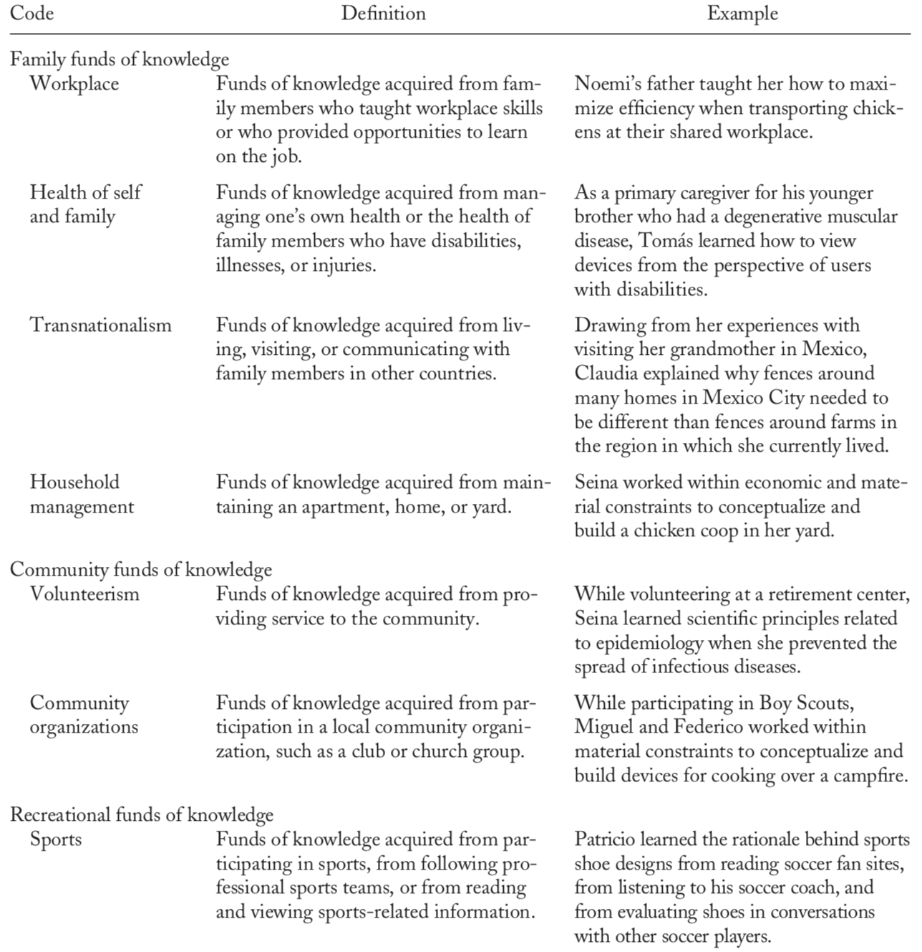
JEE Example: Codes

Slide 32

Trustworthiness
Specificity & “thick description”
Transparency
Triangulation
Consistency across researchers
Expert Verification
Reflexivity
Member Checking
Notes:
In qual research, we tend to discourage attempts to claim “valid” and “reliable” analysis, given the complex and contextualized nature of the data. Instead, we aim for “trustworthiness,” which seeks to lend credibility to the unique context and interpretative moment.
It used to be that having 3 data sources—or ‘triangulating’ your qual data—was adequate in terms of trustworthiness. Really, we need a more sophisticated and better-engineered approach, like a pyramid.

Slide 33
JEE Example
“To ensure quality during the first stage, the first author provided professional development on data collection methods (Walther et al., 2013) to the second and third authors, who were graduate students at the time of the study. During weekly team meetings, we read transcripts from the study and collectively annotated them while critiquing our data-collection techniques. A fourth colleague played devil’s advocate during these team debriefings by reading the transcripts and pointing out possible weaknesses in our data-collection methods (Erlandson, Harris, Skipper, & Allen, 1993).
To further ensure quality during the data-collection phase, we triangulated data across multiple sources over a prolonged period of time (Maxwell, 2005). .. We also ensured quality by collecting data until theoretical saturation had been reached (Glaser & Strauss, 1967; Walker, 2012).”
(pp. 287-291)
Notes:
How did the authors ensure trustworthiness?

Slide 34
JEE Example
“The third author and two external advisors evaluated randomly selected examples of coded data and confirmed the accuracy of the codes, but they suggested changes in phrasing for four codes. Using codes that incorporated their suggestions, the first and second authors independently coded 10% of the randomly selected data and achieved 92% agreement… External advisors with expertise in funds of knowledge or engineering education also evaluated our early transcripts and provided feedback on how we might improve our protocol instruments (Appendices A to C) and our interviewing techniques. On the basis of this feedback, we modified our data collection protocols and approaches as described above.”
p. 287
“We ensured that two coders independently identified the same phenomena in the data and achieved over 85% agreement in their application of codes (Saldana, 2012).”
pp. 290-291
Notes:
How did the authors ensure trustworthiness?

Slide 35
Ethics & Qualitative Research in Ed
Small samples
Vulnerable groups
IRB approval (including tribal IRBs): informed consent, etc.
Students as “subjects”
Reciprocity & participant benefits
Member checking
Participatory design

Slide 36
JEE Example: Ethics
“In our recruitment speeches, we explained that participants would meet in groups twice per month after school to identify problems in their communities that could be solved through engineering. In accordance with the National Academy of Engineering’s (2008) recommendation, we emphasized that participants would have the opportunity to make a difference through engineering. To enable the participants to work on project-related tasks from their homes, we offered each of them a notebook, a tablet computer, and wireless Internet access in their homes for the duration of the project. Finally, we stated that participants would receive $300 for participating, $150 in January and $150 in July, regardless of the outcome of their project… During the recruitment sessions, we distributed English and Spanish consent forms that had been approved by an institutional review board. “
p. 283
“Finally, after the data had been collected and analyzed, we shared our findings with the research participants (Lindlof & Taylor, 2002). They confirmed that the analysis was a fair representation of their experience, although they stated that they did not know during the time of their projects that they held funds of knowledge relevant to engineering.”
p. 291
Notes:
How did the researchers ensure ethical practice?

Slide 37
Considerations & Challenges
Overcoming the myth that qualitative educational research is “less rigorous” than other forms of research in the social & “hard” sciences
Limited modeling in field
Confronting your own bias
Protecting participants
Managing data bulk
Time
STANDOUT TIP: Integrate

Slide 38
Next Directions
IRB Approval (for human subjects research)
Collect Data!
Questions or areas of interest for future workshops?
Christine Stanton
christine.rogers1@montana.edu

Slide 39
Suggested Resources
Bazeley, P. (2009). Analysing qualitative data: More than ‘identifying themes,’ The Malaysian Journal of Qualitative Research, 2, 1-18.
Creswell, J.W. (2013). Qualitative inquiry & research design: Choosing among five approaches (3rd ed.). Thousand Oaks, CA: SAGE Publications.
Daly, S., McGowan, A., & Papalambros, P. (2013). Using qualitative research methods in engineering design research. Paper presented at International Conference on Engineering Design, Seoul, Korea. Available at: https://m.designsociety.org/download-publication/34891/using_qualitative_research_methods_in_engineering_design_research
Hewitt-Taylor J (2001) Use of constant comparative analysis in qualitative research. Nursing Standard. 15, 42, 39-42. Date of acceptance: March 19 2001.
Koro-Ljungberg, M. & Douglas, E.P. (2008). State of qualitative research in engineering education: Meta-Analysis of JEE articles 2005-2006. Journal of Engineering Education, 97(2), 163-175.

Slide 40
Suggested Resources, cont.
Maxwell, J.A. (2013). Qualitative research design: An interactive approach (3rd ed.). Applied social science research methods series (Vol. 41). Thousand Oaks, CA: SAGE Publications.
Merriam, S.B., & Tisdell, E.J. (2015). Qualitative research: A guide to design and implementation (4th ed.). San Francisco, CA: Jossey-Bass.
Miles, M.B., Huberman, A.M., & Saldaña, J. (2014). Qualitative data analysis: A methods sourcebook (3rd ed.). Thousand Oaks, CA: SAGE Publications.
Patton, M.Q. (2015). Qualitative research & evaluation methods (4th ed.). Thousand Oaks, CA: SAGE Publications.
Savin-Baden, M., & Major, C. H. (2013). Chapter 5: Personal stance positionality and reflexivity. Qualitative Research: The Essential Guide to Theory and Practice. London: Routledge.
Van Note Chismm, N., Douglas, E., & Hilson, W.J. (2008). Qualitative research basics: A guide for engineering educators. Rigorous Research in Engineering Education, NSF. Available at: https://crlte.engin.umich.edu/wp-content/uploads/sites/7/2013/06/Chism-Douglas-Hilson-Qualitative-Research-Basics-A-Guide-for-Engineering-Educators.pdf

