Slide 1

(Un)Common Sense
Small Business Sustainability:
Deciphering Eco-labels
Heather Higinbotham Davies
UnCommon Sense: Business Leadership for a Sustainable Future

Slide 2
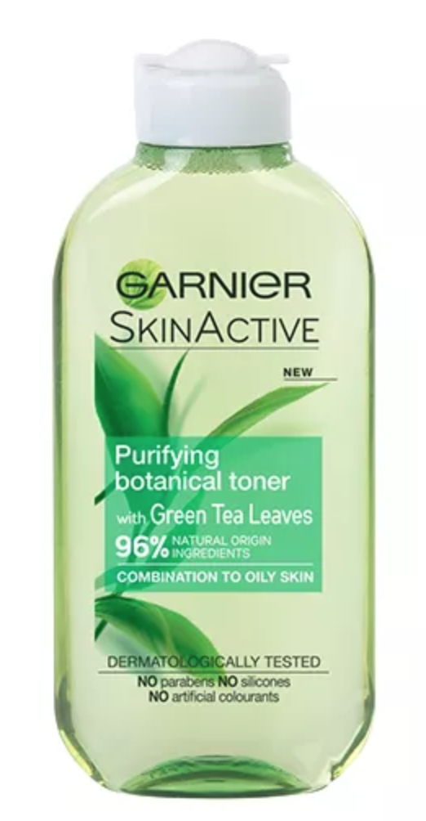
Environmental Claims
To meet consumer needs, marketers have significantly increased green advertising
Not all environmental claims are truthful or valid
Notes:
Validity: clear, consistent meaning, specific and meaningful, verifiable, does not conflict with FTC Green Guides for Environmental Marketing Claims
Standard Setting Process:
Verification: there are many tiers. Self-certification (not ideal, not verifiable, self-interest or conflict of interest), self-certification with random audits, Independent third party certification, Independent third party with on-site audits

Slide 3

Warning: Greenwash (grēn'wŏsh', -wôsh')
– verb: the act of misleading consumers regarding the Environmental practices of a company or the environmental benefits of a product or service

Slide 4
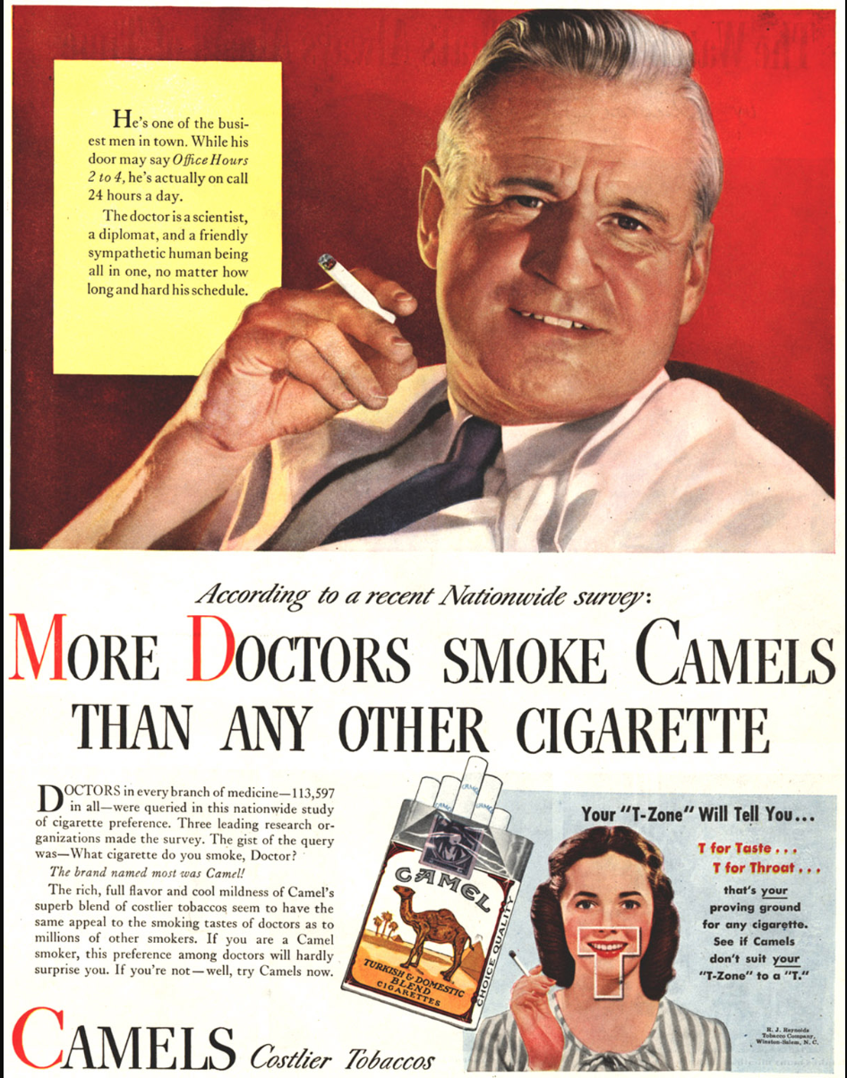

Slide 5
Greenwashing Risks
Consumers with the best intentions will be mislead into purchases that do not deliver on their claim.
Illegitimate claims will take away from those that are legitimate and slow innovation.
Consumer cynicism and doubt about environmental claims will increase.
The sustainability movement and progress will lose momentum.

Slide 6
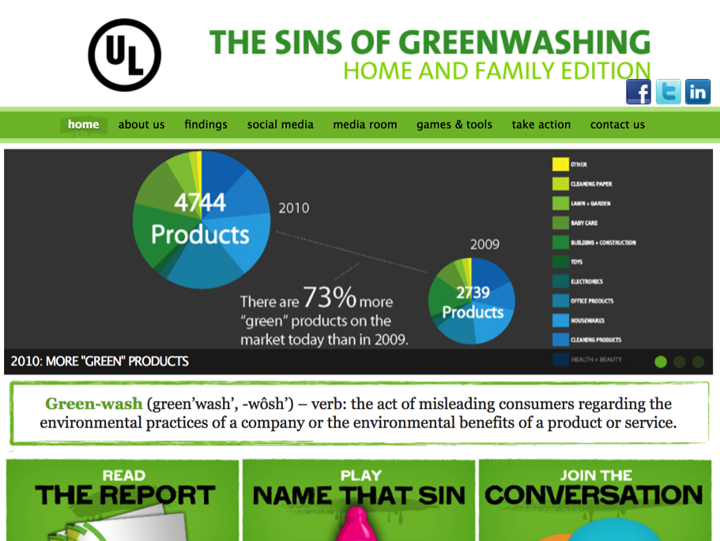
http://sinsofgreenwashing.com/
Notes:
“Natural” = arsenic, lead. Organic cigarettes. Gluten free products that don’t ever contain gluten.

Slide 7
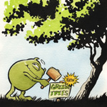
Irrelevance
Environmental claims that may be truthful but is unimportant or unhelpful.
How to Avoid?
Don’t claim unless it’s a legitimate point of competitive differentiation.
Don’t claim environmental benefits shared by all/most of the
competition.

Slide 8

Fibbing
Environmental claims that are false.
How to Avoid? Tell the truth.

Slide 9

Lesser of Two Evils
Environmental claims that may be true within the product category, but
risk distracting the consumer from greater environmental impacts.
How to Avoid?
Help consumers find the right product based upon needs and wants.
Don’t make consumers feel green about choices that are harmful
or unnecessary.

Slide 10

No Proof
Environmental claims that are not substantiated by easily accessible supporting information or by a reliable third-party certification.
How to Avoid?
Understand and confirm scientific case behind environmental claim.
Make evidence readily available, or rely on third-party certifications
whose standards are publically available.

Slide 11
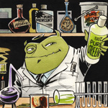
Hidden Trade Off
Suggesting a product is green based upon an unreasonably narrow set of attributes without attention given to other important environmental issues
How to Avoid?
Understand environmental impacts of product lifecycle.
Emphasize specific environmental issues and don’t distract from others.
When making claims about a single environmental impact or benefit, understand
how the product/service performs in relation to other impacts.
Seek continual environmental improvement of footprint.

Slide 12
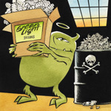
Vagueness
Environmental claims that are poorly defined or broad
so that the real meaning is misunderstood.
How to Avoid?
Use language that resonates with consumers while maintaining honesty.
Provide detailed explanations and meaning of vague names and terms.

Slide 13
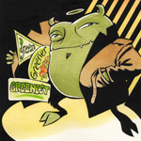
False Labels
A product that, through either words or images, gives the
impression of third-party endorsement when one doesn’t exist.
How to Avoid?
Communicate only valid third-party endorsements for environmental claims.
Favor accredited eco-labels those that address product lifecycle.

Slide 14
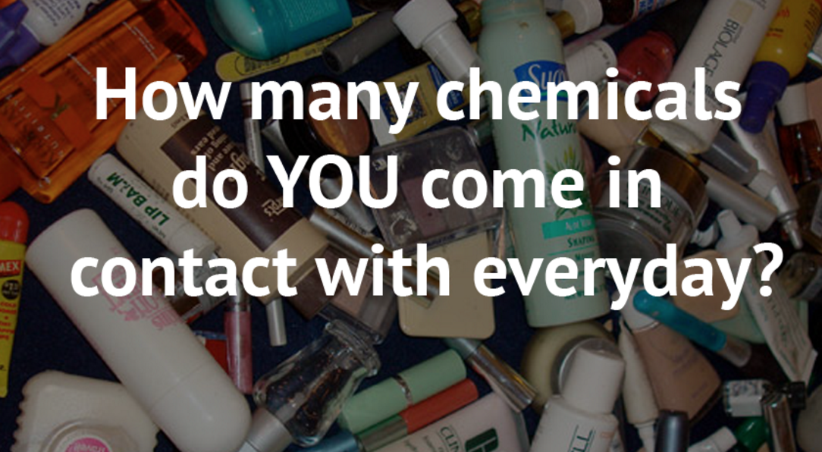

Slide 15
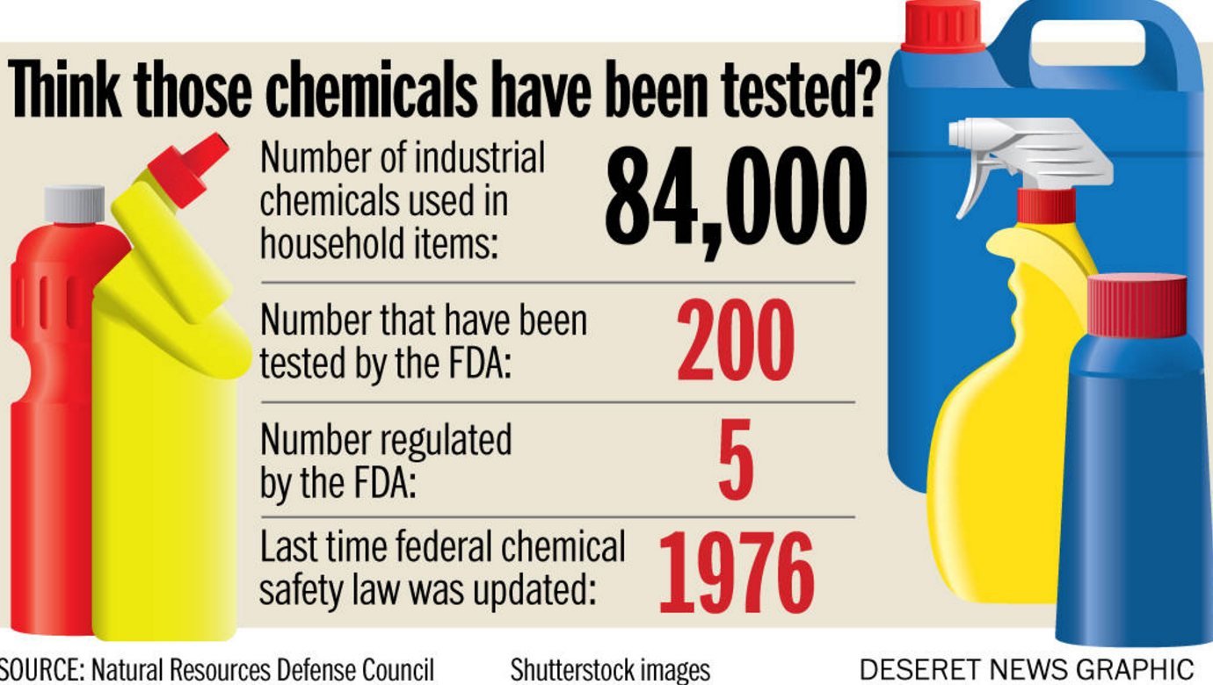

Slide 16
Eco-labels
Validity of the standard
  Clear, consistent meaning, specific, verifiable
Standard setting process
  No conflict of interest, lifecycle considerations, broad stakeholder participation, transparent development process, comments publicly available
Verification of the process
Notes:
Validity: clear, consistent meaning, specific and meaningful, verifiable, does not conflict with FTC Green Guides for Environmental Marketing Claims
Standard Setting Process:
Verification: there are many tiers. Self-certification (not ideal, not verifiable, self-interest or conflict of interest), self-certification with random audits, Independent third party certification, Independent third party with on-site audits

Slide 17






Seek credible labels!

Slide 18
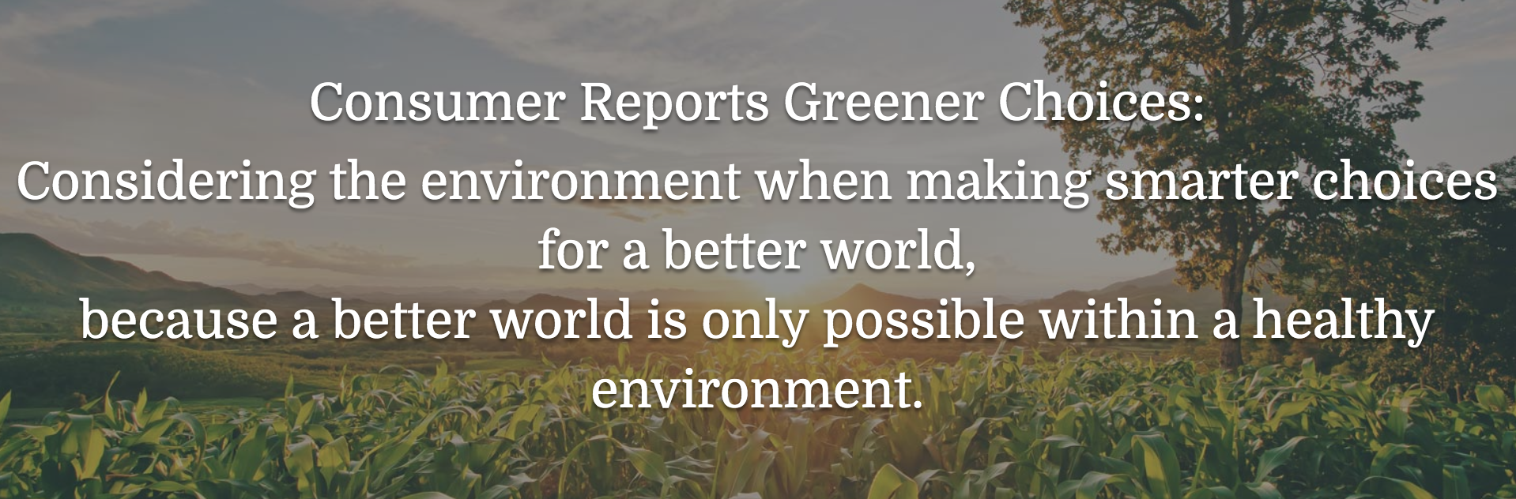

Slide 19

http://greenerchoices.org/labels/

Slide 20
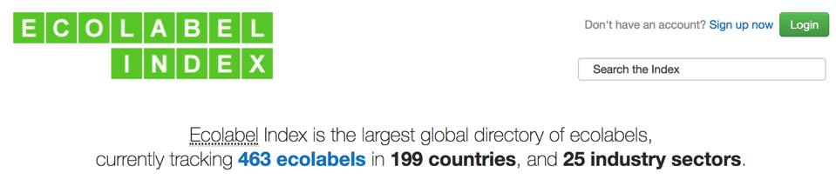
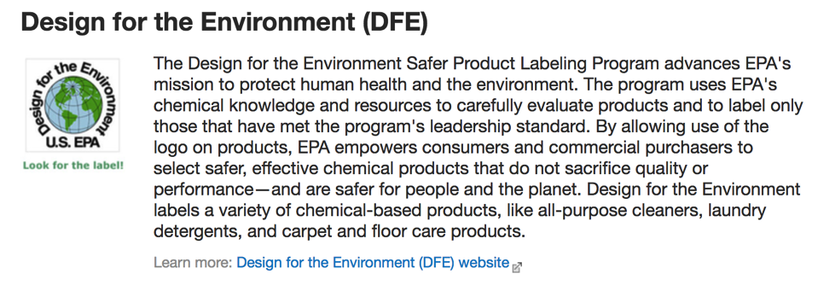
http://www.ecolabelindex.com/ecolabels/

Slide 21
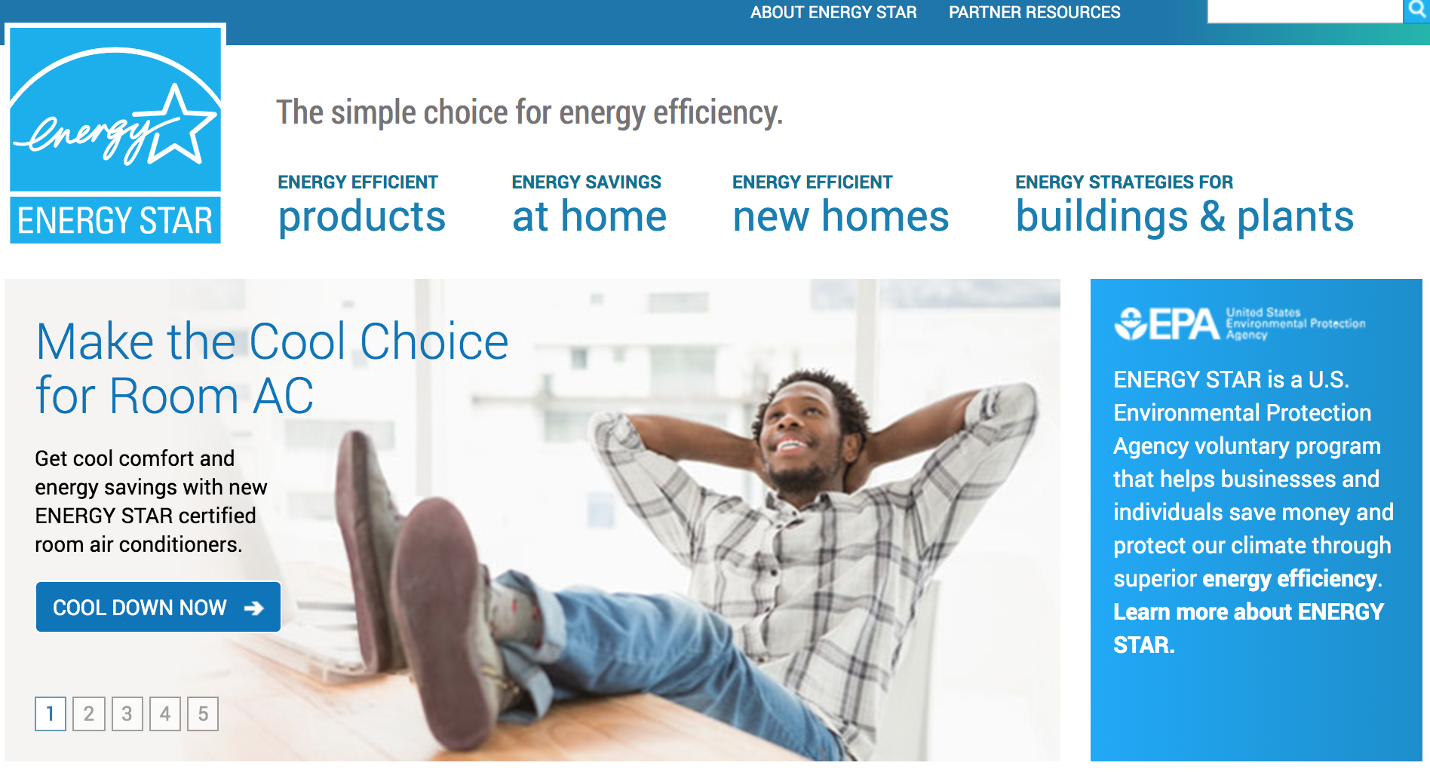
https://www.energystar.gov/

Slide 22
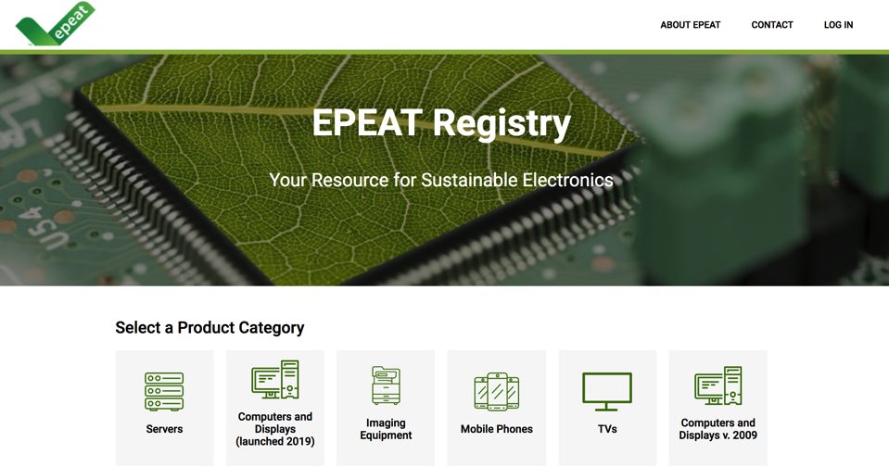
https://www.epeat.net/
https://www.epa.gov/smm-electronics
Notes:
Electronics contain valuable metals and components that can be used again in another manufacturing process.
Cadmium, hexavalent chromium, mercury, chromium, barium, beryllium and brominated flame-retardant materials are components that can pollute water and air resources without proper disposal or recycling. E-waste did not even exist as a waste stream in 1989 and now it's one of the largest and growing exponentially. — Katharina Kummer Peiry, Executive Secretary, Basel Convention Excerpts from Basel Convention November 2009 Press Advisory:
“Hazardous waste is threatening human health and the environment globally. Much of it is being exported to other countries, often to developing nations.”
One of the fastest growing [hazardous] waste streams is e-waste such as computers, television sets and mobile cell phones.
When e-waste crosses borders illegally and is indiscriminately dumped, or dismantled in unsound conditions, serious damage to human health and pollution of water, air and soil is often the result.
Electronic waste is a direct consequence of our ongoing desire to communicate from anywhere, connect more often and compute from home, office or on the road. Add an increasing demand for electronic gaming, higher definition televisions or smart cars and the result is a catastrophic accumulation of e-waste, now and into the future. An ongoing effort to address this exponentially growing problem is essential.
Montana does not have legislation requiring electronic equipment be recycled or banning electronics from landfills. Due to Montana's distance from most markets for recyclables, it may not be in the state's best interests to ban materials from landfills until reliable markets have been established for those materials.
Certified electronics recyclers: EPA database

Slide 23
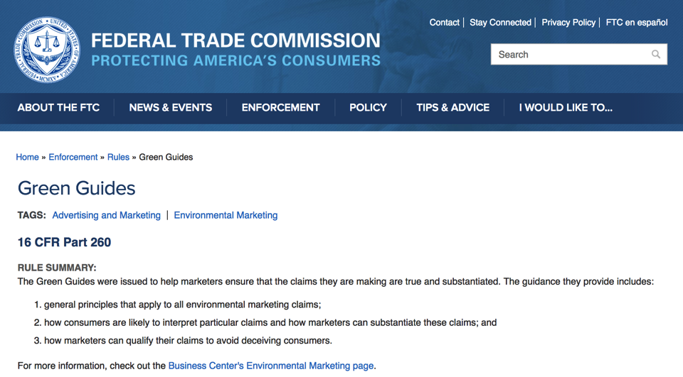
https://www.ftc.gov/enforcement/rules/rulemaking-regulatory-reform-proceedings/green-guides

Slide 24
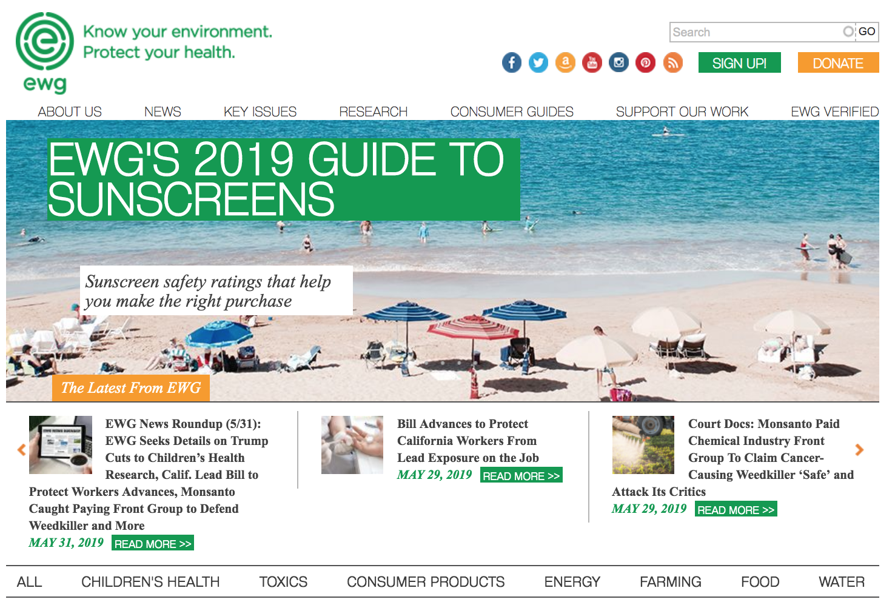

Slide 25
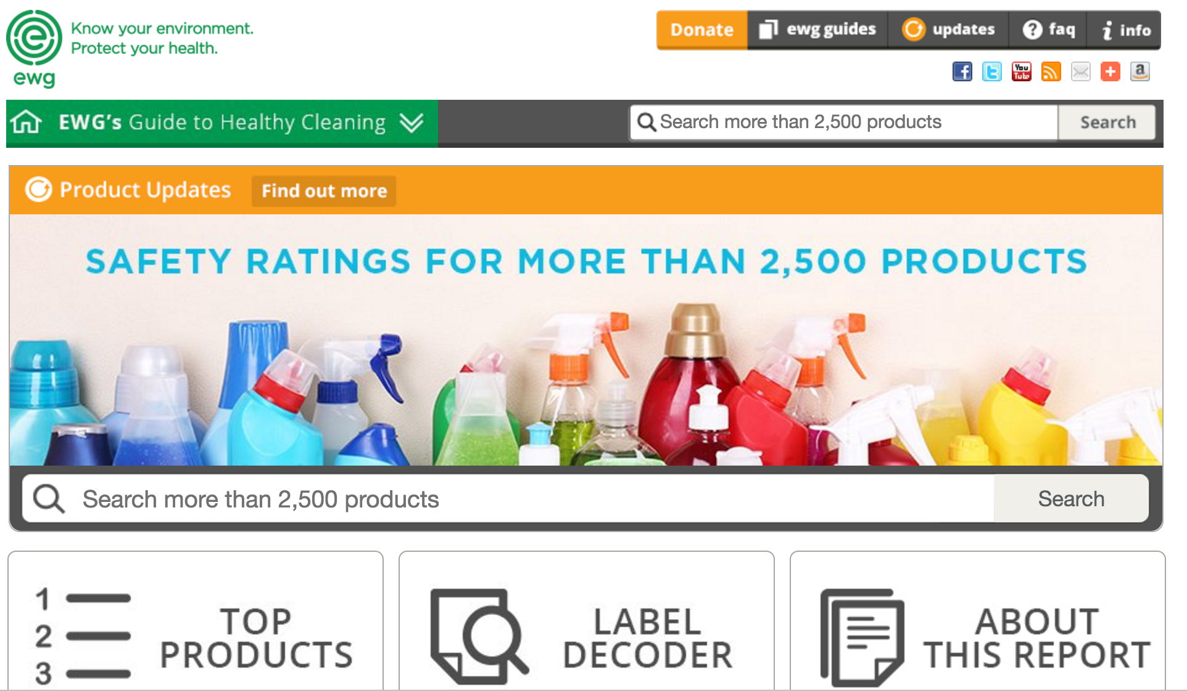

Slide 26
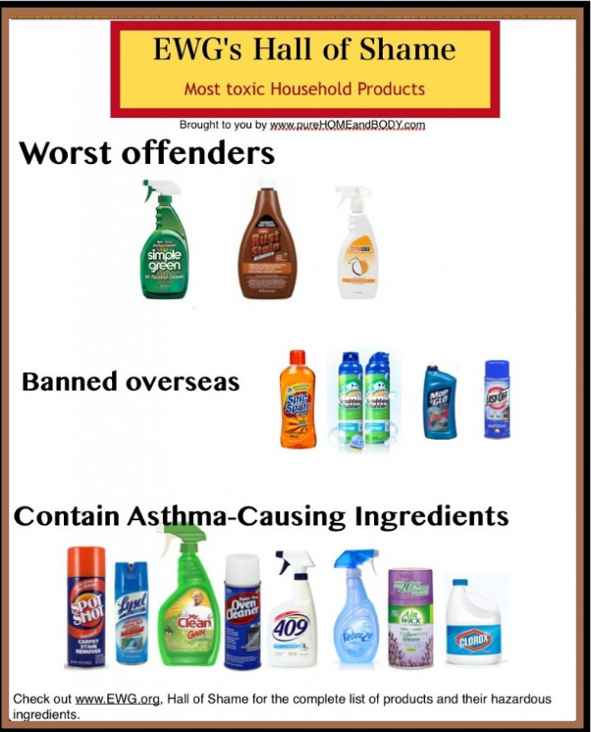

Slide 27
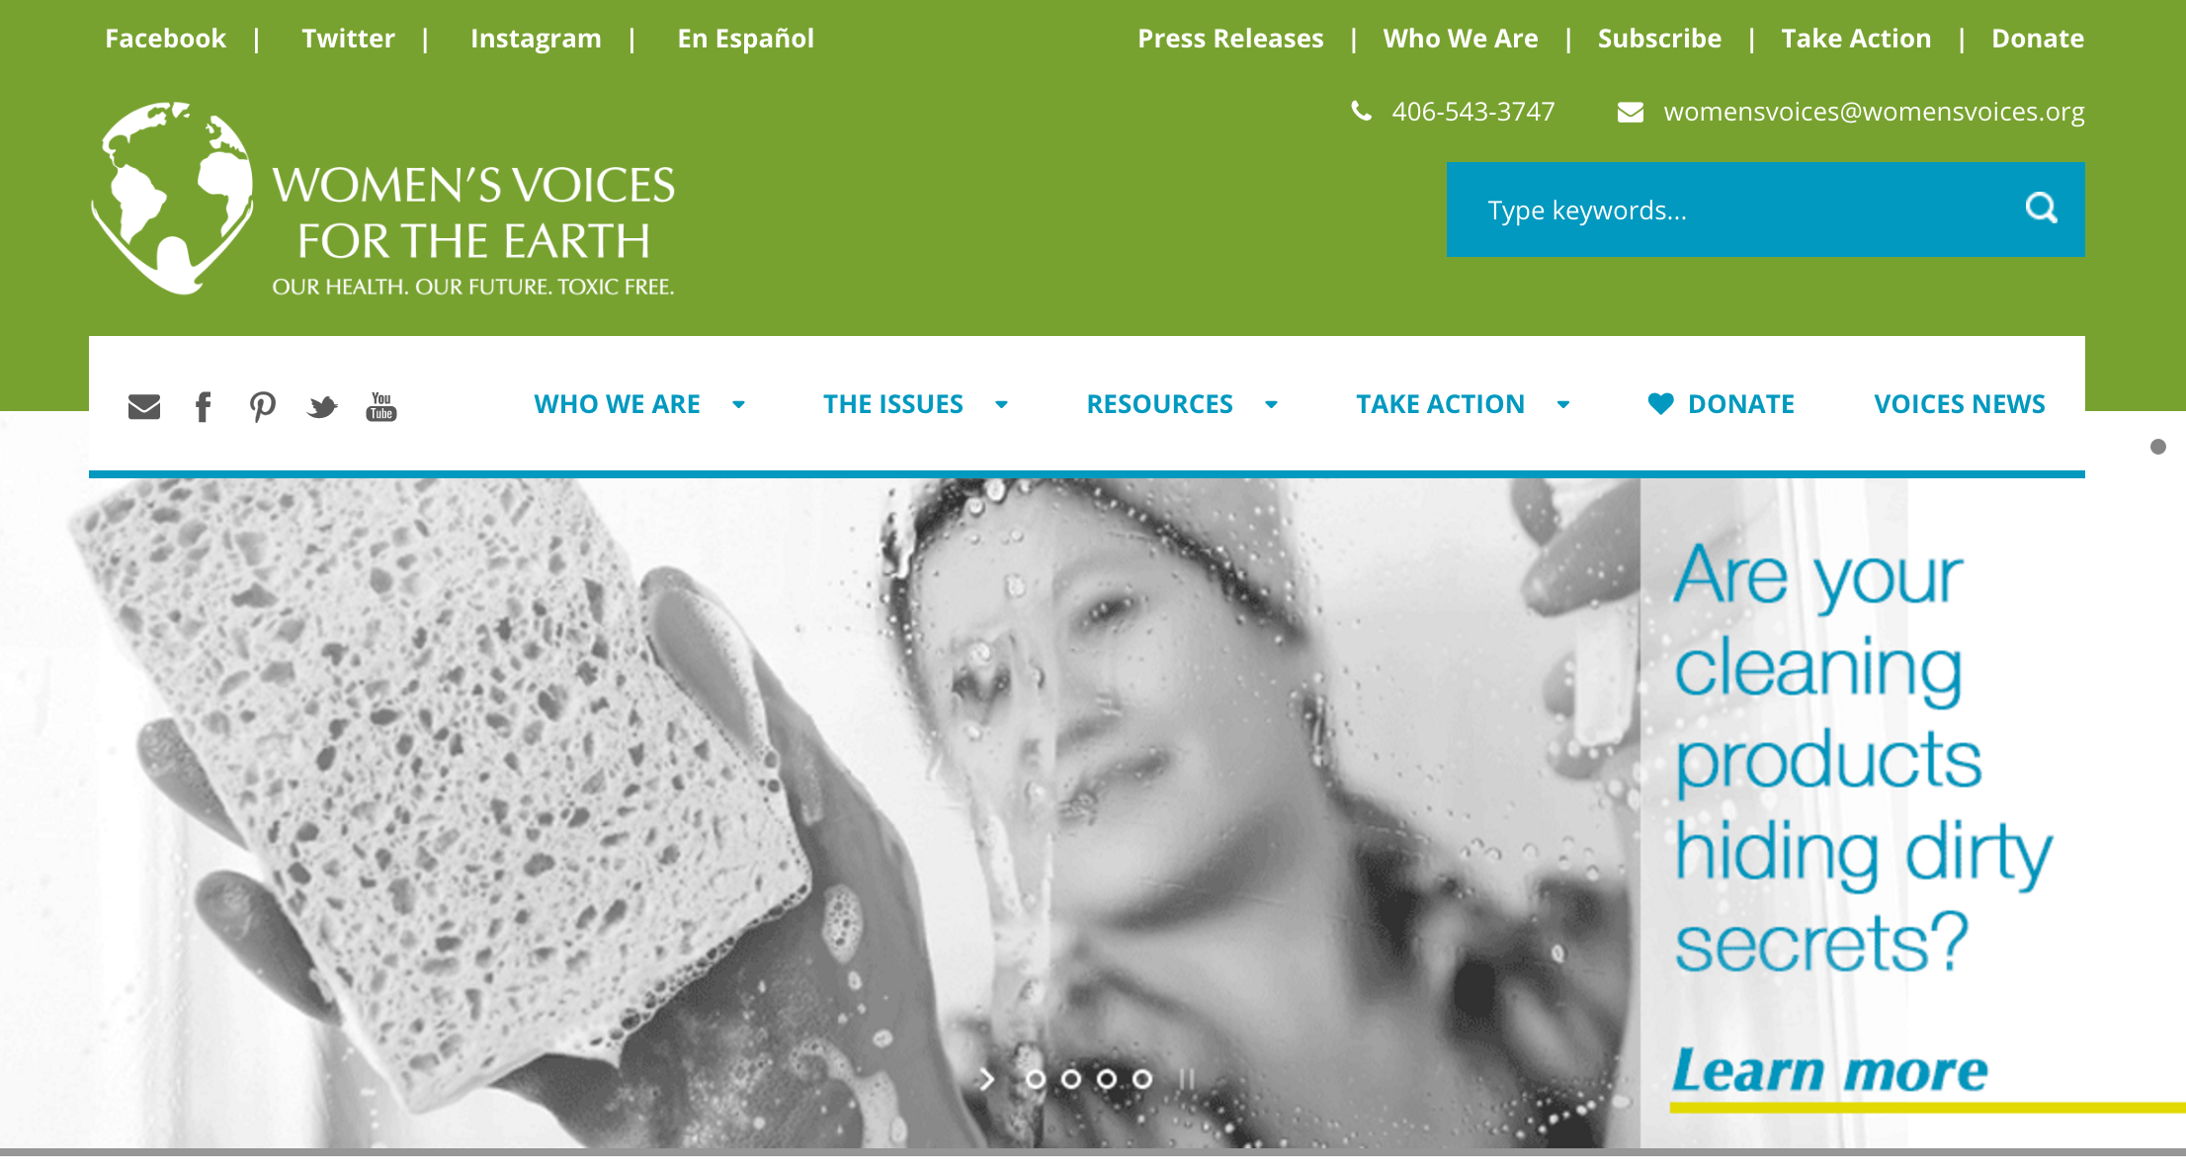
www.womensvoices.org

Slide 28
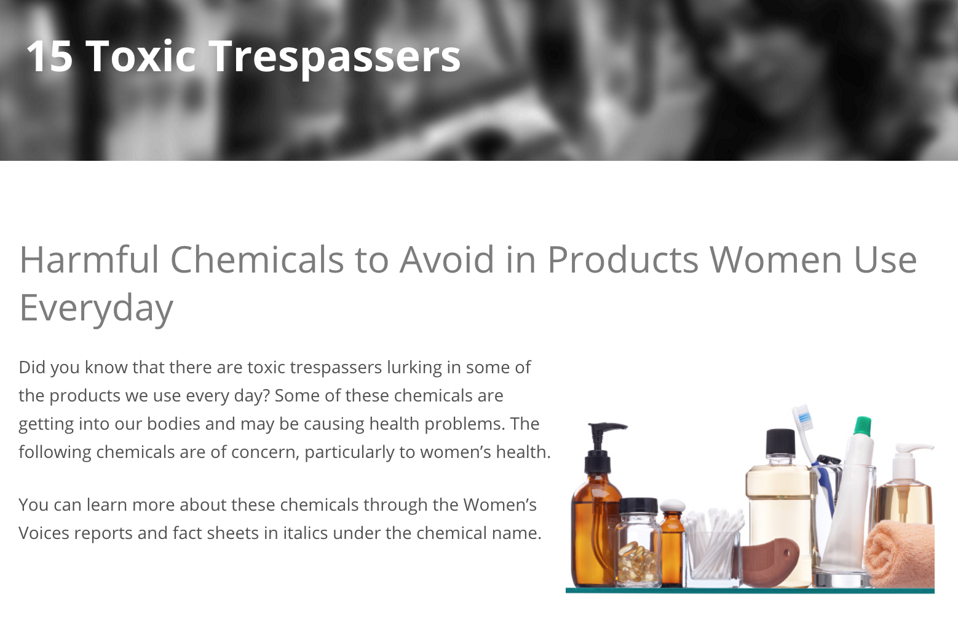

Slide 29
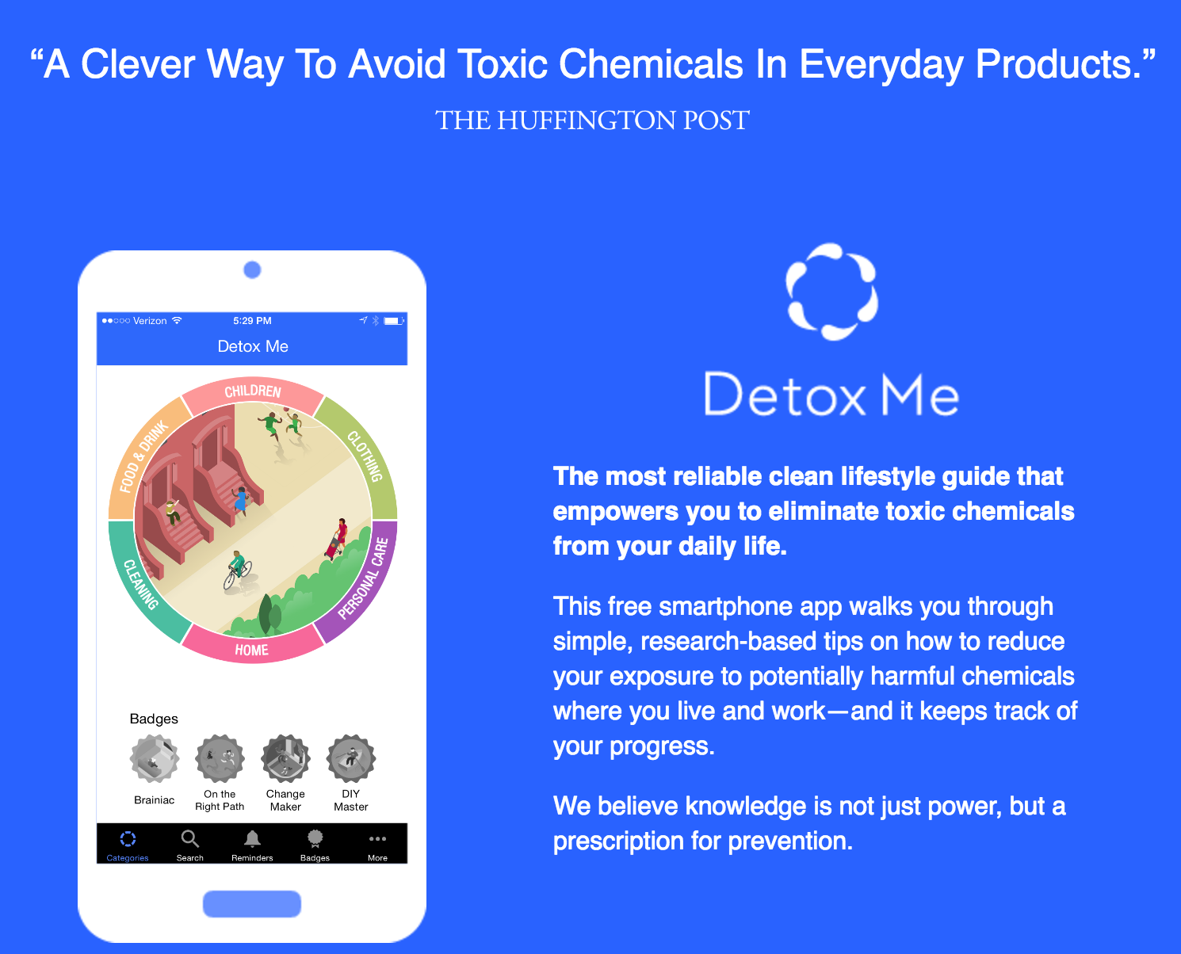

Slide 30
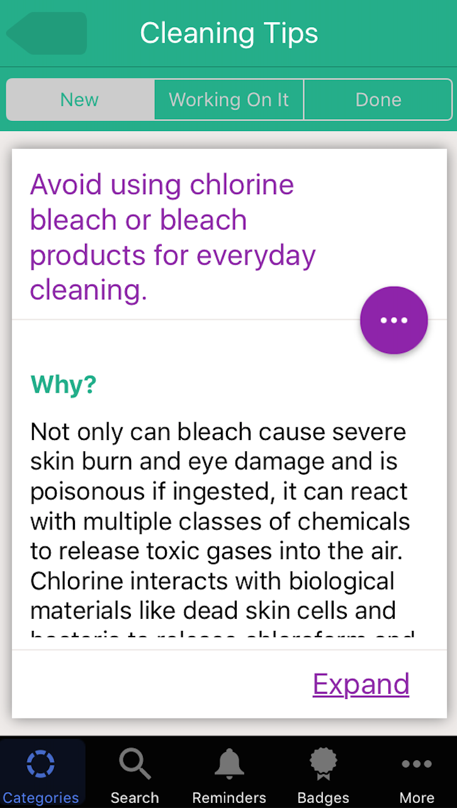
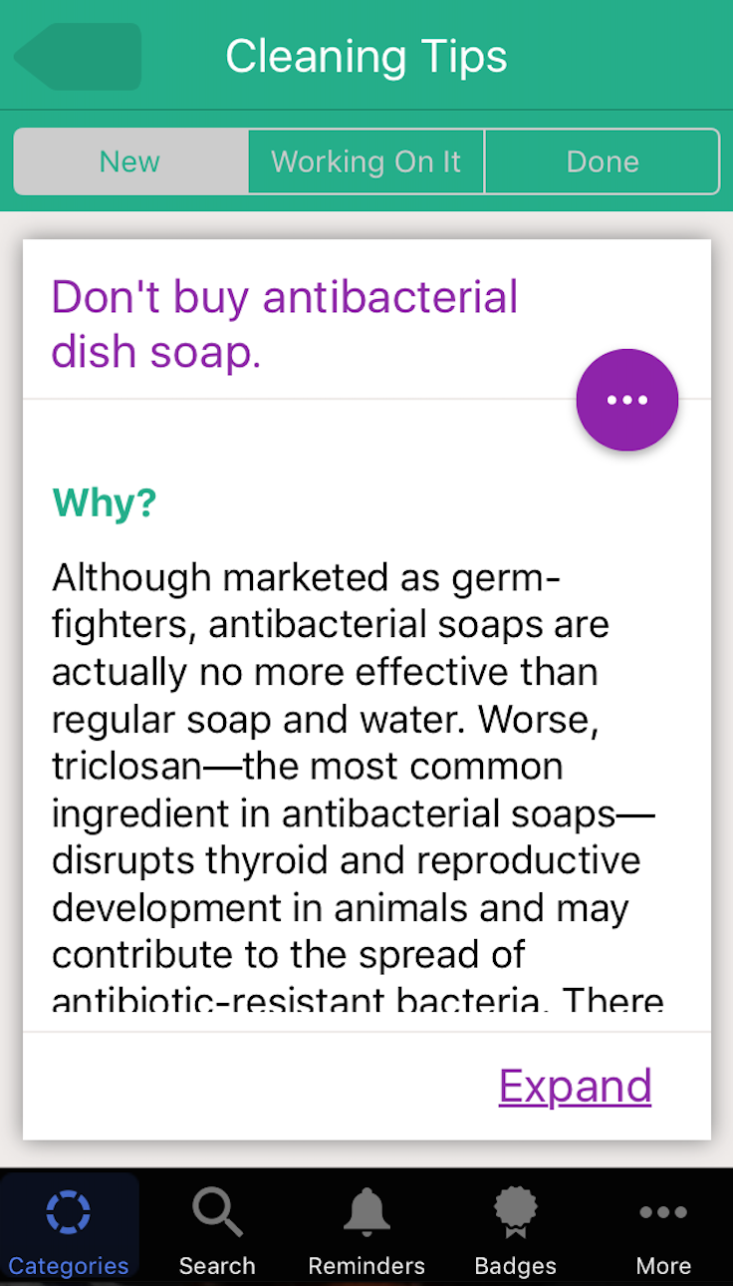

Slide 31
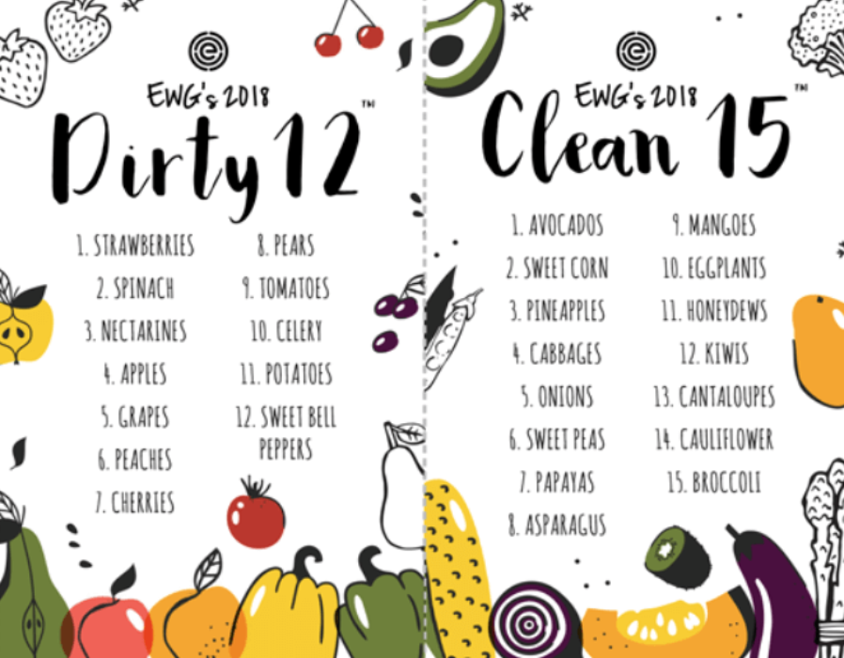

Slide 32

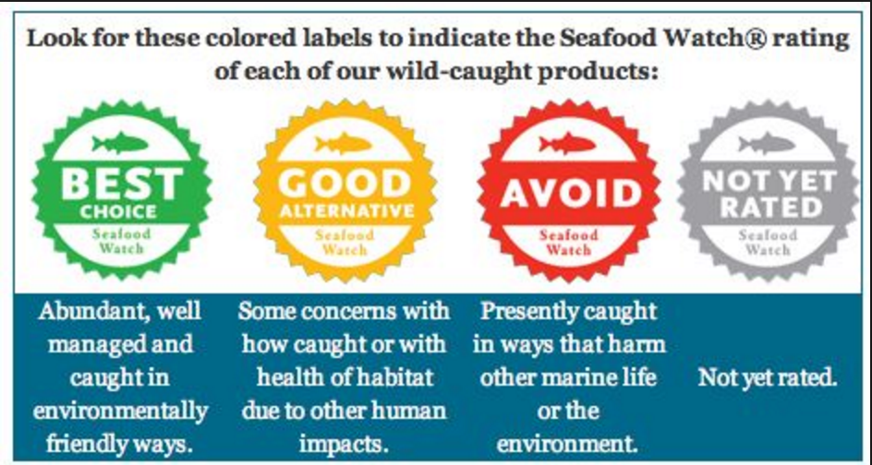

Slide 33


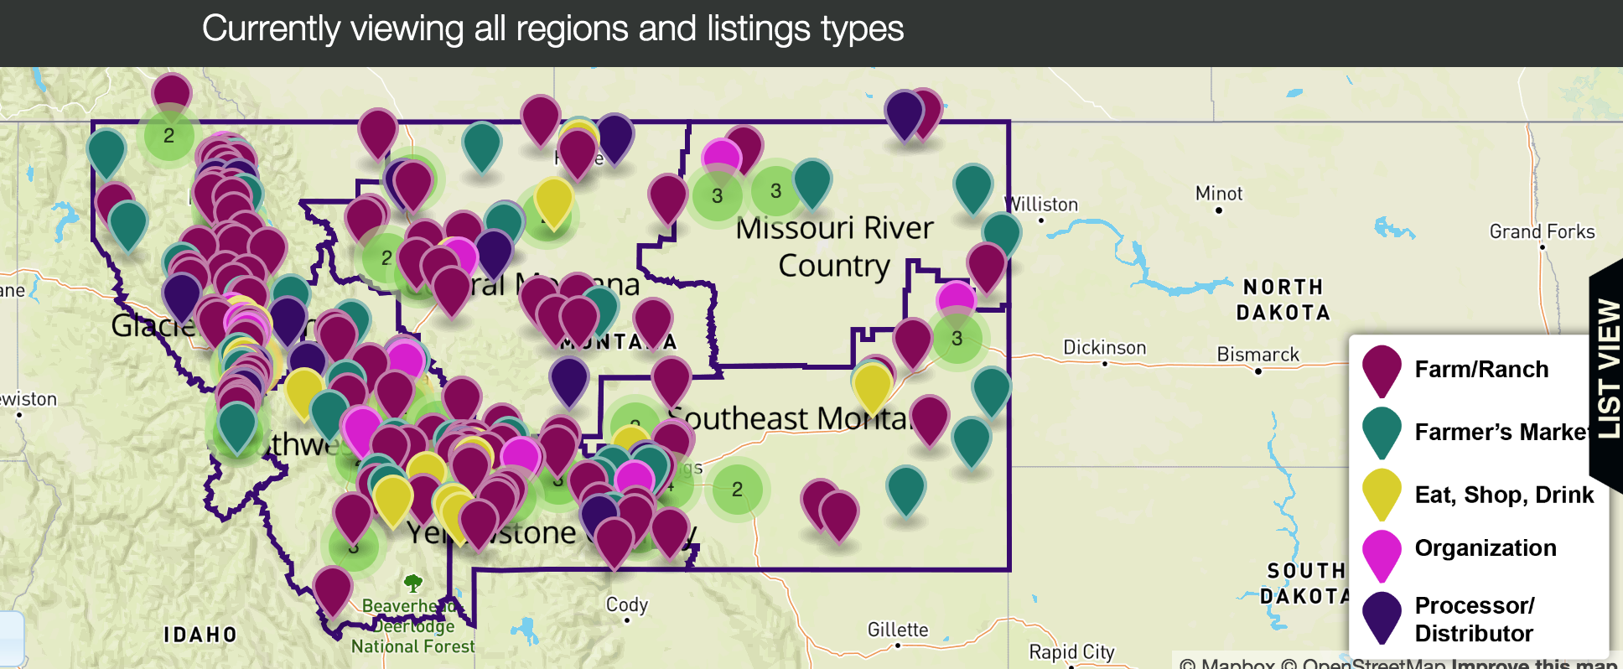
https://aeromt.org/abundant/
Notes:
Abundant Montana Directory (e.g. Sustainable meat, baked goods, vegetables, herbs, fruit, dairy, etc.).
Directory of Montana grown food, sustainable ag, farmer’s markets, agritourism
Interactive map

Slide 34

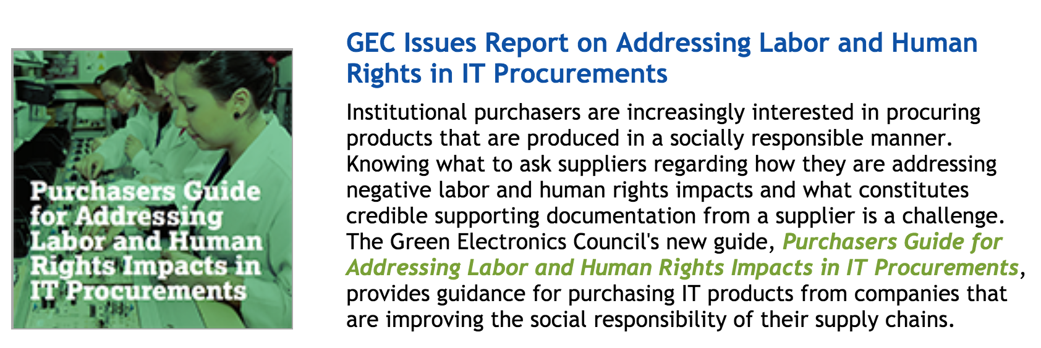
http://responsiblepurchasing.org/
Notes:
international network of buyers dedicated to socially responsible and environmentally sustainable purchasing
Information on certifications, guides for purchasing for different sectors, green procurement resources

Slide 35
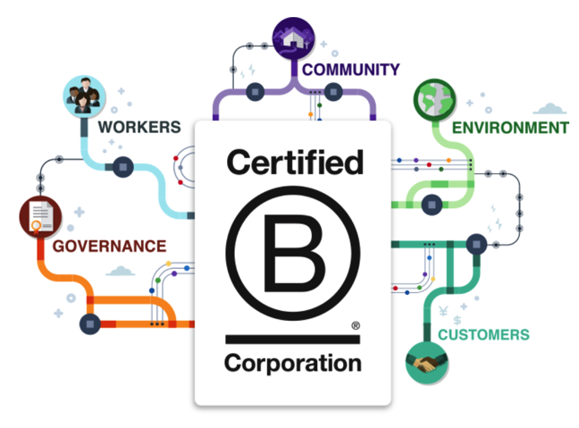
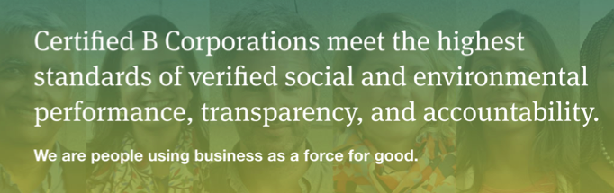
https://bcorporation.net/
Notes:
Many applicable business certification programs. For larger businesses, ISO 14001 etc. Building certifications, product certifications. B Corp specific to business operations.

Slide 36
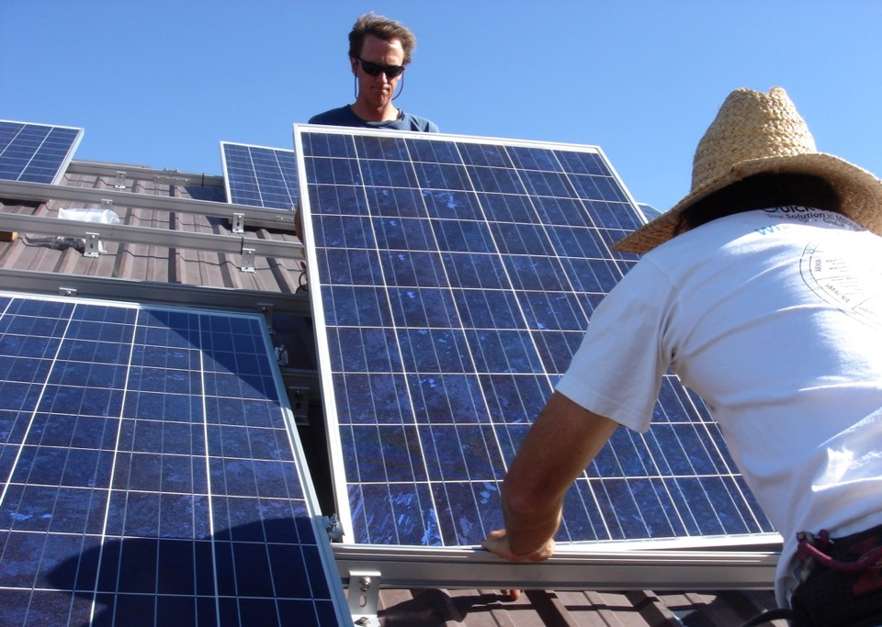
Thank you!
Heather Higinbotham Davies www.stopwastingstuff.com
Heather.Higinbotham@gmail.com (406) 600-6617

