Slide 1

(Un)Common Sense
Small Business Sustainability:
Funding and Resources
Heather Higinbotham Davies
UnCommon Sense: Business Leadership for a Sustainable Future

Slide 2

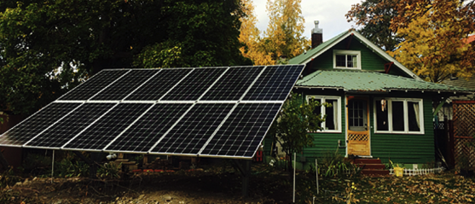
MT DEQ Alternative Energy
Revolving Loan Program
Low-interest 3.25% loans for alternative energy systems and energy conservation measures
Maximum loan amount: $40,000
Maximum loan term: 10 years
$0 down*, no pre-payment penalty
  *Closing costs include origination fee of $250 or 2% of loan amount, whichever is greater, and other fees of approximately $200
http://deq.mt.gov/Energy/renewableenergy/altenergyloan

Slide 3
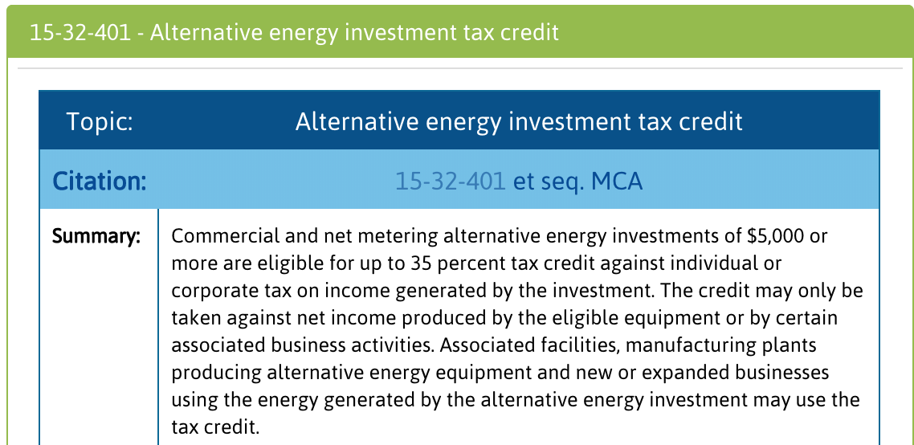
Renewable Energy Tax Incentives
http://deq.mt.gov/Energy/montanasenergy/taxincentrenew

Slide 4

REAP (Rural Energy for America)
Provides guaranteed loans (up to 75% of project costs) and grant funding (up to 25% of project costs) to agricultural producers and rural small businesses for renewable energy systems and energy efficiency improvements
https://www.rd.usda.gov/programs-services/rural-energy-america-program-renewable-energy-systems-energy-efficiency/mt
Notes:
Eligible rural areas: under 50,000 population. Ag producers can be rural or non-rural.
Total combined financing 85% of project costs max.
Loans: $5,000-$25M, up to 85% loan guarantee. Max terms range from 7 years (capital) to 15 (equipment) to 30 years (real estate)
Grants: Renewable energy systems: $2,500-$500,000. EE: $1,500-$250,000.

Slide 5
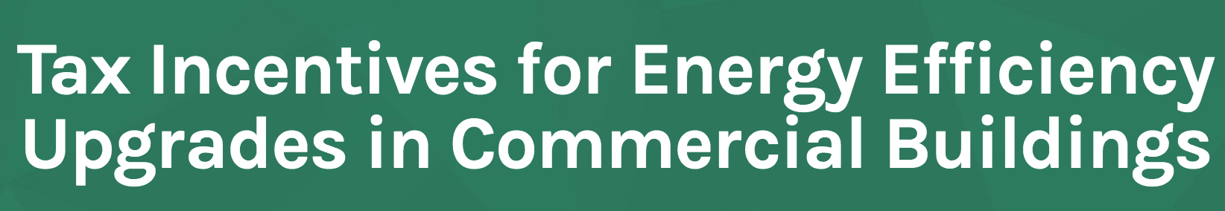
Business tax deductions for improving energy efficiency of commercial buildings
  Building envelope
  HVAC systems
  Lighting
  Renewable energy systems
  Smart meters
  Smart electric grid equipment
https://www.energy.gov/eere/buildings/tax-incentives-energy-efficiency-upgrades-commercial-buildings

Slide 6
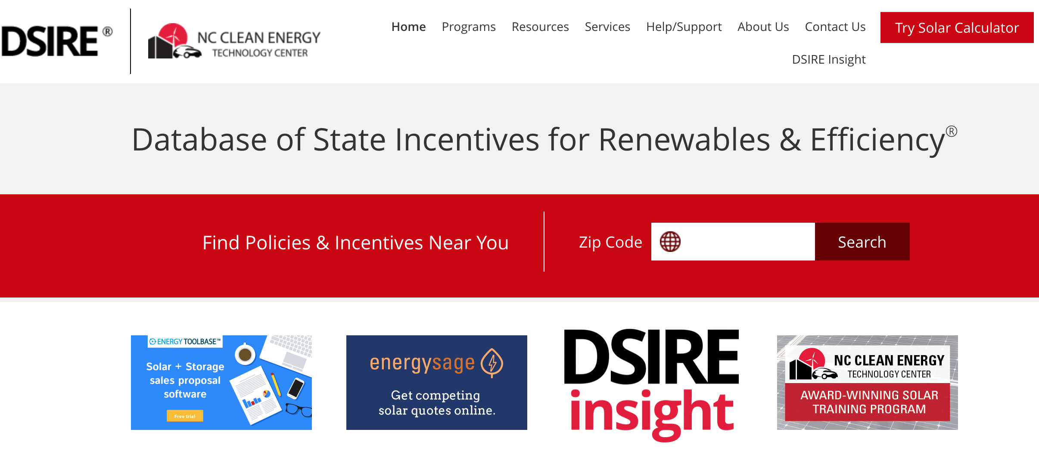
Searchable database of federal and state incentives
Resources for policymakers, developers, businesses
Data, tools, research, maps, presentations
Information and resources on renewable technologies
www.dsireusa.org

Slide 7
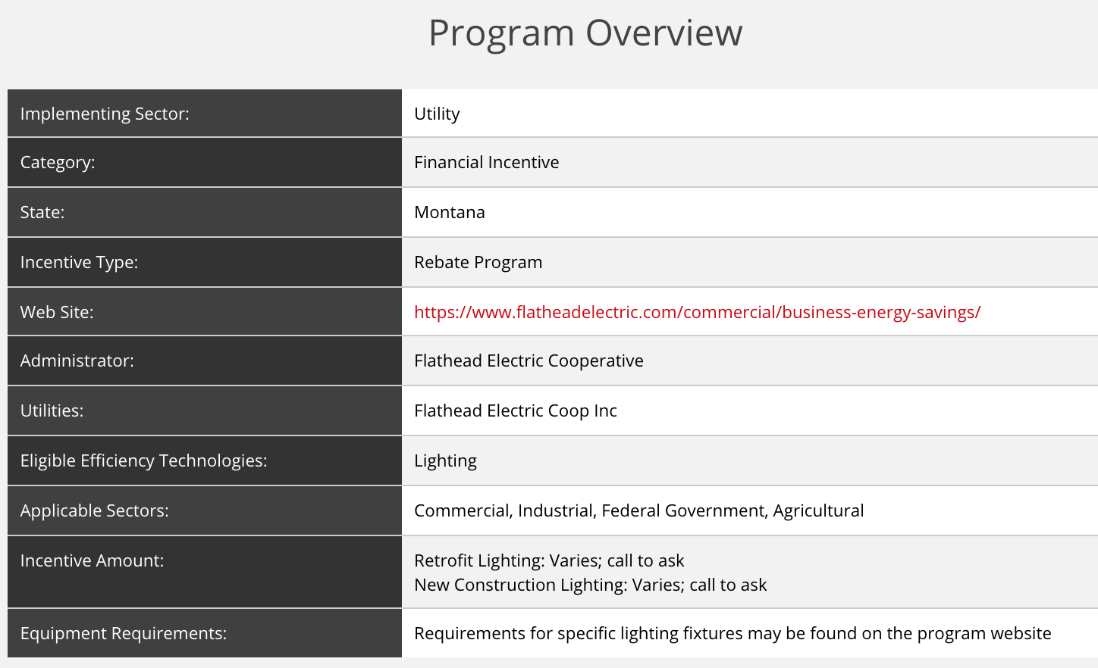

Slide 8

Prescriptive and Custom Rebates
Lighting
Air Conditioning
Refrigeration
Electronics & Appliances
Water Heating
Variable Frequency Drives
Motor Rewinds
Free energy appraisal
Electric and natural gas rebates
New or existing facilities
E+ Green Power
http://www.northwesternenergy.com/save-energy-money/business-services/business-services-montana/rebates-incentives
Notes:
Check your local utility

Slide 9


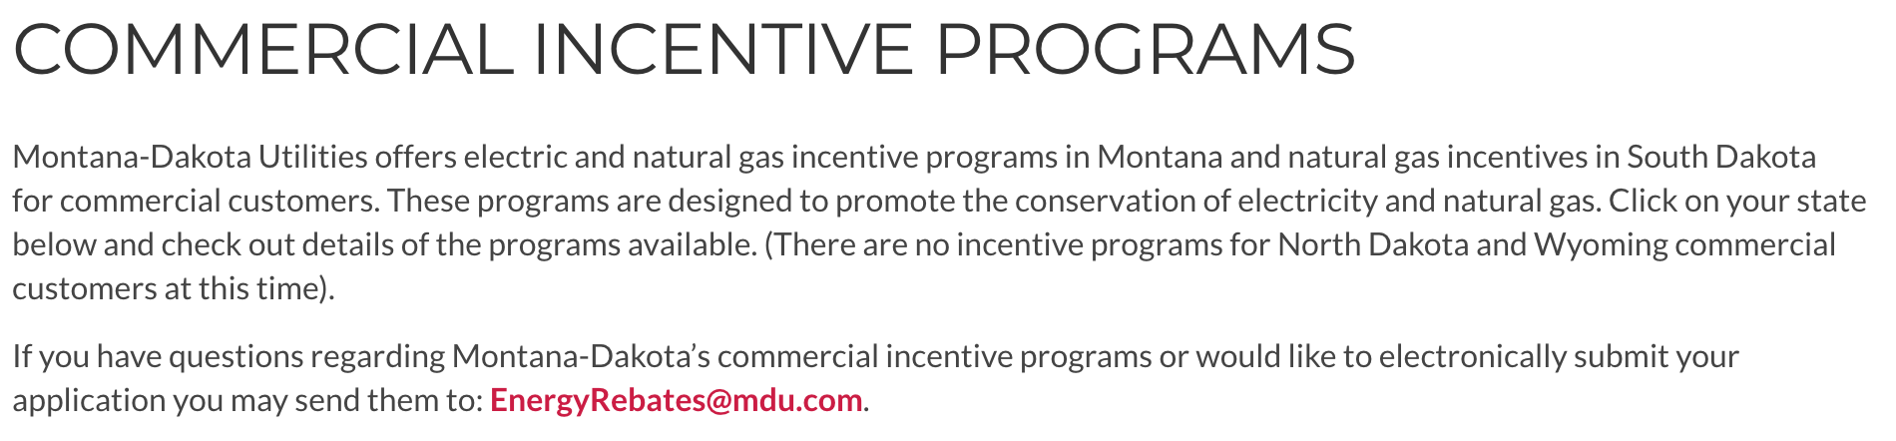
https://www.montana-dakota.com/energy-efficiency/savings-for-your-business/

Slide 10

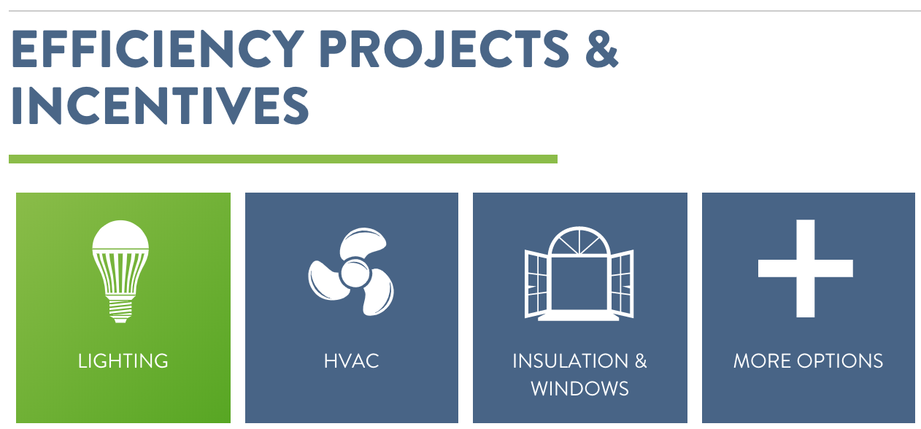
https://www.flatheadelectric.com/commercial/business-energy-savings/

Slide 11
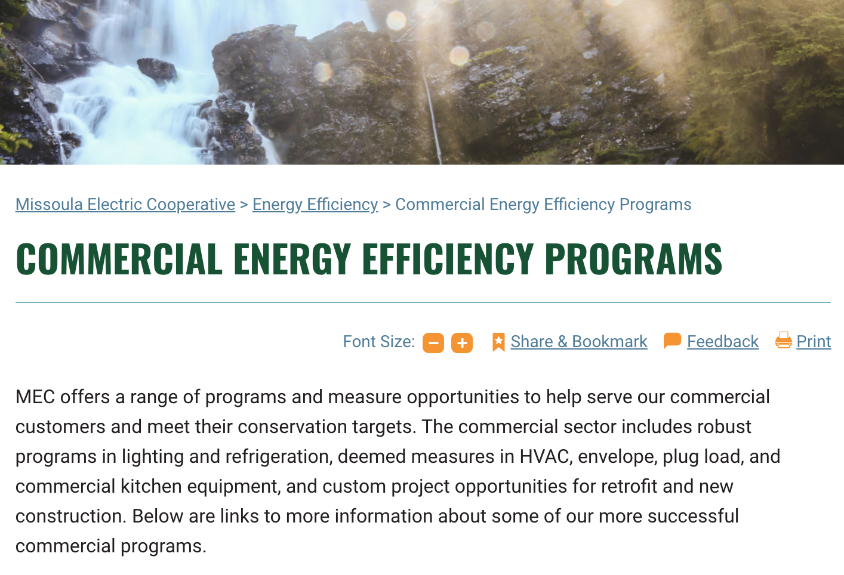

https://missoulaelectric.com/energy-efficiency/commercial-energy-efficiency-programs/

Slide 12

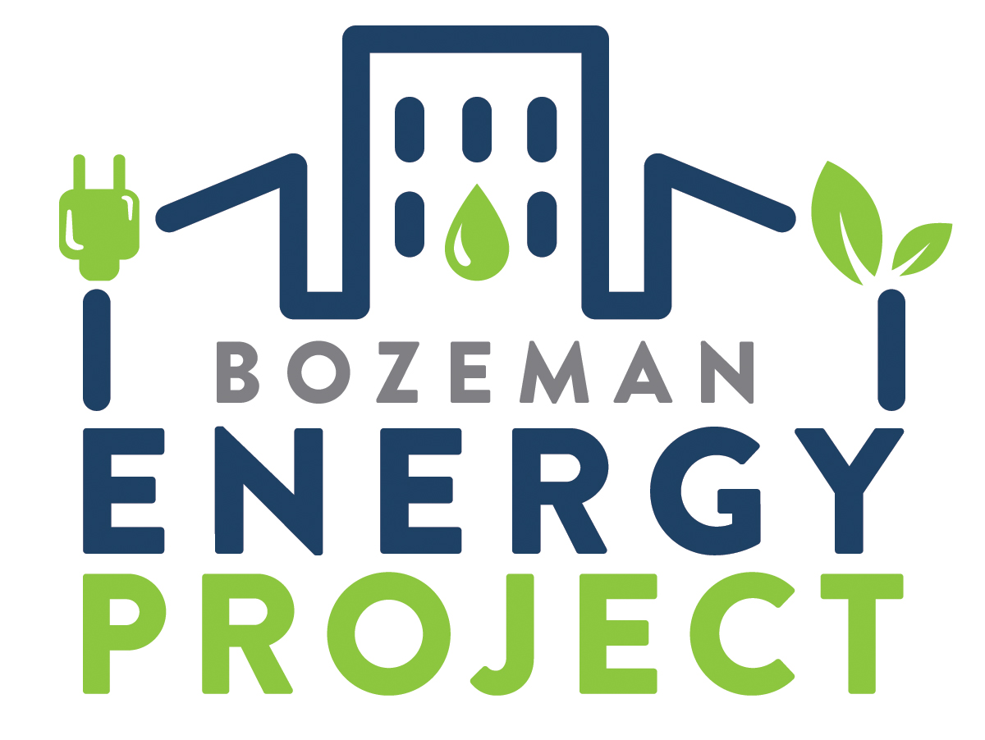

Lower energy bills
Potential utility rebates
One-time cash incentive for City of Bozeman businesses up to $2,500
Public recognition
Access to education and resources
Staff support
https://www.bozeman.net/government/sustainability/bozeman-energy-project
Notes:
Check with your local government to see what programs they offer! Incentives, rebates, resources

Slide 13
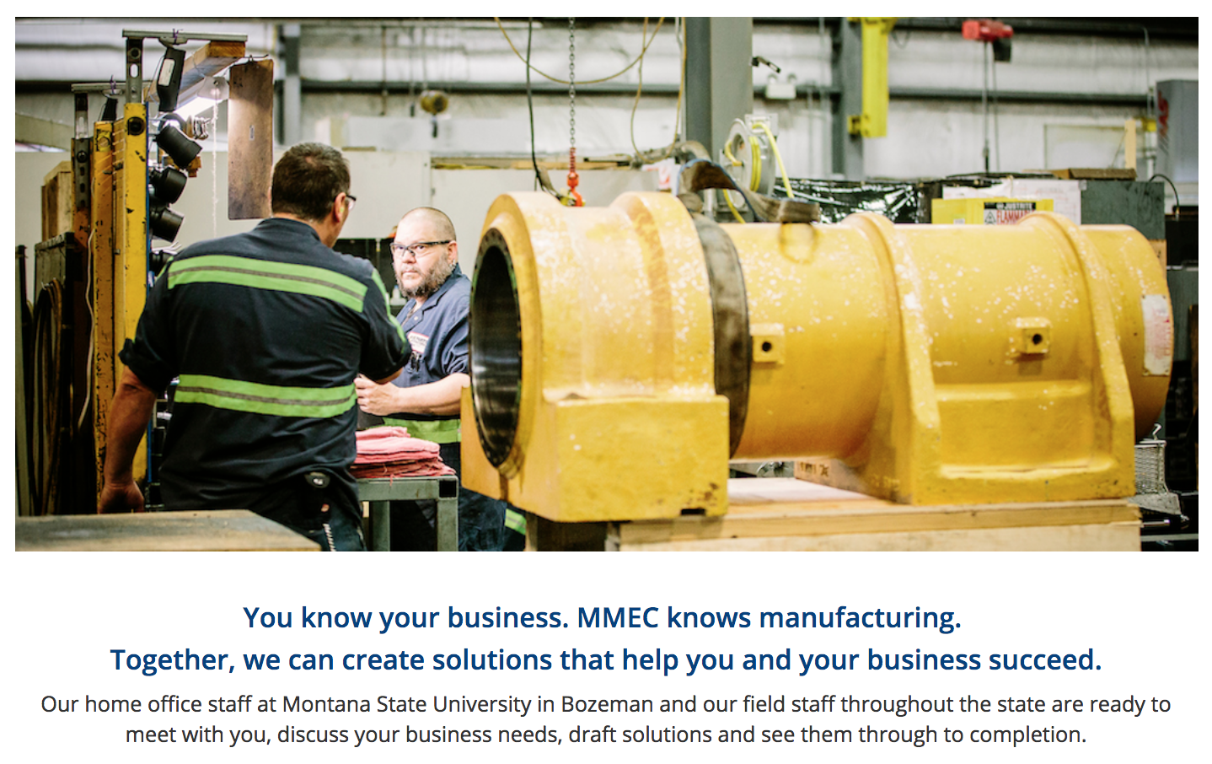
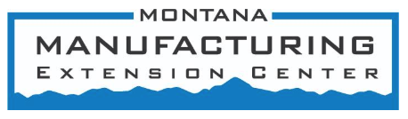
http://www.montana.edu/mmec/services/index.html

Slide 14
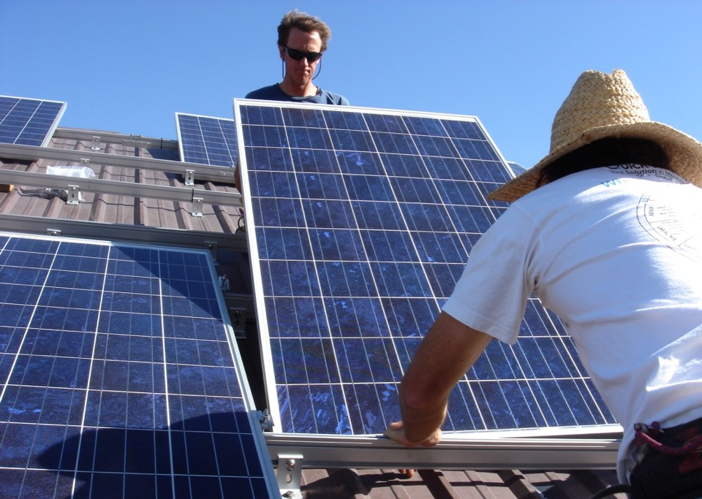
Thank you!
Heather Higinbotham Davies www.stopwastingstuff.com
Heather.Higinbotham@gmail.com (406) 600-6617

