Slide 1


406 Brewing and Taproom
Employer: Matt Muth
Intern: Esi M. Aidoo
MMEC advisor: Alistair Stewart
Program Directors: Jenny Grossenbacher & Barbara Watson

Slide 2

Introduction
MPH graduate in Community Health Education and Promotion with a focus on environmental determinants of health
Interest in P2 internship program
Pollution is a major upstream driver of poor health outcomes and community vulnerability
Promoting healthier environments through sustainable practices
Waste reduction supports stronger, more resilient communities
Committed to protecting health through prevention

Slide 3





Outline
406 Brewing
406 Brewing and Taproom
Practices Supporting Sustainability
P2 Interest and Challenges
Value Stream Mapping, Profit Velocity Model & P2 Focus Areas
Sustainable Brewery Figures & P2 Implementations Recommended
P2 Outcomes & Program Insights: Expected results and lessons learned.
Future Recommendations and Acknowledgement

Slide 4
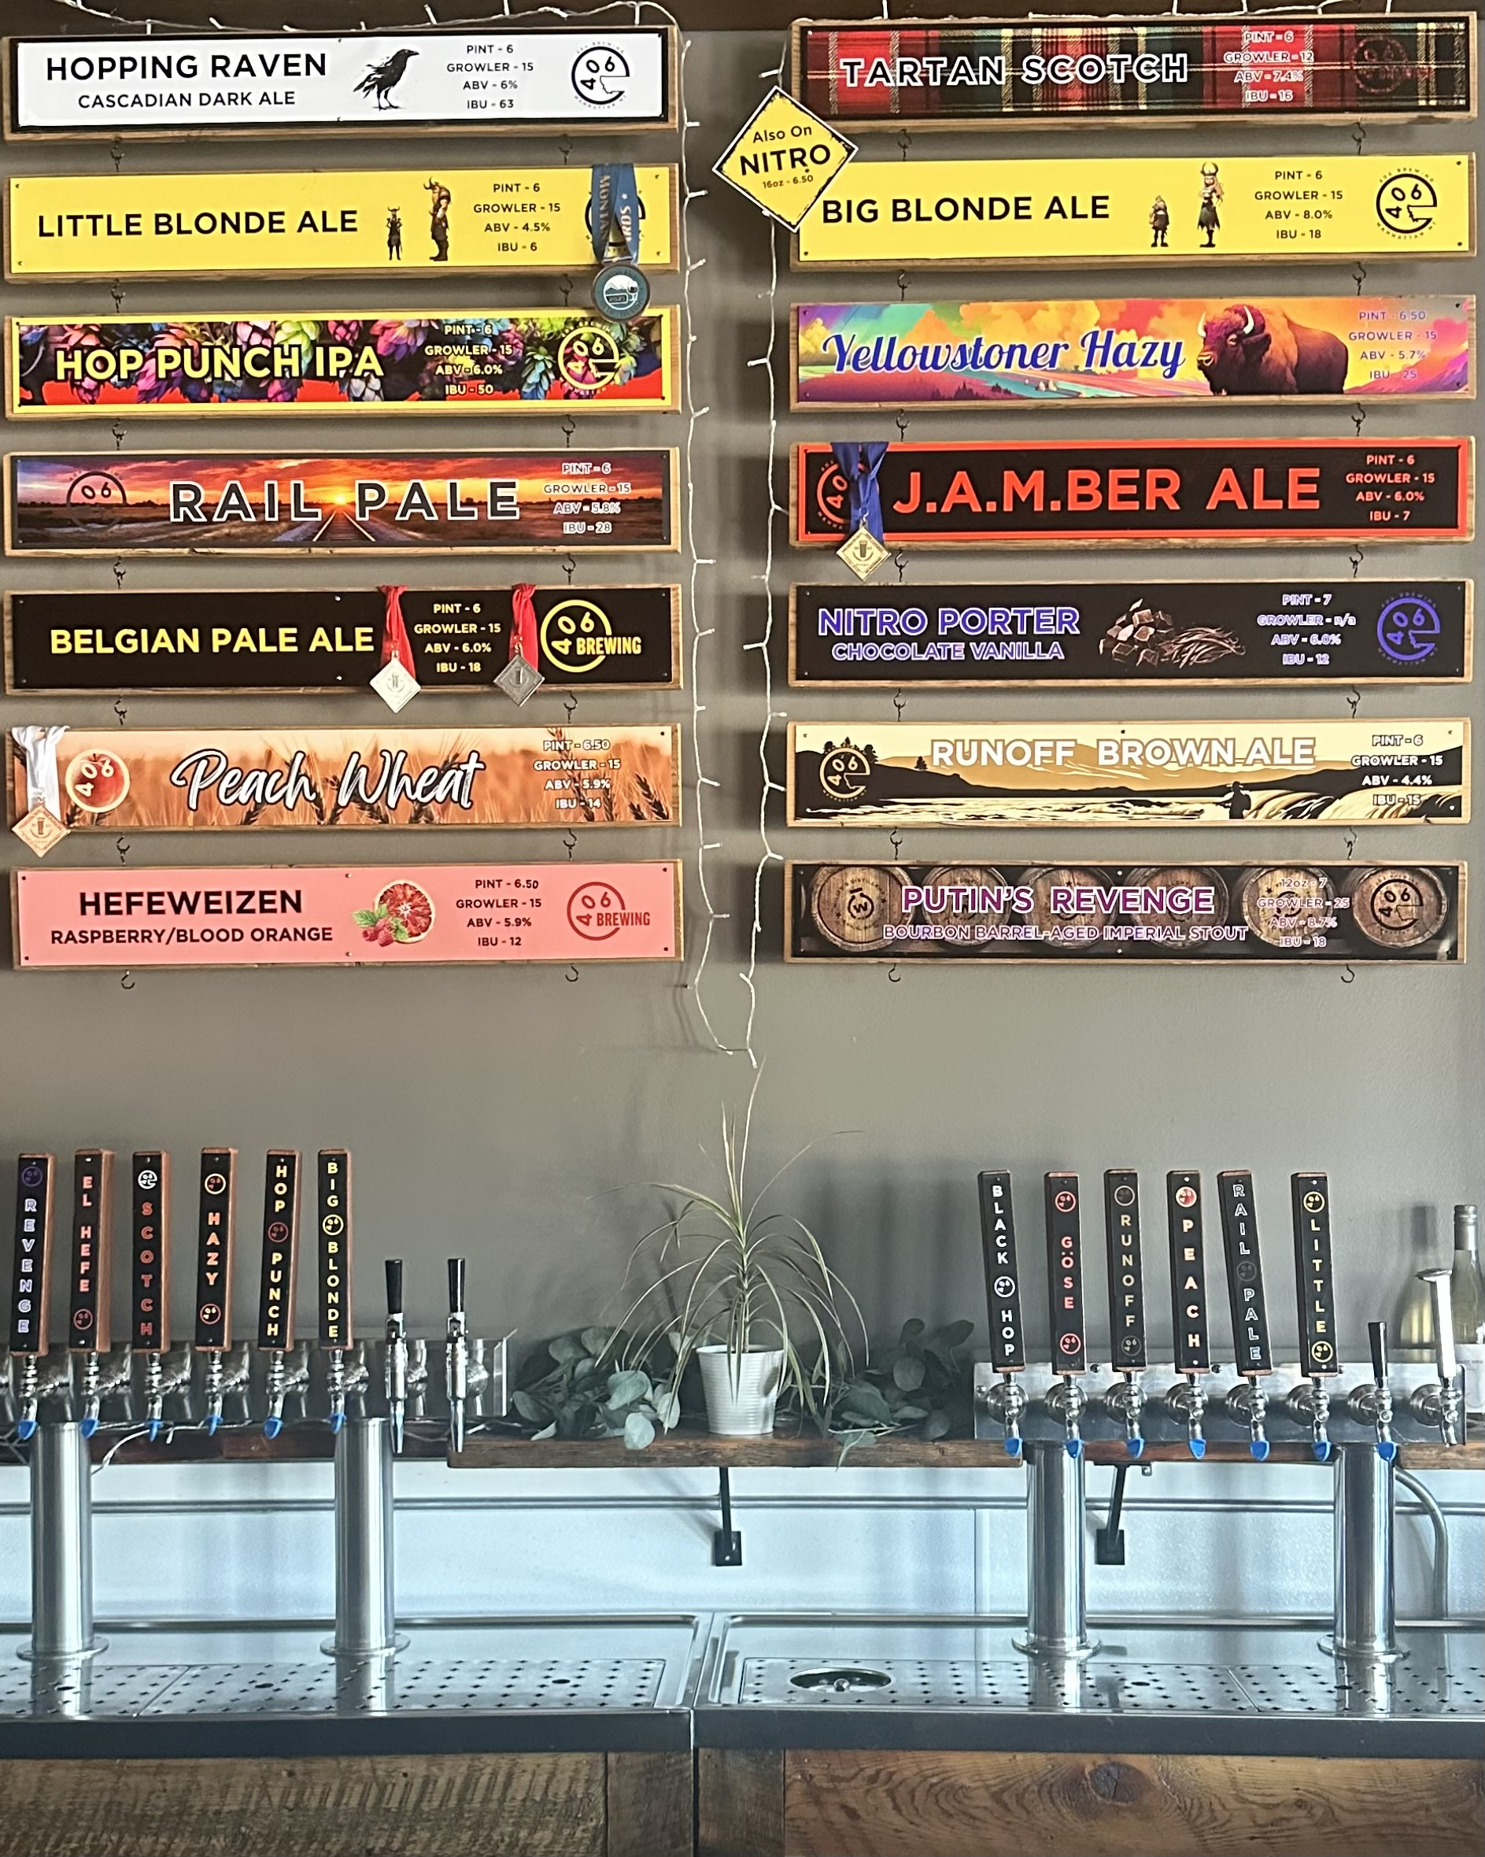
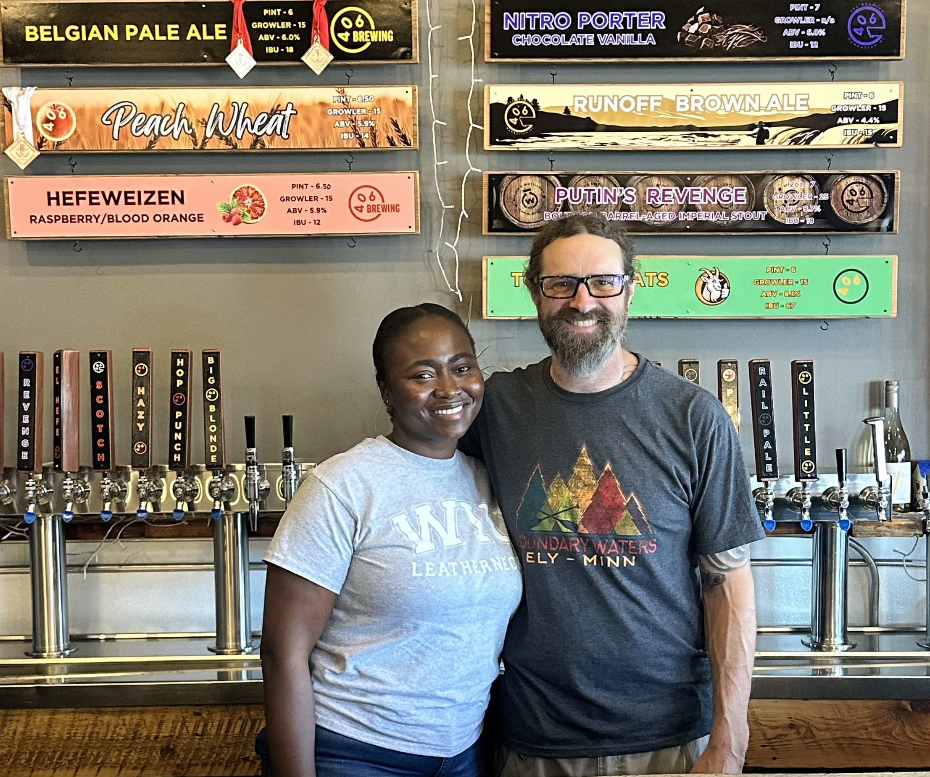
406 Brewing and Taproom
Small craft brewery located in Manhattan, Montana.
Known for its locally brewed beers and community-centred approach
Operates on a modest scale with a strong interest in sustainable practices and continuous improvement.

Slide 5
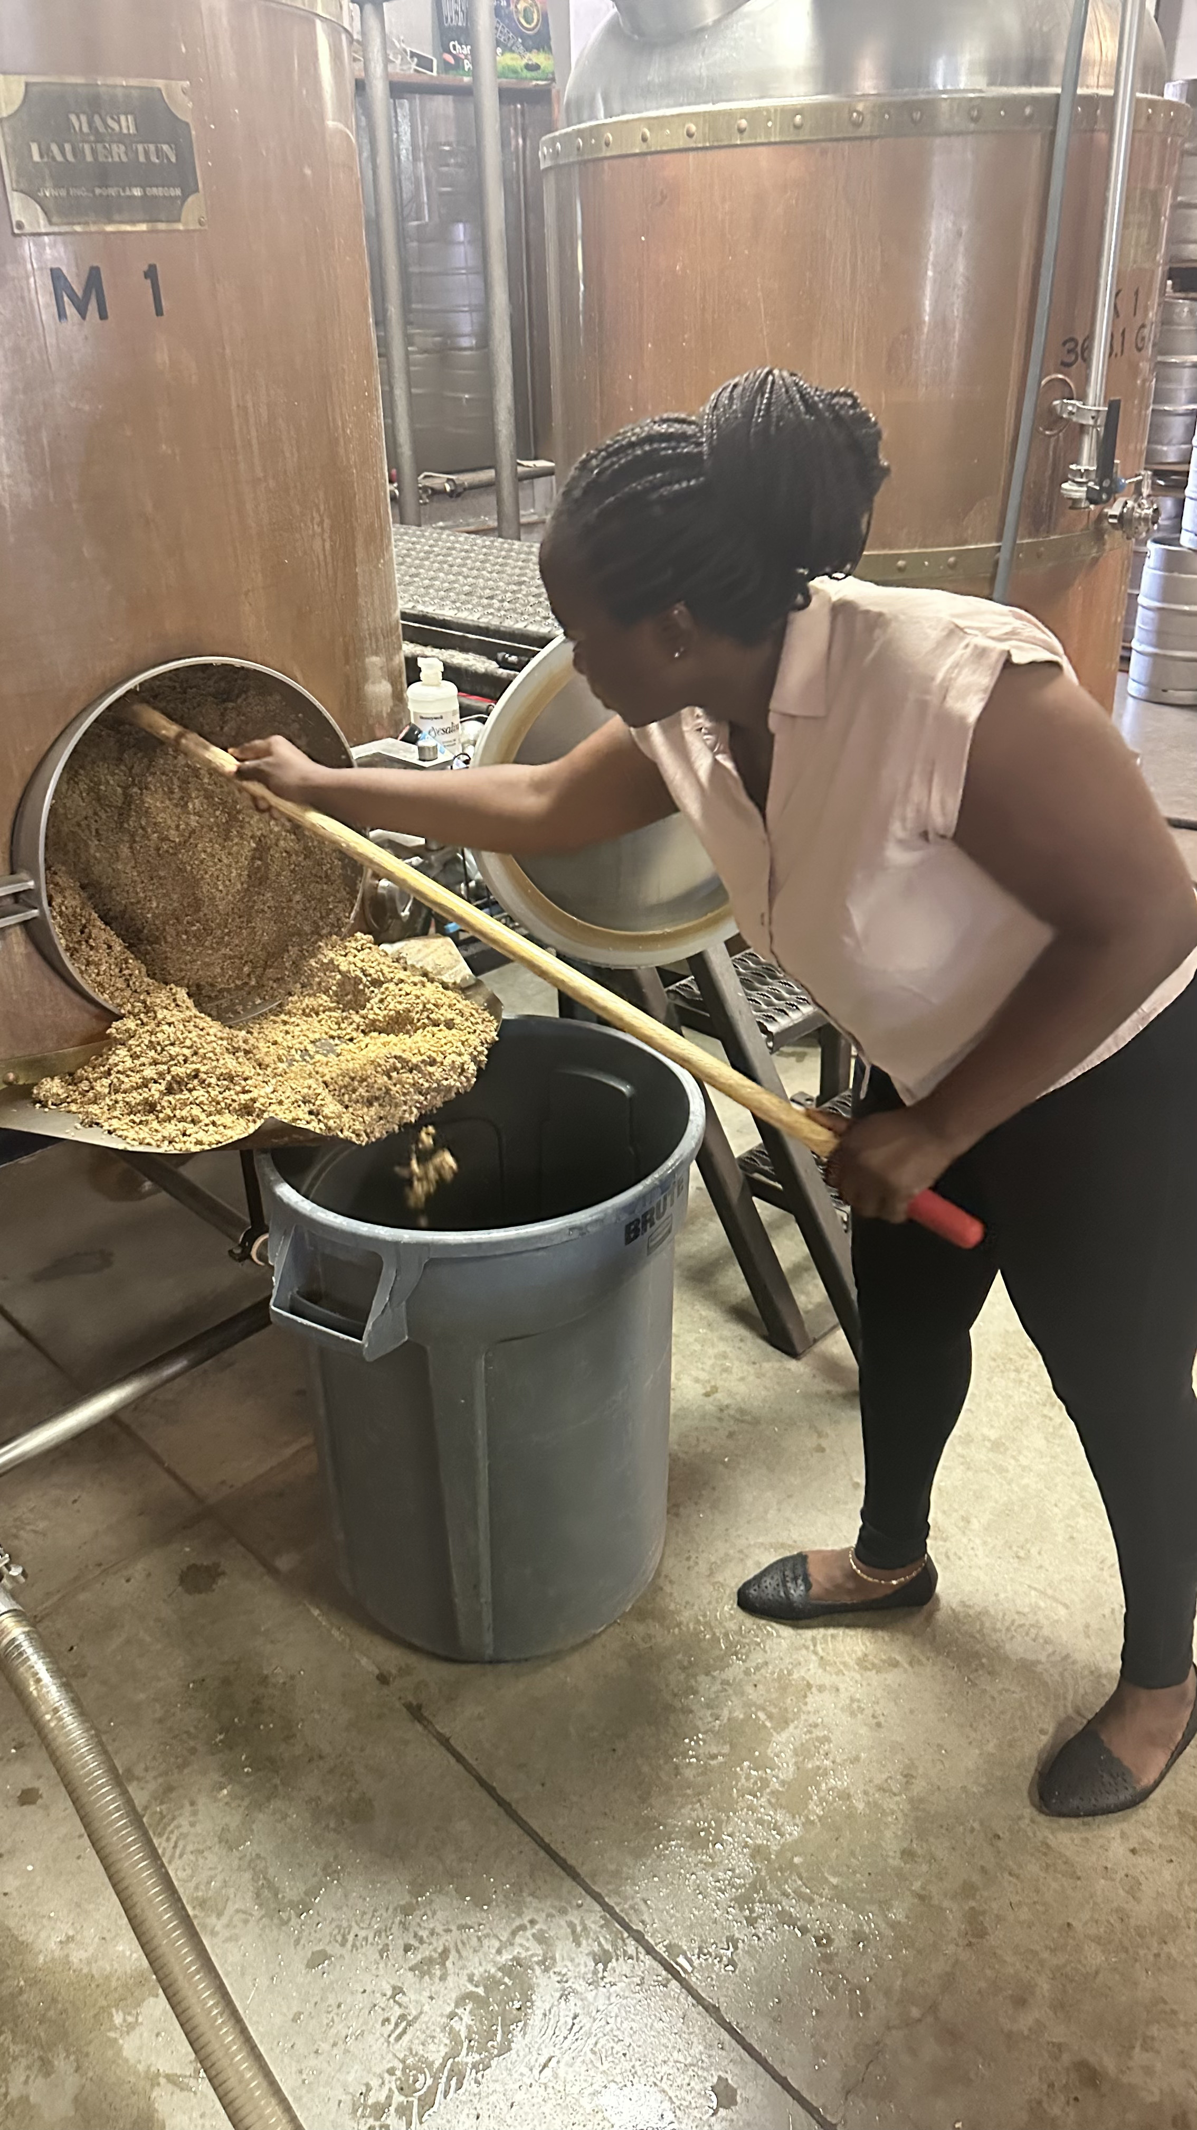
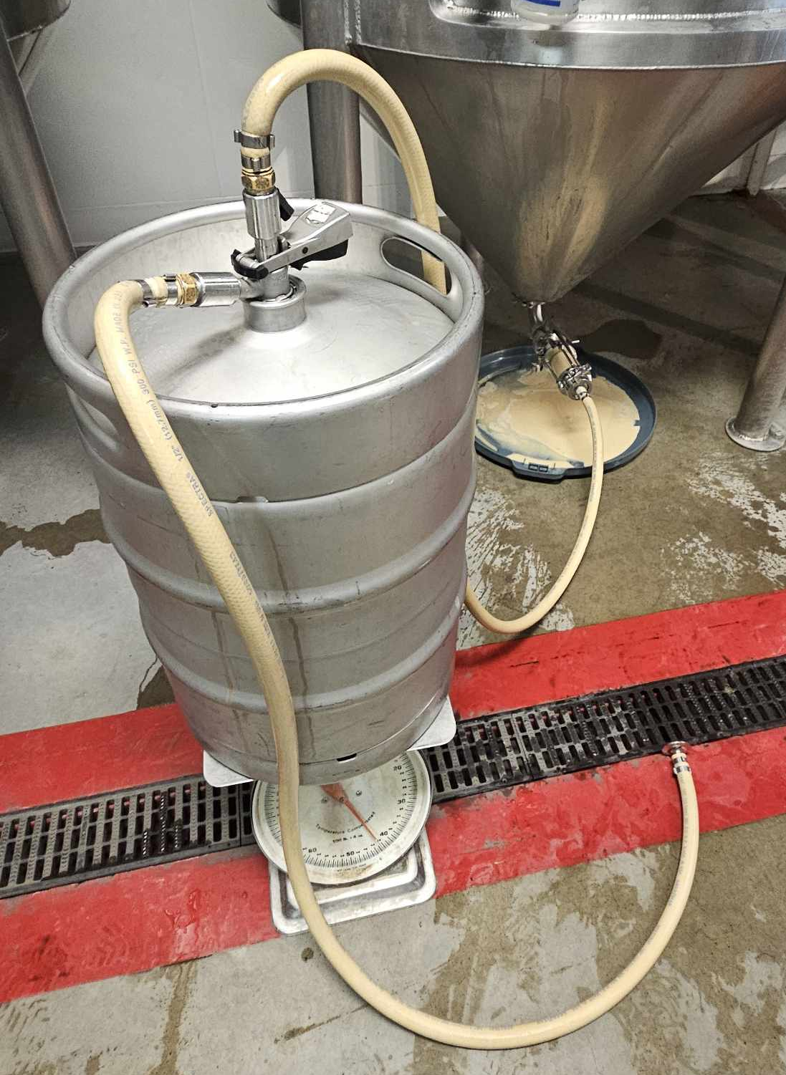
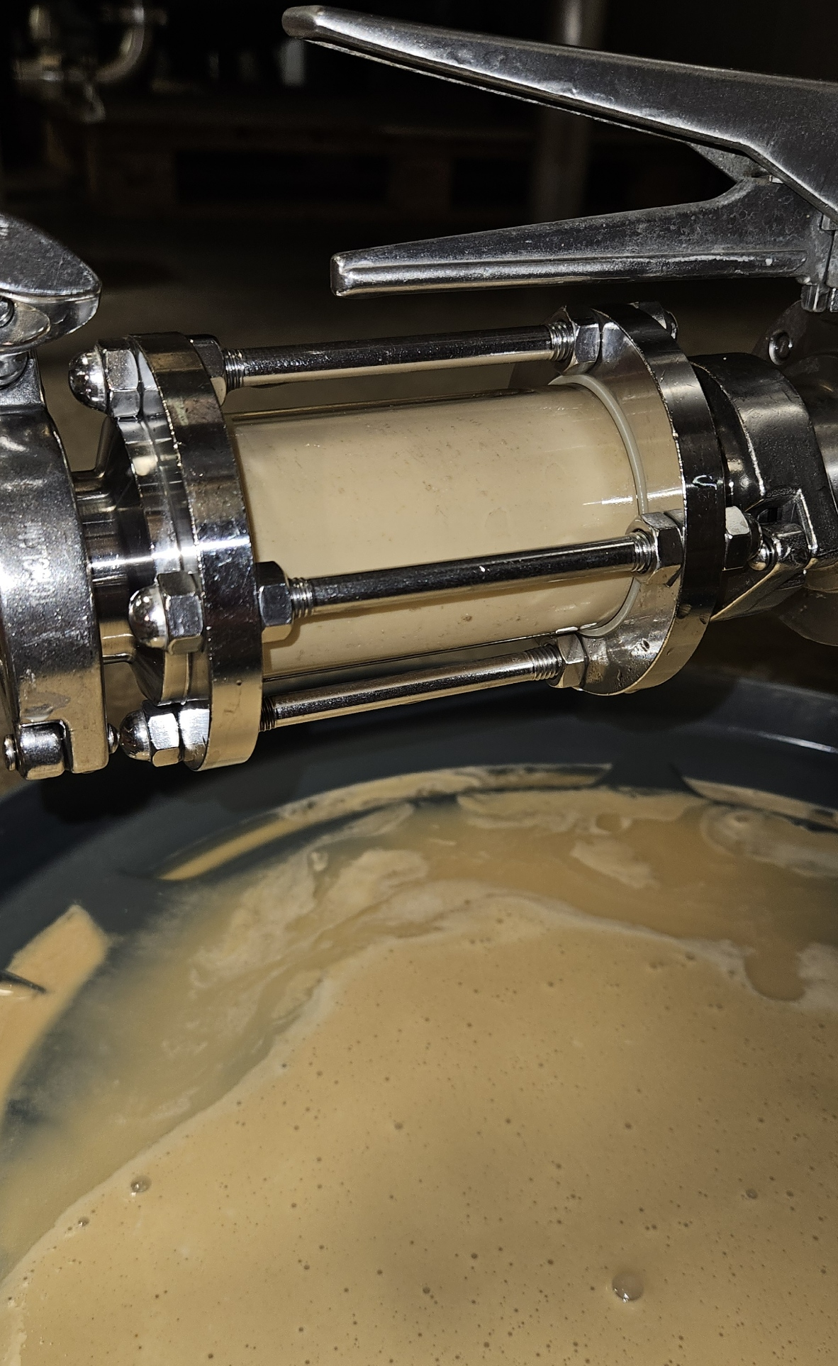

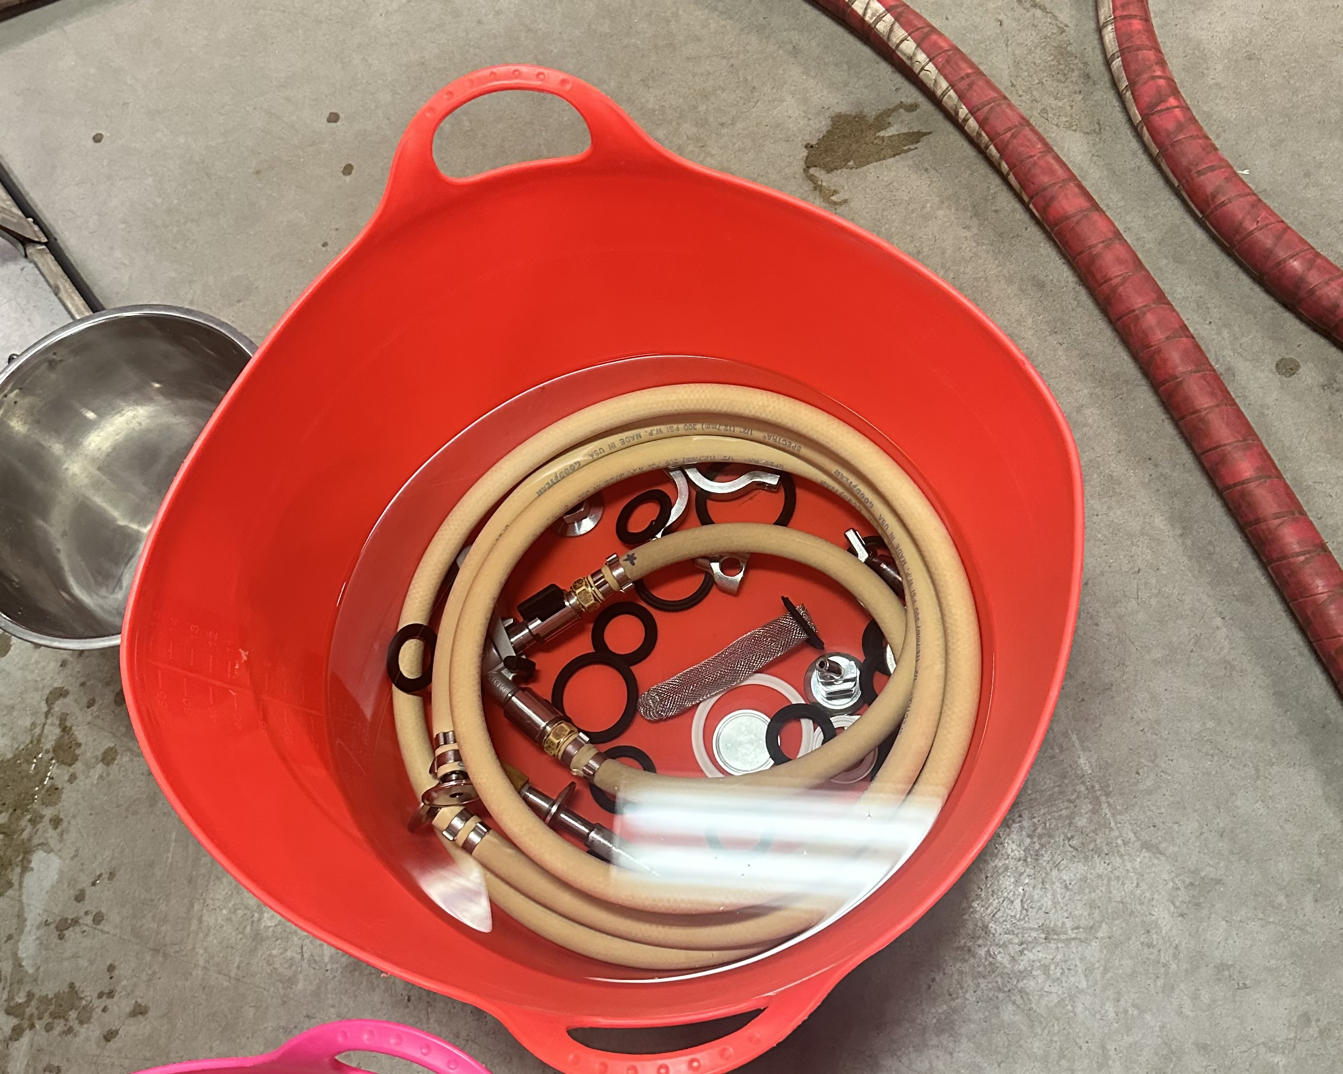
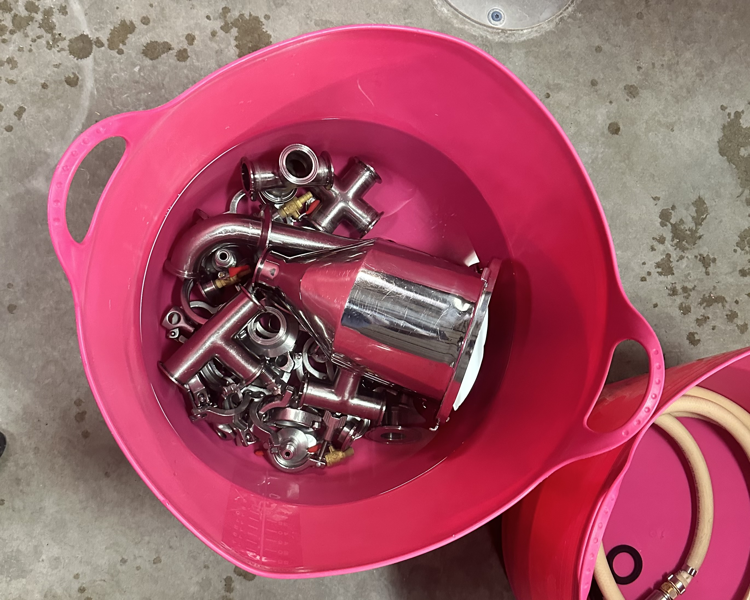
406 Practices Supporting Sustainability
Uses repurposed yeast from local breweries, reducing waste, avoiding new shipments, and cutting the carbon footprint of yeast sourcing.
70% of malt is sourced locally, supporting local agriculture and cutting transport-related emissions.
Reuses caustic and sanitizer from tank cleaning to wash small equipment
Spent grain goes to a local farmers for livestock feed

Slide 6
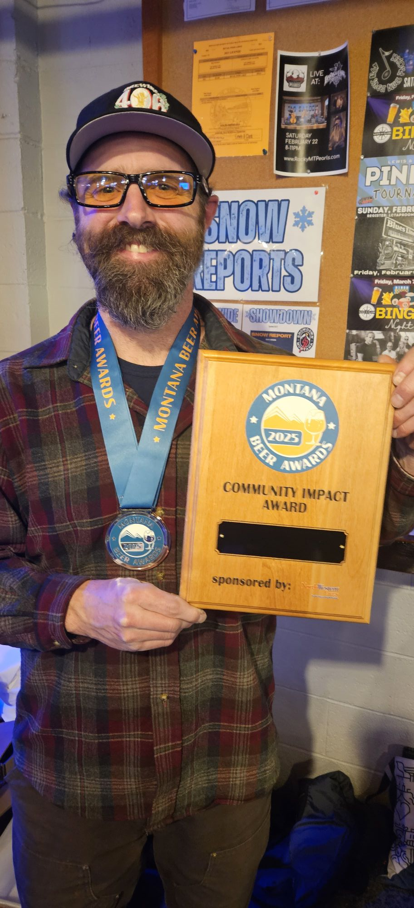
Where 406 Stands
P2 Interest Areas
Water and chemical use reduction
Cost optimization through efficiency
Community environmental benefit
External input to identify areas for improvement
Implementation Barriers
Single-operator time constraints
Limited capital for upgrades
Absence of data tracking systems
Estimated utility measurements

Slide 7
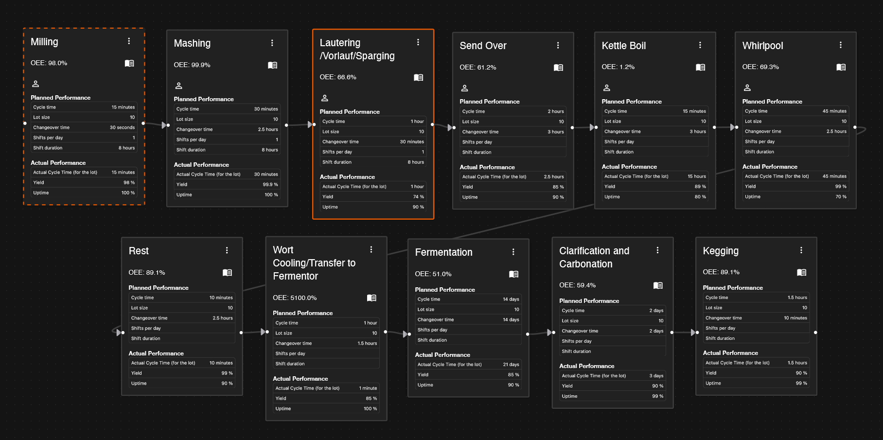
Value Stream Mapping (VSM)

Slide 8
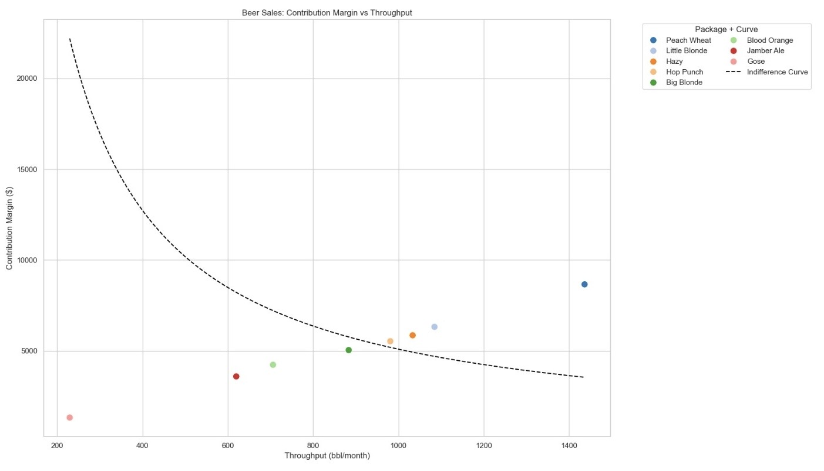
Profit Velocity Model (PVM)
Beer | pints/month | CM | Months available
Hazy | 1033.42 | 5859.49 | 2
Blood Orange | 706.14 | 4236.84 | 12
Peach Wheat | 1436.42 | 8661.61 | 2
Jamber Ale | 619.96 | 3595.79 | 6
Hop Punch | 981.02 | 5532.95 | 8
Big Blonde | 883.5 | 5044.78 | 6
Little Blonde | 1084.59 | 6323.16 | 6
Gose | 229.64 | 1331.91 | 9

Slide 9
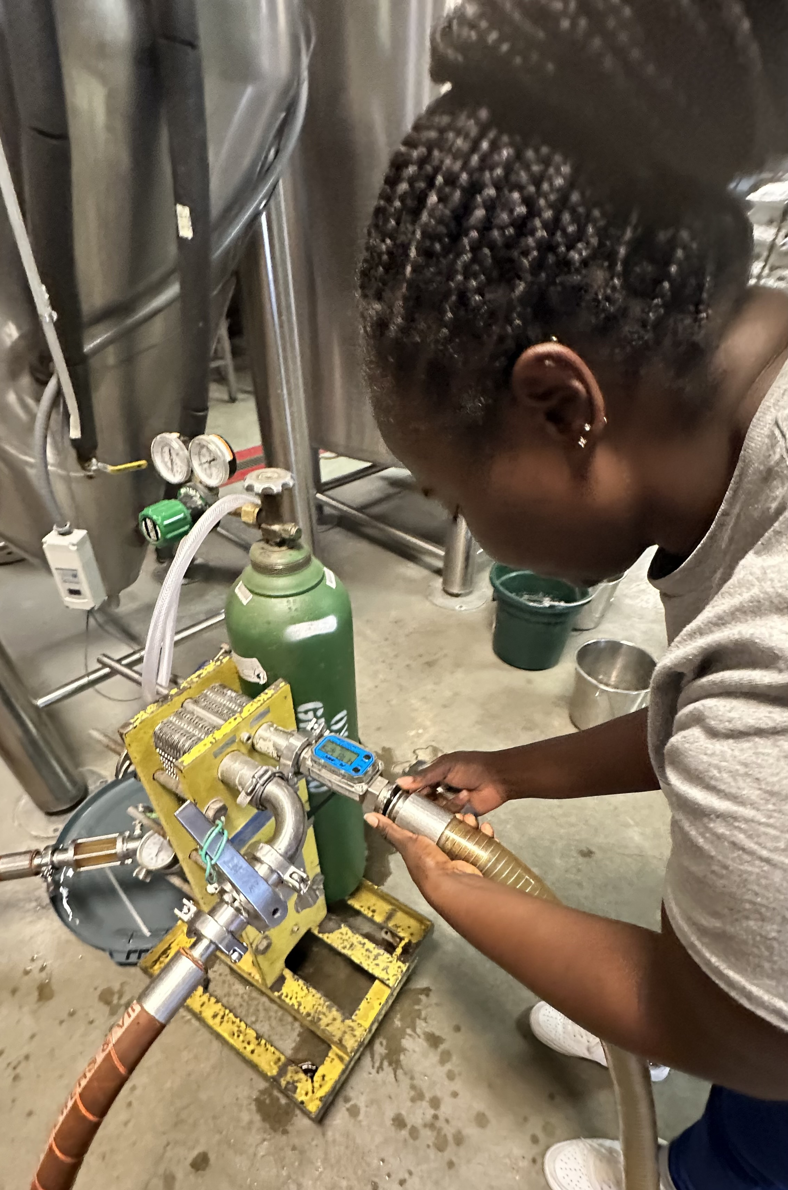
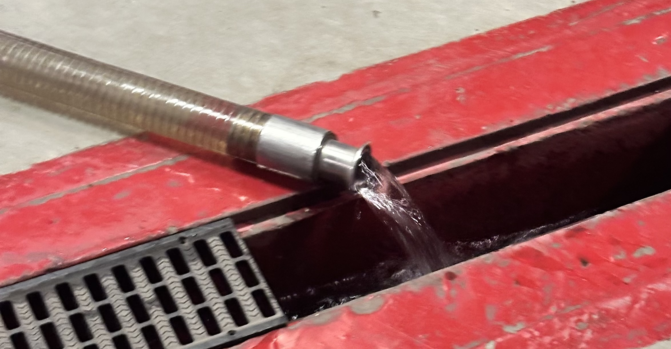



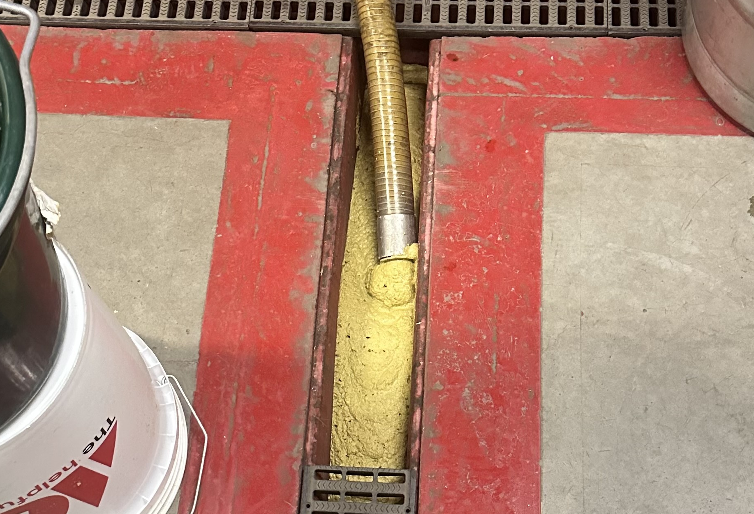

P2 Focus Areas
Wort Cooling Process
Water waste reduction during cooling processes.
Manual Keg Cleaning
Yeast Management
Manual processes consuming excessive labor, water, and CO₂ resources.
Explore reuse options to reduce high BOD/COD wastewater loading.
Utility Monitoring
Flow meters and structured data management for accurate resource tracking.

Slide 10
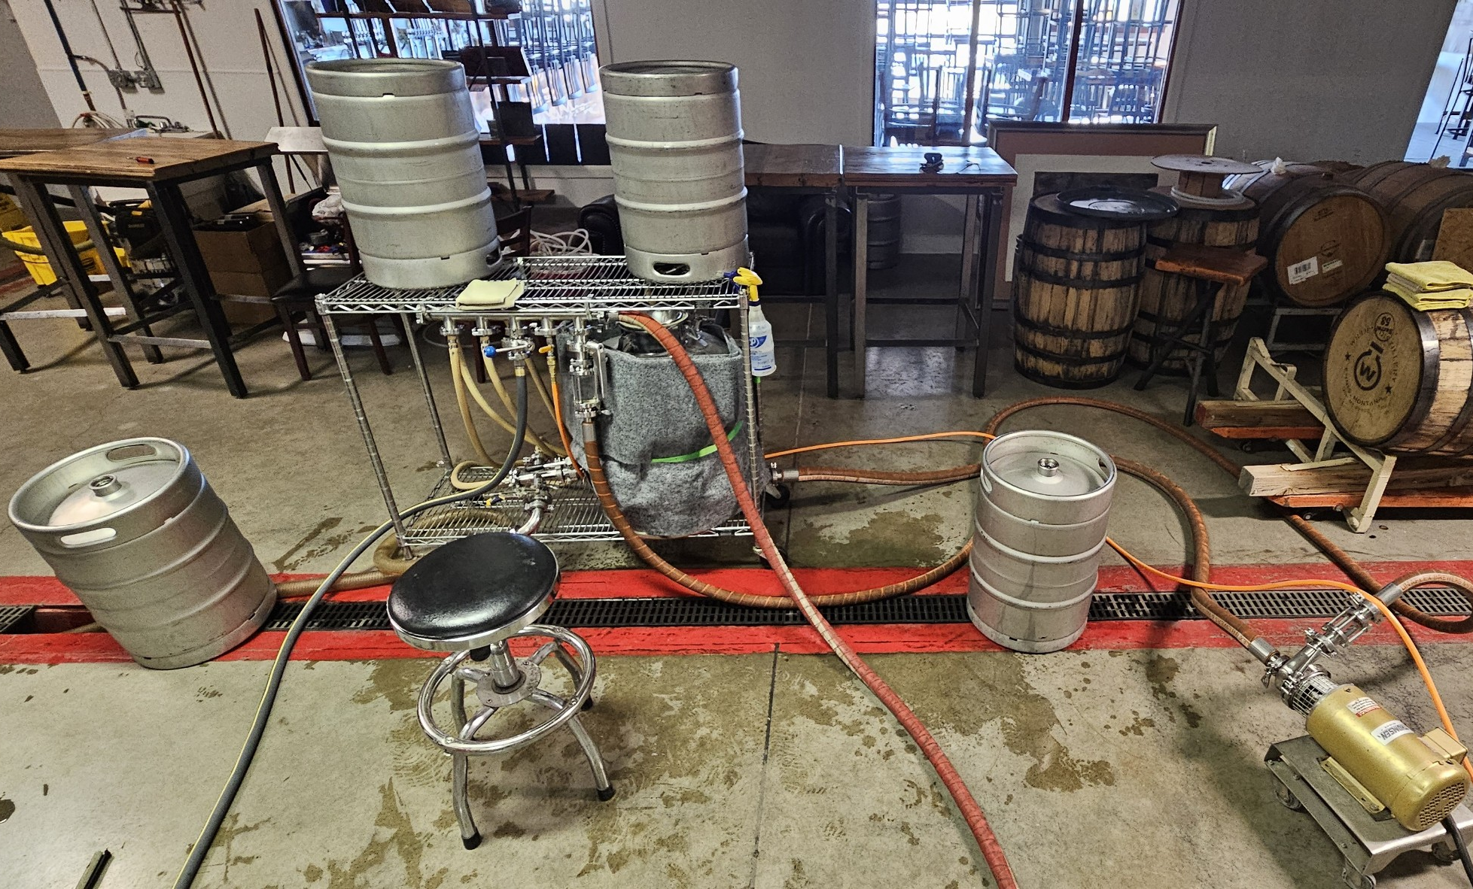
Manual Keg Cleaning Set-up
Resource | Manual Keg Washer | Automated Keg Washer | Savings (%)
Water(gal) | 420 | 120 | 71
CO₂ (lbs) | 18.5 | 4.5 | 60
Time (hrs) | 6.5 | 0.75 | 88
Energy (kWh) | 8 | 1 | 76

Slide 11
Sustainable Brewery Figures
Water Usage Analysis
Industry benchmark water-to-beer ratio is 3–7 gallons of water per 1 gallon of bee.
Ratio from a 10 bbl brew
Water Usage (gal) |  | Brewing (gal) | Brewhouse Cleaning (gal) | Fermenter Cleaning (gal) | Brite Tank Cleaning (gal) | Keg Cleaning (gal) | Floor Cleaning (gal) | Total Water Use (gal) | Water: Beer (gal:gal)
 | Current | 1058.5 | 125 | 120 | 118 | 238 | 20 | 1679.5 | 6.26
 | Wort Cooling Water recovery | 480.5 |  |  |  | 238 |  | 1101.5 | 4.11
 | Wort Cooling Water Recovery + Keg Washer | 480.5 |  |  |  | 68 |  | 931.5 | 3.47

Slide 12

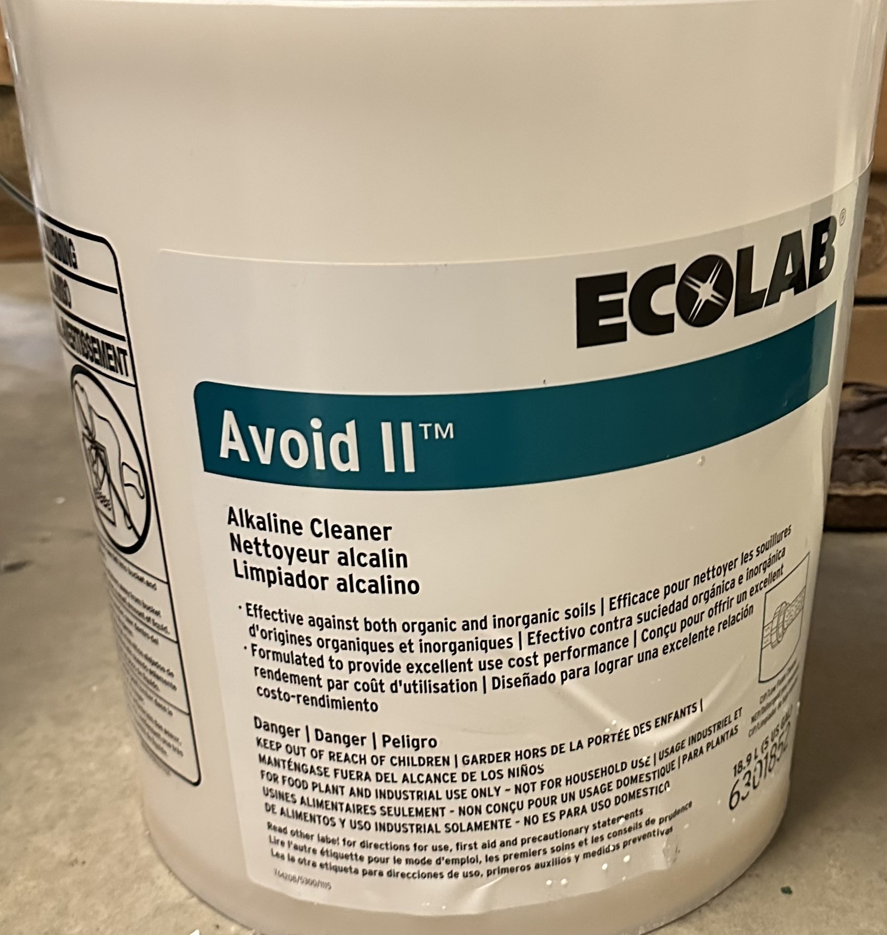
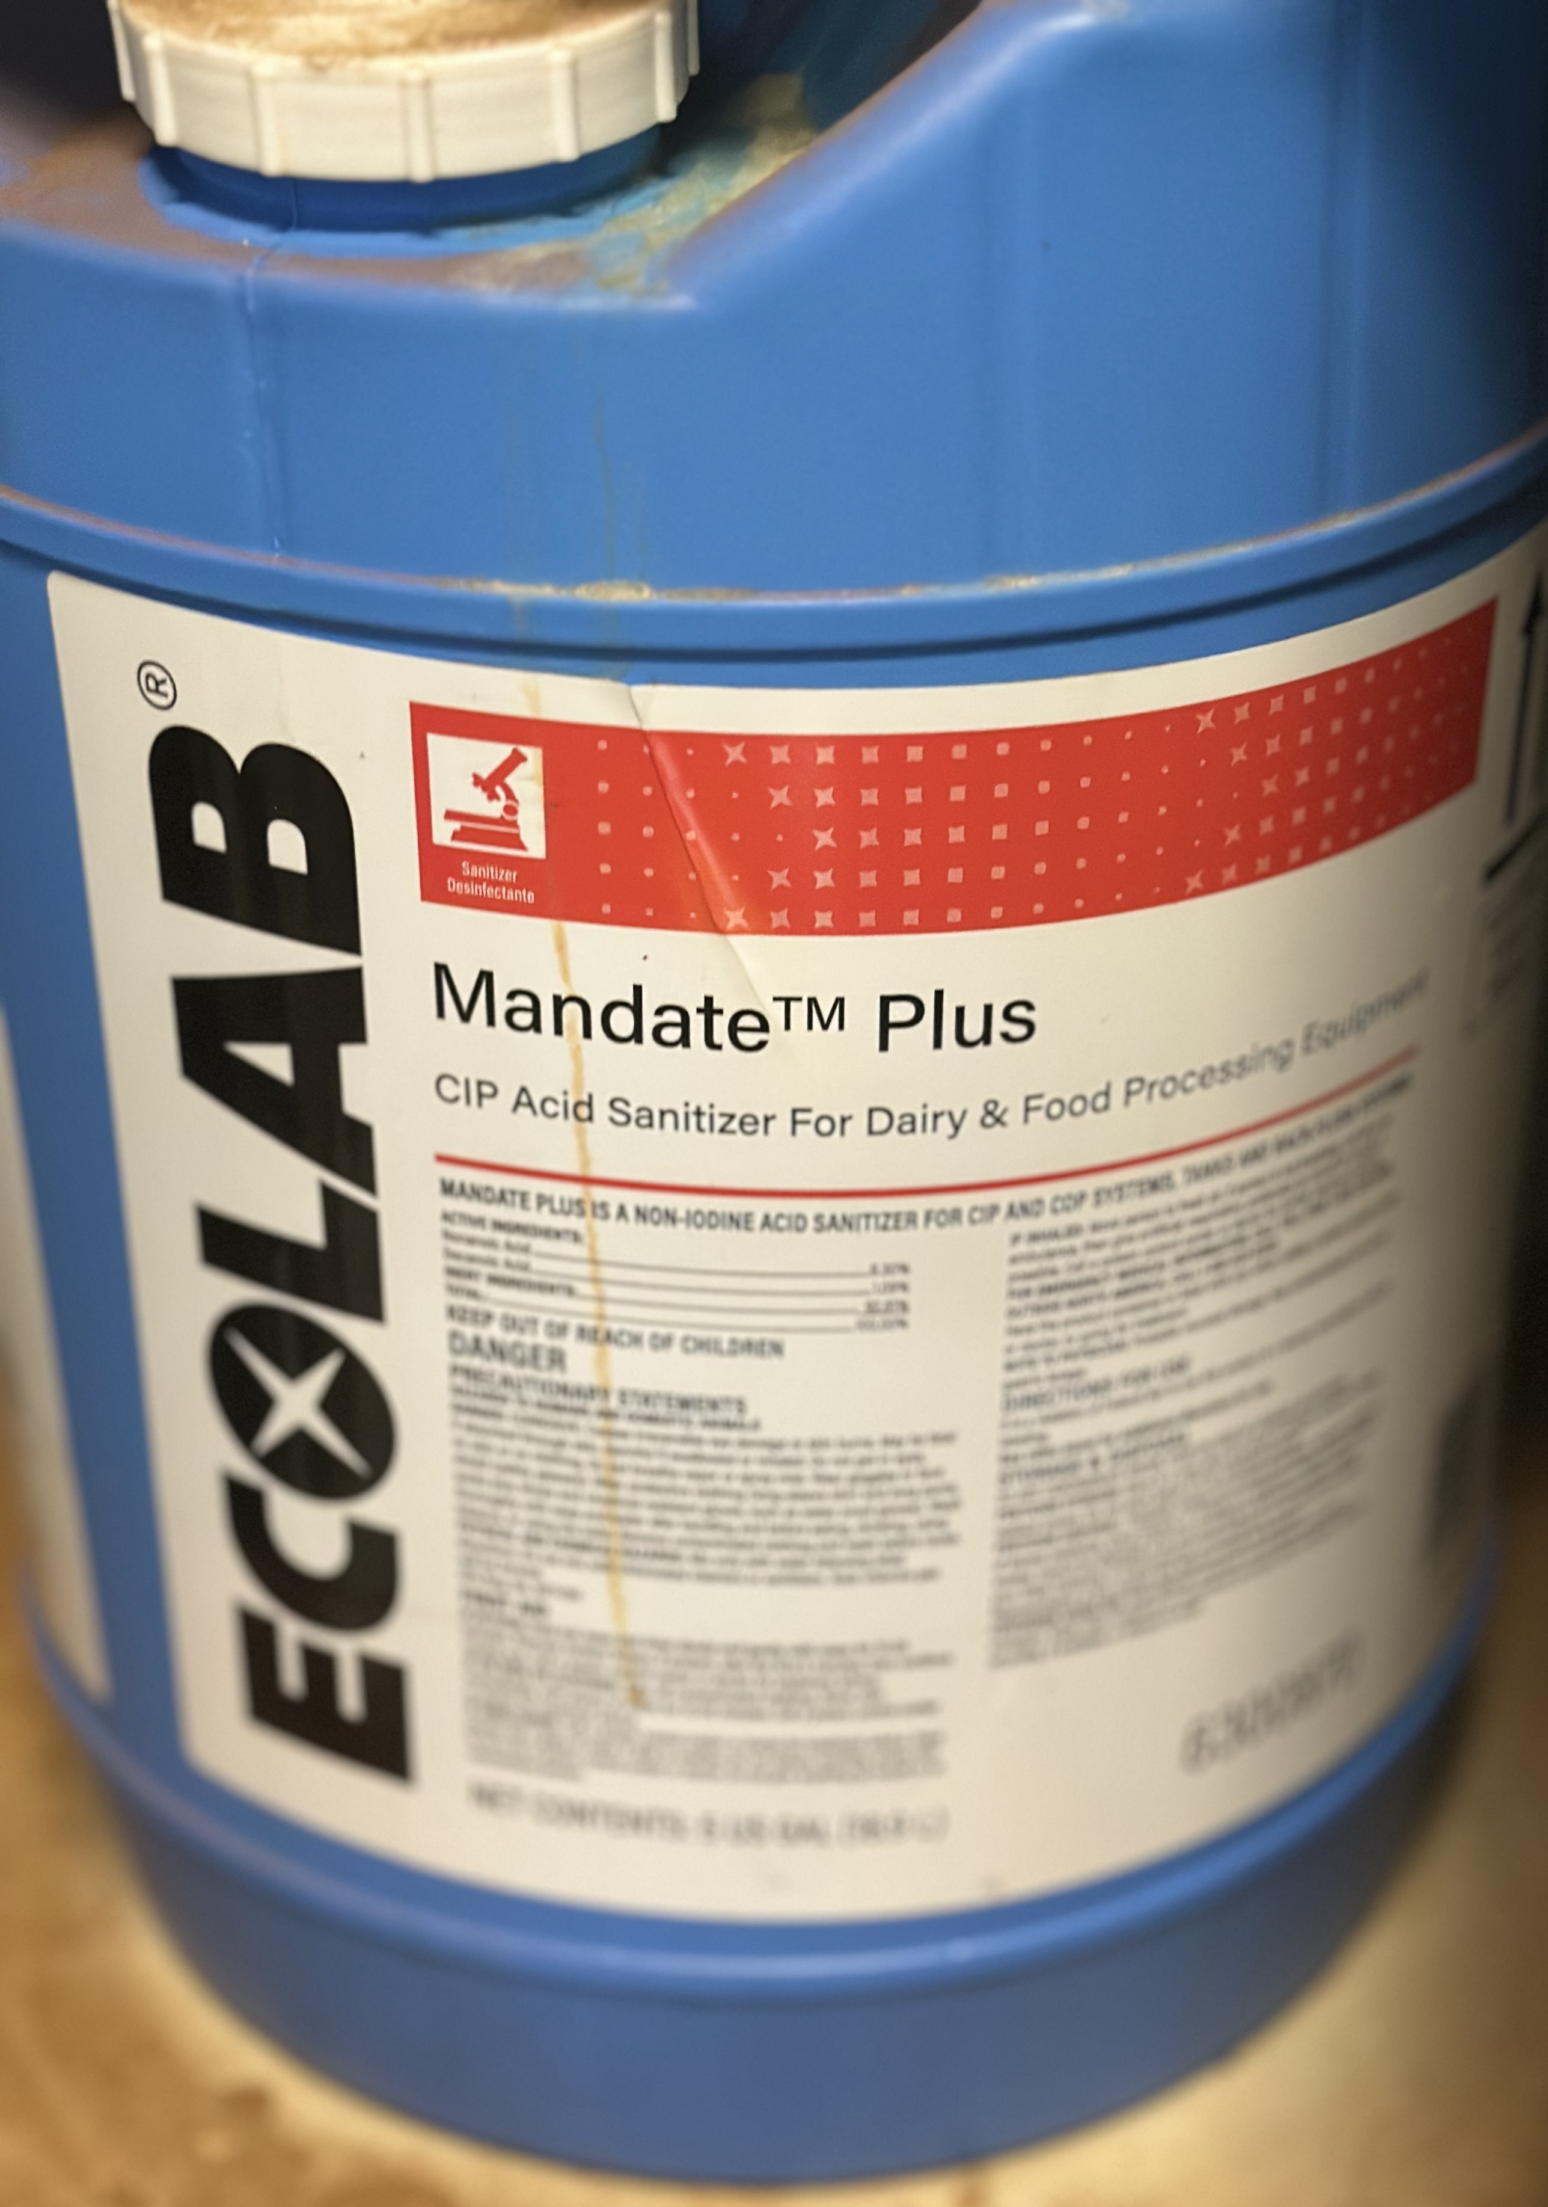
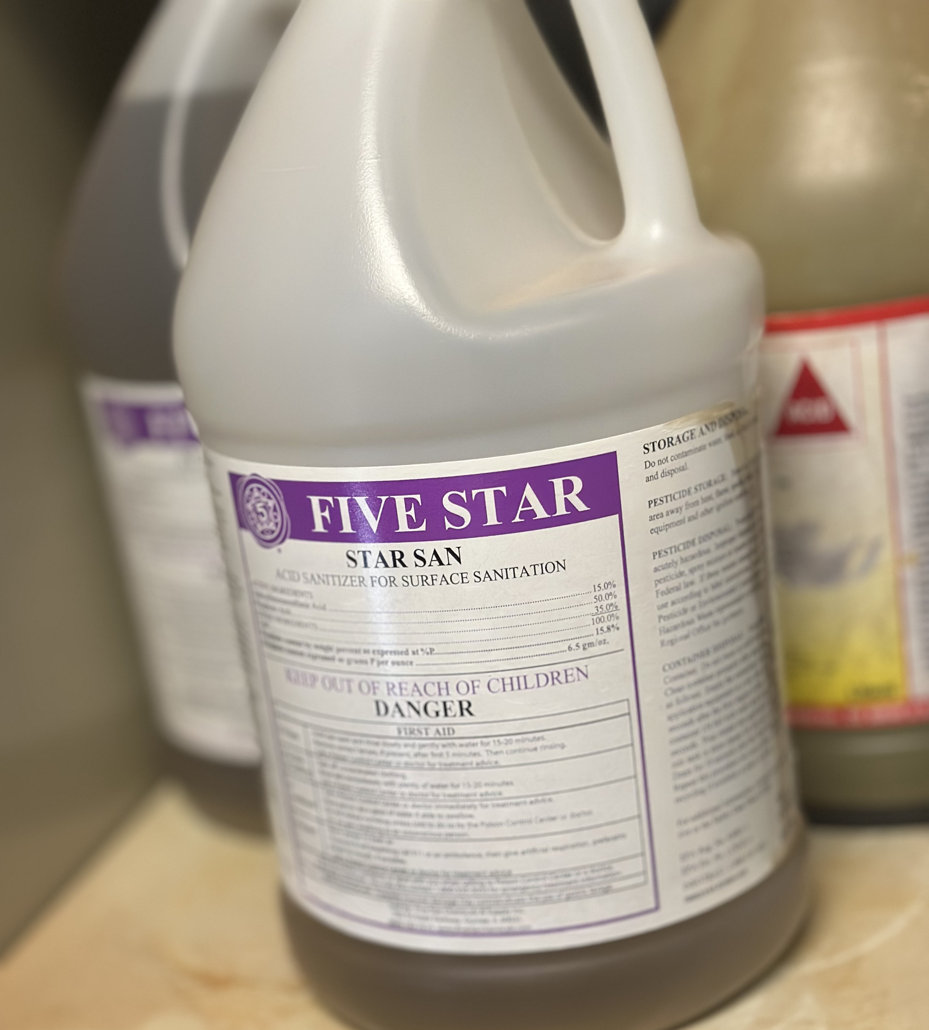
Chemical Usage Assessment
Ecolab Avoid II Alkaline Cleaner
Assessment Gaps
Recommended: 1.3-5.1 oz per gallon for brewery applications
CO₂ usage not quantified
406 Current Practice: 1.5-2.5 oz per gallon
Energy consumption requires accurate metering
Usage within optimal range, demonstrating efficient chemical management practices.

Slide 13
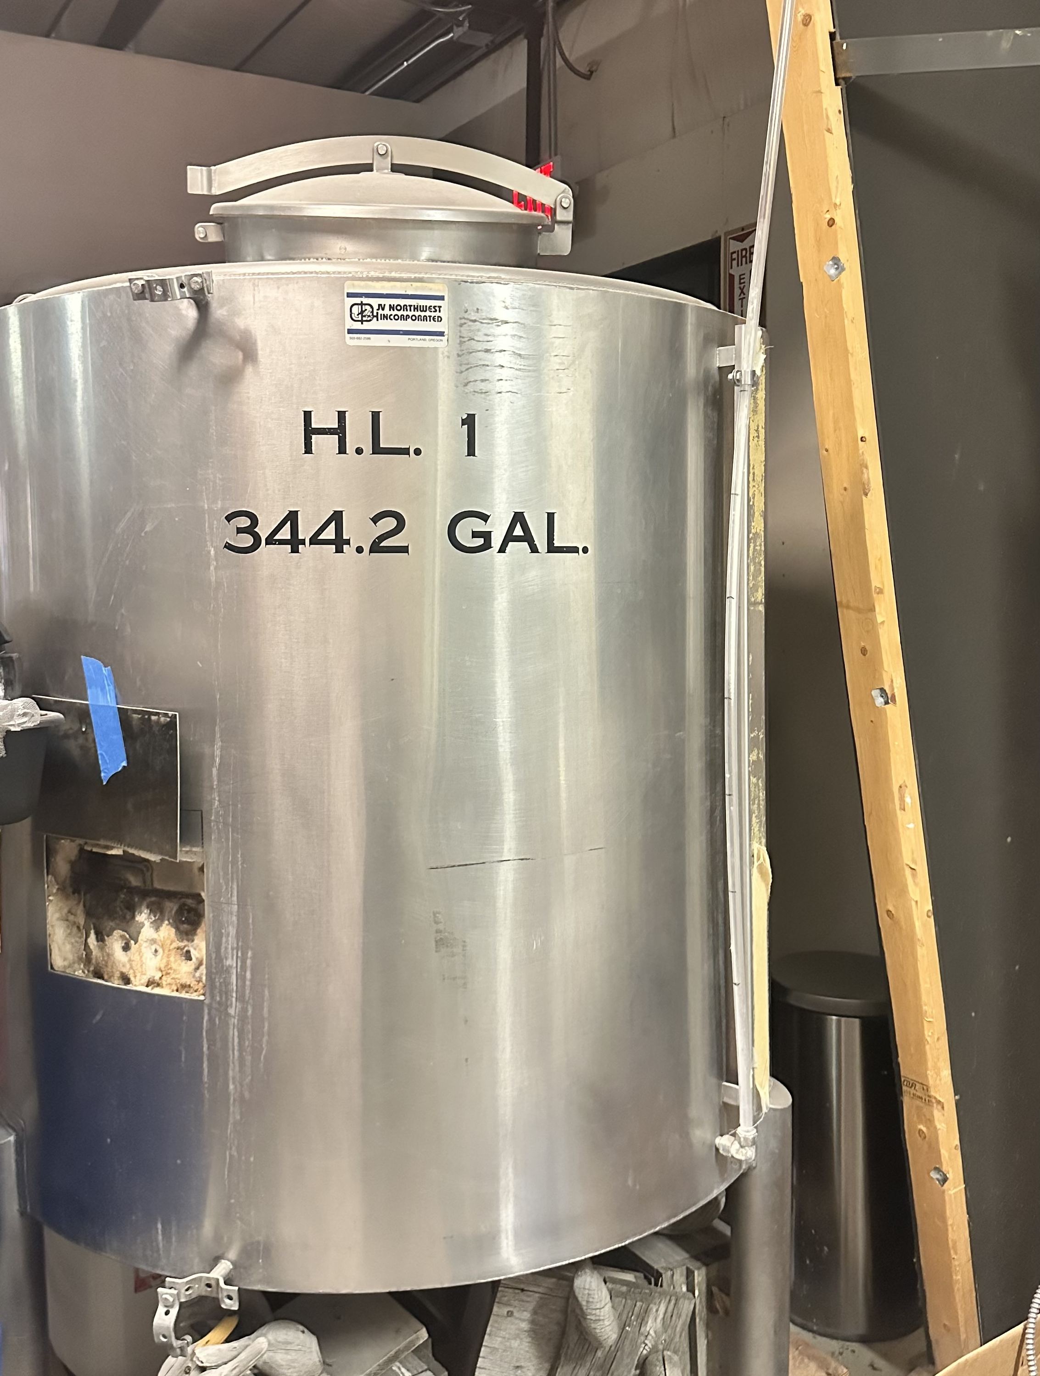
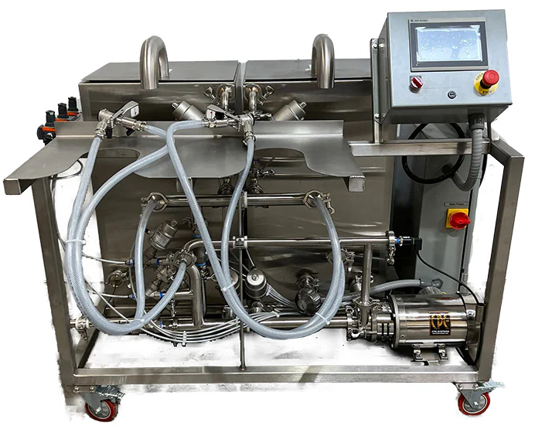
P2 Implementation Recommendations
Wort Chilling Water Recovery
Keg Washer
Save 66 labor hours ($1,188), reduce 3,624gal water and 437 lbs CO₂ annually. ROI in 8yrs
Recover 25,608gal water at 160°F saves 22.4million BTU of natural gas which generates approximately 2,616lbs of CO₂ emissions annually. ROI in 2yrs

Slide 14

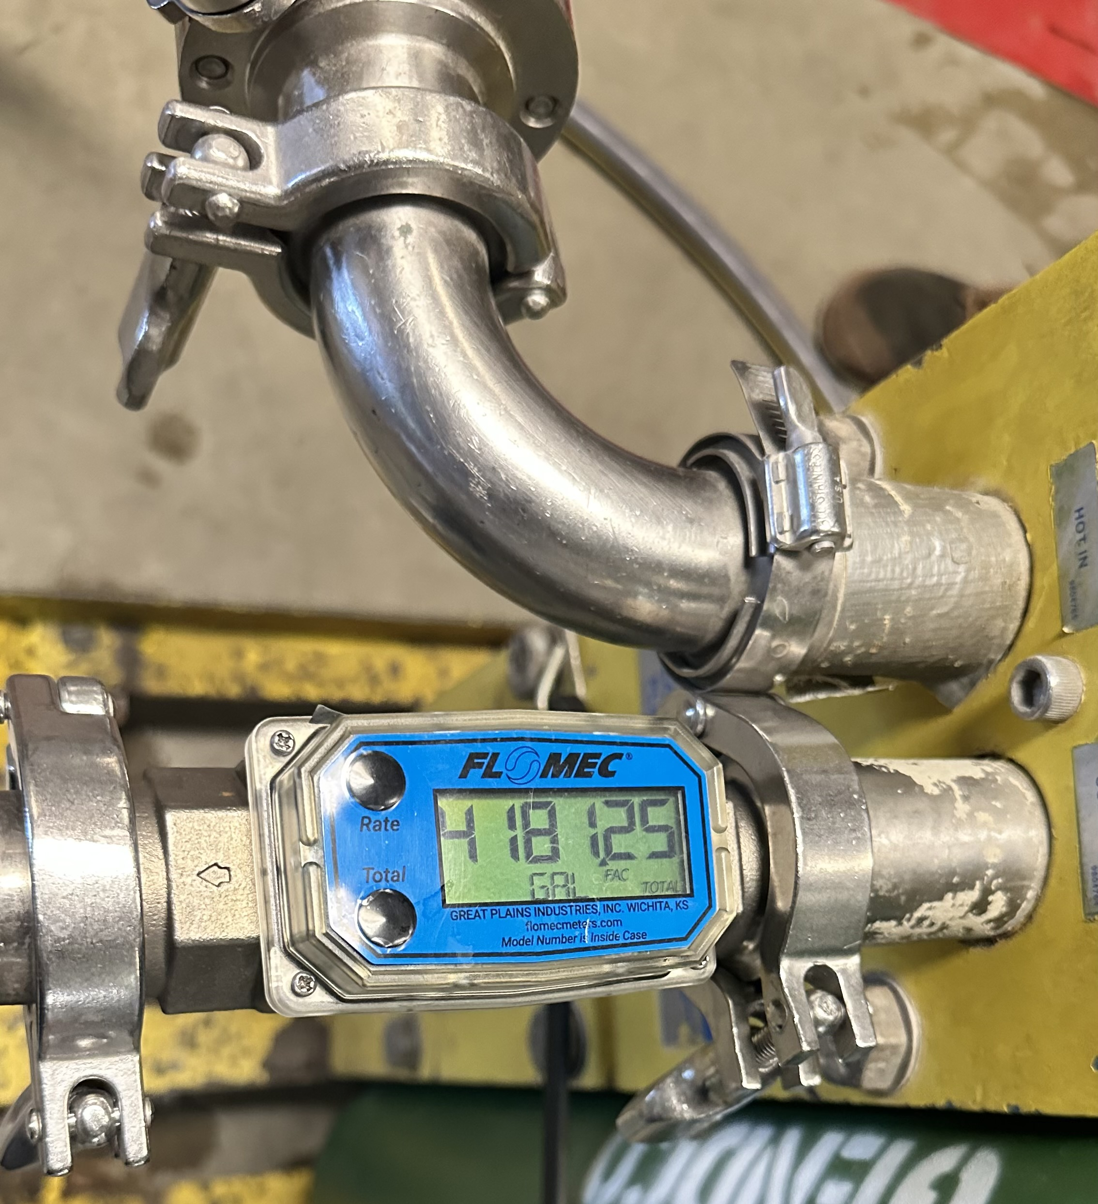
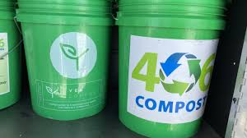
P2 Implementation Recommendations
Spent Yeast Composting
Partner with YES Compost, divert 30-35 lbs/batch from wastewater, reduce BOD/COD impact.
Utility Tracking System
Install flow meters, implement structured logging for accurate resource monitoring and ROI analysis.

Slide 15
P2 Outcomes
Recommended P2 Actions | If Implemented: |  |  |  |  |  |  | If Not Implemented
 | $ |  | Annual Reductions
 | One-time cost to implement ($) | Annual savings from P2 actions | Water Use (gal) | MTCO₂e emissions (tons) | Solid Pollution (lbs) | Solid Organic Waste Pollution (lbs) | Time (hrs) | Barrier to Implement | Plans to implement within 5 years? (Y/N)
Wort Cooling Water Recovery | 500 | 246.94 | 25,608 | 1.56 |  | - | 45 | Service Delay | Y
Keg Washer | 12,000 | 1362.85 | 3,624 | 0.198 | - | - | 66 | Funds | Y
Composting Spent Yeast | 50/mon | - | - | - | - | 1680 | - | - | Y

Slide 16
Program Insights and Future Recommendations
Personal Learning Outcomes
Future Intern Recommendations
Program Enhancement Opportunities
Early material review before site visits
Early business assignment for pre-internship research
Gained understanding of the brewing process
Ask all your questions, there is no such thing as a ”bad” question!
Improved documentation and observation skills
Tracking waste matters even when cost savings are small
Ask for help - business owners, advisors, other interns, MTP2 directors

Slide 17
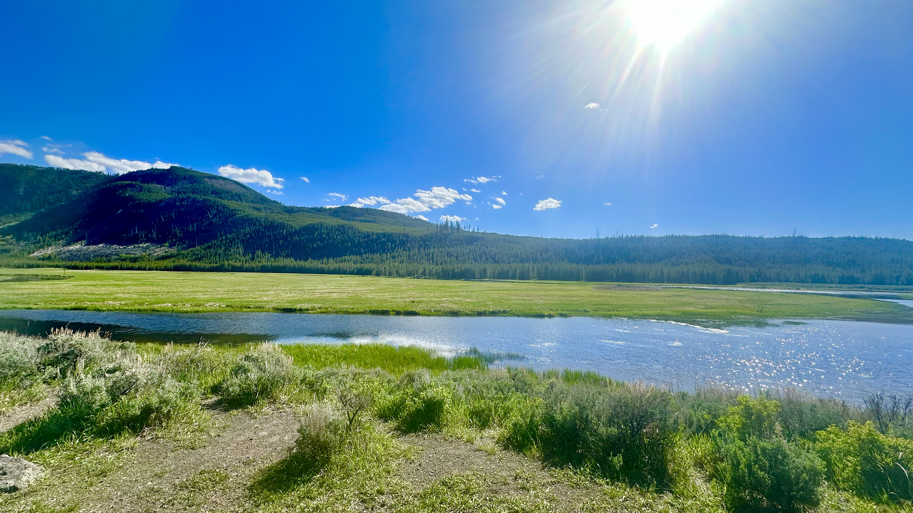



Acknowledgement
Land
Manhattan, Montana, rests on traditional lands of Indigenous nations, including the Apsáalooke (Crow), Salish, Kootenai, and Pend d'Oreille. We honor their enduring presence and stewardship, approaching our work with respect for the land and its original custodians.
Funding & Program Support
This internship was supported by the U.S. Environmental Protection Agency (EPA). Special thanks to the Montana Pollution Prevention Program (MTP2) directors and my advisor, Alistair Stewart, for their invaluable guidance.
Business Partner
Immense gratitude to 406 Brewing Company and brewer Matt Muth for this unique on-site learning opportunity, allowing direct contribution to their sustainability initiatives.

Slide 18
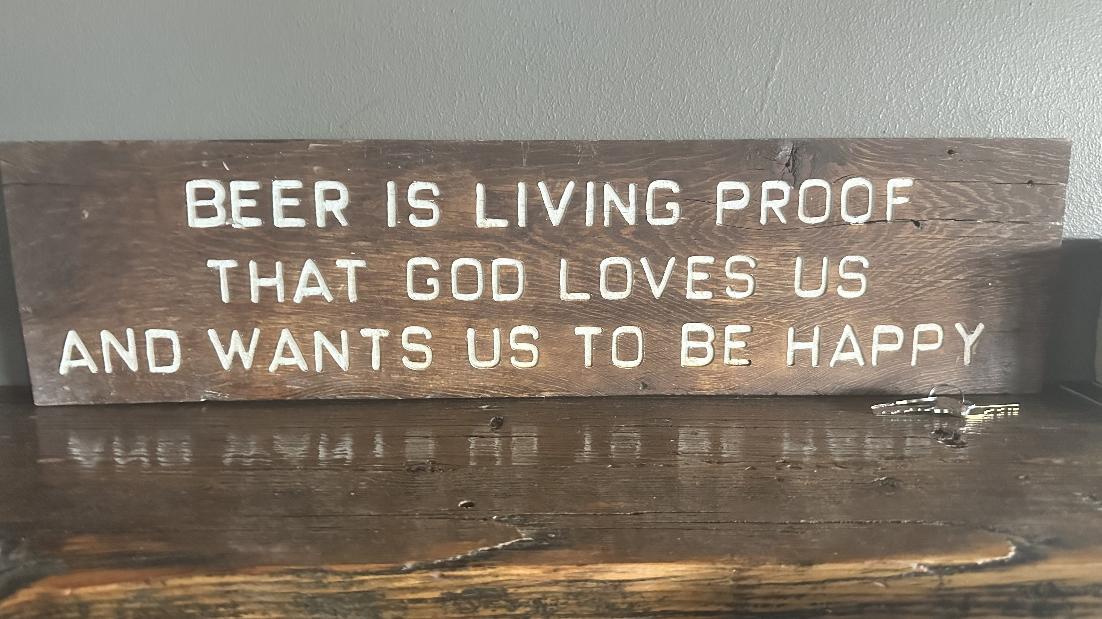
Questions?

