Slide 1
Cool Earth Creamery
MTP2 Program Report
Presented By: Nick Nelson, 2025 MTP2 Intern
Business Owner: Devin Morales, P.E.
Technical Advisor: Steven Dybdal

Slide 2
Agenda
Business overview: Pollution prevention interest and challenges
Value stream mapping
P2 areas of focus
Workflow recommendations
Recommended P2 actions
Gelato packaging: Backyard compostability test
CO2 emissions comparison by oat milk packaging type
Internship reflections

Slide 3
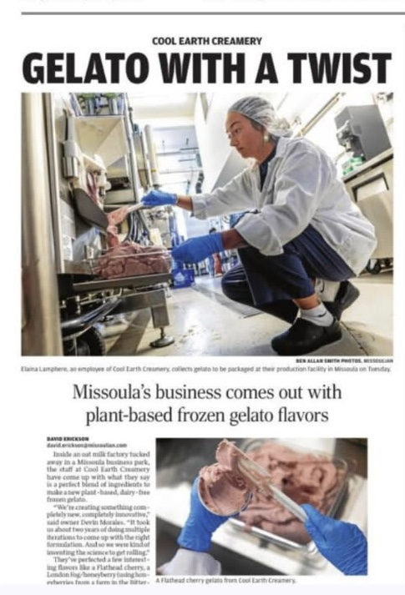
Cool Earth Creamery
P2 Interest + Challenges
4 years in operation, primarily an oat milk producer, expanding to gelato this year
Strong focus on sustainability from the start
Larger context: Resource use/environmental impact of plant-based milk vs dairy.

Slide 4
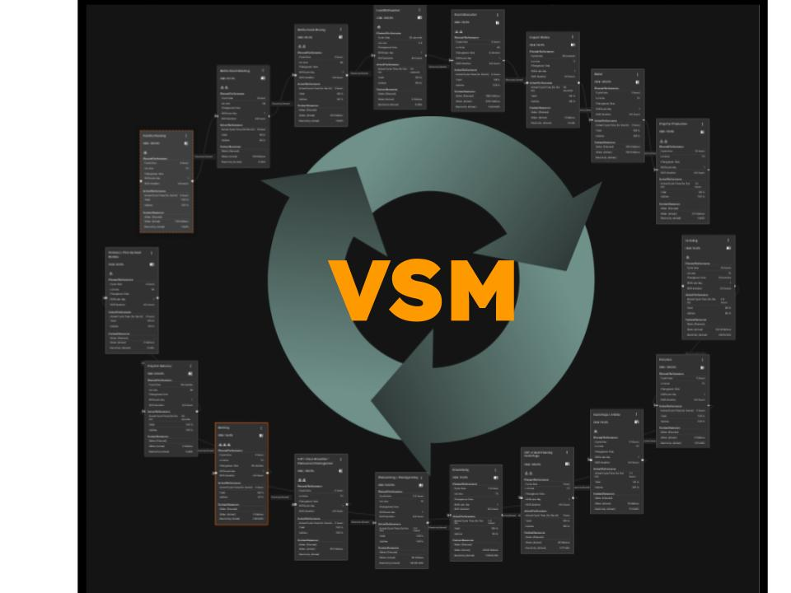
Oat Milk Production

Slide 5
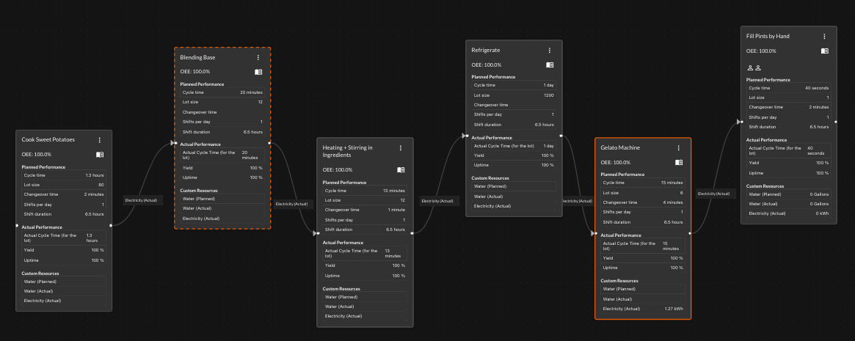
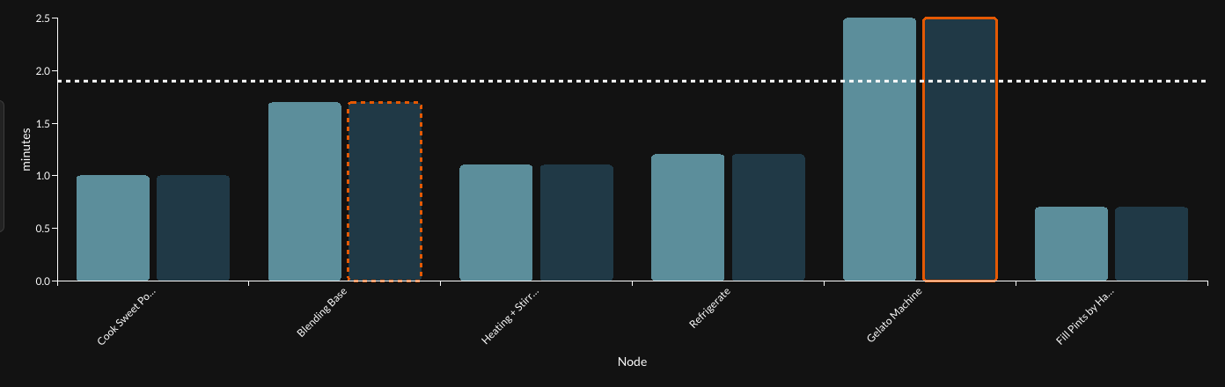
Gelato Production

Slide 6
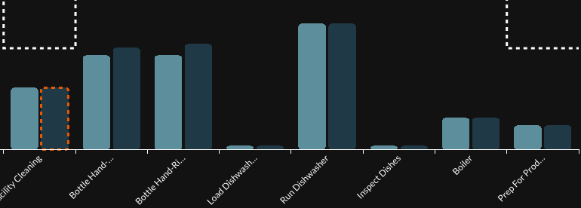
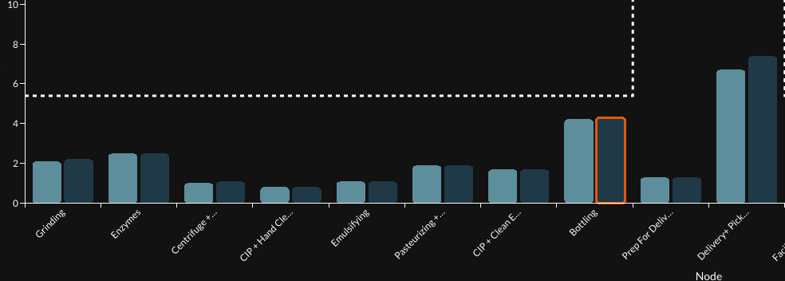
VSM Insights
Gelato Machine Constraint
Bottling
Bottleneck
Bottle
Washing:
Not apparent in VSM, but will be limiting due to facility layout.

Slide 7
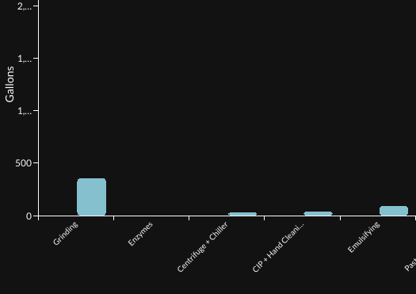
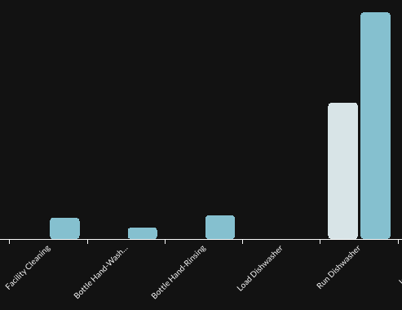
Water Usage

Slide 8
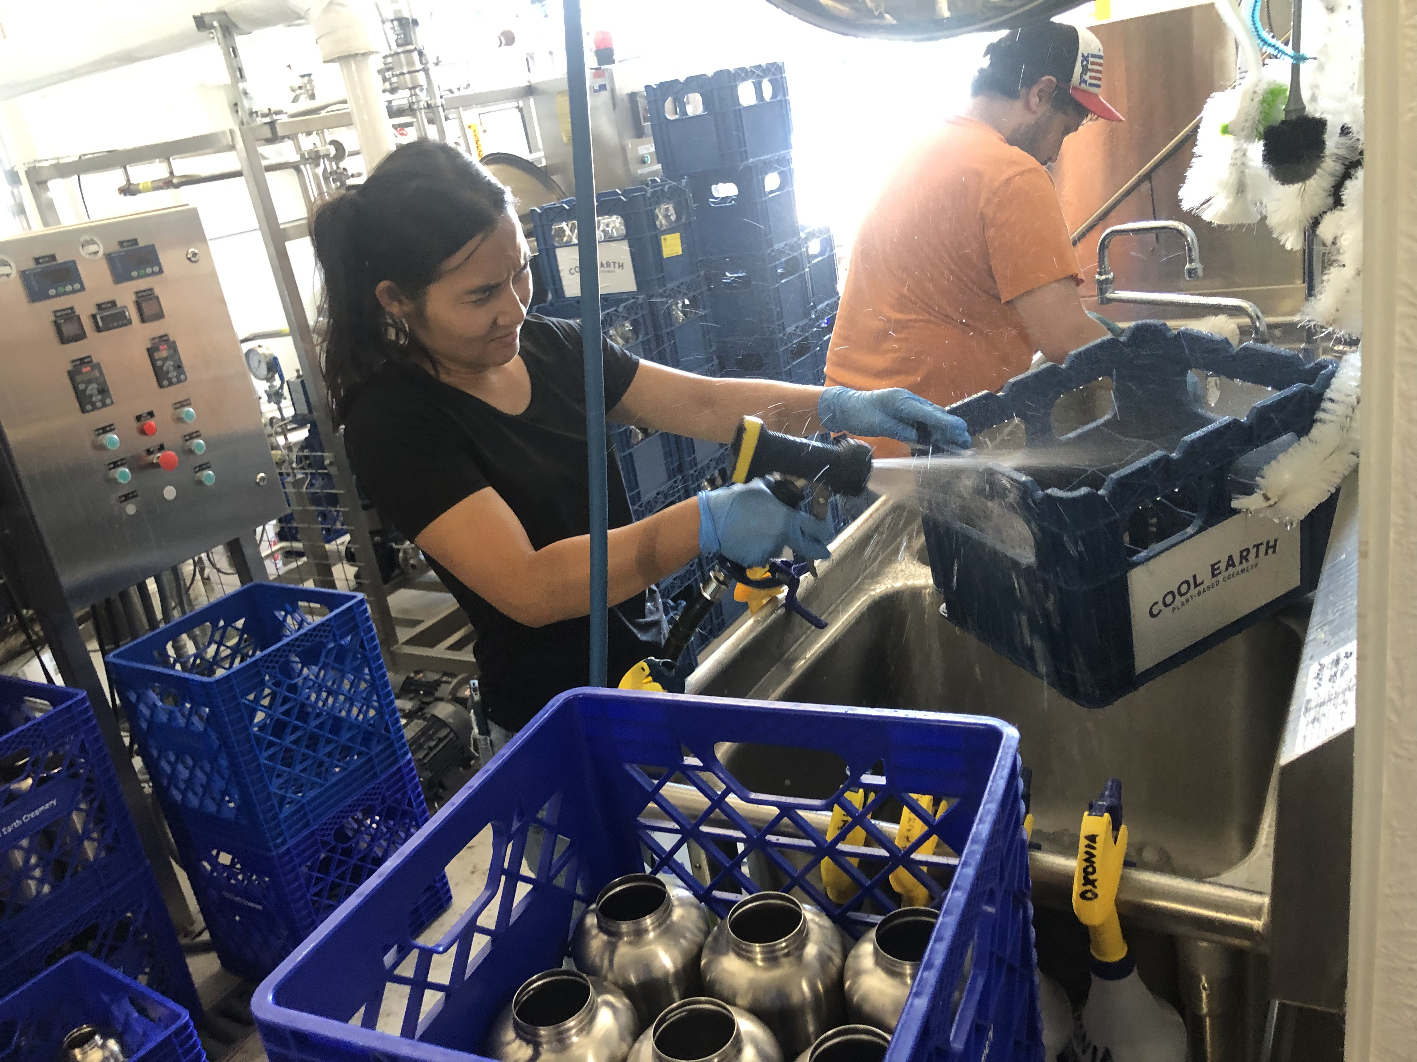
P2 Areas of Focus
Workflow Bottlenecks:
-Bottling, Bottle Washing,
-Gelato Machine
Water Consumption:
-Bottle washing, seal water
Other:
-Alternatives to plastic caps
-Charting CO2 impact by delivery distance of returnable glass vs aseptic cartons

Slide 9
Workflow Recommendations
Increase gelato machine capacity
Expand to secondary nearby facility and relocate bottle washing operation.
  Save 2-3 days per week of downtime that can be used for oat milk or gelato production
  Potential for added cold storage at new facility
  Much smaller investment and less resource-intensive than relocating all equipment to a larger facility

Slide 10
Recommended P2 Actions | One-time Cost to Implement ($) | Annual Savings from P2 Actions ($) | Resources Conserved | Barriers to Implementation | Plans to Implement in the next 5 years?
25-qt Pressure Cooker | $700 | $300+ in direct electricity savings. Reduce process time by ~50%. Cooler facility by eliminating waste heat from oven. | 3125+ kWh electricity/year | Minimal | Yes, this year
Replace Disposable Plastic Caps with Reusable Silicone Caps | $2,550 | $6,084 | Eliminates ~440 lbs of plastic waste/year | Innovation- to design caps and develop capping and cleaning system | Yes, next year
Changes to Dishwasher Cycle Steps | $0 | Missoula commercial water rate= $0.0031/gal 22,000 gal x 0.0031= $68 | Up to 22,000 gallons water/year | Food safety. Swab testing to ensure same level of cleanliness. | Yes, immediately for crates, after testing for glass

Slide 11
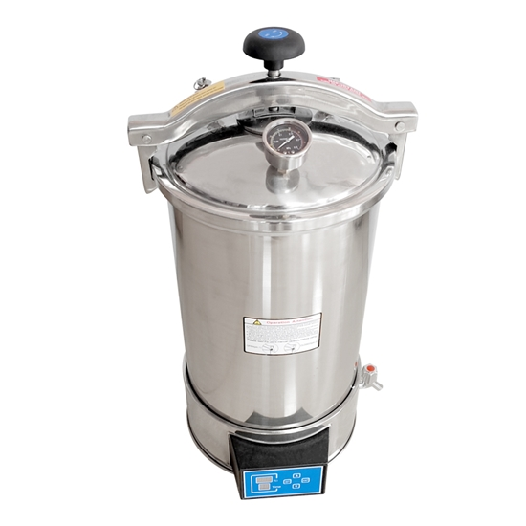
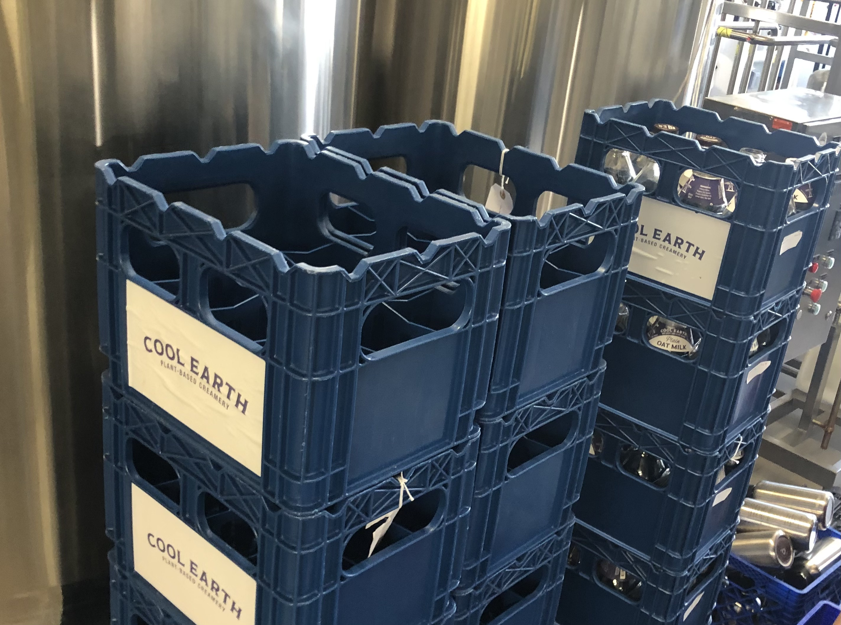
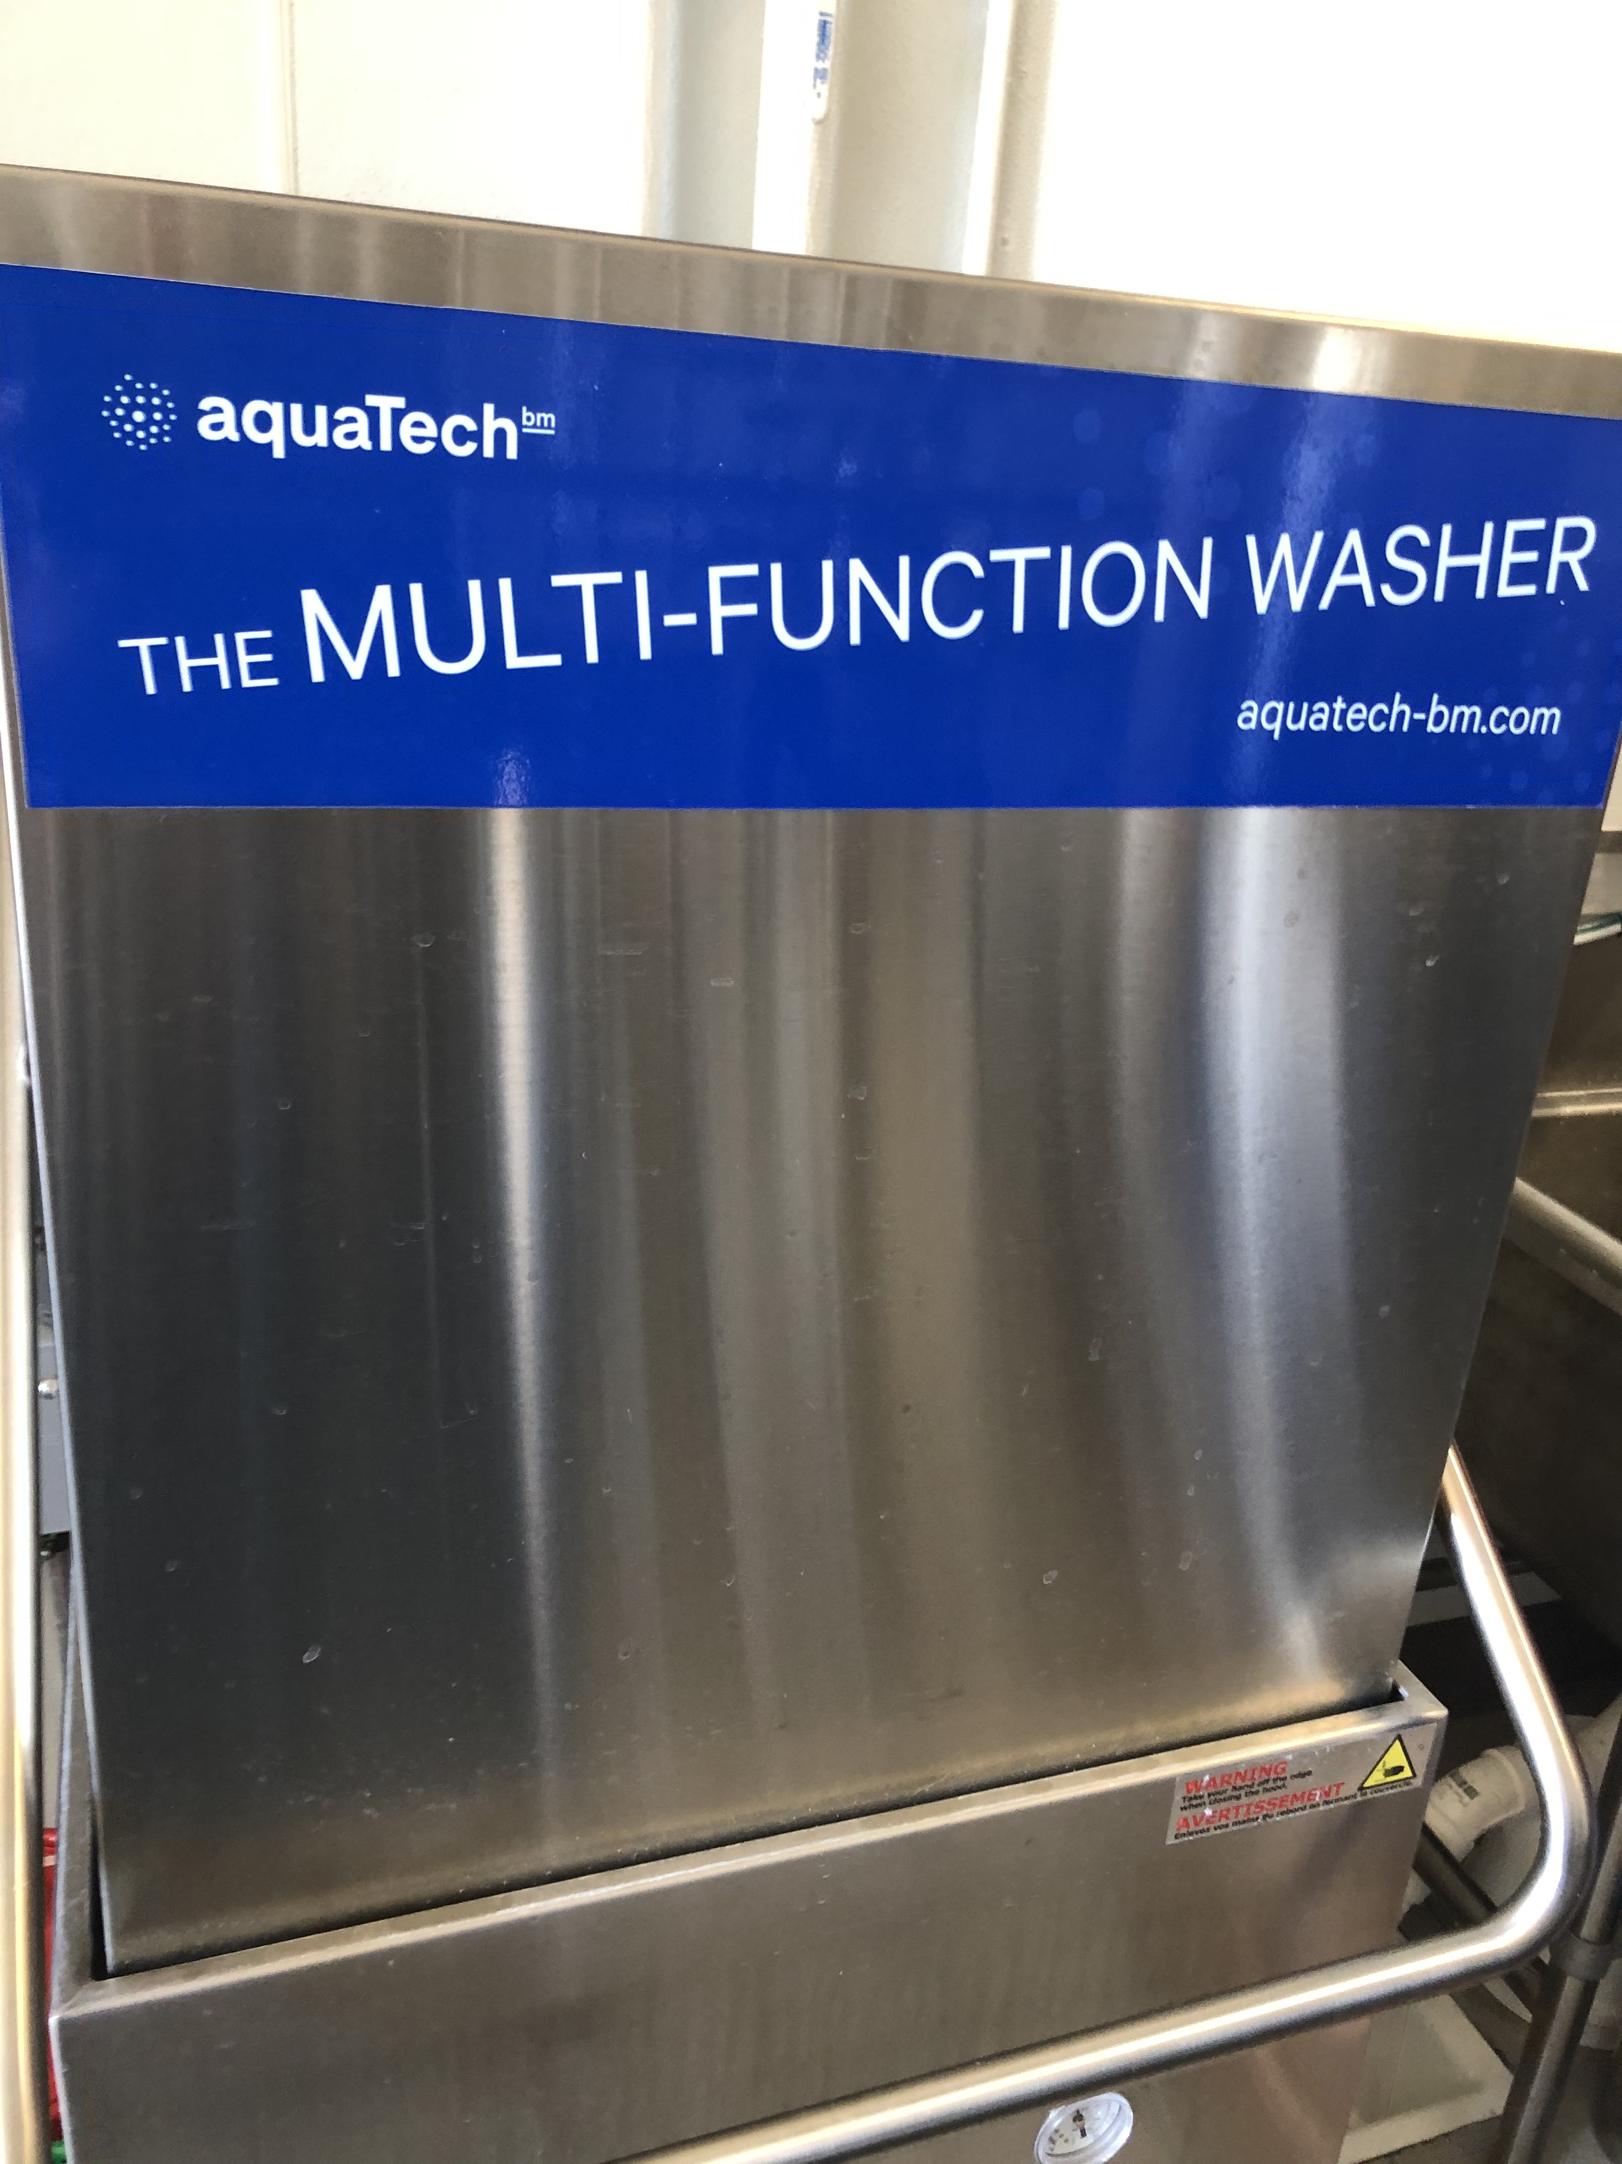
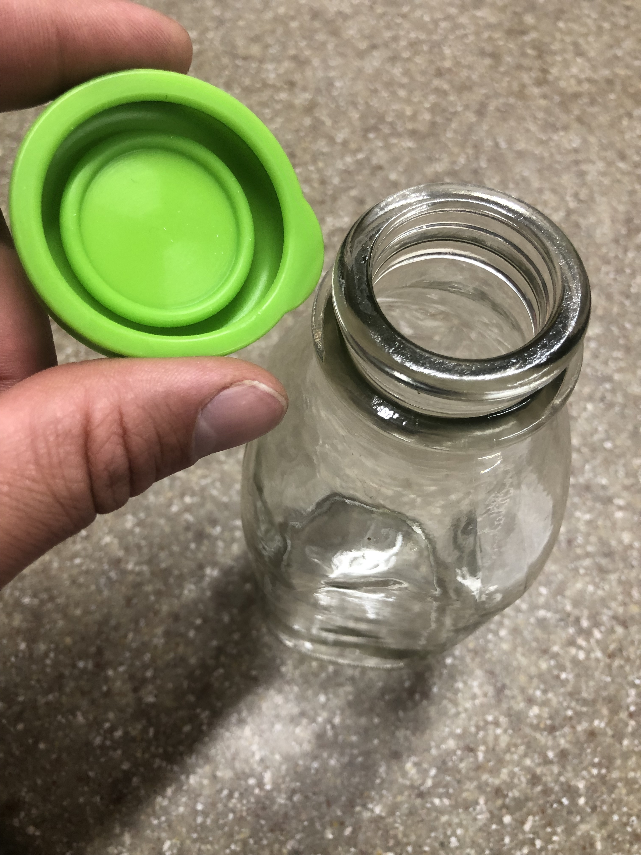
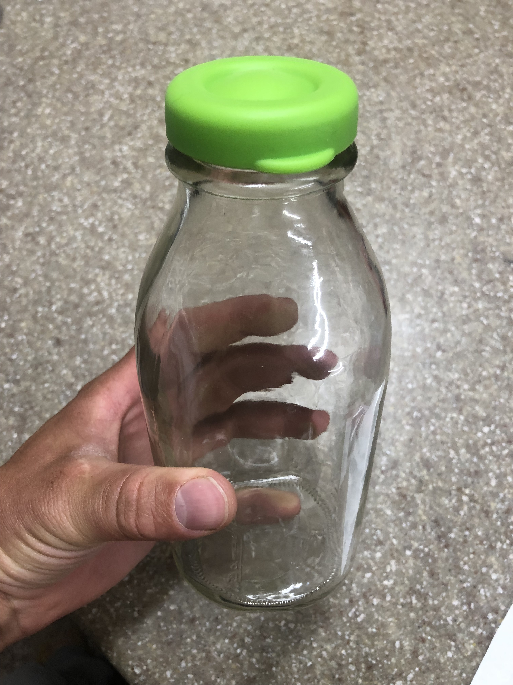
Recommended P2 Actions | One-time Cost to Implement ($) | Annual Savings from P2 Actions ($) | Resources Conserved | Barriers to Implementation | Plans to Implement in the next 5 years?
25-qt Pressure Cooker | $700 | $300+ in direct electricity savings. Reduce process time by ~50%. Cooler facility by eliminating waste heat from oven. | 3125+ kWh electricity/year | Minimal | Yes, this year
Replace Disposable Plastic Caps with Reusable Silicone Caps | $2,550 | $6,084 | Eliminates ~440 lbs of plastic waste/year | Innovation- to design caps and develop capping and cleaning system | Yes, next year
Changes to Dishwasher Cycle Steps | $0 | $0 (Water is included in HOA fee regardless of volume) | Up to 22,000 gallons water/year | Food safety. Swab testing to ensure same level of cleanliness. | Yes, immediately for crates, after testing for glass
P2 outcomes (in table) & explanation
 | $ | Annual Reductions
Recommended P2 Actions | If Implemented: | If Not Implemented:

Slide 12
Recommended P2 Actions | One-time Cost to Implement ($) | Annual Savings from P2 Actions ($) | Resources Conserved | Barriers to Implementation | Plans to Implement in the next 5 years?
Seal Water Recycling System | $2000-$4000 | Missoula commercial water rate= $0.0031/gal 10,000 gal x 0.0031= $31 | Up to 10,000 gal water/year at current production rates | Cost | Potentially in next facility expansion
Install a hanging spray nozzle at sink | $200 | Missoula commercial water rate= $0.0031/gal 5600 gal x 0.0031= $17.36 | ~5,600 gal water/year | Minimal | Yes
Install VFD for pump 1 to match Centrifuge/Chiller Flow Rates | $0 (Have an unused VFD onsite) | Free up an operator for 1-1.5 hrs/week | Some small electricity savings | Minimal | Yes

Slide 13
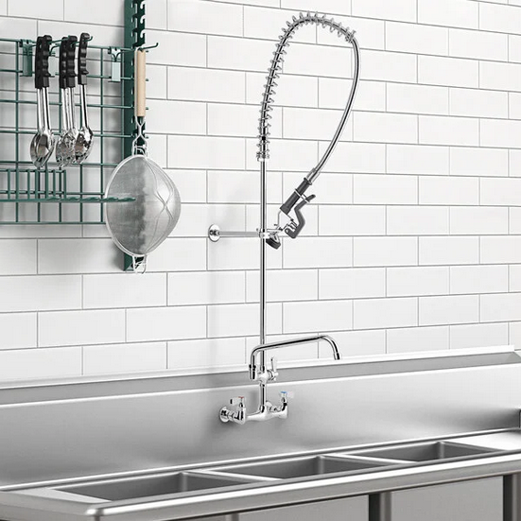
Recommended P2 Actions | One-time Cost to Implement ($) | Annual Savings from P2 Actions ($) | Resources Conserved | Barriers to Implementation | Plans to Implement in the next 5 years?
Seal Water Recycling System | $2000-$4000 | $0 at current facility | Up to 10,000 gal water/year at current production rates | Cost | Potentially in next facility expansion
Install a hanging spray nozzle at sink | $200 | $0 at current facility | ~5,600 gal water/year | Minimal | Yes
Install VFD for pump 1 to match Centrifuge/Chiller Flow Rates | $0 (Have an unused VFD onsite) | Free up an operator for 1-1.5 hrs/week | Some small electricity savings | Minimal | Yes

Slide 14
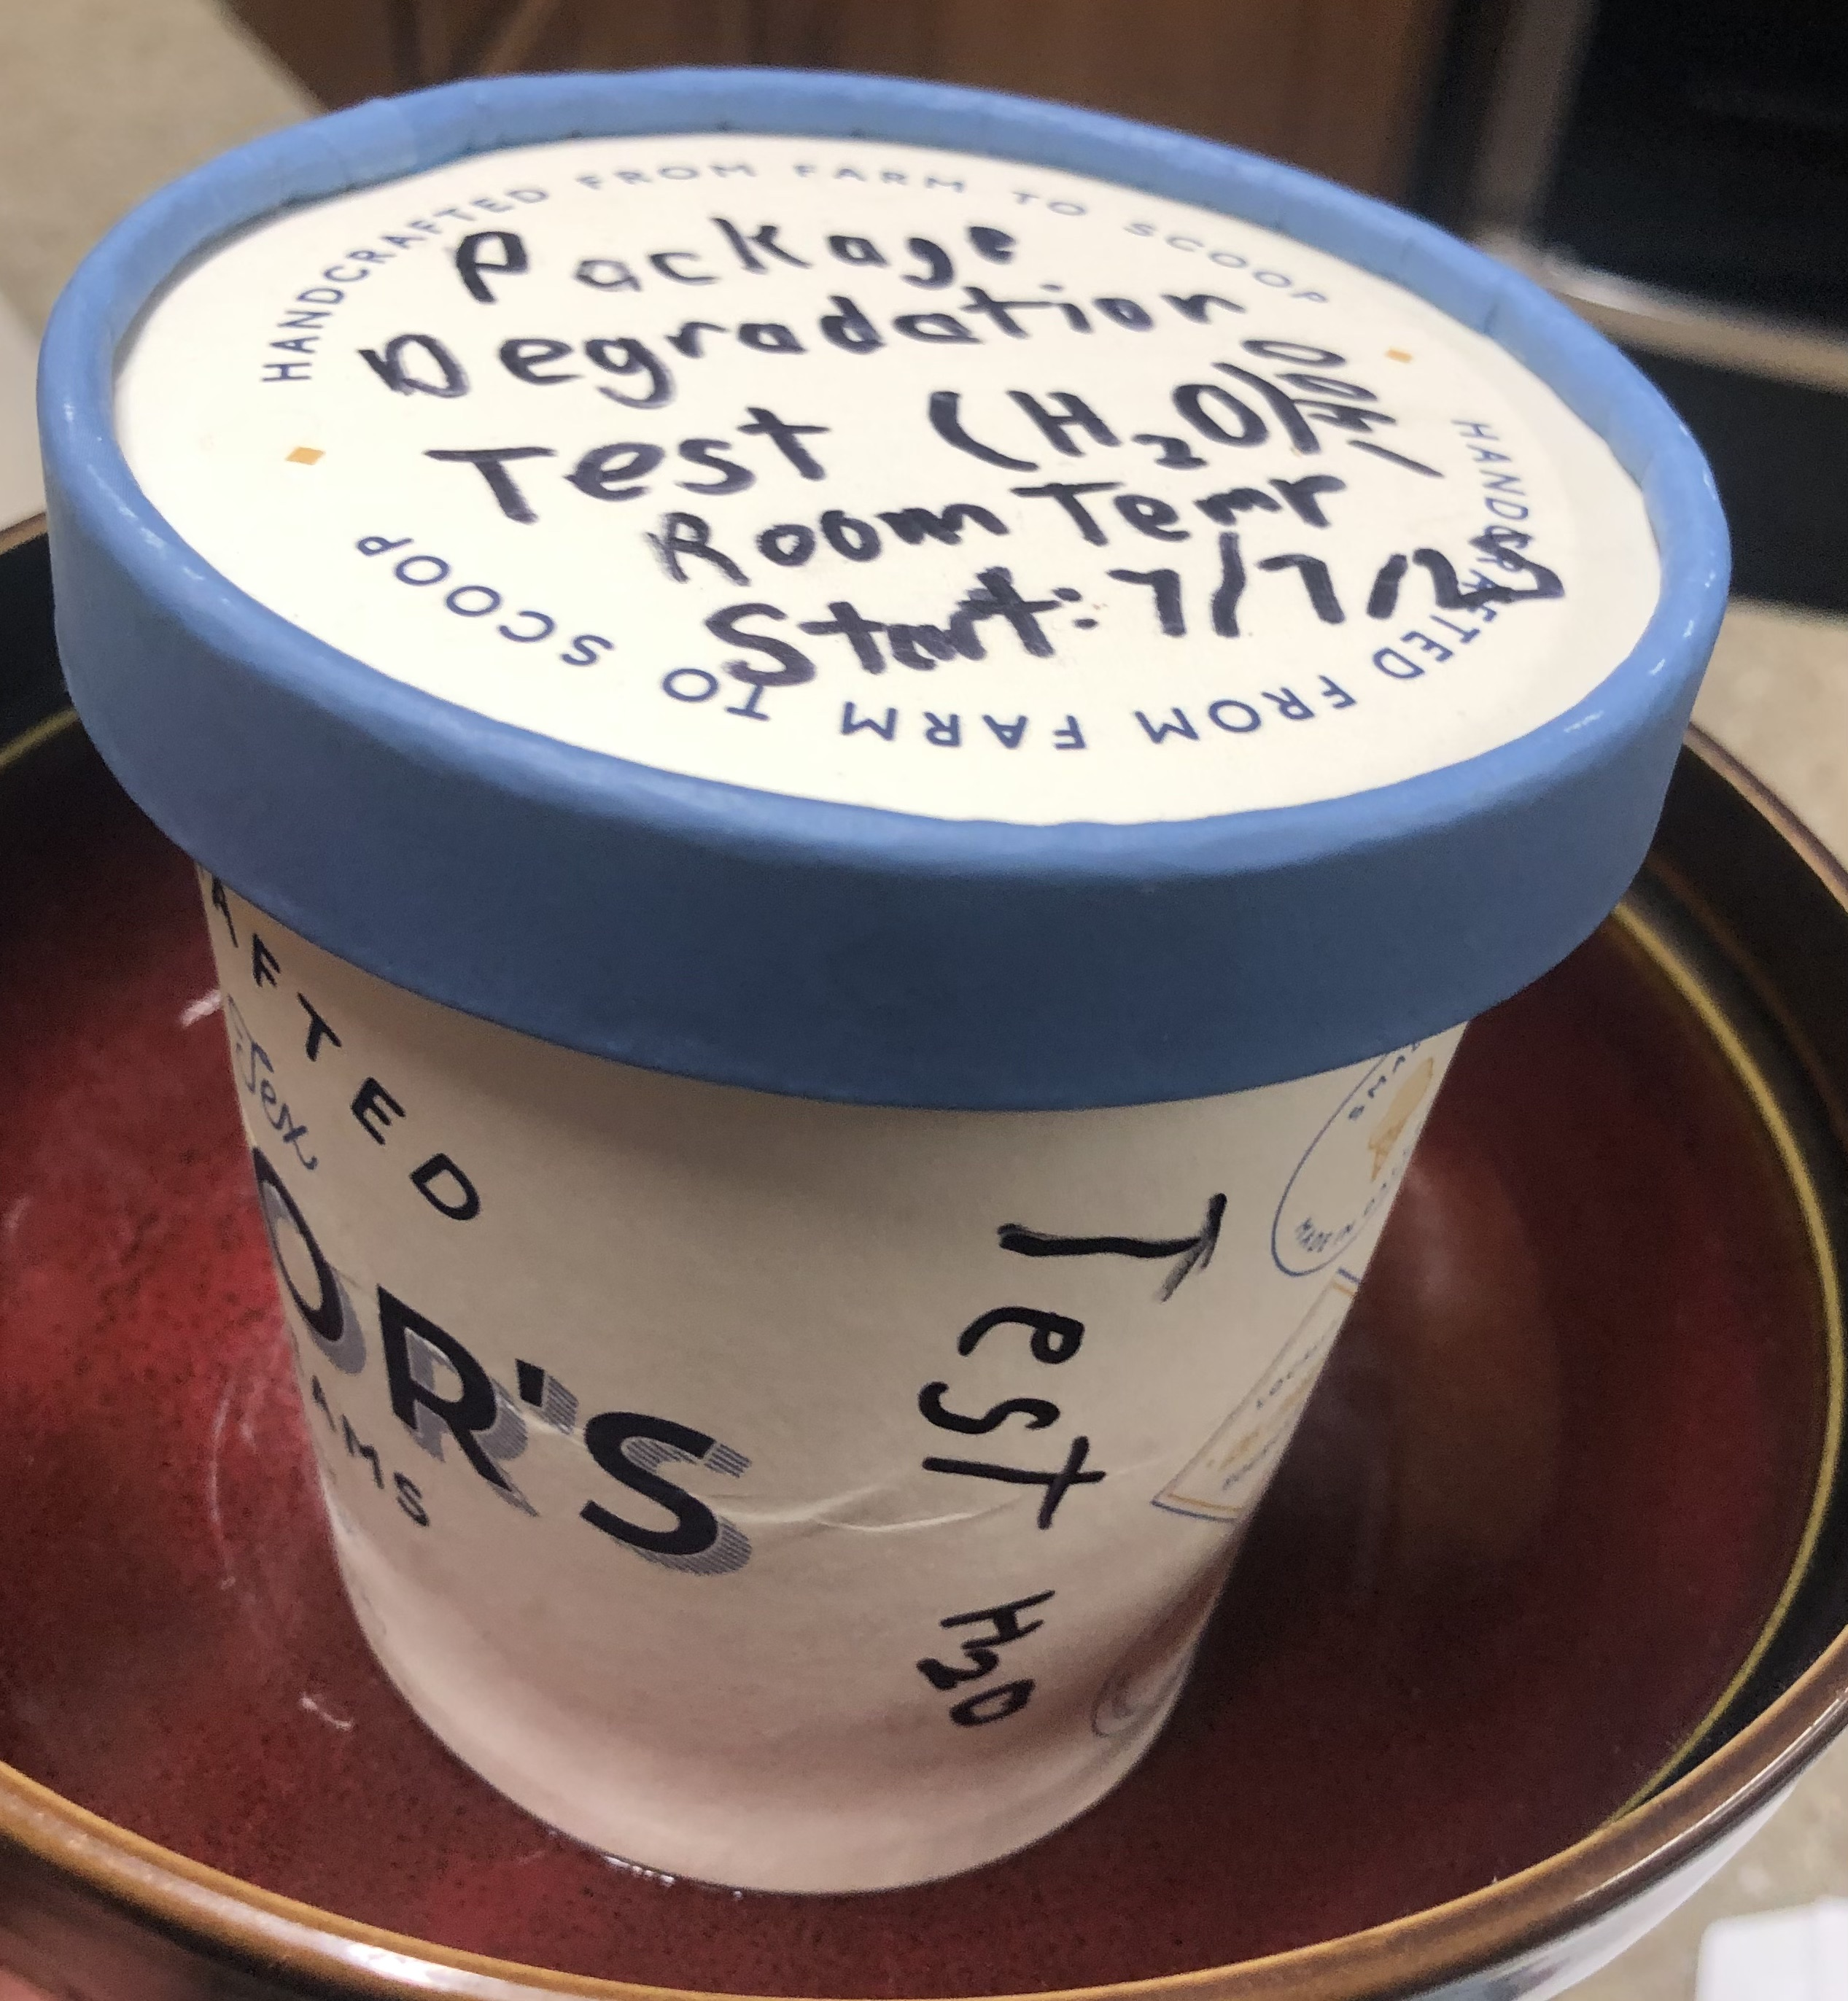
Gelato Packaging Degradation Test
Gelato packaging used by CEC is certified by Flustix to be 98.75% plastic free, and also backyard compostable.
Test: Filled package with water and left at room temperature to track degradation
Results: Structural degradation noted after 20 hours, leaking water after 24 hours

Slide 15
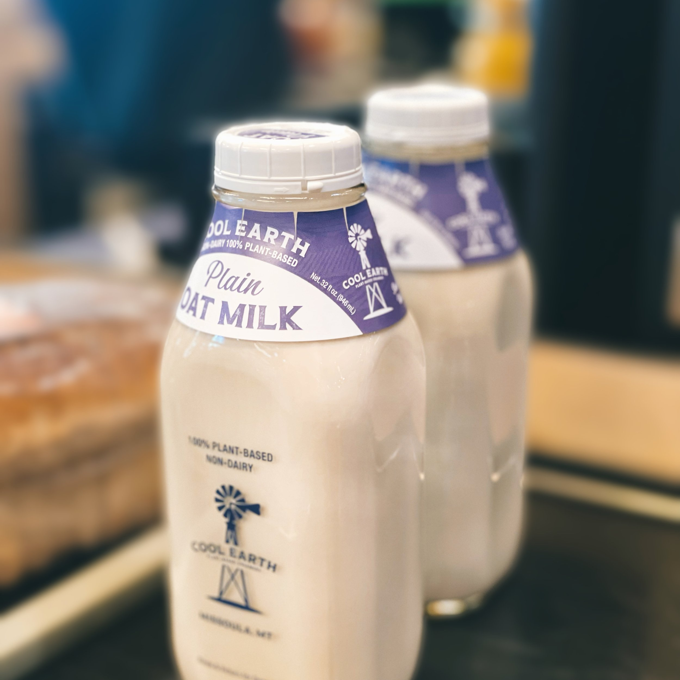
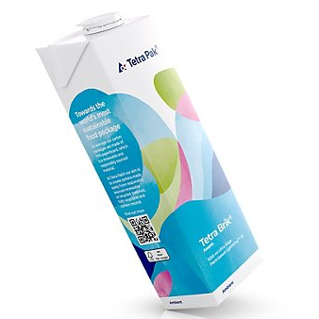
CO2e Emissions of Oat Milk in 1L Refillable Glass Bottle vs 1L Tetra Pak Carton

Slide 16
Scope
Included CO2e emissions associated with:
  Production
  Shipment to creamery, and
  Delivery to point of sale phases.
Did not include emissions associated with:
  End-of-life phase.
  Higher energy costs of UHT pasteurization required for Tetra Pak aseptic carton
  Energy required for refrigerated storage of refillable glass bottles
  Wash step of refillable glass

Slide 22
Reflections/Recommendations
  Personal learning
  This internship expanded my perspective of the avenues that exist for working toward a more sustainable world
  Excellent ntroduction to the food manufacturing in general, and plant-based food particularly
  Threaded app, VSMs, LCAs
  Recommendations for future P2 interns/MTP2
  Keep asking questions
  Think creatively
  Value your own experience and unique viewpoint as a resource

Slide 23
Acknowledgments
EPA for funding this internship
Devin and the rest of the Cool Earth Creamery team
Dr. Paul Gannon for assistance with Life Cycle Analysis
Braden Ball and the Threaded app team
Land acknowledgment
  The state of Montana is located on the traditional lands of many Indigenous peoples, including the Assiniboine, Blackfeet, Crow, Salish, and others. We honor their history, cultures, and ongoing presence.

Slide 24
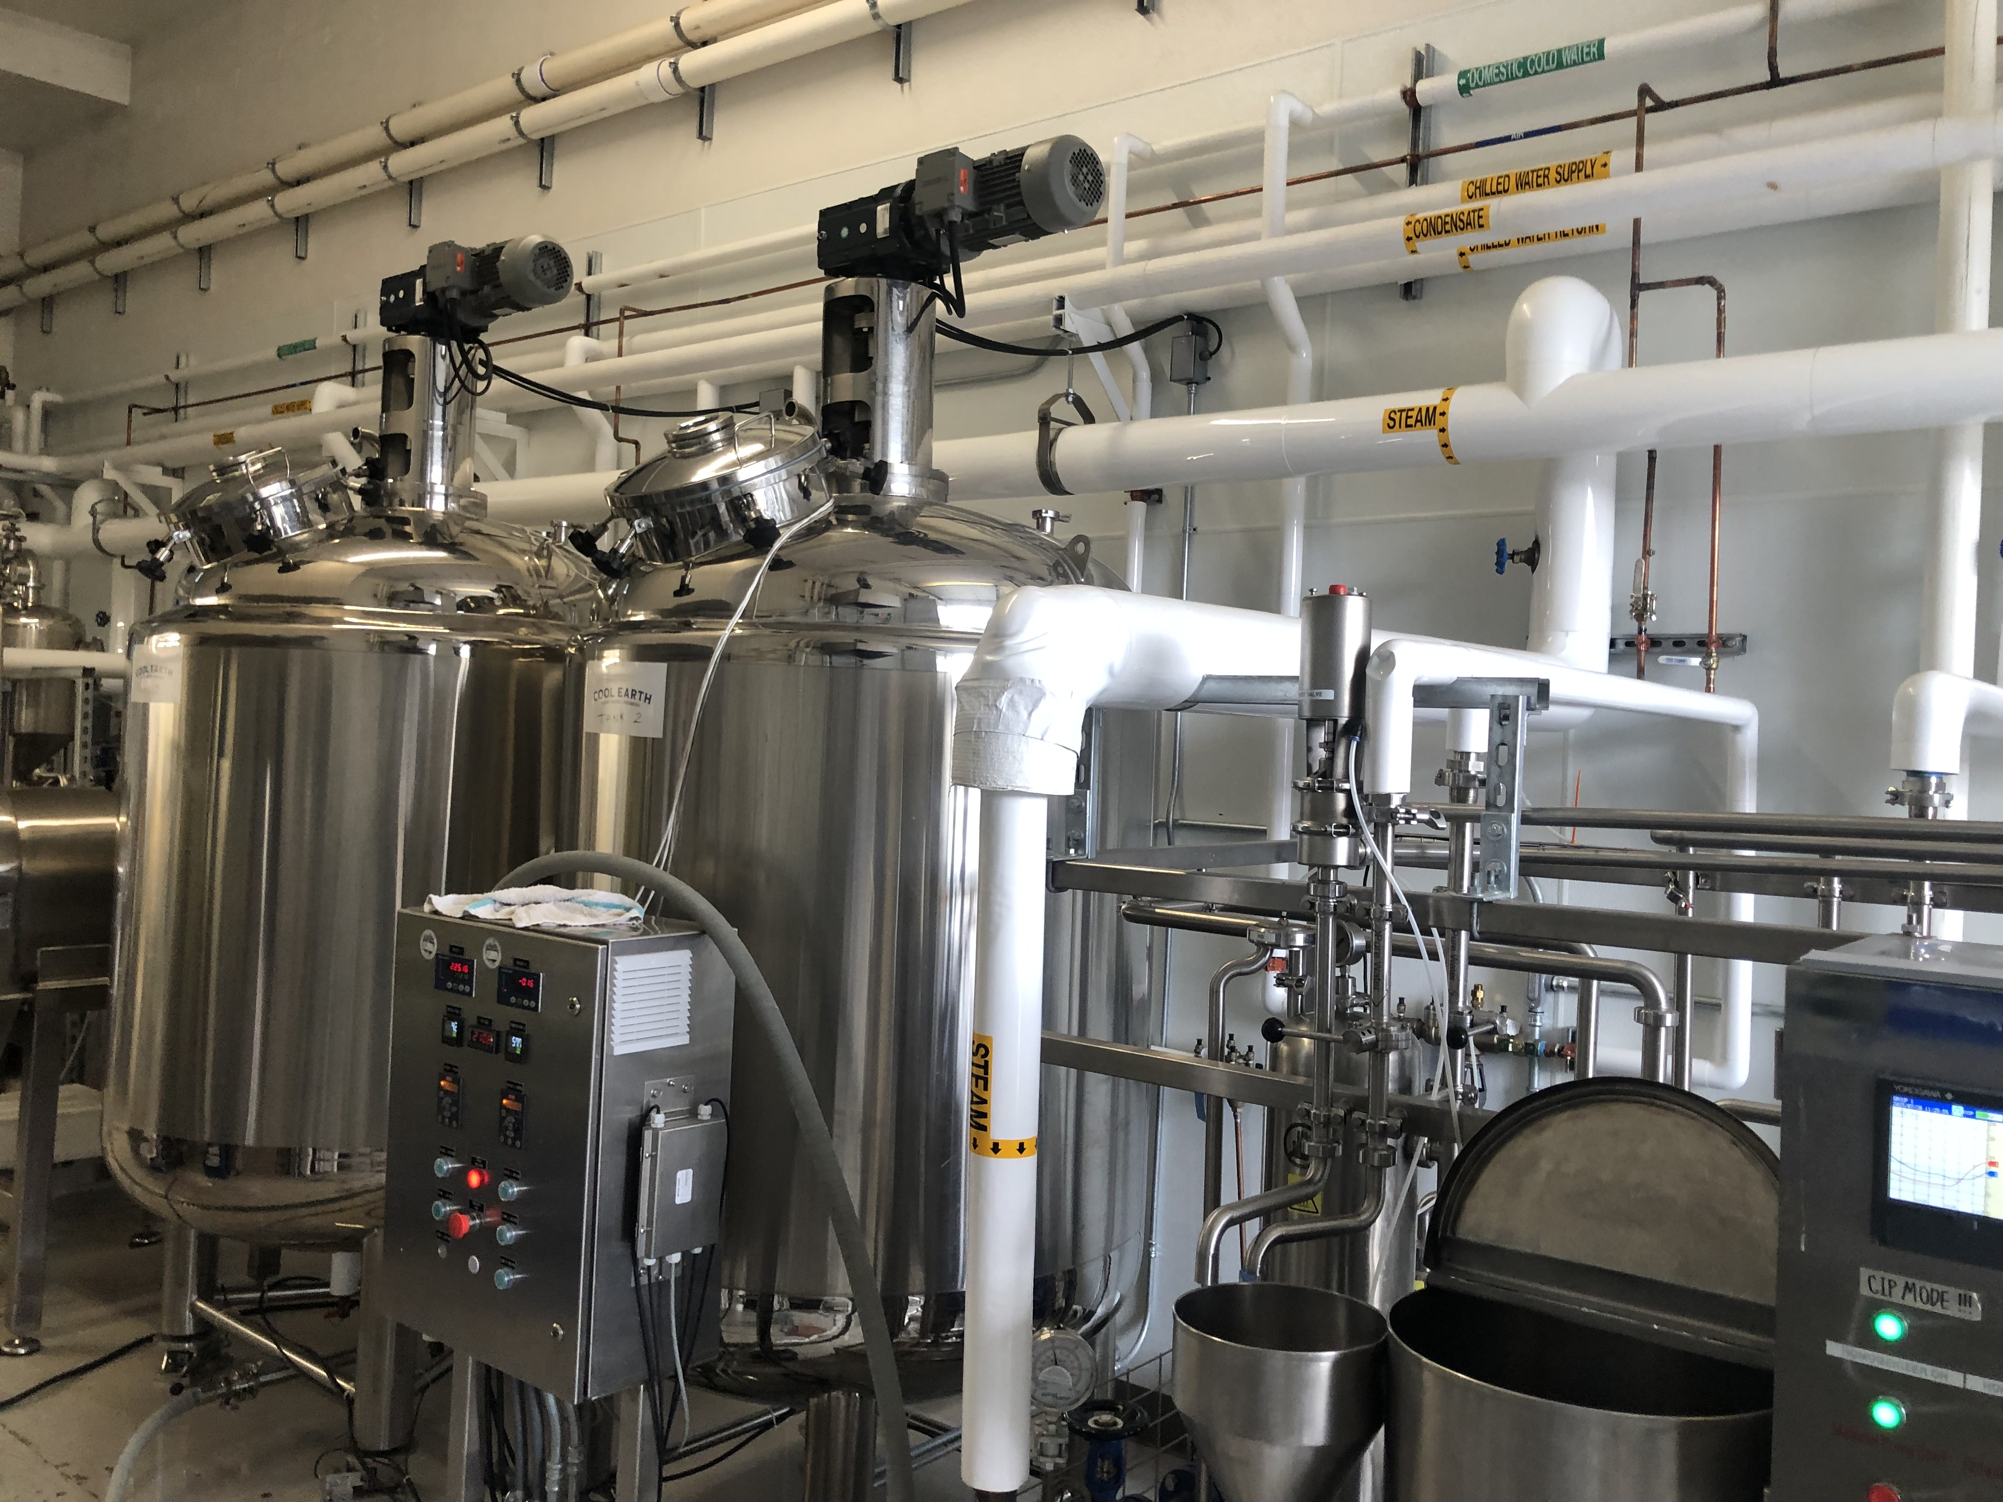
Questions?

Slide 25
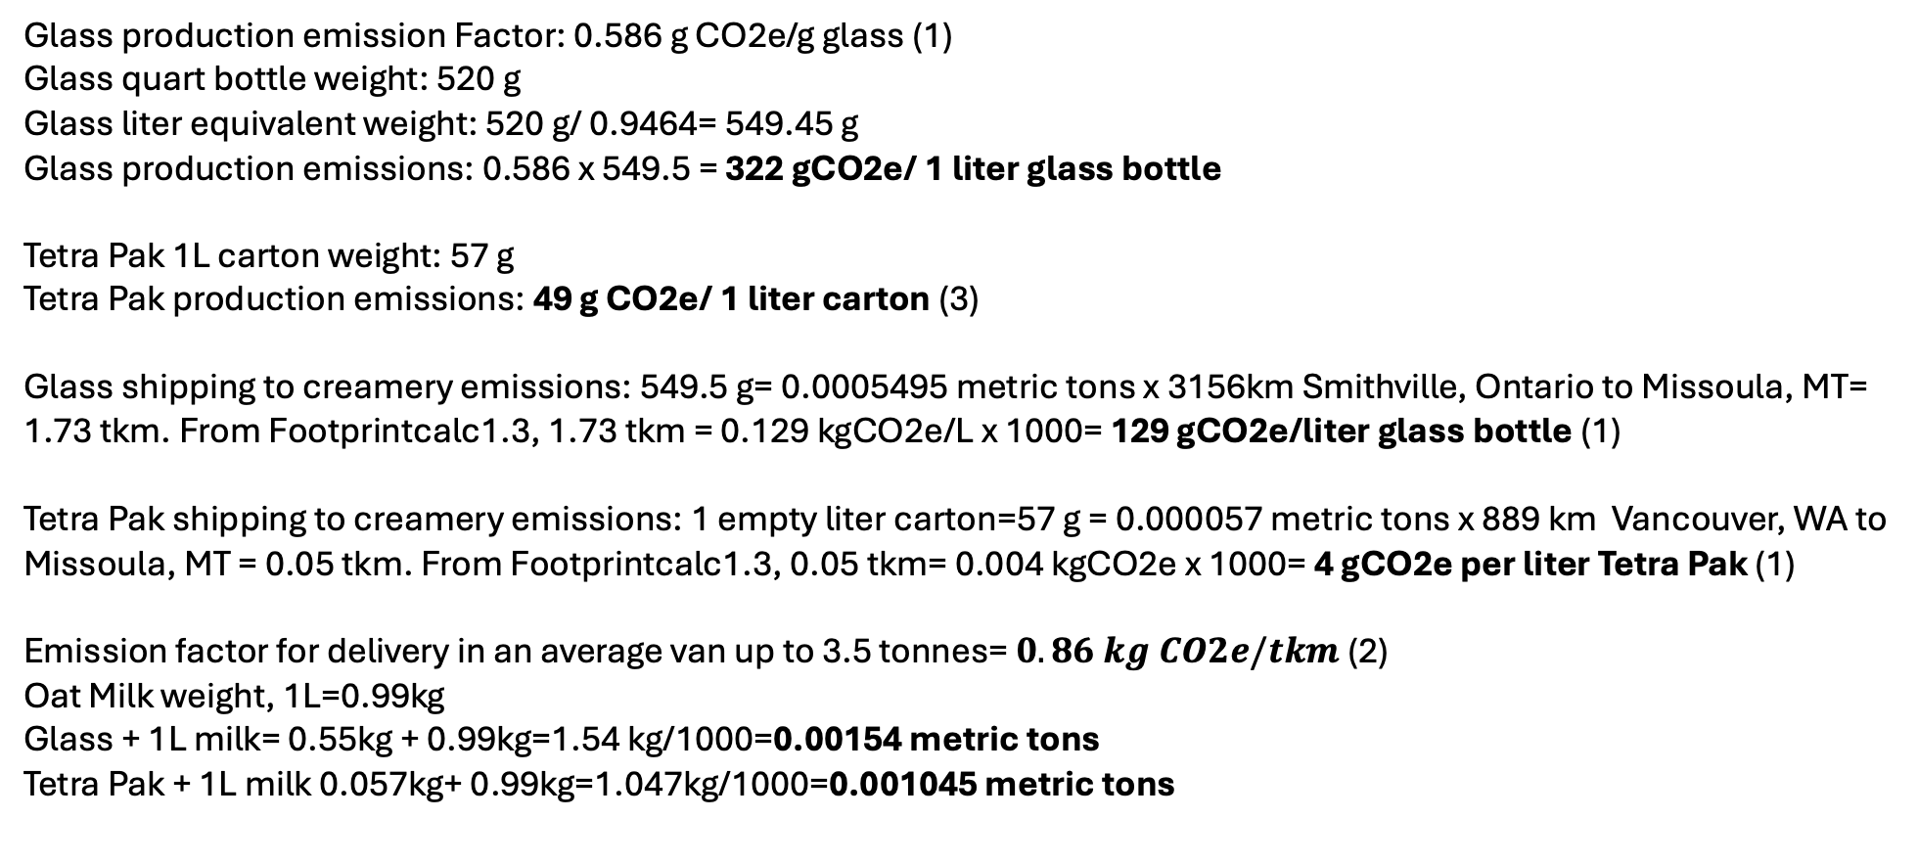
Data
Glass production emission Factor: 0.586 g CO2e/g glass (1)
Glass quart bottle weight: 520 g
Glass liter equivalent weight: 520 g/ 0.9464= 549.45 g
Glass production emissions: 0.586 x 549.5 = $\text{322 }\text{gCO}\text{2}\text{e}\text{/ 1 }\text{liter} \text{glass} \text{bottle}$
Tetra Pak 1L carton weight: 57 g
Tetra Pak production emissions: $\text{49 }\text{g} \text{CO}\text{2}\text{e}\text{/ 1 }\text{liter} \text{carton}$ (3)
Glass shipping to creamery emissions: 549.5 g= 0.0005495 metric tons x 3156km Smithville, Ontario to Missoula, MT= 1.73 tkm. From Footprintcalc1.3, 1.73 tkm = 0.129 kgCO2e/L x 1000= 129 gCO2e/liter glass bottle (1)
Tetra Pak shipping to creamery emissions: 1 empty liter carton=57 g = 0.000057 metric tons x 889 km Vancouver, WA to Missoula, MT = 0.05 tkm. From Footprintcalc1.3, 0.05 tkm= 0.004 kgCO2e x 1000= 4 gCO2e per liter Tetra Pak (1)
Emission factor for delivery in an average van up to 3.5 tonnes= $0.86 kg CO2e/tkm$ (2)
Oat Milk weight, 1L=0.99kg
Glass + 1L milk= 0.55kg + 0.99kg=1.54 kg/1000=0.00154 metric tons
Tetra Pak + 1L milk 0.057kg+ 0.99kg=1.047kg/1000=0.001045 metric tons

Slide 26
References
1. Delft University of Technology. (2025). Idemat 2025 Rev A3 database [Data set]. https://www.ecocostsvalue.com/. Accessed via Footprintcalc 1.3 software
2. Department for Energy Security and Net Zero. (2025). Greenhouse gas reporting: conversion factors 2025. UK Government. https://www.gov.uk/government/publications/greenhouse-gas-reporting-conversion-factors-2025
3. Mustafina, Z. (2023). Relationship between food shelf life and environmental impact of Tetra Pak packages (Master’s thesis, Division of Packaging Logistics, Department of Design Sciences, Faculty of Engineering LTH, Lund University). Lund University.

