Slide 1
President’s Commission on the Status of University Women
April 15, 2015 Retreat
WELCOME!!!

Slide 2

Icebreaker activity

Slide 3

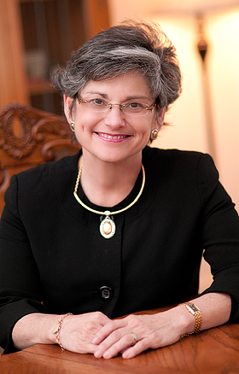
About
Formed in Fall 2011 by President Cruzado and a campus wide, grass-roots steering committee
Study, evaluate and advise President on diversity and gender equity at MSU
Continues to evolve with the campus and
members of the commission

Slide 4
Mission
In an advisory capacity, the Commission evaluates and works to improve issues related to gender equity and diversity on Montana State University’s four campuses.
Vision:
It is the Commission's pledge to facilitate the creation and sustainability of an environment of accountability, integrity, and optimism through collaboration between and among the MSU campuses, ensuring an atmosphere of equity, support, and balance.
Through its continued efforts, the Commission will work toward the discovery and elimination of institutional barriers to the success of women and inspire women to become leaders, problem solvers, and innovators making meaningful contributions to MSU, the state of Montana, and society at large.

Slide 5
Members
Members By Constituency Representatives from:
Extension
Deans
Department Head/Chair/Director
MSU—Billings
MSU—Northern
MSU College of Technology—Great Falls
Professional Council
Faculty Senate
Staff Senate
ASMSU
Graduate Student
Community Member
Members By Position
VOICE Center Coordinator
Women’s & Gender Studies Chair
Women’s Center Director
Affirmative Action Director (inclusive of Title IX Coordinator)
Chief Human Resource Officer
Senior Woman Athletic Administrator
Women’s Faculty Caucus Chair
Diversity Awareness Office Program Coordinator

Slide 6
Membership in new bylaws
Members By Position
Center for Faculty Excellence Director
Family Advocate
Equity Data Analyst (OPA)
Past Chair, PCOSUW
Chair Elect, PCOSUW
VOICE Center Coordinator
Women’s & Gender Studies Chair
Women’s Center Director
Affirmative Action Director (inclusive of Title IX Coordinator)
Chief Human Resource Officer
Senior Woman Athletic Administrator
Women’s Faculty Caucus Chair
Diversity Awareness Office Program Coordinator
Members By Constituency
Dean
Department Head/Chair/Director
MSU Extension
MSU—Billings
MSU—Northern
Great Falls College MSU
Professional Council
Faculty Senate
Staff Senate
ASMSU
Graduate Student
Additional members (including community members) to be appointed by 2.2.4

Slide 7
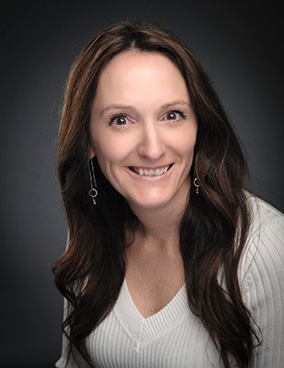
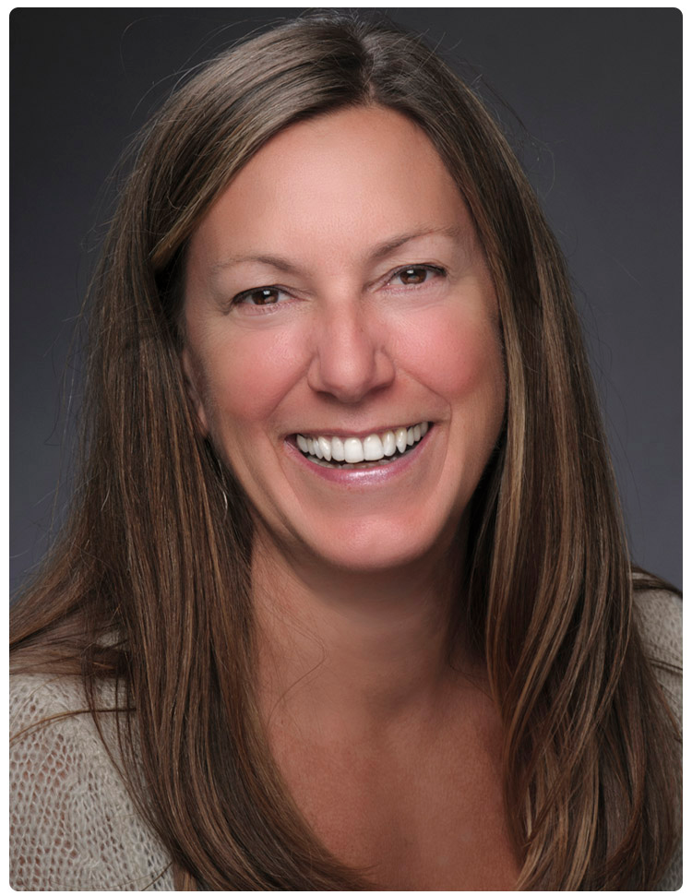
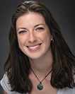
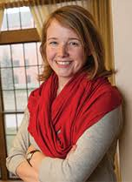
Committees
Assessment
  Review current information/data
Communication
  Increase visibility of Commission and promote purpose
Recognition
  Implement and select winners of recognition awards
Nominations
  Solicit nominations for membership
Policy Review
  On-going reactive and proactive policy review
Pictured above are awardees of the PCOSUW awards. From top left: Dr. Jessi Smith, Betsy Danforth, Ariel Donohue, Kiah Abbey.

Slide 8

Ad-Hoc Committees
Ad-Hoc committees created on an as needed bases in order to address the needs of the campus community. The Work-Life Integration Task Force was created in Fall 2013.
Work Life Integration Task Force
  Advises PCOSUW and proposes revisions to existing policies or drafts new polices and procedures to address work-life integration needs of faculty, staff and students.
  Work closely with ADVANCE Work-Life Integration Team

Slide 9
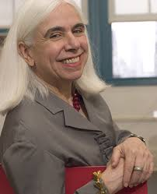
Accomplishments
Since the President’s Commission on the Status of University Women was created in 2011 we have accomplished:
Bringing in Virginia Valian as a campus speaker to present information from her world renowned book Why So Slow
Commission Award for Faculty and Staff Members
  1 faculty member and 2 staff members have
  won to date
Student Scholarships & Awards
  1 Graduate Student and 2 Undergraduate
  Student winners to date
  2 more winners selected for this years
  Day of Student Recognition

Slide 10

Accomplishments
Equity Advocate Program
  24 advocates are now spread across campus to
  ensure they are creating and supporting an
  inclusive work environment.
Policy Review Process
  A portal for individuals all across campus to submit revision ideas to specific policies in order to make them more equitable or inclusive.
Department Head Diversity Self Studies
  The Department Heads fill out Diversity self studies each year before annual reviews to gauge and discuss how they can improve diversity in their departments.

Slide 11
Long Term Vision
The long term vision of the PCOSUW is up to you!
We want to ensure the commission works to transform the campus through educational programming, inclusive policy making and weaving the mission throughout all that MSU does.

Slide 12
More Information
President's Commission
Montana State University
P.O. Box 172430
Bozeman, MT 59717-2430
Tel: (406) 994-4133
E-mail: pcosuw@montana.edu
Chair:
Lynda Ransdell
Dean, College of Education, Health and Human Development
Get involved today!
Submit a policy to the review portal: http://www.montana.edu/president/universitywomen/policy.html
Contact your Equity Advocate!
Nominate a student for the PCOSUW award!

Slide 13
Bylaws Review
Dr. Tracy Sterling
Incoming PCOSUW Chair, 2016

Slide 14
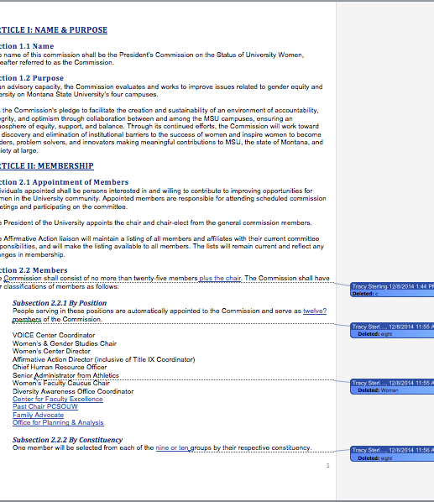
Bylaw Changes
The most updated copy of the bylaw changes was sent out prior to the retreat with the agenda.
We’ll review the changes and leave time for questions.
All changes have been approved by the Executive Committee

Slide 15
Membership Changes
Added these members by position:
  Center for Faculty Excellence
  Family Advocate
  Equity Data Analyst (Office Planning & Analysis)
  Past Chair, PCOSUW
  Chair Elect, PCOSUW
Corrected names of units (i.e. MSU Extension)
Clarified 2.2.3 to identify that Graduate Council appoints the graduate student representative for two-year term

Slide 16
Membership in new bylaws
Members By Position
Center for Faculty Excellence Director
Family Advocate
Equity Data Analyst (OPA)
Past Chair, PCOSUW
Chair Elect, PCOSUW
VOICE Center Coordinator
Women’s & Gender Studies Chair
Women’s Center Director
Affirmative Action Director (inclusive of Title IX Coordinator)
Chief Human Resource Officer
Senior Woman Athletic Administrator
Women’s Faculty Caucus Chair
Diversity Awareness Office Program Coordinator
Members By Constituency
Dean
Department Head/Chair/Director
MSU Extension
MSU—Billings
MSU—Northern
Great Falls College MSU
Professional Council
Faculty Senate
Staff Senate
ASMSU
Graduate Student
Additional members (including community members) to be appointed by 2.2.4
The new bylaws will be voted on by the entire commission at the next full commission meeting - simple majority for the new bylaws to pass.

Slide 17
Other Changes
Clarified 2.24 to add flexibility to 25-member limit (i.e. community member at discretion of President)
Clarified 2.3 language in Chair-Elect and Past Chair positions
Changed 2.4 from Office of Equity Liaison to the Office of the President Liaison
Clarified Article IV - committees are standing committees
Clarified Article V, 5.1 – President to be invited
Gender neutral language to be more inclusive throughout

Slide 18
Vote on Bylaws
Any additional questions can be directed to Tracy Sterling:
tracy.sterling@montana.edu

Slide 19


Slide 20

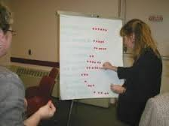

Where does PCOSUW go next?
Clicker questions on Strategic Plan progress – large group
Table Discussions – ID 3-5 Themes
Report Back
Sticky Dot Voting!
Executive Committee synthesizes information

Slide 21
PCOSUW Strategic Plan 2012-2015
Goal 1: Engage in ongoing monitoring and assessment of gender equity and inclusivity within the MSU System.
  Strategy 1: Working with appropriate partners (e.g. Affirmative Action and/or HR offices on each campus), assess gender equity for all employee categories.

Slide 22
Activity: Assemble existing gender and diversity data.
Completed
Started but only partially completed
Not started

Slide 23
Activity: Identify appropriate external benchmarks for success.
Completed
Started but only partially completed
Not started

Slide 24
Activity: Create easily interpreted reports and disseminate findings.
Completed
Started but only partially completed
Not started

Slide 25
(Goal 1, continued)
  Strategy 2: Conduct a systematic assessment of university policies for unintended bias or adverse effects on women and diverse communities

Slide 26
Activity: Participate in the 3-year Legal Council policy reviews.
Completed
Started but only partially completed
Not started

Slide 27
Activity: Flag specific policies that may need closer review.
Completed
Started but only partially completed
Not started

Slide 28
Activity: Create a process for the university community, organizations, and groups to suggest to the commission policies they believe need review.
Completed
Started but only partially completed
Not started

Slide 29
(Goal 1, continued)
  Strategy 3: Conduct a MSU system-wide evaluation of gender equity and inclusiveness through a climate study.

Slide 30
Activity: Develop or adapt as assessment instrument that will enable widespread participation and reliable results.
Completed
Started but only partially completed
Not started

Slide 31
Goal 2: Lead a collaborative effort within and among key stakeholders and partners and actively participate in shared governance.
  Strategy 1: Serve as a central clearinghouse for efforts on inclusion and diversity.

Slide 32
Activity: Create an online clearinghouse of activities, resources, and partner organizations.
Completed
Started but only partially completed
Not started

Slide 33
(Goal 2, continued)
  Strategy 2: Identify and build partnerships with key stakeholders through communication and collaboration.

Slide 34
Activity: Ensure commission seeks and provides input to key University-wide committees.
Completed
Started but only partially completed
Not started

Slide 35
Activity: Work with employee governance groups, offering expertise and resources on gender equity issues.
Completed
Started but only partially completed
Not started

Slide 36
(Goal 2, continued)
  Strategy 3: Maintain a strong relationship with the University Vice Presidents, Deans and other Leadership Positions.

Slide 37
Activity: Advise the President and campus on gender issues through a widely distributed annual report.
Completed
Started but only partially completed
Not started

Slide 38
Goal 3: Improve campus climate through education, visibility and the celebration of gender equity and diversity in the MSU system.
  Strategy 1: Promote and host workshops, focus groups, webinars and other educational opportunities to foster awareness of unconscious bias.

Slide 39
Activity: Work in collaboration with current MSU system offices that provide training to employees.
Completed
Started but only partially completed
Not started

Slide 40
(Goal 3, continued)
  Strategy 2: Develop a centralized resource of information on gender equity and diversity
    No Activity listed
  Strategy 3: Investigate a mechanism for an award structure that recognizes success in increasing and supporting diversity and people who promote diversity within the MSU system.

Slide 41
Activity: Include a list of award winners in areas related to gender equity and inclusiveness in the annual report to the President.
Completed
Started but only partially completed
Not started

Slide 42
Activity: Link to other gender equity programs’ highlights and award winners.
Completed
Started but only partially completed
Not started

Slide 43
Activity: Increase gender equity in applications of current campus awards.
Completed
Started but only partially completed
Not started

Slide 44

Table Discussion
At your table, based on the information presented this morning and your experiences on campus, please discuss and identify 3-5 themes that the PCOSUW should select for its next round of work.
How is campus going to be different as a result of what PCOSUW does?
Please consider: the best version of MSU in terms of diversity & inclusion; moving beyond gender to all forms of diversity; budget needs; policy needs; items remaining from previous strategic plan
WRITE YOUR 3-5 THEMES ON THE WALLS!

Slide 45

Each table will report back on the themes they selected for future work
Eliminate duplicates
Sticky dot voting! Everyone gets 3 votes!
The information will be reviewed by the PCOSUW Executive Committee and synthesized into a new strategic plan.
Thank you for your participation!!

Slide 46

Closing
Quick ZIP Process:
  What did I learn or re-learn today that I will take with me?

