Slide 1
INTRODUCTION TO NVIVO
Dr. Will FASSBENDER
Assistant Professor of English Education
Montana State University
Nvivo Certified Expert
February 27, 2023

Slide 2
Overview
This lunch & learn will provide a basic overview of…
  what NVivo QDAS is
  how to download the software from UIT
  getting started with the basics of NVivo

Slide 3
Agenda
QDAS/NVivo Overview
How to download the software
Getting Started with basic functions
  Importing data
  Coding data
Share additional resources from NVivo
Q&A

Slide 4
Introductions
Will Fassbender
Assistant Professor in the English Department
I started using NVivo in graduate school and became a certified expert in 2016
In the chat and face to face, I would love to know level of expertise/comfort with NVivo on a scale of 1-10.

Slide 5
A few things
Questions welcome at all times
  Ask me to slow down
  I’m happy to go over something multiple times
  Recognize that this is purely introductory…we will barely scratch the surface today

Slide 6
What is NVivo?
Qualitative Data Analysis Software (QDAS) that “supports qualitative and mixed methods research” to “help you organize, analyze and find insights in unstructured, or qualitative data like: interviews, open-ended survey responses, articles, social media and web content”
Work more efficiently
Save time
Quickly organize, store and retrieve data
Uncover connections in ways that aren’t possible manually
Rigorously back-up findings with evidence
Source: Nvivo website

Slide 7
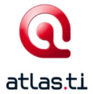




What is QDAS: Qualitative data analysis software?
There’s no one right or best way to use QDAS
QDAS programs are not the equivalent of SPSS, R, or SAS
More like a data management system
Selected based on access, support, resources
You have to tell the software what to do

Slide 8
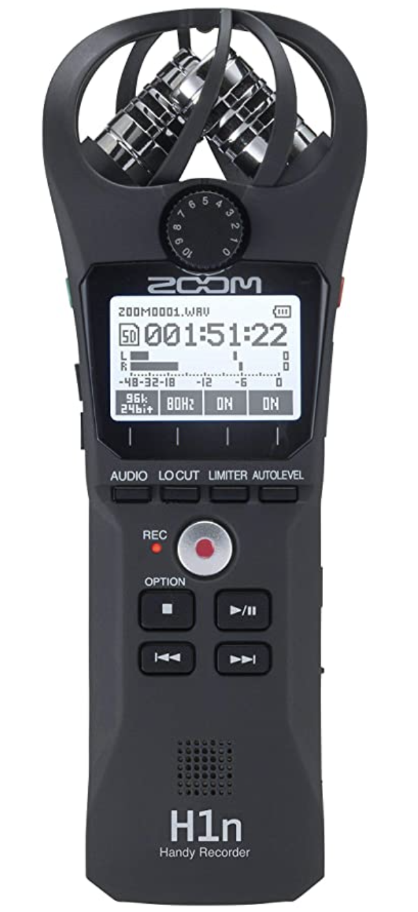










My Digital Workflow
Lit Review | Data Collection
Data Analysis | Writing/Reporting
Mendeley
PDF Expert
Evernote
Dragon
Filmic Pro
Zoom H1
Evernote
Trint
Final Cut Pro
NVivo
Scrivener
MS Word
Mendeley

Slide 9
Limitations of QDAS
What QDA software can’t do
  Analyze your data for you (yet…)
  Take control away from you
  Make the analysis process easier or faster
  Support only one kind of analysis (e.g. grounded theory, ethnography, discourse analysis)

Slide 10
Affordances of QDAS
What QDAS can do
  Impose structure on unstructured data
  Make visible your analytic strategies
  Make your project portable
  Support collaboration with others
  Create an audit trail
  Assist you in every phase of your study (before and beyond analysis)

Slide 11
QDAS across the research process
Create a “textual laboratory” (Konopásek, 2008) to organize study materials
Organize and review the literature
Capture field notes, social media, and other data types
Create a research journal to track study progress
Find every instance of a word in the data for preliminary analysis

Slide 12
QDAS across the research process
Transcribe data and connect it to the media file
Create written reflections while reading through data
Visualize relationships between codes to generate theory

Slide 13
Downloading the Software
MSU has an enterprise/site license (which makes it free to all faculty)
Getting the software onto your computer is a two-step process:
  First you need to download the software
  Second, you need to get your key via the UIT Software Portal

Slide 14
Getting Started
Let’s walkthrough the technology

Slide 15
Resources
I want to show you a few resources available to you through NVivo’s parent company Lumivero (formerly QSR International)

Slide 16
Q&A
What questions do you have about getting started?

