Slide 1
Periodic Waves and Harmonics
EELE 217 Science of Sound

Slide 2
Outline
Introduction
  Simple mass-spring systems
  More complicated mass-spring systems
Vibration with “boundary conditions”
Frequency content and the “spectrum”

Slide 3
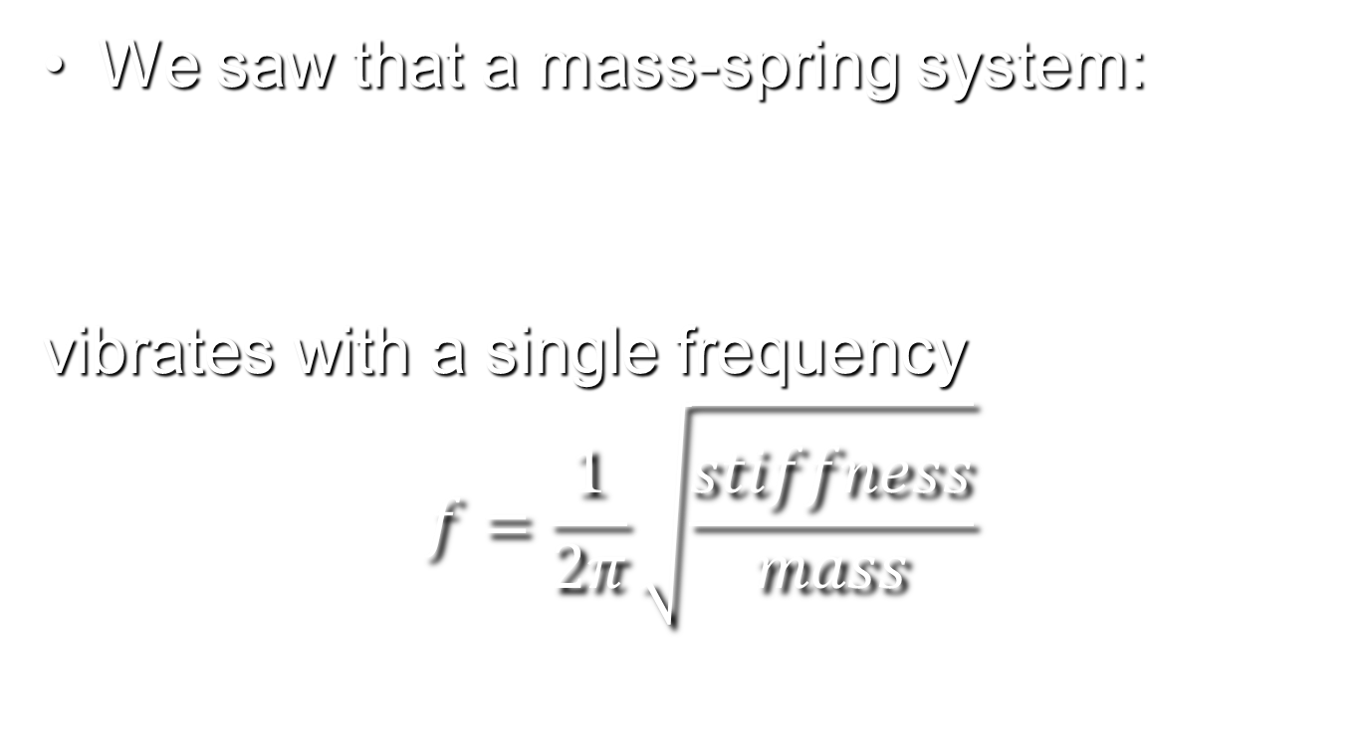
Simple Motion
We saw that a mass-spring system:
vibrates with a single frequency
$$f=\frac{1}{2π}\sqrt{\frac{stiffness}{mass}}$$
mass

Slide 4
Complicated Motion
More complicated systems like a vibrating string result in complicated patterns of motion:
Ends of string are fixed
Pull string and let go abruptly

Slide 5
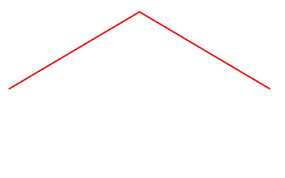
Ex: Plucked String Motion
The motion seems unexpected!

Slide 6
Complicated Motion (cont.)
Periodic complicated motion can be decomposed into a sum of simpler sinusoidal waveforms.

Slide 7




Complicated Motion (cont.)
All of the decomposed patterns have the same constraints: Length of string, and fixed points at each end.
$$λ=2L$$
$$λ=L$$
$$λ=2L/3$$
$$λ=L/2$$

Slide 8
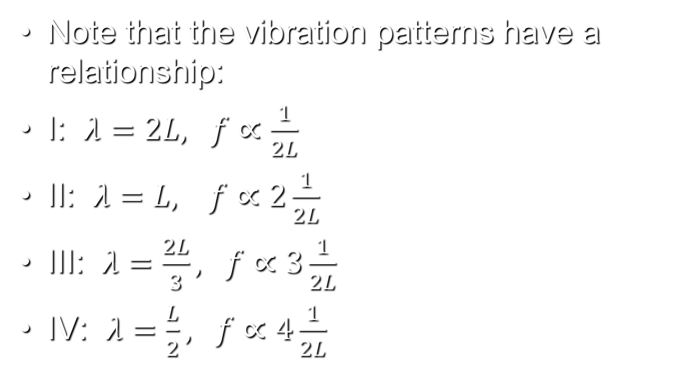
Harmonics
Note that the vibration patterns have a relationship:
I: $λ=2L, f∝\frac{1}{2L}$
II: $λ=L, f∝2\frac{1}{2L}$
III: $λ=\frac{2L}{3}, f∝3\frac{1}{2L}$
IV: $λ=\frac{L}{2}, f∝4\frac{1}{2L}$
The frequency increases by an equal amount…
These frequencies, called harmonics, partials, or overtones, are integer multiples of the “fundamental” frequency

Slide 9
Ex: Plucked String
The higher harmonics cause the string to bend very sharply, which in a real string causes those higher frequency patterns to damp out more quickly with time than the fundamental.

Slide 10
Harmonics (cont.)
In general, periodic waveforms can be represented as a sum of harmonic partials, or overtones.
The amount of vibration energy may vary from one partial to another. Our ear detects differences in partials as a change in tone quality, or timbre.

Slide 11
Ex: Organ Pipe
The pipes of an organ are usually closed at the bottom and open at the top. At pipe resonance, like the string with fixed ends, only certain air particle displacement patterns are possible.

Slide 12




Organ Pipe (cont.)
Displacement patterns
Closed end: no displacement
Open end: max displacement
Note that the corresponding frequencies 1/4L, 3/4L, 5/4L, 7/4L, …
have only ODD harmonics for a pipe closed at one end.
$$λ=4L$$
$$λ=4L/3$$
$$λ=4L/5$$
$$λ=4L/7$$

Slide 13


Harmonics and Bandwidth Examples
Harmonic series example
“Telephone” bandwidth (400 Hz – 4kHz)
Sub-100 Hz bandwidth (very quiet)
Sub-400 Hz bandwidth
Above- 4 kHz bandwidth
Full bandwidth

Slide 14
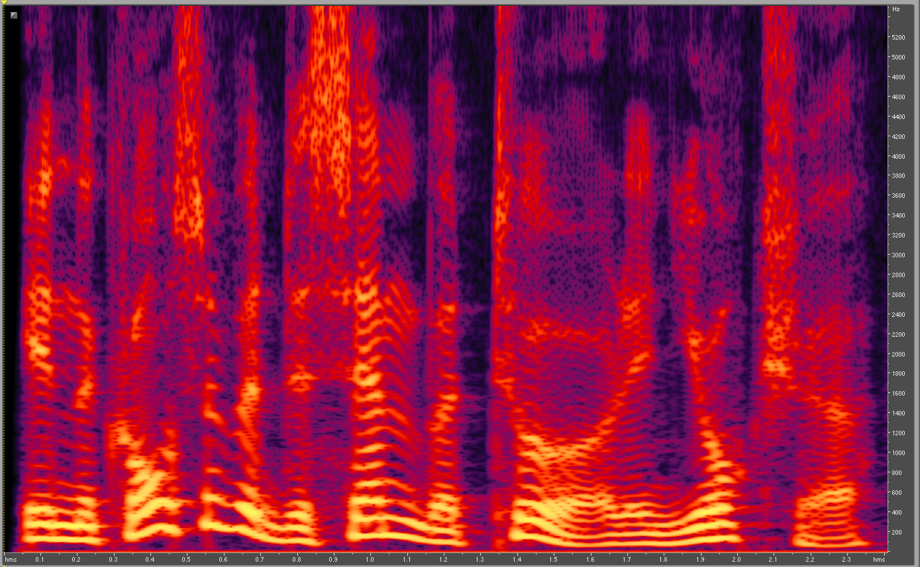
Spectrogram
In
the
course
of a
Dec---e--m--ber
T-o--ur in
Y--or--ksh--ire

Slide 15
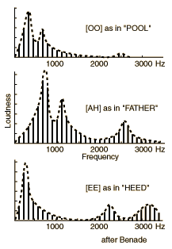
Formant Synthesis
Signal rich in harmonics (a “buzz”) with spectral shaping
Does it sound like singing? Does the vibrato help?

