Slide 1
The Science of Sound for the
Music Technology Student
Robert C. Maher
Montana State University – Bozeman
164th Meeting of the Acoustical Society of America – Kansas City – October 2012

Slide 2
Outline
Introduction
  Music Technology degree programs
  Prerequisites and math/science
  Science topics of interest to Music Tech
Lesson Example: source-filter model of musical instruments
Prospects for future work
Conclusion

Slide 3
Introduction
Music Technology degree programs are popular in the U.S. and around the world
Music Tech degrees typically include
  music theory
  audio recording and mixing
  multimedia production
  electronic and computer music
  computer applications in music composition

Slide 4
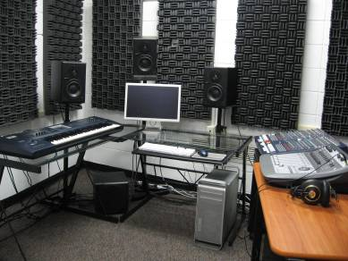

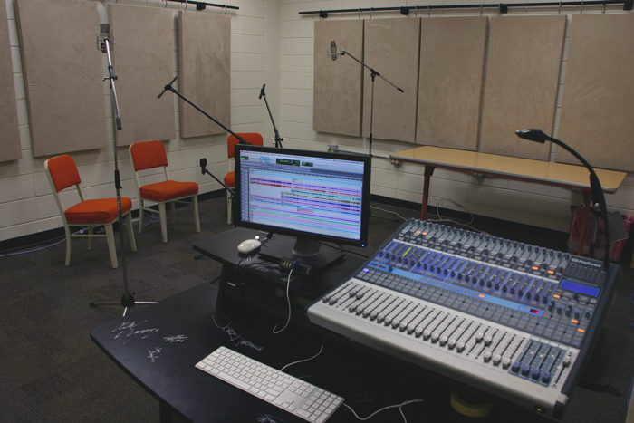
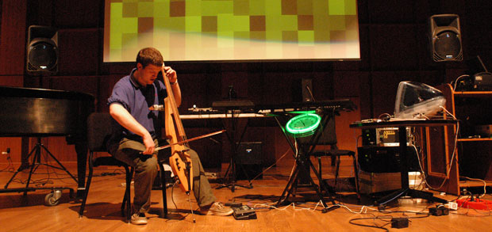
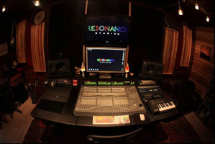
Music Technology

Slide 5
Introduction (cont.)
Example: Music Tech Bachelor of Arts
  Composition
  Sound Design
  Audio Technology
  At least 3 semesters of applied music
  Interdisciplinary collaboration
Students fulfill university general ed reqs: but no specific math/science courses

Slide 6
Introduction (cont.)
Music Tech “Science of Sound”
  Principles of mass-spring-damper systems
  Sound waves and sound properties
  Hearing physiology and psychology
  Architectural and Environmental acoustics
  Musical acoustics
  Audio engineering

Slide 7
Challenges
Use of mathematical expressions like
  c = f λ, ω = √(s/m), 20 log₁₀(p/p_{ref}) and x(t)h(t)
  are not initially meaningful
Sole reliance upon handwaving can be misleading, due to oversimplification
Time-domain vs. Frequency-domain is initially confusing, but worth emphasizing

Slide 8
What has worked for me?
Graphical views and graphical lookup
Block diagrams
Minimal use of arcane symbols

Slide 9
Graphical Representations
Time Domain: amplitude vs. time
Frequency Domain: amplitude vs. freq
Spectrogram: amp vs. freq vs. time

Slide 10
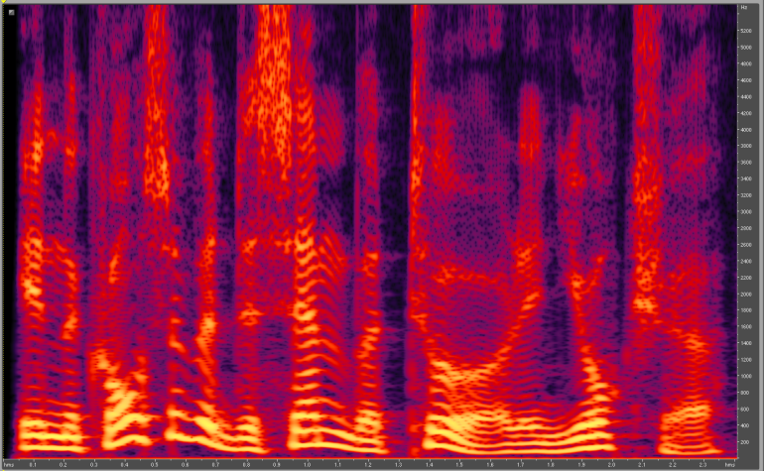
Musical Notation
Notation specifies pitches, durations, and time evolution
Representation is like a spectrogram: frequency vs. time

Slide 11
Nomograms
100
5
90
4
80
6
3.5
m
s
70
3
7
60
50
2.5
8
40
2
30
9
20
1.5
10
1
10
ω = √(s/m)

Slide 12
Example
Interpreting the effect of a filter on a musical signal
Describing a musical instrument using a lumped model

Slide 13

Bandwidth Examples
Speech bandwidth (400 Hz – 4kHz)
Sub-100 Hz bandwidth (very quiet)
Sub-400 Hz bandwidth
Above- 4 kHz bandwidth

Slide 14
Musical Instruments
Most conventional musical instruments have
  an excitation source
  a vibrating element
  a resonant body
  a means of coupling the vibrations so that they radiate into the air as sound waves

Slide 15
Musical Instruments (cont.)
The excitation is a motive force
The vibrating element usually creates many harmonics
The resonant body emphasizes some frequencies and deemphasizes others
The coupling means takes energy from the vibrating element and “loses” it (radiates) into an acoustical wave through the air

Slide 16
Example: Singing Voice
Projection from the mouth
Resonance of the throat,
nasal passages,
and the mouth
Glottis
(vocal cords)
Lungs

Slide 17
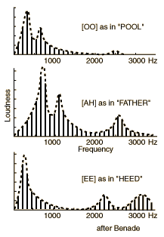
Formant Example
First three vowel formant frequencies
Vowel | I | II | III
/i/ (“eee”) | 280 Hz | 2250 Hz | 2890 Hz
/I/ (“eeh”) | 400 Hz | 1920 Hz | 2650 Hz
/a/ (“ah”) | 710 Hz | 1100 Hz | 2450 Hz

Slide 18
Conclusion
Music Technology students can understand acoustical principles with minimal math
Care must be taken to avoid oversimplification that leads to incorrect conclusions
Working with mathematically unsophisticated students is fun: it reminds us what it was like to learn things the first time.

