Slide 1
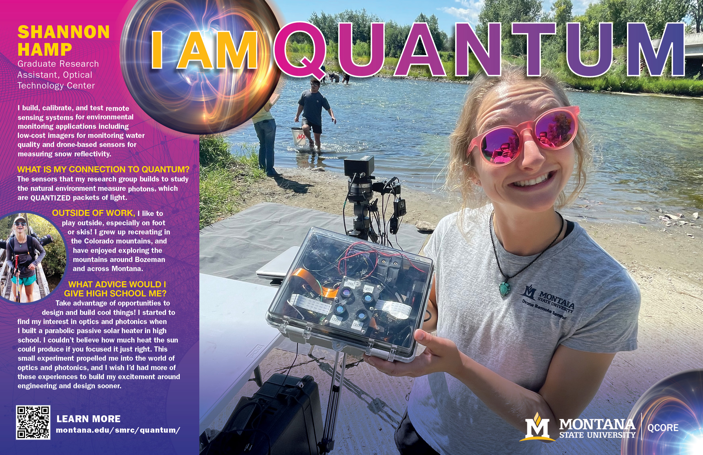
Notes:
During production of this poster set, Shannon finished her Master's degree and was hired by Spark Photonics. We created two posters for her to show her progression from her graduate work to her career.

Slide 2
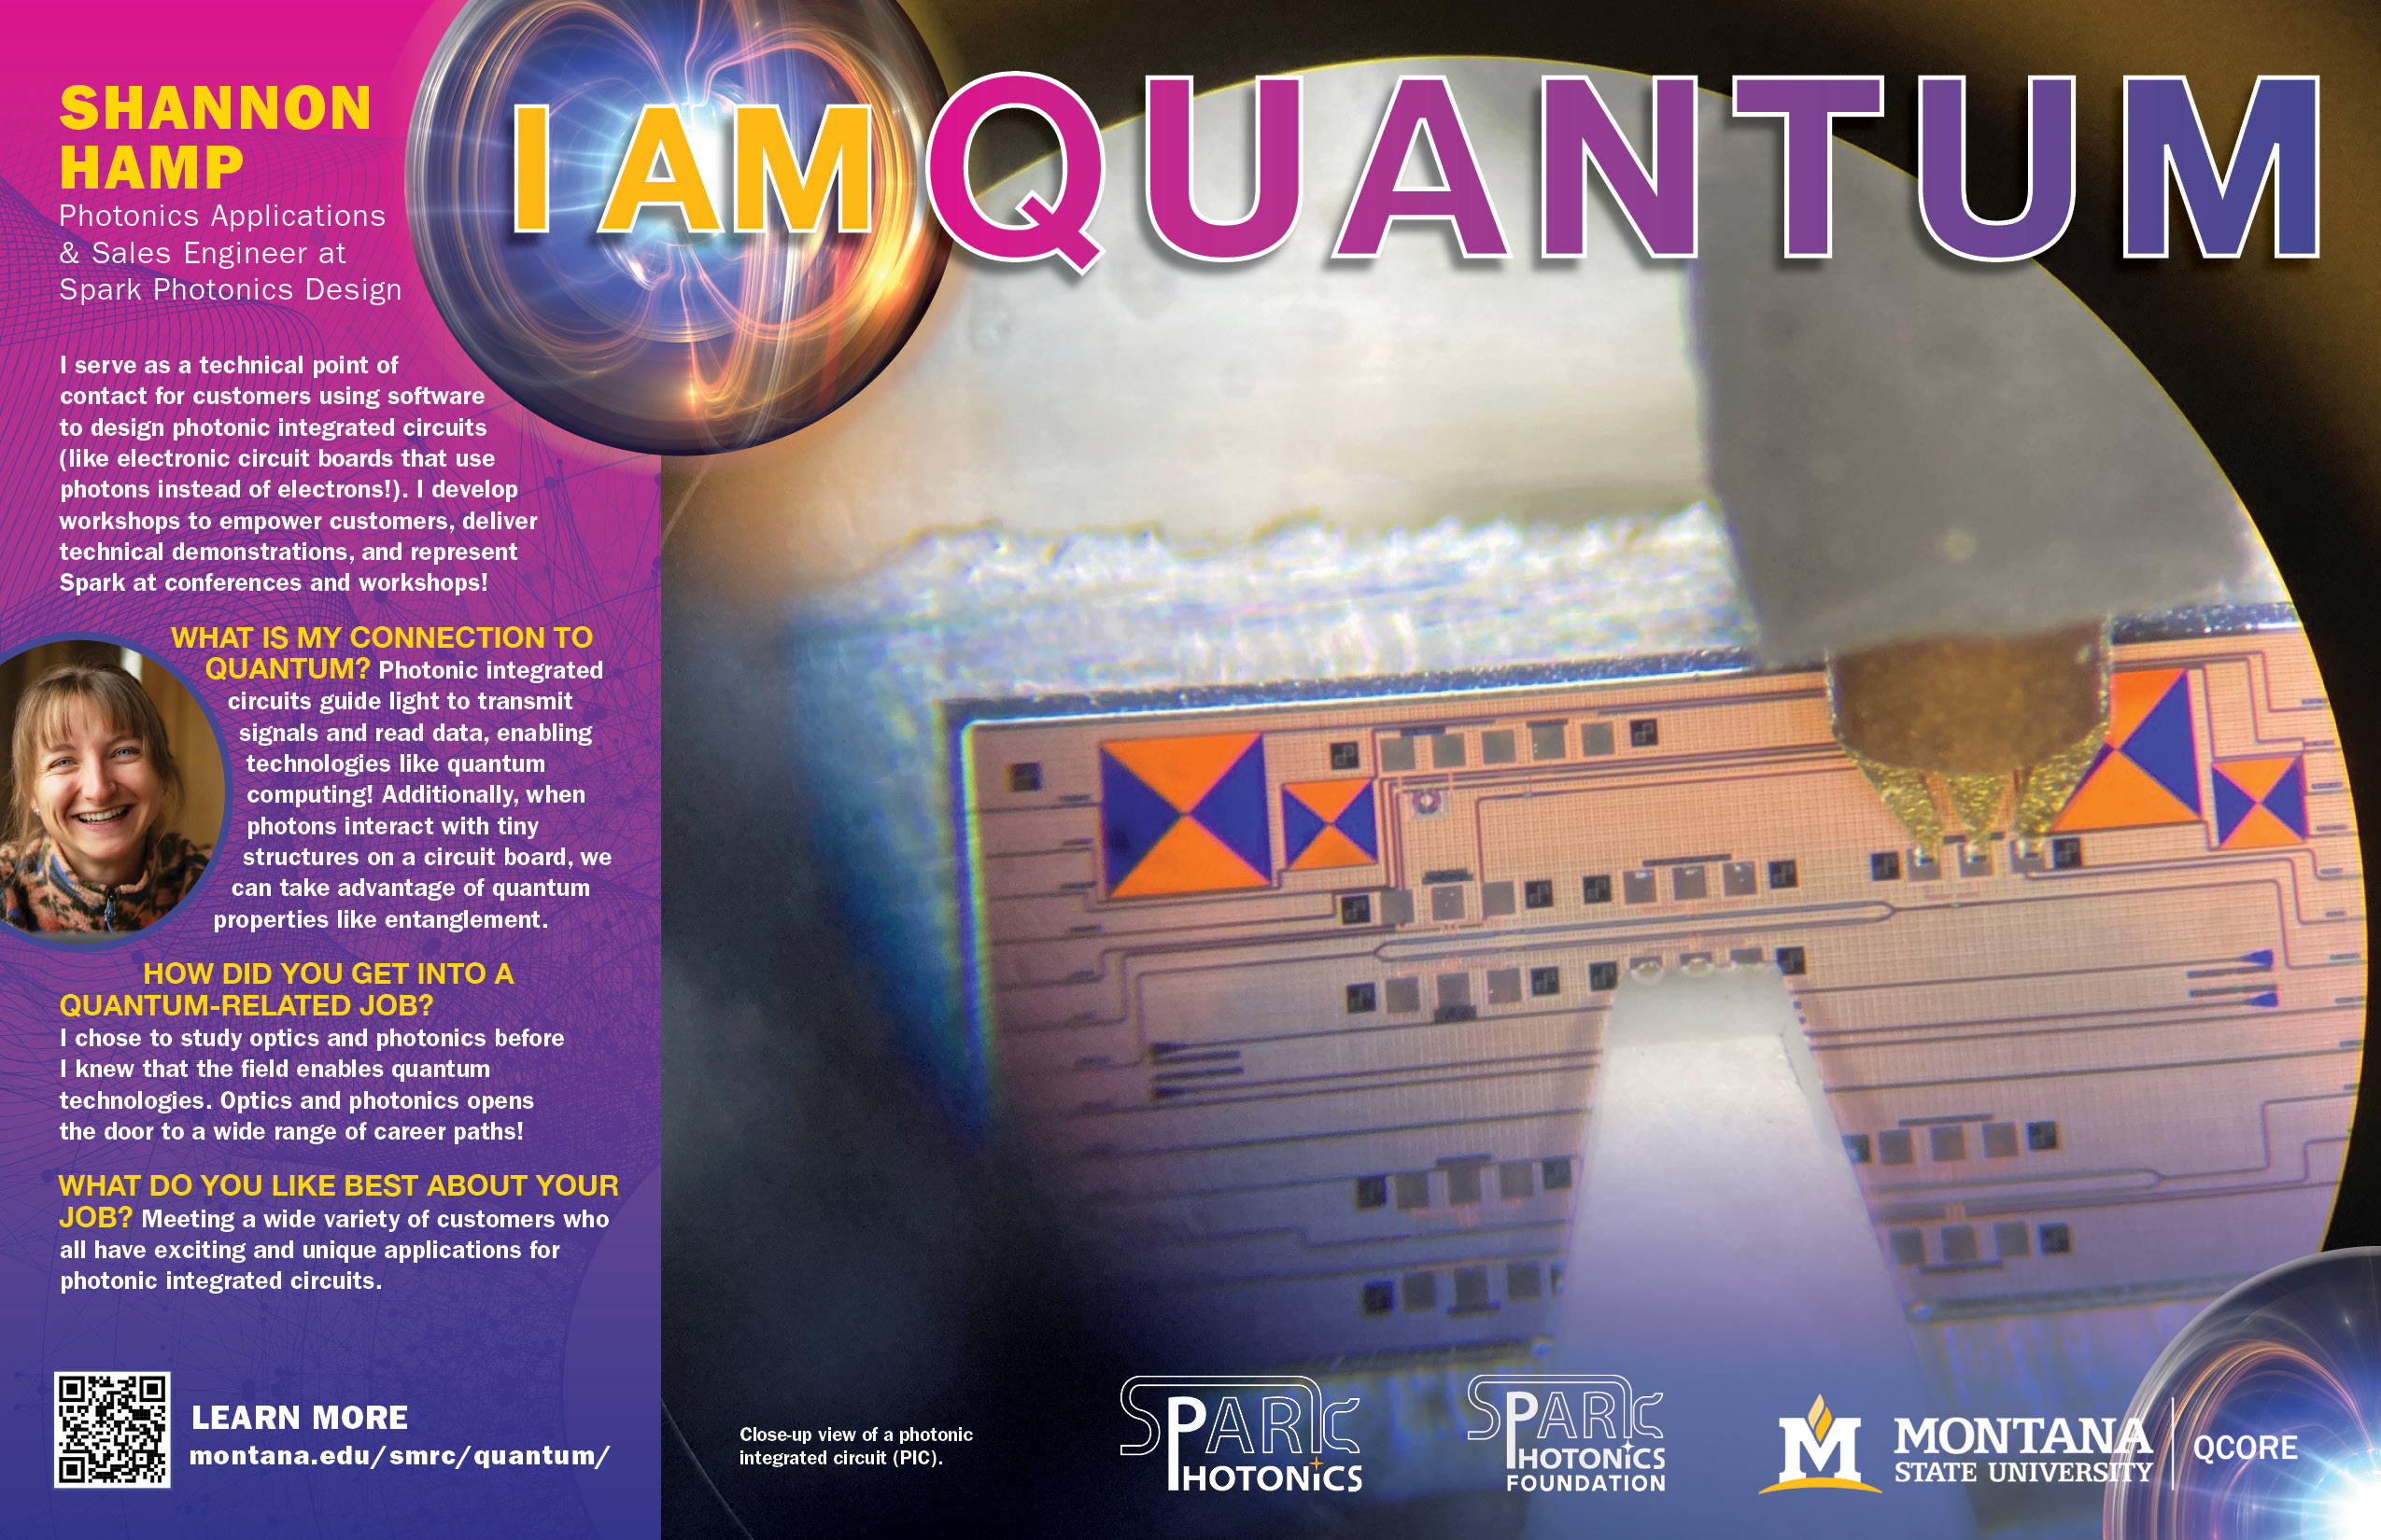
Notes:
As explained in the notes on the previous slide, during production of this poster set, Shannon finished her Master's degree and was hired by Spark Photonics. We created two posters for her to show her progression from her graduate work to her career.

Slide 3
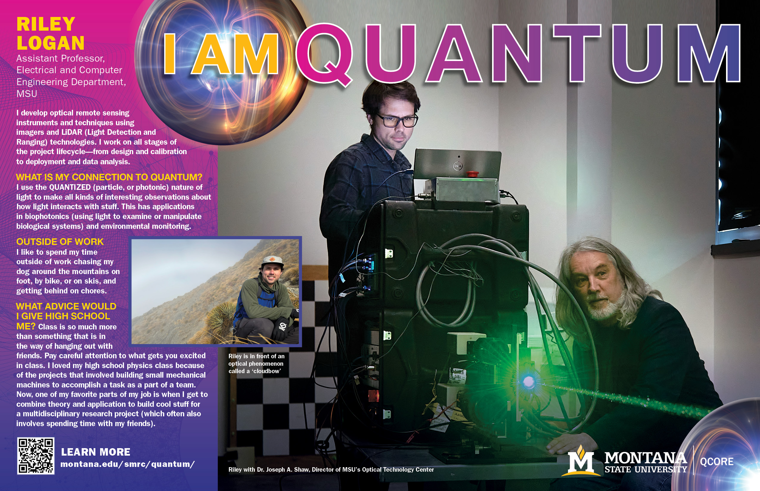

Slide 4
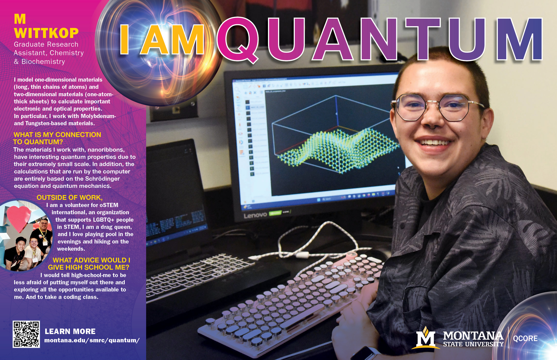

Slide 5
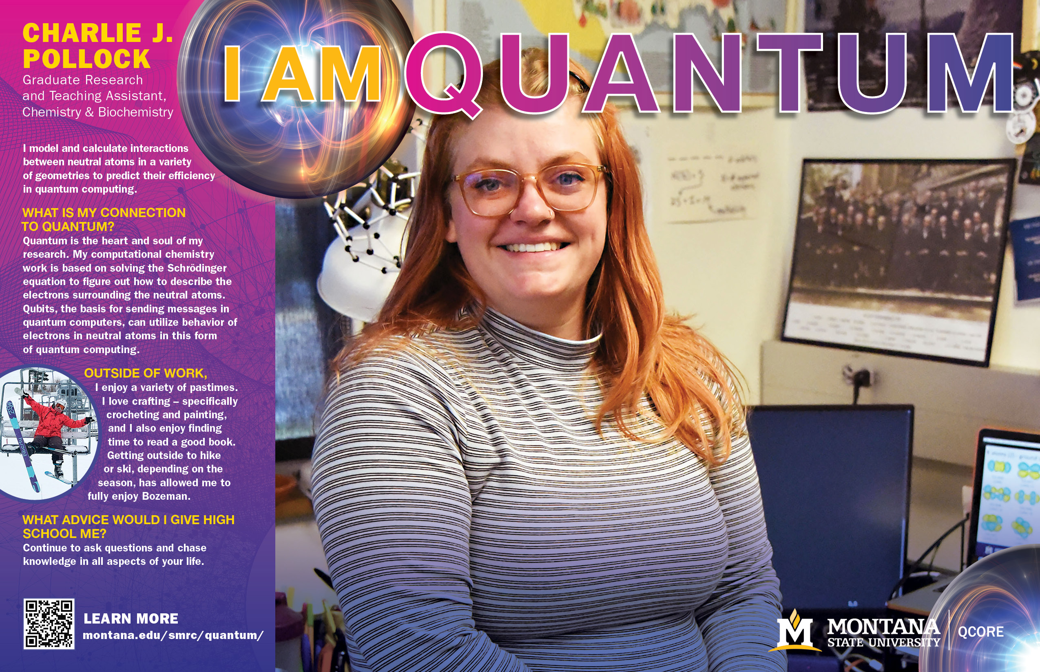

Slide 6
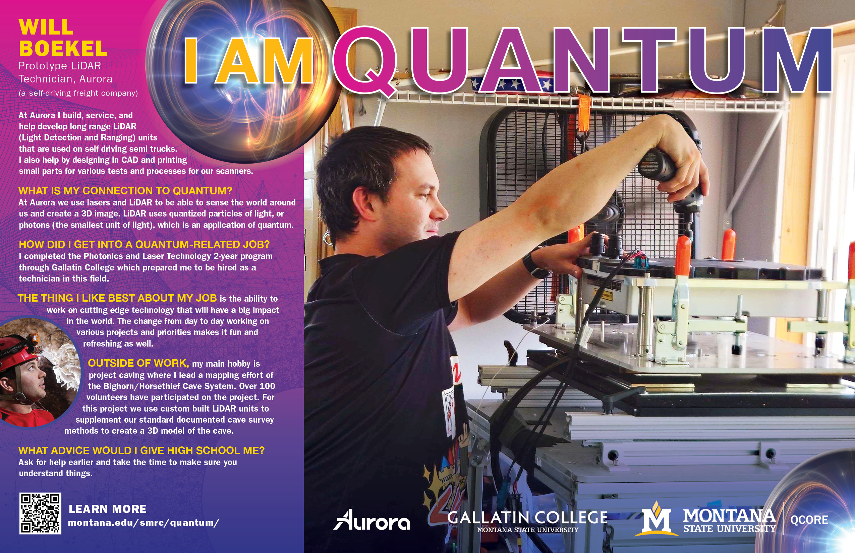
Notes:
Will Boekel is a graduate from Gallatin College's Photonics and Laser Technology program. This program allows students to earn an A.A.S. degree in just two years of coursework. To date, the program has 100% placement for students into the workforce. Will works for the self-driving freight company, Aurora at the LiDAR-focused office in Bozeman, Montana.

Slide 7
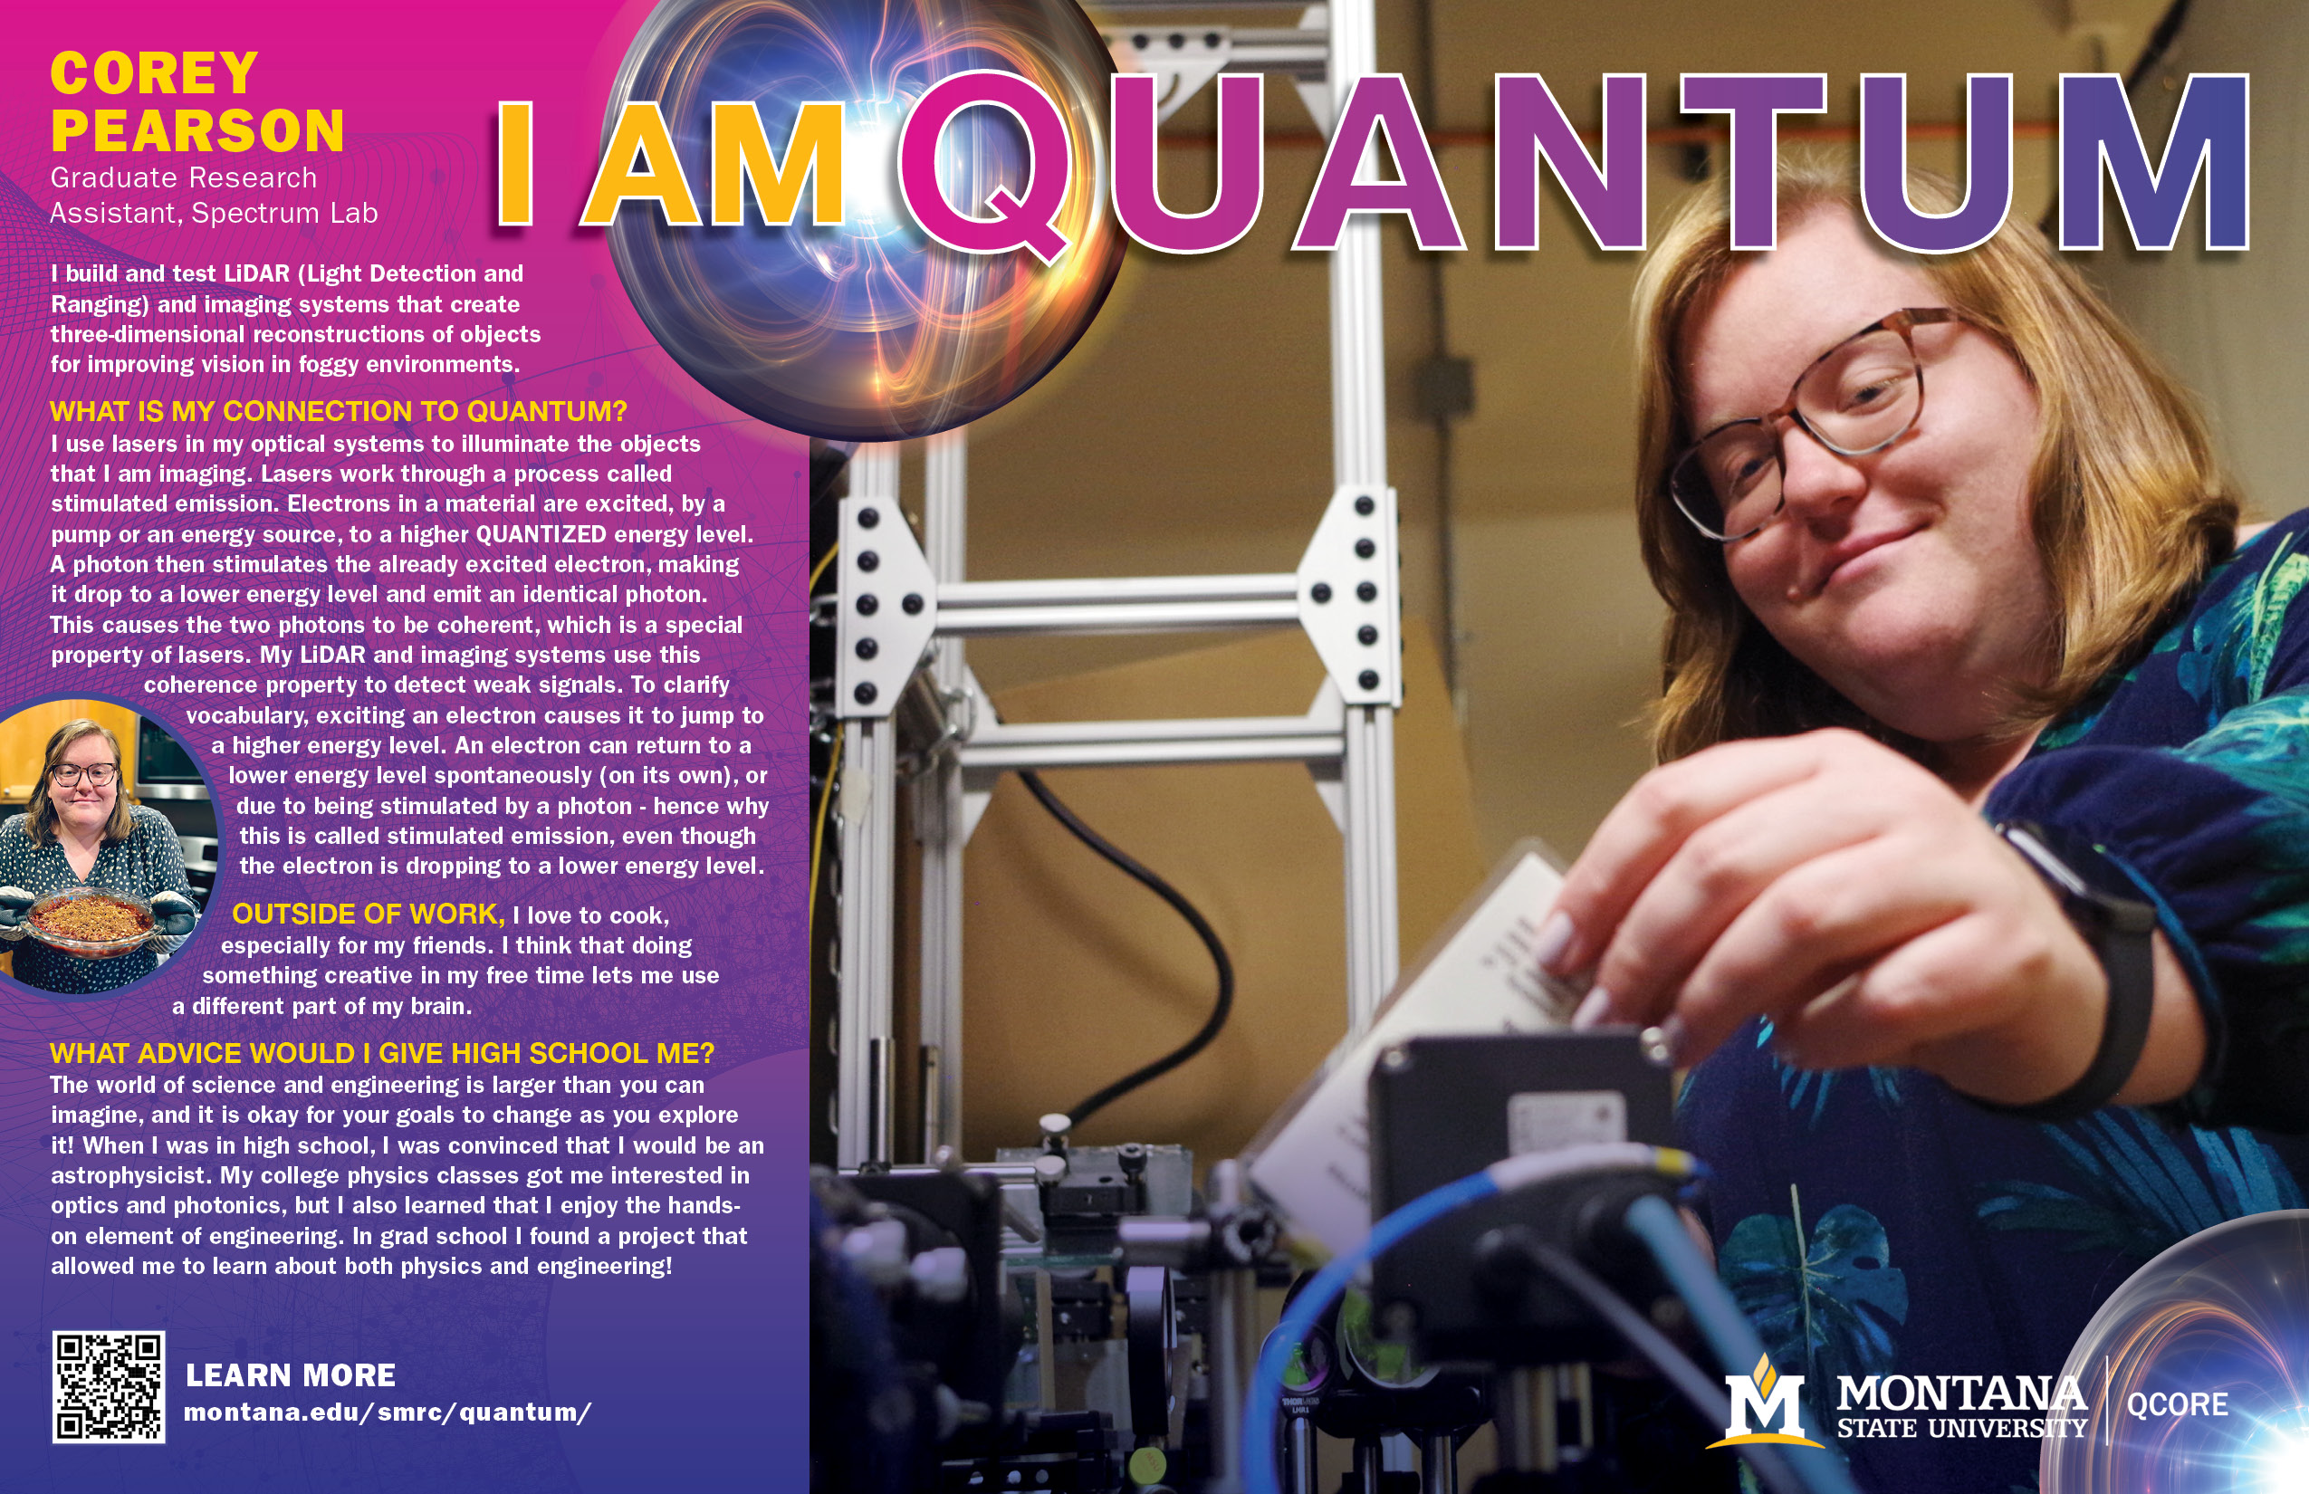

Slide 8

Notes:
QCORE, which stands for Quantum Collaborative Research and Education, is a research facility that is part of Montana State University and is located in Bozeman, Montana.
In 2025, QCORE was awarded a $31.5 million contract with the Air Force Research Laboratory in Rome, New York, for novel research in quantum applications and the development of novel quantum materials, sensors, devices and network systems. The contract supports research across the university. More than 50 MSU faculty and staff are affiliated with QCORE. Those individuals mentor students from across disciplines, including mechanical and electrical engineering, computer science, physics, chemistry, business, philosophy and art. The work performed under the contract will provide those students with direct, hands-on research and laboratory experience that ultimately will help them pursue careers in industry and government. “It opens doors for them to establish career paths with diverse emerging and established industry sectors, including the photonics, vacuum technology, cryogenics and materials industries located in Montana,” says Krishna Rupavatharam, QCORE’s chief technology officer and director of MSU’s Spectrum Lab. QCORE has become a hive of research activity for high school-aged to advanced researchers,” says Allison Harmon, MSU’s vice president for research and economic development.
The facility has test beds for quantum computing, sensing and quantum networks; equipment for materials synthesis and characterization; and cryogenic facilities for testing quantum components at the extremely low temperatures in which they operate. QCORE is currently in the process of becoming a Montana Board of Regents approved center.
Information about QCORE was taken from the news article: Montana State's quantum research facility awarded $31.5 million for sponsored research, test bed expansion, By Diana Setterberg, MSU News Service, January 13, 2026

