Slide 1




Asset Management
March 8, 2019

Slide 2
Asset Classification
Capital Assets
    Cost greater than $5,000
    Use an expense account code 63xxx
Minor Equipment
    Cost greater than $1,000 but less than $5,000
    Use expense account code 62238
Sensitive Equipment
    Cost greater than $100 but less than $5,000
    Items at greater risk of theft such as laptops, tablets, iPads, iPods, cell phones, cameras, microscopes, guns, artwork, televisions, musical instruments, etc.

Slide 3
Defining Capital Assets
Unit cost of $5,000 or more
  What makes up the cost?
      Shipping, installation, shipping insurance, initial on-site installation and set up
      Do NOT include: maintenance agreements, supplies
Complete in itself
Does not lose its identity even though it may become a component part of another item when placed in use
Life expectancy of 1 year or more

Slide 4
Donated Assets
All in-kind donations, regardless of value should be reported to Property Management
In-kind donations with value of >$5,000 are assigned a tag number and tracked by PM
If solicited by MSU and valued in excess of $5,000, the Alumni Foundation must be notified of the donation
Appraisal of capital donations from an independent party is needed for IRS purposes
$1,000-$4,999 should be added to minor inventory lists and tracked by Department
Policies listed at http://www.montana.edu/policy/gifts/

Slide 5
ITF (Intent to Fabricate)
The purchase of smaller pieces of equipment / parts that will be built into an asset with a value of at least $5,000
Find the ITF form on the PM website. PM will use the information from the form to track all purchases related to the build. It should be submitted prior to purchases being made so an asset tag # can be assigned and included on all BPAs and Pcard invoices documentation
Asset tag # will be assigned, but asset will not show on dept capital inventory until substantially complete
PM will contact dept at FYE for updates regarding substantially complete/in use date status

Slide 6
Roles & Responsibilities of Asset Management
Procurement Services
    May assist with purchase of asset
    Gathers lease information
Property Management
    Adds capital asset to record keeping system, tags asset and makes changes to asset records as necessary
    Completes inventories of capital and federally owned assets bi-annually
    Completes audits of grants when requested by OSP
    Collects inventories of minor and sensitive equipment from departments annually
    Collects verification of departmental review of capital inventory listing annually
    Responsible for coordinating/managing disposal of ALL assets with replacement value greater than $25 (E-scrap and Hazardous materials in collaboration with Safety & Risk)
Accounting
    Records depreciation, Construction Work In Progress
    Reconciles all capital expenses (finance) to capital asset recording system (assets)
Department
    Reviews and reports to PM capital asset listing at least annually, more often if changes, additions, deletions are expected
    Notifies Property Management of any changes for capital assets (location, contact, ORG changes)
    Assists Property Management with access to capital items during physical inventory
    Maintains inventory of minor and sensitive equipment
    Completes and submits PARR form for disposal of any asset with replacement value greater than $25

Slide 7
Why is it important to review your departmental capital asset listing?
Asset Control
  Where is the item located?
  If not located, where did it go? Sold? Theft? Relocated? Trash?
  PM staff required by state law to physically see the asset at least every 2 years. Location updates and contact changes from department help in this process.
  All departments will be required to submit verification of their capital property lists to PM by April 26th, 2019
Subject to Legislative Audit Review
  State auditors may come to your department to verify physical existence of an asset.
  If it is on your list, you need to know where it is when the auditor wants to see it!
  We are required to account for the existence and protection of all MSU assets, even those that are fully depreciated; adequate internal control processes
Financial Statement Ramifications
  Incorrect inventory listing may mean our assets are misstated
  Financial audit findings are reported to President, OCHE and Legislative Committee

Slide 8
Minor & Sensitive Equipment Inventory
All departments will be required to submit their minor property lists to PM by April 26th, 2019
At a minimum, your listing should contain the following information:
  Equipment Tag # (assigned by Dept)
  Description of item
  Make/Model
  Serial # (or other identifying #)
  Value/Purchase price
  Date acquired
  Location (building, room #)
  Contact/responsible party
Property Management has tags with a fillable number field available for departmental use.

Slide 9
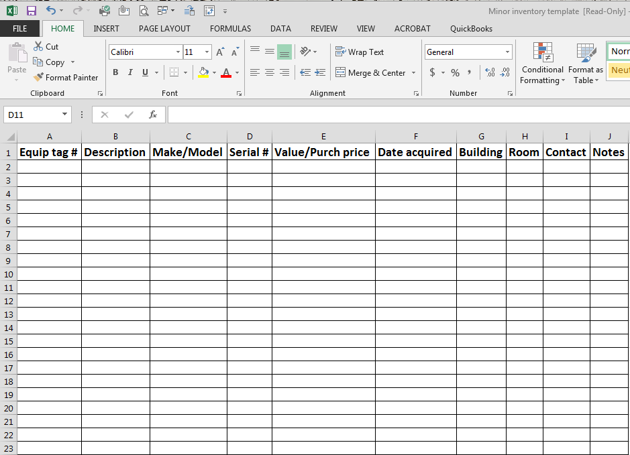

Slide 10
MSU Box for Capital Reports
Montana State Box
For login and other instructions please visit:
www.montana.edu/box.
Access your Montana State Box account here: https://montana.box.com
For access to capital reports, email Christina at Fournier@montana.edu

Slide 11
Secondary Tagging
Radio Frequency Identification (RFID)
  The system uses passive RFID technology
    The RFID tag only transmits a signal to the RFID reader
    No signal is generated unless the tag is ‘speaking’ to a nearby reader
Barcode, rather than RFID, tags will be used on any sensitive equipment.
We do not anticipate any issues or interference with most capital equipment; however barcode tags will be used on those pieces that are unable to utilize the RFID technology.

Slide 12
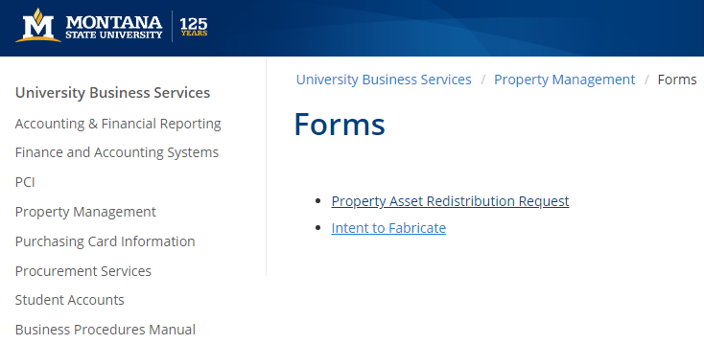
Surplus Property/Disposals
Starts with a PARR form:
Applies to any item on
campus with a value
greater than $25
Disposal can mean: sales, cannibalization, junk/broken, transfers (internal and external), trade-in

Slide 13
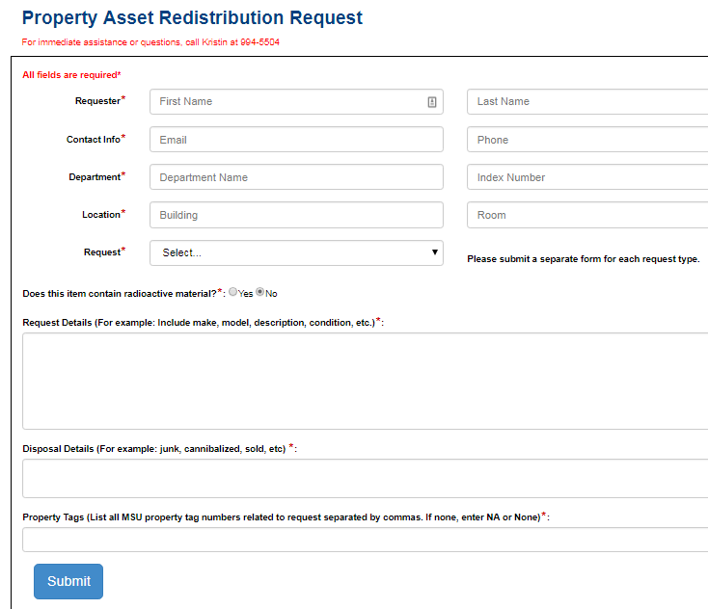
Surplus Property/Disposals
An index number must be included when you submit the form. If PM is taking your items to our storage you will not be charged. If the item is to be recycled, Facilities will charge your index for the disposal.

Slide 14
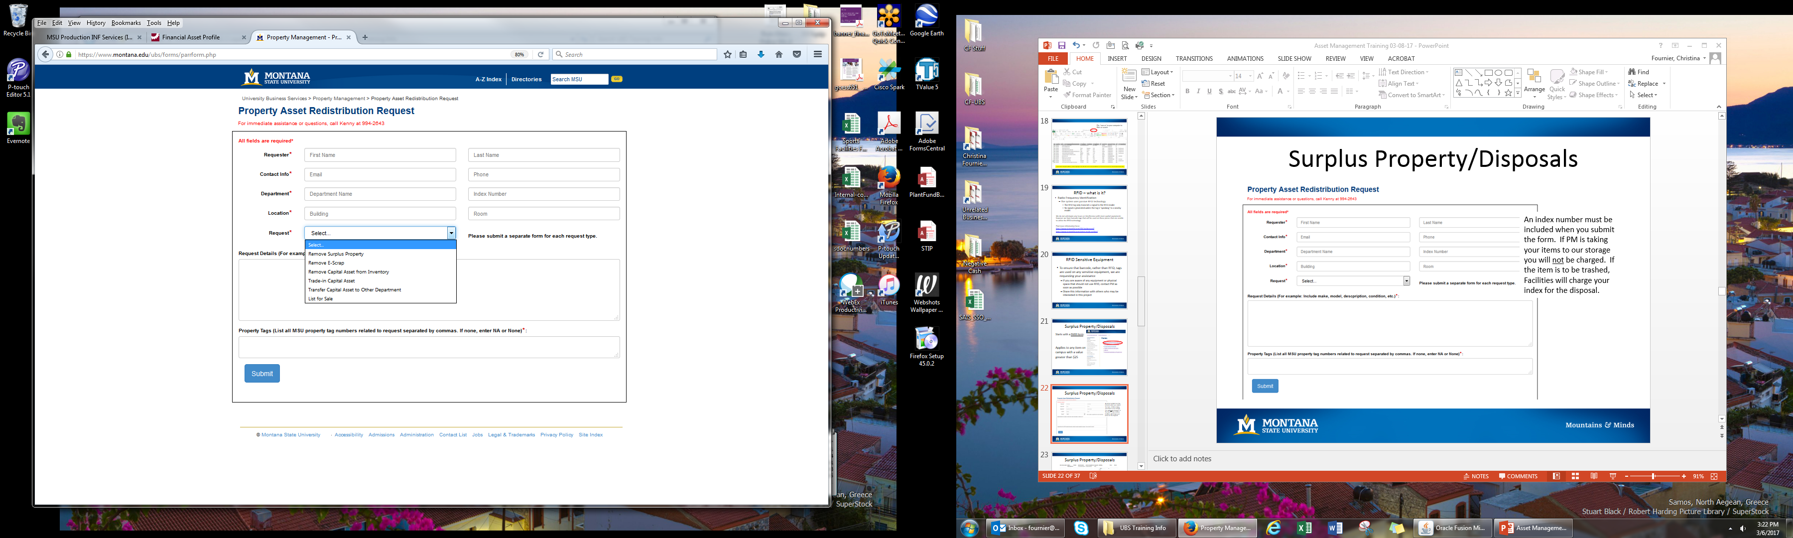

Slide 15
Surplus Property/Disposals
New PARR form generates a helpdesk ticket, similar to what UIT Helpdesk uses
You will receive an email confirmation that your ticket has been submitted
Property Management will use the ‘notes’ function to keep you informed on the progress of your request
Property Management will code your request as ‘resolved’ once E-scrap or Facilities has been notified. Please do not respond ‘no’. Wait until the asset has been removed/relocated, then confirm ‘yes’. PM has no way of tracking E-scrap or Facilities work order progress. Your confirmation ‘yes’ will close the ticket.

Slide 16
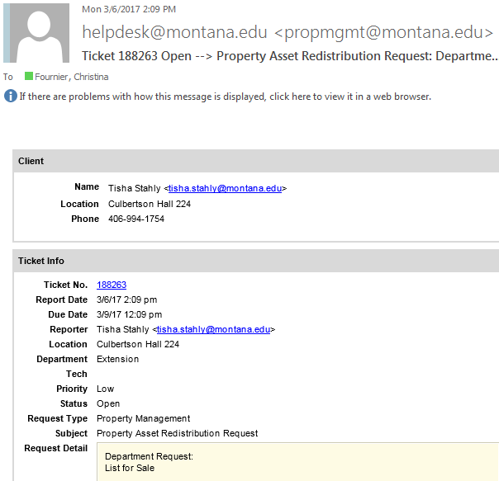
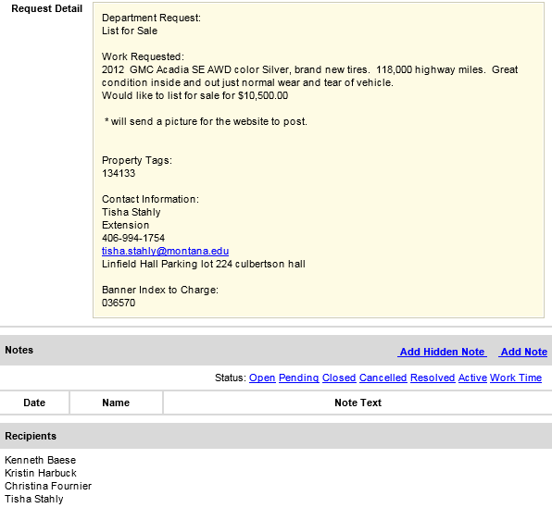

Slide 17
Dealing with Transfers of Capital
Transfers between departments
  Department getting rid of item completes the PARR form
  Property Management will make the org change to the asset in the system
Transfer caused by Professor/PI leaving MSU for another university
  Contact Property Management. New process is being developed and will be communicated by OSP soon
  Items on a grant may be transferred if OSP approves
  Most MSU owned assets will not transfer, that includes items purchased with IDC funds

Slide 18
Dealing with Trade - Ins
Complete PARR form, choosing ‘trade-in capital asset’ from drop down list
Send a copy of invoice, showing the transfer credit to Property Management for deletion of asset
Make note of transfer on new purchase paperwork (BPA or Pcard). Invoice should show transfer credit.
Not allowed for vehicles

Slide 19
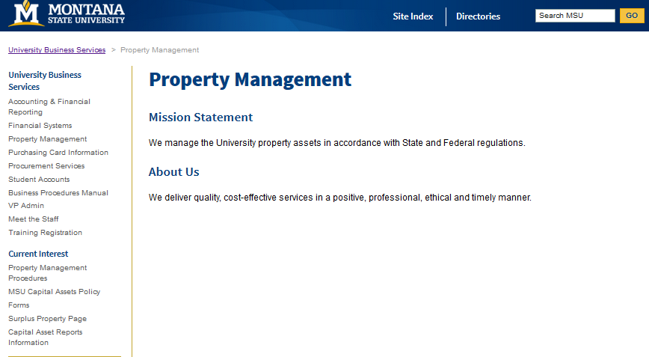
Property Management Surplus
Items are retained for MSU redistribution for at least a period of two weeks.
Then they become available to other state agencies, schools, charitable organizations, etc. before being available for public sale.

Slide 20
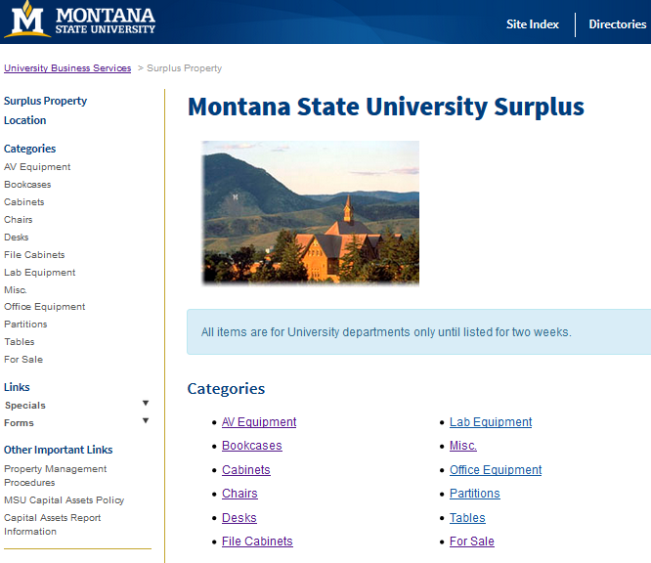

Slide 21
Surplus FAQs
We don’t need this office chair/filing cabinet/ bookcase anymore. Can someone from the office/a student/the PI take it home?
  No. All MSU assets must be offered for another business purpose before they are made available for sale/giveaway to anyone for personal use. Some items with a high demand on campus are held for longer periods of time.

Slide 22
Surplus FAQs
This computer equipment is still good, we just don’t want it. Are you just going to throw it away?
  No. The E-scrap program also looks to redistribute computer equipment that is still functional and useful.

Slide 23
Surplus FAQs
I sent my PARR form in yesterday. When are you coming to take this stuff?
  Property Management will contact you to make arrangements to view the item(s), to decide if it is something that will be kept for surplus or recycled. PM will contact Facilities Services to have the item removed, either to our storage units or to recycling. PM is not permitted to remove items from departments. And please remember we are only a staff of 2! If you know you need to free the space quickly (to accommodate delivery of new furniture, for example) please note that on the PARR form. We will make every effort to work with your schedule.

Slide 24
Surplus FAQs
How much is this going to cost my department to remove surplus items?
  Facilities Services bills at an hourly rate. Charges depend on the number of items moved, but usually the charges are minimal. If you have a larger number of items to move, you can contact Facilities directly for an estimate.

Slide 25
Surplus FAQs
How does my department get surplus?
  See something you like on the surplus website? Call or email Property Management! We can meet you at storage to look at items in person. Facilities Services must move most items to your campus location.

Slide 26
Surplus FAQs
We have some specialized lab equipment that is still pretty valuable and we’d like to sell it ourselves. Can we do that?
  Yes, but... A PARR form is still required and must be approved by PM before any sale arrangements are made. Property Management will work with you to determine the best means to sell (state auction site, MSU website, your contacts with potential interested parties). PM requires a copy of the sales receipt to include with the disposal records and a special revenue account code (53985) must be used to record the proceeds from the sale in Banner.

Slide 27
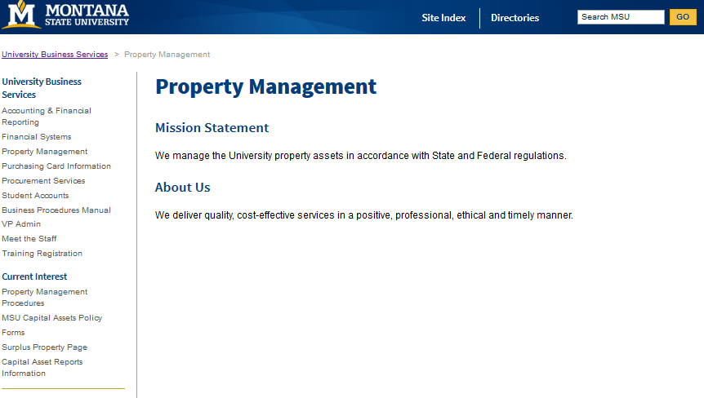
Find more info here:
Visit our website:
http://www.montana.edu/ubs/propertymanagement/index.html
Office of Audit Services Information available at http://www.montana.edu/audit/guidance.html

Slide 28
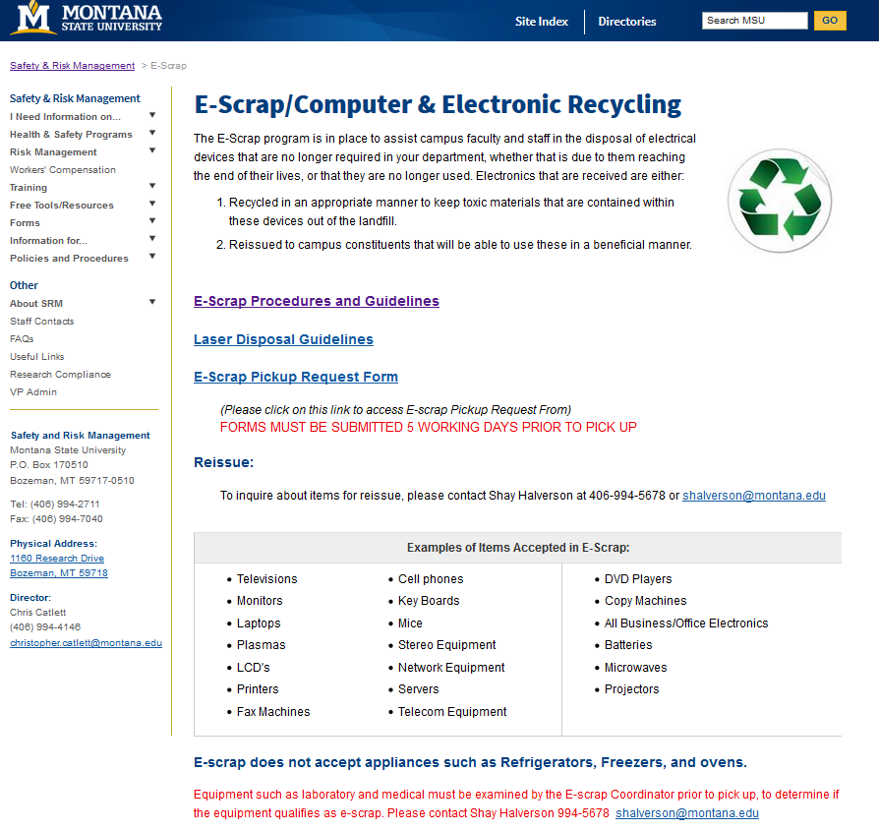
E-scrap info here:
Visit the website:
http://www.montana.edu/wwwsrm/escrap/index.html

Slide 29
Relocation Information
Relocating a department requires the coordinated efforts of several MSU support areas.
Office of Facility Services:
Work Control, 994-2107
Logun Norris, Recycling Coordinator, 994-6871, logunnorris@montana.edu
Sustainability & Recycling:
Sustainability Office, 994-6873, asmsusustain@montana.edu

Slide 30
Contact Information
Property Management:
Kristin Harbuck, 994-5504
Kristin.Harbuck@montana.edu
Zachary Martinez, 994-2643
zacharymartinez@montana.edu
Property Management Supervisor/General UBS questions:
Christina Fournier, Financial Manager, 994-3653
Fournier@montana.edu or UBSHelp@montana.edu
E-scrap Coordinator:
Shay Halverson, 994-5678
shalverson@montana.edu

Slide 31
Upcoming!
Year-End Information - due to PM by April 26th
  Annual capital inventory verification
  Minor/Sensitive inventory submission

Slide 32


