Slide 1
New MSU Box for Capital Reports
Montana State Box
Montana State Box is a new file storage and collaboration service at MSU, free to faculty, staff and students. It is a great tool available across platforms (including Windows, Mac, iOS, and Android) for storing, accessing, and sharing files easily and securely.
For login and other instructions please visit:
www.montana.edu/box.
Access your Montana State Box account here: https://montana.box.com

Slide 2
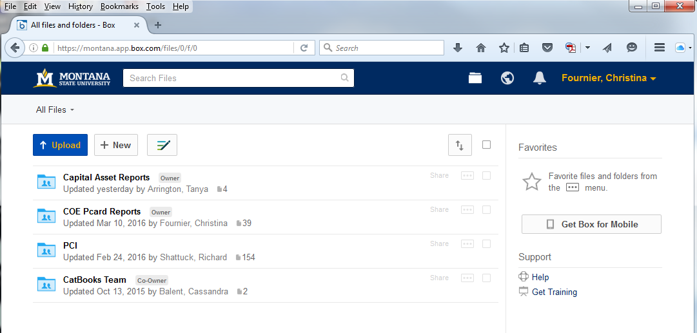

Slide 3
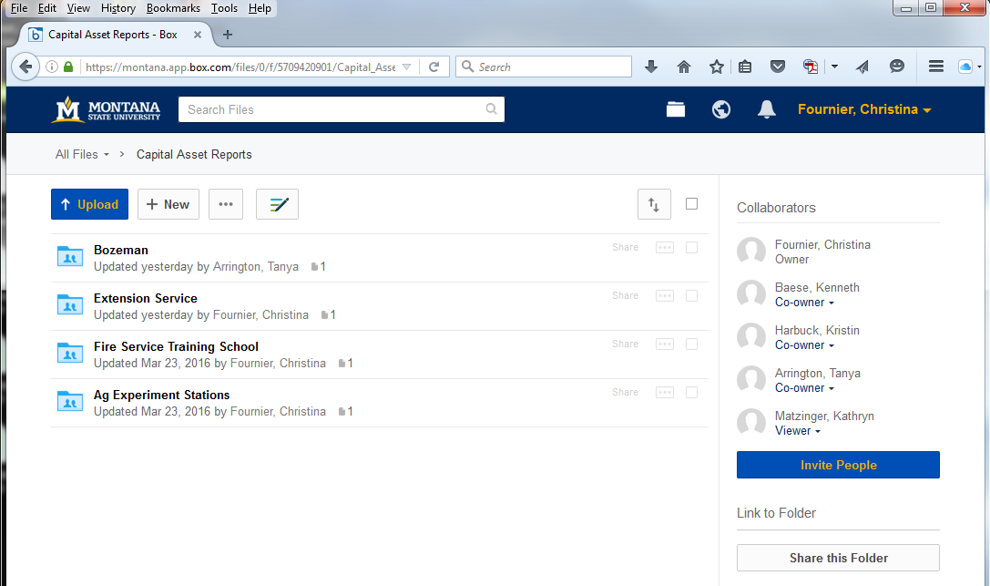
We will update the reports every two weeks or so. If you need to see something more recent, please contact PM.

Slide 4
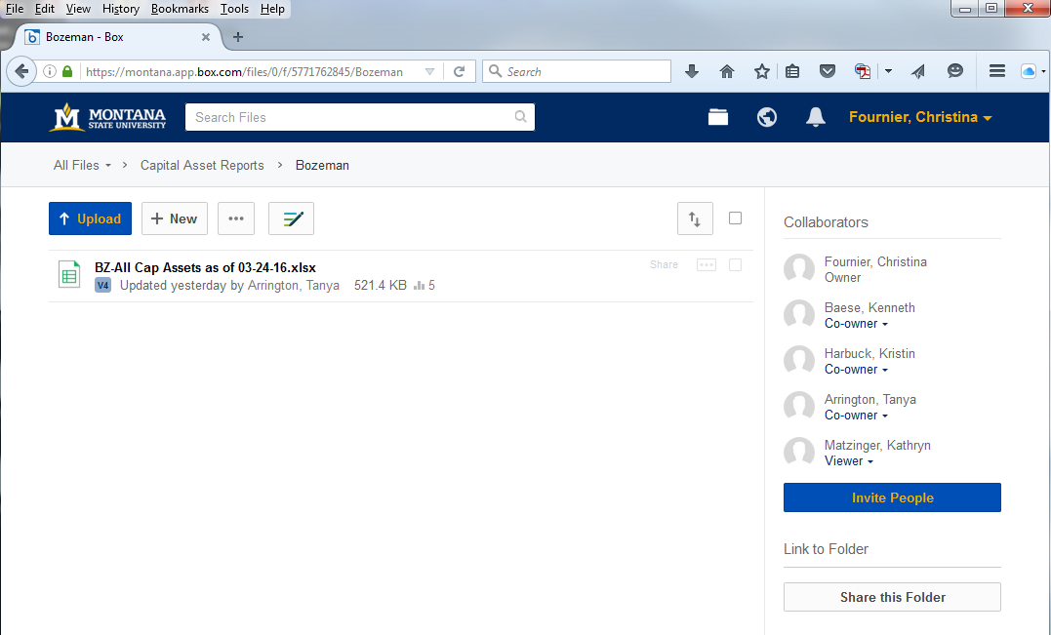

Slide 5
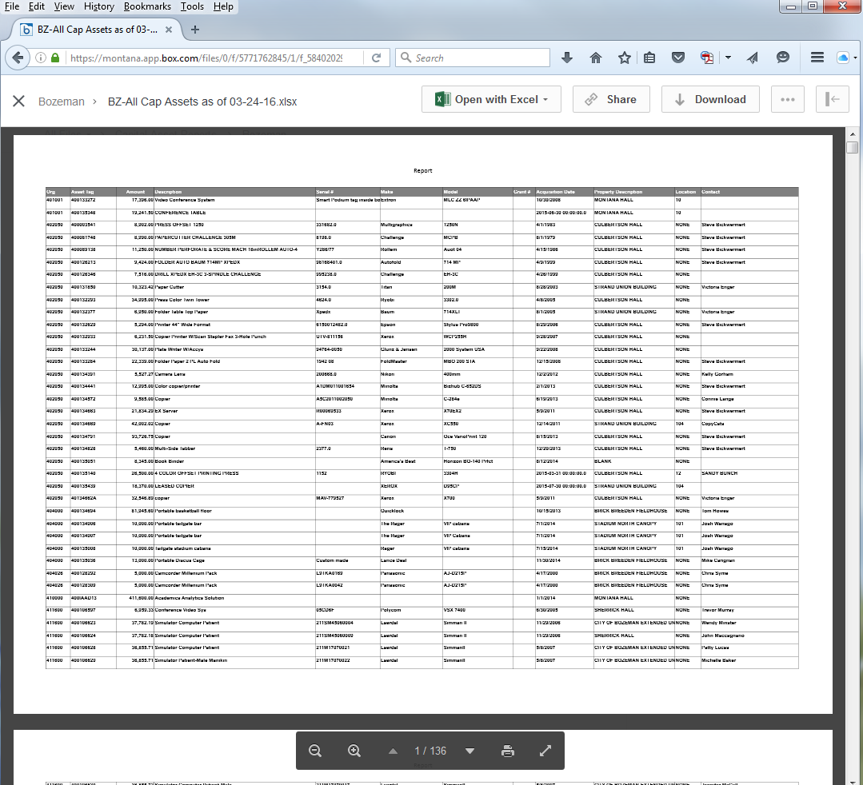

Slide 6
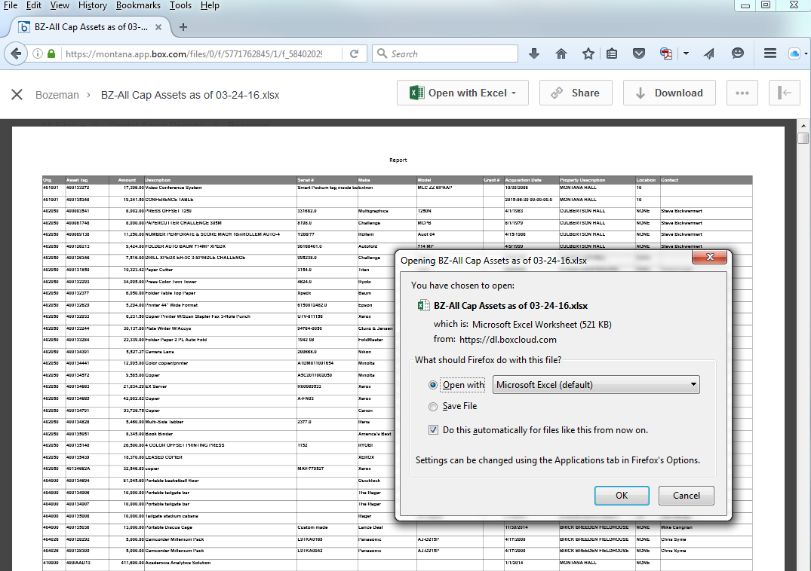

Slide 7
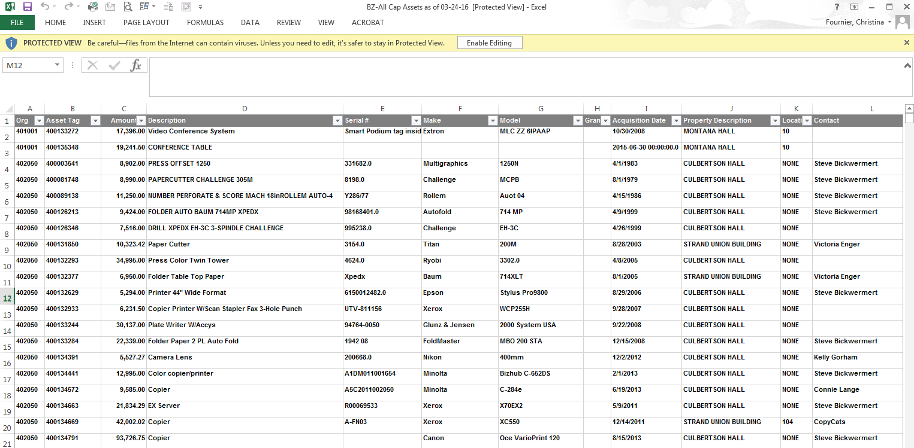

Slide 8
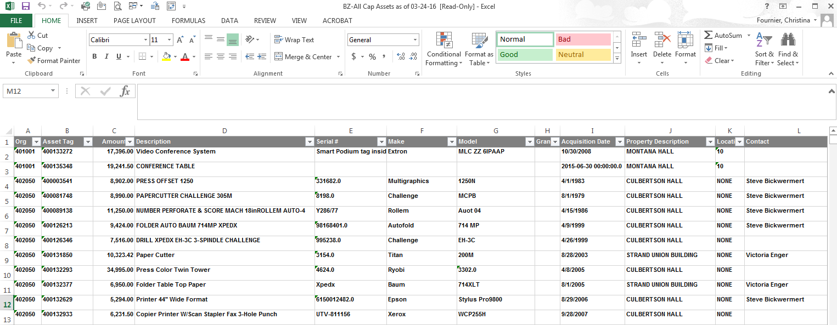
File, ‘save as’ to your computer to filter by your ORG number or search for a particular asset

