Slide 1

Paying Employees/ Independent Contractors and Other Tax Issues

Slide 2
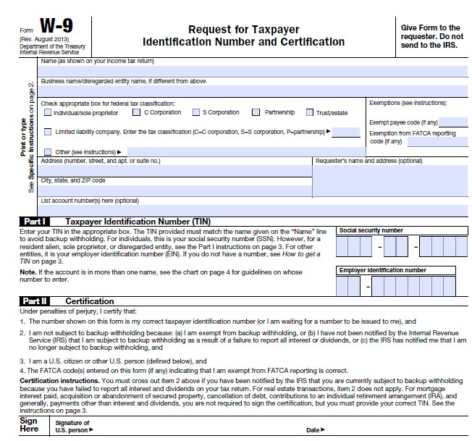



Slide 3
Independent Contractor vs. Employee
Behavioral Control
  Degree of direction and control
  How, when or where work is done
  Who provides tools or equipment
Financial Control
  Significant investment
  Opportunity for profit or loss
Relationship of Parties
  Part of MSU’s regular business/mission

Slide 4
8 Key Factors
Degree of control exercised by MSU over the details of the work
Which party invests in the facilities used by the worker
Opportunity of the worker for profit or loss
Whether MSU can discharge to individual
Whether the work is an integral part of MSU’s regular business
Permanency of the relationship
Relationship the parties believe they were creating
Provision of employee benefits

Slide 5
If not determined an independent contractor, may need to follow:
One-Time special payment procedures
Does not replace Additional Compensation procedures for Tenure Track Faculty or Full-time Professionals
Cannot be used for Classified employees
Use 4ONEPY position number and ONEPAY title on LOA

Slide 6
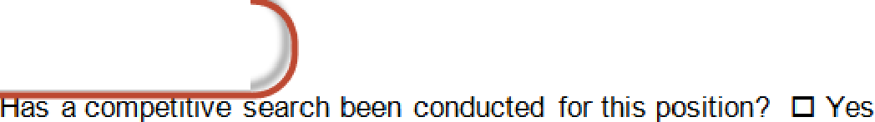



r!1
MONTANA
STATE UNIVERSITY
Letter of Appointment
I
0 Professional
Departmen t Use Only:
PrE!p are d By and contact ph one fl::
HR Use-O nly:
HR _
Provost
VPR _
□ Research
c
:EP AF Tran sa ction #:
)
D New Hir e (EPAF ne eded)
D New lOA as of July 1st with Change (EPAF needed)
□ New LOA as of July 1st no change (EPAF nor needed)
□ No
□ No , cli ck here to request a backgroun d check:
http://WWW.montana.edul hr/Recruitment/professional/bground.html
P re -Employment Background Ctileck reques ted? □ Yes
Name of Hire Address
)
( Date
If a :>Qli cable, current information of Ex iring Letter of_A , o_in_tment:
Employee GID: Position Title: Position Number: Monthly Salary of $
Contract Term: AY □
Start Date:
End Date:
FTE:
Department/Office/College:
FY □
!As of [Date]_,_you are hereb
Employee G ID - : 0 0 0 0 0 0 0 0 0
a ointed as follows:
,,-------------,,,,,
Start Date: first of month End Date: last of month FTE: o
Department/Office/College:
Position Title: ONEPAY
'
Use this position '
Position Number: 40 NEPv----....J,
on EPAF also )
_,
M ont h ly S al aryo f: $ totalamoun ;',,
Contract Term: AY □ FY □
Your job duties are to: [D escribe duties and any other unique conditions of employment]
•
MONTANA
STATE UNIVERSITY
Mountains
&
Minds

Slide 7
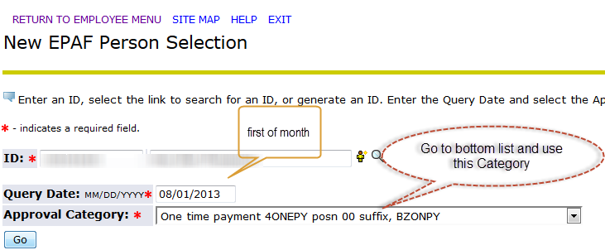
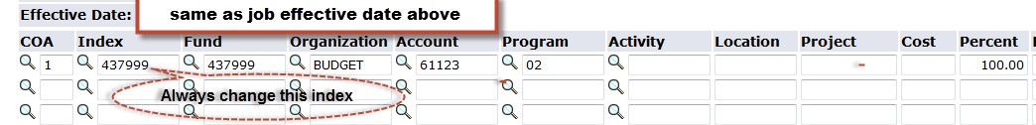
Complete and submit a “One time payment” EPAF

Slide 8
It em
Job s Eff ective Dat e: MM/ DD /YYYY*
Job Ch an ge Reaso n : * ( N o t Ent era ble ) Job S t at u s: * (Not Ent era ble )
Curr ent Value New Value
0B/ 31 / 2 013
o fm
ENDTM
--
T
D n. 1 ••= - - n 1■ - ■ 1.a.
ppro vall L e v el l User Name
Required Action
_ M_I a_x A_-la_n_ _T h_o_m_p s o-n- - - - - - - - - - - - - - - - - I App rove
_, _ 9_ 8_ _ __( 0_N_E_P_Y_l )_ O_n_e_ T_ im e_ _Pay - A_p-p _r_ov_e r 0MAXT
99 - (ONEPY2) One Time pay applier 0. FHARPElR r-N-o-t S-e - l_ec_ t_e d- - - - - - - - - - - - 1-,-""1 " 0.
I Fiona Ann Harper I Appl y
l:==========================;l_l'" N_o_ t_ S_e_le_c_ t_e d l .. -1
INot Selected
l.:] U.
I:============================================ !
INot Selected l.:]
_ '"I_No_ t_ Se_-le_c_ t_e d
'"l.:]"" a_ - - - - - - - - - - - - -
I Not
Selected l.:]
INot Selected
[ Sa ve and Add New Ro ws
l.:] U.
INot Selected l.:]
Com ment
Ple ase type a brief description of services and reason for paym ent and if an LOA was sen t through for approvals.
App ro val Types I Accoun t Distributi on I Ro uting Queue I Tran saction Hist ory
•
MONTANA
Mountains
&
Minds
STATE UNIVERSITY

Slide 9
Other Tax Issues – Fringe Benefits
What are Fringe Benefits?
Cash, cash equivalents, property, services or other benefits provided to an employee by an employer or a third party in addition to regular salary.
–Life, health and disability insurance
–Education assistance
–Club memberships
–Gift certificates
–Courtesy car
–Tickets to entertainment events
–Meals
–Cell phone

Slide 10
Which Fringe Benefits are Taxable?
All fringe benefits are taxable unless specifically excluded by a provision of the Internal Revenue Code.
The fair market value of the benefit (i.e., what a disinterested person would pay) is subject to withholding and reported as income on a W-2 in the year the benefit is received.

Slide 11
What Fringe Benefits are Excluded from Income?
Internal Revenue Code §132(a) provides an exclusion from gross income for any fringe benefit which qualifies as a—
  de minimis fringe
  working condition fringe
  no-additional-cost service
  qualified transportation fringe
  qualified employee discount; or
  qualified moving expense reimbursement

Slide 12
What is Considered De Minimis?
IRS Regulations do not define ―De Minimis‖
Other regulations permit a business gift of $25 or less to be given to a client, so some use $25 as a limit
The IRS Auditor’s Fringe Benefit Guide discusses that $100 is NOT de minimis
So, between $25 and $100 is risky, but there is no clear guidance.

Slide 13
Working Condition Fringe Benefit
Items that, had the employee paid for themselves would have been deductible on their tax return, are considered tax-free working condition fringe benefits because they are ordinary and necessary in the performance of duties (Publication 529)
–Uniforms
–Tools and equipment
–Professional licenses
–Travel expenses
Examples: a carpenter’s saw, an accountant’s calculator, a police officer’s uniform

Slide 14
Clothing
To qualify for tax-free treatment, provision of clothing must either be de minimis or considered a working condition fringe
De minimis is something that occurs infrequently and is of low value. Remember-- low value is not defined by the IRS
The staff each receive a shirt with the MSU logo, for example, Move-In Day vests

Slide 15
Clothing (continued)
The IRS auditor’s manual indicates that uniform allowances are taxable unless:
  They are required to be worn for employment and
  They are not suitable for everyday use
Clothing is always allowable if required for safety (goggles, harnesses, etc.)

Slide 16
Meals
Occasional meals can be excludable, if the following three conditions are met:
–Meal is reasonable in value, and is not provided regularly or frequently, (i.e., it is de minimis); and
–Provided for Overtime Work -Overtime work necessitates an extension of the employee's normal work schedule; and
–Enables Overtime Work -Provided to enable the employee to work overtime

Slide 17
Other Tax Issues – Gift Cards
Non Employees:
$25 or less considered a ‘business gift’
Recipient must sign acknowledgement of receipt of gift card to support departmental purchase
Above $25? Employees:
All taxable, regardless of amount. Notify HR, so amount can be included in employee’s W2 Recipient must sign acknowledgement of receipt of gift card to support departmental purchase

Slide 18
Other Tax Issues – Long Term Travel
Temporary Travel is defined as less than 1 year
Travel over 365 days is considered ‘indefinite’ and may be taxable
Contact UBS if you have someone expected to be in travel status over 1 year
Expenses are still reimbursable. Meals and lodging may be taxable.

Slide 19
Other Tax Issues – Donation of Award/Honorarium
Generally recipient must accept award/royalty/ honorarium and then donate it back to MSU
Direct transfer to MSU may be allowed if the following conditions are met:
  No action was required by the recipient, i.e. enter contest, submission of paperwork, deliver presentation
  Unexpected in nature, not payment for service
  Not required to perform substantial future services
Contact UBS for specific IRS letter requirements

Slide 20
Important Contacts
Laura Humberger, Associate VP Financial Services, 994-4361 lhumberger@montana.edu
Katie Matzinger, Director of Accounting, 994-7508 Katie.Matzinger@montana.edu
Max Thompson, HR, Payroll/Compliance Manager, 994-3651 maxt@montana.edu
Other/General UBS questions:
Christina Fournier, UBS, Financial Manager, 994-3653 Fournier@montana.edu or UBSHelp@montana.edu

