Slide 1
University Information Technology
Networking
Telephones
Data Centers
Banner
ID & Account Management
Desktop Support
Security
Student Labs
Service Desk
UIT Service Desk
406-994-1777
helpdesk@montana.edu
M-F: 8 a.m. – 7 p.m.
MSU Library-1st Floor, Rm 115G
M-F: 8 a.m. - 5 p.m.
excluding holidays
Vice President for IT & CIO
Dr. Ryan Knutson
ryan.knutson2@montana.edu
montana.edu/uit

Slide 2
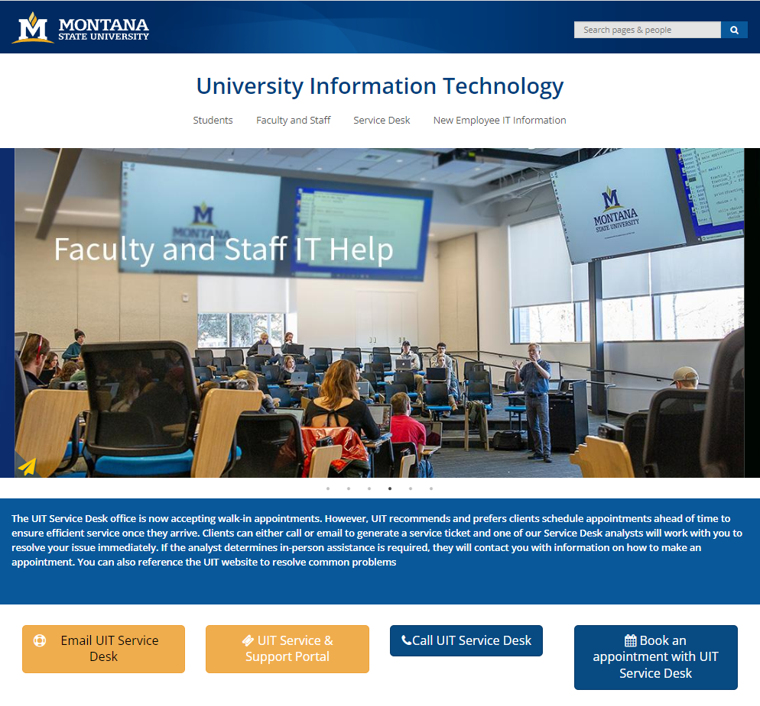

montana.edu/uit

Slide 3
MSU Technology Landscape
Campus Network Connections
IDs and Passwords
Computer Resources
Getting Help

Slide 4
Network Connections
How your devices connect to MSU networks…
  Ethernet/LAN -- “plugged in”
  MSU Domain -- “on the domain”
  Wi-Fi MSU-Secure -- “wireless”
  VPN – “remote” connect to MSU network from off campus

Slide 5
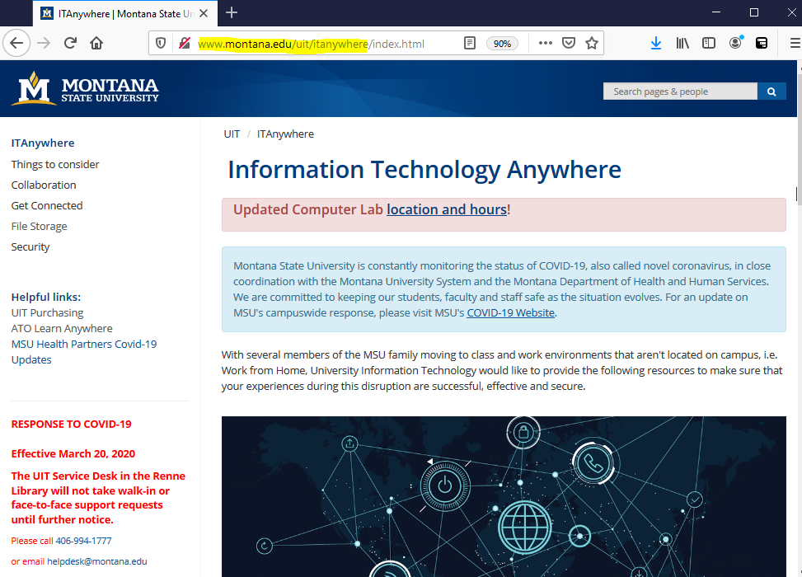
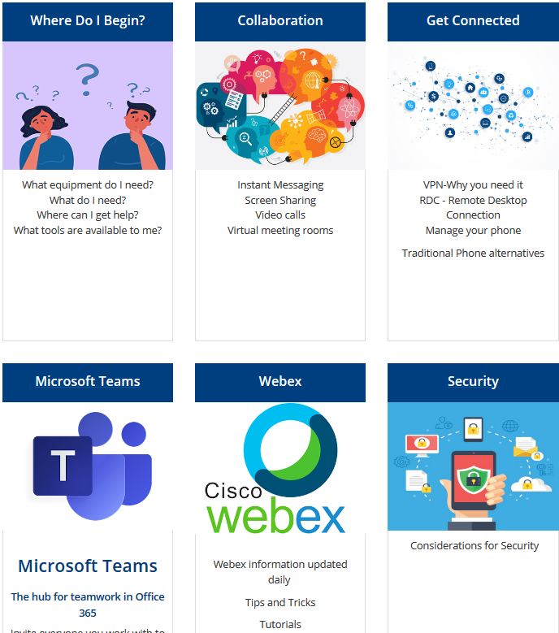
IT Anywhere:
www.montana.edu/uit/itanywhere
Collaboration Tools:
Microsoft Teams, Webex
VPN
Cisco AnyConnect
Remote Desktop
Use your campus computer remotely
Remote Computer Labs
Access to Student Lab workstations

Slide 6
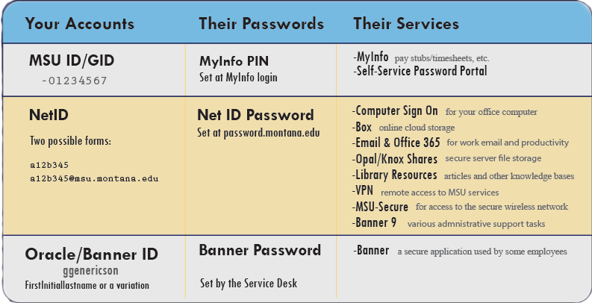
IDs and Passwords
MSU ID
NetID
Banner
MSU ID No password NetID Claim
-01212121
a12e345
a12e345@msu.montana.edu

Slide 7
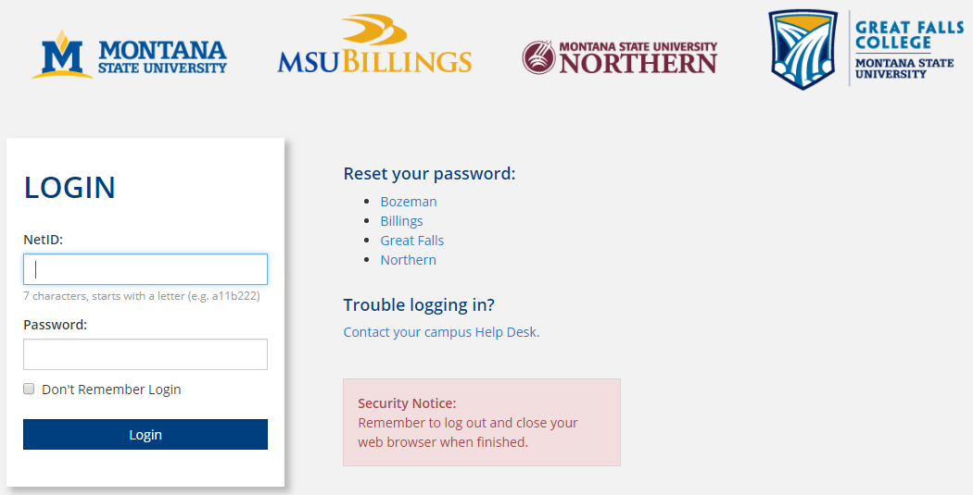
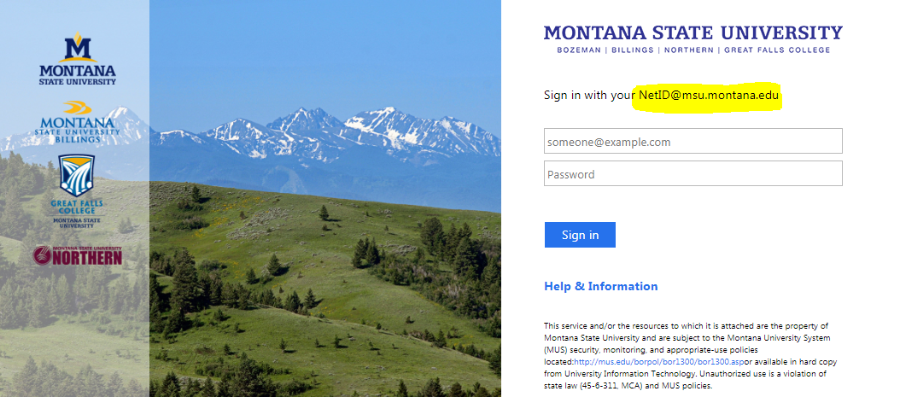

NetID
Two Formats
  Standard format:
  a12e345
  UPN format:
  a12e345@msu.montana.edu
Depends on the service you are accessing
Correct format is displayed in example on each login screen
Standard format
UPN format

Slide 8

Passwords
password.montana.edu
self-service password portal using ReACT
Should you have to change your NetID password, you may need to update it on mobile devices where it is used for your MSU email, MSU-Secure wireless and mobile apps.
Duo is a form of two-factor authentication that uses an app on a mobile device, phone call, passcode or token to verify the person logging into your account is indeed you and not someone with malicious intent.

Slide 9

Computer Software
Trellix Anti-Virus required
Ivanti LANDesk required
Spirion required
Jamf required for Apple devices
Microsoft Office 365
on up to five devices!
Adobe Acrobat Pro
Webex
Microsoft 365
OneDrive
SharePoint
Keeper

Slide 10
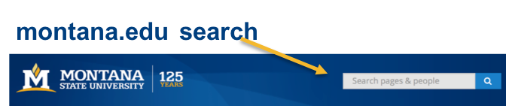
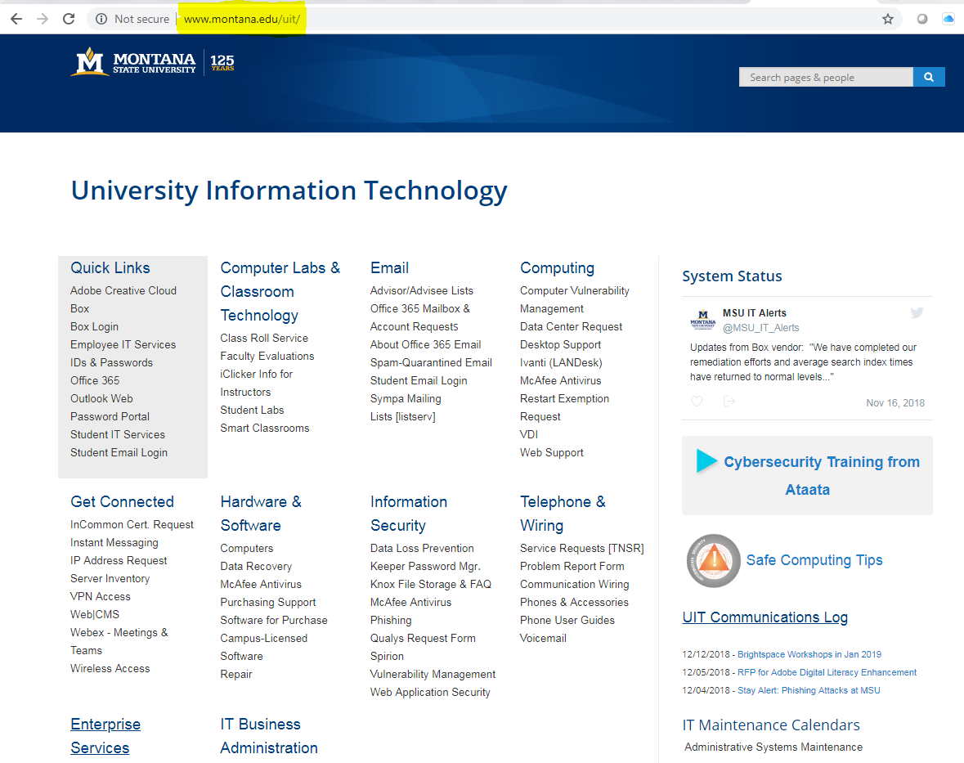
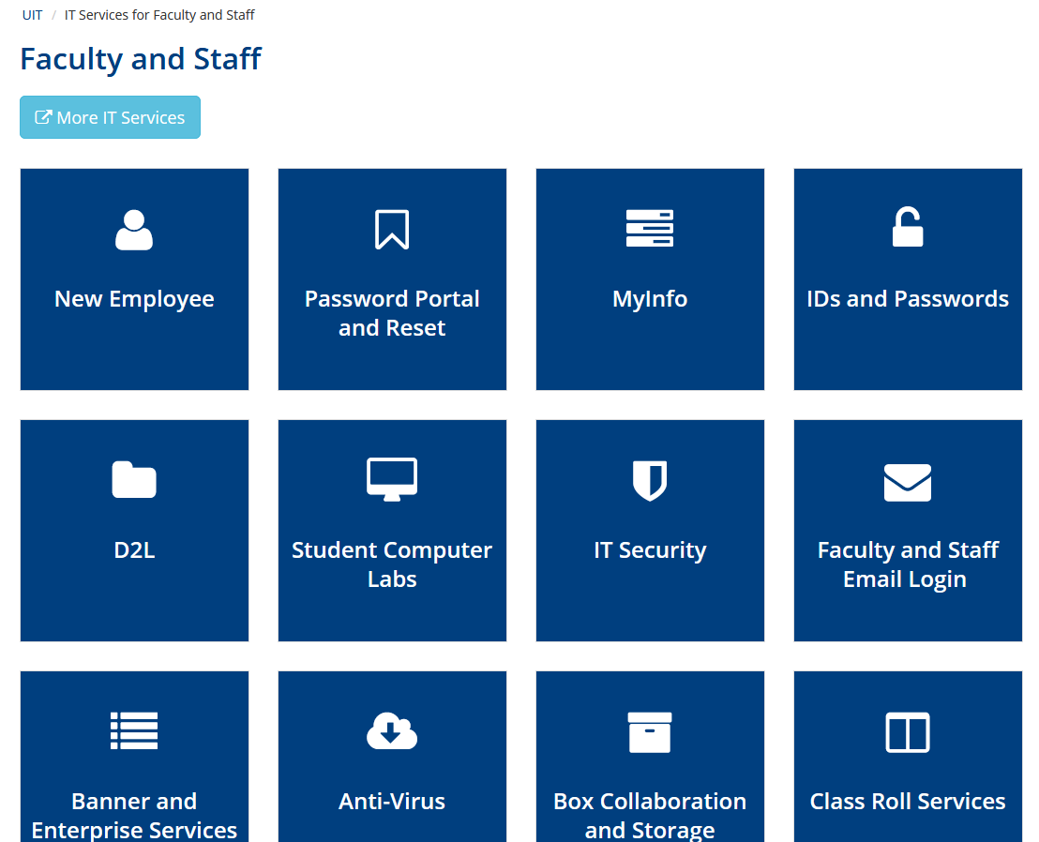
Resources
1
montana.edu/uit
Training
HR
MSU Library
LinkedIn Learning
via MSU Library
Ask UIT
2
3

Slide 11
Where do I get help?
Department IT Leads
College & Department Level IT Support
desktop support • unique systems • most immediate response
University Information Technology
IT Infrastructure and Support
network • phones • security • information systems • campus software
AV • learning technologies • student labs
Service Desk
helpdesk@montana.edu
406-994-1777

Slide 12
College & Department IT Support https://www.montana.edu/uit/departmental_it_contact.html
CLSIThelp@montana.edu Letters and Sciences
EHHDIThelp@montana.edu Education Health and Human Development
AGIThelp@montana.edu Agriculture
CONIThelp@montana.edu Nursing
COEIThelp@montana.edu Engineering
CAAIThelp@montana.edu Arts and Architecture
AUXIThelp@montana.edu Auxiliary Services
FSIThelp@montana.edu Facilities Services
ExtensionIT@montana.edu Extension Services
LIBIThelp@montana.edu Library
HRIThelp@montana.edu Human Resources

Slide 13
Good to Know Stuff
Before you call
Information that helps us help you - Questions we may ask you:
Your NetID (and those you are requesting services for)
Ticket # for existing requests
Network Name or IP Address of your computer: 153.90.168.38
Network Name or IP of Printers: \\topaz\?
Server name for shared drives: \\opal\? or \\knox\?
How critical is the problem? (how many people impacted, what workflow is stopped?)

Slide 14
UIT Service Desk
Monday-Friday 8 AM-7 PM
406-994-1777
(Leave a message anytime.)
helpdesk@montana.edu
Review these slides and learn much more our IT Orientation page:
www.montana.edu/uit/facultystaff/neo.html

Slide 15
Questions?

