Slide 1
Presenting Your Research

Slide 2
Planning
Accept that it will be exciting and nerve-wracking
  Mistakes will be made
  Computers will crash
Know your audience
What to cover
  Breadth and depth
  From larger picture to specificity and back to larger
What to say vs what to show
  Plan your presentation BEFORE you create your slides!

Slide 3
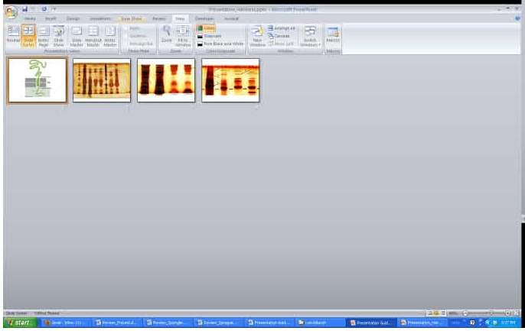
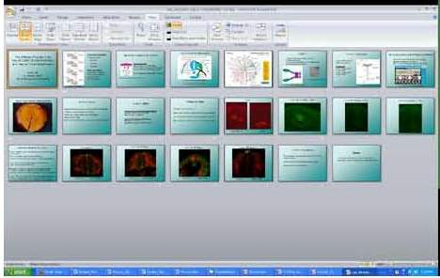
Planning
How many slides
How much to practice
  Do not read from notes

Slide 4
Power Point Creation
Supplements/complements your verbal presentation
As little text as possible
Think about colors, background, font size
Check spelling, grammar, layout
Always acknowledge your support (financial and otherwise)

Slide 5
Presentation
Introduction
  From a title slide (or two)
    You
    Your lab
    Acknowledge anyone in the room
  Background on your mentor’s/lab’s work
    Overall focus
    Cool things they do
    What is the larger relevancy
  Tie-in to what you worked on

Slide 6
Presentation
Content
  What will engage the audience
  What will tell your story
  What worked and what didn’t; it’s science, something always “fails”
  Do we need all your methods or just some
  Will we better understand a point with words, a graphic, or both
  Stories, anecdotes, and examples
  Transitions from slide to slide

Slide 7
Presentation
Images/Figures
  Illustrate and complement
  Explain charts and figures before you discuss them
    Axes
    Colors
    Comparisons
  Captions need to be readable

Slide 8
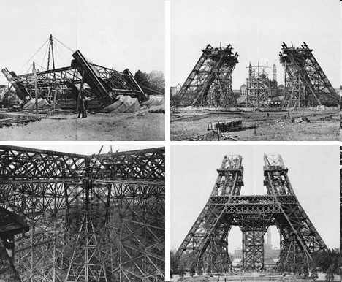

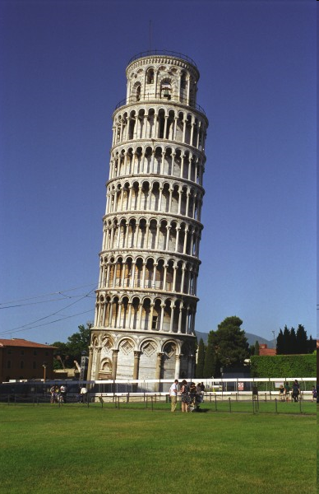
Structure-Function Relationship
How the Structure is Generated
The pieces that make it a whole
LOSS OF FUNCTION
Structure

Slide 9
Presentation
Wrap up
  Tell us again
    In a different way
    With conclusion and future plans
  Acknowledgments
  Questions

Slide 10
Do
Look at the audience
Show confidence
Speak loudly and slowly
Tell us what you know AND what you think, but be clear about which is which
  Answering a question you don’t know the answer to
Be careful with value statements
Clarify the complexities
Practice, rehearse, and speak from memory
Refer back to previous presenters

Slide 11
Do Not
Overdo the text
Read your slides
Use notes
Present what you have stumbled over
Look at the screen (unless using a pointer)
Swoosh the pointer around
Fail to practice
Speak above us
Forget to acknowledge

Slide 12
For Your First One-On-One Meeting
Slide colors/format
First slide complete
Idea for layout of presentation (slide ideas)
Final slide complete with acknowledgements

