Slide 1
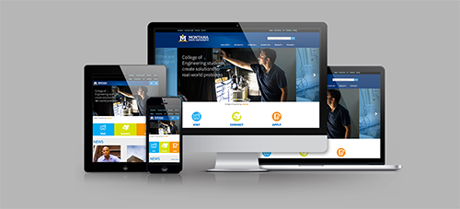
CMS 110
Introduction to the CMS
Welcome to the new Montana State University Content Management System!

Slide 2
Getting Started

Slide 3

Browser suggestions
Do not use Internet Explorer.
Use Google Chrome, Safari, or Firefox.

Slide 4
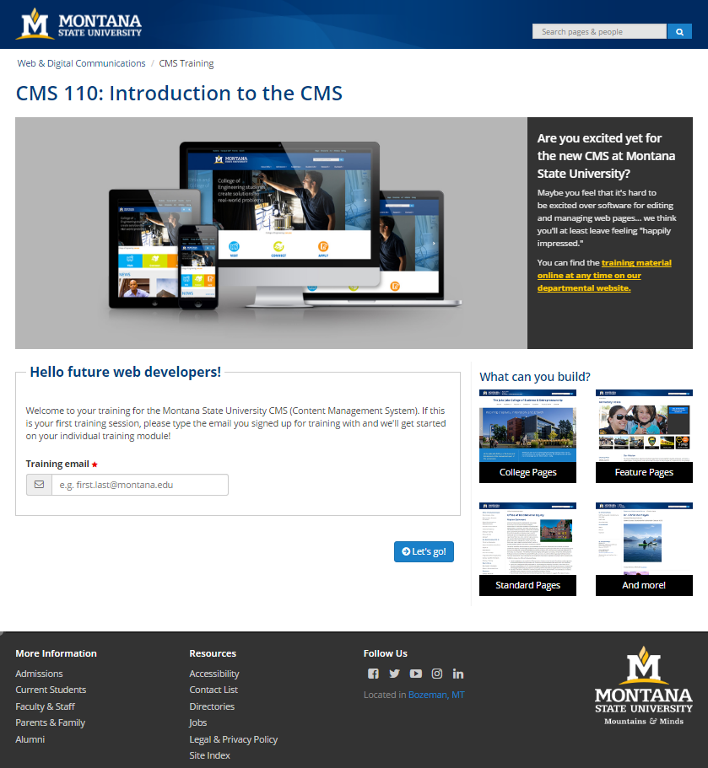
CMS training site
http://ou.montana.edu/cms-training

Slide 5
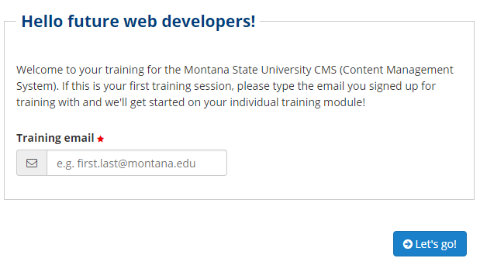
Training module
Everyone has a personal training module.
Enter the email used when RSVP’ing.

Slide 6
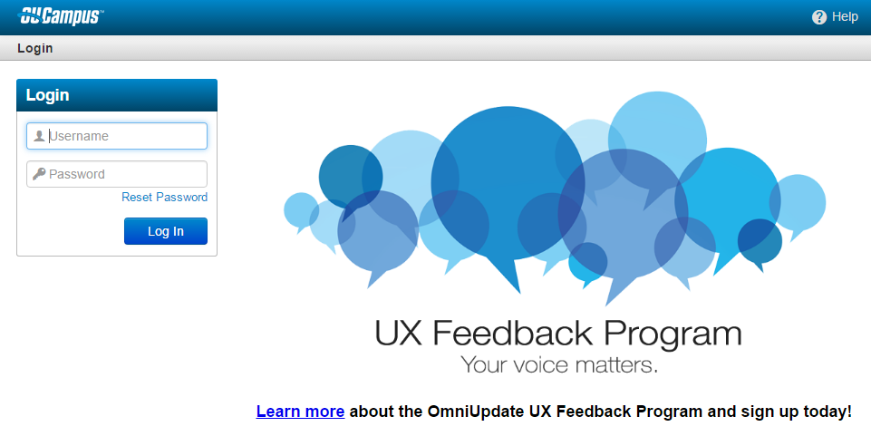
Common issue
If a “Skinning Error” occurs, verify that the URL in your browser resembles:
  https://cms.msu.montana.edu/10/#oucampus/MSU-Bozeman/***

Slide 7
Logging in
Every page created by the CMS has an invisible log-in button called the DirectEdit button.
Hidden so only content developers can use it.

Slide 8
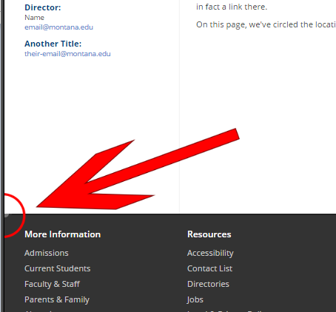
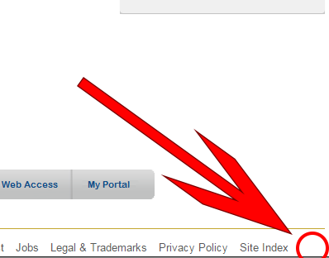
Version 2 templates
Version 1 templates

Slide 9
CMS user accounts
When you log into the CMS with your NetID it is with an account that is unique to you.
Users can be granted access to specific sites and site sections.
My Website
Jane
Mary
John
Henry

Slide 10
User Interface
Navigating the CMS.

Slide 11
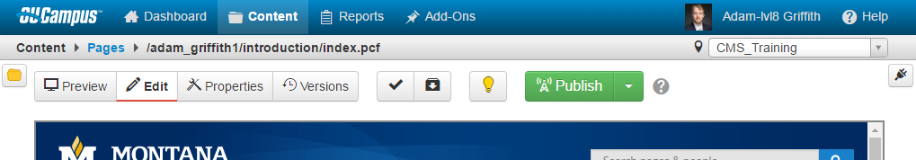
Global navigation
All menus are hover.
Content
  Pages
  Assets
  Recycle Bin
Add-Ons
  Hyperlinks to other tools and documentation.
Help docs

Slide 12
Breadcrumb navigation
Pages
File path.
  Websites are just files and folders after all.

Slide 13
Current site
The site content being worked on.
Search and navigate to other managed sites.

Slide 14
Page actions toolbar
Actions you can perform on the currently displayed web page.

Slide 15

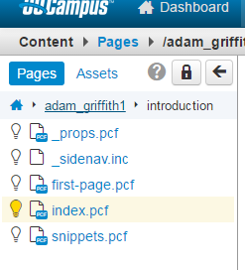

Side navigation
Expand using the icon.
Mini navigation view.
Clicking “keep synced” icon will make sure the current folder for the page you are viewing is shown.

Slide 16
Working with Pages
Let’s edit a page!

Slide 17
Navigate
Let’s navigate to the first page we’ll edit within the CMS!
Click first-page.pcf.

Slide 18
Staging vs. published
Our CMS is a “push” CMS, it “pushes” or publishes to the public web server when YOU are ready.
Staging
Published

Slide 19
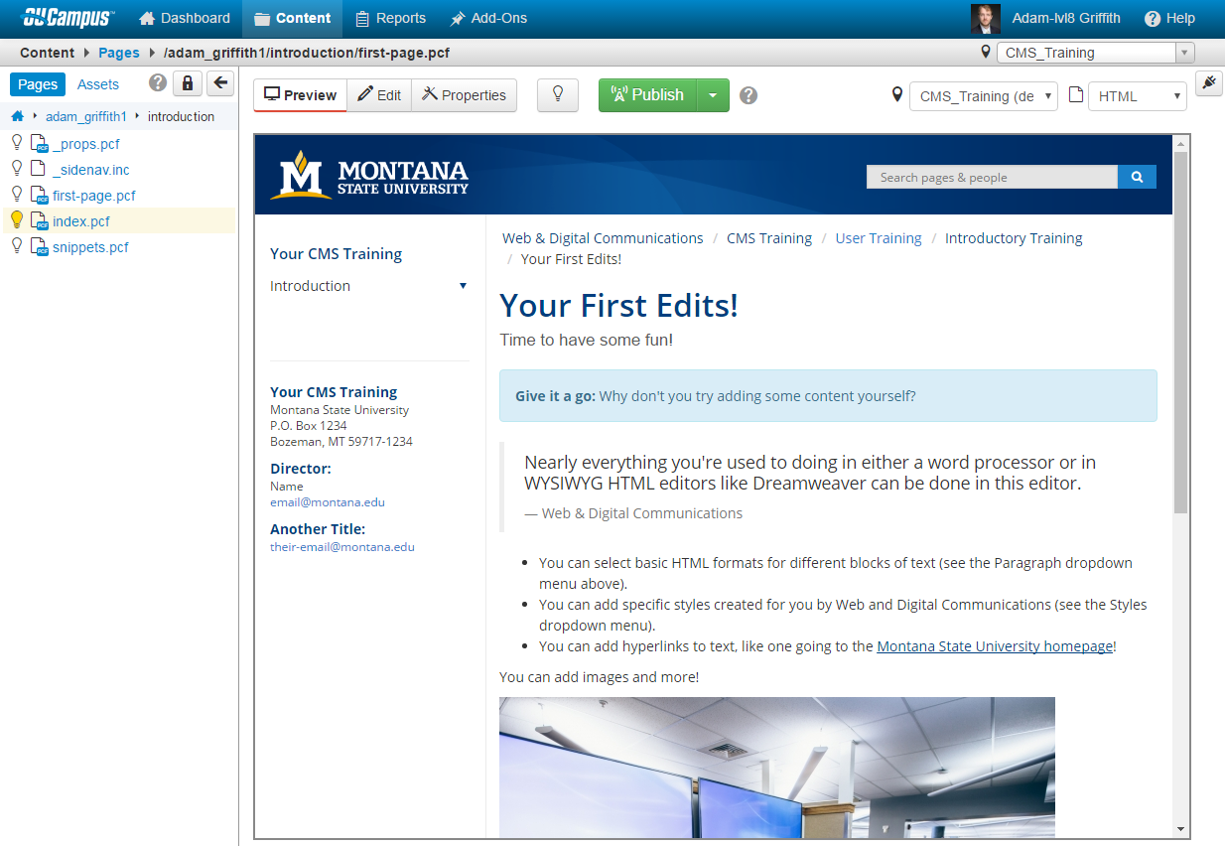

The [ Preview ] view
Staging version of the page.
Can see live version of the page using:

Slide 20

The checkout system
Pages are “checked out” when someone is editing them, like a library book.
No one can edit a page someone else is working on.
Prevents conflicting edits!

Slide 21

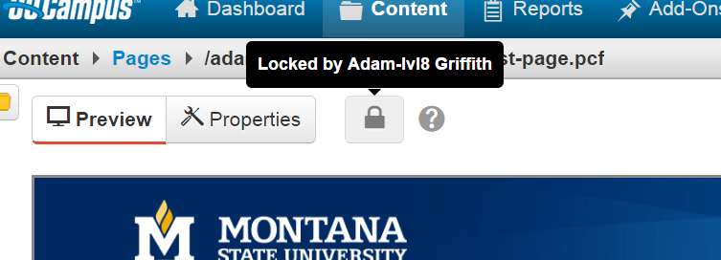
Checked out to you.
Checked out to someone else.
  Tooltip tells you who is working on it.

Slide 22
Web & Digital can check a page back in.
  E.g. coworker checks out the homepage and goes on sabbatical.
  Submit a request with the locked file’s URL.

Slide 23
Editing a Page
Adding content to existing pages.

Slide 24
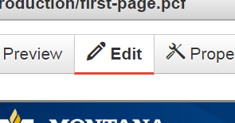
Let’s check out this page!
Editing a page always checks it out, even if it’s not already
Click [ Edit ] on the top left of the page controls.

Slide 25
Content/editable regions
Content in the CMS is divided into different regions.
  Combinations of them can be brought in and out of existence to build different pages types.
  No longer have to worry about breaking the HTML of the entire web page!
When you are in [ Edit ] view, these regions show up as green buttons.

Slide 26
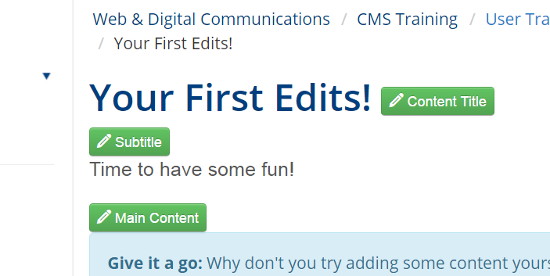
Content Regions Example
The currently enabled content regions are highlighted in red.

Slide 27
The editor
We’re going to edit the main content region.
Click the green button.

Slide 28
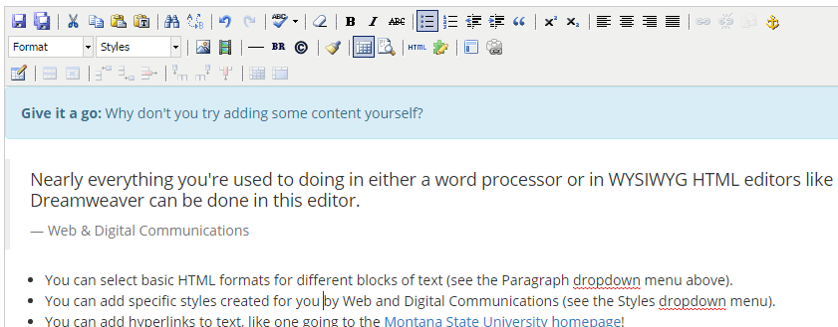
The editor (or WYSIWYG)
The CMS editor displaying content in the main content region.

Slide 29

The editing window should look very familiar: it is very similar to any standard word processing software.
Most operations you are used to using are here, and many have similar keyboard shortcuts.

Slide 30
Accessibility rules for headings
Do not use Heading 1. The page title already uses this.
Do not fake headers with bolds and underlines.
Use headings in sequence, 2,3,2,3, etc. as you would in MS Word.

Slide 31
Upload rules for images
Upload images at roughly the size you plan on displaying them at.
72 dpi resolution
Do not upload images of large file sizes

Slide 32
Accessibility rules for images
All images must have image descriptions.
Descriptions are the text you would use if you could not use the image.
  Must be no more than 255 characters
  If text in the image is reiterated elsewhere on the page this text can be very short.
Sometimes images are of equations. Having page content underneath providing office hours to go over content is also acceptable.

Slide 33
{{ The dependency manager }}
You can navigate through the structure of your site to other pages on your site.
When you make a selection within your own site, it will show up as a strange looking “dependency” tag with brackets.
  This is so that the CMS can keep track of where your link goes even if the target page moves or is renamed.
  No more broken links when you move things!

Slide 34
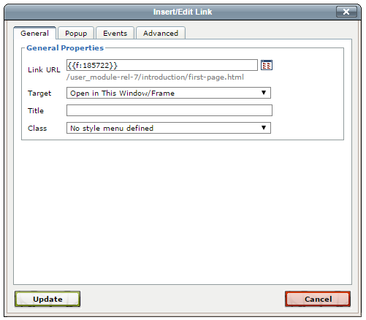
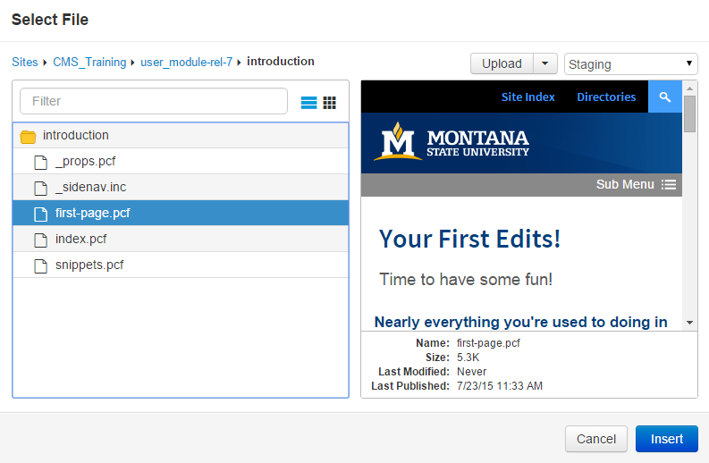

Slide 35
Saving
Always remember to save your work.
Let’s do that now.

Slide 36
Even though you have saved your work, it has still only changed in the CMS itself (staging).
The file that is viewed by others on montana.edu has not changed yet.
You can see this if you scroll down and click the green button.

Slide 37
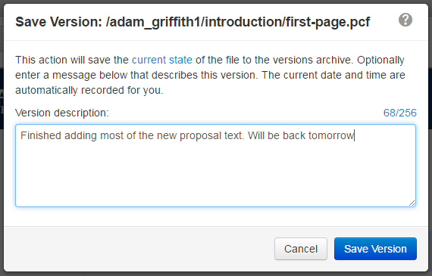

Save a version
Save your work for a later time and create a save history.

Slide 38
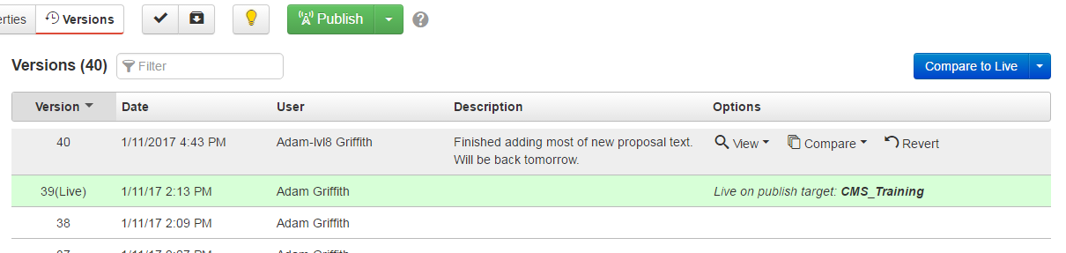
The [ Versions ] view
You can view or revert to any previous version.
The green row is the version that
is published.

Slide 39
Publishing
In order for your webpage changes to be visible to others, you must “Publish” your page to the web server.
There are a couple of options for this. You can either:
  Publish immediately
  Schedule a publish
  Submit page to another user for publish approval.
  You can also schedule an expiration for your page.

Slide 40

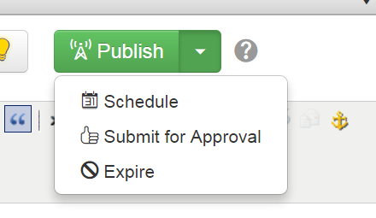
If your site has a workflow mandated for it, your pages may always go to another user for review first.
Select:
Or select another option.

Slide 41
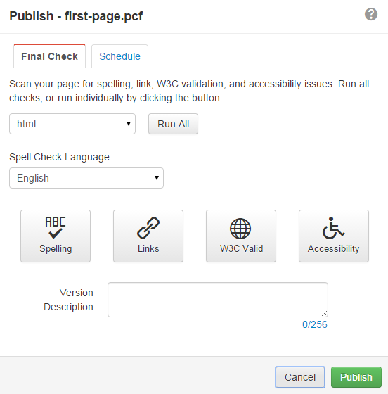
Sample page publish dialog

Slide 42

Final check
Run the page through reviews and give it a version description.
  Useful for checking spelling and links.
  The version description is useful for if you or anyone else ever needs to remember what changes were made or why.
Scroll down and click

Slide 43
First published page
Congratulations! You’ve published a page!
Notice that the page is now checked back in: it no longer has the yellow, lit lightbulb next to it in the side navigation.
This means it’s now open to editing for anyone with access to it.
Let’s see our page as it actually looks on the web server.

Slide 44
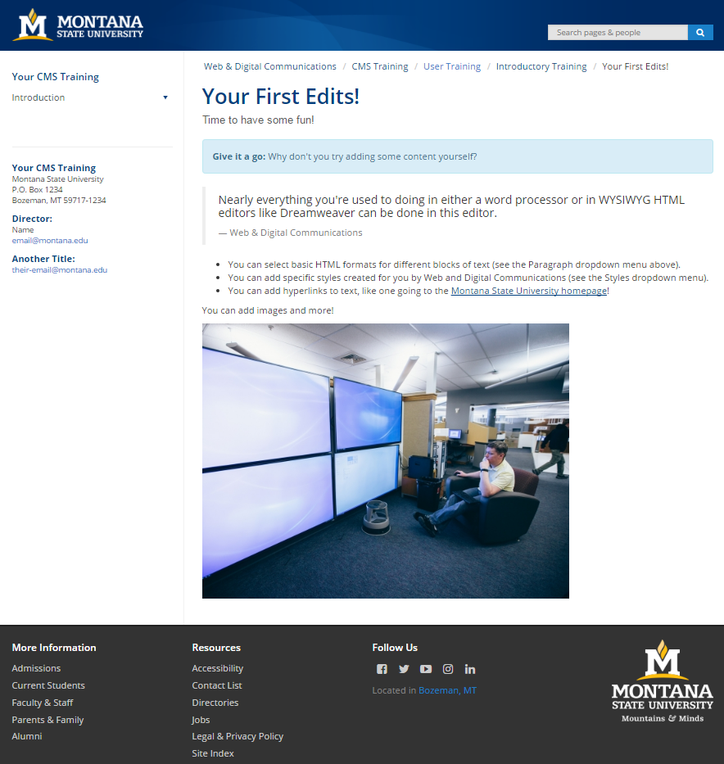
Sample published page

Slide 45
Now you are a web developer!
With the title comes an important note; browsers were built for speed and do not always ask the internet for the latest versions of things.
Combat this with:
  Reloading the page using:
    [ Ctrl ] + [ Shift ] + [ r ] in Google Chrome.
    [ Ctrl ] + [ r ] in other browsers.
  Trying the URL in a different browser.
  Restarting your machine.

Slide 46
Making new content
Creating brand-new stuff!

Slide 47
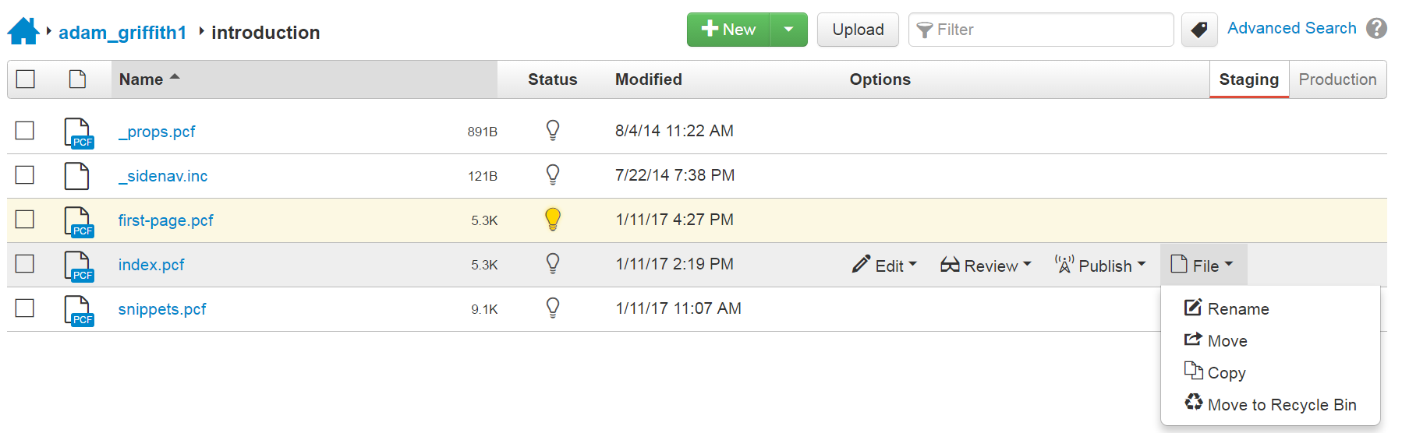
Site file browser
Click [ Content ] > Pages in the main CMS menu.
File operations are available upon hover.

Slide 48
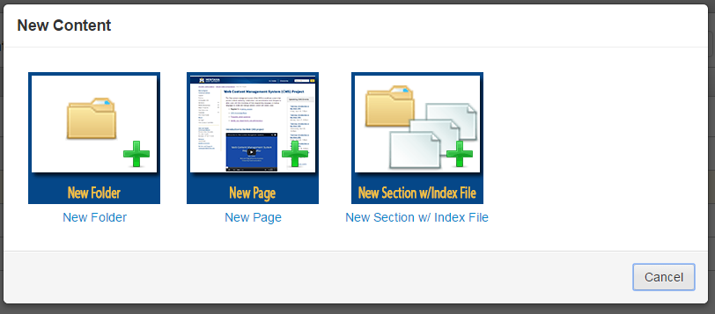
New site section
You should see a number of template options.
Let’s make a new site section so we can group several web pages together (like a book chapter).

Slide 49
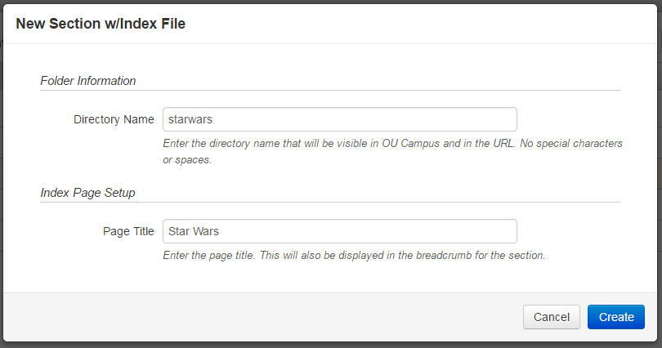
Provide the name for the URL and human readable title to go with it.

Slide 50
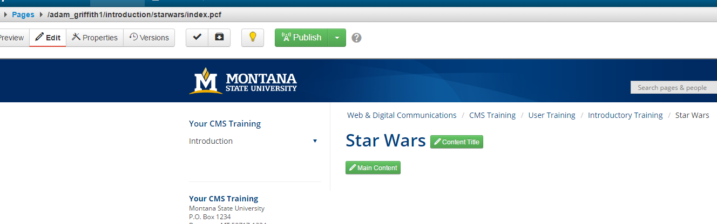
Site sections have titles (the breadcrumbs links).
Each breadcrumb links to the index page for the associated site section.

Slide 51

New page
Go back to the file browser and click
Let’s make a new page in our new site section.

Slide 52
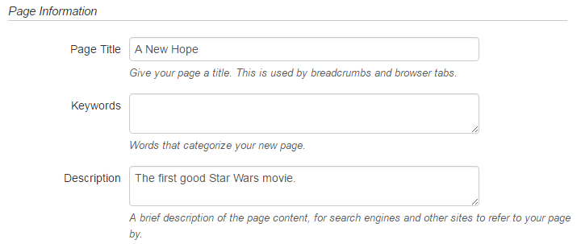
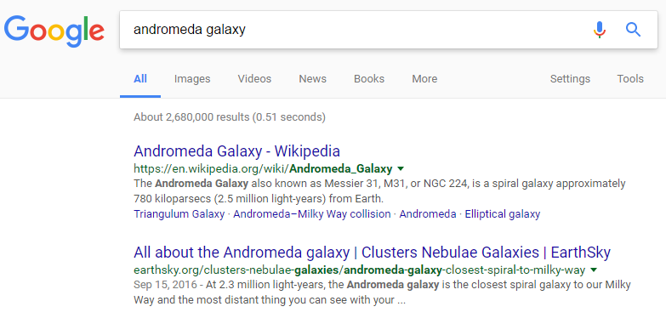
Page parameters
Title for the page.
Description text for Google.

Slide 53
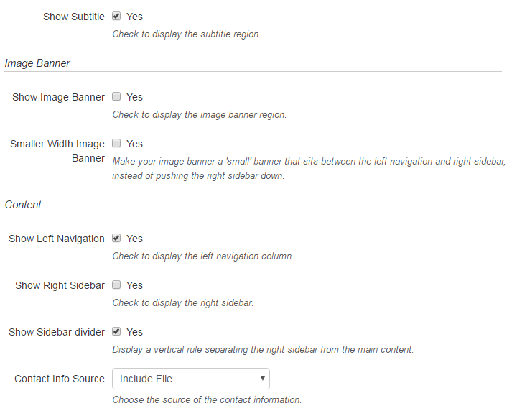
Add other editable regions.
Think before disabling Show Left Navigation.
  Don’t want to trap users on a page.

Slide 54
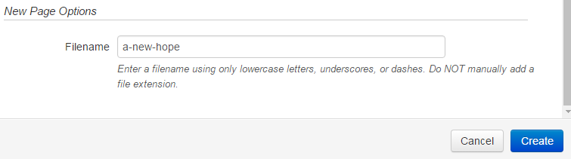
Filename
  Lowercase
    my-File is a different file than my-file.
  Short (sentence-long file names place you at the bottom of search results)

Slide 55

Never stuck with editable regions.
With the file checked out click
and change it.

Slide 56
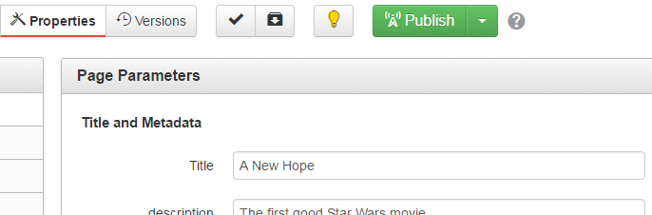
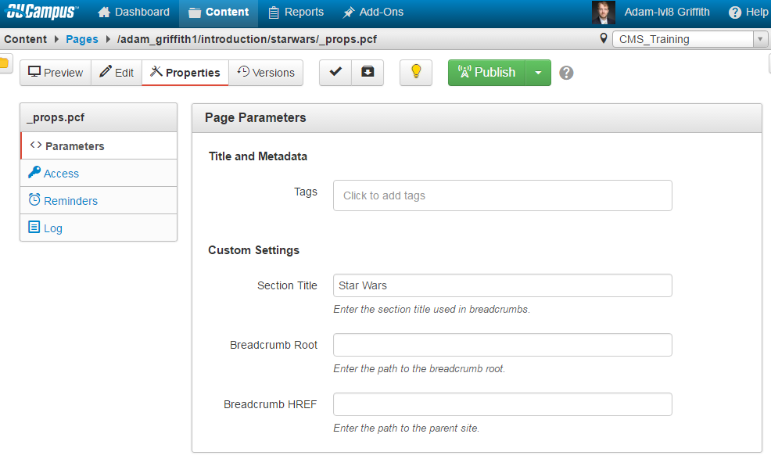
Updating breadcrumbs
Pages: changed in the page properties under Title.
Sections: defined in the _props.pcf files.
  W&D can help republish large site sections.

Slide 57
Site navigation
Navigate “up a directory” to your main training module folder.
Select the _sidenav.inc file.

Slide 58
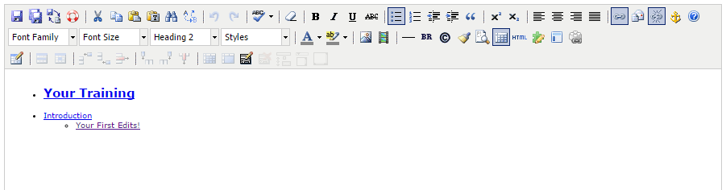
Sample _sidenav.inc file

Slide 59
Adding Navigation
Add another line in the same indentation level as Your First Edits!.
You can type in whatever you like, but it should correspond to the page name and be short enough to navigate easily.
Now select this, and click the hyperlink button.

Slide 60
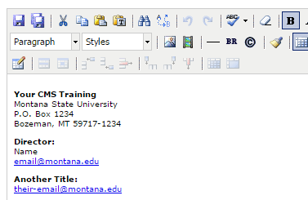
Contact region
Now select the _contact.inc file.
It defines the site contact information.
Bolded text, line-breaks, and new paragraphs are all you need!

Slide 61
Advanced tools
What else can we do?

Slide 62
Snippets
Snippets are special pre-created chunks of HTML code.
They will often not look the same in the editor as they do on a finished page because they allow for easy ways to create polished, consistent content.
Expand the left navigation area, and let’s go to the file called snippets.pcf.

Slide 63

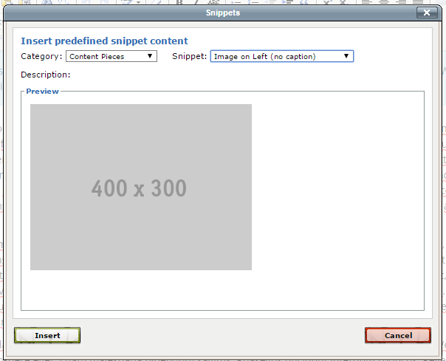
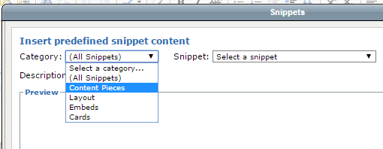
In the editor put the cursor down, click the button and choose a snippet.

Slide 64
Images on right or left with or without captions.
Tables
Faculty & Staff listings
FAQs
Multi column layouts
Cards
Panels

Slide 65
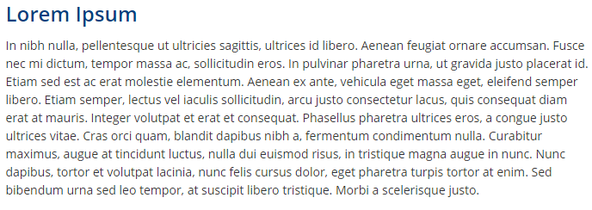
Assets
Great for modularizing out repetitive content.
E.g. 10 pages share the same bottom paragraph and header.

Slide 66
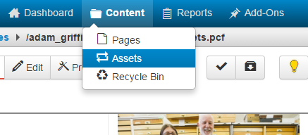
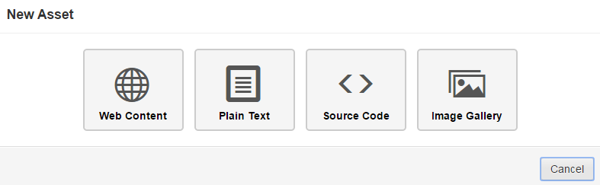
Assets can be found in the content menu.
There are 4 assets. Let’s choose Web Content.

Slide 67
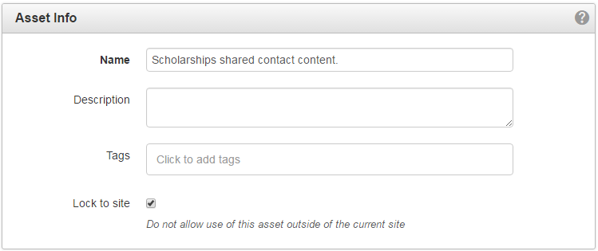
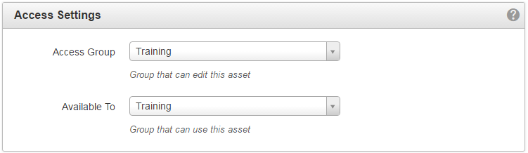
All assets have the Asset Info and Access Settings panels.
Lock to the site.
Set the two groups to your site name.

Slide 68
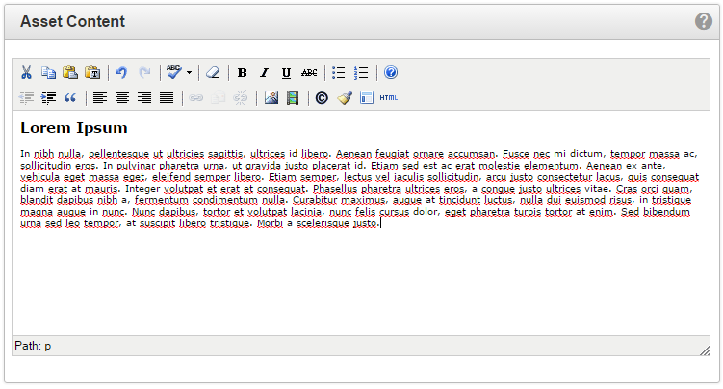
Copy-paste in the desired content from another CMS page.
Publish the asset!

Slide 69
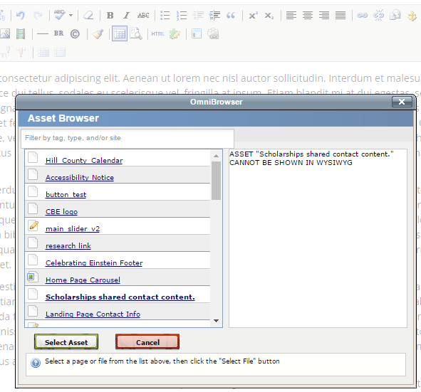
Back on the web page where you want to use the asset put the cursor down and choose Insert/Edit Asset.
Select your asset.

Slide 70
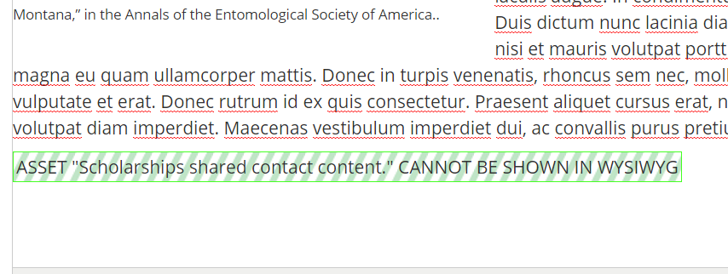
Assets in the WYSIWYG are green striped boxes.
To delete put the cursor inside it and hit the [ Delete ] key.

Slide 71
If you change and republish the asset all pages that use it will republish too!

Slide 72
Image gallery assets can be built too.
  When added the [ Banner ] region they become sliders of the first five images.
  When added to the [ Main Content ] region they become a thumbnail image gallery with a popup image slider of all images.

Slide 73
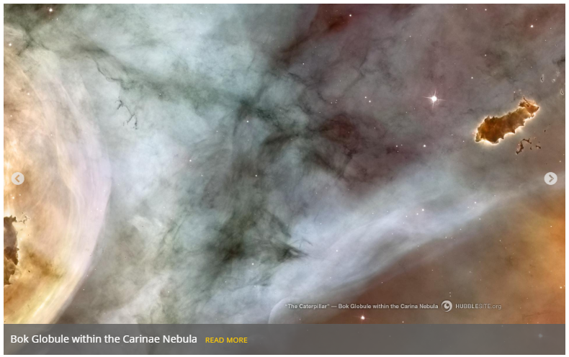
Image slider example.

Slide 74
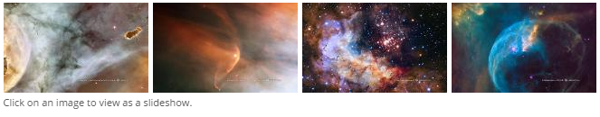
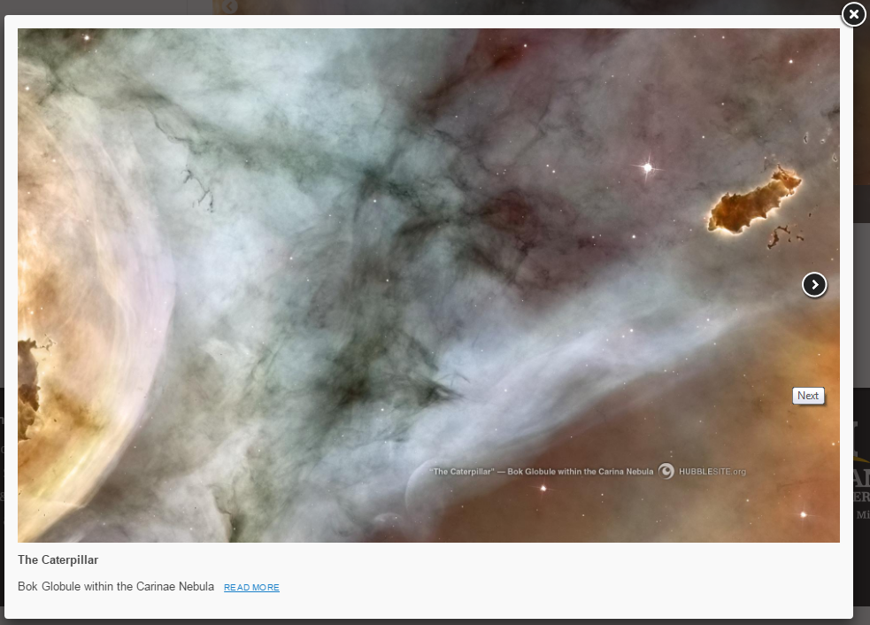
Image gallery example

Slide 75
Web forms are assets too.
Must complete additional training before you can create them.
Submit a request to our team.

Slide 76
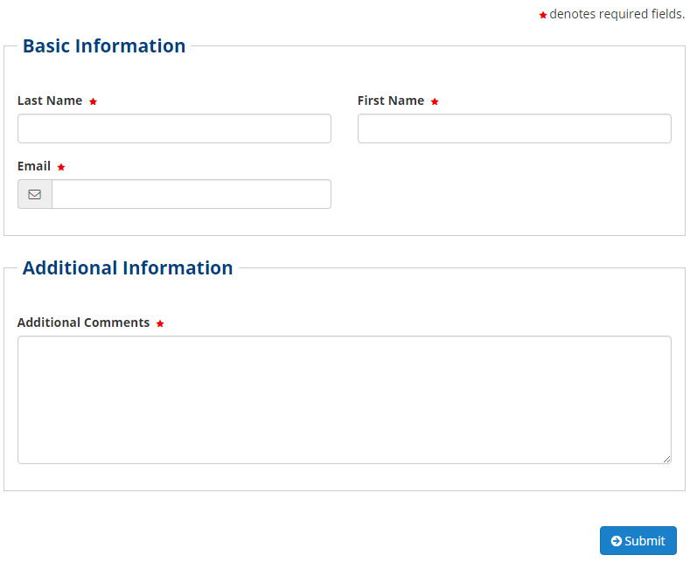
Example comment form.

Slide 77
Uploading files
How do I get images and documents onto my site?

Slide 78
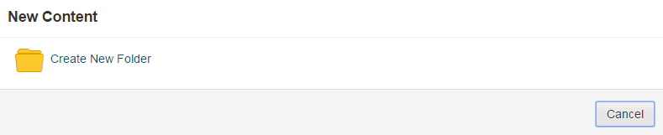
Where to upload?
All sites have the following directories.
  /images & /documents
You can use the [ New ] > Folder to further organize these directories. Only time this option is used.

Slide 79

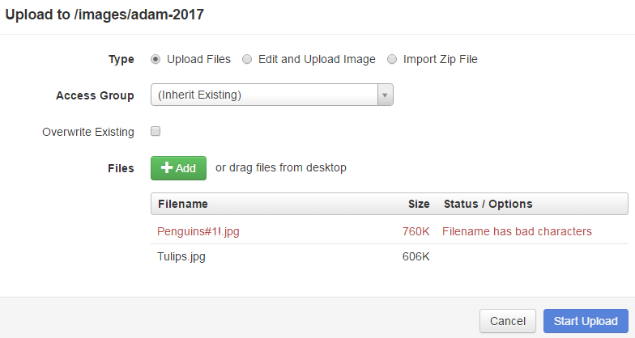
Uploading
Click
Drag and drop or navigate to one or more files to upload.
If your file has bad characters, click on the filename to change it.

Slide 80
Common mistake
Once the files are uploaded do not forget to publish them before using them on a web page!

Slide 81
Best upload practices
Use Overwrite Existing on the upload dialog to replace old files with new files of the same name.
Helps keep the site clean and the CMS seamlessly replaces the old file with the new. Just save and publish and done!

Slide 82
Example:
  Replace CV.pdf with a new CV.pdf each term.
  Also helps keep Google search results from confusing people with results filled with old versions of your files!

Slide 83
Additional Information

Slide 84
Help!
Online CMS Documentation
Submit a Support Ticket
Attend an Open Support session for the CMS
  Available only at the MSU-Bozeman Campus
Check out our new upcoming trainings!

Slide 85
Thank You

